Slide 1
Spatial and temporal variation of sediment production in the upstream part of the Loire River (35000 km²)
Presented by
BELBAL Brahim Hichem
Co-authors
ANTOINE Germain (EDF R&D)
BOYAVAL Sebastien (LHSV
CERDAN Olivier (BRGM)
TACCONE Florent (EDF R&D)
VANDROMME Rosalie (BRGM)
April 2023

Slide 2
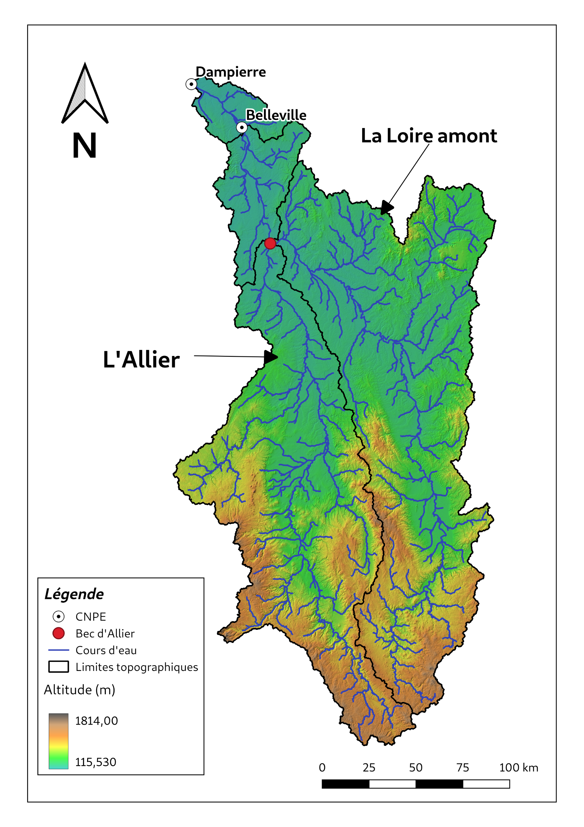
Contexte
A secondary river channel downstream the Loire and Allier basins
Over the last decade, the secondary channel has experienced a change in its sediment dynamics
An increasing silting of the bed of the Loire and the secondary channel by fine sediments
Dredging is costly both economically and environmentally
The managers of the channel are seeking to improve their sediment management

Slide 3
Questions and Methodology
How can we explain the changes in the sediment dynamics of the river secondary channel ?
Methodology
A large-scale modeling of soil erosion upstream of the channelized riverbed using the SWAT model (Arnold et al. 1998) to determine the spatiotemporal dynamics of sediment production
A Global and local calibration of the SWAT model using continuous measurement and reconstructed timeseries (Delmas et al. 2011) for a better model performance
A small-scale modeling of the channelized riverbed using TELEMAC 2D model (Hervouet 2007) to assess
An articulation of the two scales to assess the impact of each process and scale on the sediment dynamics of the secondary channel

Slide 4
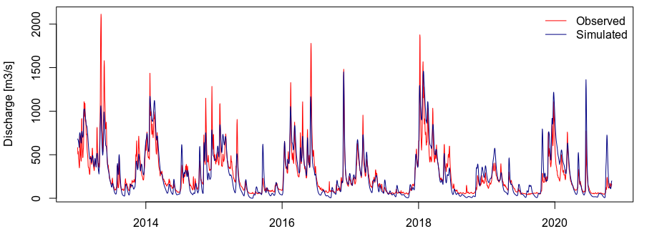
SWAT Model Global Calibration
Hydrological calibration of the SWAT model using a discharge measurement station at the entrance of the channelized riverbed:
An automatic calibration using the SWATplusR package (Schurz 2019)
A good fitting between measured and simulated flows (A)
A good peak timing (B)
An underestimation of the highest flow peaks (B)
A balanced water balance
(A)
(B)

Slide 5
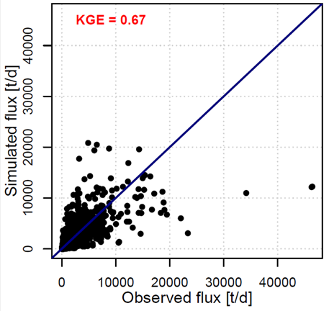
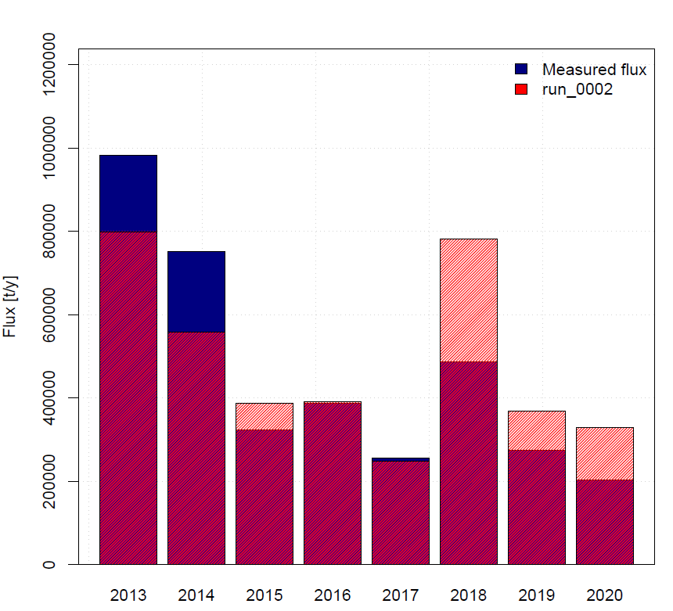
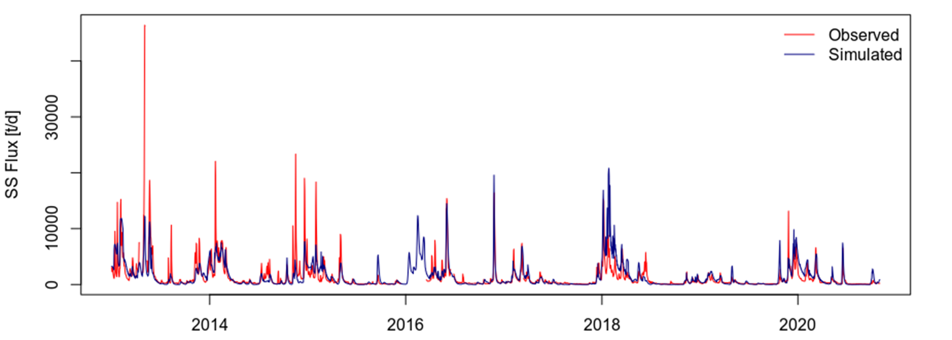
SWAT Model Global Calibration
Sediment calibration of the SWAT model using a measurement station at the entrance of the channelized riverbed:
An acceptable performance (A)
A good reproduction of SS fluxes trends (B)
A strong underestimation on SS peaks (B)
A good reproduction of annual fluxes (C)
(A)
(C)
(B)

Slide 6
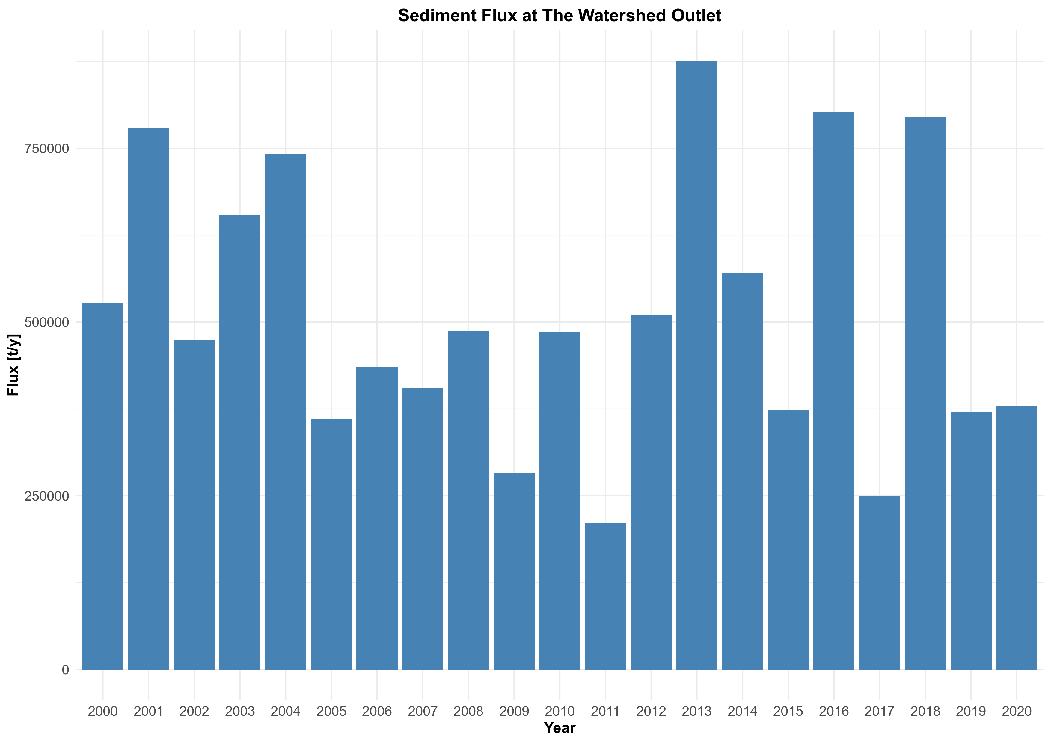
SWAT Model Results
The first results from the SWAT model show that suspended sediment inputs are highly variable spatially from one sub-basin to another (A)
The contributing sub-basins are those close to the main watercourse of the Loire and the Allier, whereas most of the headwater sub-basins have no contributions (A)
From a temporal perspective, 2013, 2016 and 2018 appear to be special with the highest SS flux values (B)
(B)
(A)

Slide 7
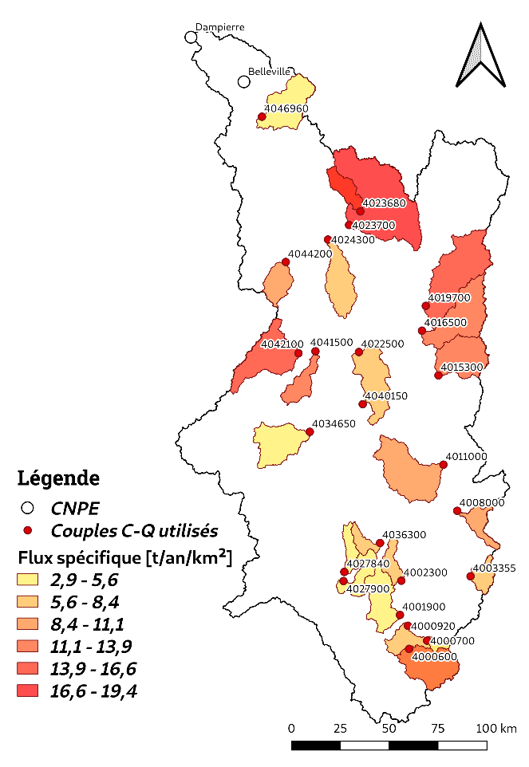
Conclusion and perspectives
The absence of sediment export from certain sub-basins seems suspicious, which may require a local calibration of the model
The local calibration of the model requires a lot of continuous sediment data and the use of methods such as the IRCA method (Improved Rating Curve Approach; Delmas et al. 2011) may be useful to value infrequent and uncertain data
Even if 2013, 2016 and 2018 are particular, a similar trend was previously observed between 2001 and 2004
Although the results of the SWAT model confirmed a trend of increasing suspended sediment production, they do not provide all the answers to the changes in sediment dynamics observed in the secondary channel
These results also confirm the need to investigate the interactions between SS and the complex morphodynamics of the middle Loire.
Legend
Sediment Yield [t/y/km²]

Slide 8
bibliography
Arnold, J. G., Srinivasan, R., Muttiah, R. S., & Williams, J. R. (1998). Large area hydrologic modeling and assessment part I: model development 1. JAWRA Journal of the American Water Resources Association, 34(1), 73-89.
Cheviron, B., Delmas, M., Cerdan, O., & Mouchel, J. M. (2014). Calculation of river sediment fluxes from uncertain and infrequent measurements. Journal of hydrology, 508, 364-373.
Delmas, M., Cerdan, O., Cheviron, B., & Mouchel, J. M. (2011). River basin sediment flux assessments. Hydrological processes, 25(10), 1587-1596.
Ferguson, R. I. (1986). River loads underestimated by rating curves. Water resources research, 22(1), 74-76.
Gay, A., Cerdan, O., Delmas, M., & Desmet, M. (2014). Variability of suspended sediment yields within the Loire river basin (France). Journal of Hydrology, 519, 1225-1237.
Hervouet, J. M. (2007). Hydrodynamics of free surface flows: modelling with the finite element method. John Wiley & Sons.
Schürz, C. (2019). SWATplusR: Running SWAT2012 and SWAT+ Projects in R. R Package Version 0.2, 7, 1-3.

Slide 9
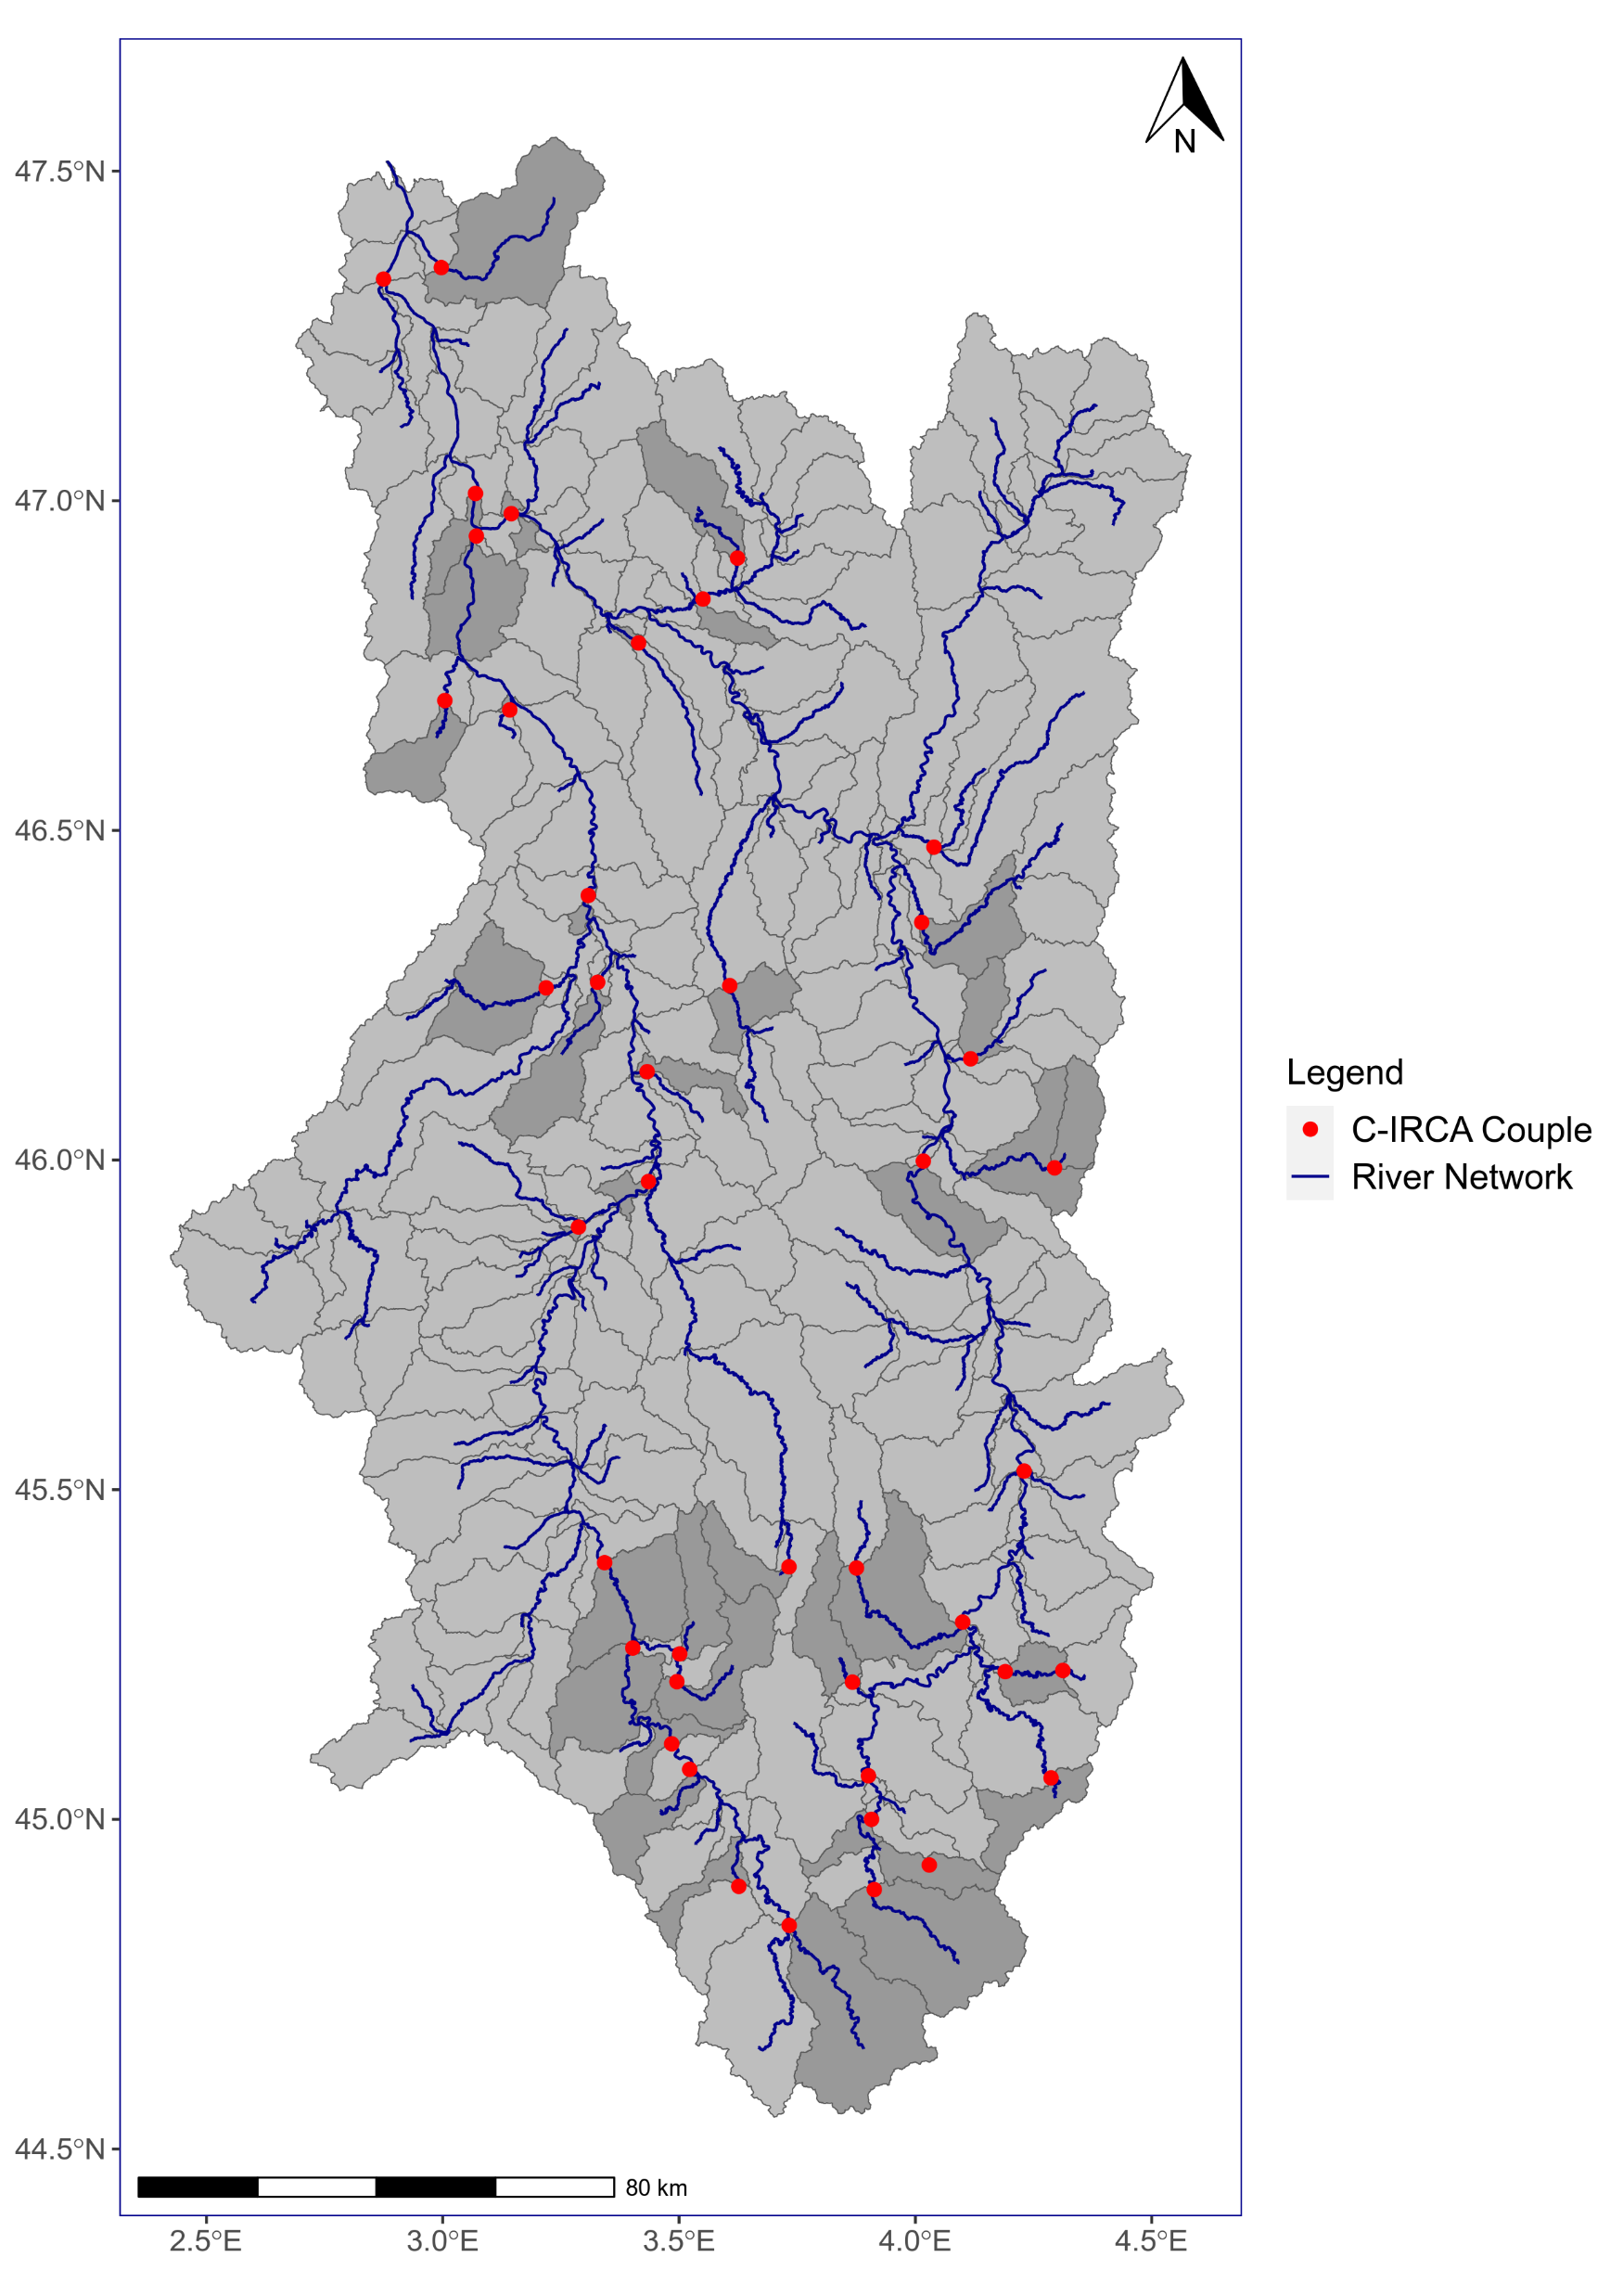
SWAT Model Local Calibration (ongoing work)
Based on multi-site calibration:
Calibration data for 42 sub-basins (A)
From discrete and infrequent SS data
A reconstruction of the temporal chronicles with the IRCA method (Improved Rating Curve Approach; Delmas et al. 2011)
A method based on the relationship C = aQ^b with a storage term to correct underestimations of the classical method (Ferguson 1986)
A method more suitable for infrequent and uncertain data (Cheviron et al. 2014)
(A)

Slide 10
IRCA Method (Delmas et al. 2011)
A C(Q) relationship by flow category:
Baseflow
$C_{Qbase}= \overline{C}$_{measured.Qbase}
For rising and falling limb of the hydrograph
$C_{c,d}=a_{c,d}{Q_{c,d}}^{b_{c,d}}+a_{5c,d}δS$
Where C the SS concentration, Q the measured flows, the parameters a, b and a5 are parameters optimized by the IRCA algorithm, the term 𝜹𝑺 is the variation of the sediment stock S(t) over two successive time steps, with :
$$S\left(t\right)=exp\left(−\frac{Q_{EFF}F}{Q_{0}}\right)$$
Where S(t) is the stock of available sediment at a time t (dimensionless value in the interval [0,1]), QEFF is the instantaneous flow in the rising phase or the moving average flow in the receding flood phase, F is a factor to control the magnitude of S(t), and Q₀ is the highest value of the base flow.

Slide 11
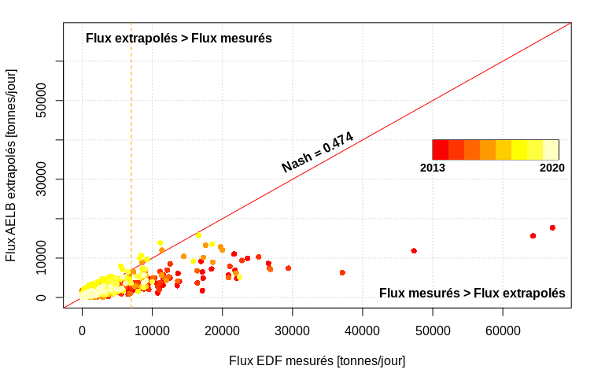
Validation of the IRCA Method
Application of the method on an infrequent data set
A comparison between the IRCA results and the measured SS fluxes
To evaluate the robustness of the method and identify its limitations
A threshold effect with a strong correlation of flows < 8000 tons/day and a dispersion of points beyond
The dispersion of points concerns mainly the years 2013 and 2014
Simulated Flux > Measured Flux
Simulated Flux < Measured Flux

Slide 12
Validation of the IRCA Method
Separating the points year by year greatly improves the correlation
A trend confirmed on an annual scale
Year | 2013 | 2014 | 2015 | 2016 | 2017 | 2018 | 2019 | 2020
NSE | 0,36 | 0,38 | 0,43 | 0,75 | 0,60 | 0,79 | 0,56 | 0,69

Slide 13
Application of the IRCA Method
A selection of 24 sub-basins under the constraint of data availability
Different sediment yields from one basin to another with values ranging from 2.9 to 19.4 [tons/year/km²].
A difference that cannot be explained by the size of the basins
What is the reason for this difference?

