Slide 1
Degradation of a foreland river after the Wenchuan Earthquake, China:
A complex interaction among weirs, sediment supply and sediment mining
Yongpeng Lin¹, Chenge An¹, Shan Zheng², Ruihua Nie³, Gary Parker⁴, Marwan A. Hassan⁵, Matthew J. Czapiga⁶, Xudong Fu¹
¹Tsinghua University, ²Wuhan University, ³Sichuan University, ⁴University of Illinois, Urbana-Champaign, ⁵University of British Columbia, ⁶University of South Carolina.
Since the 2008 Wenchuan (Ms. 8.0) Earthquake, the Shi‑ting River in the Longmen Mountain, China, experienced more than 20 m bed degradation in 7 years.
Potential reasons:
Sediment dis-connectivity due to in-channel weirs
The mobilization (“magic sand”) effect of fine sediment supply due to post-earthquake landslides
Sediment mining
QR Code for the Abstract:
Research Prototype
Take Home Messages
1/4
1-D Morphodynamic Model & Computational Scenarios
Idealized Cases:
A Single Weir
Effect of Weirs on bedload transport & bed degradation
More Realistic Cases: Cascading Weirs & Mining
Background picture: Aerial photo of the Renmin Canal, Shi-ting River, Sichuan, China, taken in 2021

Slide 2
Degradation of a foreland river after the Wenchuan Earthquake, China:
A complex interaction among weirs, sediment supply and sediment mining
Questions:
What is the effect of weirs on bed degradation when coupled with fine sediment supply?
How much does sediment mining contribute to the dramatic degradation in the Shi-ting River?
Methods:
1-D river morphodynamic model
Analysis of satellite images
QR Code for the Abstract:
Research Prototype
Take Home Messages
2/4
1-D Morphodynamic Model & Computational Scenarios
Idealized Cases:
A Single Weir
Effect of Weirs on bedload transport & bed degradation
More Realistic Cases: Cascading Weirs & Mining
Background picture: Aerial photo of the Renmin Canal, Shi-ting River, Sichuan, China, taken in 2021

Slide 3
Degradation of a foreland river after the Wenchuan Earthquake, China:
A complex interaction among weirs, sediment supply and sediment mining
Key points:
The weir preferentially traps coarse sediment and delivers fine sediment, enhancing the “magic sand” effect of increased gravel mobility and thus downstream degradation.
The contribution of sediment mining (16 Mt/year) is one order of magnitude larger than the contribution of weirs and fine sediment.
QR Code for the Abstract:
Research Prototype
Take Home Messages
3/4
1-D Morphodynamic Model & Computational Scenarios
Idealized Cases:
A Single Weir
Effect of Weirs on bedload transport & bed degradation
More Realistic Cases: Cascading Weirs & Mining
Background picture: Aerial photo of the Renmin Canal, Shi-ting River, Sichuan, China, taken in 2021

Slide 4
Degradation of a foreland river after the Wenchuan Earthquake, China:
A complex interaction among weirs, sediment supply and sediment mining
You are kindly invited to click on the different steps outlined on this slide to obtain more information on this particular subject.
Clicking the close button on the top right-hand corner will always bring you back to the first slide.
QR Code for the Abstract:
Research Prototype
Take Home Messages
4/4
1-D Morphodynamic Model & Computational Scenarios
Idealized Cases:
A Single Weir
Effect of Weirs on bedload transport & bed degradation
More Realistic Cases: Cascading Weirs & Mining
Background picture: Aerial photo of the Renmin Canal, Shi-ting River, Sichuan, China, taken in 2021

Slide 5
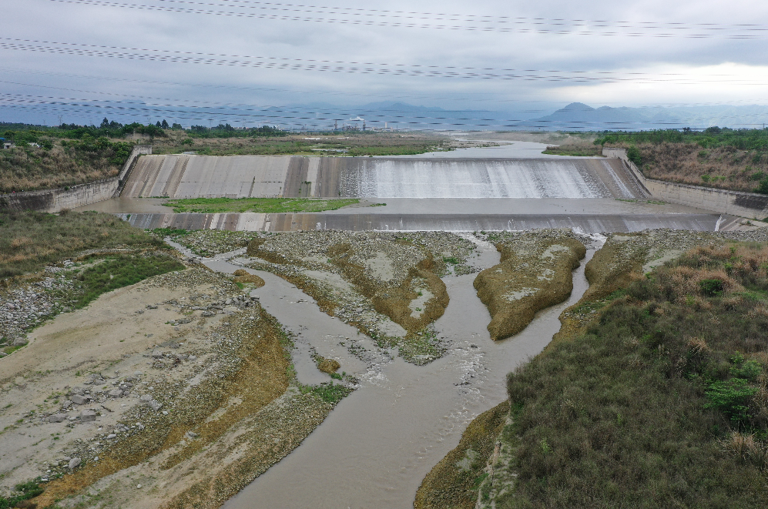
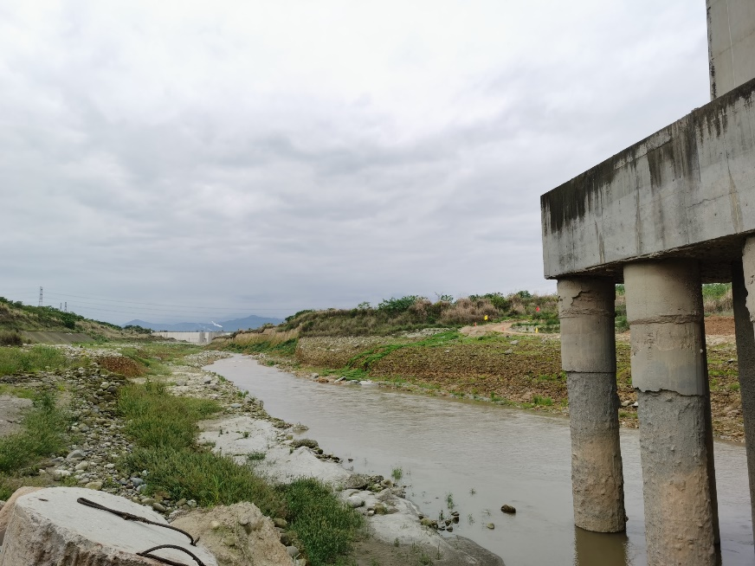
Degradation of a foreland river after the Wenchuan Earthquake, China:
A complex interaction among weirs, sediment supply and sediment mining
X
Downstream of the Renmin Weir, severe bed incision occurred and led to the exposure of bridge foundations.
24 m
Research Prototype
Take Home Messages
Severe bed degradation
in the Shi-ting River:
The Renmin Weir
Aerial photo of the Renmin Canal (Weir) in the Shi-ting River.
The weir was buried beneath the riverbed before the earthquake in 2008, but was 24 m above the riverbed in 2021.
1-D Morphodynamic Model & Computational Scenarios
Results for Idealized Cases with a Single Weir
Effect of Weirs on bedload transport & bed degradation
1/3
Results for More Realized Cases with Cascading Weirs
Background picture: Aerial photo of the Renmin Canal, Shi-ting River, Sichuan, China, taken in 2021

Slide 6
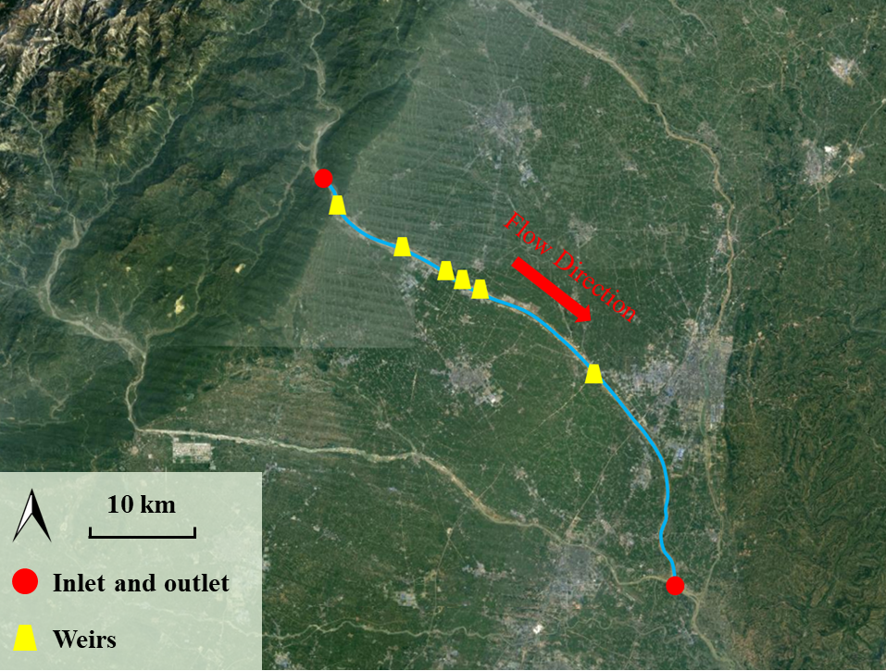
Degradation of a foreland river after the Wenchuan Earthquake, China:
A complex interaction among weirs, sediment supply and sediment mining
X
Weir No. | Initial drop height* (m) | Drop height in 2015 & 2022 (m)
1 | 2 | 7.1 | 4.7
2 | 1 | 19.5 | 30.1
3 | 1 | 18.8 | 24.0
4 | 5.5 | - | -
5 | 5 | 12.5 | -
6 | 7 | - | -
Research Prototype
1
Take Home Messages
2
3
4
5
6
Cascading weirs
in the Shi-ting River:
Results for Idealized Cases with a Single Weir
Drop height: elevation difference between the weir crest and the downstream riverbed.
1-D Morphodynamic Model & Computational Scenarios
Effect of Weirs on bedload transport & bed degradation
2/3
Results for More Realized Cases with Cascading Weirs
Background picture: Aerial photo of the Renmin Canal, Shi-ting River, Sichuan, China, taken in 2021

Slide 7
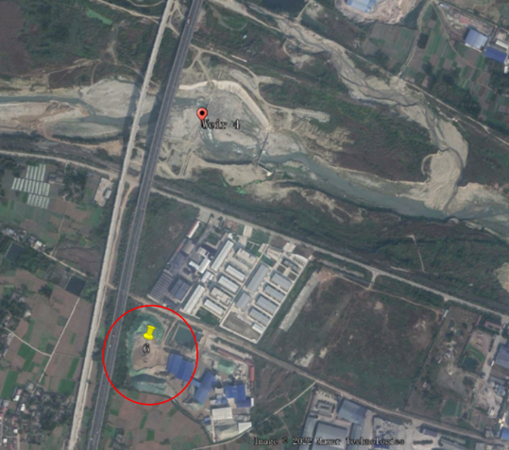
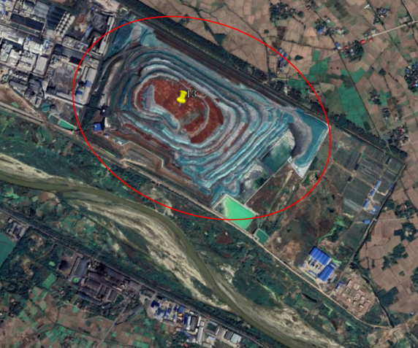
Degradation of a foreland river after the Wenchuan Earthquake, China:
A complex interaction among weirs, sediment supply and sediment mining
X
Research Prototype
Take Home Messages
Typical mining sites
Area of the sand pile: 150 m × 80 m (left figure); 1000 m × 500 m (right figure).
Mining rates of 0-2 m/year are applied in simulation at the mining sites for calibration.
Sediment mining
in the Shi-ting River:
1-D Morphodynamic Model & Computational Scenarios
Results for Idealized Cases with a Single Weir
Effect of Weirs on bedload transport & bed degradation
Distribution of mining sites in the Shi-ting River in 2022 (Yellow Pins)
Observed from Google Earth
3/3
Results for More Realized Cases with Cascading Weirs
Background picture: Aerial photo of the Renmin Canal, Shi-ting River, Sichuan, China, taken in 2021

Slide 8
Degradation of a foreland river after the Wenchuan Earthquake, China:
A complex interaction among weirs, sediment supply and sediment mining
X
Model formulations:
Notation:
h_{w}: flow depth S: bed slope
S_{f}: friction slope Fr: Froude number
C_{f}: bed resistance coefficient
U: flow velocity
I_{f}: flood intermittency factor
p: porosity of the bed deposit
z_{b}: bed elevation
q_{bT}: total sediment transport rate
q_{bi}: sediment transport rate of the i-th grain size range
F_{i}: fraction of surface material in the i-th grain size range
f_{Ii}: exchange fraction in the i-th grain size range
L_{a}: thickness of active layer
(1) Flow hydraulics: Back water equation
Research Prototype
(2) Sediment conservation: Exner equation with an active layer formulation
Take Home Messages
1-D Morphodynamic Model & Computational Scenarios
Results for Idealized Cases with a Single Weir
Effect of Weirs on bedload transport & bed degradation
1/4
Results for More Realized Cases with Cascading Weirs
Background picture: Aerial photo of the Renmin Canal, Shi-ting River, Sichuan, China, taken in 2021

Slide 9
Degradation of a foreland river after the Wenchuan Earthquake, China:
A complex interaction among weirs, sediment supply and sediment mining
X
Model formulations:
Notation:
W_{i}*: dimensionless sediment transport rate of the i-th size range
u*: flow shear velocity
R: submerged specific gravity of sediment
φ_{i}: the ratio of bed shear stress to reference shear stress for the i-th grain size range
f_{i}: fraction of substrate material in the i-th grain size range
η: thickness of deposit above the weir
q_{bi,up}: sediment transport rate from upstream
(3) Sediment transport relation: Wilcock and Crowe
Research Prototype
(4) Maximum sediment transport rate at the weir
Take Home Messages
Results for Idealized Cases with a Single Weir
1-D Morphodynamic Model & Computational Scenarios
※ The weir is non-erodible.
Effect of Weirs on bedload transport & bed degradation
2/4
Results for More Realized Cases with Cascading Weirs
Background picture: Aerial photo of the Renmin Canal, Shi-ting River, Sichuan, China, taken in 2021

Slide 10
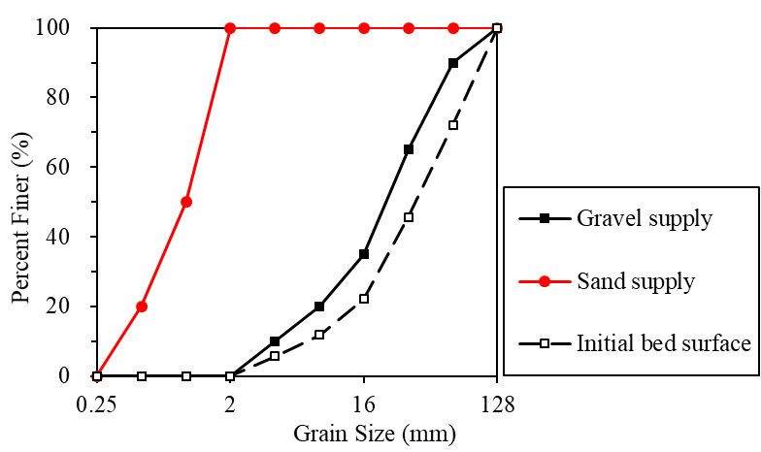
Degradation of a foreland river after the Wenchuan Earthquake, China:
A complex interaction among weirs, sediment supply and sediment mining
X
Computational conditions:
Channel length: 50 km
Discharge per unit width q_{wf} : 6 m²/s (close to 10-year flood)
Flood intermittency factor I_{f} : 0.03
Pre-earthquake sediment feed: 2×10⁻³ m²/s gravel
Post-earthquake sediment feed: 2×10⁻³ m²/s gravel + 2×10⁻³ m²/s sand
Initial bed slope: 5.2 ‰
Initial surface geometric mean grain size: 30.4 mm
Initial substrate texture: the same as gravel supply
※ Initial condition: pre-earthquake equilibrium
Research Prototype
Take Home Messages
1-D Morphodynamic Model & Computational Scenarios
Results for Idealized Cases with a Single Weir
Effect of Weirs on bedload transport & bed degradation
3/4
Results for More Realized Cases with Cascading Weirs
Background picture: Aerial photo of the Renmin Canal, Shi-ting River, Sichuan, China, taken in 2021

Slide 11
Degradation of a foreland river after the Wenchuan Earthquake, China:
A complex interaction among weirs, sediment supply and sediment mining
X
Computational Scenarios (Single weir):
Case No. | Weir height (m) | Weir location (km)
1 | No weir
2 | 0 | 5
3 | 2 | 5
4 | 5 | 5
5 | 5 | 10
6 | 5 | 20
7 | 10 | 5
Pre- and post-earthquake sediment feed conditions
No sediment mining
Cases 4-6: effect of weir location
Cases 2-4 & 7: effect of weir height
Research Prototype
Take Home Messages
1-D Morphodynamic Model & Computational Scenarios
Results for Idealized Cases with a Single Weir
Effect of Weirs on bedload transport & bed degradation
4/4
Results for More Realized Cases with Cascading Weirs
Background picture: Aerial photo of the Renmin Canal, Shi-ting River, Sichuan, China, taken in 2021

Slide 12
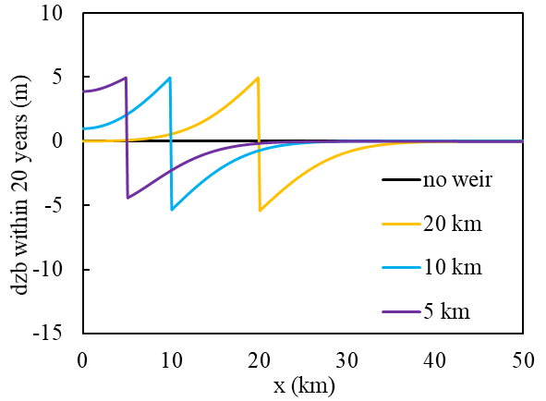
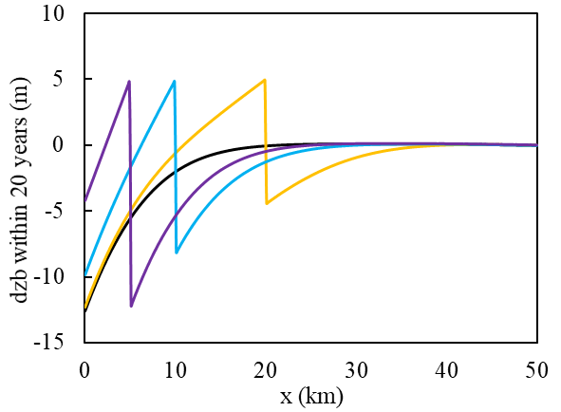
Degradation of a foreland river after the Wenchuan Earthquake, China:
A complex interaction among weirs, sediment supply and sediment mining
X
Only gravel supply
Gravel and sand supply
Effect of weir location
Only gravel supply: weir location hardly affects the degradation depth downstream of the weir.
Both gravel and sand supply: larger degradation depth with a closer weir.
Research Prototype
Take Home Messages
1/2
Weir locations = 5 km, 10 km, and 20 km; Weir height = 5 m.
dzb: denotes deviatoric bed elevation
1-D Morphodynamic Model & Computational Scenarios
Idealized Cases:
A Single Weir
Effect of Weirs on bedload transport & bed degradation
More Realistic Cases: Cascading Weirs & Mining
Background picture: Aerial photo of the Renmin Canal, Shi-ting River, Sichuan, China, taken in 2021

Slide 13
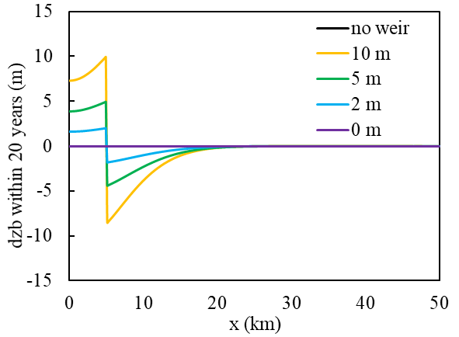
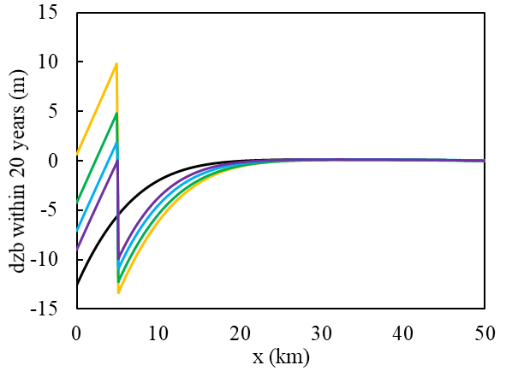
Degradation of a foreland river after the Wenchuan Earthquake, China:
A complex interaction among weirs, sediment supply and sediment mining
X
Effect of weir height
Only gravel supply: degradation depth is almost equal to the weir height.
Both gravel and sand supply: even a sill with zero weir height leads to 10 m degradation.
Only gravel supply
Gravel and sand supply
Research Prototype
Take Home Messages
2/2
Weir locations = 5 km; Weir height = 0, 2, 5 and 10 m.
dzb: denotes deviatoric bed elevation
1-D Morphodynamic Model & Computational Scenarios
Idealized Cases:
A Single Weir
Effect of Weirs on bedload transport & bed degradation
More Realistic Cases: Cascading Weirs & Mining
Background picture: Aerial photo of the Renmin Canal, Shi-ting River, Sichuan, China, taken in 2021

Slide 14
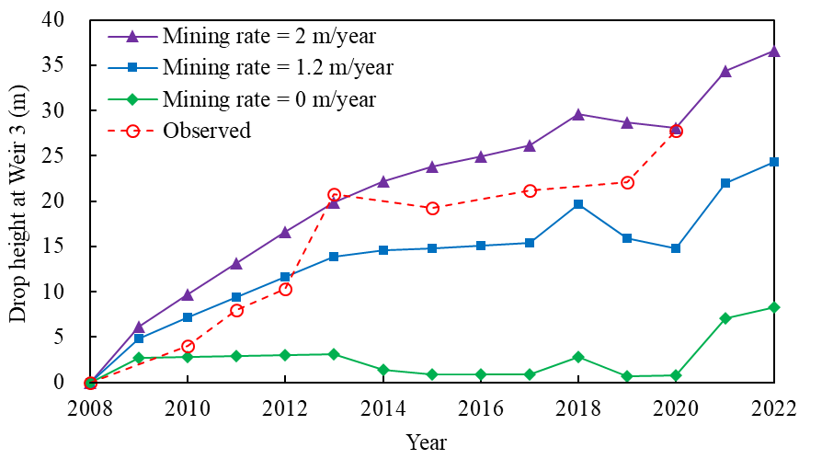
Degradation of a foreland river after the Wenchuan Earthquake, China:
A complex interaction among weirs, sediment supply and sediment mining
X
Simulation vs. Observation (drop height at Weir 3)
The observed drop height at Weir 3 increases rapidly from 0 m to about 20 m before 2013, but keeps relatively stable afterwards.
In our simulation, mining rates of 0-2 m/year are applied.
1.2 m/year (16 Mt/year): Simulation agrees reasonably with the observed trend, with a generally declining rate of bed degradation over time.
2 m/year: Simulated drop height increases consistently even after 2013, which is different from the observation.
Research Prototype
Take Home Messages
Results for Idealized Cases with a Single Weir
1/3
1-D Morphodynamic Model & Computational Scenarios
Effect of Weirs on bedload transport & bed degradation
Simulated and observed drop height at Weir 3
More Realistic Cases: Cascading Weirs & Mining
Background picture: Aerial photo of the Renmin Canal, Shi-ting River, Sichuan, China, taken in 2021

Slide 15
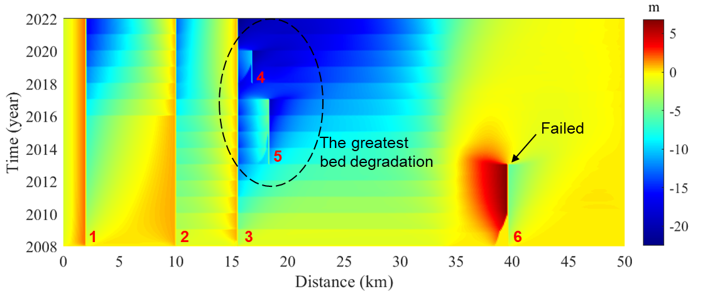
Degradation of a foreland river after the Wenchuan Earthquake, China:
A complex interaction among weirs, sediment supply and sediment mining
X
Spatiotemporal variation of dzb
Upstream of the weir: traps bedload and leads to bed aggradation
Downstream of the weir: causes significant bed degradation
The largest degradation occurs in the region 15-35 km downstream of the inlet, mostly due to the large interval between two weirs.
Research Prototype
Take Home Messages
Simulated spatiotemporal variation of dzb (deviatoric bed elevation), mining rate = 1.2 m/year
Results for Idealized Cases with a Single Weir
2/3
1-D Morphodynamic Model & Computational Scenarios
Effect of Weirs on bedload transport & bed degradation
More Realistic Cases: Cascading Weirs & Mining
Background picture: Aerial photo of the Renmin Canal, Shi-ting River, Sichuan, China, taken in 2021

Slide 16
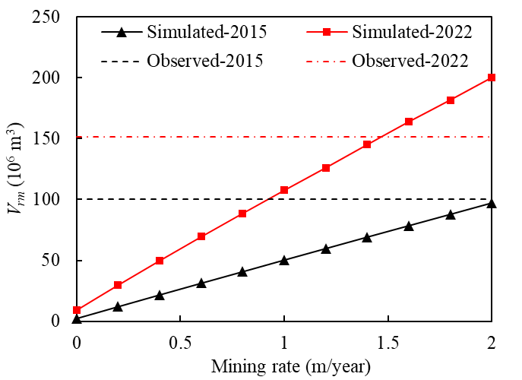
Degradation of a foreland river after the Wenchuan Earthquake, China:
A complex interaction among weirs, sediment supply and sediment mining
X
Contribution of sediment mining to bed degradation
Observed V_{rm}: 1×10⁸ m³ in 2015, 1.5×10⁸ m³ in 2022.
Simulated V_{rm} without sediment mining: 2×10⁶ m³ in 2015, 9×10⁶ m³ in 2022, which are 1-2 orders of magnitude smaller than observation.
Simulated V_{rm} agrees well with the observation with mining rate = 2 m/year (2015) and 1.5 m/year (2022).
Research Prototype
Take Home Messages
Observed and simulated V_{rm} (net volume of sediment eroded from the channel) in the Shi-ting River with different mining rates.
Results for Idealized Cases with a Single Weir
3/3
1-D Morphodynamic Model & Computational Scenarios
Effect of Weirs on bedload transport & bed degradation
More Realistic Cases: Cascading Weirs & Mining
Background picture: Aerial photo of the Renmin Canal, Shi-ting River, Sichuan, China, taken in 2021

Slide 17
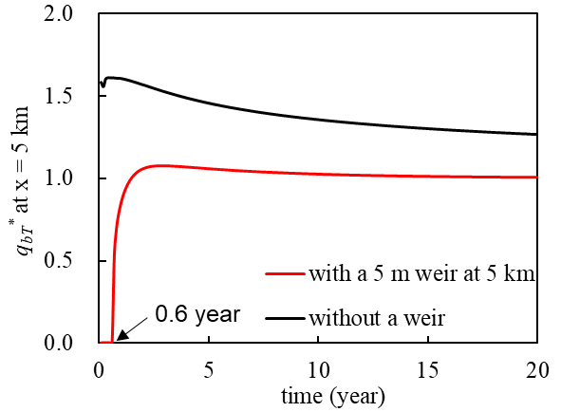
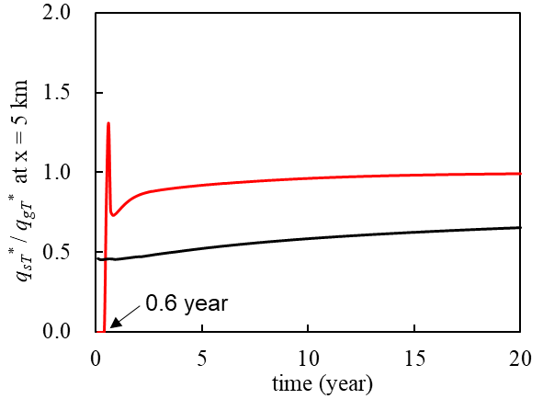
Degradation of a foreland river after the Wenchuan Earthquake, China:
A complex interaction among weirs, sediment supply and sediment mining
X
(a)
Bedload transport across the weir
The weir generally reduces the bedload transport rate by about 30% within 20 years.
The weir preferentially delivers fine sediment, which leads to a finer bedload downstream.
Research Prototype
Take Home Messages
(b)
Panel a: Dimensionless sediment transport rate
Panel b: Ratio of sand transport rate to gravel transport rate
1-D Morphodynamic Model & Computational Scenarios
Results for Idealized Cases with a Single Weir
Effect of Weirs on bedload transport & bed degradation
Results for More Realized Cases with Cascading Weirs
1/2
Background picture: Aerial photo of the Renmin Canal, Shi-ting River, Sichuan, China, taken in 2021

Slide 18
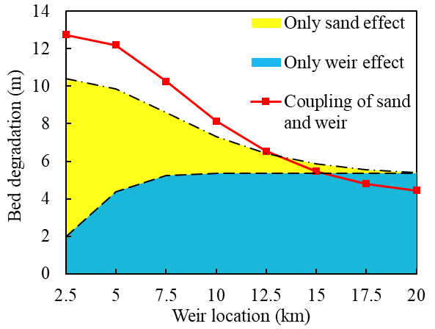
Degradation of a foreland river after the Wenchuan Earthquake, China:
A complex interaction among weirs, sediment supply and sediment mining
X
Coupling effect: weir & fine sediment
When weir location < 12.5 km：
> +
coupling effect > sand effect + weir effect
The weir traps gravel and delivers sand, enhancing the “magic sand” effect on bed degradation.
Research Prototype
Take Home Messages
Simulated bed degradation immediately downstream of the weir after 20 years.
: degradation induced only by “magic sand”
: degradation induced only by the weir
: degradation induced by the two effects
Results for Idealized Cases with a Single Weir
1-D Morphodynamic Model & Computational Scenarios
Effect of Weirs on bedload transport & bed degradation
Results for More Realized Cases with Cascading Weirs
2/2
Background picture: Aerial photo of the Renmin Canal, Shi-ting River, Sichuan, China, taken in 2021

Slide 19
Degradation of a foreland river after the Wenchuan Earthquake, China:
A complex interaction among weirs, sediment supply and sediment mining
X
Sediment mining, not excess sand from the Wenchuan earthquake, is likely the key factor for the dramatic bed degradation in the Shi-ting River.
A longer spatial interval between weirs leads to larger bed degradation.
The weir preferentially traps gravel and delivers sand, which can enhance the “magic sand” effect on downstream degradation.
Research Prototype
Take Home Messages
1-D Morphodynamic Model & Computational Scenarios
Results for Idealized Cases with a Single Weir
Effect of Weirs on bedload transport & bed degradation
The QR code for the abstract
My email: linyp19@mails.tsinghua.edu.cn
Results for More Realized Cases with Cascading Weirs
Background picture: Aerial photo of the Renmin Canal, Shi-ting River, Sichuan, China, taken in 2021

Slide 20
X
24 m
in 2021
Background picture: Aerial photo of the Renmin Canal, Shi-ting River, Sichuan, China, taken in 2021

