Slide 1
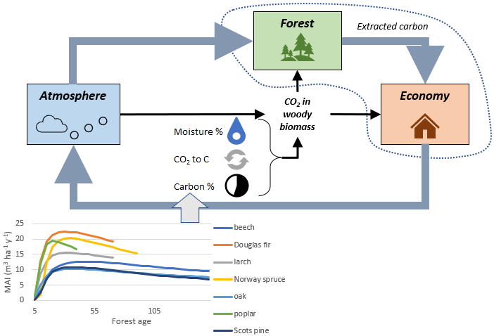
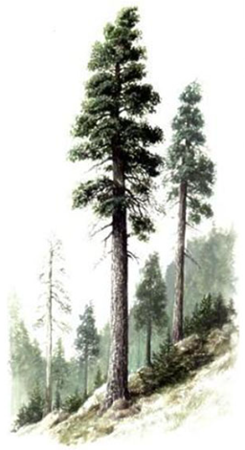
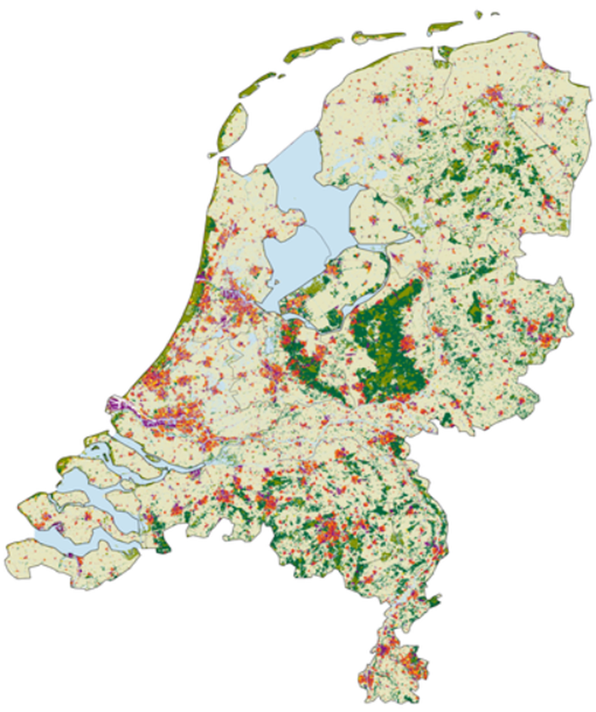
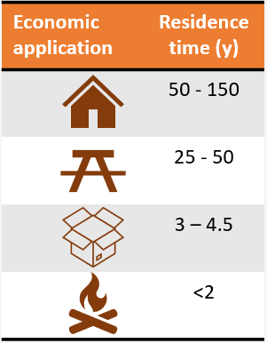
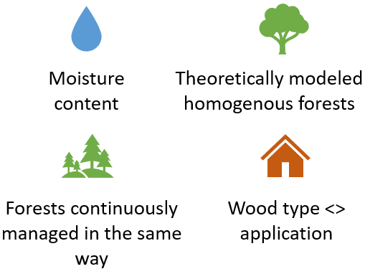
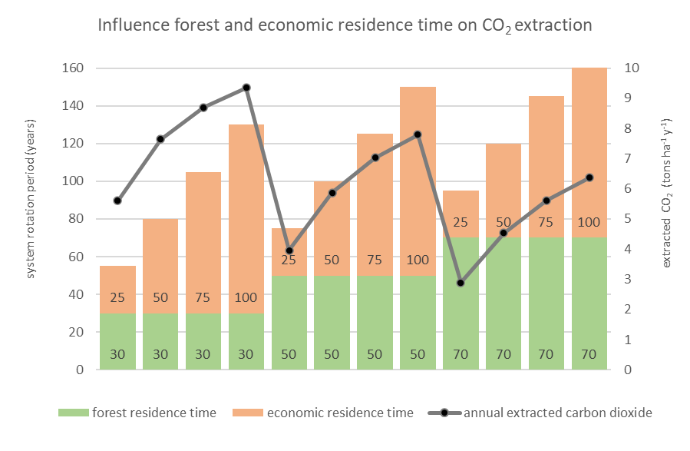
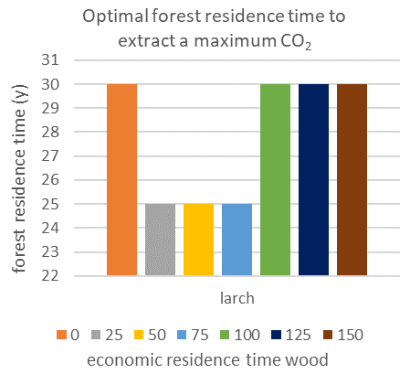
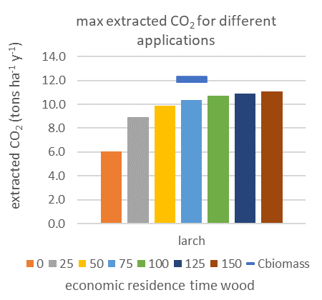
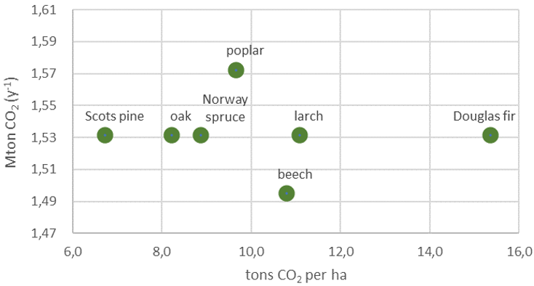
Climate mitigation using wood in the Netherlands: a modelling approach from family home to national scale
Jaap Bos¹, Angelique Lansu¹, P.W. Gerbens-Leenes², and Jikke van Wijnen¹ 1) Open University, 2) University of Groningen
INTRODUCTION
METHODOLOGY
EU: Planting trees -> mitigate climate change
Options in economic chain?
Optimal configuration?
Focus: Dutch forests
660,000 family homes up to 2050
Available forest: 375,000 ha
150 Mton CO₂ p/y
DISCUSSION
SYNTHESIS
Option housing low compared to annual emissions.
->1.5 Mton of CO₂ annually (1% yearly emissions)
Ideal felling age depends on application.
Higher economic residence time increases annual CO₂ extraction - CO₂ for wood growth never fully extracted.
RESULTS
Pattern CO₂ extraction for larch in CO₂-wood system with different combinations of forest age and economic residence time.
Tons CO₂ per ha and total tons CO₂ for family homes
References
MSc Thesis
Further research

