Slide 1


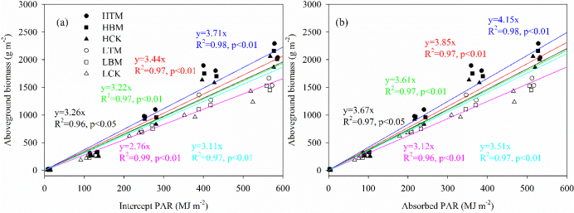
Plastic mulching combined with fertilizer application affects maize light use, growth and grain yield
Lihong Wu ^{a, b}, Hao Quan ^{a, b}, Hao Feng ^{b, c, *}, Dianyuan Ding ^{b, c, *}, Kadambot H.M. Siddique ^{d}
ª College of Water Resources and Architectural Engineering, Northwest A&F University, Yangling, Shaanxi 712100, China
^{b} State Key Laboratory of Soil Erosion and Dryland Farming on the Loess Plateau, Institute of Soil and Water Conservation, Northwest A&F University, Yangling, 712100, China
Introduction
Mulch and fertilizer significantly affected (P < 0.05) fIPAR and fAPAR in both seasons, except for fIPAR at R3 in the second season (Table 2). Fertilizer significantly increased fIPAR and fAPAR in the high fertilizer treatment regardless of mulch application.
Plastic film mulching (PM) can modify soil hydrothermal conditions, surface optical characteristics, accelerate crop development, and increase crop biomass accumulation and yield. However, only a few studies have quantified the effect of PM on light and heat resources use and crop phenological development. Quantifying the effect of changes in light use capacity and ground temperature on crop growth and development is important for the improvement of farmland production mechanism under PM.
we aimed: (1) to quantify the light use characteristics of maize canopy and develop the corresponding empirical function; (2) to investigate the effects of PM and nitrogen application on soil temperature and maize growth dynamics; (3) to determine the improvement of yield and RUE under PM combined with fertilizer measures.
The dynamic change in the photosynthesis rate (A) peaked at V12 and then decreased. Mulch and fertilizer measures significantly affected A (P < 0.05) in both seasons. The high fertilizer treatments had higher A values than the low fertilizer treatments. Mulch and fertilizer positively interacted with A (P < 0.05)—as nitrogen fertilizer increased, A value increased by 34.8%, 44.4%, and 47.0% on average for HCK, HTM, and HBM compared to LCK, respectively.
Materials and Methods
A field experiment was undertaken from April to September in 2019 and 2020 at the Shuguang Irrigation Research Station (40°43’N, 107°13’E, 1039 masl) in the HID, which has a temperate continental climate with mean annual precipitation of 135 mm and mean annual temperature of 7.8°C.
Conclusions
The linear relationship occurred between AGB and cumulative intercept PAR and absorbed PAR (Fig. 8; R2 > 0.90). Mulch had a significant effect (P < 0.01) on crop development in both seasons, mulch affected the length of the crop growing period. For example, TM and BM increased the average length of the grain-filling stage by 6 and 4 days relative to CK.
Plastic film mulching and fertilization application synergistically regulate canopy light use characteristics and leaf area growth dynamics, ultimately determining the radiation use capacity of crop. Results showed that optimized canopy light conditions and improved crop photosynthesis rate by adding nitrogen under film mulching conditions promoted biomass accumulation and yield formation. The farmland crop radiation use capacity can be promoted by increasing LAI and SPAD caused by TM under a high nitrogen supply and thus achieved high crop yield and nitrogen use efficiency. This study recommended that further research be conducted to breed the cultivar (large canopy) combined with nitrogen postponing application to further increase mulching farmland production and radiation use capacity.
Fig. 1. (a) Distribution of daily and cumulative air temperature and (b) daily pan evaporation (Ep) and cumulative Ep in relation to days after maize sowing in two growing seasons. Dashed and solid lines represent cumulative observations in 2019 and 2020, respectively.
Preliminary results
SPAD initially increased before VT, peaked at VT, and then decreased until maturity (Fig. 5). In both seasons, the high fertilizer treatments had 3.6–22.1% greater values than the low fertilizer treatments. Mulching increased maize leaf SPAD (P < 0.05) by 5.6–17.4% under TM and 1.9–8.7% under BM, relative to CK, with SPAD ranked TM > BM > CK. The interaction between mulch and fertilizer measures significantly increased leaf SPAD values, with HCK, HTM, and HBM 11.0%, 26.3%, and 18.5% higher than LCK, respectively.

