Slide 1
Overcoming Fragmentation of Geochemical Data Resources:
Collaboration between
EarthChem, Astromat, GEOROC, & MetBase
Kerstin Lehnert, Marthe Klöcking,
Dominik Hezel, Lucia Profeta, Peng Ji, &
Adrian Sturm

Slide 2
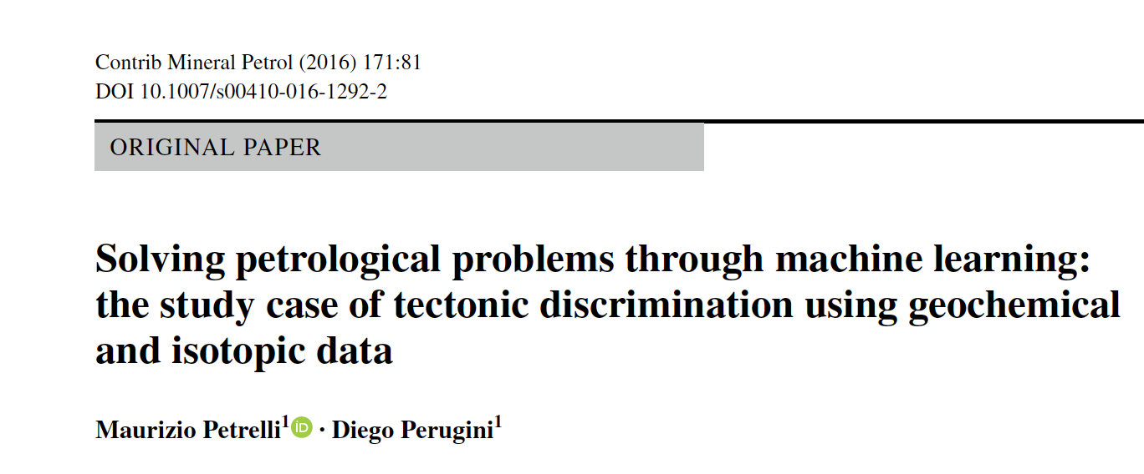
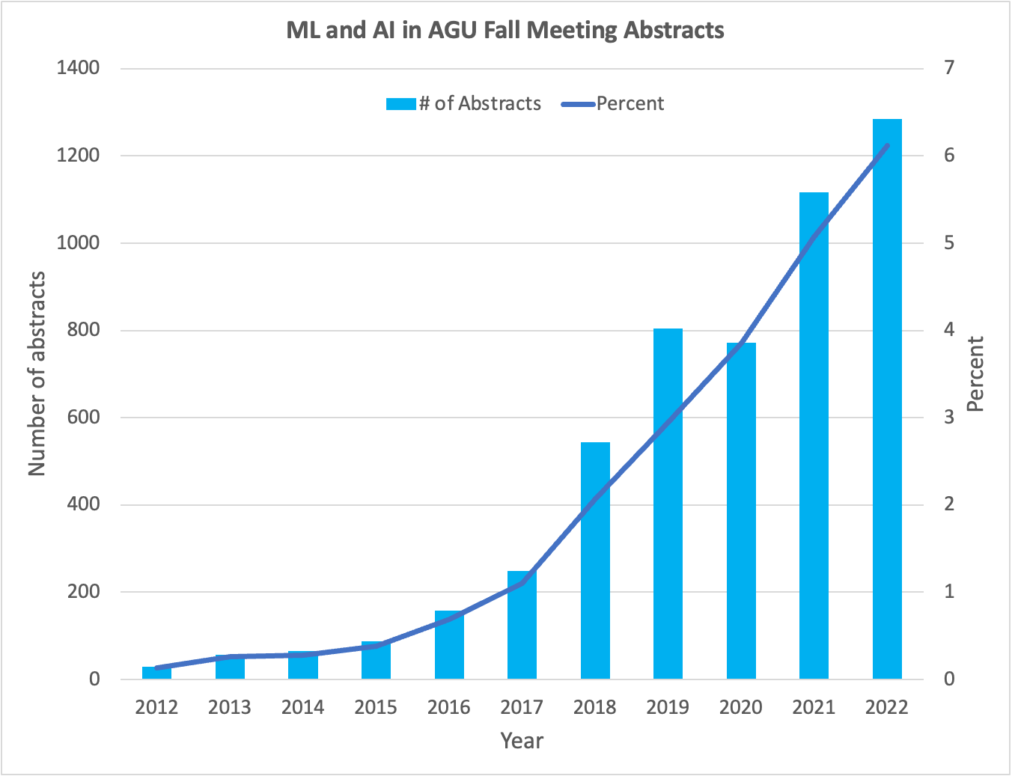
Demand for Data
“To provide a robust and quantitative tool, we extract a large number of samples from open-access and comprehensive global petrological databases like PetDB (http://www.earthchem.org/petdb) and GEOROC (https://georoc.eu/).”
Courtesy of Brooks Hanson, AGU
Courtesy of Brooks Hanson, AGU

Slide 3
The Fragmentation Problem
Geochemical data resources tend to be built in thematic, institutional, national, or programmatic silos.
Geochemical data systems are not interoperable due to the lack of geochemistry data standards.
The content of the data systems is not coordinated and therefore sometimes duplicated, making merging of datasets complex.
The data systems compete for users to demonstrate relevance to obtain funding.
The community loses out!
    Competition is a waste of resources.
    Sharing & reuse of data are impeded.
Notes:
Global initiative to address the ‘Fragmentation Problem’
Converge on global data standards for geoanalytical data.
Engage the community in development & implementation of these standards.
EarthChem, GEOROC, Astromat, & MetBase are founding members of OneGeochemistry.
The current activities are the first step toward

Slide 4
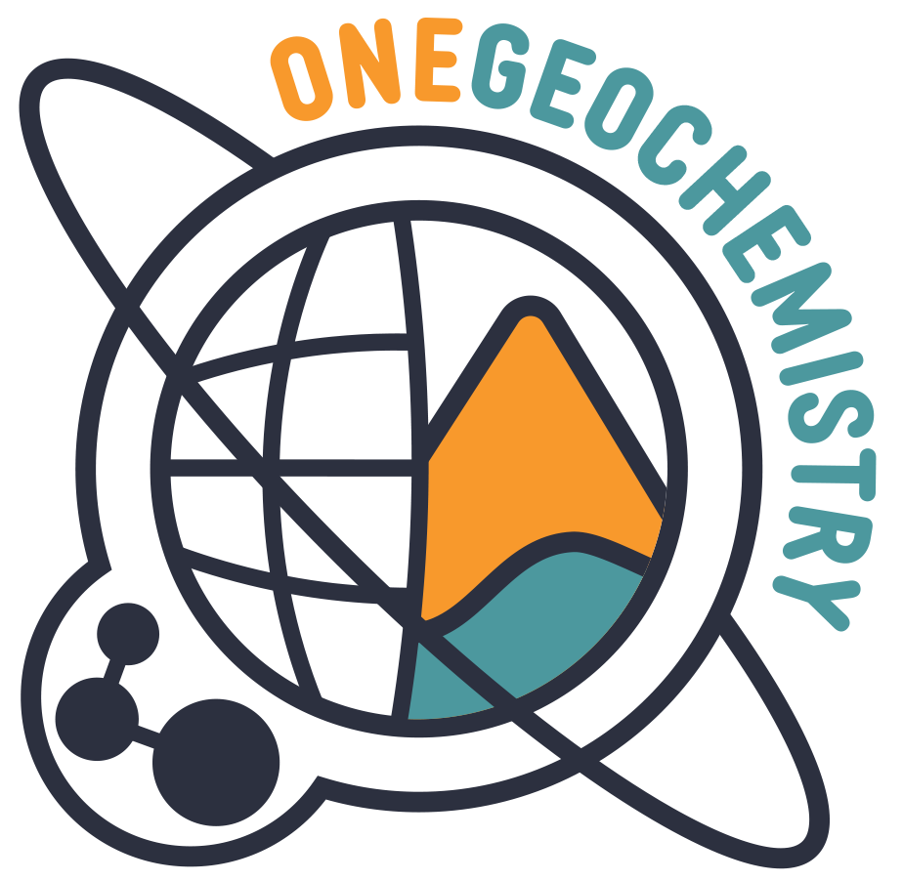
EarthChem, GEOROC, Astromat, MetBase:
Common Goals
Democratize access to geochemical data to maximize their utility for science and society.
Develop & promote best practices and standards for geochemical data to advance data-driven discovery and innovation with geochemical data.
EarthChem, GEOROC, Astromat, & MetBase are founding members of the OneGeochemistry Initiative

Slide 5
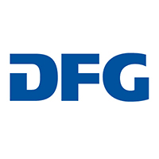


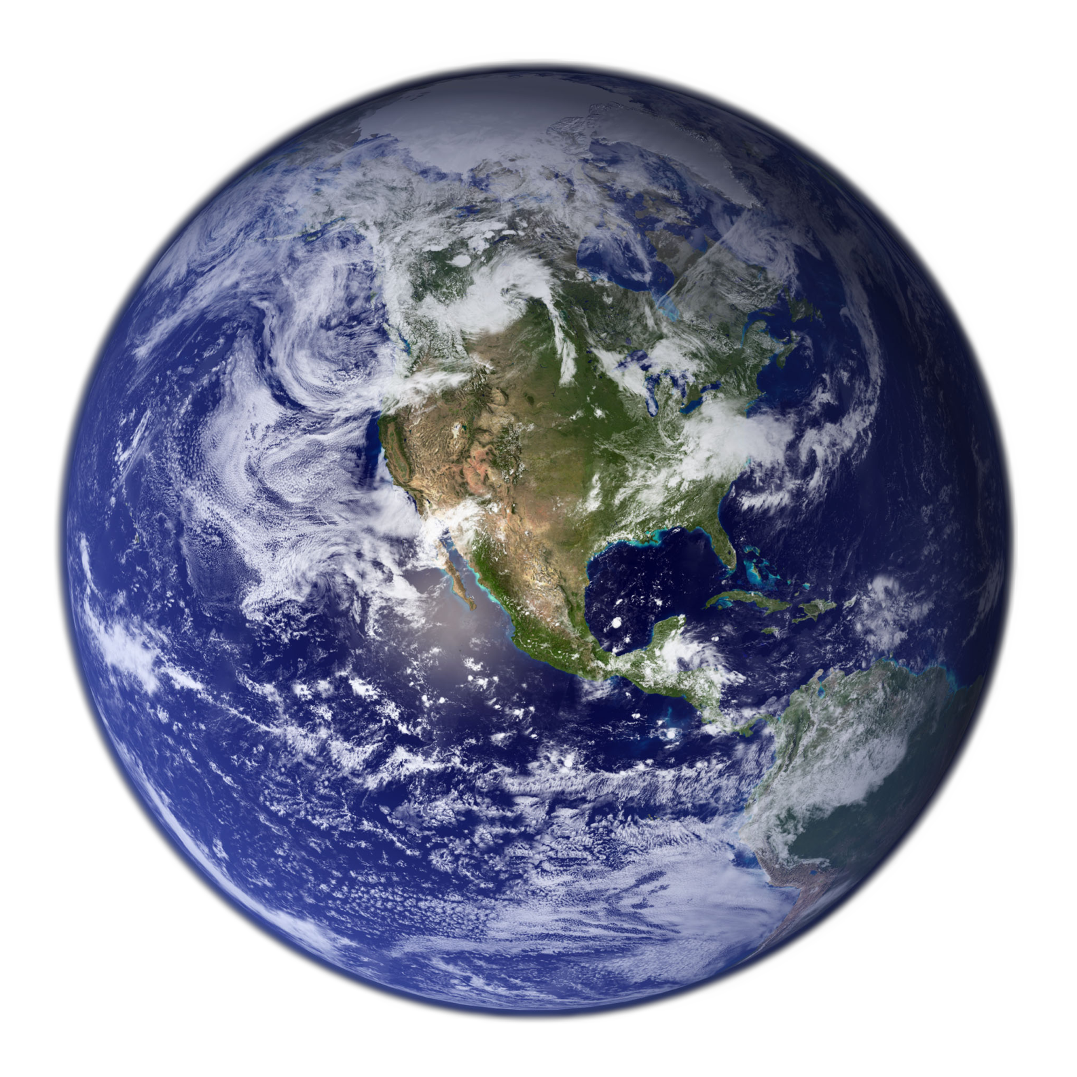








The Collaborators
Funded by:
Geochemistry
of terrestrial rocks & minerals
Cosmochemistry
of astromaterials & meteorites

Slide 6
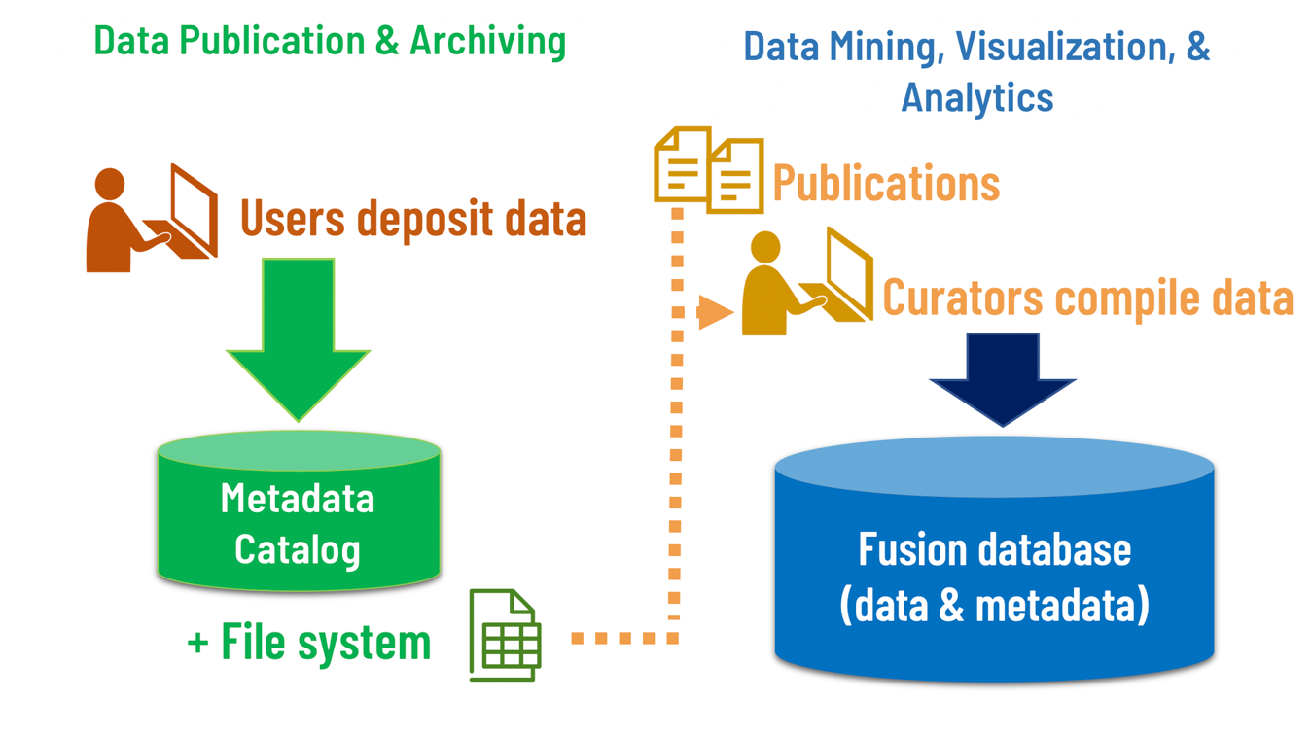
Components of Data Systems
EarthChem & DIGIS Repositories, Astromat Archive
GEOROC, PetDB (EarthChem), AstroDB, MetBase

Slide 7
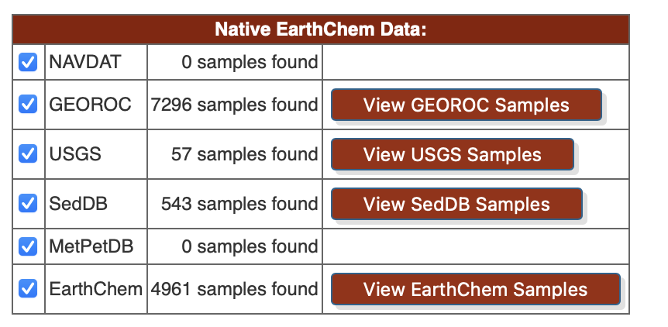
Connections
Joint development of database schema for GEOROC & PetDB in 1998.
  Vocabularies and schema have diverged.
  PetDB moved to the ODM2 data model.
GEOROC provided its content to the EarthChem Portal using EarthChem XML schema developed in 2006.
Astromat synthesis database uses the ODM2 schema used for PetDB.
EarthChem Portal search result:

Slide 8

Addressing Common Challenges through Collaboration
Provide comprehensive content to fulfill user needs.
Modernize infrastructure & architecture to scale to growing data volume.
Improve usability of search/retrieval/ingestion software (GUI, API) to broaden usage.
Perform data validation and quality assurance.
Ensure sustainability (availability of content, resources).

Slide 9
4 Steps to Overcome Fragmentation
Step 1: Formalize the collaboration
  MOU signed between EarthChem & DIGIS in 2021 to define scope of the collaboration, as well as roles & responsibilities of the two collaborators.
  Contract signed between MetBase & Astromat in 2022 to migrate MetBase content to Astromat.
Step 2: Facilitate collaboration between teams.
  In-person workshop & regular virtual meetings of EarthChem & DIGIS teams.
  Regular virtual meetings between Astromat & MetBase system engineers.
Step 3: Identify duplication & agree on complementarity
  Division of data entry, software development, and service provision tasks
Step 4: Implement (within the constraints of existing resources)

Slide 10
Implementation: Achievements
Fixed the GEOROC – ECP pipeline to update GEOROC content in the Earthchem Portal (added >17 million analytical values to the ECP!)
Aligned data models between PetDB & GEOROC and Astromat & MetBase.
De-duplication of content is ongoing between PetDB & GEOROC and Astromat & MetBase.
Migration of MetBase content into Astromat in progress (inclusion of all MetBase references in Astromat completed).
Harmonizing vocabularies for all 4 systems is ongoing
  Vocabulary for analytical methods completed in machine-readable format (thanks to Steve Richard!), to be released at Research Vocabularies Australia.
  Vocabulary for chemical variables is completed, others are in development in alignment with emerging efforts of the OneGeochemistry initiative.
Credit to Steve Richard (USGIN) for his work on the vocabularies!

Slide 11
Moving Forward
Complete a shared vocabulary for tectonic settings (GEOROC & PetDB).
Create joint data entry & curation tool for GEOROC & PetDB based on the EarthChem Admin Tool; Astromat is already using it.
Offer a single data submission interface for researchers to publish their data for inclusion into GEOROC, PetDB, and Astromat.
Further evolve the plan for a single Search Index & Interface for GEOROC & PetDB.
Shared community engagement events (e.g. workshop at Goldschmidt 2023).
Find funding for the collaboration – it’s a lot of effort & unfunded!

Slide 12

Thanks.
And please join us for the following workshops:
Open Data in Geochemistry Part 1:
Navigating the Present Data Infrastructure Landscape
Saturday, July 8, 2023 (virtual)
Open Data in Geochemistry Part 2:
Managing, Publishing, and Archiving Imagery Generated by Geochemical and Cosmochemical Sample Analysis
Sunday, July 9, 2023 (hybrid)
See you in Lyon!
Notes:
Ω

