Slide 1
Long-term increase in precipitation intermittency and intensity at Paleogene mid-latitudes
By: Jake Slawson¹ and Piret Plink-Bjorklund¹
¹Department of Geology and Geological Engineering, Colorado School of Mines

Slide 2
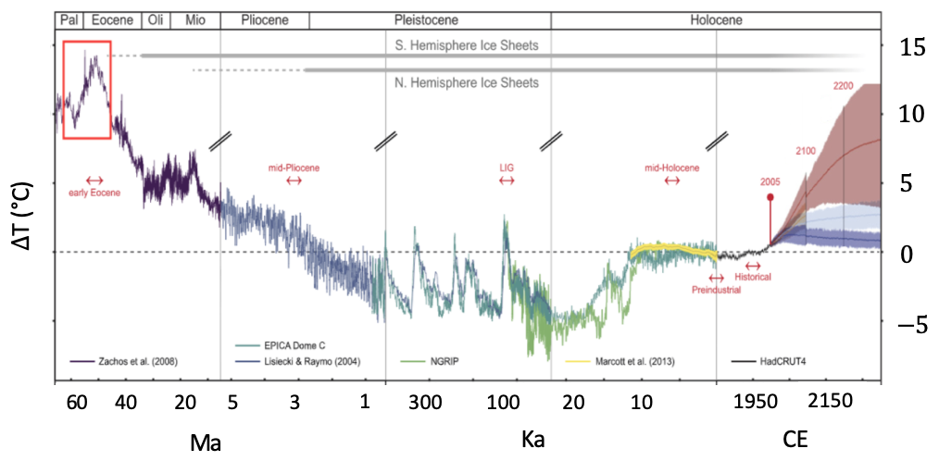
World by 2150
Under RCP5-8.5, climate models predict temperatures like those of the Early Eocene by 2150 (Burke et al., 2018)
Effectively reversing 49 Ma of cooling in a matter of centuries
Intermediate scenarios still result in temperatures similar to the mid-Pliocene
Modified from Burke et al., 2018

Slide 3
Using the past to predict the future
Under RCP8.5, temperatures like those of the Early Eocene are expected by 2150 CE (Burke et al., 2018)
Worst case scenarios looking less likely – what is the value in studying such extreme conditions?
We can see how much we have to save!
How do Earth systems respond to rapid increases in atmospheric carbon dioxide?
The Paleocene Eocene Thermal Maximum (PETM) and Early Eocene Climatic Optimum (EECO) are a series of rapid global warming events (hyperthermals)
Continents in similar location to present
Similar rate and magnitude of CO2 release to the present
Modified from Burke et al., 2018

Slide 4
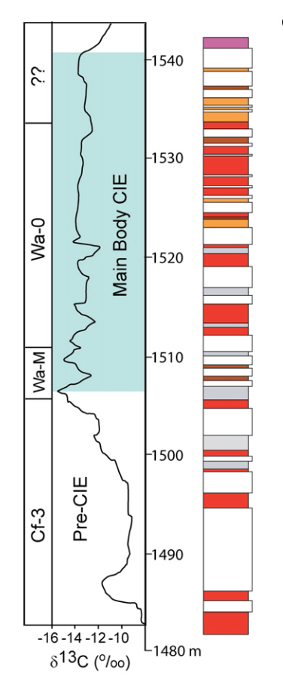
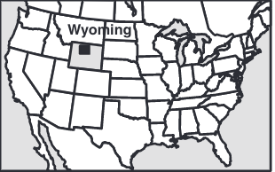
What were the PETM and EECO like?
Mid-latitudes: shifted from relatively wet, temperate conditions to a warm, highly variable hydroclimate prone to flooding (Tateo, 2020; Carmichael et al., 2017, 2018)
Poles: warm, ever wet conditions with crocodiles and palm trees in Greenland and Antarctica (West et al., 2015)
Some researchers have noted dramatic changes in climate prior to maximum CO2 conditions (Kraus et al., 2013; Zellman and Plink-Bjorklund, 2021)
Potential nonlinear relationship between greenhouse gas emissions and changes in earth systems - dramatic changes in climate may be expected prior to 2150 CE
Kraus et al., 2013

Slide 5
Filling a knowledge gap
How did global hydroclimate change during the Early Paleogene hyperthermals?
Does the timing of hydroclimate change relative to greenhouse gas emissions indicate a nonlinear, threshold driven relationship?
Modified from Burke et al., 2018

Slide 6
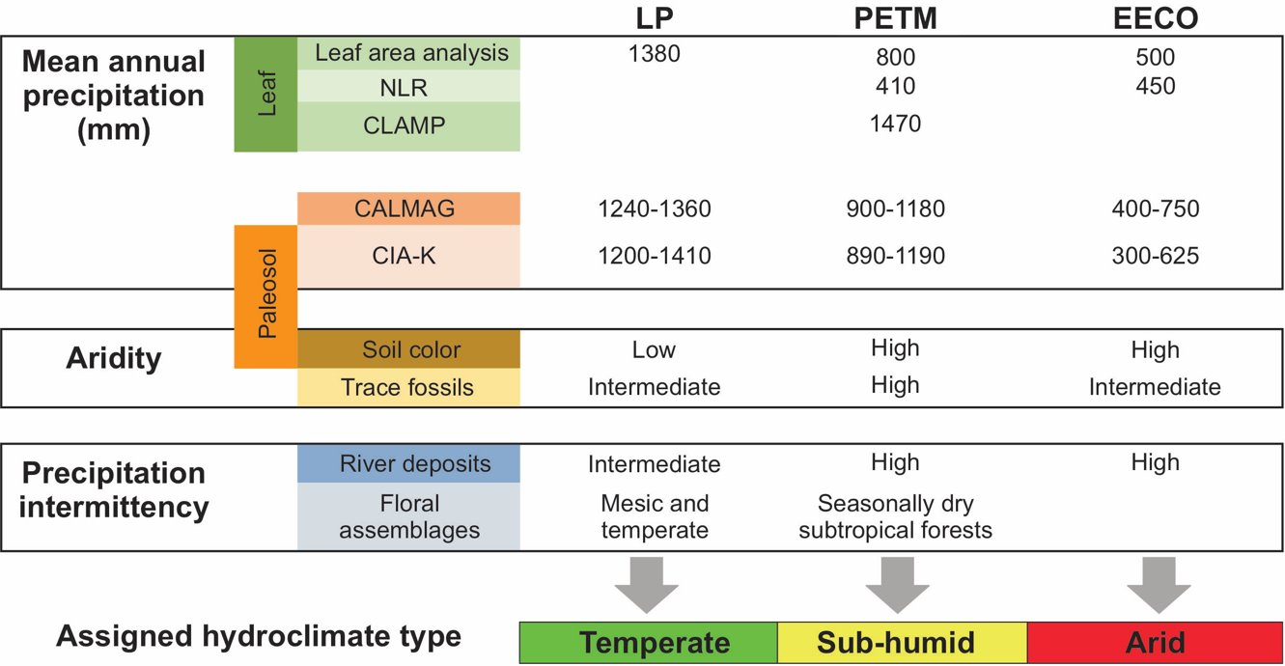
Approach
Perform a global data compilation of published hydroclimate data from the Early Paleocene to Post-EECO (~66 to 49 Ma)
Use proxy evidence to assign a hydroclimate type to study locations
Use hydroclimate type and paleogeographic reconstructions to create global hydroclimate maps through the Early Paleogene

Slide 7
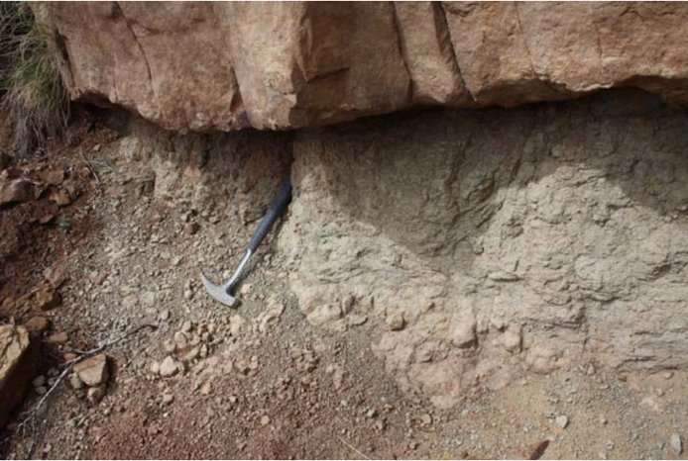
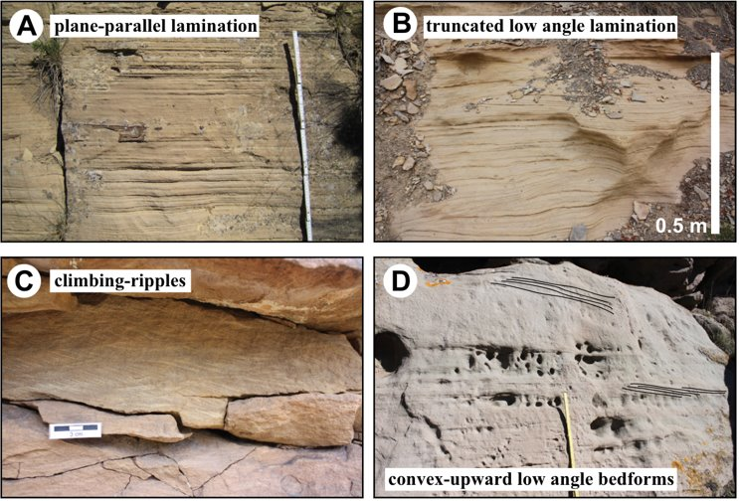
Hydroclimate proxies
Paleosols
Climofunctions estimate mean annual precipitation (MAP) by treating loss or gain elements as a function of chemical weathering via precipitation and temperature (Sheldon et al., 2002; Lukens et al., 2019)
Seasonality can be related to color
Paleobotany
Leaf shape and size related to mean annual temperature (MAT) and MAP, respectively (Wilf et al., 1998; Peppe et al., 2011)
Climate variables estimated based on nearest living relatives in modern world (Greenwood et al., 2005)
Fluvial sedimentology
Supercritical flow structures, in-channel bioturbation, and presence of fluvial fans are indicative of fluctuations in river discharge as a function of precipitation intermittency (Fielding, 2006; Plink-Bjorklund, 2015; Hansford and Plink-Bjorklund, 2020)
Clay mineralogy
Hydrolysis of feldspars produces clay mineral assemblages based on degree of weathering as a function of temperature and precipitation (Chamley 1989; Tateo, 2020)
Golab 2010
Birgenheier et al., 2020

Slide 8
Table 1. Hydroclimate type
​ Hydroclimate ​ | ​ MAT ​ | ​ MAP and intermittency ​ | ​ Modern Example ​
Warm, ever-wet (WEW) ​ | >20°C ​ | Perennial, ever-wet >2000 mm/yr ​ | Amazon rainforest ​
Monsoonal (M) to cool monsoonal (CM) with seasonal precipitation ​ | M: >20°C ​ CM: <20°​ ​ | Seasonal monsoonal, 500-2000 mm/yr ​ | M: India ​ CM: Japan ​
Warm (WS) or cool (CS), sub-humid to semi-arid with intermittent precipitation ​ | WS: >20°C​ CS: <20°C ​ | Intermittent, WS: 500-2000 mm/yr, CSI: <500-1200 mm/yr ​ | WS: Cameroon ​ CS: Colorado, USA ​
Warm (WA) or cool (CA), arid with intermittent precipitation ​ | WA: >20°C​ CA: <20°C ​ | Intermittent, <500 mm/yr ​ | WA: Algeria ​ CA: Southern Kazakhstan ​
Warm, humid subtropical (HS) or cool temperate (CT)​ | HS: >15°C​ CT: <15°C ​ | Perennial, 500-2000 mm/yr ​ | HS: Florida, USA ​ CT: Poland ​
Cold and dry with seasonal freeze-thaw (CD) ​ | -5 to 5°C ​ | Perennial, 500-1500 mm/yr ​ | Yukon, Canada ​
Cool, ever-wet (CEW) ​ ​ | <20°C ​ | Perennial, >2000 mm/yr ​ | Western Washington, USA ​

Slide 9
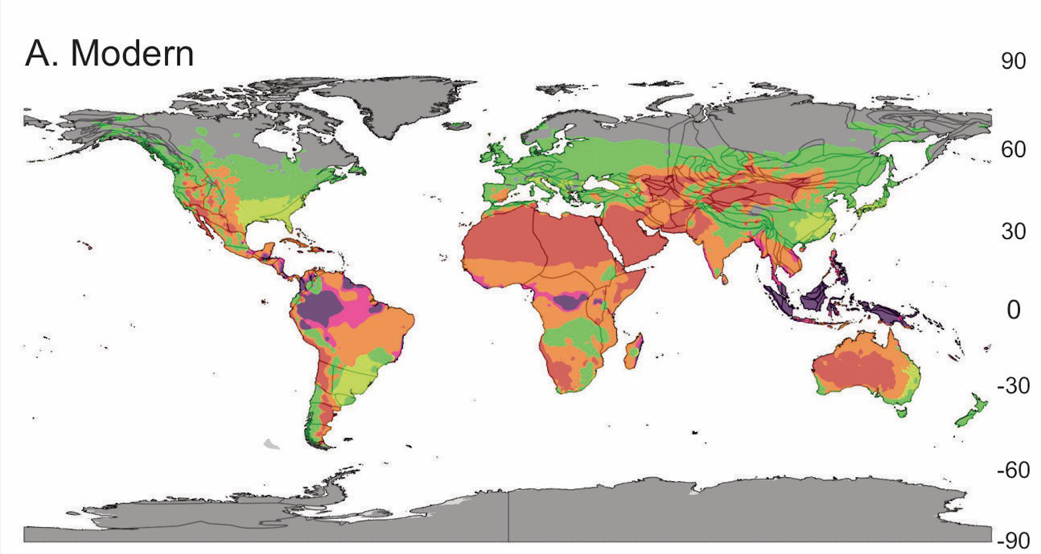
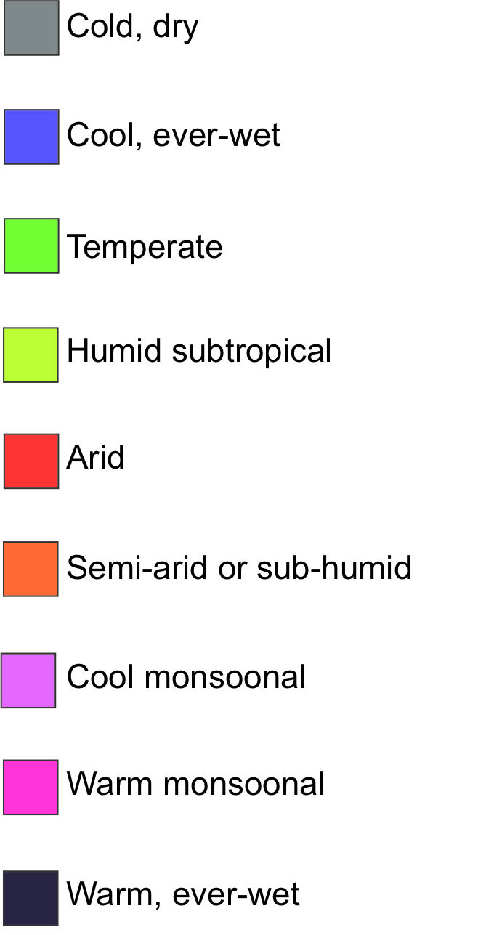
Modern
Paleogeographic map from Scotese, C. R., 2001. Atlas of Earth History, Volume 1, Paleogeography, PALEOMAP Project, Arlington, Texas, 52 pp. Modern climate classification adapted from Peel et al., 2007.

Slide 10
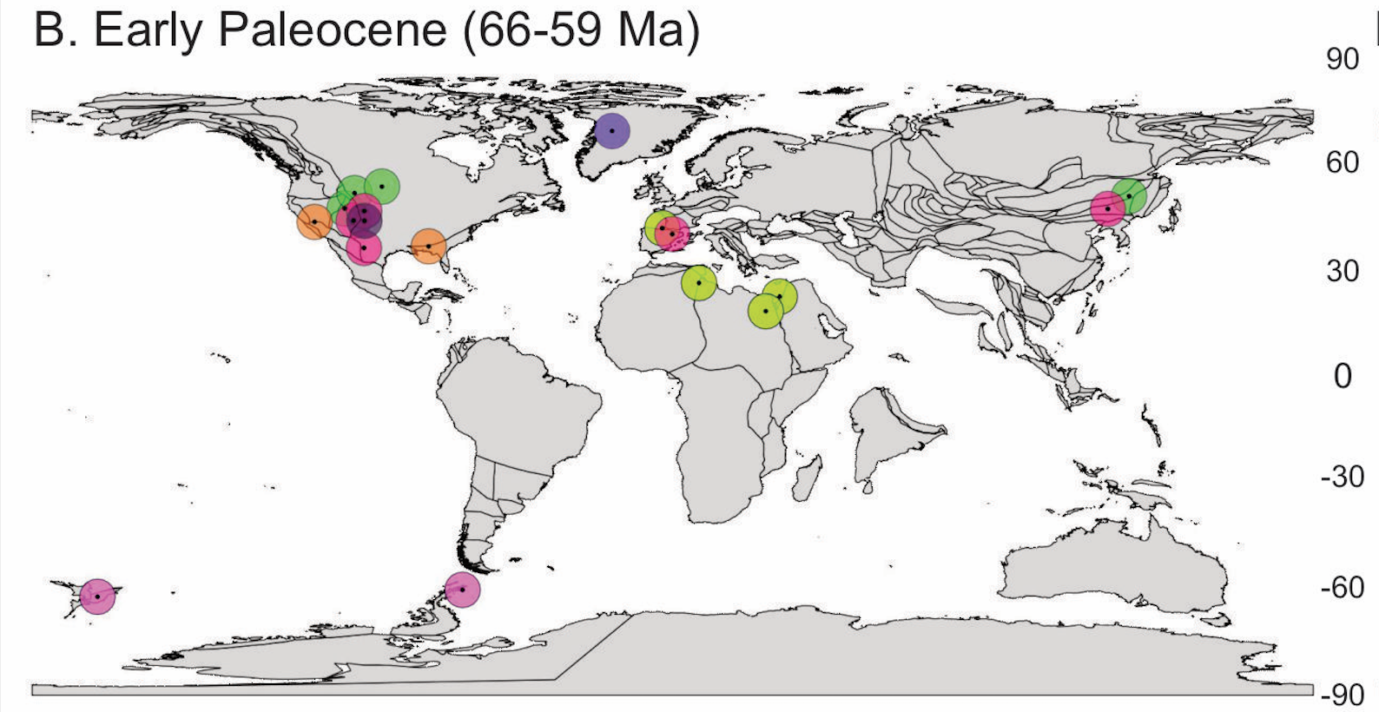
Early Paleocene (66-59 Ma)
Paleogeographic map from Scotese, C. R., 2001. Atlas of Earth History, Volume 1, Paleogeography, PALEOMAP Project, Arlington, Texas, 52 pp.

Slide 11
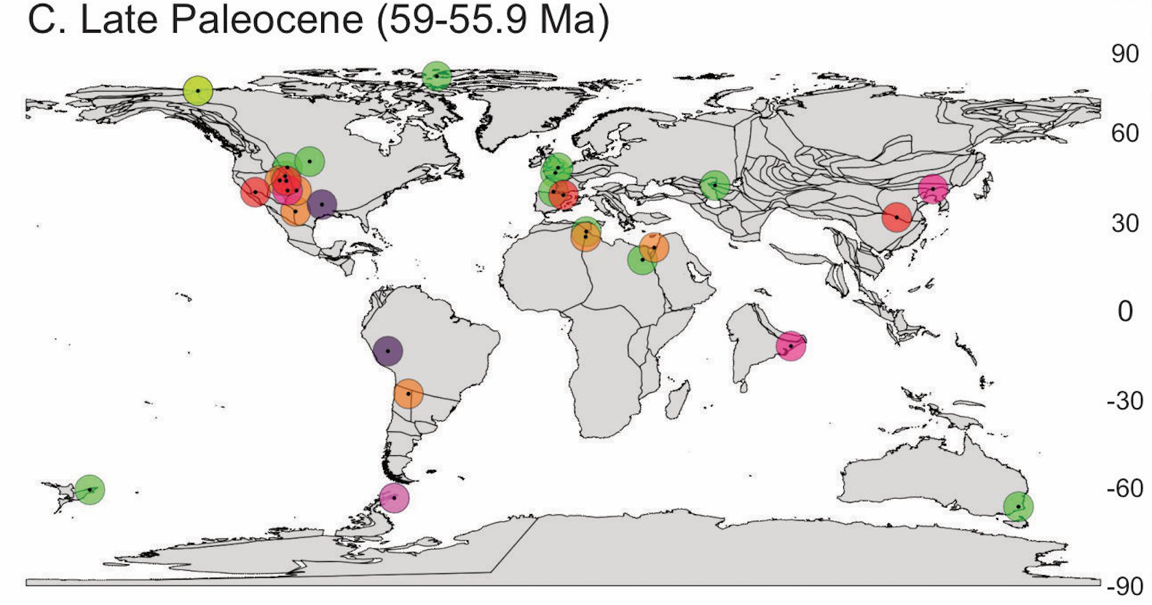
Late Paleocene (59-56 Ma)
Paleogeographic map from Scotese, C. R., 2001. Atlas of Earth History, Volume 1, Paleogeography, PALEOMAP Project, Arlington, Texas, 52 pp.

Slide 12
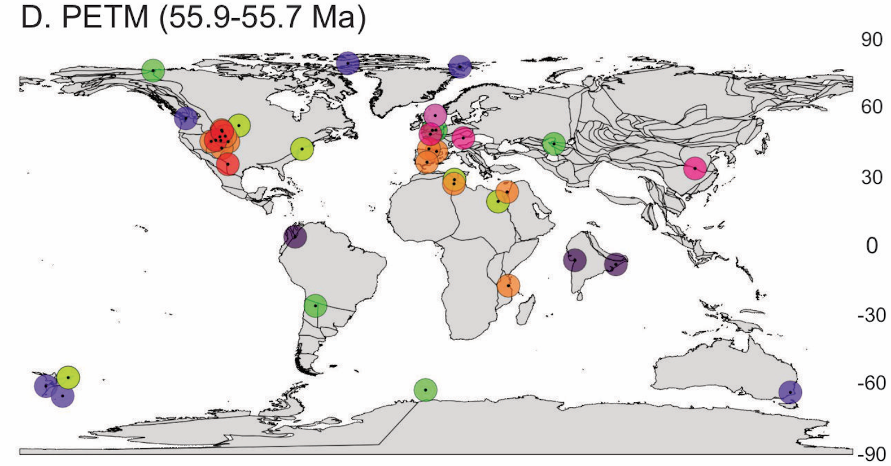
PETM (55.9-55.7 Ma)
Paleogeographic map from Scotese, C. R., 2001. Atlas of Earth History, Volume 1, Paleogeography, PALEOMAP Project, Arlington, Texas, 52 pp.

Slide 13
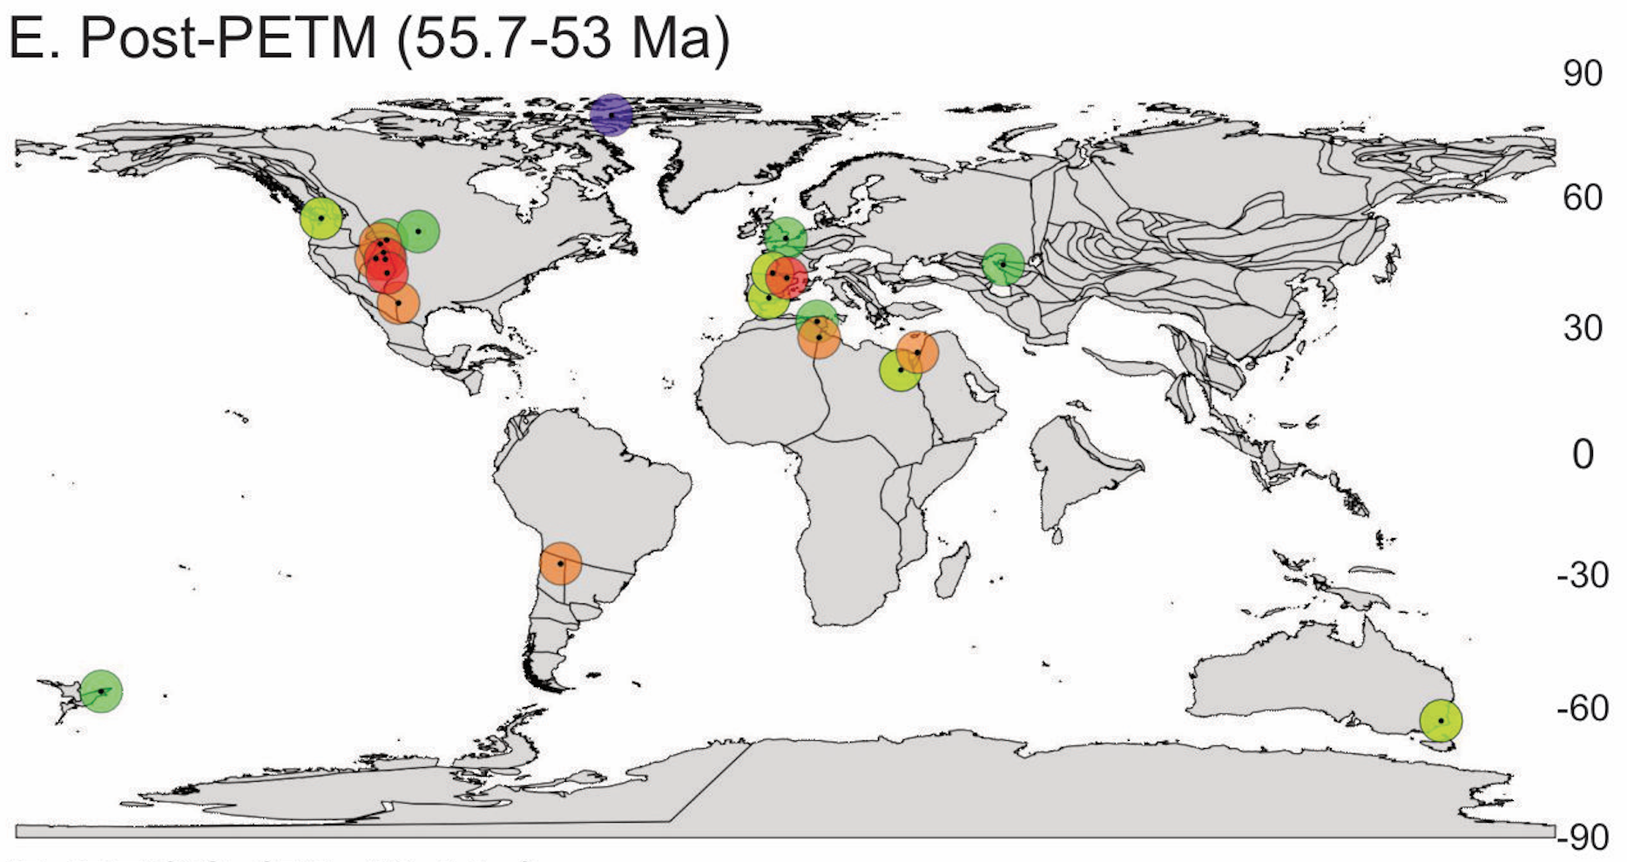
Post-PETM (55.7-53 Ma)
Paleogeographic map from Scotese, C. R., 2001. Atlas of Earth History, Volume 1, Paleogeography,PALEOMAP Project, Arlington, Texas, 52 pp.

Slide 14
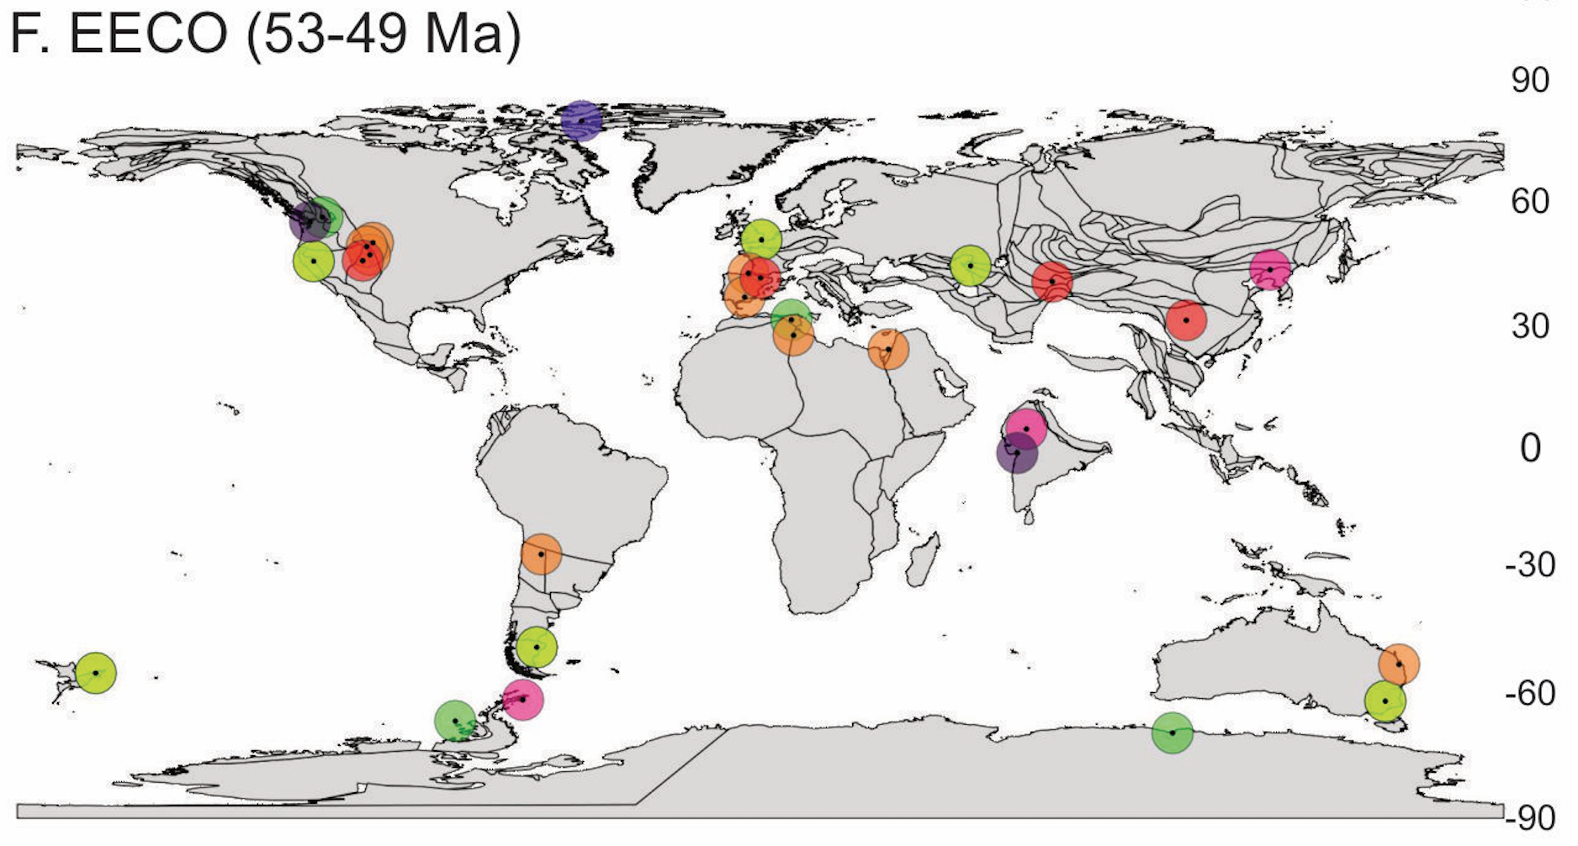
EECO (53-49 Ma)
Paleogeographic map from Scotese, C. R., 2001. Atlas of Earth History, Volume 1, Paleogeography,PALEOMAP Project, Arlington, Texas, 52 pp.

Slide 15
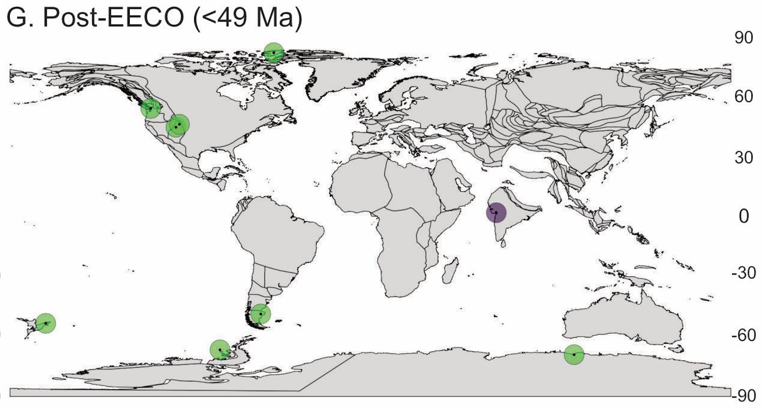
Post-EECO (< 49 Ma)
Paleogeographic map from Scotese, C. R., 2001. Atlas of Earth History, Volume 1, Paleogeography,PALEOMAP Project, Arlington, Texas, 52 pp.

Slide 16
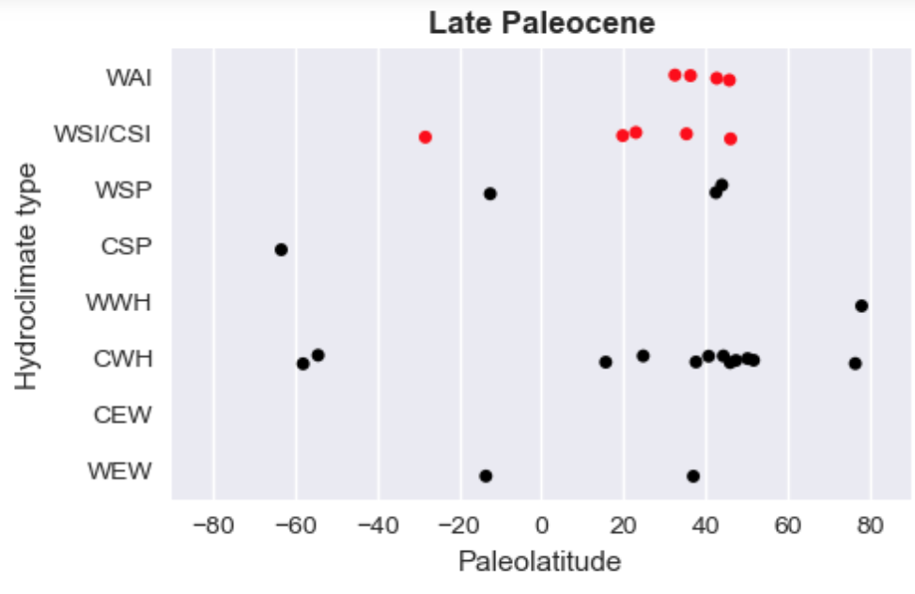
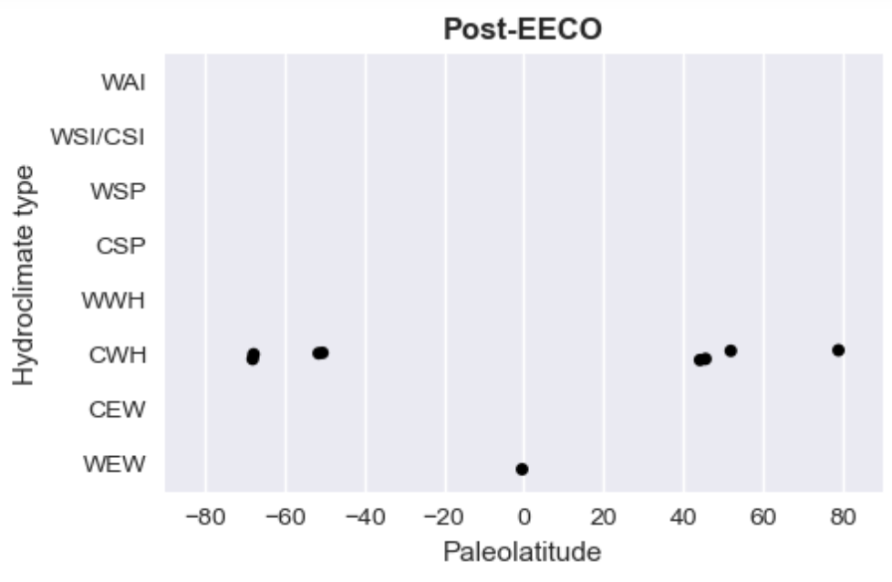
Latitudinal change in hydroclimate
Observe increased aridity and intermittency at 20° and 40° latitude beginning in Late Paleocene

Slide 17
Discussion/Conclusions
jslawson@mines.edu
The most dramatic spatial shifts in hydroclimate occurred in the Late Paleocene, suggesting a non-linear relationship between greenhouse gas emissions and changes in Earth systems
Polar rainforests existed already in the Early Paleogene
Mid-latitudes (30-60°) shifted from temperate, perennial to arid, highly intermittent hydroclimate types in the Late Paleocene
Post-EECO cooling period is characterized by a shift back to "normal" conditions at mid-latitudes
Spatial shifts in hydroclimate suggest altered atmospheric circulation under extreme greenhouse gas conditions
Expanding Hadley Cell? (Fu et al., 2006; Lu et al., 2007) Expanded ~2° since 1979 (Staten et al., 2008)
Intensified extratropical storms and atmospheric rivers? (Rush et al., 2021)
Other hypotheses? Testing these by collaborating with paleoclimate modelers and performing field work in the Uinta Basin, UT
Implications for the future:
Dramatic changes in hydroclimate may be expected prior to 2150 CE
It often takes much longer to reverse changes in Earth systems than it does to cause them
Nonlinearities between greenhouse gas emissions and global hydroclimate suggest altered atmospheric circulation in a warmer world

Slide 18
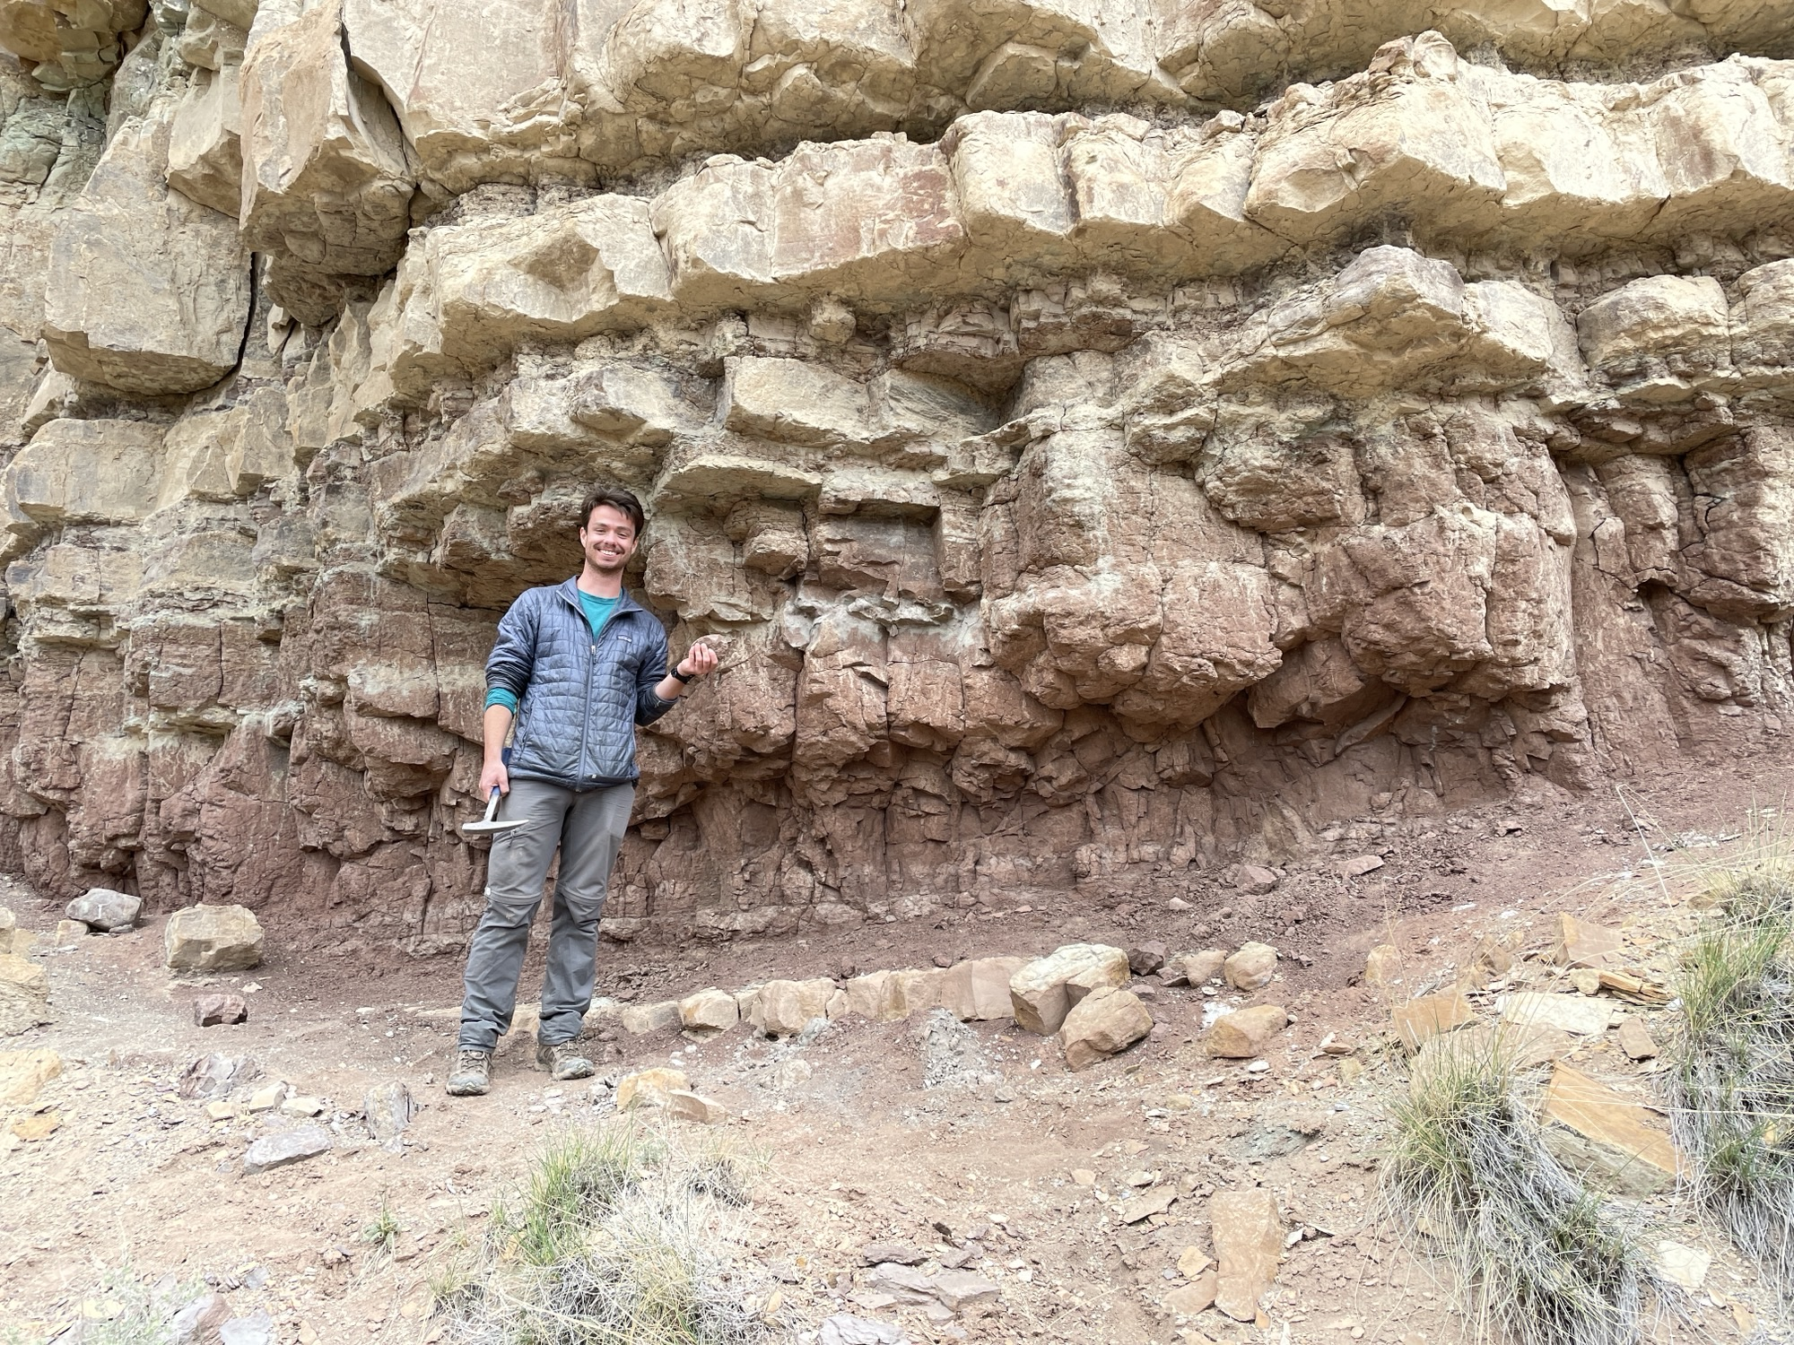
Conclusions continued
What's on the horizon for these maps?
Writing and publishing – please make suggestions!
Creating a publicly available data set for Early Paleogene climate (ArcGIS webmap)
Collaborating with climate modelers for a model-proxy comparison
How was atmospheric circulation altered during the Early Paleogene? What can this tell us about a warmer world?
High-resolution field-based study of changes in hydroclimate in the Uinta Basin, Utah
jslawson@mines.edu

