Slide 1
Spatio-temporal, geospatial, and time series analysis of water quality estimation using Landsat 8,9, Sentinel-2, and MODIS series for the region of India: A Google Earth Engine based web-application
Presented By:
Abhinav Galodha, Ph.D. Research Scholar, IIT Delhi
Supervisors
Prof. Brejesh Lall, DEE, IIT- Delhi
Dr. Shaikh Zia Ahammad, DBEB, IIT- Delhi
Dr. Sanya Anees, DECE, IIIT- Guwahati
School of Interdisciplinary Research (SIRe), Indian Institute of Technology Delhi, India
1

Slide 2
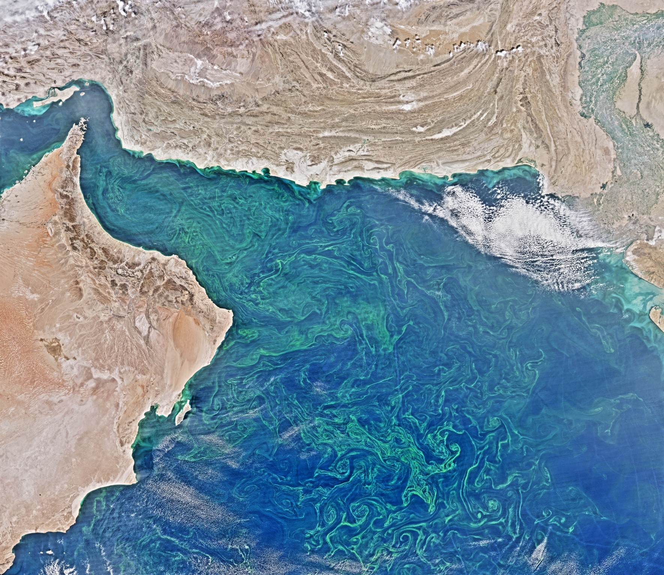
Outline
Introduction and Background
Problem statement
Graphical Abstract
Research gaps
Dataset and proposed study area
Work Plan
Methodology
Work done
References
Phytoplankton Bloom in the Arabian Sea
Credit: N. Kuring, http://earthobservatory.nasa.gov/IOTD/view.php?id=85718
2

Slide 3
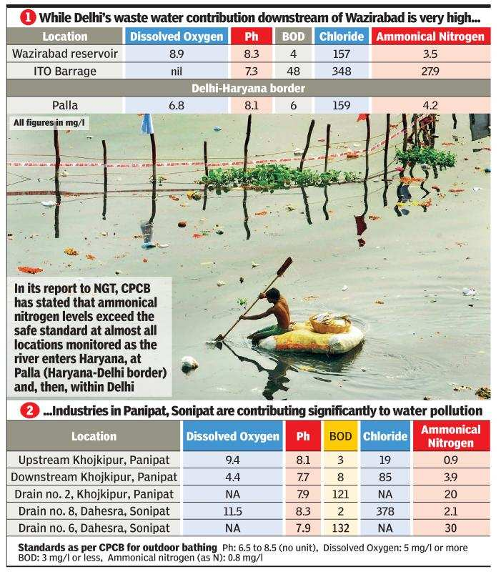
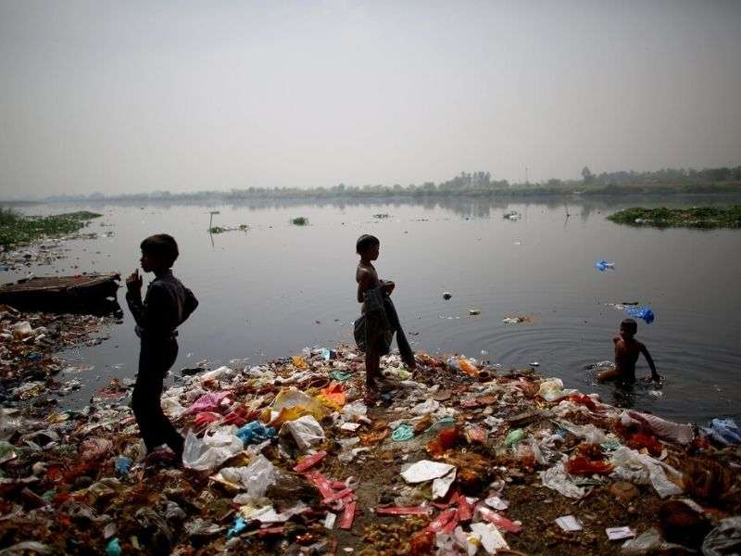
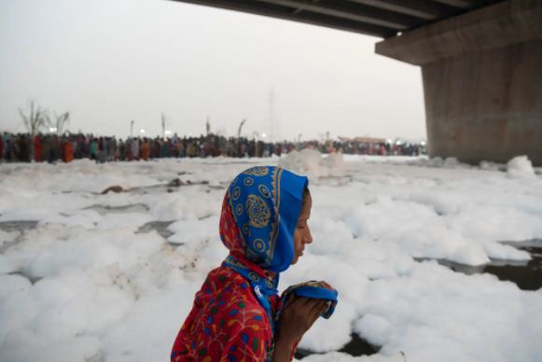
Yamuna water quality worsening, shows UPPCB data for Noida:
(22nd Jan 2022)
Introduction
On Delhi’s Toxic River, Prayers to a Sun Struggling to Shine Through Smog
(11th Nov 2021)
Source: https://www.nytimes.com/2021/11/11/world/asia/india-pollution-yamuna-chhath.html
3
Notes:
1) Every year, a four-day festival to the sun god Surya highlights the Indian city’s extreme air and water pollution, with a river so filled with foam it resembles a blizzard’s aftermath.
2) The condition of the Yamuna has worsened this year as the river enters Noida with no dissolved oxygen in it and exits the city even more polluted, data as provided from the Uttar Pradesh Pollution Control Board (UPPCB)

Slide 4
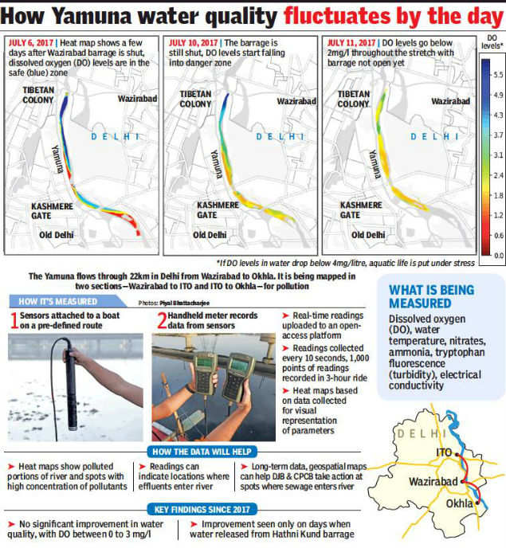
Rs 5,000 crore was spent by Delhi in 27 years, but Yamuna continues to die. 6-point action agenda to clean the Yamuna by 2025
(19^{h} Nov 2021)
.
Introduction
Processing Satellite Imagery for Monitoring Water Quality
(5^{h} Sept 2018)
Drones, and AI can be used to monitor Yamuna: NGT-constituted panel
(03^{h} Feb 2019)
Source: https://www.thehindu.com/news/cities/Delhi/delhi-govt-has-prepared-six-point-action-plan-to-clean-yamuna-kejriwal/article37555481.ece
4
Notes:
27 years have passed, yet the 22 km stretch of Yamuna that passes through Delhi remains choked and is dying. Additional STPs to be constructed.
Polluted water influences all aspects of life, including people, animals, and the environment. Earth observation (EO) satellites provide near real-time information about water quality. There is freely available data that can help decision-makers and policymakers.
2) Polluted water influences all aspects of life, including people, animals, and the environment.
Earth observation (EO) satellites provide near real-time information about water quality. There are freely available data that can help decision-makers and policymakers.
3) Drones, artificial intelligence and satellite imagery could be used to monitor pollution level of the Yamuna caused by dumping of debris at the floodplains of the river, NGT committee report.

Slide 5
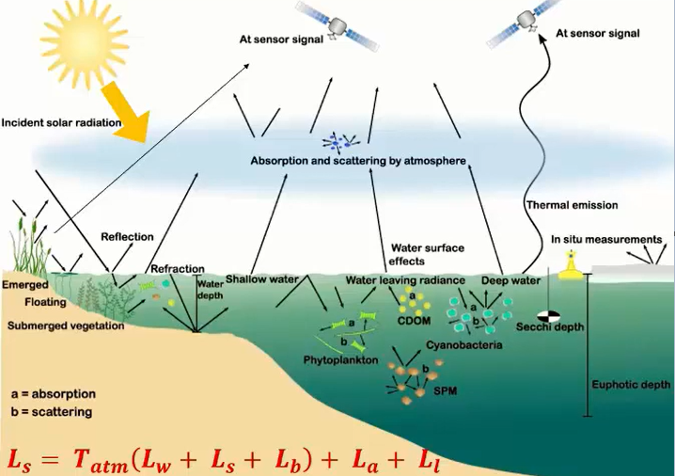
Background: Water Quality Monitoring with Earth Observation
Optically Active constituents (OAC)
Chlorophyll-a
Total Suspended Solids (TSM/SPM)
Colored Dissolved Organic Matter (CDOM)
Bottom and Adjacency Effect
Optically deep water
Optically shallow water
Adjacency effect
Atmosphere
90-95% of the signals at sensors originate from contributions of the water surface and the atmosphere
Only 5-10% include the signal interested in water remote sensing
Interaction of Light with water
Credit: Dornhofer and Oppelt 2016 & Koponen 2006
5
Notes:
Optically deep water: water surface, water body & water constituents are sources of radiation from within the lake
Optically shallow water: water leaving radiance includes radiation reflected from the bottom
Adjacency effect: small/narrow lakes or coastal areas

Slide 6
Problem Statement
Rising water security crisis and receding water across has global implications.
Spatial variability does not always benefit regional conditions.
To encounter spatial-temporal challenges, it is mandatory to focus on using drones and UAVs (airborne monitoring).
Reasons to use UAVs
Cloud-free, haze-free (acquisition) with broader spatial resolution and better revisiting time
Flexibility of mounting with any sensor and payload
Easily deployable for quick and emerging natural calamities (flood, earthquake)
Source: https://www.sdg6data.org/
Source: https://www.rd-alliance.org/rda-disciplines/rda-and-sustainable-development-goals-sdgs
6
Notes:
WQ monitoring is an important issue that needs to be addressed due to its rising water security crisis and global implications.
Space monitoring efficiently tracks the WQ variation across space and time, but its spatial variability does not always benefit regional conditions.

Slide 7
Graphical Abstract
Figure: Showing the importance of multispectral and hyperspectral, UAV-based imagery estimation of water quality monitoring, sampling, and geospatial mapping
7

Slide 8
Research Gaps
Lack of spectral information to estimate and differentiate WQ parameters
Field surveying and laboratory analysis could be non-homogeneous and spatially undistributed.
The precision and accuracy of collected field and in-situ data need comparative data
01
02
03
04
Limited studies have tried to evaluate and establish the relationship between UAV platforms and satellite-borne datasets.
UAVs arrange to cover inaccessible areas.
Hyperspectral sensors can acquire spectrally rich information from the scene that helps identify diverse features both spatially and spectrally.
Cost and operations can be a challenge.
8

Slide 9
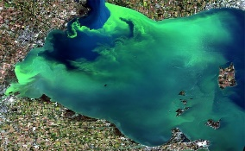
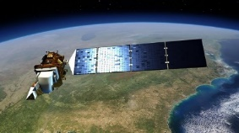
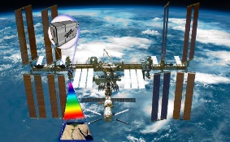
Dataset and Proposed Study Area
Sensor (Instrument) | Spectral Range | Data Format | Spectral Resolution | Spatial Pixel | Temporal Resolution (Revisit Time)
Red Edge-P | Blue (475nm), Green (560 nm), Red (668 nm), Red-Edge (717 nm), NIR (842 nm) | VRT (Virtual Dataset) | 5 spectral bands, acquired imagery @ 1.6 MP resolution | 2.65 cm/pixel ~ GSD | 25 -30 minutes (100% recharge)
Landsat series (8,9) Sentinel-2 MODIS (TERRA/AQUA) | 400 – 2500 nm 12-bit dynamic range (Overall SNR is improved0 400 – 2300 nm 16-bit decimal numbers | Level – 1,2 Products and GeoTIFF, HDF5 format. | 9 spectral bands (OLI and TIRS sensors) 13 spectral bands (4 @ 10 m, 6 @ 20 m, 3 @ 60 m), Orbital swath width (290 km) | 30 meters (B1-7, 9), 15 meters (B8), 100 meters (B10-11) 10 meters (B2-4, B8), 20 meters (B5 – B7, B8a, B11, B12), 60 meters (B1, B9, B10) | 16 days 10 days
PRISMA, DESIS (Hyperspectral Instrument) | 400 – 1010 nm, 1350 - 2505 | Decimal Number values (DN) | 2.55 nm (DESIS) 11-13 nm spectral sampling (VNIR – SWIR) | 30 m (PRISMA), 30 m (DESIS), 205 sq meter sampled @ 2.55 nm, 406 sq meter sampled @ 10.21 nm, 30 m (VNIR, SWIR) and 5 m PAN. | 7-14 days
* Prosed Study Area: Ganga River Basin and In-land water bodies around Delhi region
9
Notes:
VNIR Channel : 400-1010 nm
SWIR Channel: 1350-2505 nm

Slide 10
Identify Empirical Methods , Machine Learning techniques for water quality parametric estimation
Literature Review
Work Plan
Google Earth Engine
Airborne Dataset (UAV)
Spaceborne Dataset (Landsat, Sentinel, MODIS)
In-situ data/ WQ parameters (Sample Collection from Field Sites)
Database repository
Empirical-Equation Analysis / Spectral Analysis of selected WQ parameters
Develop prediction models for WQ parameter estimation
Creating Training Data, Validation Data
Creating Test Dataset
Neural Network Models
Empirical Algorithms
Geospatial interpolation
Establish relationship b/w observed WQ parameters
Workflow: A suggested framework to predict and assess water quality parameters.
Creation of geospatial maps
to show WQ estimation for the study area
Spectral indices, Sensitive Band Ratios for WQ estimation with imagery
10

Slide 11
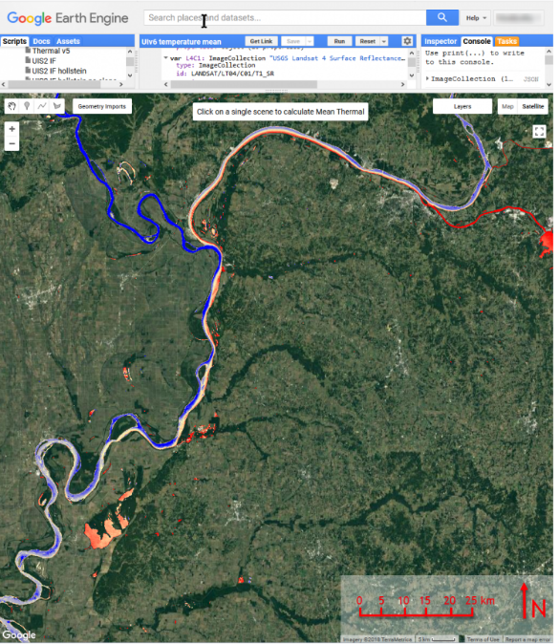
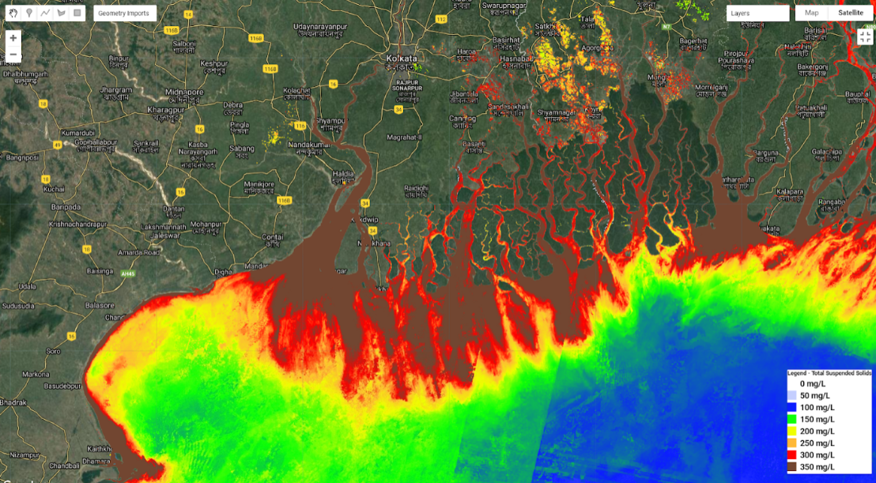
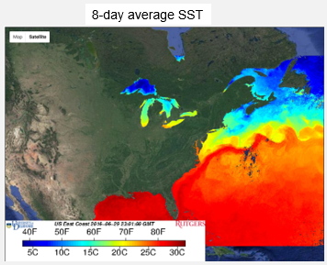
Google Earth Engine
The Creation of a water quality monitoring web application using space-borne satellite datasets (Landsat, Sentinel, MODIS).
Methodology
Input
Data Processing
Model Creation
Output
Landsat-8 Water Indices (NDWI, MNDWI, ANWIsh)
Sentinel-2,3 Time Series Stack
MNDWI = (Green - SWIR) / (Green + SWIR)
NDWI = (Green – NIR)/(Green + NIR)
Chl-a, TOC, Turbidity, SPM indices
Landsat-Time Series Stack
NDVI = (ρNIR-ρRed)/(ρNIR + ρRed)
Cloud Cover Masked
(Chl-a) = (6.317 NDVI) + 5.022
Landsat-8, Sentinel-2
(Land cover classification)
(SDD) = (-15.204* ρ₄) + 3.333
MODIS Terra-Aqua Dataset (SST, Salinity)
NDCI = (ρR-ρRed Edge)/(ρR + ρRedEdge)
(NDTI) = (ρSWIR1-ρSWIR2 Edge)/(ρSWIR1+ρSWIR2)
Source: MODIS: Sea surface temperature (SST)
11

Slide 12
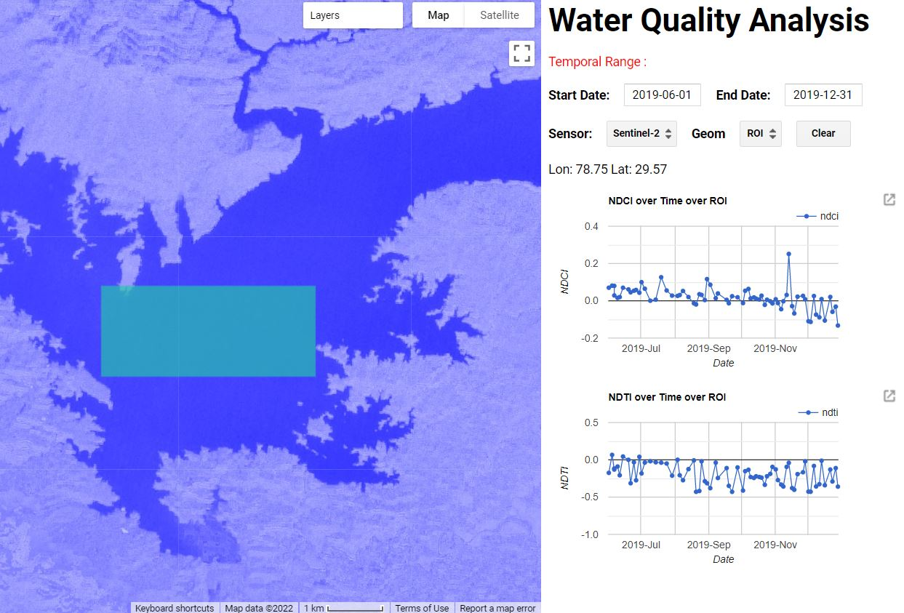
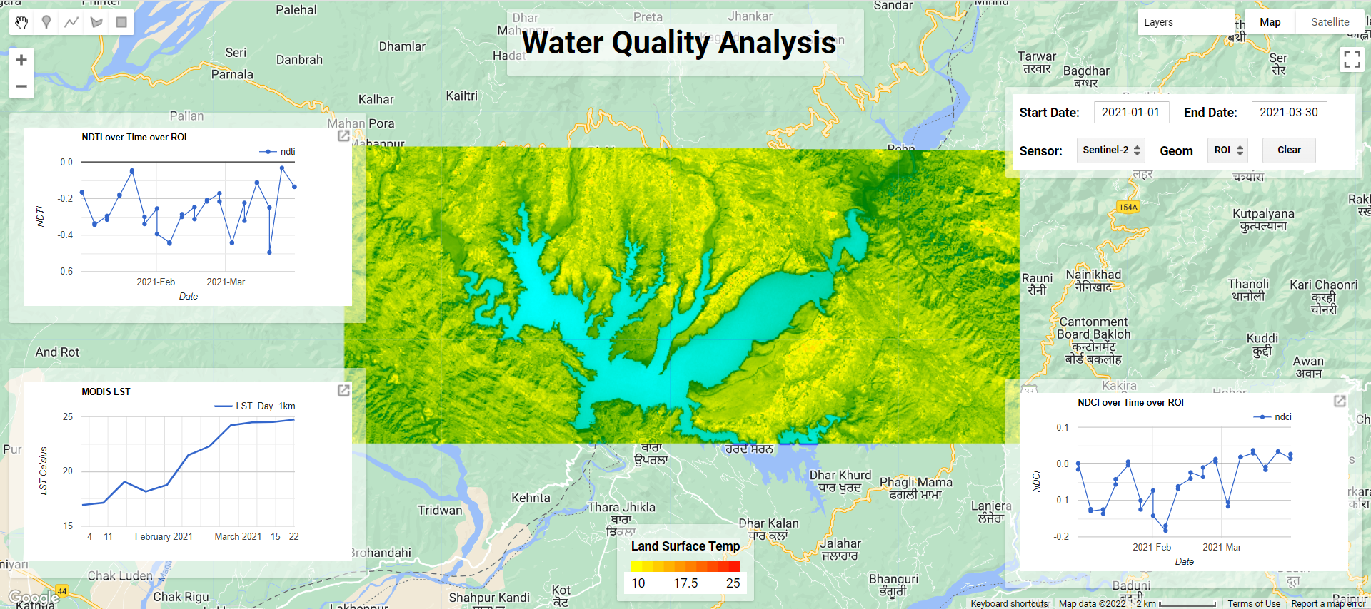
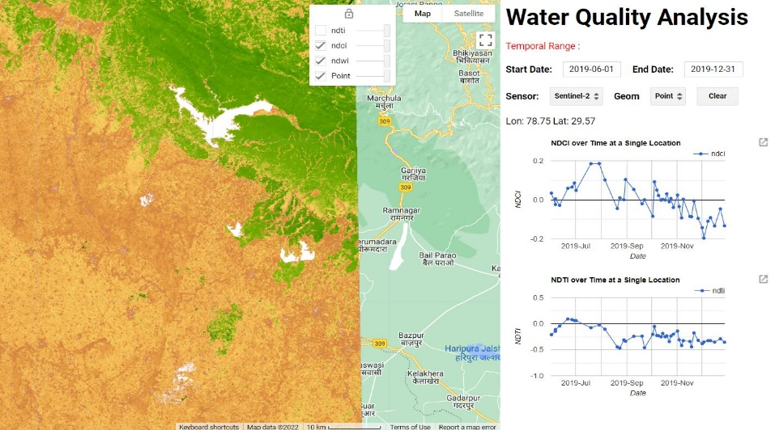
Work done I: Water Quality Assessment GUI in Google Earth Engine

Slide 13
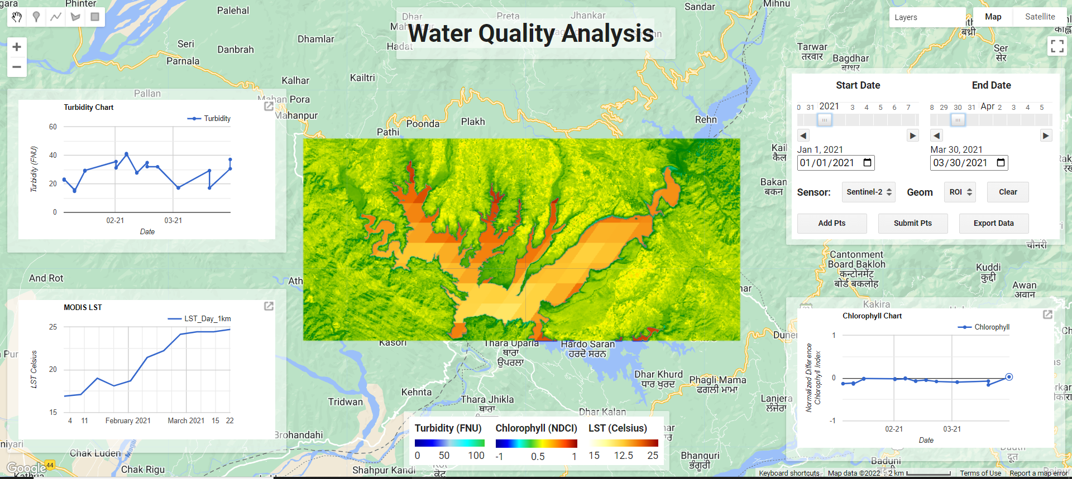
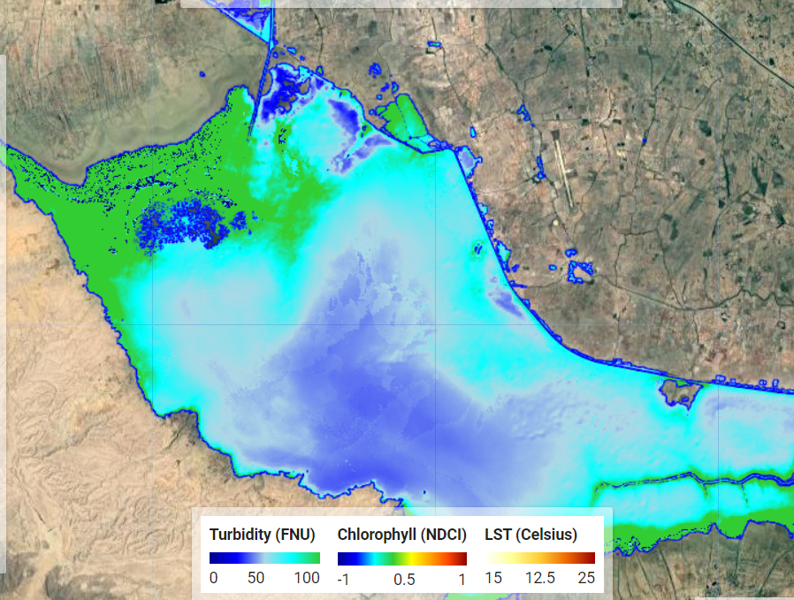
Work done I: Discussion

Slide 14
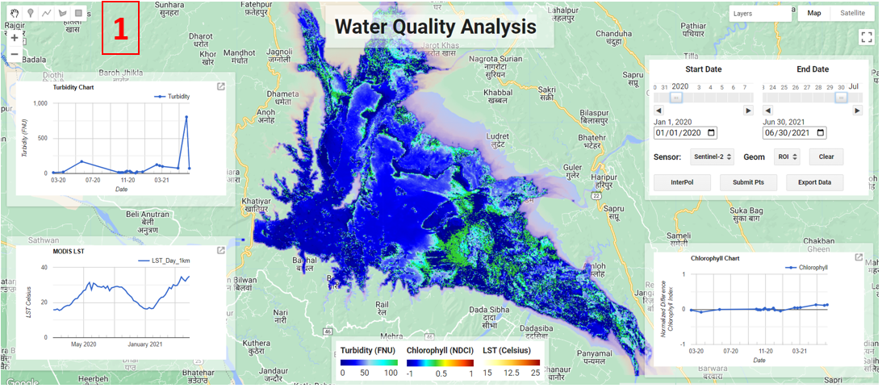
Work done I: Discussion

Slide 15
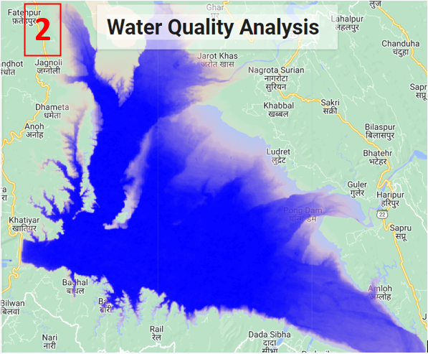
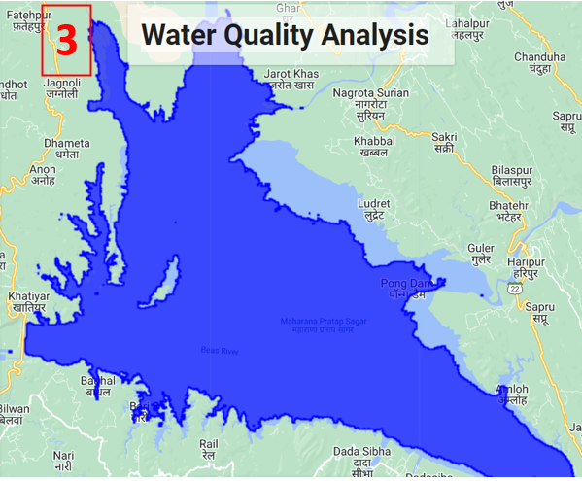
Work done I: Discussion

Slide 16
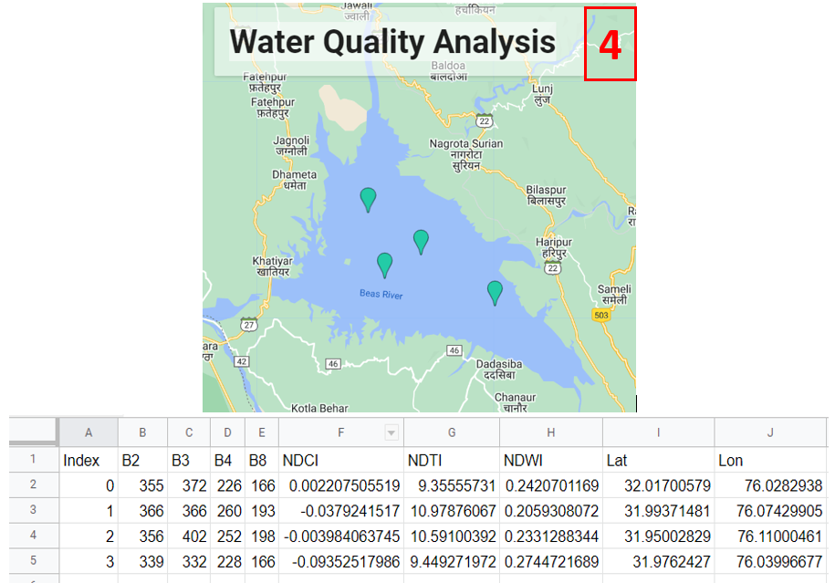
Work done I: Discussion

Slide 17
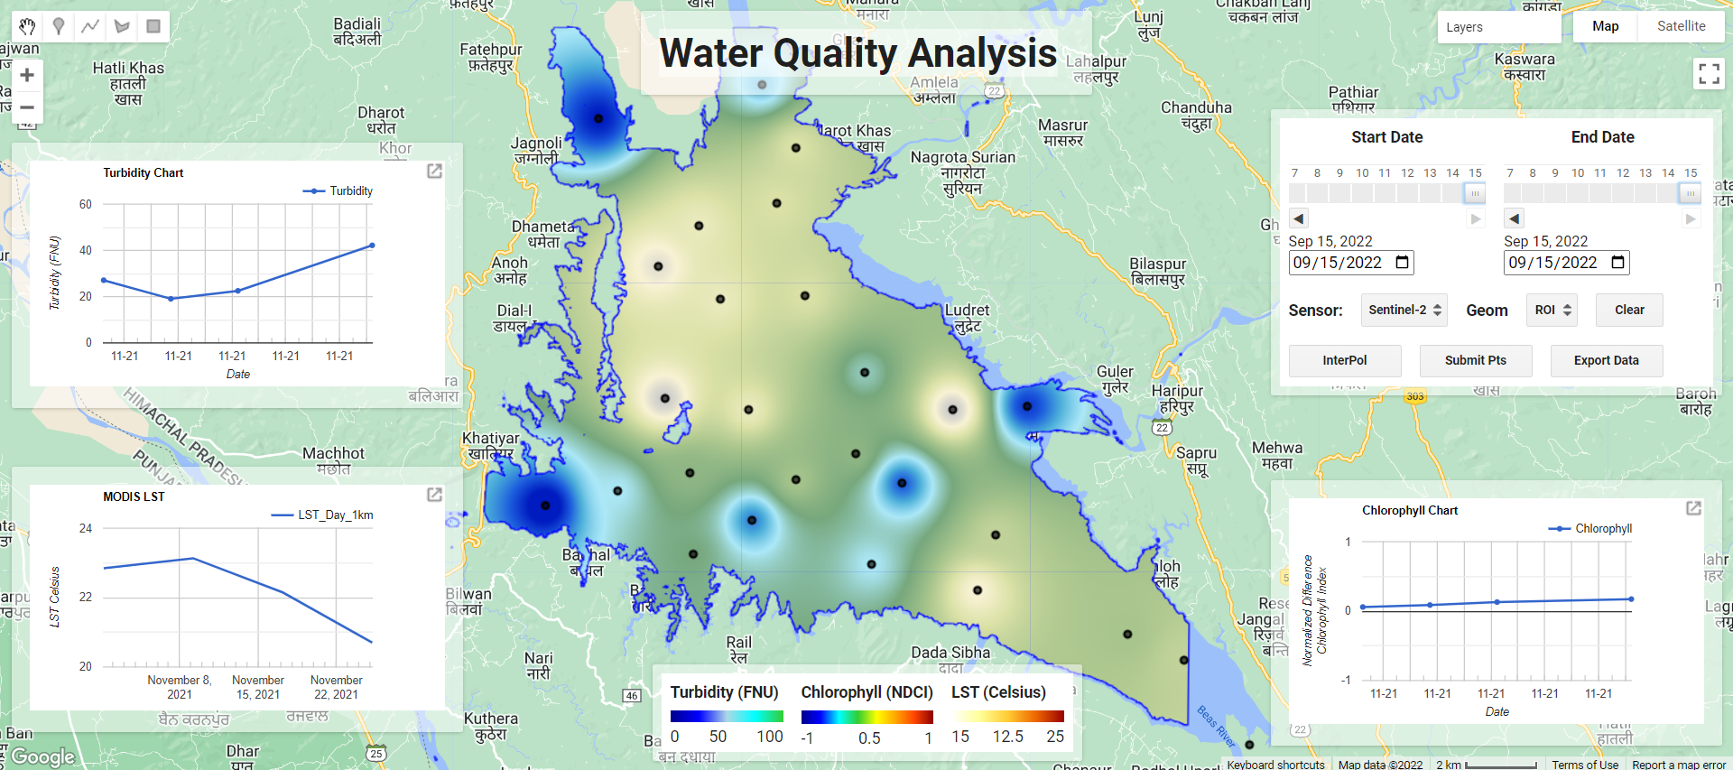
Work done I: Discussion

Slide 18
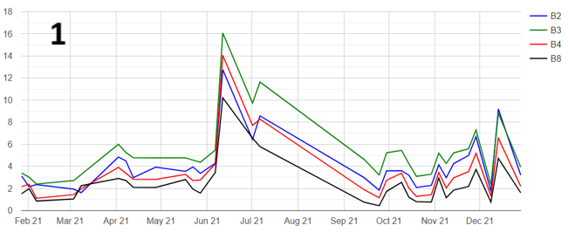
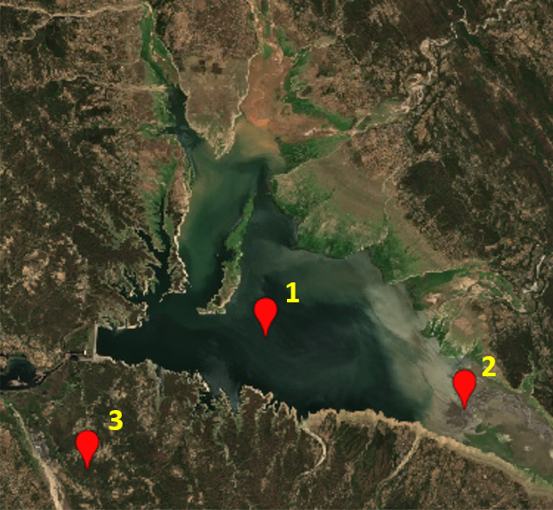
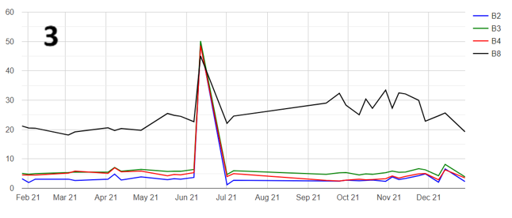
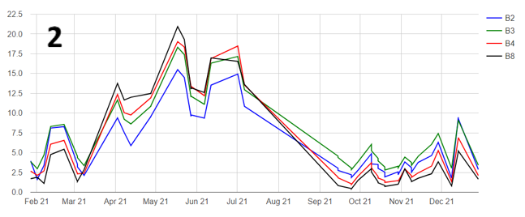
Work done I: Discussion

Slide 19
Work done I: Discussion

Slide 20
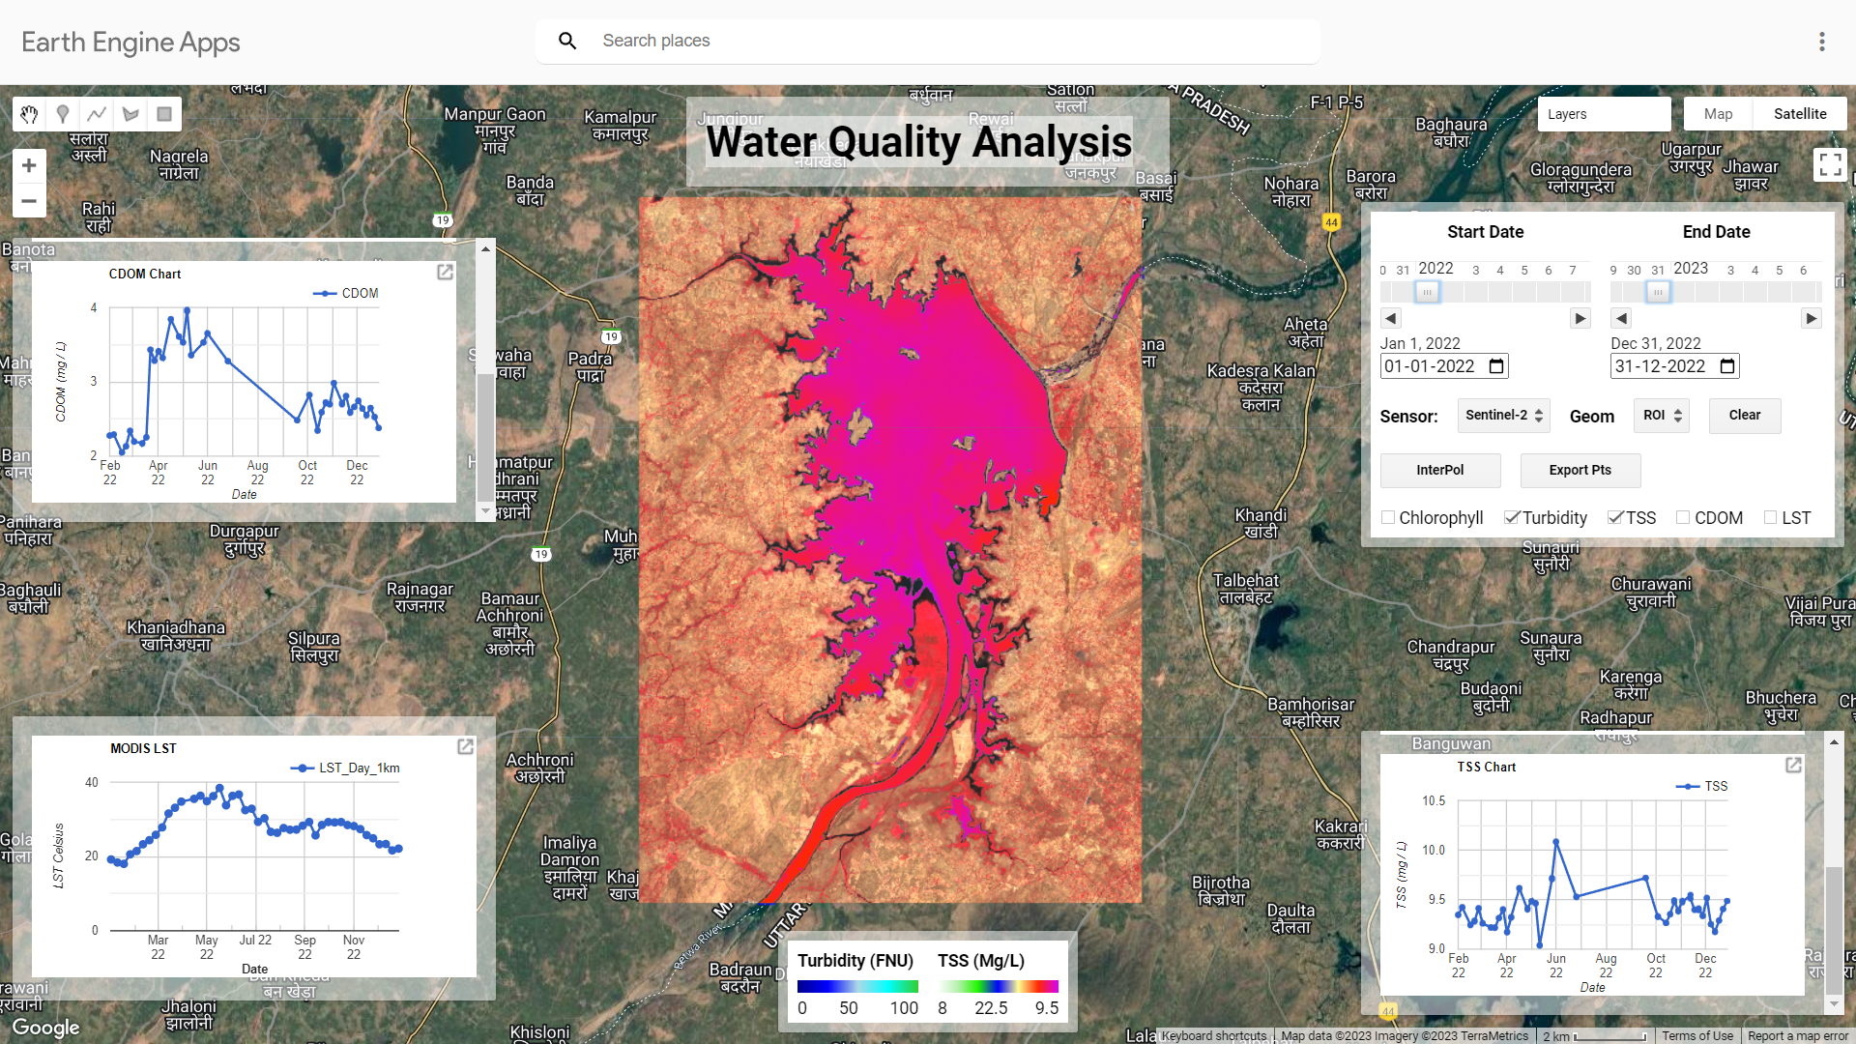
Work done I: Discussion

Slide 21
References
Bohn, V. Y., Carmona, F., Rivas, R., Lagomarsino, L., Diovisalvi, N., & Zagarese, H. E. (2018). Development of an empirical model for chlorophyll-a and Secchi Disk Depth estimation for a Pampean shallow lake (Argentina). The Egyptian Journal of Remote Sensing and Space Science, 21(2), 183-191.
Gholizadeh, M. H., Melesse, A. M., & Reddi, L. (2016). A comprehensive review on water quality parameters estimation using remote sensing techniques. Sensors, 16(8), 1298.
Guo, A. J., & Zhu, F. (2018). Spectral-spatial feature extraction and classification by ANN supervised with center loss in hyperspectral imagery. IEEE Transactions on Geoscience and Remote Sensing, 57(3), 1755-1767.
Isgró, M. A., Basallote, M. D., & Barbero, L. (2021). Unmanned Aerial System-Based Multispectral Water Quality Monitoring in the Iberian Pyrite Belt (SW Spain). Mine Water and the Environment, 1-12.
Lin, L., Chen, C., & Xu, T. (2020). Spatial-spectral hyperspectral image classification based on information measurement and CNN. EURASIP Journal on Wireless Communications and Networking, 2020(1), 1-16.
Mbuh, M. (2019). Use of Hyperspectral Remote Sensing to Estimate Water Quality. In Processing and Analysis of Hyperspectral Data. IntechOpen.
Peterson, K. T., Sagan, V., & Sloan, J. J. (2020). Deep learning-based water quality estimation and anomaly detection using Landsat-8/Sentinel-2 virtual constellation and cloud computing. GIScience & Remote Sensing, 57(4), 510-525.
Setia, R., Lamba, S., Chander, S., Kumar, V., Singh, R., Litoria, P. K., ... & Pateriya, B. (2021). Spatio-temporal variations in water quality, hydrochemistry, and controlling factors in India’s perennial river. Applied Water Science, 11(11), 1-15.
Transon, J., d’Andrimont, R., Maugnard, A., & Defourny, P. (2018). Survey of hyperspectral earth observation applications from space in the sentinel-2 context. Remote Sensing, 10(2), 157.
Wang, L., Xu, M., Liu, Y., Liu, H., Beck, R., Reif, M., ... & Wu, Q. (2020). Mapping freshwater chlorophyll-a concentrations at a regional scale integrating multi-sensor satellite observations with google earth engine. Remote Sensing, 12(20), 3278.
Yigit Avdan, Z., Kaplan, G., Goncu, S., & Avdan, U. (2019). Monitoring the water quality of small water bodies using high-resolution remote sensing data. ISPRS International Journal of Geo-Information, 8(12), 553.
https://appliedsciences.nasa.gov/join-mission/training/english/arset-integrating-remote-sensing-water-quality-monitoring-program
https://www.nytimes.com/2021/11/11/world/asia/india-pollution-yamuna-chhath.html
https://www.thehindu.com/news/cities/Delhi/delhi-govt-has-prepared-six-point-action-plan-to-clean-yamuna-kejriwal/article37555481.ece

Slide 22
Summary
Fundamentals of Remote Sensing
Components of remote sensing
Features of the EM spectrum
Spatial, Temporal, Spectral, and Radiometric Resolution
Interaction of Light
How light propagates through the atmosphere and water column and back to the sensor
Constituents of the water column and their inherent optical properties
Methodology of work
Results and Discussion
Creation of a Water Quality GEE-based dashboard
Optical Inherent WQ parameters (Chl-a, CDOM, TSS, Turbidity, and LST)
Accessing Satellite Imagery
Data Access Tools
OceanColor Web
Google Earth Engine

Slide 23
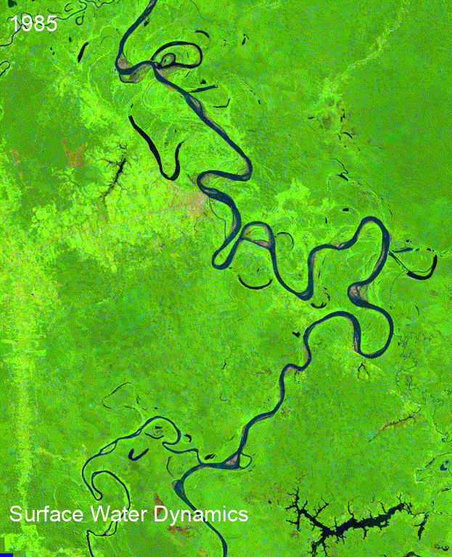
Thank you
Connect with me
Abhinav.Galodha@sire.iitd.ac.in

