Slide 1
Cartographic evaluation of the risk of Cu, Co and I deficiency in the soil cover of the Central Federal District (Russia) provoking spatial variation of the endemic morbidity level (on example of thyroid diseases)
J. Bech¹, V.S. Baranchukov², E.M. Korobova²
¹Faculty of Biology, University of Barcelona (UB), Barcelona, Spain
(jaumebechborras@gmail.com)
²Vernadsky Institute of Geochemistry and Analytical Chemistry, Rus. Ac. of Sci., Moscow, Russia (korobova@geokhi.ru)

Slide 2
Theoretical basis
Analysis of the biogeochemical concept of the biosphere created by Vernadsky, of biogeochemical endemic diseases and chemical ecology suggested by Vinogradov and of studies in geochemical ecology developed by Kovalsky, has led us to the hypothesis that stable biogeochemical endemic diseases could appear only after the formation of Homo sapiens as a species who acquired possibility to survive in practically all environments including geochemically unfavorable for their living (i.e. with deficiency or excess of biologically significant elements while the best conditions correspond to elements’ optimum levels).
The first endemic diseases of geochemical nature resulted from discrepancy between the geochemical environment in which Homo sapiens was formed and geochemical conditions of the colonized areas (human and animal goiter, scurvy, tooth decay or fluorosis, etc.). Biogeochemical endemic diseases of the second type spread due to technogenic contamination of the environment and affected all species within the area (Mo gout, Minamata, Itai-Itai, and Yusho human diseases) (Korobova, 2017).

Slide 3
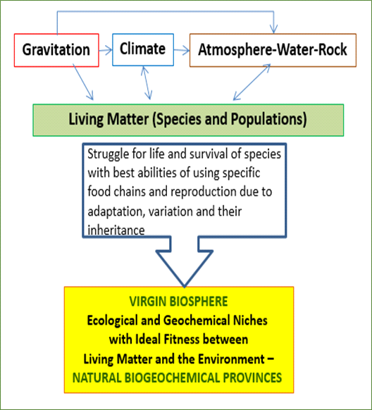
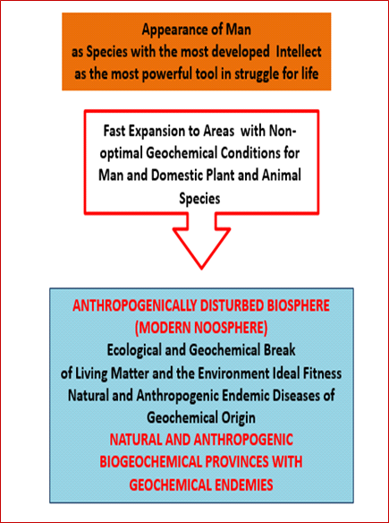
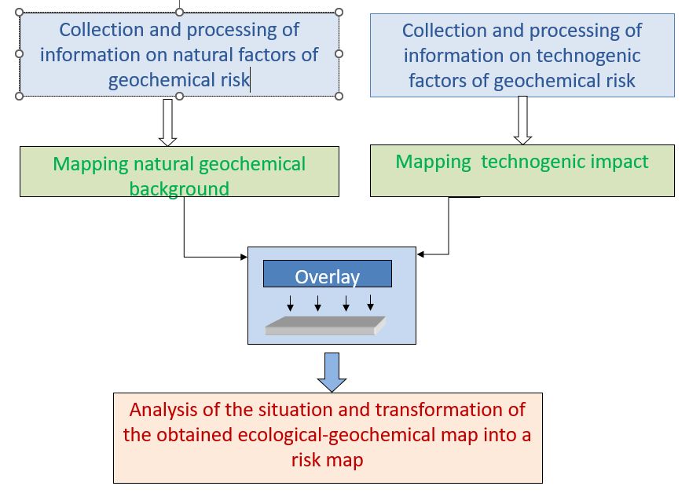
Principles for creating ecological and geochemical risk maps
Theoretical basis – the concept of bi-layered structure of
modern noosphere
Basing on the idea of bi-layered structure of modern noosphere a sequence of operations for creation of a risk map of endemic diseases of a geochemical nature in modern noosphere should be as follows.
Harmonic/sustainable structure of the primary biosphere formed in the long run of co-evolution of living organisms and environment
Appearance of humans who acquired ability to survive in geochemically unfavorable conditions led to spread of stable endemic diseases
No risk of existence for stable endemic diseases (individuals weakened by the disease did not survive due to competition for survival).
Stable endemic diseases of the first kind appeared in colonized areas and affected only humans and domesticated animals
The proposed technique was used for cartographic evaluation of the risk of Cu, Co and I deficiency in the soil cover of the Central Federal District (Russia) related to spatial variation of morbidity level among local population.
Contamination of the environment has reached such a scale that modern eco-geochemical situation in any area can be interpreted now as a result of the combined effect of both natural and anthropogenic geochemically unfavourable factors (biogeochemical endemies of the second kind affecting all species including aborigine).

Slide 4
The main goal and methods
The main goal of the presented study is evaluation of contribution of the natural geochemical risk of human diseases in the Central part of the Russian plain provoked by deficiency of biologically significant microelements (Cu, Co and I) in the environment.
To estimate the ecological and geochemical risk we used the concept of lower and upper threshold concentrations in soils leading to specific diseases in cattle grazing within the particular areas based on numerous experimental data (Kovalsky, 1974), the data on I, Cu and Co variation in the soil cover of different oblast’s of the Central Federal District (Russia), and available published medical data of thyroid diseases in these areas.
The cartographic basis used for the creation of preliminary assessment maps of the distribution of trace elements in the soil cover of the region was the Unified State Register of Soil Resources of Russia (scale 1:2 500 000). Levels of Cu, Co and I content in soils were based on published data of the elements concentration in soils and our original experimental database with due regards to their genetic types, soil-forming rocks and granulometric composition.
Medical data was obtained from statistic materials of Russian Central Research Institute of Organization and Informatization of Healthcare of the Ministry of Health «Morbidity of the entire population of Russia» in the period of 2013-2017.

Slide 5
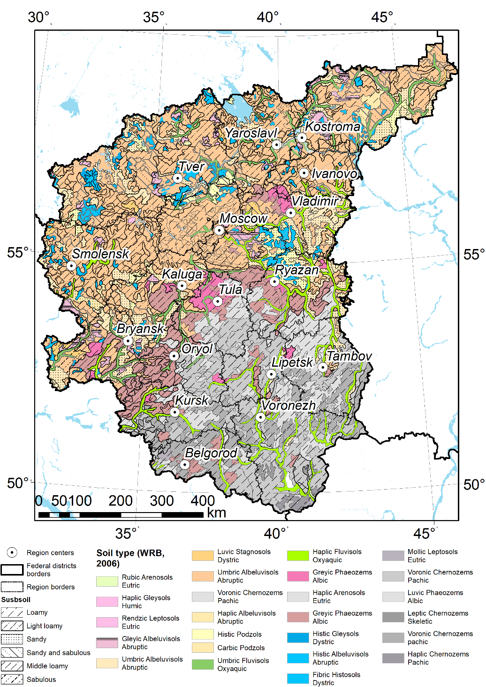
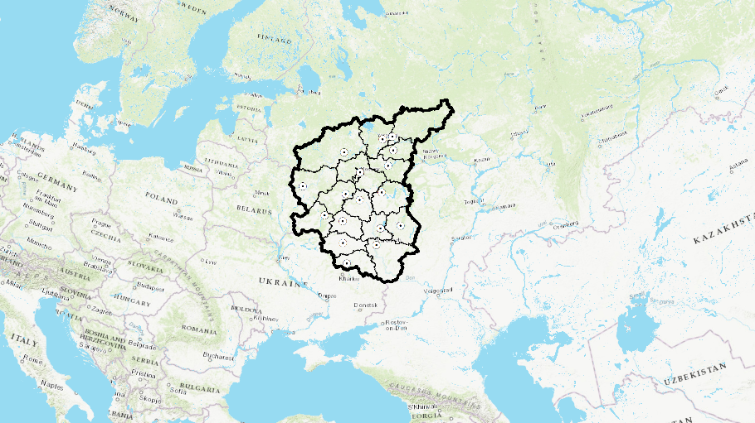
Study area
The Central Federal District (CFD) occupies the central part of the East European Plain. It has an area of 650,205 km², which is larger than any of the European countries and includes 18 subjects. CFD greatly exceeds the other federal districts of the country in terms of population and has a high.
The Central Federal District (CFD) of Russia is a highly populated area (26.9% of Russia's population, average population density of 57.7 people/km²) with a developed infrastructure where agriculture specializes in the cultivation of cereals, vegetables, sunflowers, and cattle breeding. The territory is also known for a deficiency of Cu, Co and I in the environment and respectively in the main agricultural plants and animals cultivated in the CFD, as well as in the diets of the local rural and urban population living on local products.

Slide 6
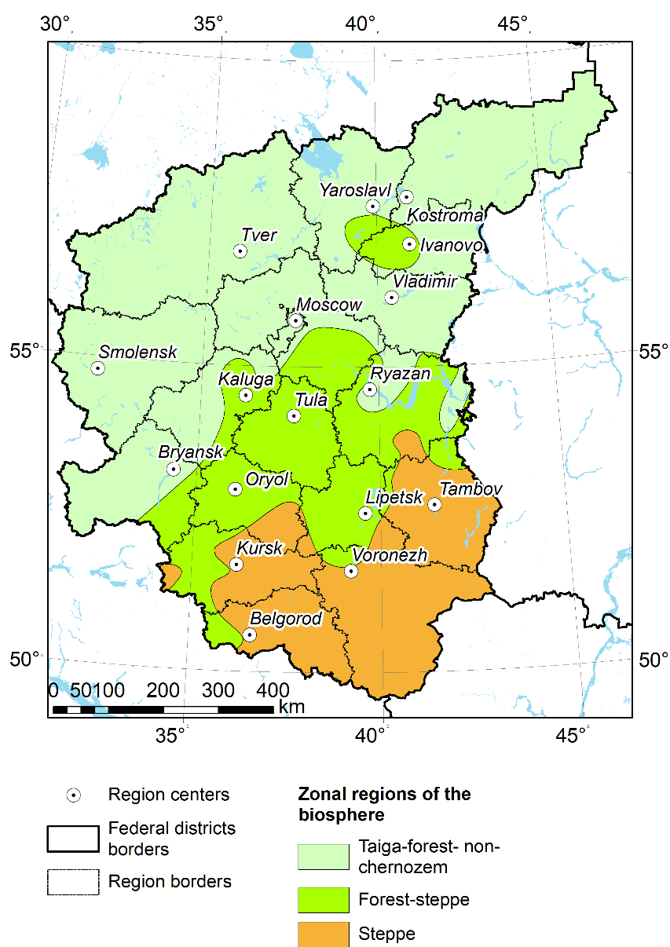
Zonal evaluation of the sufficiency of Cu, Co and I for farm animals (Kovalsky, 1974) within the study area
The study area is located in three zonal regions. According to V.V.Kovalsky, every zone is characterized by specific variation of micronutrients and different sufficiency of trace elements for animals .
Number of soil samples used to evaluate their distribution in terms of the availability of certain elements | Co | Cu | I
Taiga-forest non-chernozem | 552 | 1119 | 296
Forest-steppe | 47 | 58 | 9
Steppe | 304 | 342 | 49
Levels of sufficiency according to element concentration in soils (mg/kg) | Deficiency | Within metabolic regulation | Excess
Co | <7 | 7-30 | >30
Cu | <15 | 15-60 | >60
I | <5 | 5-40 | >40

Slide 7
Co, Cu and I variation in soil cover as a basis of geochemical risk assessment
Soil type | Texture | Estimated concentration, mg/kg
 |  | Co | Cu | I
Greyic Phaeozems Albic | Сlay | 8.40 | 25.29 | 2.00
Haplic Gleysols Humic | Light loamy | 10.29 | 23.61 | 1.23
Fibric Histosols Dystric |  | 5.74 | 8.31 | 9.23
Gleyic Albeluvisols Abruptic | Middle loamy | 7.06 | 14.88 | 1.23
Greyic Phaeozems Albic | Middle loamy | 8.50 | 25.29 | 2.50
Haplic Albeluvisols Abruptic | Сlay | 6.18 | 12.72 | 0.50
Histic Gleysols Dystric |  | 5.74 | 8.31 | 5.31
Histic Podzols | Sandy | 6.18 | 12.72 | 0.79
Luvic Phaeozems Albic | Middle loamy | 9.20 | 16.00 | 4.00
Mollic Leptosols Eutric | Сlay | 14.00 | 2.60 | 4.10
Rendzic Leptosols Eutric | Middle loamy | 15.11 | 46.40 | 0.79
Rubic Arenosols Eutric | Sandy | 9.20 | 16.00 | 0.50
Umbric Albeluvisols Abruptic | Sandy | 7.06 | 14.88 | 0.79
Umbric Fluvisols Oxyaquic |  | 14.00 | 26.66 | 2.27
Voronic Chernozems Pachic | Light loamy | 11.36 | 17.83 | 5.60
Voronic Chernozems Pachic | Middle loamy | 11.00 | 19.00 | 4.10
Voronic Chernozems Pachic | Сlay | 11.00 | 19.00 | 5.60

Slide 8
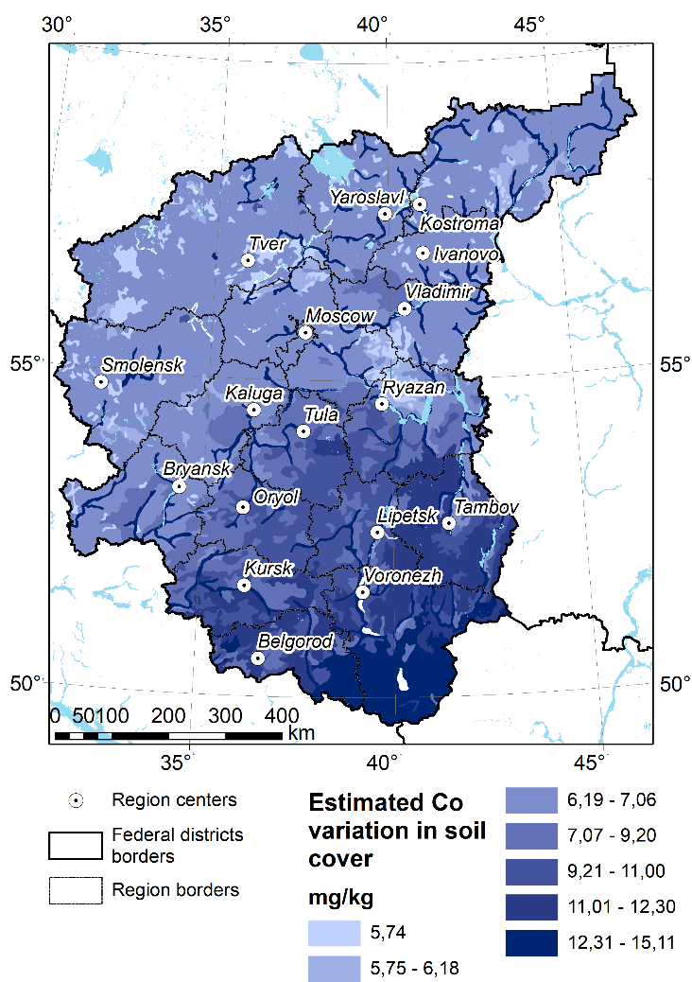
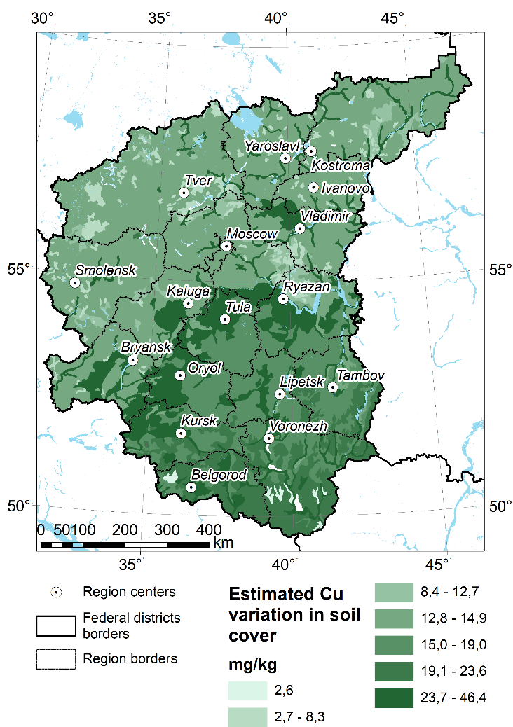
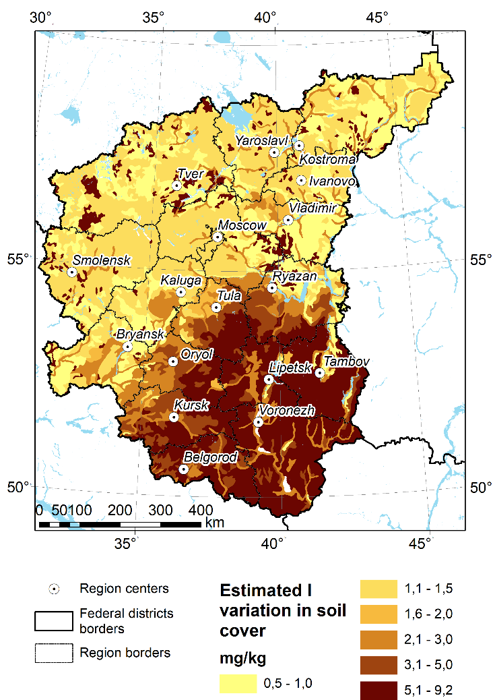
Geochemical risk assessment of the potential availability of Co, Cu and I in soil cover

Slide 9
Correlation between geochemical risk and thyroid disorders on the oblast’ level
Average annual incidence of thyroid disease per 100,000 people between 2013 and 2017 on the level of administrative unit "oblast" showed a significant inverse correlation with cartographic estimates of soil I and I+Cu+Co status weighted for the areas with due regard to their soil structure (with exception of Bryansk and Oryol oblast’ significantly affected by technogenic contamination with radioisotope ¹³¹I and of Moscow urbanized oblast’ in which medical service and living conditions are higher and diets mainly consist of imported products).
Significant negative correlation was found also between thyroid disorders level and combined concentration of three studied elements (R=-0.460). Urban population suffered from thyroid diseases to higher extent as compared to rural (R=-0.593).

Slide 10
Conclusion
The presented mapping allowed demonstration of zonal and regional peculiarities in Cu, Co and I status of the soil cover in CFD. The obtained cartographic estimates are comparable with the published averaged results at the oblast level.
Comparison with the published medical information on the cases of average annual thyroid disorders registered for the first time in their life for the period from 2013 to 2017 on the level of administrative unit "oblast" showed a significant inverse correlation with the cartographic estimates of soil I and combined (I+Cu+Co) status with due regard to soil structure (14 units in CFD with exception of Bryansk and Oryol oblast’ significantly affected by technogenic contamination by ¹³¹I radioisotope and of Moscow urbanized oblast’).
Urban population suffered from thyroid diseases to a higher extent as compared to rural (R=-0.593) that corresponds to our previous estimates and the studies of other researches.
The results confirmed the possibility of assessing the geochemical risk of endemic diseases based on geochemical soil maps and identifying the negative contribution of micronutrient deficiency in the environment to thyroid morbidity in the population, even at a fairly generalised spatial level.
However, our experience shows that to further develop the proposed approach, the availability of medical information on disease prevalence at the settlement level would be more informative and accurate.

Slide 11
References
Kovalsky, V.V. Geochemical Ecology (Nauka, Moscow, 1974) [in Russian].
Korobova, E.M. Principles of spatial organization and evolution of the biosphere and the noosphere. Geochem. Int. 55, 1205–1282 (2017). https://doi.org/10.1134/S001670291713002X Korobova, E.M. Toxicity as a Biogeochemical Problem. Geochem. Int. 58, 1092–1096 (2020). https://doi.org/10.1134/S0016702920100080 Korobova, E., Romanov, S. & Silenok, A. Endemic diseases of geochemical origin and methodological approaches toward their prevention and elimination. Environ Geochem Health 42, 2595–2608 (2020). https://doi.org/10.1007/s10653-019-00442-z Korobova, E.M., Baranchukov, V.S., Kurnosova, I.V. et al. Spatial geochemical differentiation of the iodine-induced health risk and distribution of thyroid cancer among urban and rural population of the Central Russian plain affected by the Chernobyl NPP accident. Environ Geochem Health 44, 1875–1891 (2022). https://doi.org/10.1007/s10653-021-01133-4
Baranchukov, V., Korobova, E., and Romanov, S.: Application of Geoinformation Technologies for minimization of thyroid gland diseases in the impact areas of the radioiodine fallout, EGU General Assembly 2020, Online, 4–8 May 2020, EGU2020-9000, 2020. https://doi.org/10.5194/egusphere-egu2020-9000

Slide 12
Many thanks for your attention
Acknowledgements. The study was partly funded by RFBR and
BRFBR project #20-55-00012.

