Slide 1
Desert dust, volcanic ash and forest fire ash as plant fertilizers in an ambient and elevated CO2 levels
Anton Lokshin^{1,2}, Daniel Palchan² and Avner Gross¹ 1. Department of Environment, Geoinformatics and urban Planning sciences, Ben Gurion University of the Negev, Israel 2. Department of Civil Engineering, Ariel University, Israel
Notes:
Hy everyone, my name is Anton Lokshin. In the two minutes I have I will focus on the role of atmospheric dust as foliar fertilizer. לתקן

Slide 2
Increasing CO2 threatens human nutrition
(Mayers et al, Nature 2014)
(Loladze 2014, eLife)
Notes:
for the past 20 years Several studies indicate that the future elevated levels of CO2 will increase the biomass and carbon content of plants but at the same time the concentration of other nutrients are expected to decrease as we can see in this graph – increase in carbon and reduction in other essential elements such as… And when we are talking about agricultural plants, for example grasses and legumes, the projected reduction in concentration might threaten the future of human nutrition. Its recently published in nature and science.

Slide 3
Atmosphere is a huge nutrient reservoir
(NASA, 2006)
Notes:
But the soils are not the only source of nutrients. In fact, we already know that the atmosphere is a huge reservoir of nutrients that move from one place to another in atmospheric circulation. I want to demonstrate this movement by watching a short video - this is a video made by Nasa, one year of global atmospheric circulation – orange, green, white. Say here also that desert dust, fire ash and volcanic ash are the most important particles.

Slide 4
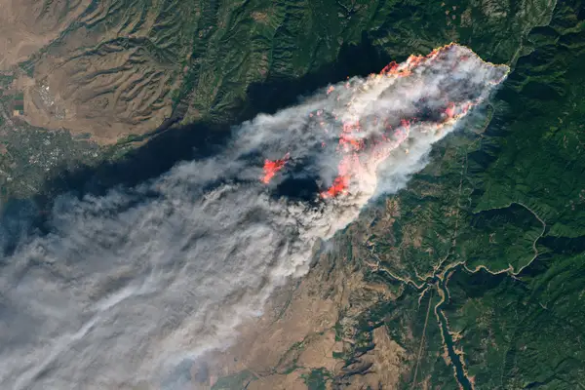
Atmospheric particles enriched with life sustaining nutrients
P, K, Ca, Mg, Mn, Fe, Cu, Ni
Notes:
The three most abundant atmospheric particles are desert dust, volcanic ash and fire ash. These particles enriched with a life sustaining nutrients such as P, K. We know that in a long term, these particles supply nutrients to ecosystems, and they replenish nutrient reservoirs in soils, however we do not know the immediate and direct impact of these particles on plants nutrition. In this research we aimed to study direct and immediate nutritional impact of Desert dust, volcanic ash and fire ash on plants nutrition. Since these particles arrive from the air, we decided to study their impact by applying dust and ashes directly to roots and directly to the foliage. In agriculture, foliar fertilization methods is a common practice using synthetic fertilizers, however in ecological studies this phenomenon is overlooked.

Slide 5
Research goal
Our goal is to study the direct and immediate impact of desert dust, volcanic ash and fire ash on plants nutrition
Notes:
In this research we aimed to study direct and immediate nutritional impact of Desert dust, volcanic ash and fire ash on plants nutrition. Since these particles arrive from the air, we decided to study their impact by applying dust and ashes directly to roots and directly to the foliage. In agriculture, foliar fertilization methods is a common practice by using synthetic fertilizers, however in ecological studies foliar nutrient assimilation is mostly overlooked.

Slide 6
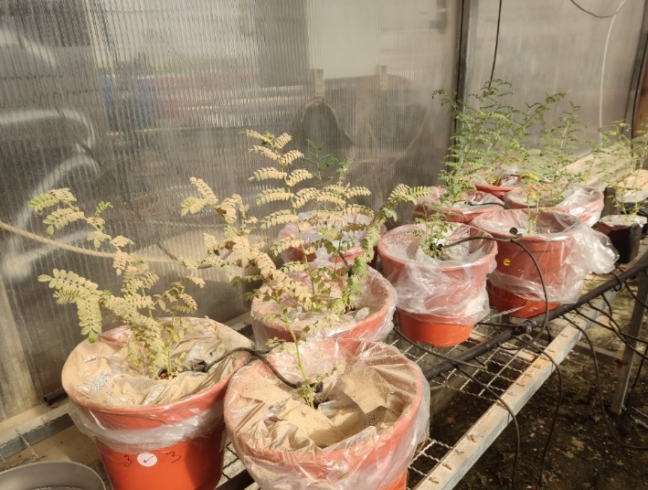
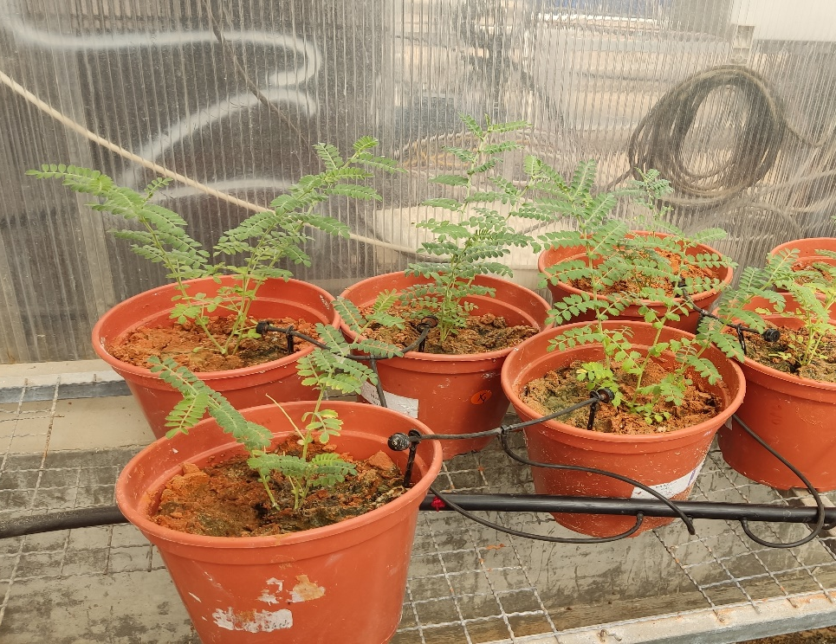
Experimental Design
Foliar application
Root application
Notes:
We designed an experiment where we collected dust from negev desert, volcanic ash from etna mountain from cicily and we produced fire ash by burning branches of pine trees. We used chickpea as a model plant. we Grew them in a two isolated rooms one with ambient and other under elevated CO2 levels. Four weeks after germination, when the plants were strong enough, we applied dust and ashes in a two separate manners – directly to the roots and directly to the leaves while covering the top of the pots to prevent percolation of particles to the roots. Then we waited for three weeks after which we terminated the experiment. We measured the biomass and nutrients concentration.

Slide 7
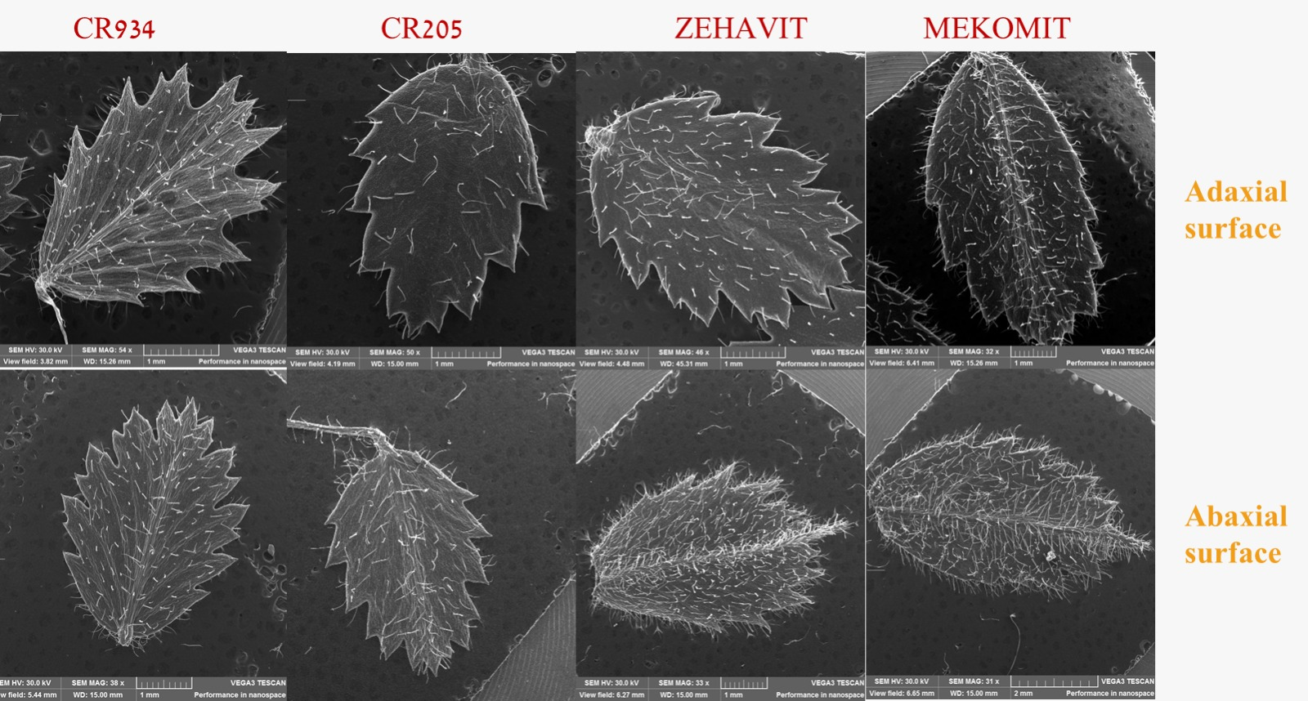
Mechanism - plant acidifies leaf surface
Photo taken by Elnatan Golan
Gross et al. 2021
Notes:
An ongoing work of A.Gross, Ran Erel, Sudeep Tiwari and Glnatan Golan suggests that the chemical environment on the surface of chickpea leaves is highly acidic as you can see at the right figure, I measured chickpea leaves ph and it is very acidic. Such an acidic environment drives the solubilization of nutrients that considered to be biologically unavailable for roots. This happens due to secretion of organic acids from the tips of trichomes. Elnatan Golan showed that Chickpea spices that have more trichomes will secrete more organic acids which in turn will increase their ability to use atmospheric particles as nutritional source.

Slide 8
Now come back with me to the future (of an elevated CO2)
Notes:
Now please come back with me to the future of elevated CO2 levels.

Slide 9
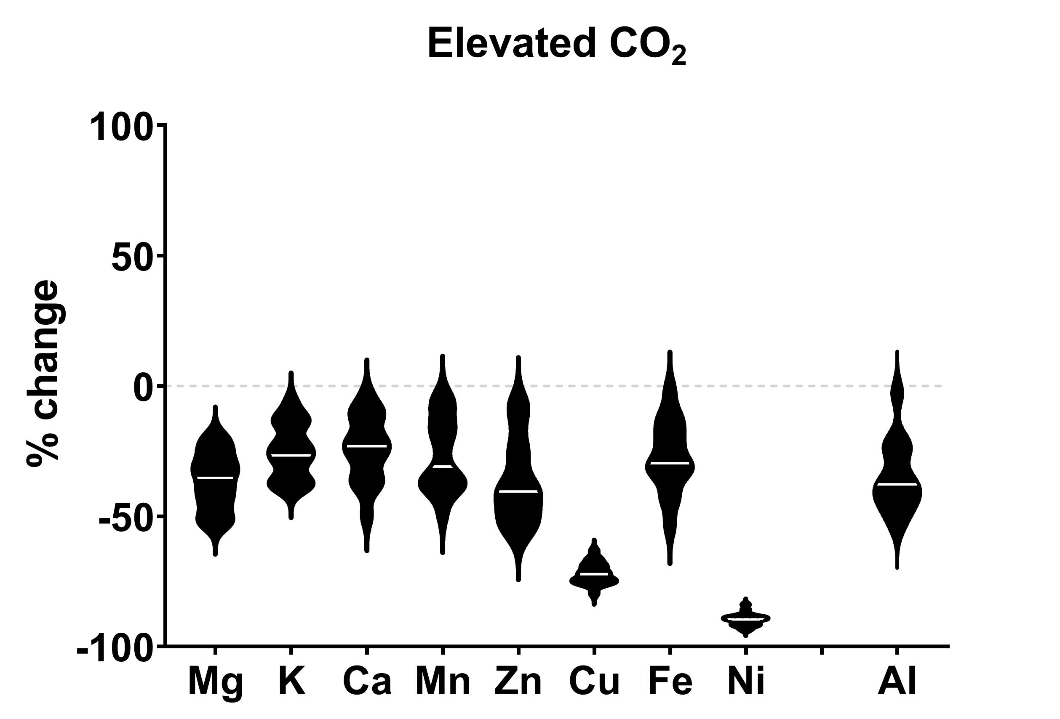
Nutrient concentration reduction under elevated CO2
(n=20)
Notes:
As I mentioned before, we also grew chickpea plants under elevated co2 levels. Here we see the change of nutrient concentration in plants that grew under elevated co2 levels in comparison to plants that were grown under ambient co2 levels. You can clearly see reduction of nutrients such as Mg, K, Ca, Fe especially larger reduction more that 50% for Cu and Ni. Such a dramatic reduction of nickel might be harmful for plants because Ni is essential for activation of Urease enzyme that is needed for nitrogen assimilation. Now look what happened after foliar application of volcanic ash -

Slide 10
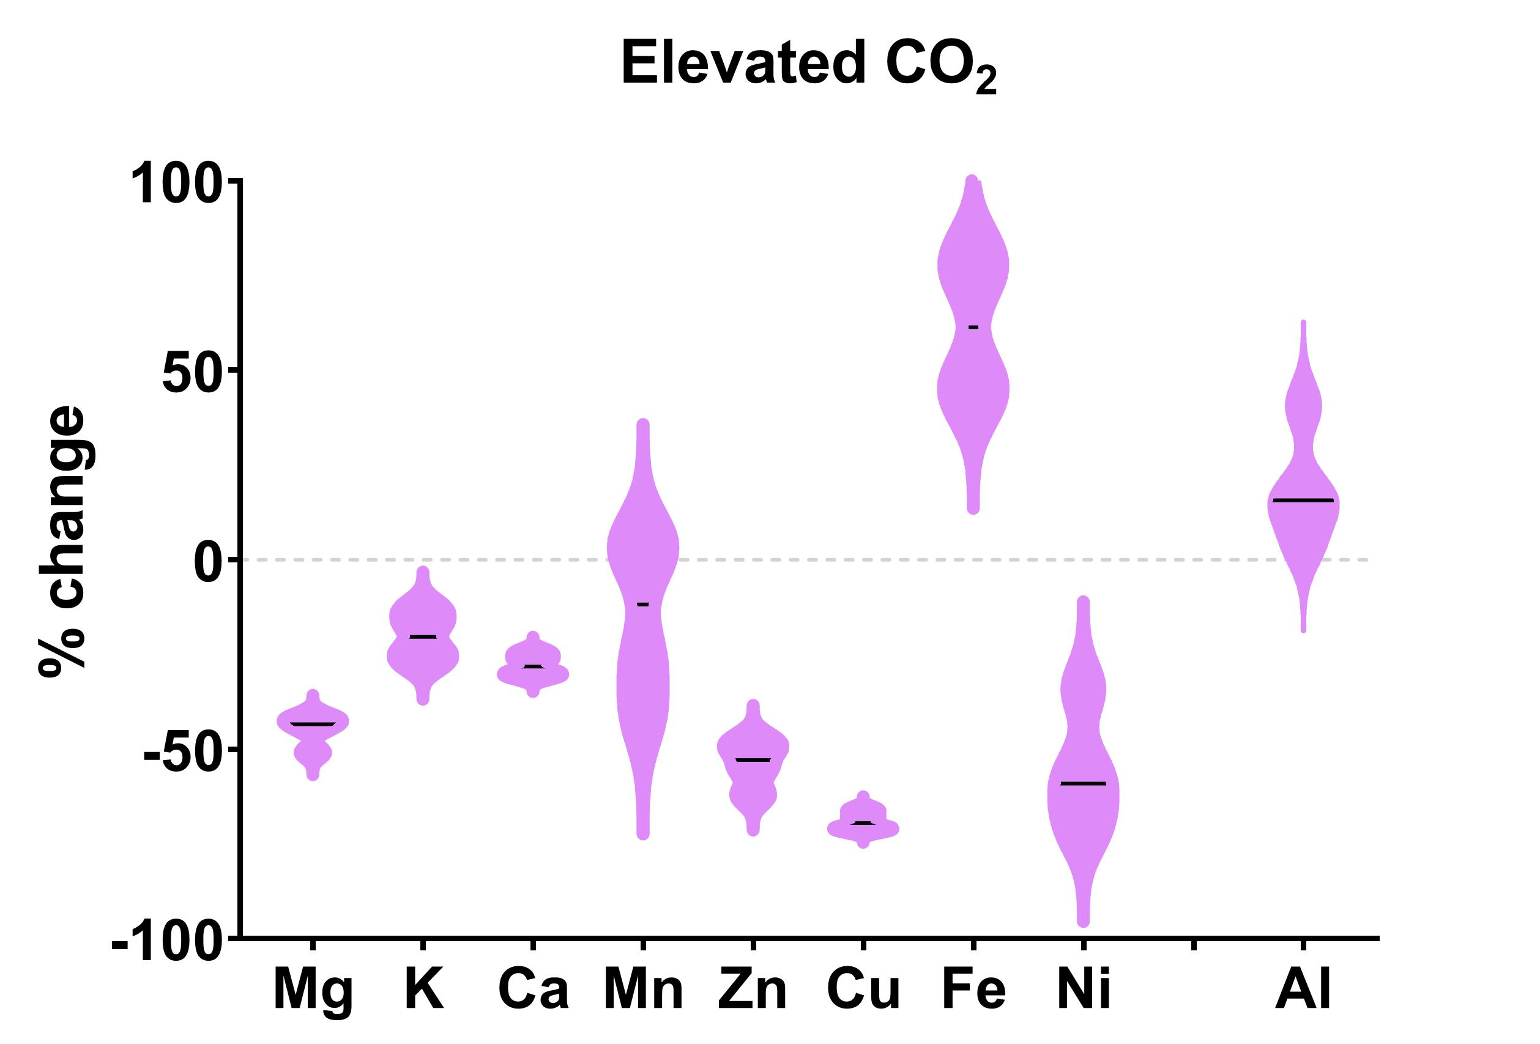
Foliar application of volcanic ash increases nutrient concentrations
Foliar application of volcanic ash
Notes:
we found that foliar application of volcanic ash under eco2 increased the concentration of Fe and Ni. I added Al to the graph because It’s concentration is abundant in dust and ash so it can serve as a tracer for nutrient flux.

Slide 11
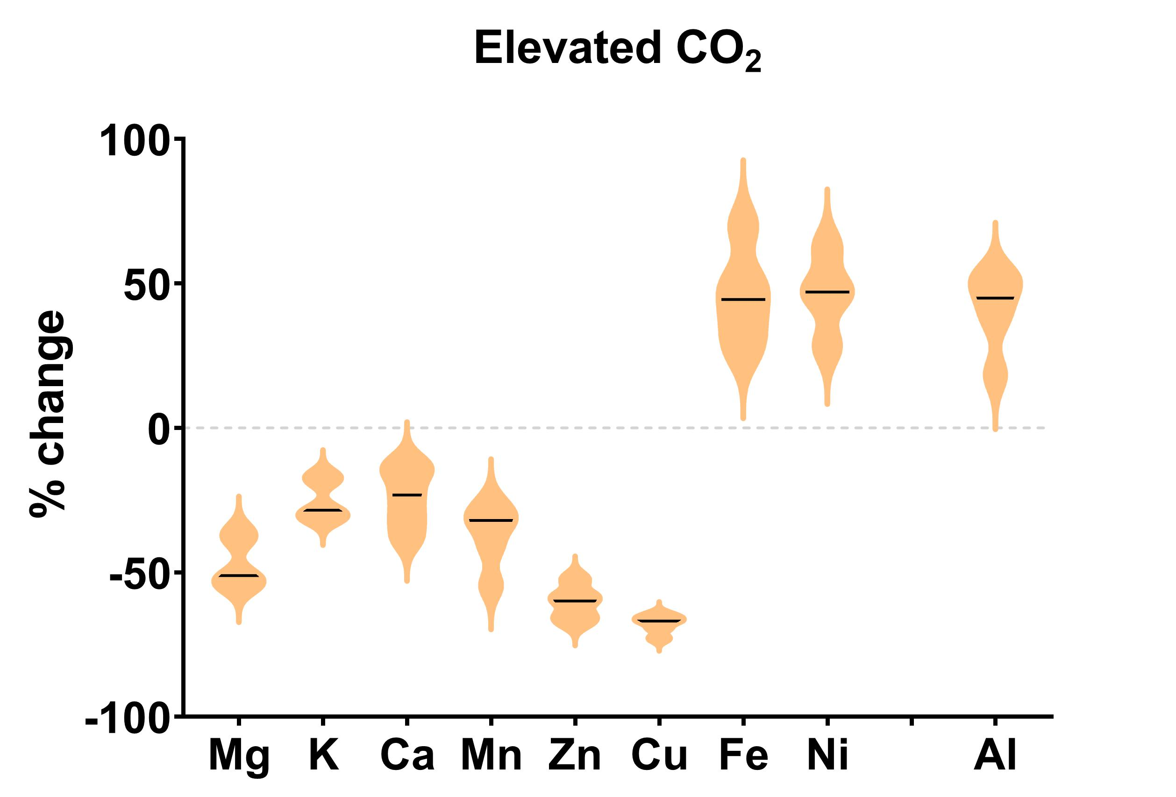
Foliar application of dust increases nutrient concentrations
Foliar application of Desert dust
Notes:
The impact of a foliar application of desert dust was even more impressive, specifically regarding Ni. Ni concentration became even higher than under ambient co2 condition but still in a nontoxic levels. These results show that in the future, foliar assimilation might be a highly important mechanism for plants nutrition. The roots may not work as well in the future world as we see in the black violins, but leaves can compensate.

Slide 12
Summery
Foliar nutrient uptake – direct nutritional impact
Increased biomass after application of desert dust, volcanic ash, fire ash
Reduction of nutrient concentration under eCO2, BUT
Foliar application under eCO2 increases the concentration of Fe, Ni
Notes:
We started from the question regarding the direct and immediate impact of atmospheric particles on plants nutrition. We saw that foliar assimilation pathway was the only way in which plants took nutrients from atmospheric particles. Then we grew plants under elevated co2 levels, and indeed we saw the reduction in nutrients concentration. Foliar application of dust and ash increased the concentration of Fe and Ni which means that this process might partially compensate the downregulation of roots.

Slide 13
Acknowledgments
Dr. Ran Erel (Volcani Center)
Prof. Yigal Erel, Mr. Ofir Tirosh (HUJI)
Prof. Alon Angert, Ms. Tal Weiner (HUJI)
KKL climate team doctoral fellowship
ISF 144/19
Notes:
I want to acknowledge Dr Ran Erel and his team and volcani center for their scientific contribution. As well as Prof. Igal Erel And KKL – JNF as well and ISF funds for supporting our research.

Slide 14
Thank you!
Notes:
I want to thank Daniel palchan and avner gross for their dedication to the research and supervision. Ran Erel and volcani center for their scientific contribution. And KKL – JNF as well and ISF funds for supporting our research.

Slide 15
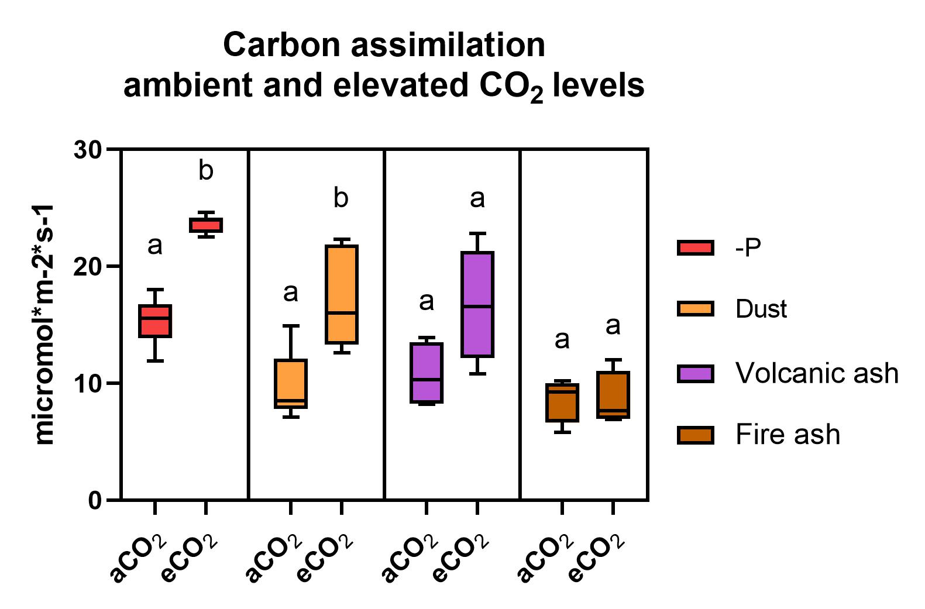
Elevated CO2 enables higher C assimilation even for dusted leaves
Notes:
But look how the dust coverage of leaves was less harmful in an higher co2 condition. Add hoding capacity graph, also graph of growing on soil,

Slide 16
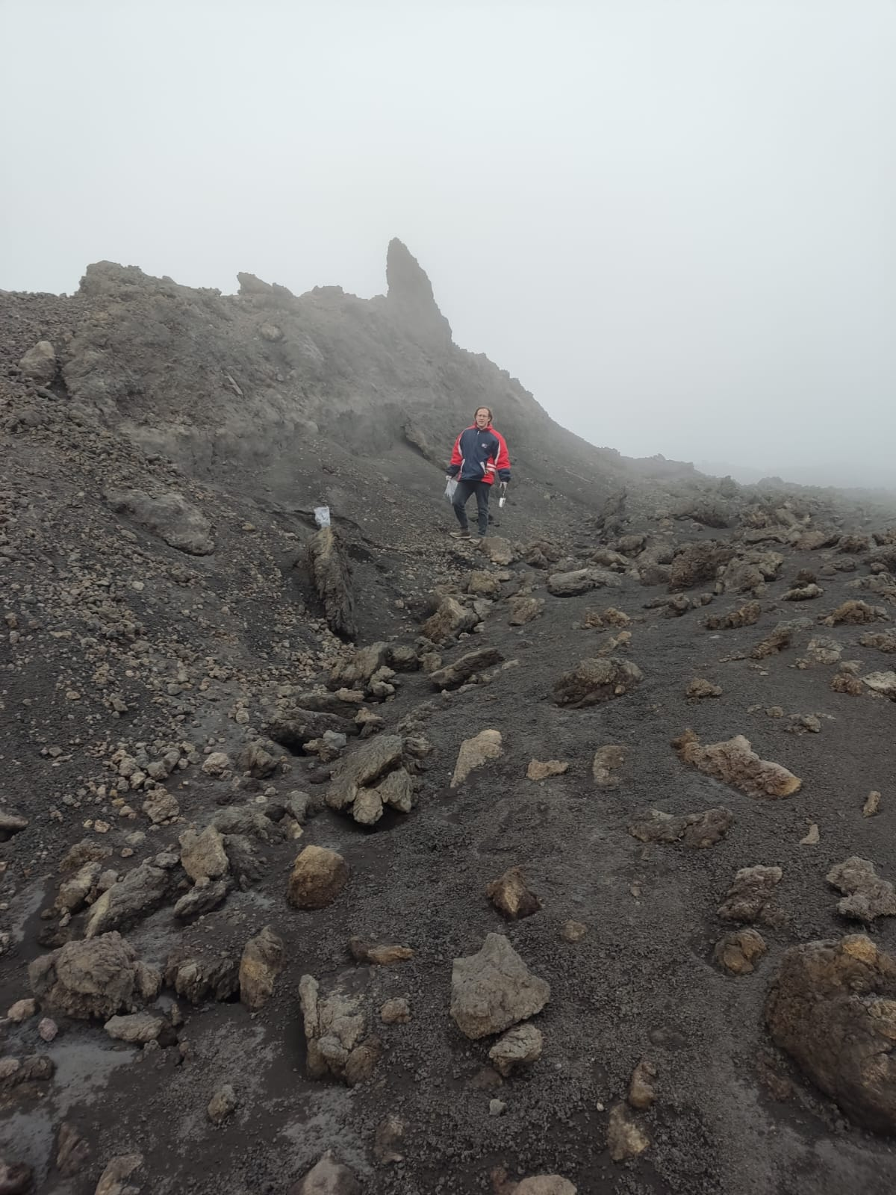
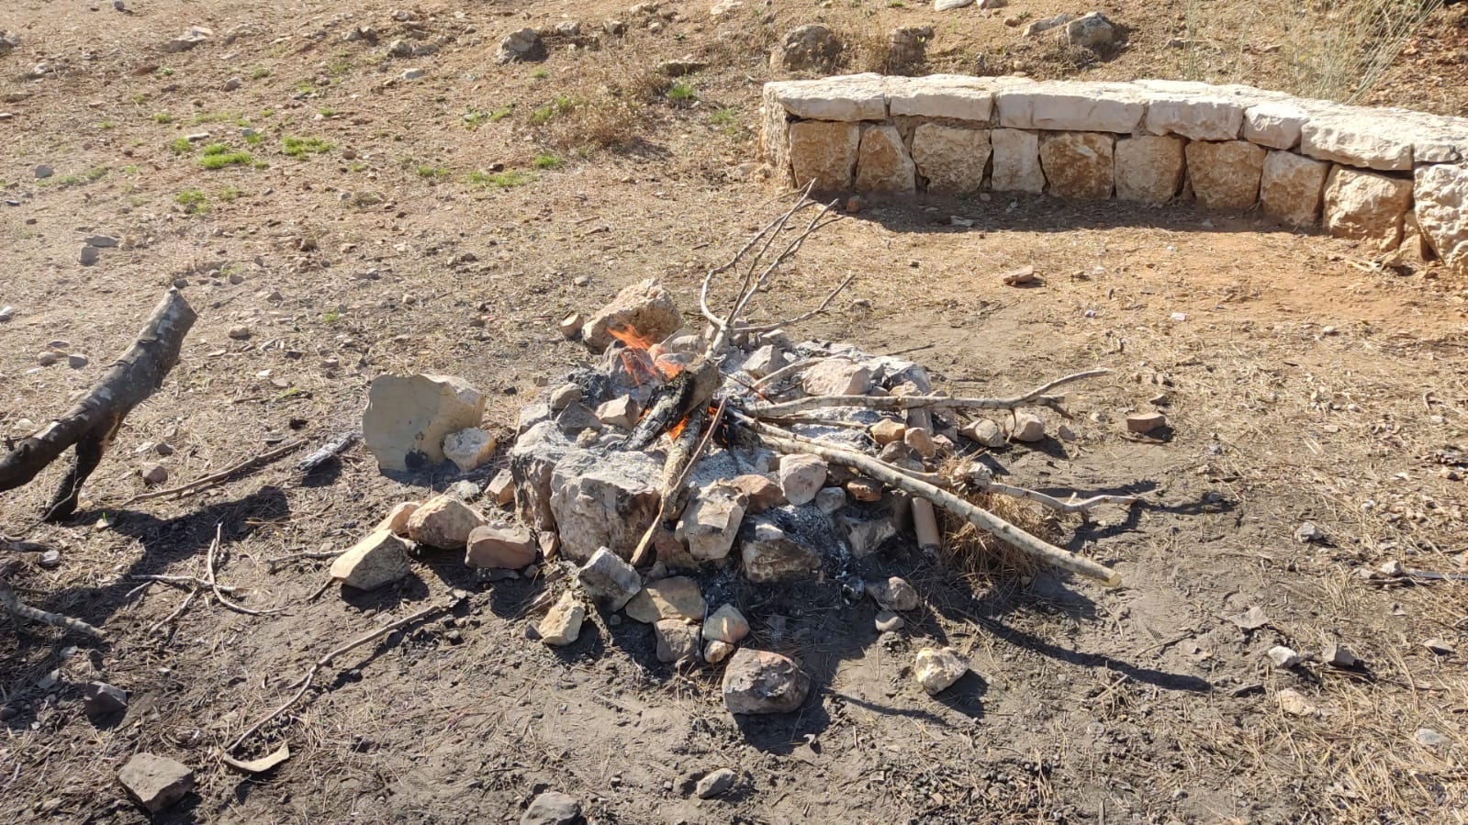
Desert dust, fire and volcanic ash are the most abundant particles in the atmosphere
Negev Desert
Volcanic ash from Mount Etna
Burning of pine branches
Notes:
In this research I further study the direct effect of dust particles dust and ashes are the most significant particles in the atmosphere, so we decided to study the direct fertilizing effect of atmospheric particles in an ambient and elevated CO2 levels. So We collected desert dust from Negev desert, Fire ash from burning pine branches. Volcanic ash we collected from Etna mount in Cicily.

Slide 17
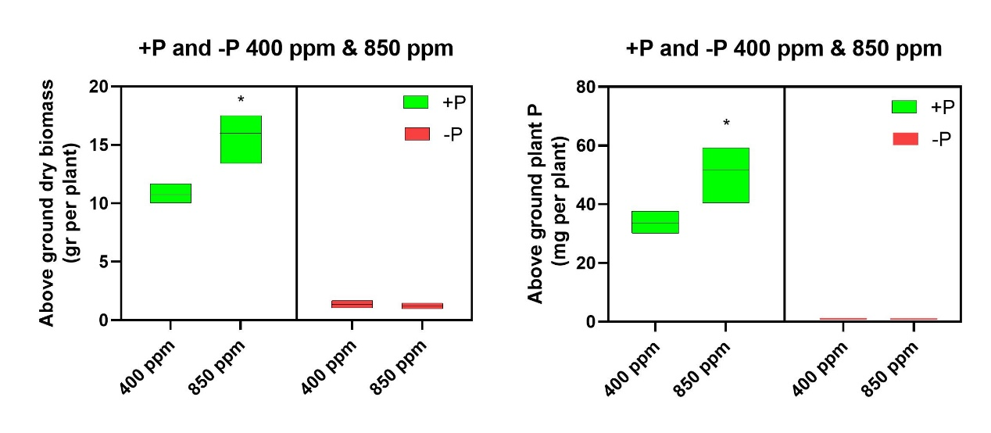
Results

Slide 18
Results – growing in soil

Slide 19
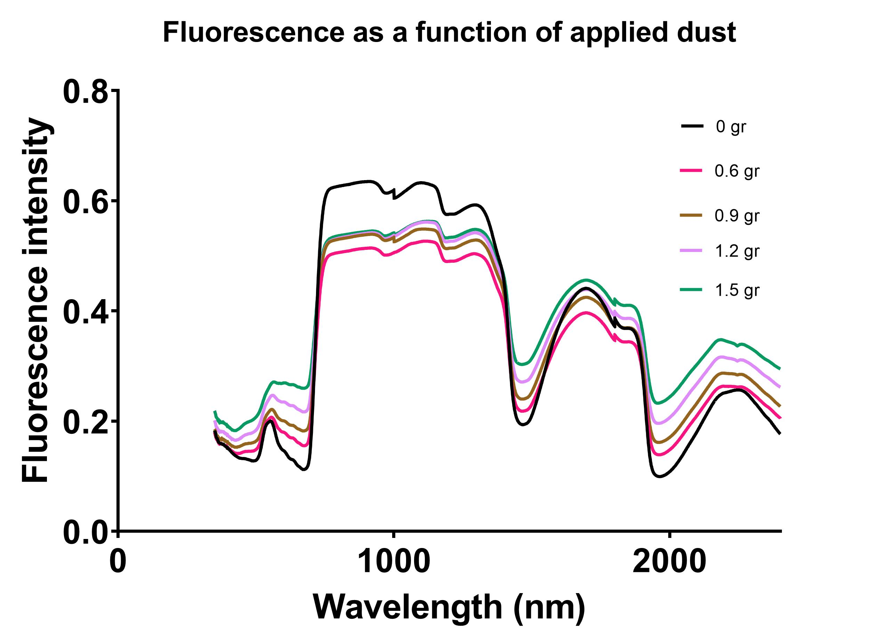
Methods
Semi-quantification of particle mass on leaves FieldSpec 4 Hi-Res NG Spectroradiometer

Slide 20
Holding capacity

