Slide 1
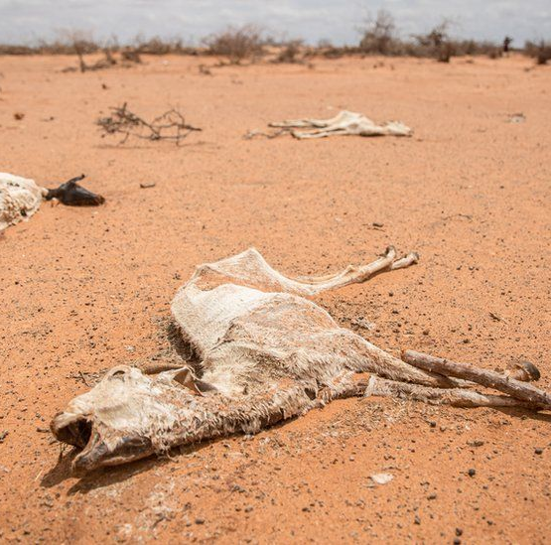
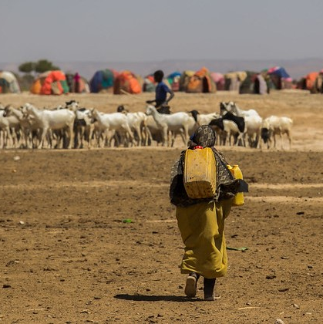
Drought intensity and successiveness together displace populations in Somalia
Woi Sok Oh , Juan Rocha , and Simon Levin
1,2
3
2
1 High Meadows Environmental Institute, Princeton University
2 Department of Ecology & Evolutionary Biology, Princeton University
3 Stockholm Resilience Centre

Slide 2
Droughts as well as armed conflicts severely damages Somali’s wellbeing,
leading to a huge wave of population movements.

Slide 3
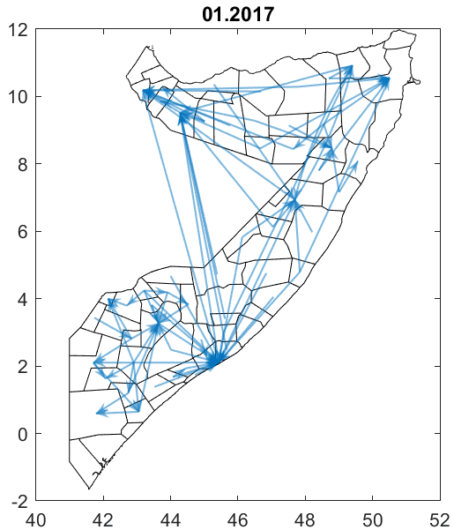
Droughts as well as armed conflicts severely damages Somali’s wellbeing,
leading to a huge wave of population movements.

Slide 4
Droughts as well as armed conflicts severely damages Somali’s wellbeing,
leading to a huge wave of population movements.
But how do droughts affect migration decisions?

Slide 5
Protection & Return Monitoring Network (PRMN) Data
Provided by UNHCR (United Nations High Commissioner for Refugees)
39 local partners monitored IDPs at strategic points (e.g., transit sites, established IDP settlements, border crossings, and ad hoc locations) and interviewed displaced people.
IDP flows from 2016 to 2022 (ongoing); We used monthly flows in 2017-2018.
Origin district
IDP flows
Destination district

Slide 6
Bootstrapping Temporal Exponential Random Graph Model
ERGM is used to “describe parsimoniously the local selection forces that shape the global structure of a network” (Hunter et al. 2008)
coefficients
{0,1}
Logistic regression
$$p\left(x\right)=\frac{\exp\left(b_{0}+b_{1}x\right)}{1+\exp\left(b_{0}+b_{1}x\right)}$$
a vector of model
statistics for network $y$
No flow (0)
Flow (1)
coefficients
ERGM
$$P\left(Y=y\right)=\frac{\exp\left(θ^{′}g\left(y\right)\right)}{k\left(θ\right)}$$
Normalizing constant
bTERGM
$$P\left(Y^{t}|θ,Y^{t−1}\right)=\frac{\exp\left(θ^{′}g\left(Y^{t},Y^{t−1}\right)\right)}{k\left(θ\right)}$$
Maximum pseudolikelihood estimation with bootstrapping

Slide 7
We quantitatively find both drought intensity and successiveness drive displacement decisions using temporal network model in 2017–2018.
admin2
admin1
 | District |  | Region
Edges (intercept) | -5.634 | * | -3.766 | *
Mutual | 0.693 | * | 0.864 | *
Transitive | 1.282 | * | 0.565 | *
Cyclic | -0.106 |  | -0.199 | *
Experience (prev. 3 month) | 23.163 | * | 22.383 | *
Experience (year ago) | 21.810 | * | 21.444 | *
Reciprocity | 0.756 | * | -0.280
(O) Total conflict events | -0.005 |  | 0.256
(D) Total conflict events | 0.001 |  | -0.183
(O) SPI-3, lag 0 | -0.112 | * | -0.262 | *
(D) SPI-3, lag 0 | -0.209 | * | 0.143
(O) SPI-3, lag 1 | -0.125 | * | 0.066
(D) SPI-3, lag 1 | 0.303 | * | -0.206
(O) SPI-3, lag 2 | 0.050 |  | 0.182
(D) SPI-3, lag 2 | -0.027 |  | -0.090
(O) Successive low SPI-3 | -0.051 |  | 0.092
(D) Successive low SPI-3 | 0.122 | * | -0.315 | *
+ : Frequently observed
- : Rarely observed
Triadic network structures are statistically significant.
Previous displacement experiences are critical on destination decisions.
Conflict occurrences are insignificant to displacement.
Drought intensity has no lag or 1-month lag in displacement decisions.
Less successive droughts pull people at the region level.
(O) Origin attribute
(D) Destin. attribute

Slide 8
We quantitatively find both drought intensity and successiveness drive displacement decisions using temporal network model in 2017–2018.
admin2
admin1
 | District |  | Region
Edges (intercept) | -5.634 | * | -3.766 | *
Mutual | 0.693 | * | 0.864 | *
Transitive | 1.282 | * | 0.565 | *
Cyclic | -0.106 |  | -0.199 | *
Experience (prev. 3 month) | 23.163 | * | 22.383 | *
Experience (year ago) | 21.810 | * | 21.444 | *
Reciprocity | 0.756 | * | -0.280
(O) Total conflict events | -0.005 |  | 0.256
(D) Total conflict events | 0.001 |  | -0.183
(O) SPI-3, lag 0 | -0.112 | * | -0.262 | *
(D) SPI-3, lag 0 | -0.209 | * | 0.143
(O) SPI-3, lag 1 | -0.125 | * | 0.066
(D) SPI-3, lag 1 | 0.303 | * | -0.206
(O) SPI-3, lag 2 | 0.050 |  | 0.182
(D) SPI-3, lag 2 | -0.027 |  | -0.090
(O) Successive low SPI-3 | -0.051 |  | 0.092
(D) Successive low SPI-3 | 0.122 | * | -0.315 | *
Triadic network structures are statistically significant.
Previous displacement experiences are critical on destination decisions.
Conflict occurrences are insignificant to displacement.
Drought intensity has no lag or 1-month lag in displacement decisions.
Less successive droughts pull people at the region level.
(O) Origin attribute
(D) Destin. attribute

Slide 9
We quantitatively find both drought intensity and successiveness drive displacement decisions using temporal network model in 2017–2018.
admin2
admin1
 | District |  | Region
Edges (intercept) | -5.634 | * | -3.766 | *
Mutual | 0.693 | * | 0.864 | *
Transitive | 1.282 | * | 0.565 | *
Cyclic | -0.106 |  | -0.199 | *
Experience (prev. 3 month) | 23.163 | * | 22.383 | *
Experience (year ago) | 21.810 | * | 21.444 | *
Reciprocity | 0.756 | * | -0.280
(O) Total conflict events | -0.005 |  | 0.256
(D) Total conflict events | 0.001 |  | -0.183
(O) SPI-3, lag 0 | -0.112 | * | -0.262 | *
(D) SPI-3, lag 0 | -0.209 | * | 0.143
(O) SPI-3, lag 1 | -0.125 | * | 0.066
(D) SPI-3, lag 1 | 0.303 | * | -0.206
(O) SPI-3, lag 2 | 0.050 |  | 0.182
(D) SPI-3, lag 2 | -0.027 |  | -0.090
(O) Successive low SPI-3 | -0.051 |  | 0.092
(D) Successive low SPI-3 | 0.122 | * | -0.315 | *
Triadic network structures are statistically significant.
Previous displacement experiences are critical on destination decisions.
Conflict occurrences are insignificant to displacement.
Drought intensity has no lag or 1-month lag in displacement decisions.
Less successive droughts pull people at the region level.
(O) Origin attribute
(D) Destin. attribute

Slide 10
We quantitatively find both drought intensity and successiveness drive displacement decisions using temporal network model in 2017–2018.
admin2
admin1
 | District |  | Region
Edges (intercept) | -5.634 | * | -3.766 | *
Mutual | 0.693 | * | 0.864 | *
Transitive | 1.282 | * | 0.565 | *
Cyclic | -0.106 |  | -0.199 | *
Experience (prev. 3 month) | 23.163 | * | 22.383 | *
Experience (year ago) | 21.810 | * | 21.444 | *
Reciprocity | 0.756 | * | -0.280
(O) Total conflict events | -0.005 |  | 0.256
(D) Total conflict events | 0.001 |  | -0.183
(O) SPI-3, lag 0 | -0.112 | * | -0.262 | *
(D) SPI-3, lag 0 | -0.209 | * | 0.143
(O) SPI-3, lag 1 | -0.125 | * | 0.066
(D) SPI-3, lag 1 | 0.303 | * | -0.206
(O) SPI-3, lag 2 | 0.050 |  | 0.182
(D) SPI-3, lag 2 | -0.027 |  | -0.090
(O) Successive low SPI-3 | -0.051 |  | 0.092
(D) Successive low SPI-3 | 0.122 | * | -0.315 | *
Positive SPI-3 : wet
Negative SPI-3 : dry
Triadic network structures are statistically significant.
Previous displacement experiences are critical on destination decisions.
Conflict occurrences are insignificant to displacement.
Drought intensity has no lag or 1-month lag in displacement decisions.
Less successive droughts pull people at the region level.
(O) Origin attribute
(D) Destin. attribute

Slide 11
We quantitatively find both drought intensity and successiveness drive displacement decisions using temporal network model in 2017–2018.
admin2
admin1
 | District |  | Region
Edges (intercept) | -5.634 | * | -3.766 | *
Mutual | 0.693 | * | 0.864 | *
Transitive | 1.282 | * | 0.565 | *
Cyclic | -0.106 |  | -0.199 | *
Experience (prev. 3 month) | 23.163 | * | 22.383 | *
Experience (year ago) | 21.810 | * | 21.444 | *
Reciprocity | 0.756 | * | -0.280
(O) Total conflict events | -0.005 |  | 0.256
(D) Total conflict events | 0.001 |  | -0.183
(O) SPI-3, lag 0 | -0.112 | * | -0.262 | *
(D) SPI-3, lag 0 | -0.209 | * | 0.143
(O) SPI-3, lag 1 | -0.125 | * | 0.066
(D) SPI-3, lag 1 | 0.303 | * | -0.206
(O) SPI-3, lag 2 | 0.050 |  | 0.182
(D) SPI-3, lag 2 | -0.027 |  | -0.090
(O) Successive low SPI-3 | -0.051 |  | 0.092
(D) Successive low SPI-3 | 0.122 | * | -0.315 | *
High : More successive
Low : Less successive
Triadic network structures are statistically significant.
Previous displacement experiences are critical on destination decisions.
Conflict occurrences are insignificant to displacement.
Drought intensity has no lag or 1-month lag in displacement decisions.
Less successive droughts pull people at the region level.
(O) Origin attribute
(D) Destin. attribute

Slide 12
Thank You!
w.oh@princeton.edu
@oh_woi
woisokoh.com

