Slide 1
OSPP
The infancy of Chinese geoarchaeology: dilemmas from the Quaternary to the Anthropocene
Zhao Yajing
Doctor Candidate
Peking University
School of Archaeology
University of Bristol
School of Earth Sciences
Zhu Zhicai Post-doc University of Bristol
School of Earth Sciences
Michael. J .Benton Professor University of Bristol
School of Earth Sciences
Hao Lu
Assistant Professor Beijing Normal University School of History

Slide 2
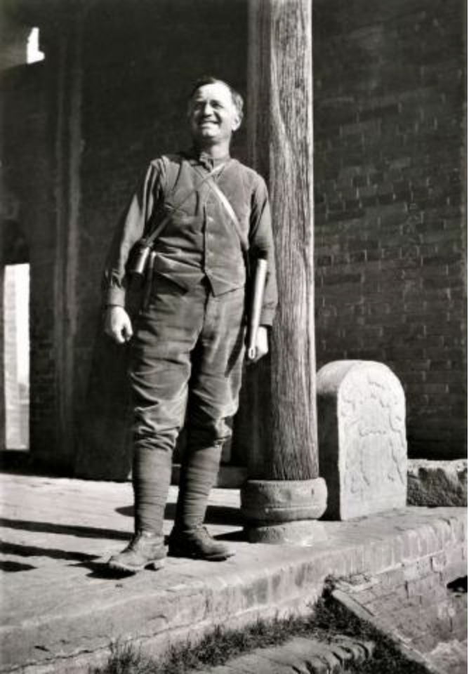
Introduction
Joseph Gunnar Anderson （1874-1960）
1906
1901
01
Academic significance
Founding-father of Chinese geoarchaeology
A microcosm of emerging archaeology
Geoscience
Research
Inter
-disciplinary
Research gap
Disciplinary boundary
Northern
Europe
02
East
Asia
Scientific Question
How the geoscience knowledge transferred into archaeological understanding?
1916
1921
03
Geoscience
Research
Methodology
Histography on history of science
Archaeological
Geology
04
Asia
Credit to Yangshao Museum
1923
1922
Archaeology in narrow sense
Geoarchaeology Study
Academic Transition Timeline: From Geoscience to Archaeology

Slide 3
Andersson
Geoarchaeological Scheme
Stratigraphy |  | Planetology | Topography | Geological Time |  | Glacial Age | Landscape | Paleo-climate | People Existence
Gravel |  | Deer remains and wild sheep | Cut through riverine | Quaternary | Holocene | Post-glacial Age | Forest turned into agricultural landscape | Damper | Yangshao People
Loess | Banqiao | Elephas primigen-mammals | Accumulative Topography |  | Late Pleistocene | Glacial Age | Steppe-like | Arid | Lapse
 | Malan |  |  |  | Middle Pleistocene
Red-clay (Hipparion) |  | Hipparion fauna, rhinoceros | Erosional Topography | Tertiary | Late Pliocene | Pre-glacial Age | Wetland dominant | Humid | Man of the ordos
Neolithic Revolution
Geological Transition
Origin of Mankind
Firm geological standpoint
Landscape centered Quaternary climate studies lead to the conclusion of Neolithic revolution.

Slide 4
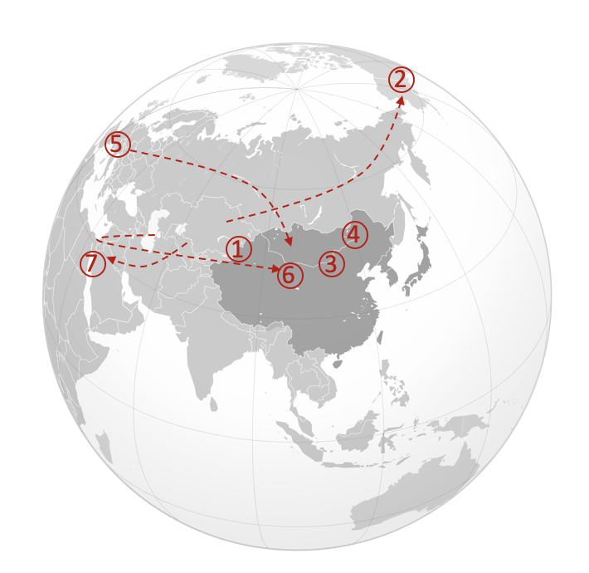
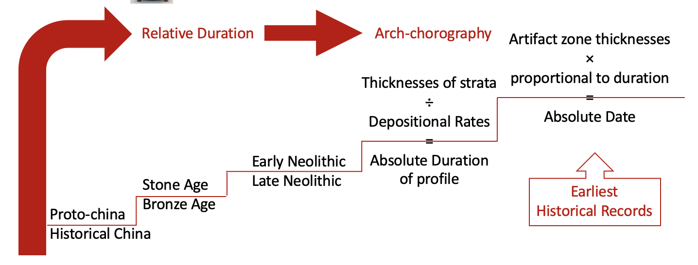
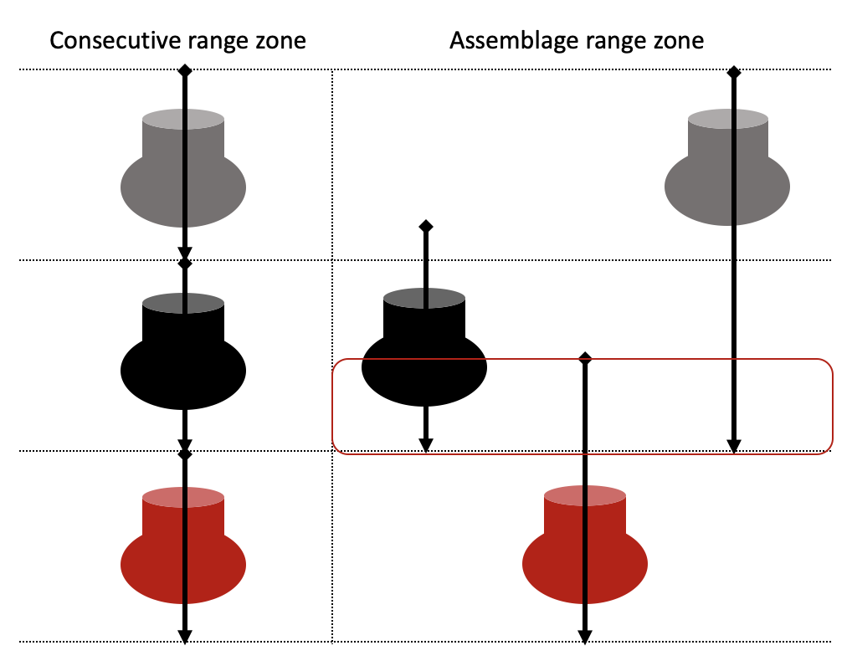
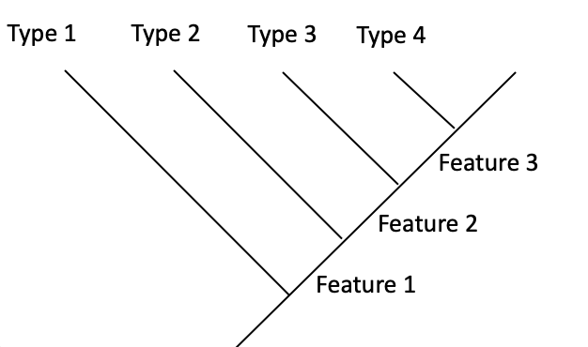
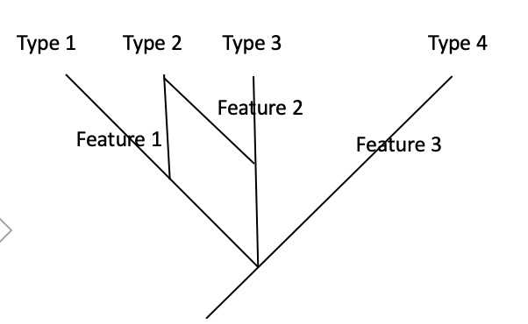
Andersson
Three Dilemmas between Geoscience and Archaeology
1. Dilemma of Fossils & artifacts
2. Stratigraphy Dilemma
Shared Principle Suppression; Cutting relationships
Difference (1) Unconformity (2) Included fragments
Joseph G. Anderson Geological Report No. 5, Vol 1. 1923.pp. 15
3. Chorography Dilemma
Shared Principle Evolution of Gradualism Difference (1) Common ancestor or Local independent origins (2) Tree building

Slide 5
Conclusion
The infancy of Chinese geoarchaeology
Profile first & Archaeological Unit first
01
Perspective inclination
Geoarchaeology
Geologist, paleontologist and later archaeologist
02
Scientific spirit
Yes
03
Limitations of trans-disciplinary
No
04
Fieldwork Methodology
Geoscience
Credit to Yangshao Museum
Joseph G. Anderson Zhujiazhai Archaeological Site. 1945. pp. 5
Thank you for your attention!

Slide 6
1.1
Common ancestor VS Local independent origins
01
Shared Environmental background
4
5
02
Andersson
Fieldworks
Prehistoric stone tool
2
03
Shared Hipparion fauna
7
1
3
6
04
Primitive races of mankind
05
Neolithic wave from Europe
Culture
Viewpoints
Two waves
An art migration of design
Copper-bearing culture wave
06
Western Origin of the legendary Yellow Emperor
07
Neolithic revolution of domestication

Slide 7
1.2
Taxonomy and tree building
Anatomy based tree building
Type 1
Type 2
Type 3
Type 4
Type | 1 | 2 | 3 | 4
Feature 1 | 0 | 1 | 1 | 1
Feature 2 | 0 | 0 | 1 | 1
Feature 3 | 0 | 0 | 0 | 1
Feature 2
Feature 1
Feature 3
Flatten hierarchy
Paralleled features
Type 1
Type 2
Type 3
Type 4
Multi-layered
Accumulated features
Color based tree building of Artifacts
Type | 1 | 2 | 3 | 4
Feature 1 | 1 | 1 | 0 | 0
Feature 2 | 0 | 1 | 1 | 0
Feature 3 | 0 | 0 | 0 | 1
Feature 3
Feature 2
Feature 1

Slide 8
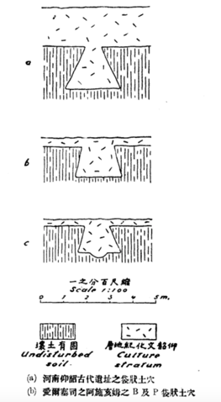
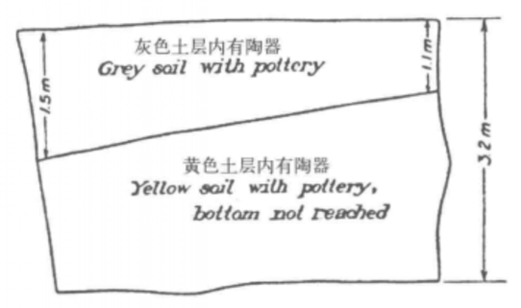
2.1
Stratigraphy
Thickness
Suppression
2. Cutting relationships
3. Unconformity
4. Included fragments
Unknown
Grey soil
Special layer
Yellow soil
Yellow soil
Grey soil
Red soil
Trench II
Loc. 1
Trench II
Loc. 2
Trench III
Joseph G. Anderson Geological Report No. 5, Vol 1. 1923.pp. 15

Slide 9
3.1
Chorography Transferring
Hour-glass
Arthur Holmes (1911)
Penck and Brückner Scheme
Geology
Chorography
Carboniferous | 340
Devonian | 370
Silurian | 430
Relative Duration
Arch-chorography
Artifact zone thicknesses
×
proportional to duration
=
Absolute Date
Thicknesses of strata
÷
Depositional Rates
=
Absolute Duration
of profile
Early Neolithic
Late Neolithic
Earliest
Historical Records
Stone Age
Bronze Age
Proto-china
Historical China

Slide 10
3.2
Relative Chorography
Consecutive range zone
Assemblage range zone
Time BCE | Relative Chorography | Feature
Late Neolithic Age | Qijia Culture | The extend of pattern complexity
 | Yangshao Culture
 | Machang Culture
Bronze Age | Xindian Culture | The number of bronzeware
 | Siwa Culture
 | Shajiang Culture
Age Gap | 300
Stratigraphy

Slide 11
3.3
Absolute Chorography Deduction
Time BCE | Andersson 1925 |  | Siyong Liang’ view |  |  | Andersson 1943
Late Neolithic Age | Qijia Culture | 3500-3200 | Qijia Stage |  | 3500-3200
 | Yangshao Culture | 3200-2900 | XX Stage |  | 3200-2900
 | Machang Culture | 2900-2600 | Hougang Stage |  | 2900-2600
Bronze Age | Xindian Culture | 2600-2300 | Yangshao-Machang Stage |  | 2500-2000 | Qijia Culture | 2500-2200
 | Siwa Culture | 2300-2000 |  | Longshan | 2300-2000 | Yangshao Culture | 2200-1700
 | Shajiang Culture | 2000-1700 | Xindian Stage |  | 2000-1700
Age Gap |  | 300 | 2 meters |  | 300 | Machang Culture | 1700-1300
Baseline
Western
Origination
Baseline
Chinese
Literature
Baseline
Bronze
Age

