Slide 1
Identification of thresholds on Sea surface temperature and chlorophyll-a for understanding environmental suitability of V. vulnificus incidence
Yusuf Jamal, Moiz Usmani, Mayank Gangwar, and Antarpreet Jutla

Slide 2
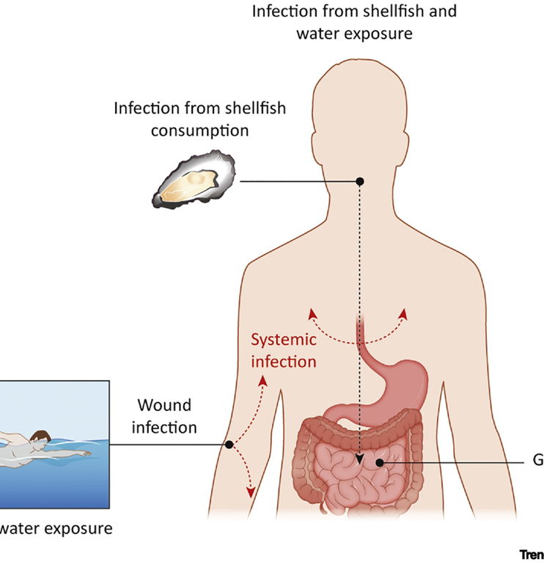
Background
Vibrio spp. are pathogenic bacteria native to warm and brackish water which accounts for around 80000 illnesses and 100 deaths annually in the United States.
V. vulnificus has the highest mortality rate of all seafood-borne pathogens.
Understanding the environmental conditions that lead to increased V. vulnificus growth and spread can aid in the development of early warning systems and targeted prevention strategies.
Figure source: Baker-Austin, C., & Oliver, J. D. (2020). Vibrio vulnificus. Trends in Microbiology, 28(1), 81–82. https://doi.org/10.1016/j.tim.2019.08.006

Slide 3
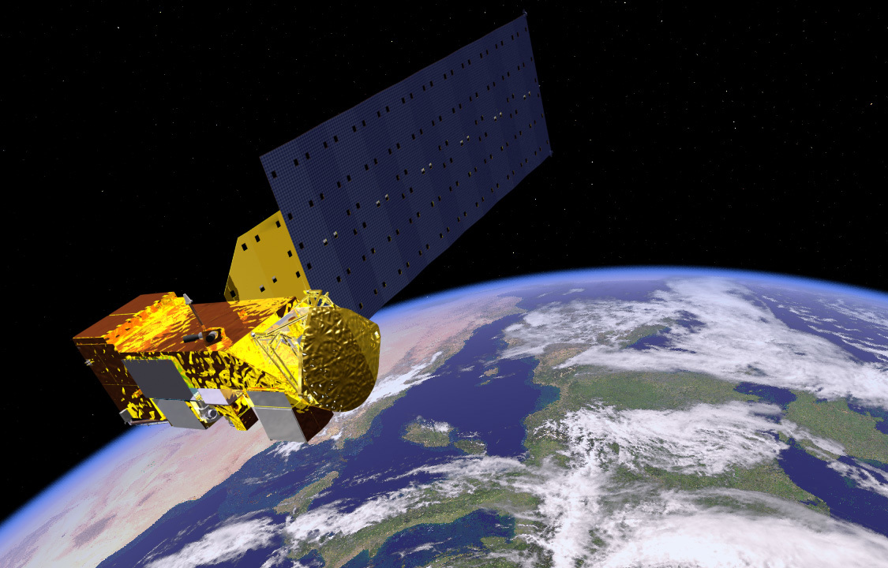
Methodology
Remote sensing datasets on SST and chlorophyll-a from AQUA MODIS
V.vulnificus cases data from Florida Department of Health
Statistical analysis to estimate association
Seasonal analysis to estimate temporal variability of association
https://www.floridahealth.gov/licensing-and-regulation/
https://sealevel.nasa.gov/missions/aqua

Slide 4
Study region

Slide 5
Cases distribution with chlorophyll-a
 | Q1 | Q2 | Q3 | Q4
Cases | 13 | 23 | 19 | 25
Chlorophyll range(mg/m3) | 6.98-12.57 | 12.73-16.78 | 17-21.56 | 21.74-44.73
Overall
 | Q1 | Q2 | Q3 | Q4
Cases | 3 | 2 | 1 | 5
Chlorophyll range(mg/m3) | 9.16-14.27 | 14.36-18.58 | 18.77-22.77 | 22.89-37.80
Non-summer
 | Q1 | Q2 | Q3 | Q4
Cases | 9 | 17 | 21 | 22
Chlorophyll range(mg/m3) | 6.63-11.36 | 11.55-14.70 | 14.78-19.93 | 20.47-45.17
Summer

Slide 6
Overall Results for chlorophyll
Category 1 | Category 2 | Odds ratio
Q1, Q2 | Q3, Q4 | 1.13
Q1 | Q2-Q4 | 1.85
Q1, Q3 | Q2, Q4 | 1.13
Q1-Q3 | Q4 | 0.78
Quartile based odds ratios
Category 1 | Category 2 | Odds ratio
D1, D6, D8 | D2, D3, D4, D5, D7, D9, D10 | 3.23
D1, D4, D6, D8 | D2, D3, D5, D7, D9, D10 | 2.57
D1, D2, D4, D6, D8 | D3, D5, D7, D9, D10 | 2.21
D1, D2, D4, D6, D7, D8 | D3, D5, D9, D10 | 2.06
D1, D2, D4, D6, D7, D8, D10 | D3, D5, D9 | 1.67
Decile based odds ratios

Slide 7
Seasonal results
Non-summer months show little association with chlorophyll, the odds of cases in summer months are higher for chlorophyll concentrations in Q3 and Q4
Category 1 | Category 2 | Odds ratio summer | Odds ratio non-summer
Q1, Q2 | Q3, Q4 | 2.30 | 0.57
Q1 | Q2-Q4 | 3.16 | 0.52
Q1, Q3 | Q2, Q4 | 1.64 | 1.00
Q1-Q3 | Q4 | 2.00 | 1.00

Slide 8
Cases distribution with SST
 | Q1 | Q2 | Q3 | Q4
Cases | 2 | 10 | 20 | 48
SST range(⁰C) | 15.37-20.52 | 20.76-26.17 | 26.35-30.66 | 30.83-32.75
Overall
 | Q1 | Q2 | Q3 | Q4
Cases | 0 | 2 | 2 | 7
SST range(⁰C) | 14.29-18.54 | 18.62-20.55 | 20.63-23.24 | 23.56-29.16
Non-summer
 | Q1 | Q2 | Q3 | Q4
Cases | 8 | 13 | 21 | 27
SST range(⁰C) | 23.51-27.80 | 28.06-30.74 | 30.89-31.50 | 31.51-32.88
Summer

Slide 9
Overall results for SST
Category 1 | Category 2 | Overall Odds ratio | Odds ratio summer | Odds ratio non-summer
Q1, Q2 | Q3, Q4 | 6.93 | 1.81 | 3.18
Q1 | Q2-Q4 | 12.57 | 2.70 | -
Q1-Q3 | Q4 | 7.02 | 1.55 | 3.13
Odds ratios higher than chlorophyll
Comparable odds ratios in summer months
SST greater than Q3 is strongly associated with cases, with most cases occurring in Q4
Overall, SST above Q1 have high odds of V.vulnificus infection

Slide 10
Analysis for Biscayne Bay
In contrast to Tampa Bay, chlorophyll shows year round association with cases as illustrated by high odds ratios
SST behavior similar to Tampa Bay with values above Q1 showing high association with cases.
Similar to Tampa Bay, highest number of cases occur in the last two quartiles for both SST and chlorophyll
Analysis suggests that cases association with chlorophyll is seasonal and depends on location.
SST behavior is comparable for all locations.

Slide 11
Assigning thresholds
Chlorophyll's role could be highly variable depending on the location and season. However, it is observed that a greater number of cases have occurred when chlorophyll concentrations exceed Q2.
Overall,SST above Q1 shows high odds of infection.
For non-summer months SST above Q2 can be regarded as threshold beyond which odds ratio increase.
For summer months, no sharp threshold exist for SST since all quartiles have high odds of infection with Last two having highest odds.

Slide 12
Thank you!
For any questions
Contact: yjamal@ufl.edu

