Slide 1
European Geosciences Union,
23-28 April 2023, Vienna, Austria
The Swedish Deep-Sea Expedition
1947 – 1948
Lennart Bornmalm, Björn Malmgren, Antoon Kuijpers, and Anders Stigebrandt

Slide 2
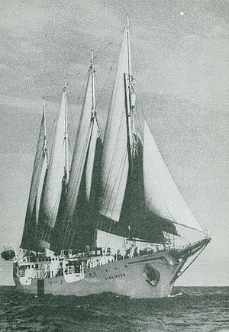
The Albatross expedition
(The Swedish Deep-Sea Expedition) was a Swedish oceanographic expedition that sailed around the world during 15 months between July 4, 1947, and October 3, 1948, covering 45 000 nautical miles. The expedition is considered the second largest Swedish research expedition after the Vega expedition.

Slide 3
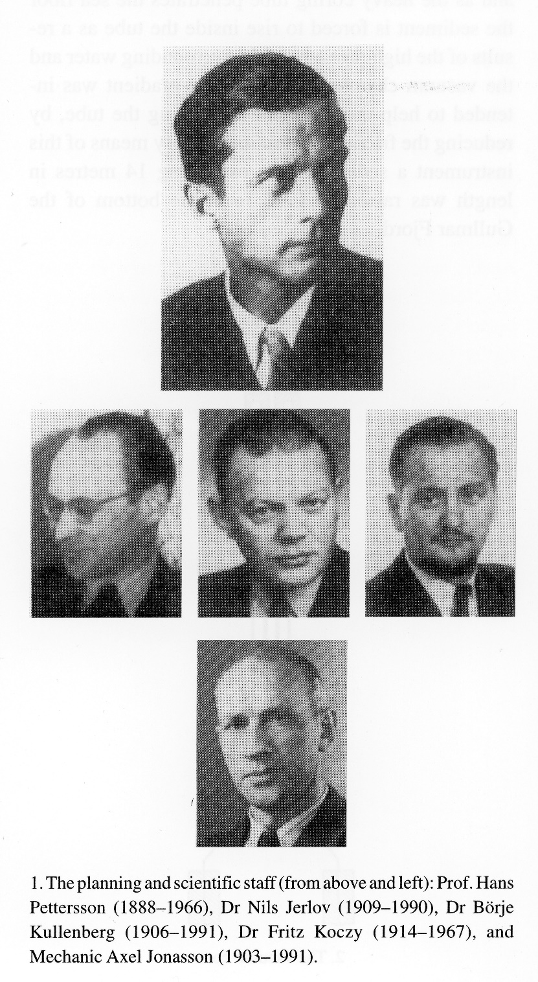
Planning & scientific staff

Slide 4
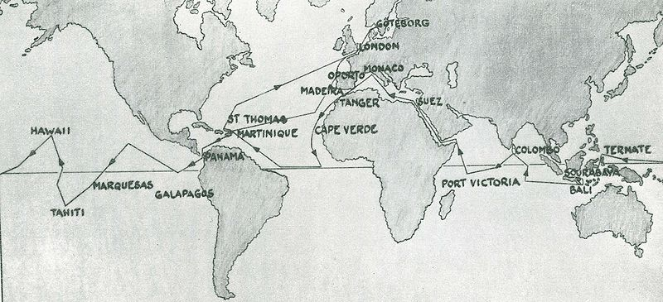
The journey of the Swedish Deep Sea Expedition

Slide 5
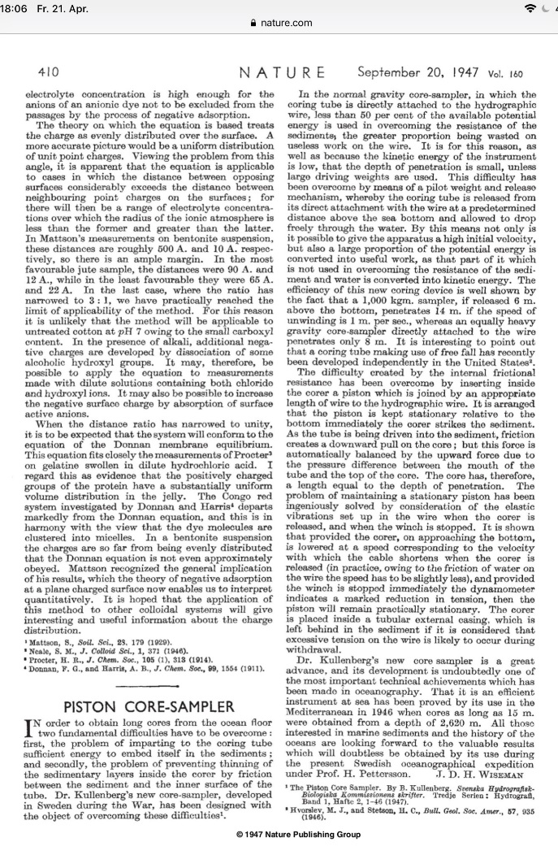
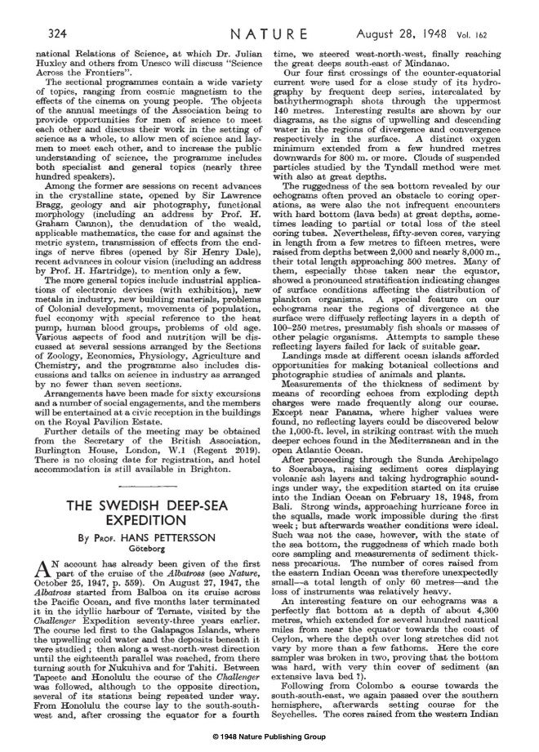
‘Nature’ journal reports about the Albatross expedition, 1947 and 1948

Slide 6
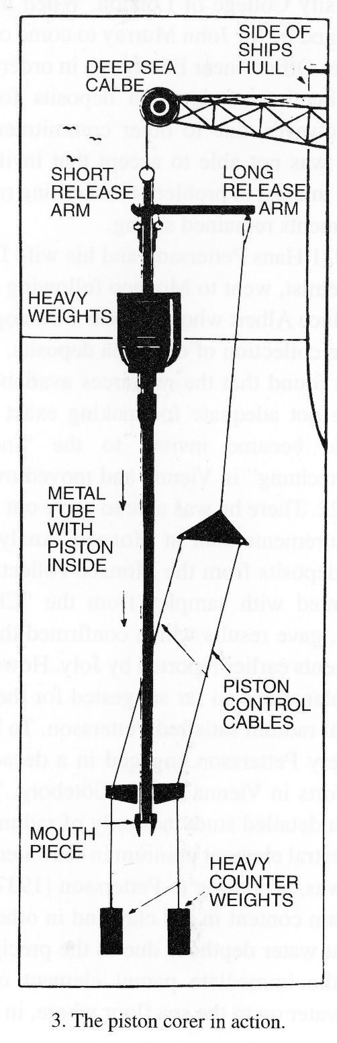
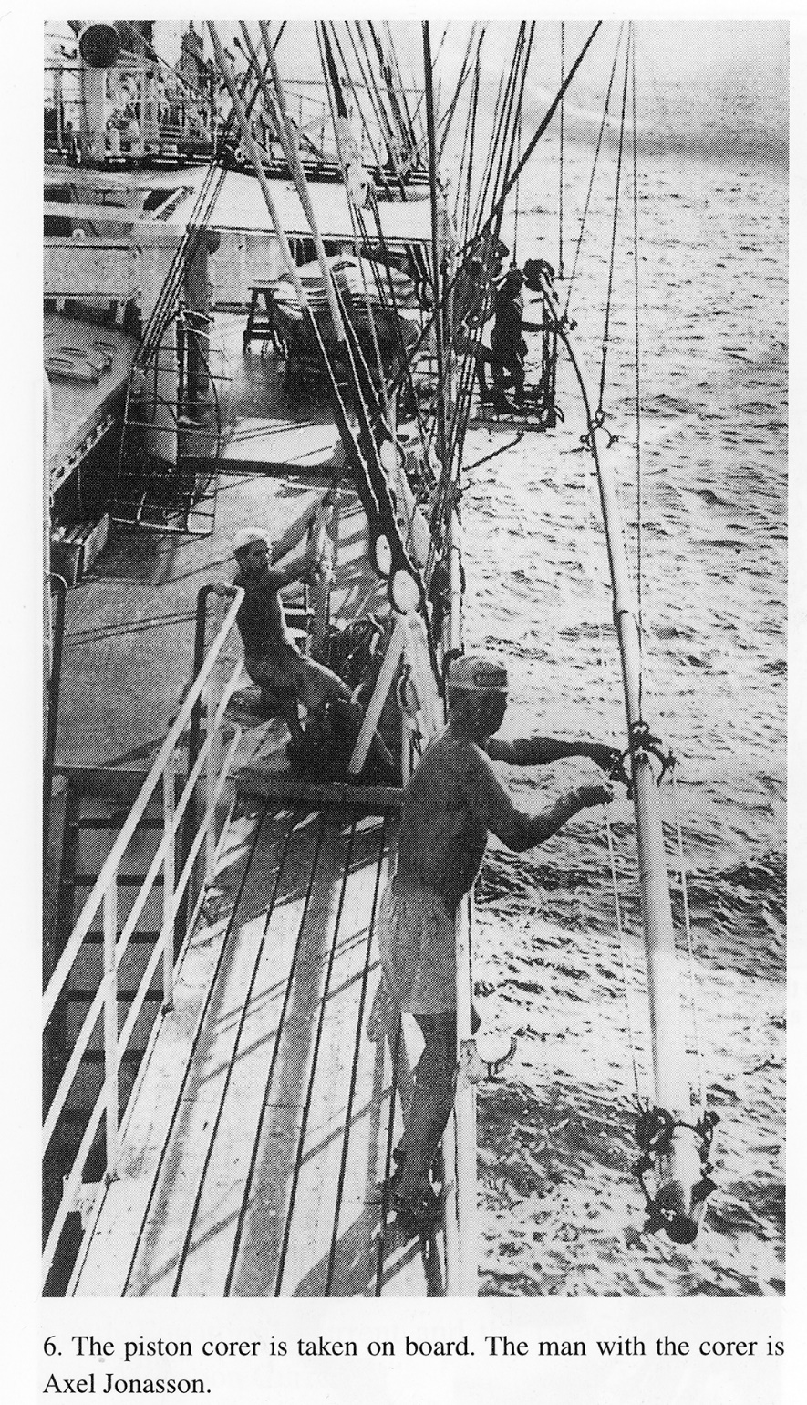
The Piston corer
This sediment coring device was developed by Dr. Börje Kullenberg in cooperation with engineer Axel Jonasson (with the corer, in front on photo)

Slide 7
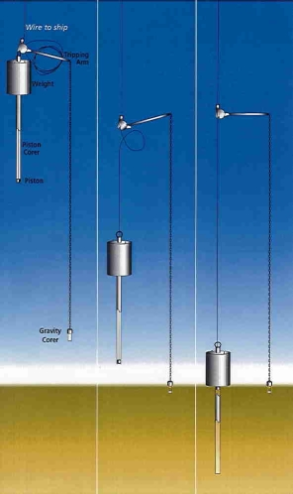
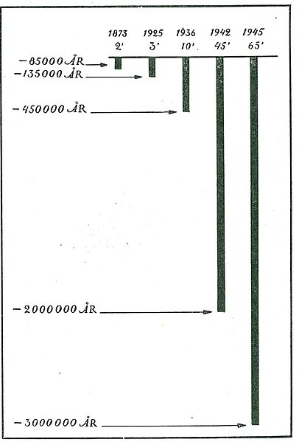
Piston coring mechanism significantly increasing the length of sediment cores

Slide 8
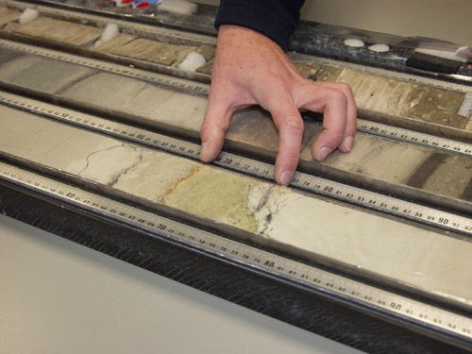
Sediment cores

Slide 9
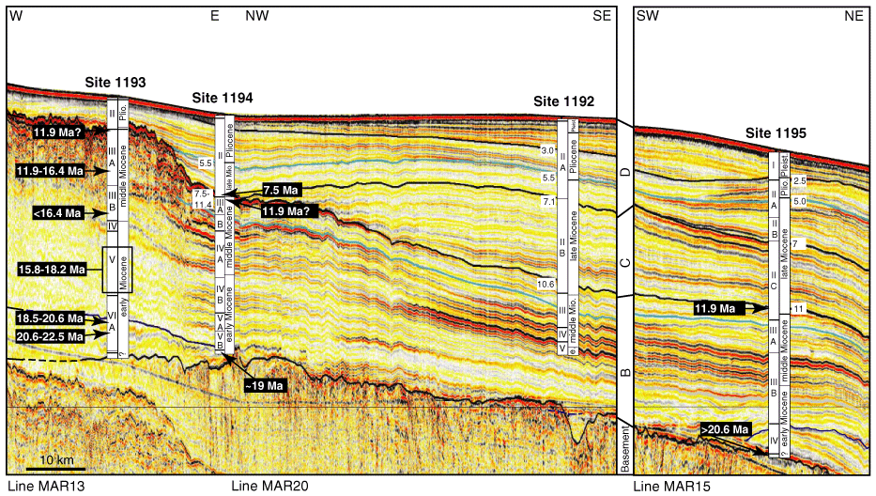
Biostratigraphy

Slide 10
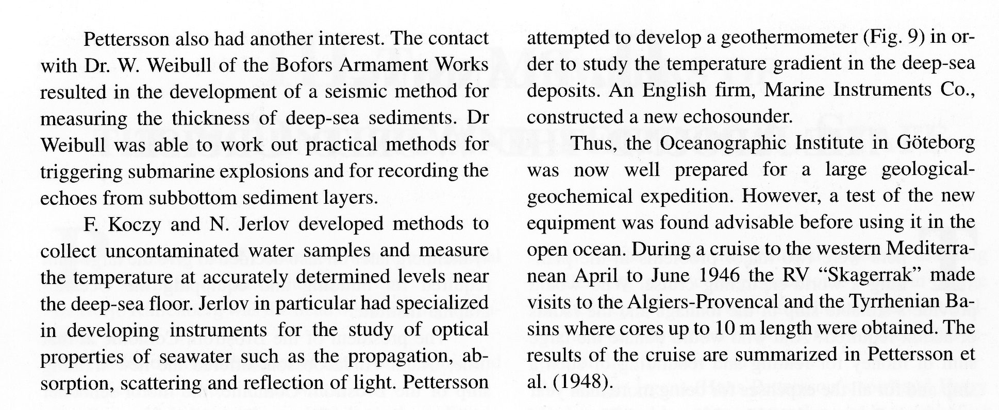
Apart from the retrieval of long sediment cores, a seismic method using explosives was developed and various new oceanographic (water properties) measurements were introduced

Slide 11
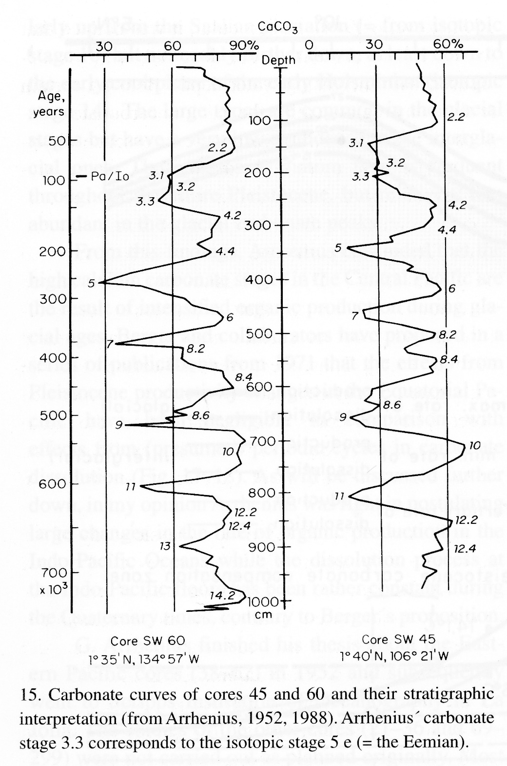
Carbonate curves of Albatross cores 45 (the East Pacific Ridge) and 60 (the East Central Pacific Basin)
with stratigraphic interpretation

Slide 12
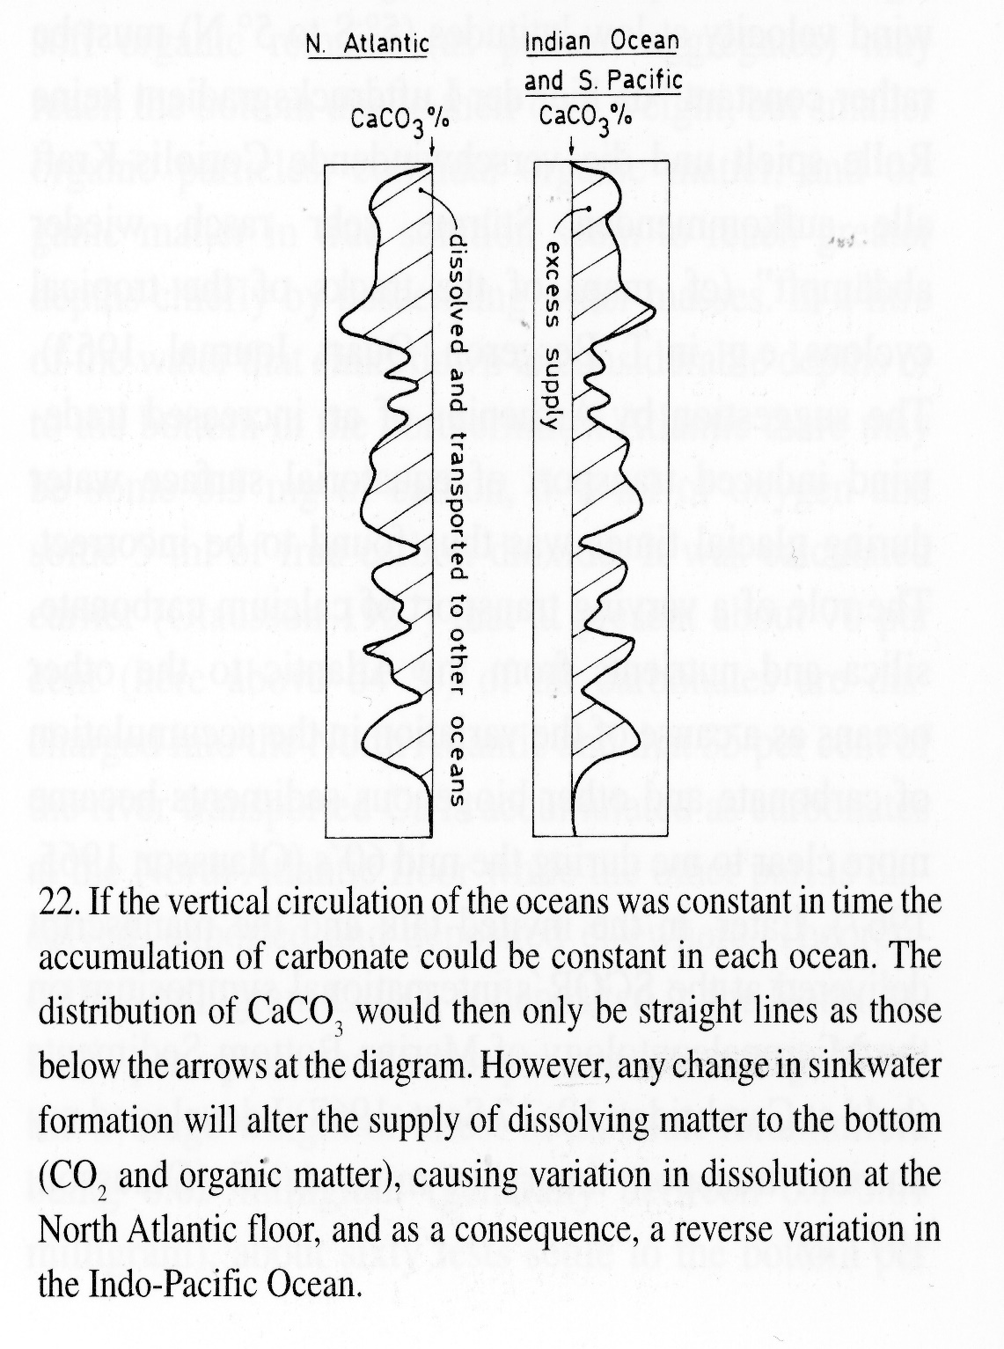
During the Albatross expedition, it was discovered that the CaCO3 content varied between the world's oceans, e.g. Arrhenius, 1952; Olausson, 1972.

Slide 13
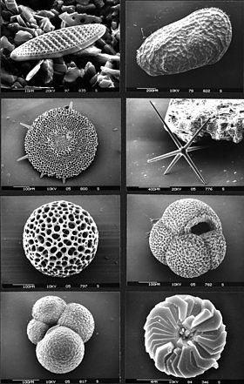
Micropaleontology
–important tool within Marine Geology

Slide 14
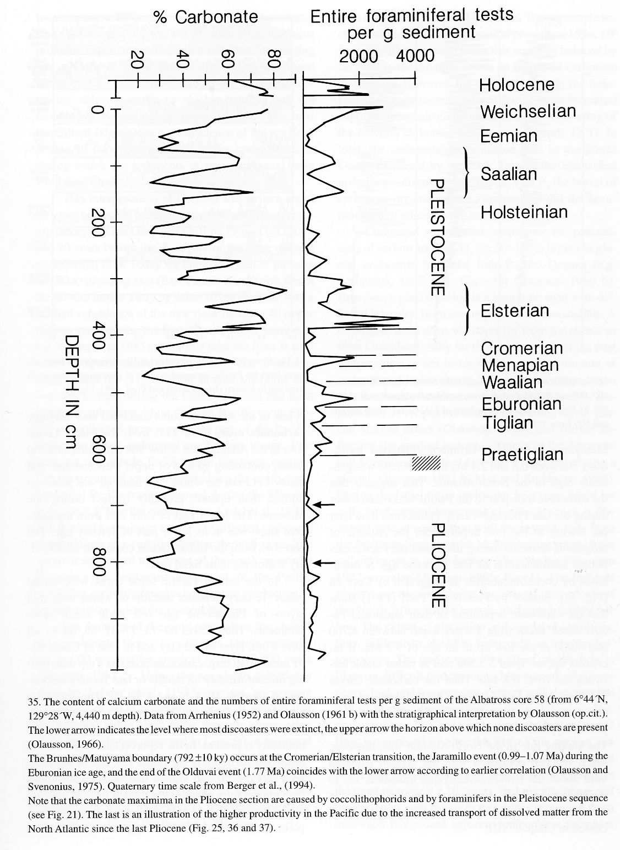
New developments in marine geoscience
The content of calcium carbonate and the numbers of entire foraminiferal tests per g sediment of the Albatross core 58 (Pacific Ocean) 4 400 m depth

Slide 15
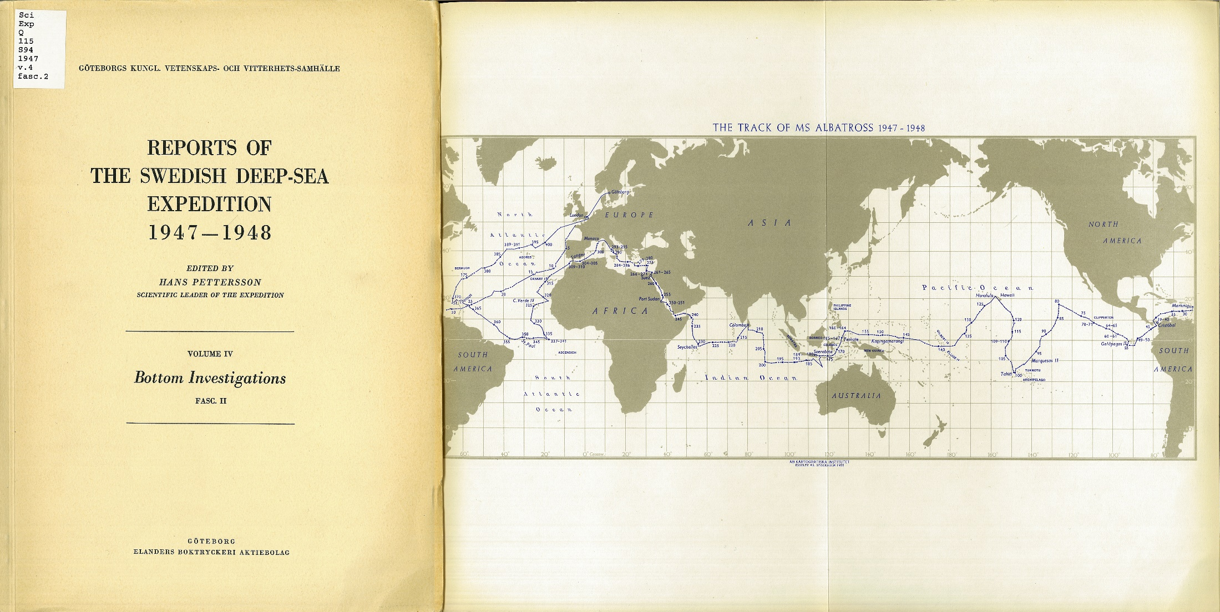
Example from the Report series published after the Expedition

Slide 16
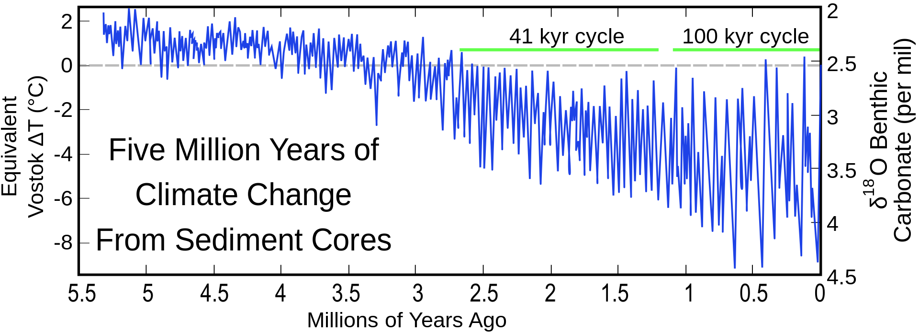
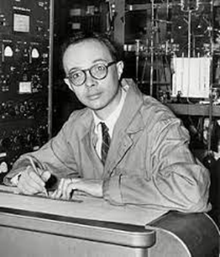
Cesare Emiliani (1922-1995)

Slide 17
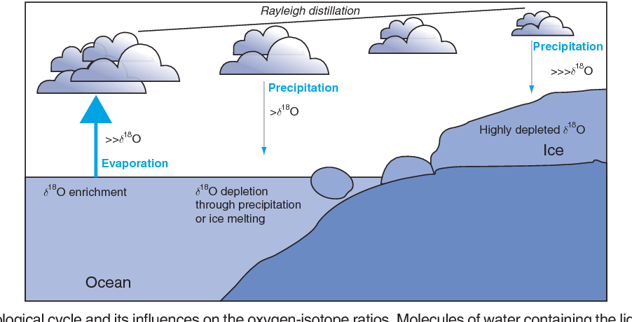

Introduction stable isotope analyses, Emiliani
paleoceanography , a new science born

Slide 18
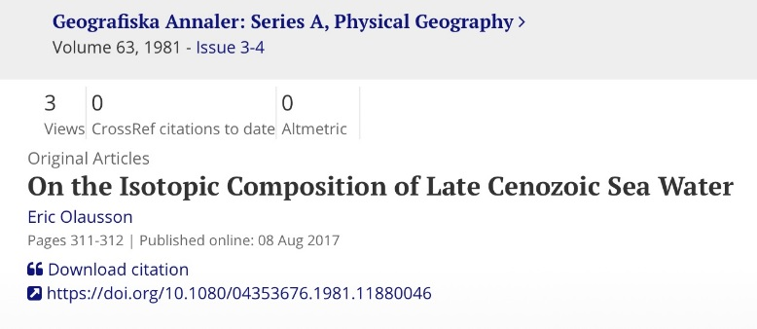
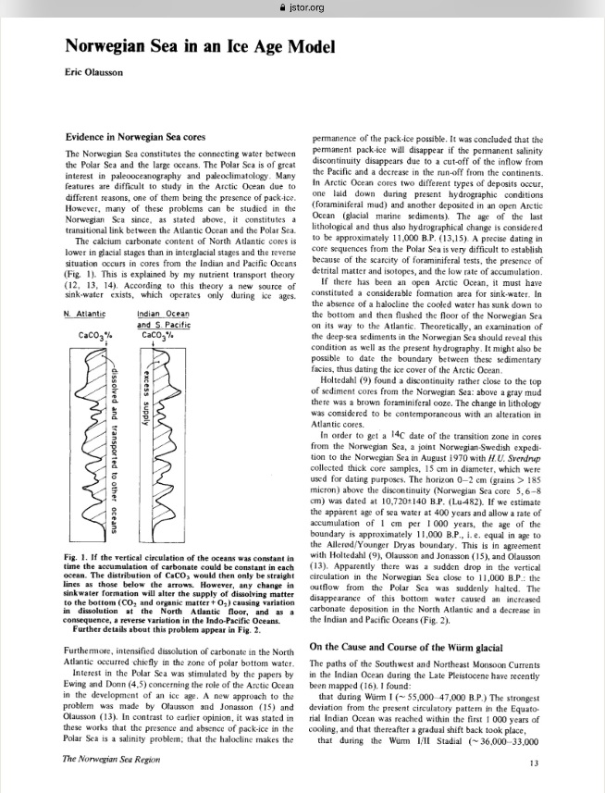
Eric Olausson,
University of Gothenburg
Studied Albatross cores between the 1960’s and 1980’s
Found arguments for a pattern of global ocean water mass exchange and a (partly) open Arctic during the Last Glacial Maximum – later in broader context confirmed

Slide 19
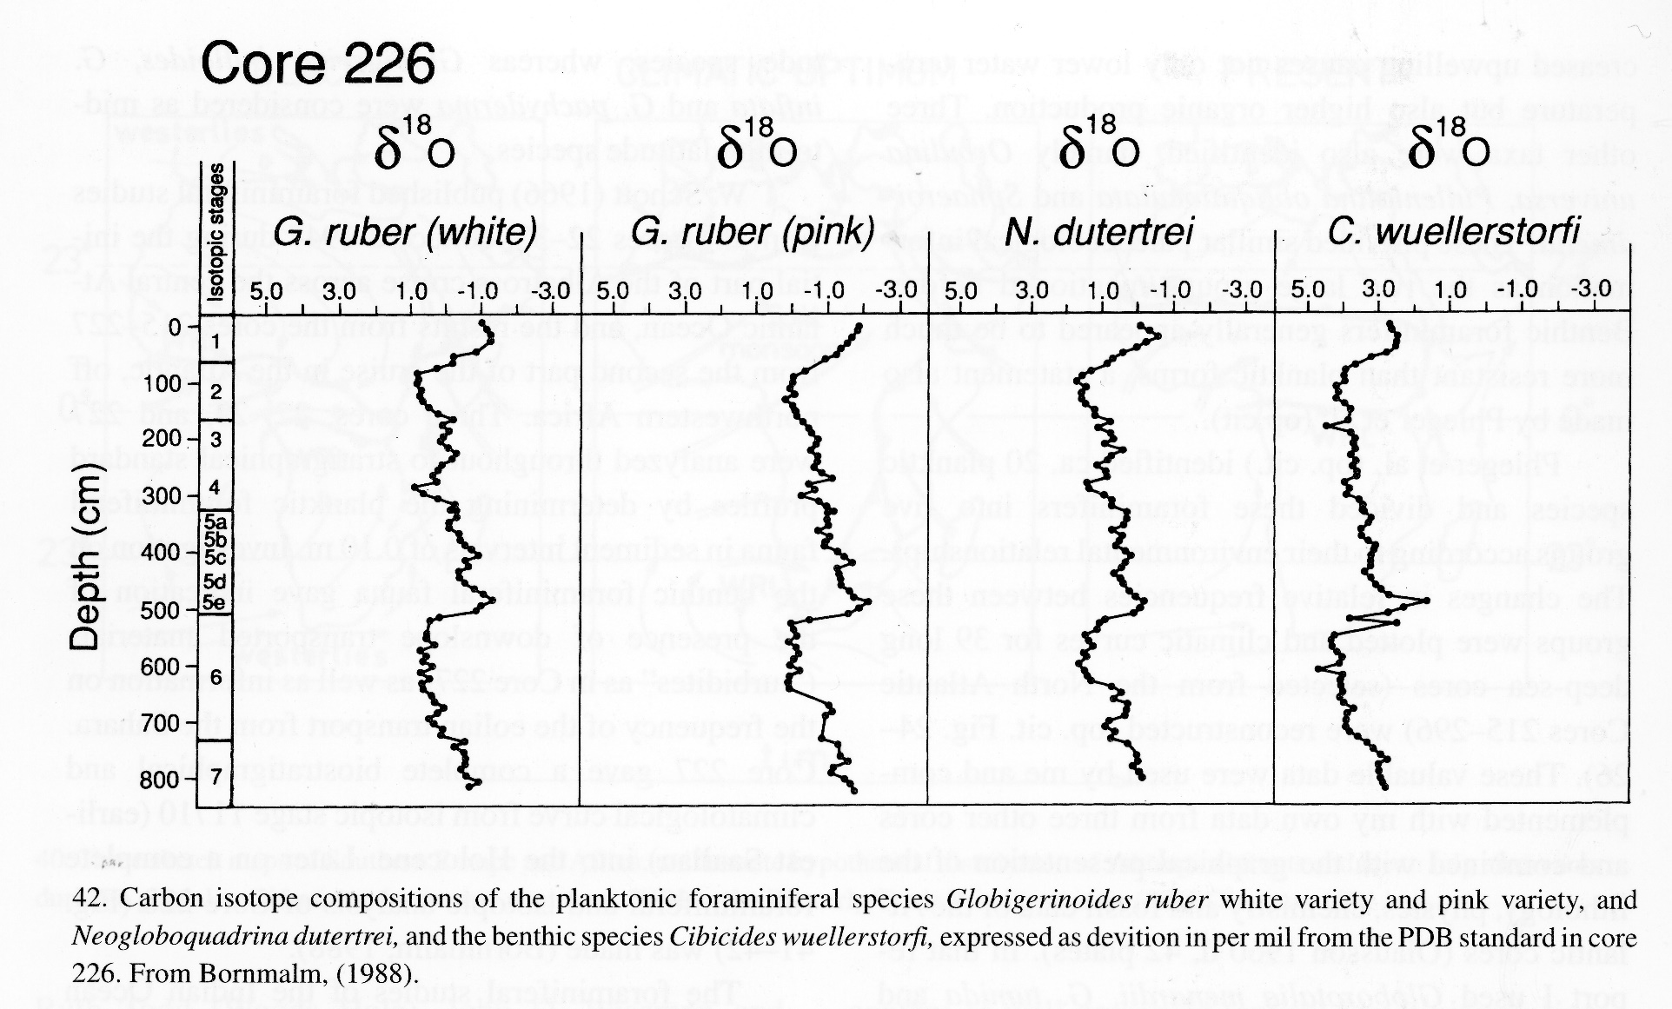

Slide 20
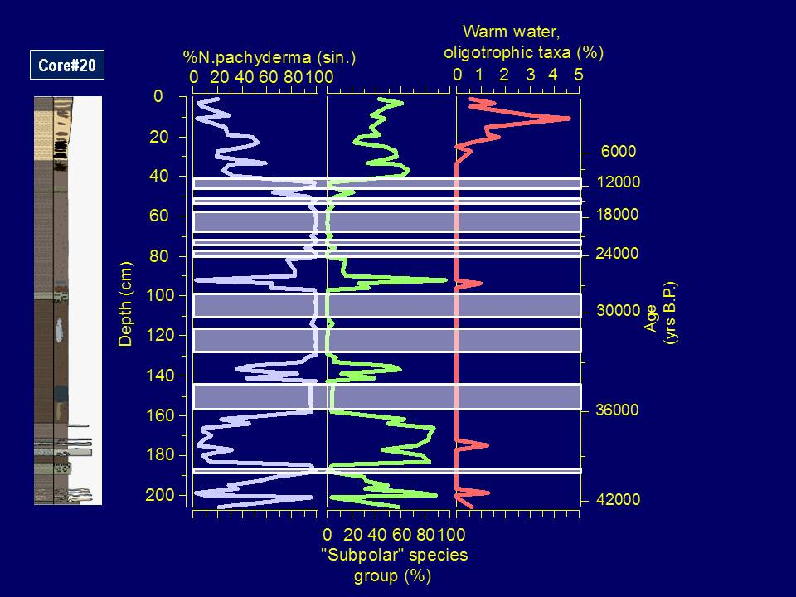

Slide 21
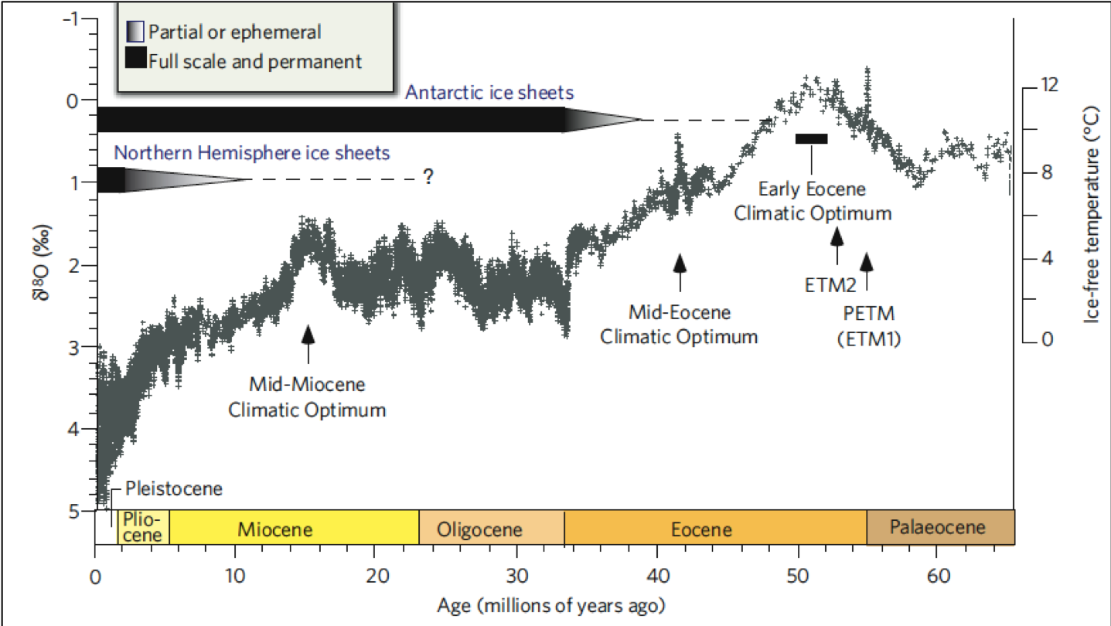
Climate development based on d18O, Zachos et al., 2008.

Slide 22
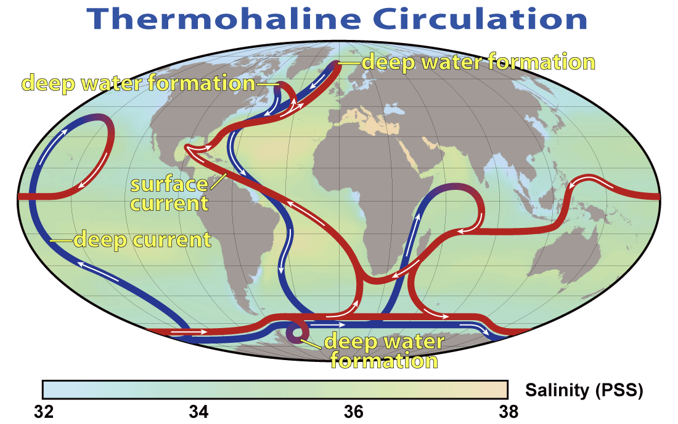

Slide 24
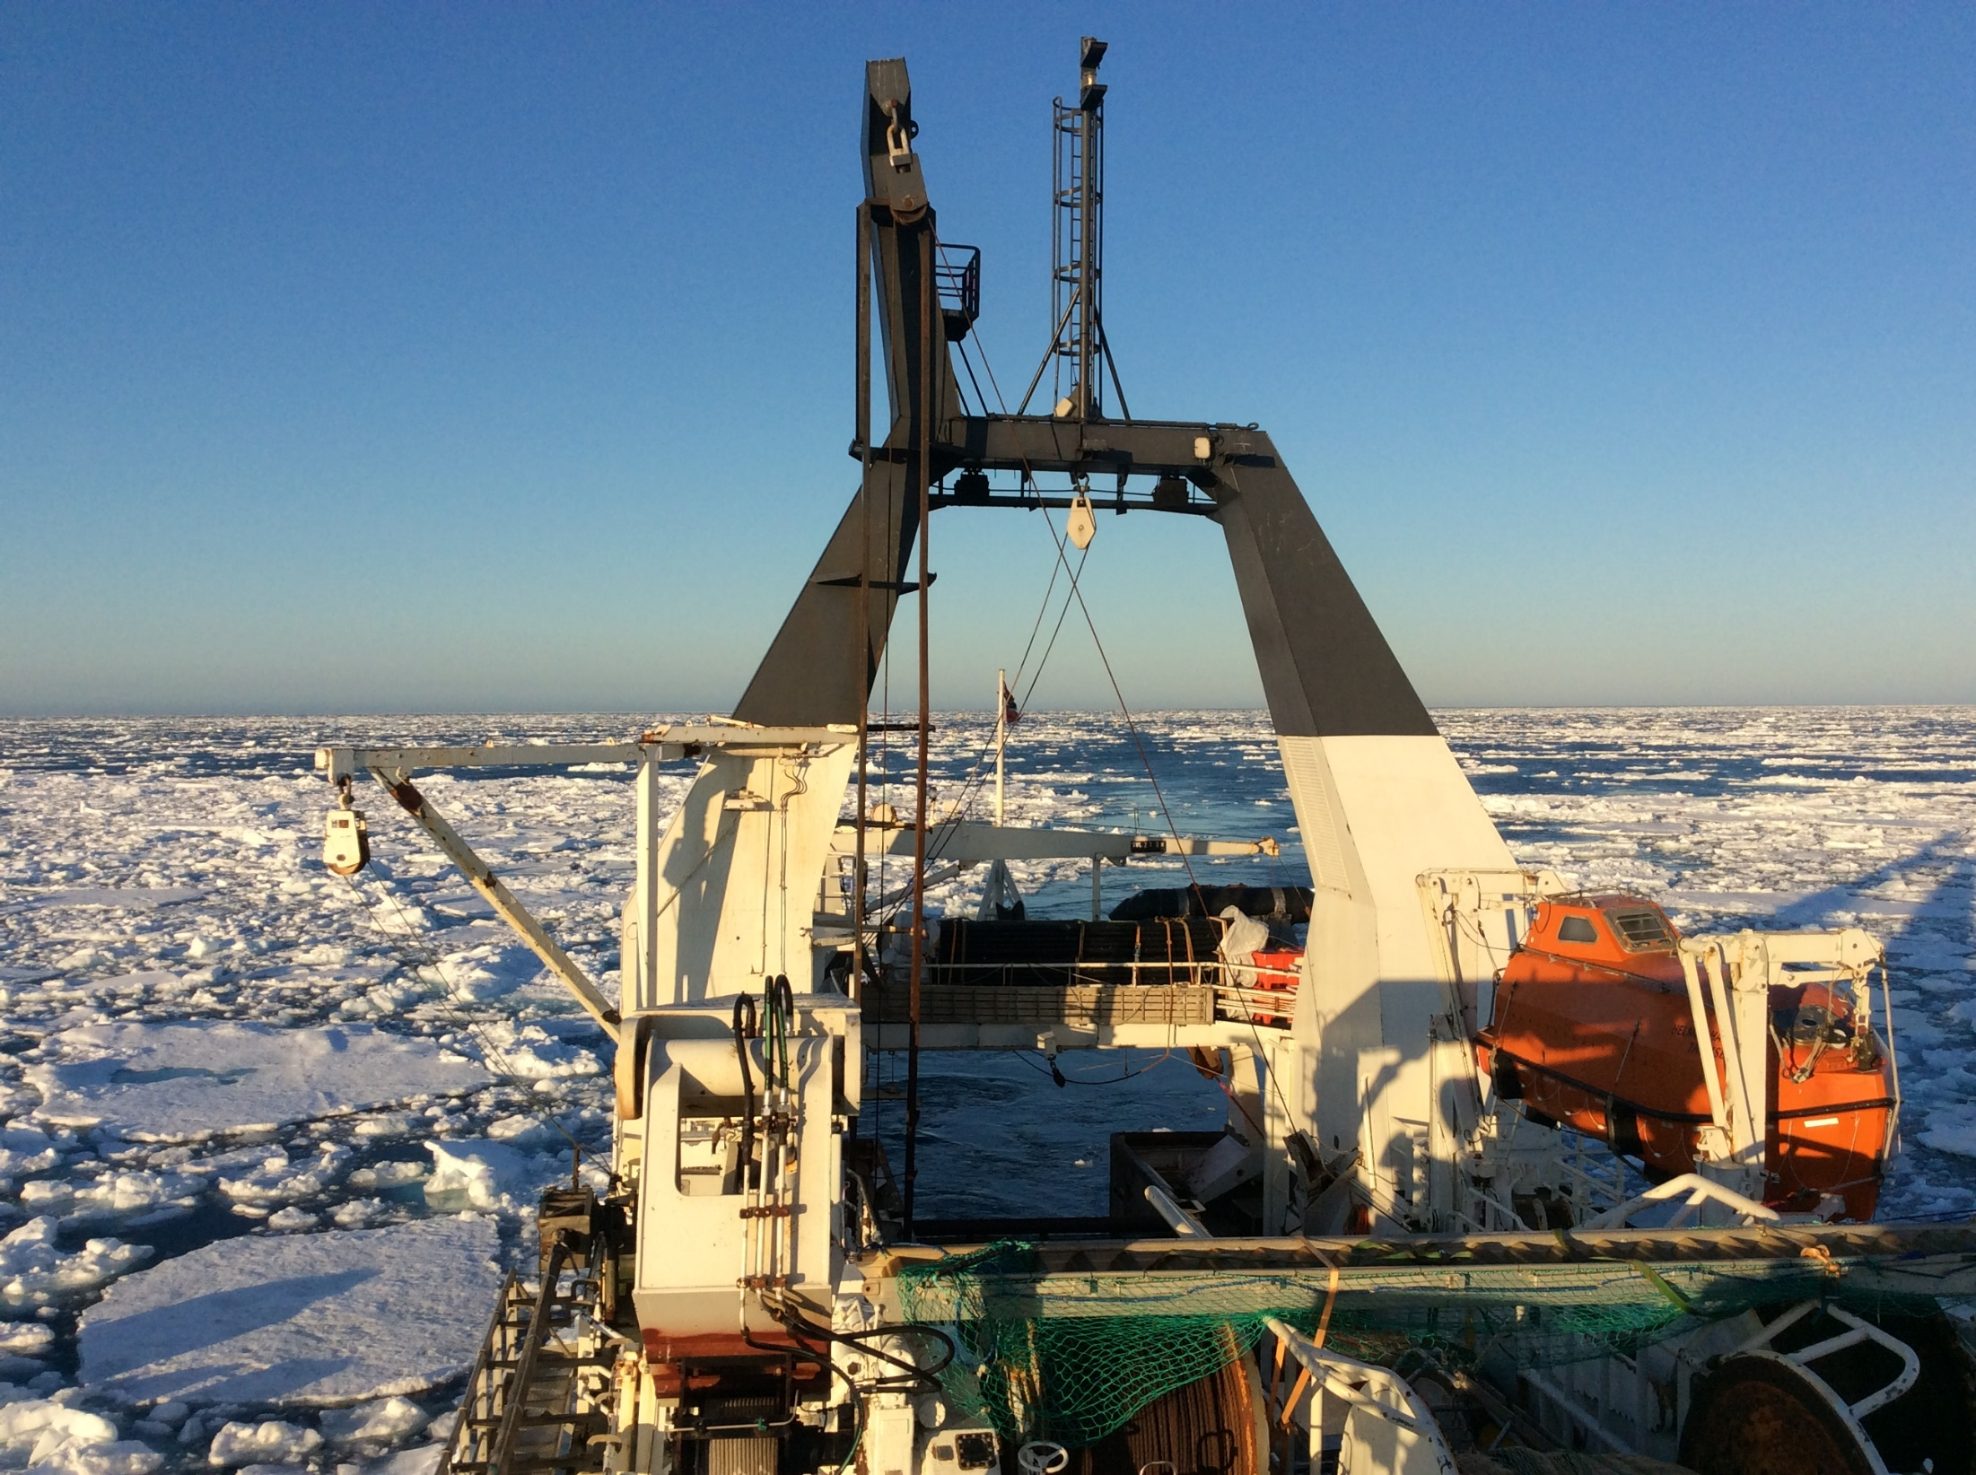
Thanks for your
attention
Link to Albatross document https://sverigesradio.se, Albatrossexpeditionen

