Slide 1
Nonlinear Scattering of Relativistic Electrons by Oblique EMIC Waves
DOI: 10.3389/fspas.2023.1163515
12:15–12:25|EGU23-17286
Miroslav Hanzelka^{1,2}, Wen Li¹, Qianli Ma^{1,3}, Luisa Capannolo¹

Slide 2
Motivation – ELFIN Observations
ELFIN statistics (~400 km altitude)
Broad aim: How does electron scattering by EMICs depend on wave parameters $B_{w}$ (amplitude) and $θ_{k}$ (wave normal angle)?
Questions:
How does force bunching (=“anomalous” trapping) affect the scattering into the loss cone?
How does the scattering/precipitation pattern change at higher wave normal angles?
How efficient is the precipitation of counter-streaming electrons compared to the co-streaming?
→ Test-particle study
2019-2022, 144 EMIC-driven events

Slide 3
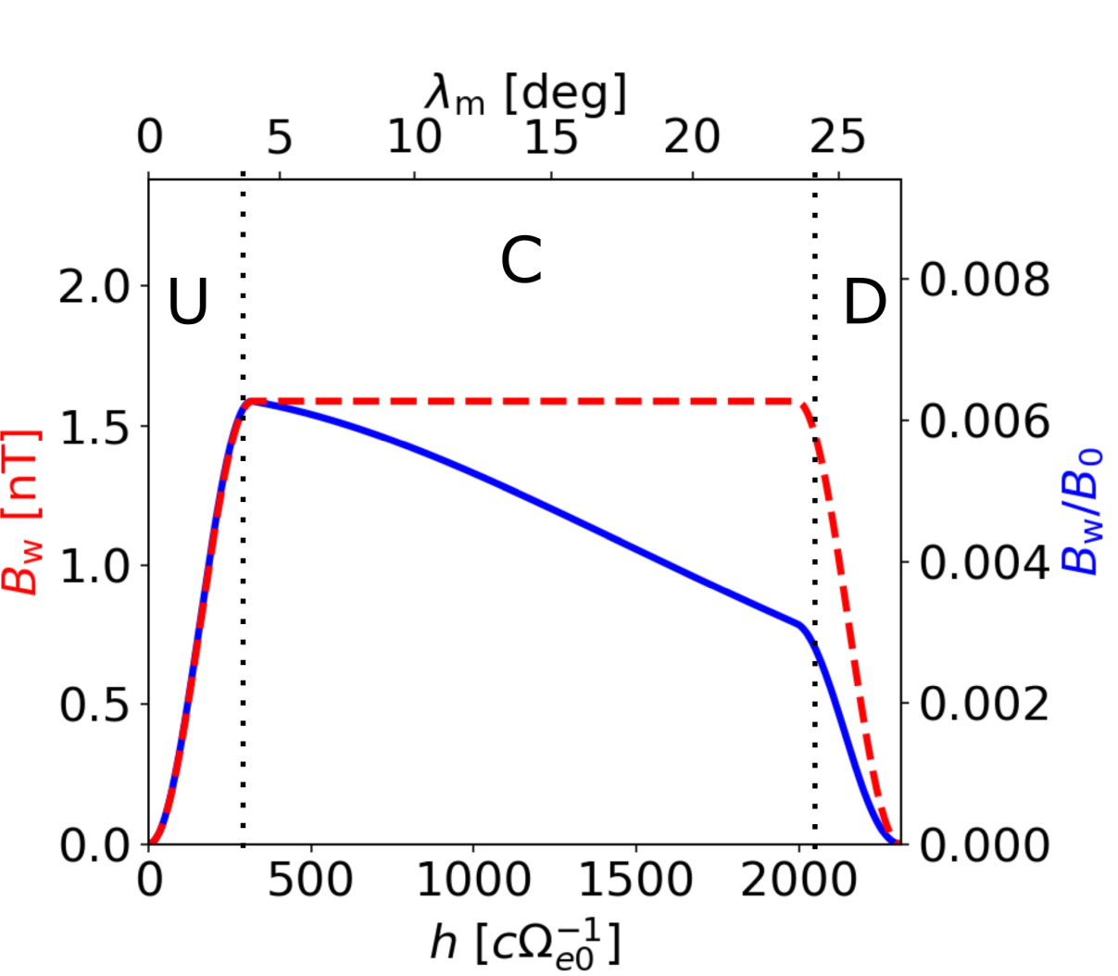
Method and Input Parameters
Forward-in-time test-particle simulation → analyze advection and diffusion
Backward-in-time test-particle simulation → analyze perturbed PSD
Wave amplitude model:
Input:
Helium band EMIC
Wave frequency $ω={0.8 Ω}_{He0}∼0.76 Hz$
Plasma frequency $ω_{pe0}=15 Ω_{e0}$
Electron kinetic energy 900 keV – 30 MeV
Minimum resonance energy:
$$E_{Rmin}≈mc^{2}\left(\sqrt{1+\frac{n^{2}Ω_{e}^{2}}{k_{∥}^{2}c^{2}}}−1\right)$$
~ 2.9 MeV for parallel waves at the equator

Slide 4
Trajectory Examples
Force bunching
Trapping + bunching + diffusion
Multiresonance diffusion
$θ_{k}={45}^{∘}$, $B_{w}=1.6 nT$

Slide 5
Advection and Diffusion – Quasi-parallel
Propagation along the wave
$${B_{w}}/{B_{0eq}}=0.16 \%$$
$${B_{w}}/{B_{0eq}}=2.56 \%$$
$${\left\langle Δα_{eq}\right\rangle }_{φ}=\frac{1}{N_{φ}}\sum_{1}^{N_{φ}}{(α_{eq}(t_{mirror})}−α_{eq}(0))$$
$σ_{φ}\left(α_{eq}\right)$ …. Standard deviation
Force bunching → motion away from loss cone
Phase-trapping and diffusion → scattering into the loss cone
Equatorial loss cone angle = 3.6 deg

Slide 6
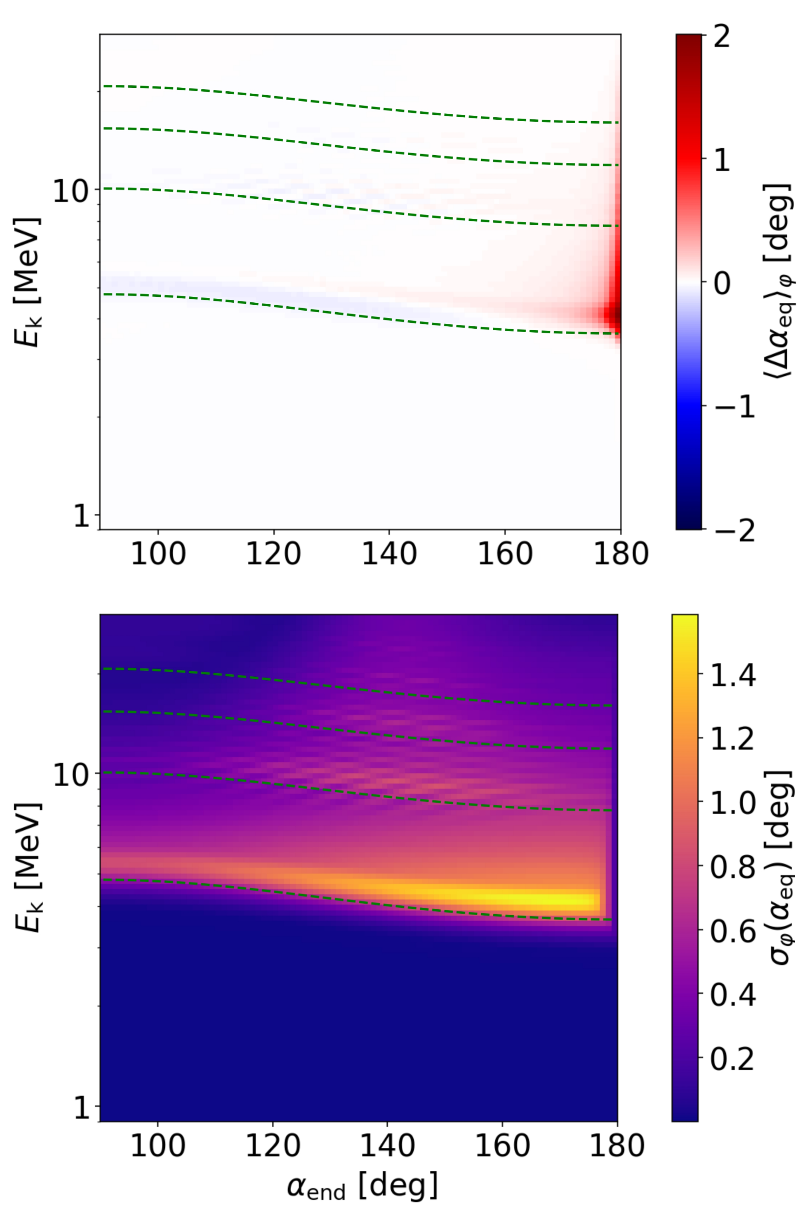
Advection and Diffusion – Oblique
Propagation along the wave
Propagation against the wave
$$θ_{k}={45}^{∘}$$
$$θ_{k}={70}^{∘}$$
$$θ_{k}={70}^{∘}$$
$${B_{w}}/{B_{0eq}}=0.16 \%$$

Slide 7
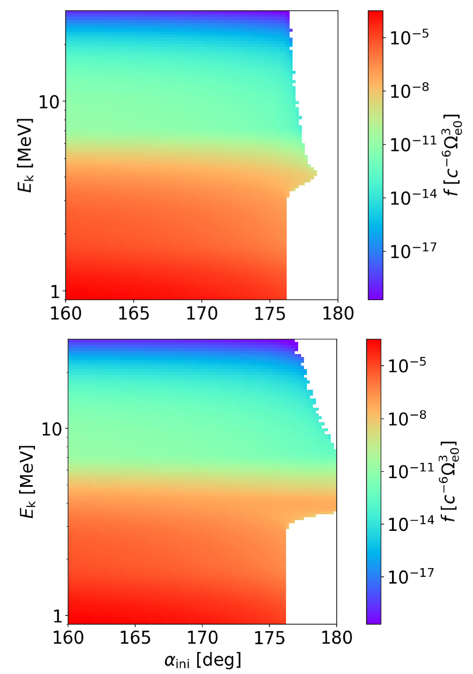
Perturbed PSD
Propagation along the wave
Propagation against the wave
$$θ_{k}=5^{∘}$$
$$θ_{k}={70}^{∘}$$
$$θ_{k}={70}^{∘}$$
$${B_{w}}/{B_{0eq}}=0.16 \%$$
$${B_{w}}/{B_{0eq}}=0.64 \%$$
LCA = 6.1 deg
LCA = 3.7 deg

Slide 8
Summary and Future Directions
Summary:
Higher order resonances can affect trajectories even when $θ_{k}$ is small
Advection can dominate over diffusion in certain regions of the $(α,E_{k})$ space
Scattering of electrons propagating against oblique EMICs is significant
Very oblique EMIC waves are not efficient in scattering electrons at high pitch angles
Force bunching and advection of particles in the loss cone is compensated by diffusion from higher pitch-angle regions
Future:
What is the long-term evolution of the electrons PSD (multiple bounces)?
How do force bunching effects caused by chorus waves and EMIC waves compare?
For more details, see https://doi.org/10.3389/fspas.2023.1163515

