Slide 1
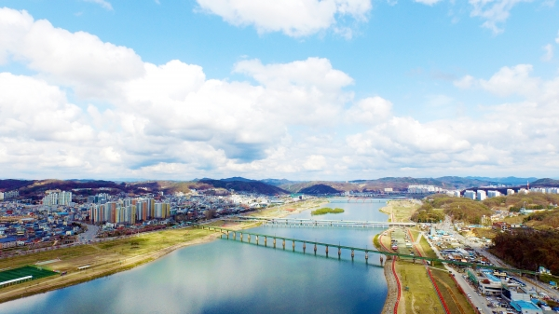
Simulation of long-term rainfall runoff using LSTM(Long Short-Term Memory) networks ;case of Samcheok Osipcheon basin in South Korea
An Sung Uk1), Choi Seung Cheol 2) , Kim Byng Sik3)
1). Master’s Student, Department of Urban Environmental and Disaster Management, Kangwon National University (E-mail:aso750@kangwon.ac.kr)
2). Researcher, AI for Climate & Disaster Management Center (E-mail : tmdak781@kangwon.ac.kr)
3). Corresponding Author. Professor, Department of Urban Environmental and Disaster Management,
Kangwon National University (E-mail: hydrokbs@kangwon.ac.kr)

Slide 2
Table of Contents
Introduction 1.1 Research Background and Purpose 1.2 Research Trends
Theory and methodology 2.1 LSTM(Long Short – Term Memory) 2.2 Flowchart
Application and Analysis 3.1 Current status of the target basin 3.2 LSTM Model Learning and Results 3.3 LSTM – MLP Ensemble Model Learning and Results
Conclusion

Slide 3
Introduction 1.1 Research Background and Purpose 1.2 Research Trends

Slide 4
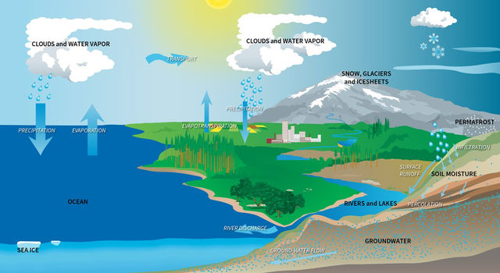
1. Introduction
1.1 Research Background and Purpose
Long-term data rainfall, runoff, and evaporation time series are required in the basin for water resource management
In this study, several input data groups were learned from the LSTM model to select the optimal model and ensemble with MLP (Multi Layer Perceptron) to simulate the runoff of the Samcheok Osipcheon basin in south korea, respectively
< Physical rainfall-runoff models >
TANK, TOP-Model, SWAT etc.
< Artificial Intelligence >
LSTM, RNN, CNN etc.

Slide 5
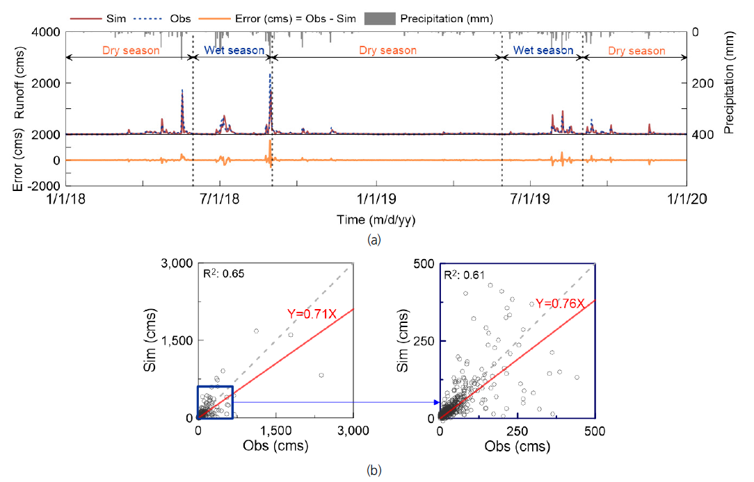
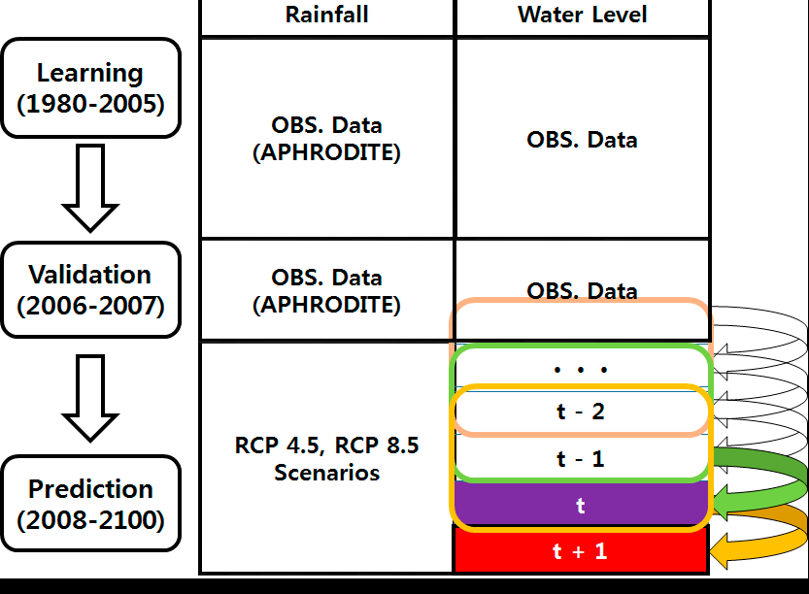
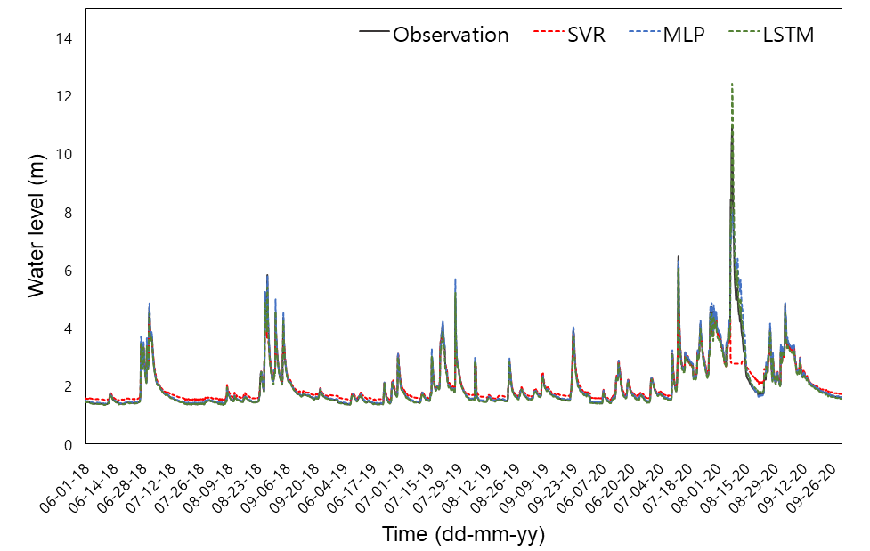
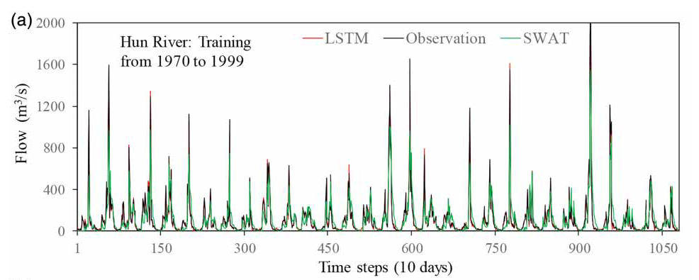
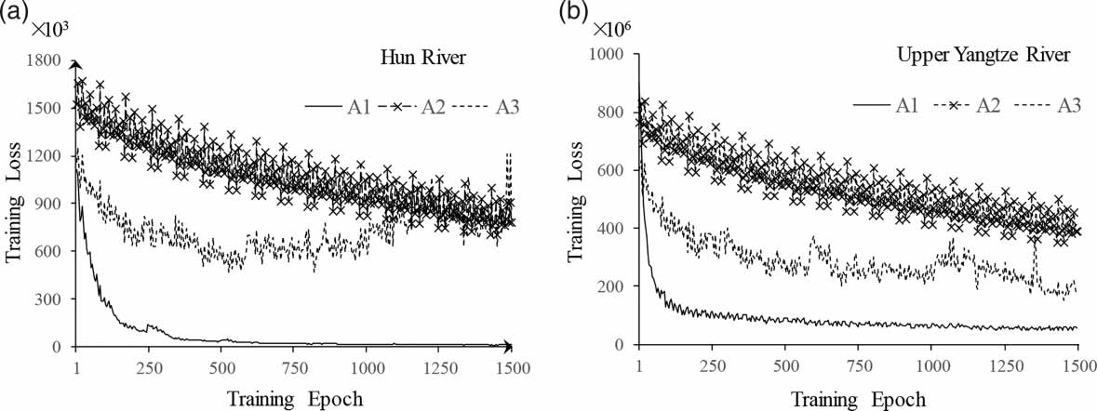
1. Introduction
1.2 Research Trends
Studies are being conducted to predict dam inflows and water levels using deep learning techniques
Results of previous domestic and international studies
Key Contents
마스터 텍스트 스타일을 편집합니다
둘째 수준
셋째 수준
넷째 수준
다섯째 수준
Prediction of Dam Flow Using LSTM
Analysis of future leakage using LSTM
Analysis of future runoff of Mekong River basin under climate change scenario using deep learning and presentation of utilization
<Conceptual diagram of outflow analysis using LSTM>
Han Hee-chan et al. (2021) predicted the inflow of the Soyang River dam using LSTM and showed high accuracy compared to the actual measurement
Jeong Jae-won et al. (2021) predicted the water level of the Seomjingang River 1, 3, and 6 hours ahead of time using LSTM, found to be underestimated, and suggested limitations and improvement measures
Lee et al. (2020) analyzed the future runoff of the Mekong River basin using LSTM and verified the usability of deep learning techniques
Xu et al. (2020)은 LSTM을 이용하여 중국 양쯔강 및 훈강을 대상으로 유출량을 예측함
Prediction of inflow of Soyanggang Dam using Deep Learning Model (LSTM-s2s)
High accuracy for dam inflow prediction
<Results of Dam Inflow Prediction Using LSTM>
※ Han et al (2021)
※ Lee et al. (2020)
Prediction of flood level using LSTM
Estimation of River Flow Using LSTM
Using the Deep Learning Model (LSTM), the river water level is predicted 1, 3, and 6 hours ahead, and the prediction accuracy is compared and analyzed according to the prior prediction time
<Results of water level prediction using deep learning techniques>
Excellent performance is confirmed by predicting runoff volume in China's Yangtze and Hun River basins
<Runoff Forecast Results>
※ Jung et al (2021)
※ Xu et al. (2020)

Slide 6
2. Theory and methodology 2.1 LSTM(Long Short – Term Memory) 2.2 Flowchart

Slide 7
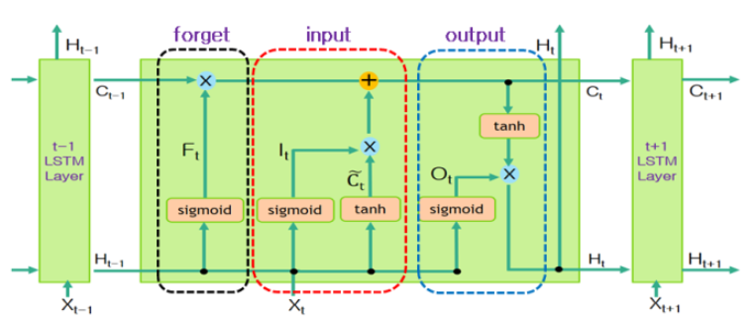
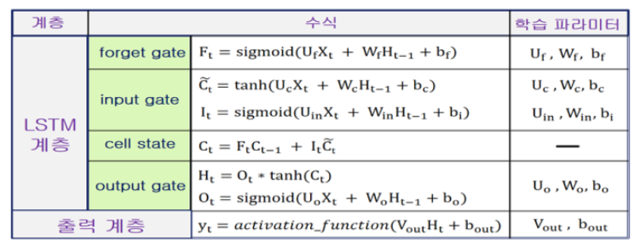
2. Theory and methodology
2.1 LSTM (Long Short-Term Memory)
LSTM (Long-term Short-Term Memory) model is used to improve the long-term dependency problem of RNN

Slide 8
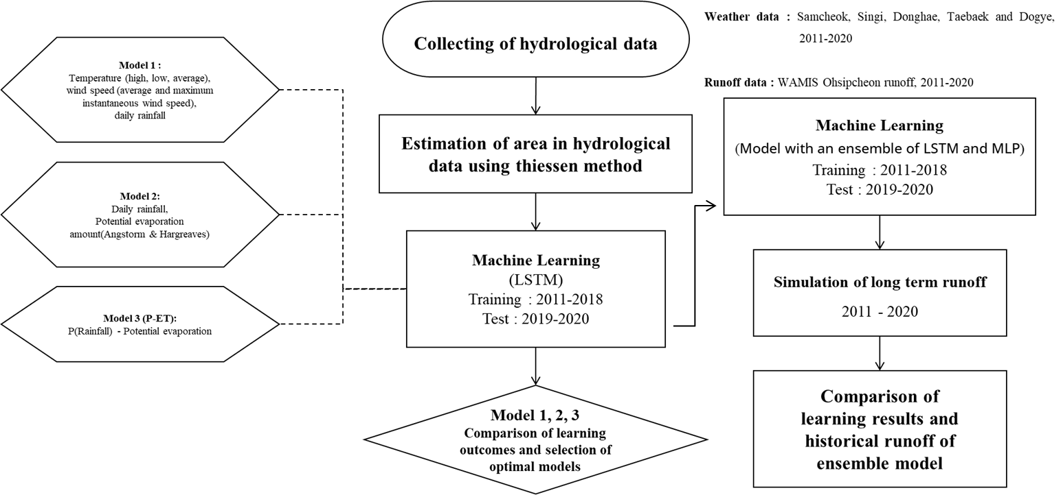
2. Theory and methodology
2.2 Flowchart

Slide 9
3. Application and Analysis 3.1 Current status of the target basin 3.2 LSTM Model Learning and Results 3.3 LSTM – MLP Ensemble Model Learning and Results

Slide 10
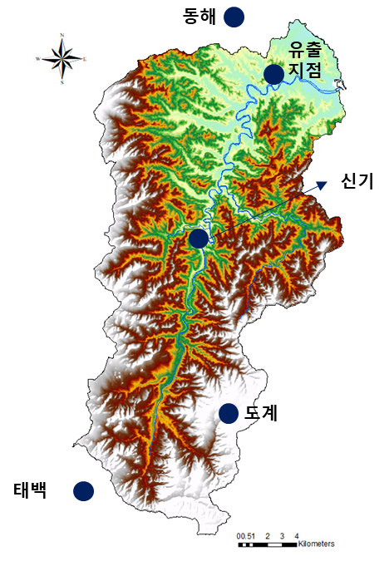
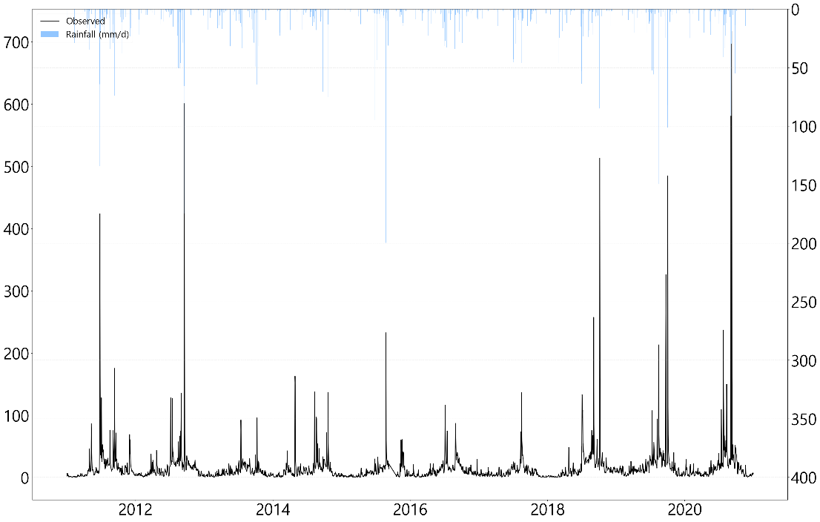
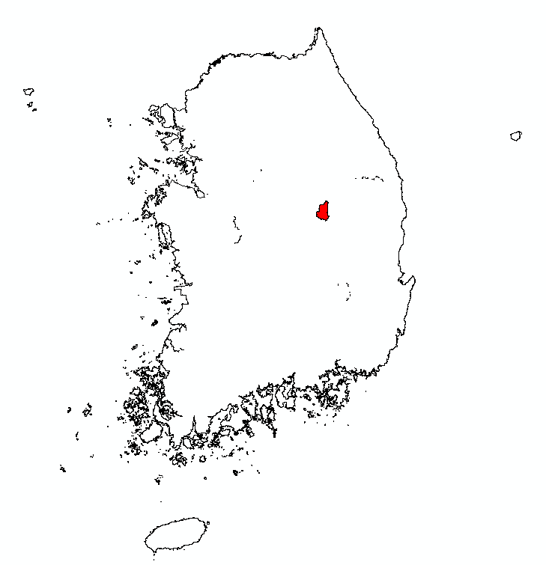
3. Application and Analysis
3.1 Current status of the target basin
Daily weather station data from 2011 to 2020 are collected at five weather stations in ASOS (Donghae, Taebaek) and AWS (Samcheok, Singi, and Dogye) and WAMIS collects daily runoff data from the estuary of Samcheok Osipcheon during the same period
Estimation of potential evaporation using Angstrom & Hargreaves formula collecting of weather data based on the area ratio of Thiessen based on 5 observatories
대상 유역 현황도
유량 관측 자료 시계열(2011-2020)
Discharge ($m^{3}/s$)
Train
Rainfall ($mm$)
Test
2011 - 2018
2019 - 2020
○ Basin area: 350.16${ km}^{2}$
Time(day)
※ AWS : Automatic Weather Station, ASOS : Automated Synoptic Observing System, WAMIS : WAter resources Management Information System

Slide 11
3. Application and Analysis
3.2 LSTM Model Learning and Results
Six weather observation elements, PET (daily rainfall, potential evaporation), and P-ET (daily rainfall – potential evaporation) are used as input data for each of the three LSTM models to compare the results after learning to select the optimal model
Simulating the amount of outflow after ensemble with MLP (Multi Layer Perceptron) with the same input as the selected model's input
Model 1
Model 2
Model 3
P : Daily rainfall(mm)
Tmax : The highest temperature(°C)
Wmax : The highest temperature(°C)
Tmin : The lowest temperature(°C),
Wmean : Average wind speed(m/s),
Tmean : The average temperature(°C)
P, ET
P : Daily rainfall(mm)
ET : Potential evaporation amount (H a r g r e a v e s & A n g s t o r m)
P - ET
P : Daily rainfall(mm)
ET : Potential evaporation amount (H a r g r e a v e s & A n g s t o r m)

Slide 12
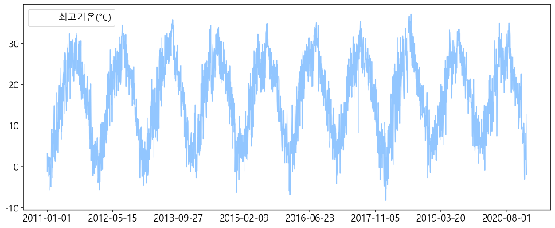
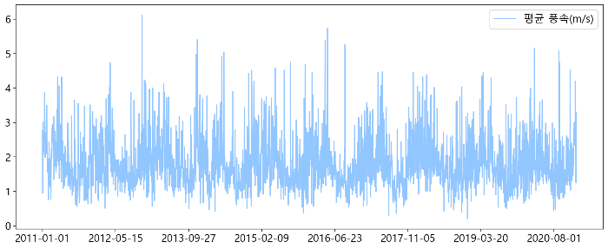
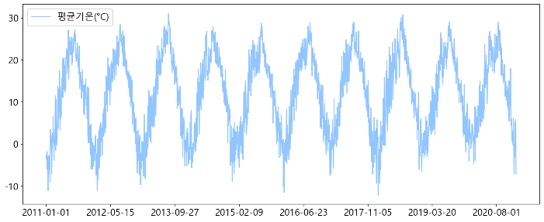
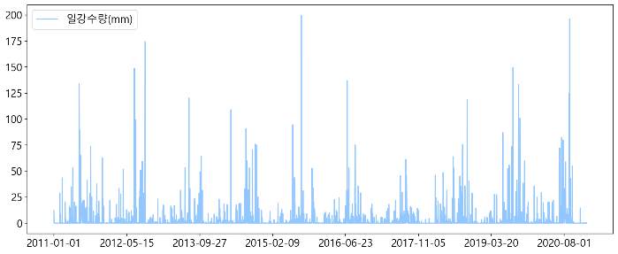
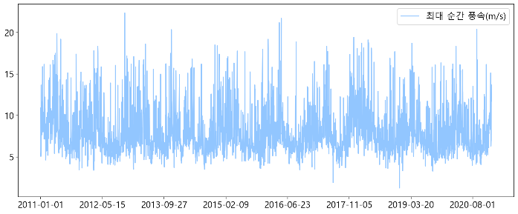
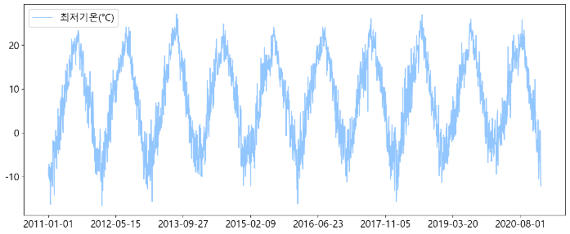
3. Application and Analysis
3.2 LSTM Model Learning and Results
Current Status of Weather Data Time Series Using Thiessen Area Ratio
 | mean | std | min | max | var
Tmax(°C) | 16.93 | 9.55 | -8.14 | 37.23 | 91.38
 | mean | std | min | max | var
Wmean (m/s) | 1.82 | 0.73 | 0.20 | 6.11 | 0.53
 | mean | std | min | max | var
Tmean(°C) | 11.83 | 9.35 | -12.10 | 31.07 | 87.59
 | mean | std | min | max | var
P(mm) | 3.39 | 12.66 | 0 | 199.60 | 160.35
 | mean | std | min | max | var
Wmax(m/s) | 8.17 | 2.86 | 1.24 | 22.35 | 8.22
 | mean | std | min | max | var
Tmin(°C) | 7.43 | 9.56 | -16.56 | 27.05 | 91.55

Slide 13
3. Application and Analysis
3.2 LSTM Model Learning and Results
< ET(Model – 2) >
Evapotranspiration (mm)
Hagreaves & Angstorm formula
 | mean | std | min | max | var
ET (mm/d) | 9.99 | 4.32 | 1.40 | 19.10 | 18.73
Time(day)
< P – ET (Model – 3) >
Precipitation(P) minus Evaporation(ET)
P-ET(mm)
 | mean | std | min | max | var
P-ET | 2.56 | 12.04 | 0 | 196.68 | 144.88
Time(day)

Slide 14
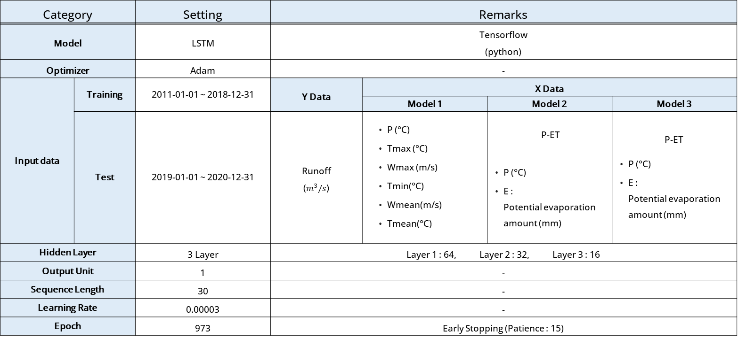
3. Application and Analysis
3.2 LSTM 모델 parameter 설정
Model parameter

Slide 15
3. Application and Analysis
3.2 LSTM Model Learning and Results
Model structures and parameters are empirically set and learned 973 times in total using Early Stopping, which stops learning when there is no change in loss during a period of learning
Input Layer
$$H_{t−1}$$
64, 32, 16
64, 32, 16
64, 32, 16
64, 32, 16
Layer 1
(64)
. . .
$$C_{t−1}$$
. . .
. . .
. . .
Cell state ($C_{t−1})$
$$F_{t}$$
$$I_{t}$$
$$O_{t}$$
Layer 2
(32)
64, 32, 16
forget gate
sigmoid
sigmoid
$$H_{t−1}$$
input gate
tanh
output gate
. . .
sigmoid
Layer 3
(16)
. . .
hidden state ($h_{t−1})$
Tmax
Tmean
Precipitaion
. . .
Evapotranspiration
Output Layer
(1)
Input ($X_{t})$
$$X_{t−1}$$

Slide 16
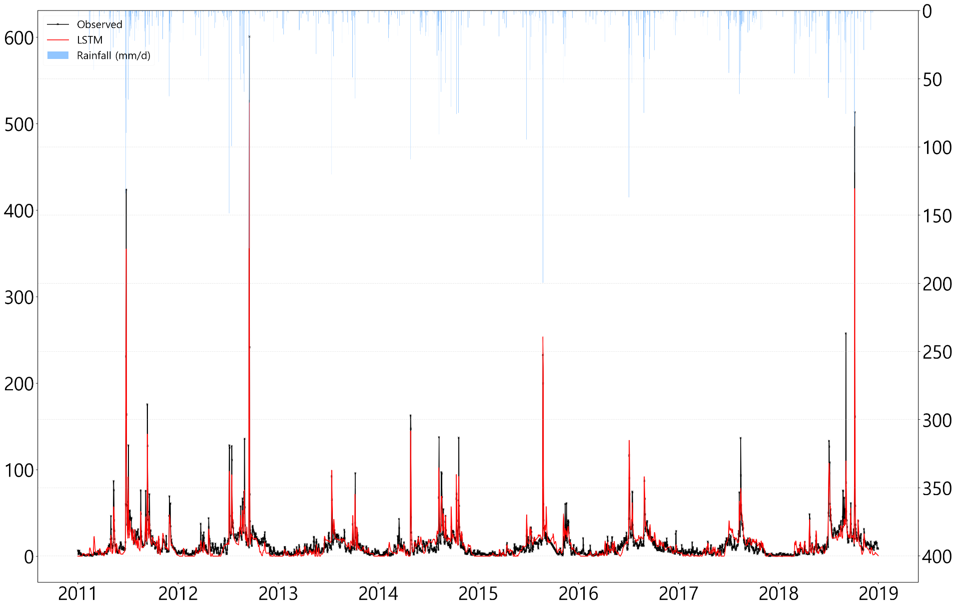
3. Application and Analysis
3.2 LSTM Model Learning and Results (Training) – Model 1
RMSE : 8.89 NSE : 0.87 R2 : 0.87
Discharge ($m^{3}/s$)
Precipitation ($mm$)
Time(day)

Slide 17
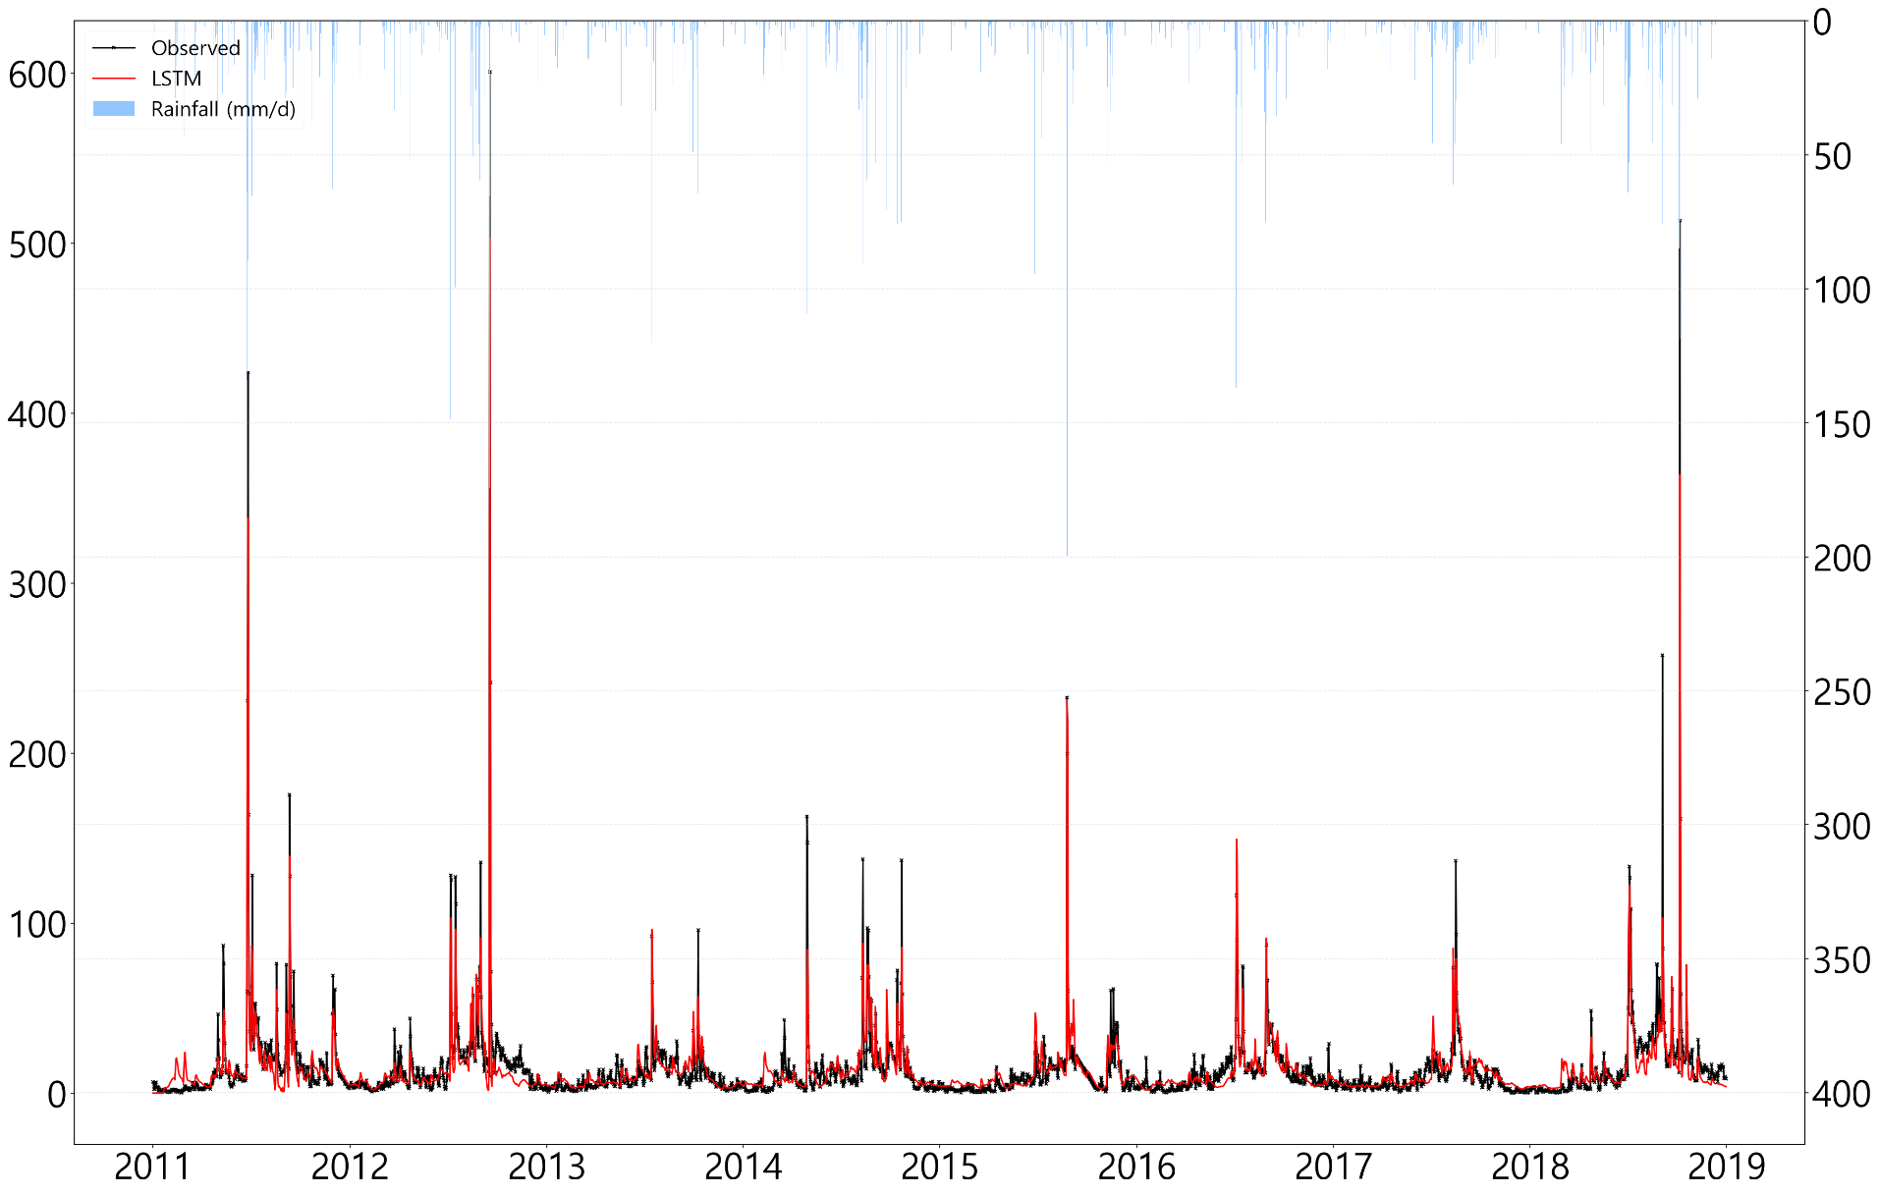
3. Application and Analysis
3.2 LSTM Model Learning and Results (Training) – Model 2
RMSE : 9.72 NSE : 0.84 R2 : 0.85
Discharge ($m^{3}/s$)
Precipitation ($mm$)
Time(day)

Slide 18
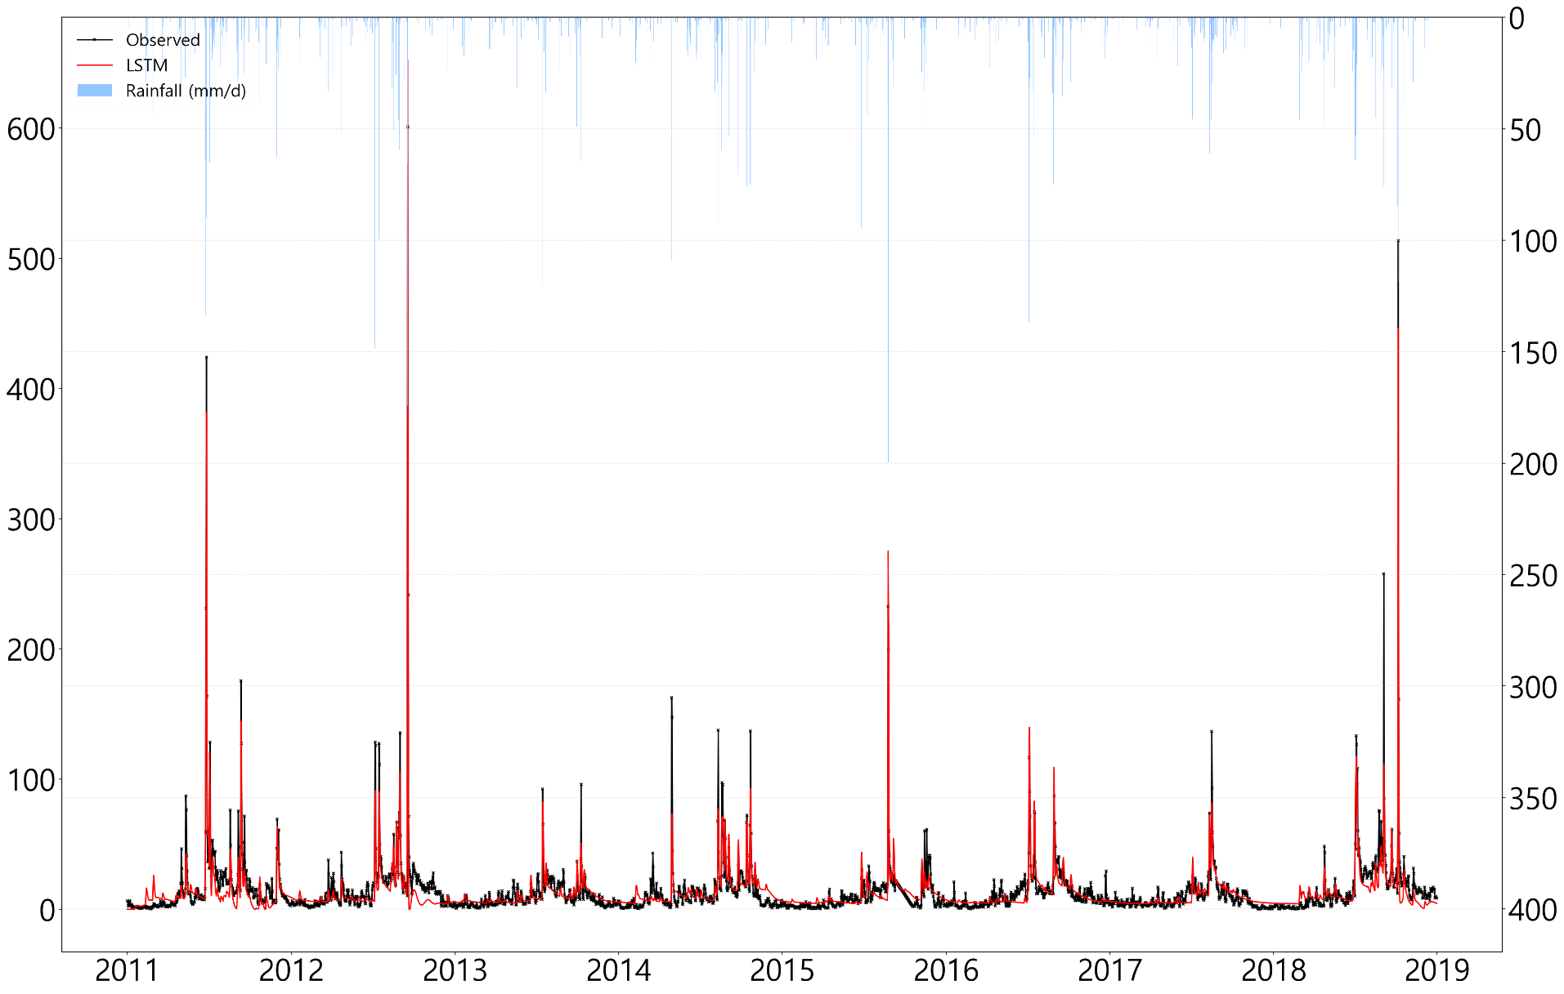
3. Application and Analysis
3.2 LSTM Model Learning and Results (Training) – Model 3
RMSE : 9.28 NSE : 0.86 R2 : 0.86
Discharge ($m^{3}/s$)
Precipitation ($mm$)
Time(day)

Slide 19
3. Application and Analysis
3.2 LSTM Model Learning and Results (Training)
 | Model 1 | Model 2 | Model 3
ME | -0.56 | 0.01 | -0.72
MAE | 5.47 | 5.56 | 5.85
MSE | 79.04 | 94.53 | 86.14
RMSE | 8.89 | 9.72 | 9.28
NRMSE % | 36.2 | 39.6 | 37.8
PBIAS % | -4.1 | 0.1 | -5.3
RSR | 0.36 | 0.4 | 0.38
rSD | 0.92 | 0.85 | 0.92
NSE | 0.87 | 0.84 | 0.86
mNSE | 0.49 | 0.49 | 0.46
rNSE | 0.39 | -1.17 | -0.92
d | 0.96 | 0.95 | 0.96
md | 0.75 | 0.73 | 0.71
rd | 0.83 | 0.35 | 0.46
cp | 0.84 | 0.81 | 0.83
r | 0.93 | 0.92 | 0.93
R2 | 0.87 | 0.85 | 0.86
bR2 | 0.77 | 0.71 | 0.75
KGE | 0.89 | 0.83 | 0.88
VE | 0.6 | 0.6 | 0.57

Slide 20
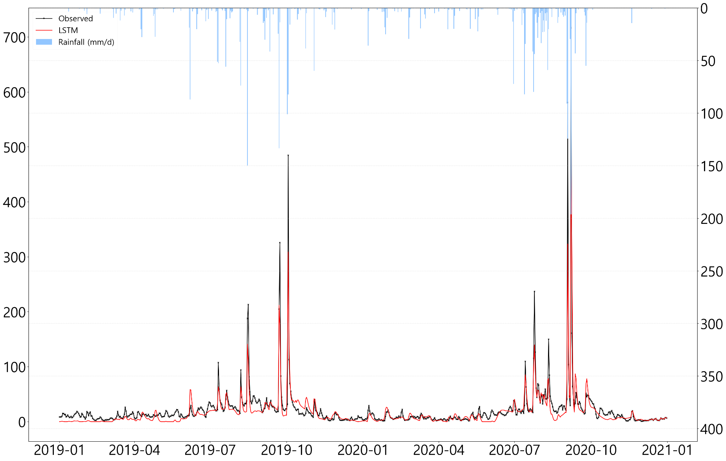
3. Application and Analysis
3.2 LSTM Model Learning and Results (Test) – Model 1
RMSE : 19.67 NSE : 0.81 R2 : 0.84
Discharge ($m^{3}/s$)
Precipitation ($mm$)
Time(day)

Slide 21
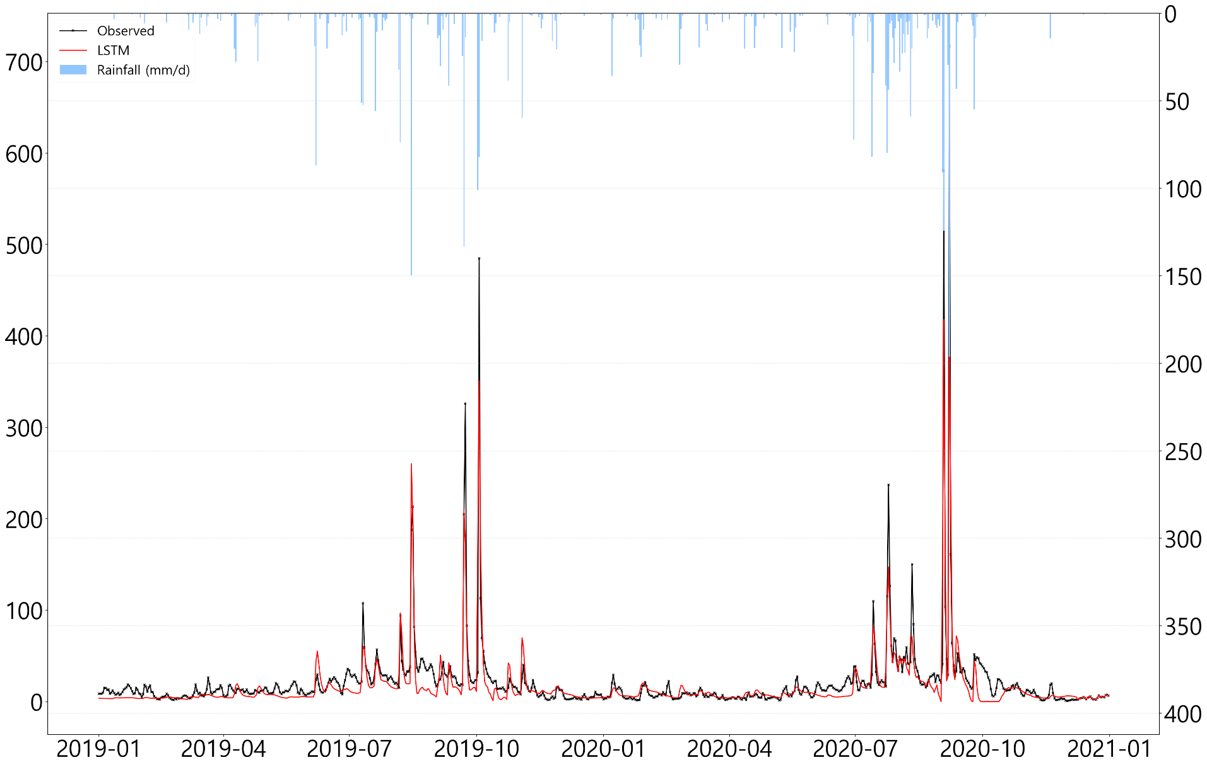
3. Application and Analysis
3.2 LSTM Model Learning and Results (Test) – Model 2
RMSE : 19.69 NSE : 0.81 R2 : 0.84
Discharge ($m^{3}/s$)
Precipitation ($mm$)
Time(day)

Slide 22
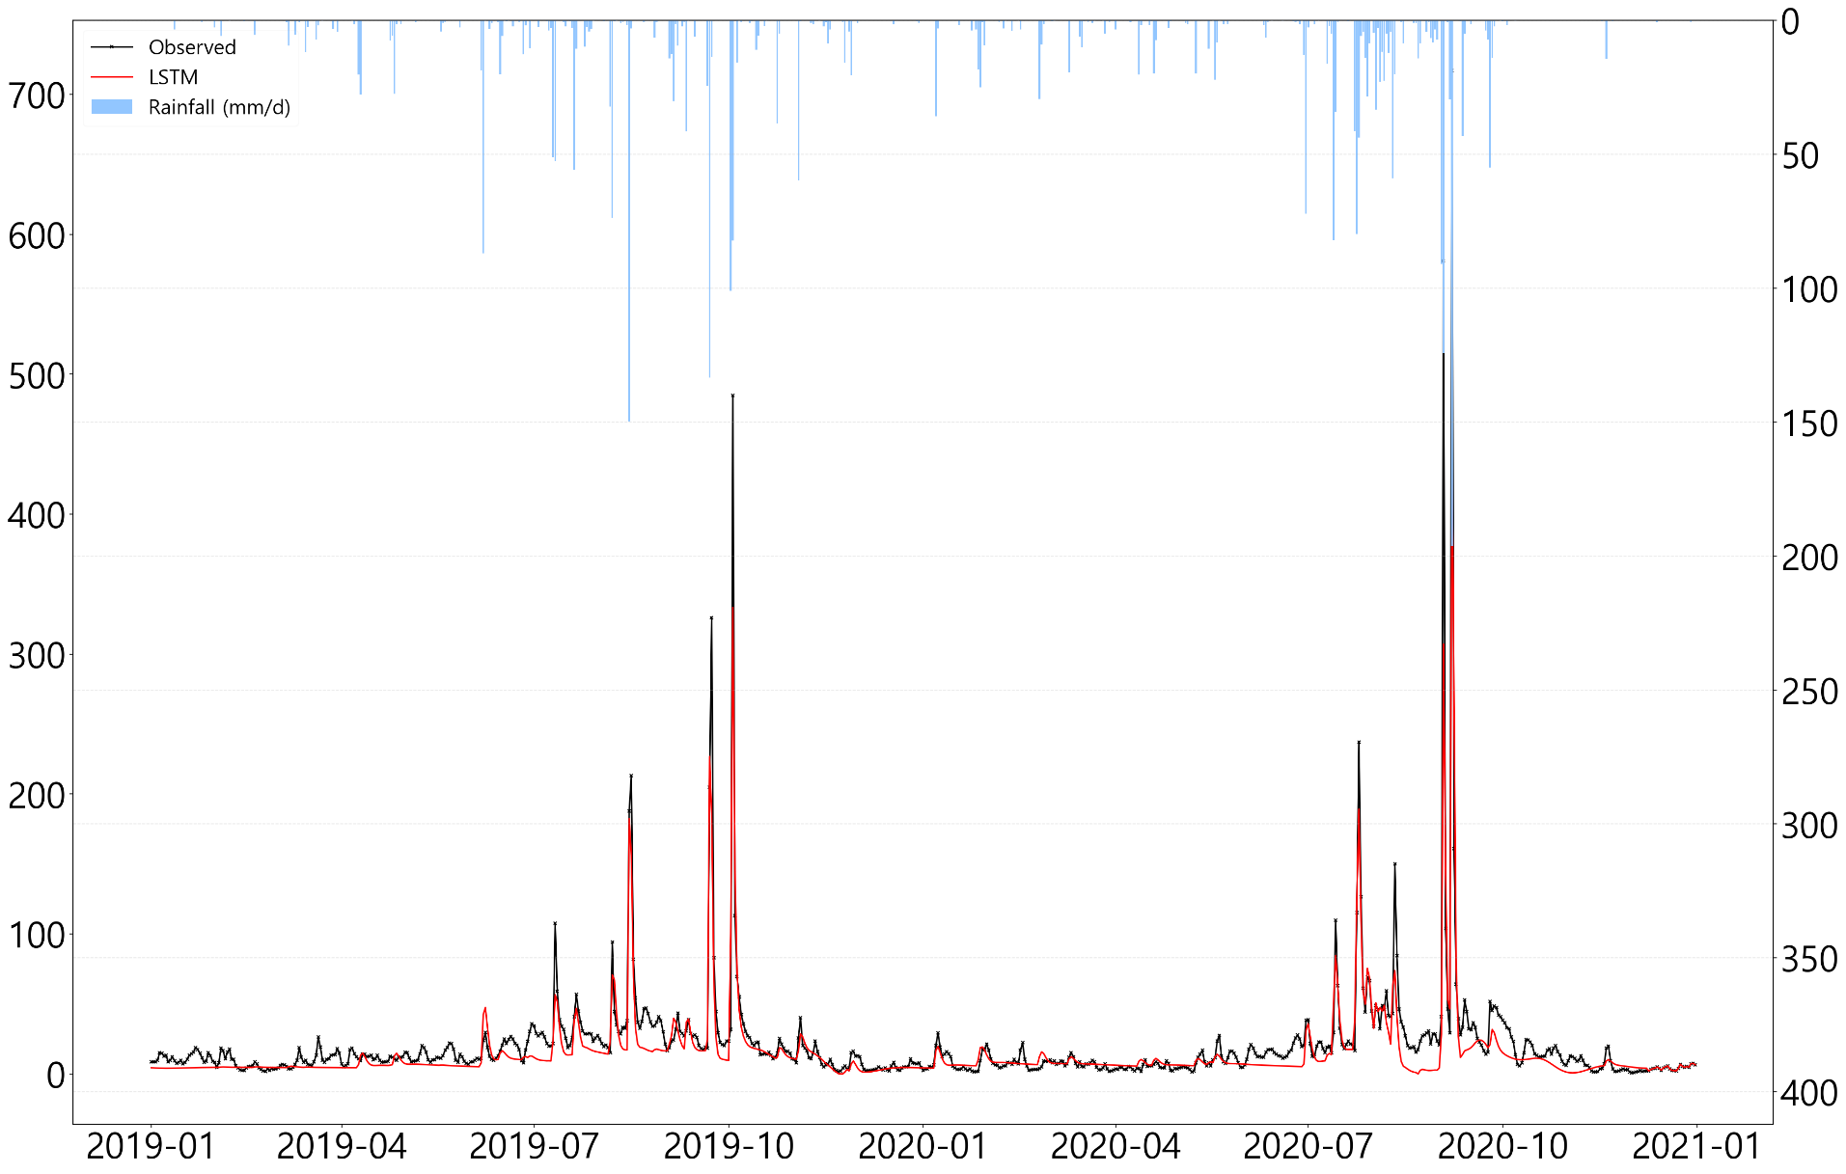
3. Application and Analysis
3.2 LSTM Model Learning and Results (Test) – Model 3
RMSE : 19.73 NSE : 0.81 R2 : 0.87
Discharge ($m^{3}/s$)
Precipitation ($mm$)
Time(day)

Slide 23
3. Application and Analysis
3.2 LSTM Model Learning and Results (Test)
 | Model 1 | Model 2 | Model 3
ME | -3.99 | -4.34 | -5.67
MAE | 8.77 | 8.95 | 8.54
MSE | 386.75 | 387.55 | 389.41
RMSE | 19.67 | 19.69 | 19.73
NRMSE % | 43.5 | 43.6 | 43.7
PBIAS % | -19.1 | -20.8 | -27.2
RSR | 0.44 | 0.44 | 0.44
rSD | 0.76 | 0.78 | 0.72
NSE | 0.81 | 0.81 | 0.81
mNSE | 0.47 | 0.46 | 0.48
rNSE | 0.88 | 0.84 | 0.88
d | 0.94 | 0.94 | 0.93
md | 0.74 | 0.74 | 0.75
rd | 0.96 | 0.95 | 0.96
cp | 0.85 | 0.85 | 0.85
r | 0.92 | 0.91 | 0.93
R2 | 0.84 | 0.84 | 0.87
bR2 | 0.6 | 0.61 | 0.59
KGE | 0.68 | 0.69 | 0.61
VE | 0.58 | 0.57 | 0.59
As a result of the test, NSE of Model 1, 2, and 3 was 0.81, and$R^{2}$ of Model 3 was the highest at 0.87, but Model 1 was finally selected because RMSE and PBIAS of Model 1 were the lowest
LSTM – Model 1 simulation results and models with Multi-Layer Perceptron (MLP) added, respectively, compared time series after simulation (2011 – 2020)

Slide 24
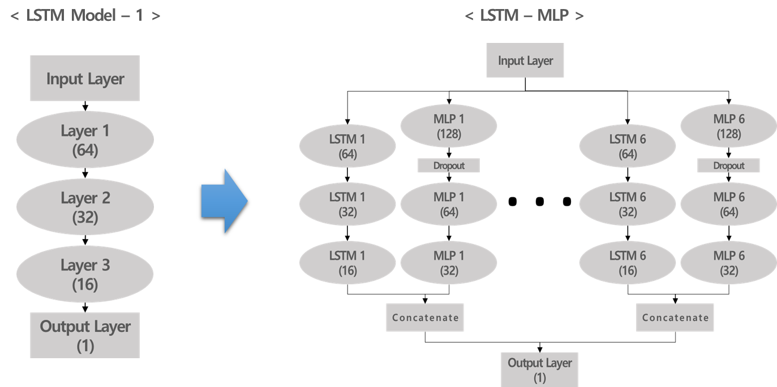
3. Application and Analysis
3.3 LSTM – MLP Ensemble Model Learning and Results
Learn 6 LSTM-MLP models by ensemble MLP(Multi Layer Perceptron) on the selected LSTM – Model 1 (using mean)
Model parameter
Model structure |  | Setting | Note
Model |  | LSTM - MLP | Tensorflow (python)
Optimizer |  | Adam | Learning Rate : 0.00003
Input data | Training | 2011-01-01 ~ 2018-12-31 | Y data | X data
 | Test | 2019-01-01 ~ 2020-12-31 | Runoff ($m^{3}/s$)
Hidden Layer |  | LSTM : 3 Layer | Activation : tanh Layer 1 : 64, Layer 2 : 32, Layer 3 : 16
 |  | MLP : 3 Layer | Activation : tanh Layer 1 : 128, Layer 2 : 64, Layer3 : 32
Output Layer |  | 1Layer | Concatenate
Epoch |  | 1200 | -
Tmin(°C)
Wmean(m/s)
Tmean(°C)
P (°C)
Tmax (°C)
Wmax (m/s)

Slide 25
3. Application and Analysis
3.3 LSTM – MLP Ensemble Model Learning and Results(Training) – LSTM - Model 1
RMSE : 8.89 NSE : 0.87 R2 : 0.87
Discharge ($m^{3}/s$)
Precipitation ($mm$)
Time(day)

Slide 26
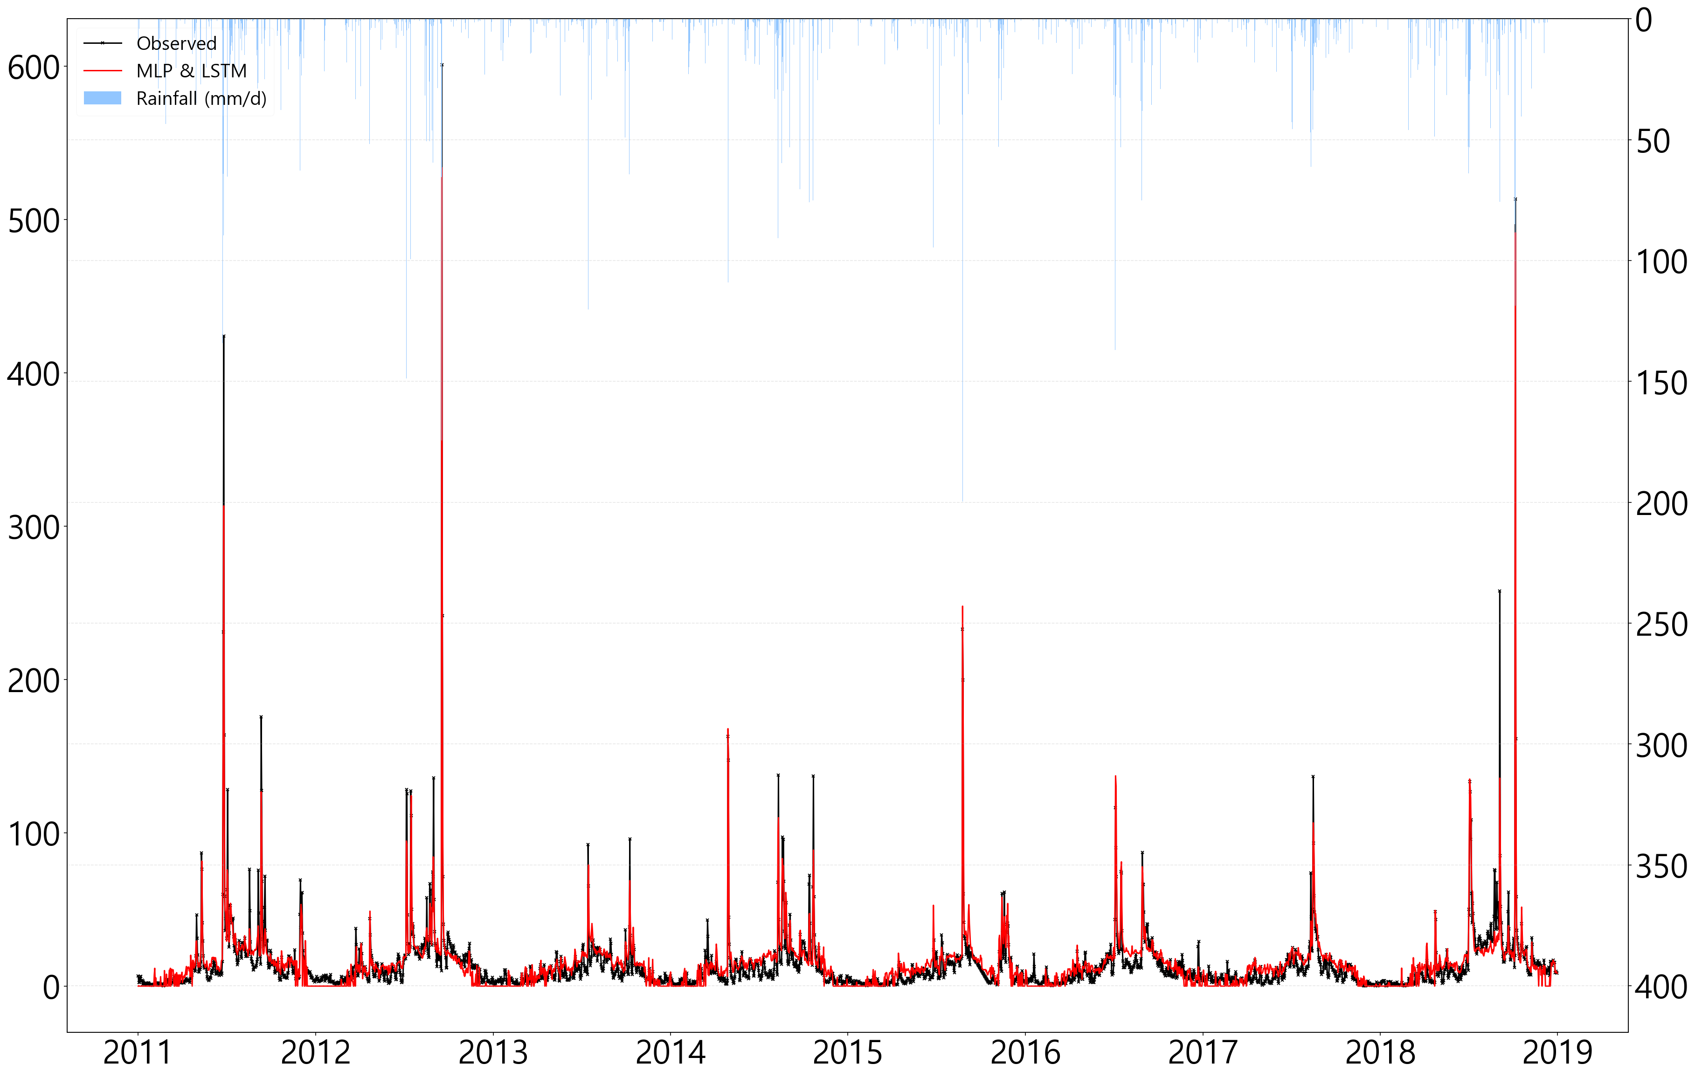
3. Application and Analysis
3.3 LSTM – MLP Ensemble Model Learning and Results(Training) – LSTM - MLP
RMSE : 8.07 NSE : 0.89 R2 : 0.89
Discharge ($m^{3}/s$)
Precipitation ($mm$)
Time(day)

Slide 27
3. Application and Analysis
3.3 LSTM – MLP Ensemble Model Learning and Results(Training)
 | LSTM - Model 1 | Ensemble Model
ME | -0.56 | 0.86
MAE | 5.47 | 5.28
MSE | 79.04 | 65.11
RMSE | 8.89 | 8.07
NRMSE % | 36.2 | 32.8
PBIAS % | -4.1 | 6.2
RSR | 0.36 | 0.33
rSD | 0.92 | 0.91
NSE | 0.87 | 0.89
mNSE | 0.49 | 0.51
rNSE | 0.39 | 0.35
d | 0.96 | 0.97
md | 0.75 | 0.75
rd | 0.83 | 0.82
cp | 0.84 | 0.87
r | 0.93 | 0.95
R2 | 0.87 | 0.89
bR2 | 0.77 | 0.81
KGE | 0.89 | 0.88
VE | 0.6 | 0.62

Slide 28
3. Application and Analysis
3.3 LSTM – MLP Ensemble Model Learning and Results(Test) – LSTM – Model 1
RMSE : 19.67 NSE : 0.81 R2 : 0.84
Discharge ($m^{3}/s$)
Precipitation ($mm$)
Time(day)

Slide 29
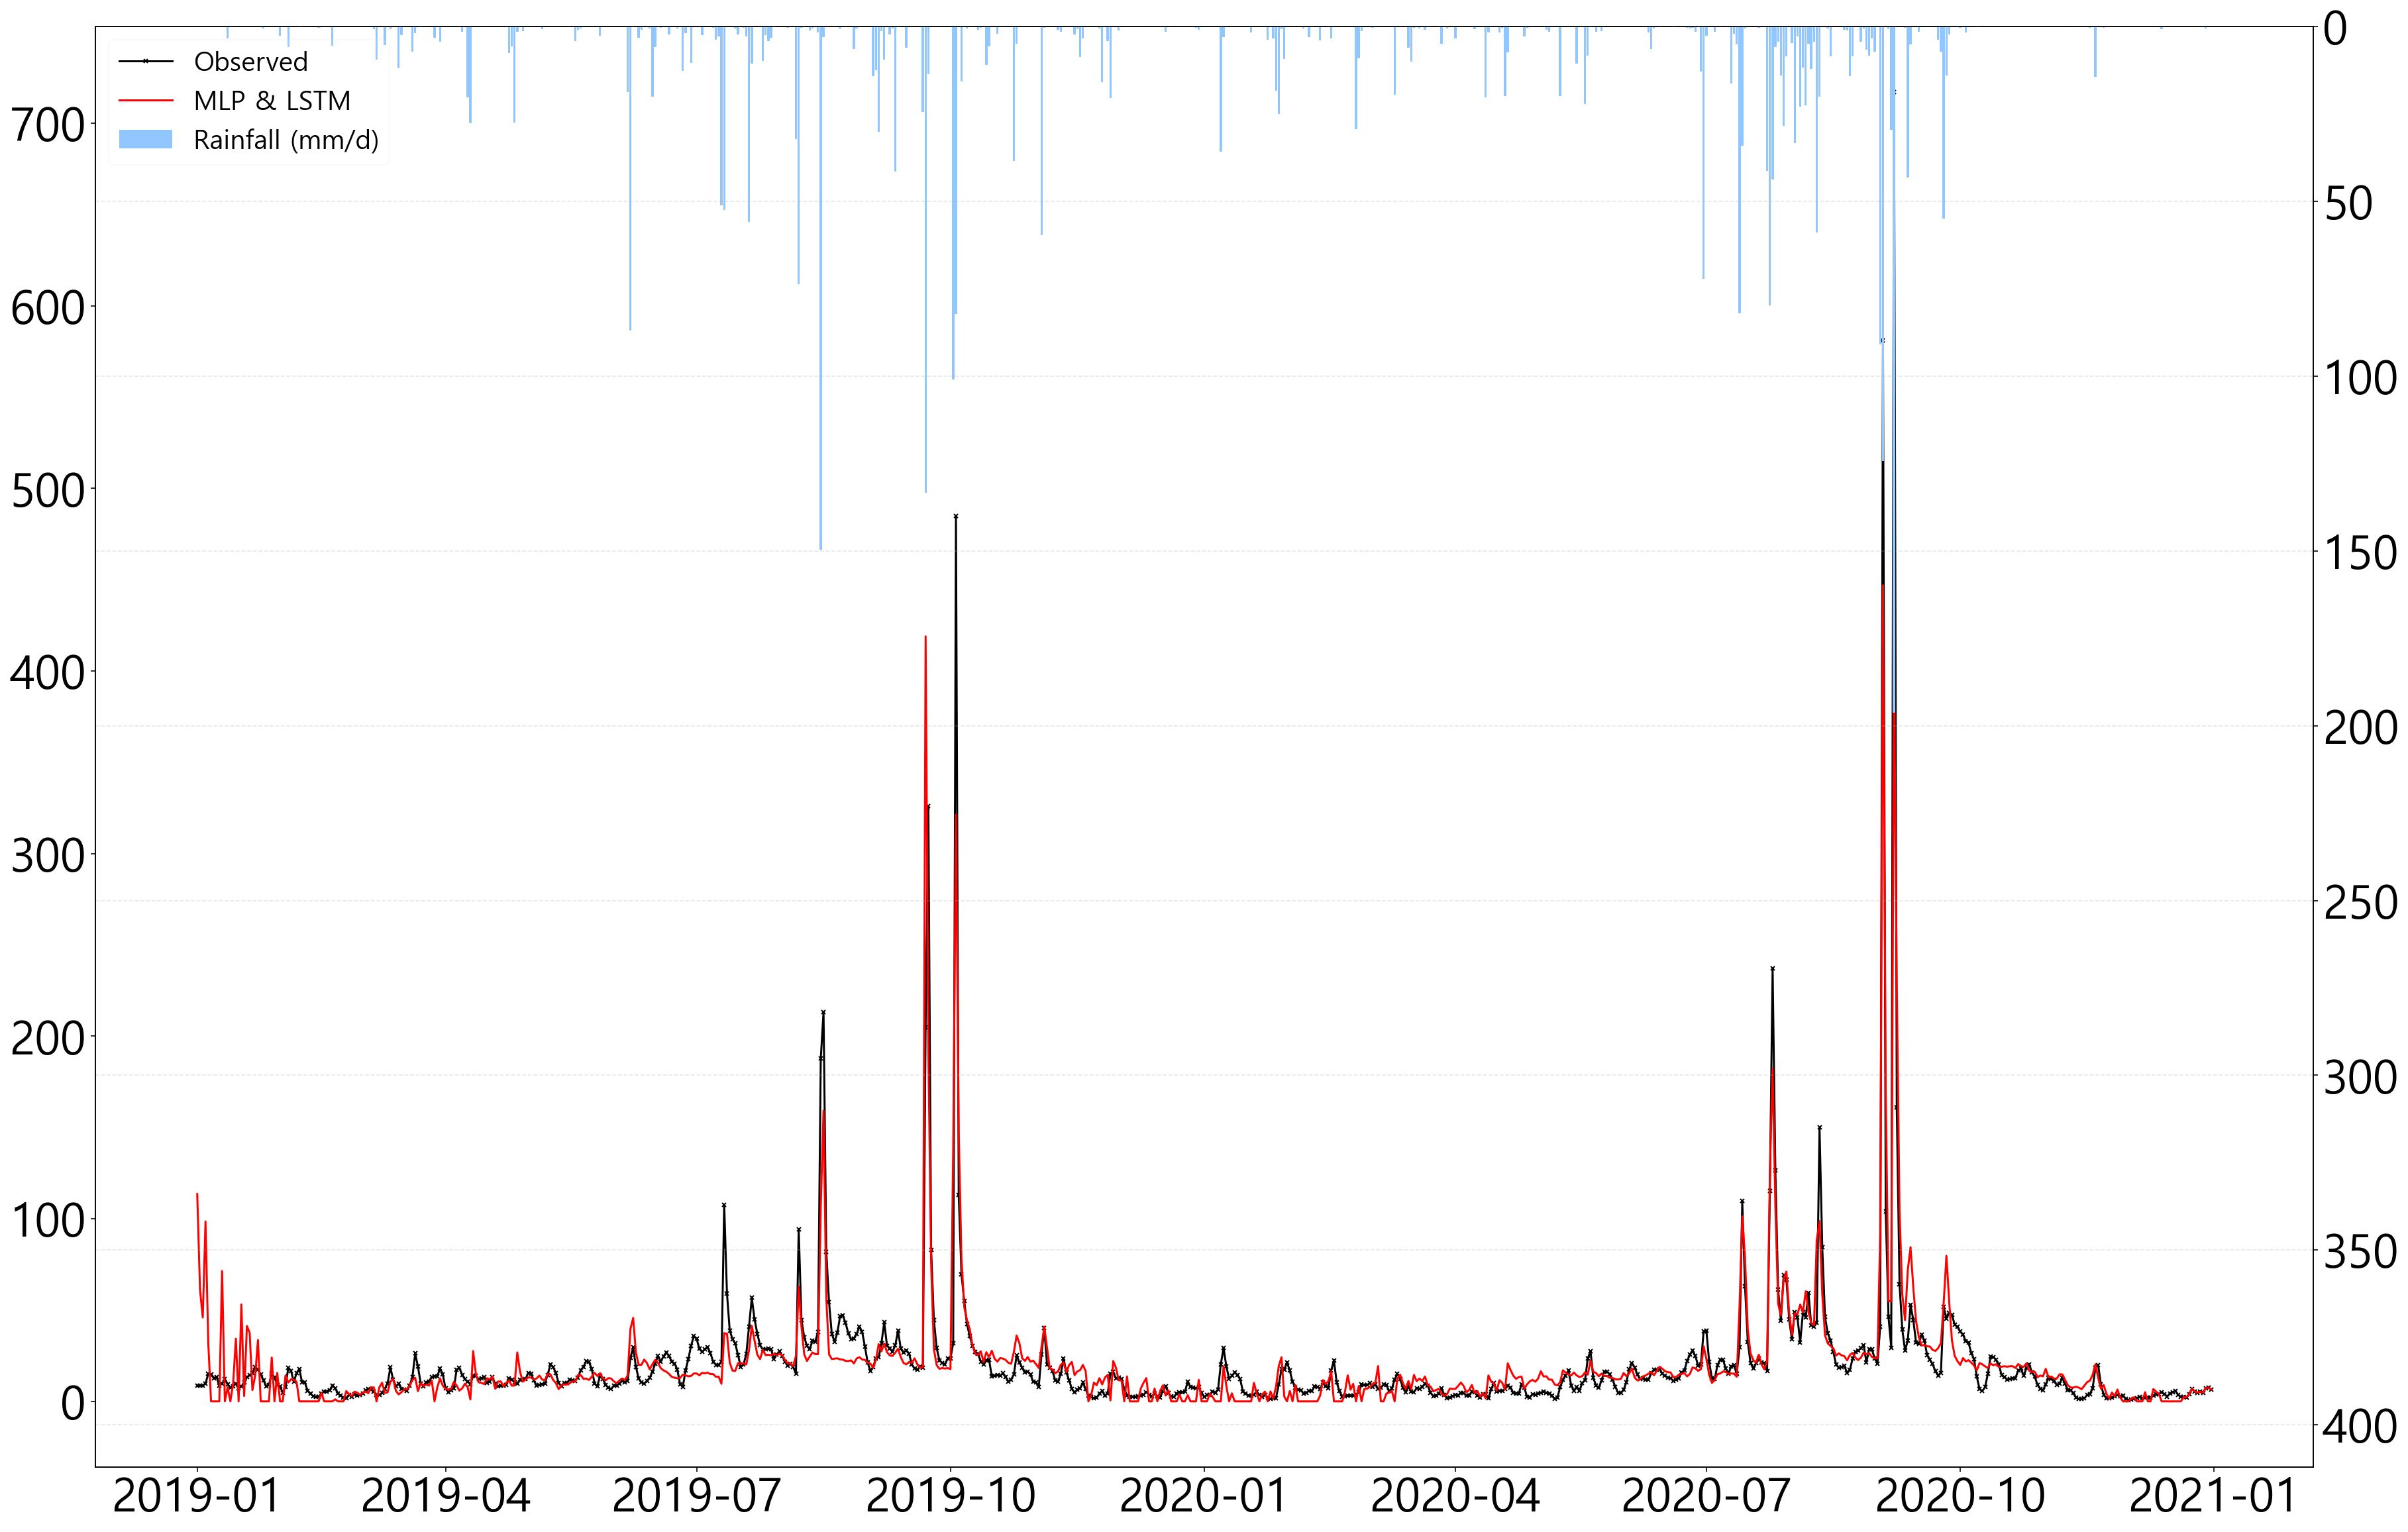
3. Application and Analysis
3.3 LSTM – MLP Ensemble Model Learning and Results(Test) – LSTM - MLP
RMSE : 21.31 NSE : 0.78 R2 : 0.78
Discharge ($m^{3}/s$)
Precipitation ($mm$)
Time(day)

Slide 30
3. Application and Analysis
3.3 LSTM – MLP Ensemble Model Learning and Results(Test)
 | LSTM - Model 1 | Ensemble Model
ME | -3.99 | -0.5
MAE | 8.77 | 8.63
MSE | 386.75 | 454.25
RMSE | 19.67 | 21.31
NRMSE % | 43.5 | 47.2
PBIAS % | -19.1 | -2.4
RSR | 0.44 | 0.47
rSD | 0.76 | 0.81
NSE | 0.81 | 0.78
mNSE | 0.47 | 0.48
rNSE | 0.88 | 0.7
d | 0.94 | 0.93
md | 0.74 | 0.73
rd | 0.96 | 0.9
cp | 0.85 | 0.83
r | 0.92 | 0.89
R2 | 0.84 | 0.78
bR2 | 0.6 | 0.6
KGE | 0.68 | 0.77
VE | 0.58 | 0.59

Slide 31
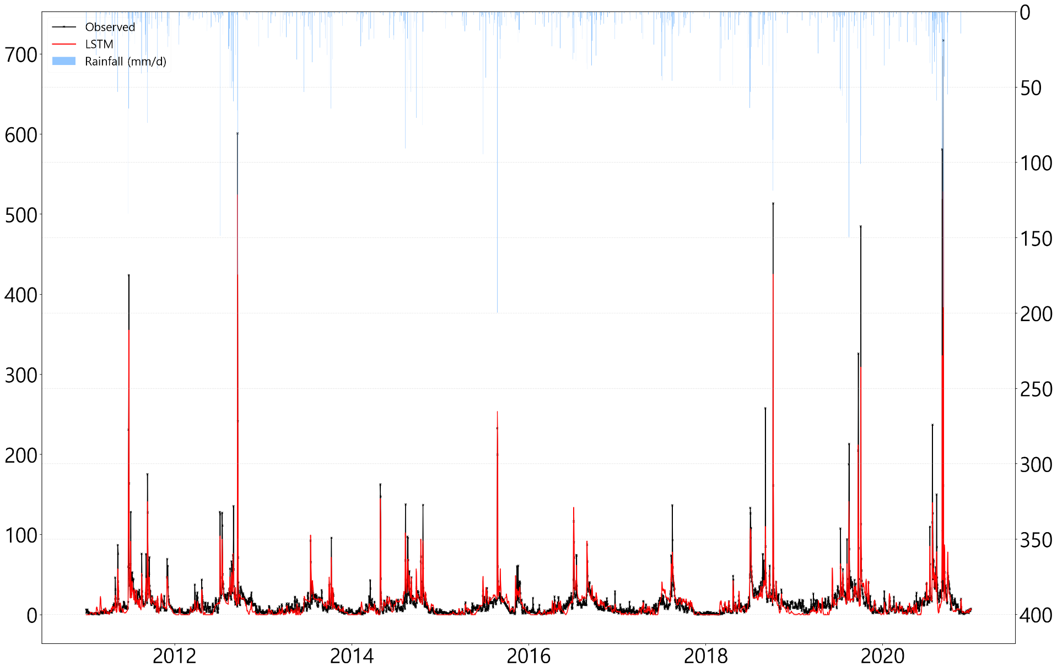
3. Application and Analysis
3.3 LSTM – MLP Ensemble Model Learning and Results(Simulation) – Model 1
RMSE : 11.9 NSE : 0.84 R2 : 0.85
Discharge ($m^{3}/s$)
Precipitation ($mm$)
Time(day)

Slide 32
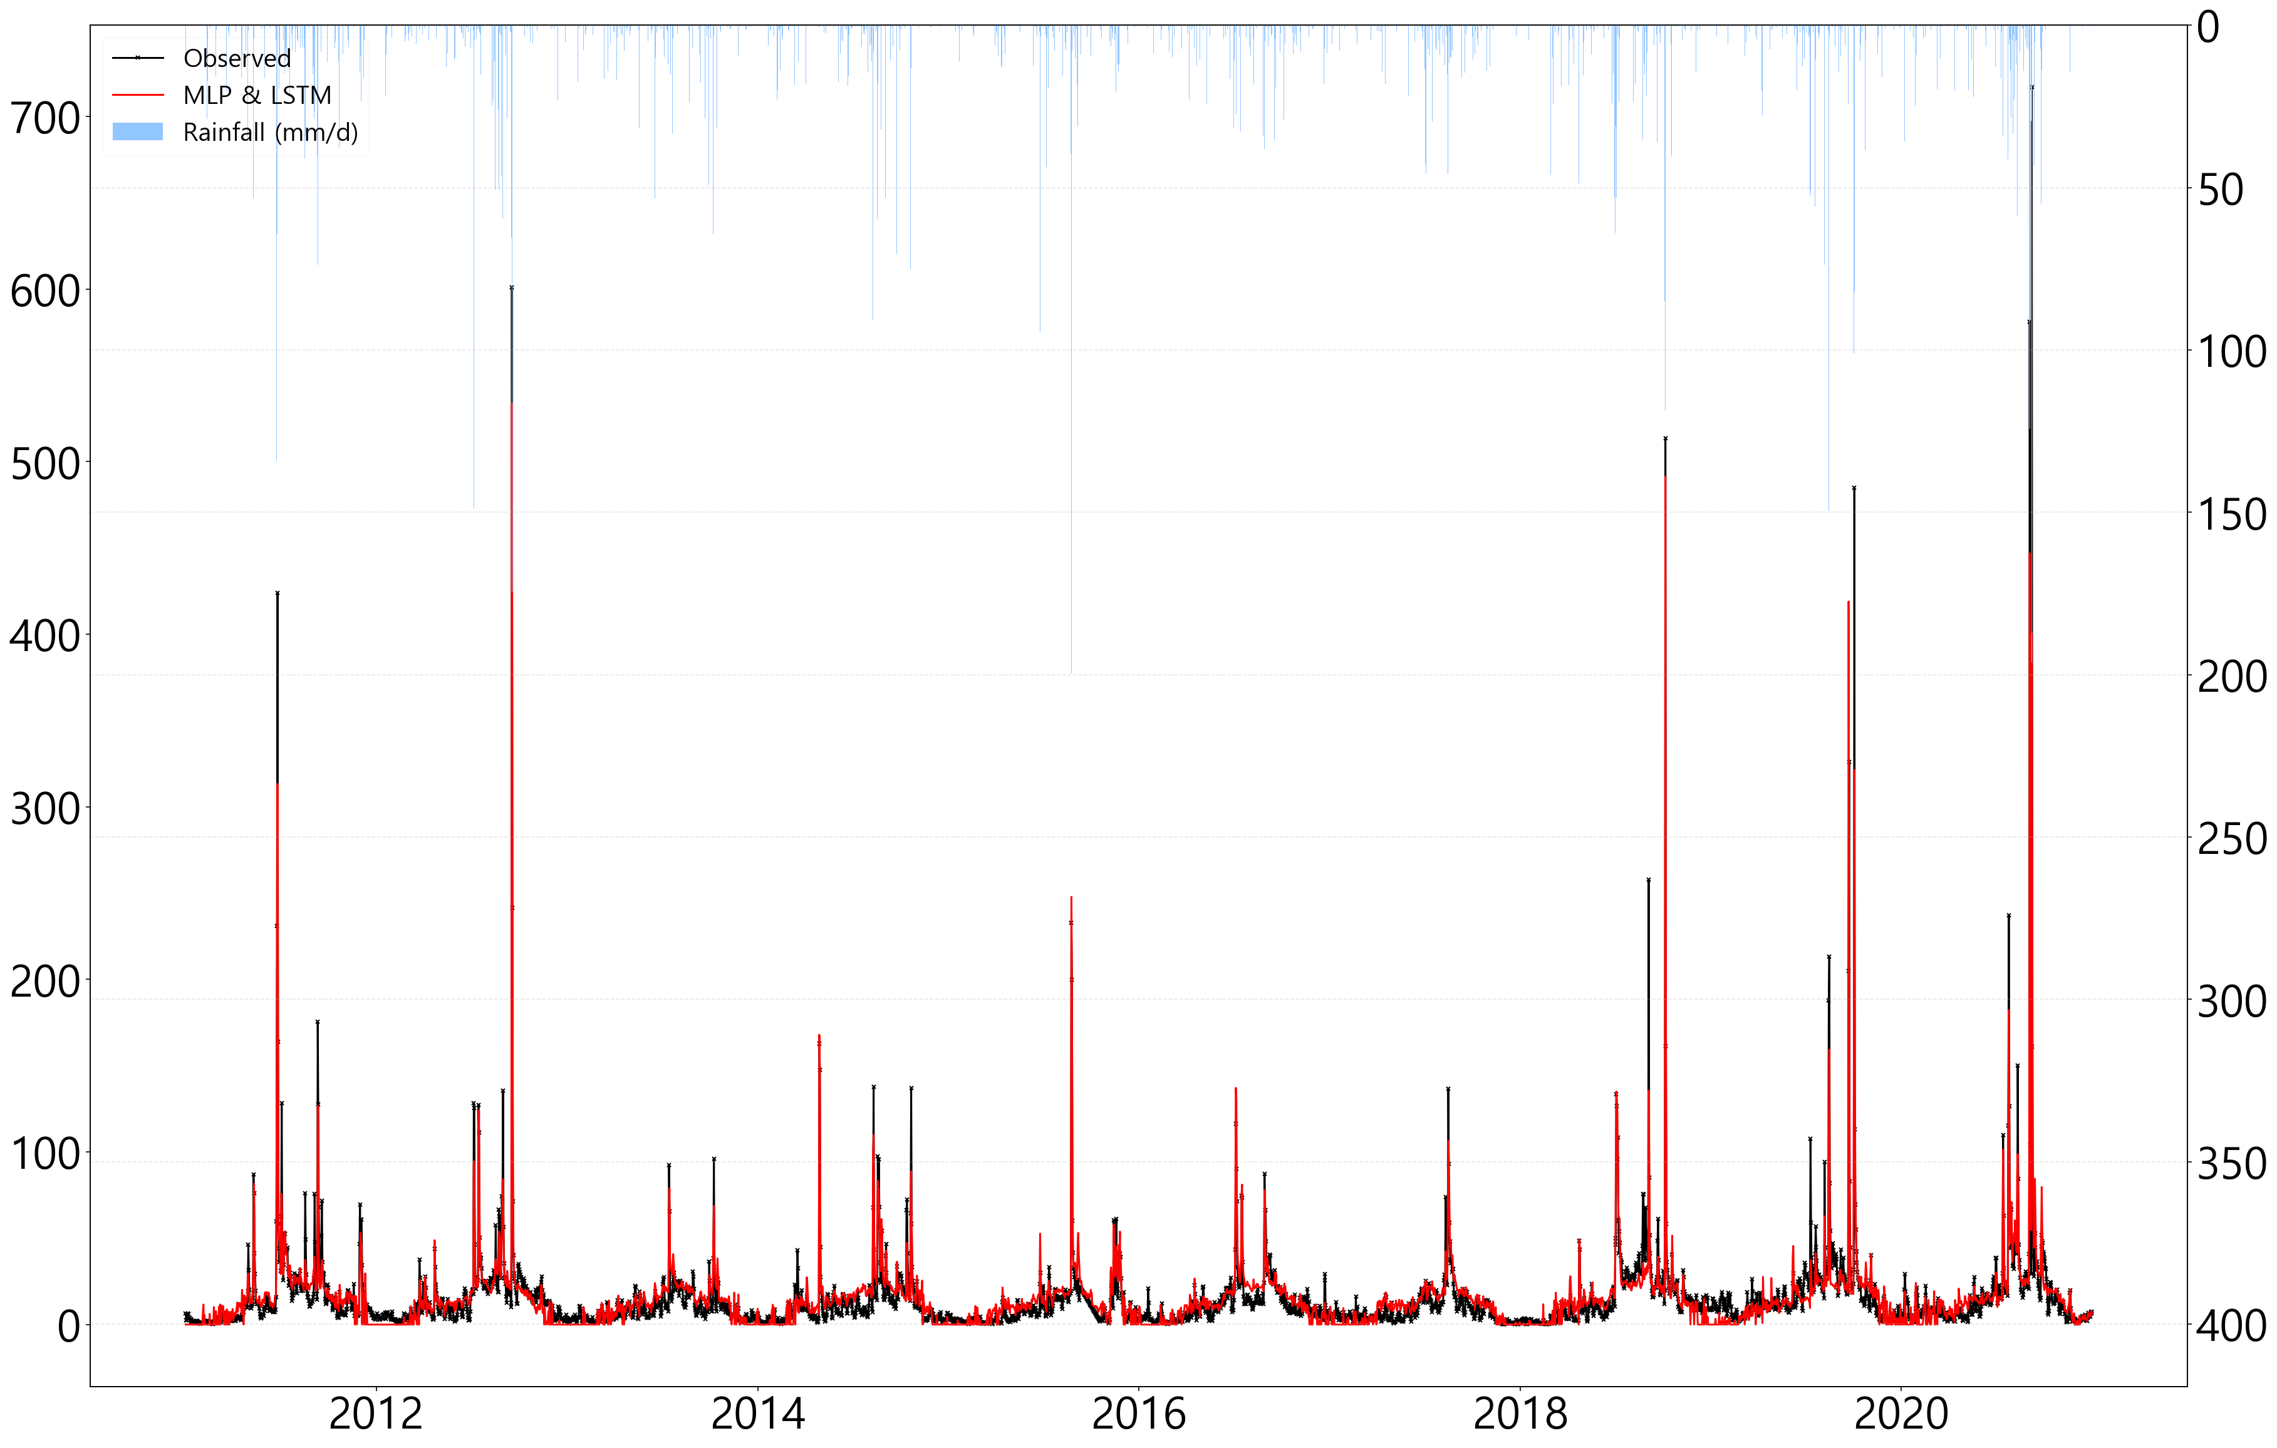
3. Application and Analysis
3.3 LSTM – MLP Ensemble Model Learning and Results (Simulation) – LSTM - MLP
RMSE : 11.64 NSE : 0.85 R2 : 0.85
Discharge ($m^{3}/s$)
Precipitation ($mm$)
Time(day)

Slide 33
3. Application and Analysis
3.3 LSTM – MLP Ensemble Model Learning and Results (Simulation)
 | LSTM - Model 1 | Ensemble Model
ME | -1.31 | 0.35
MAE | 6.19 | 5.89
MSE | 141.51 | 135.42
RMSE | 11.9 | 11.64
NRMSE % | 39.7 | 38.8
PBIAS % | -8.6 | 2.3
RSR | 0.4 | 0.39
rSD | 0.85 | 0.86
NSE | 0.84 | 0.85
mNSE | 0.49 | 0.51
rNSE | 0.57 | 0.53
d | 0.95 | 0.95
md | 0.75 | 0.75
rd | 0.87 | 0.86
cp | 0.85 | 0.85
r | 0.92 | 0.92
R2 | 0.85 | 0.85
bR2 | 0.69 | 0.72
KGE | 0.81 | 0.84
VE | 0.59 | 0.61

Slide 34
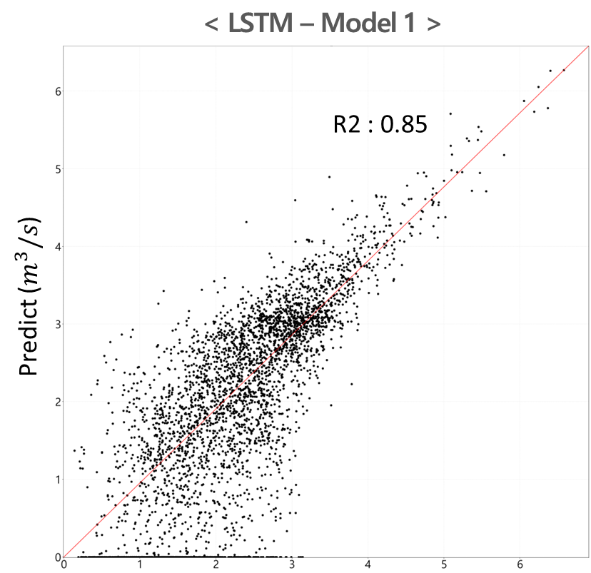
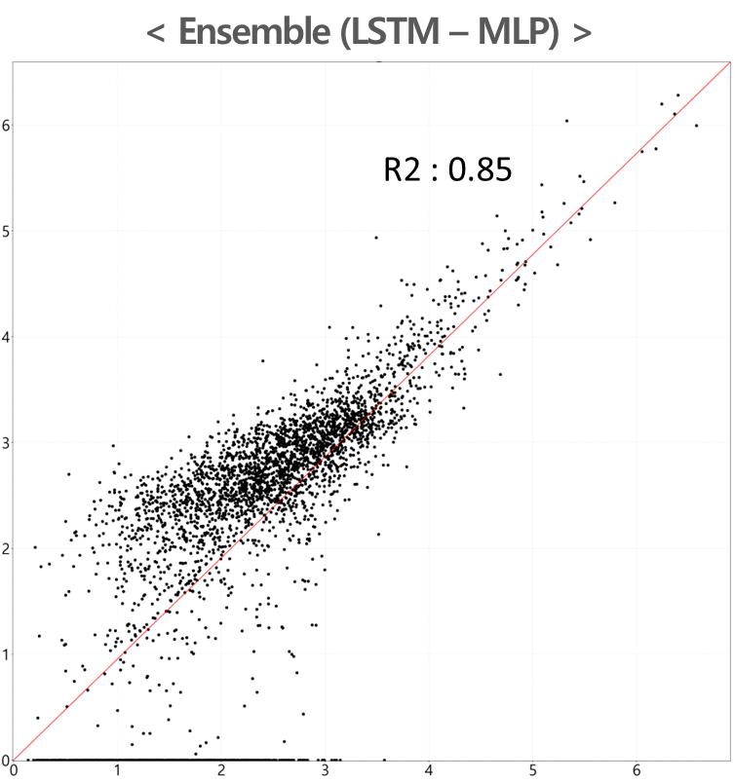
3. Application and Analysis
3.3 LSTM – MLP Ensemble Model Learning and Results (Simulation)
The error was reduced, but it was a slight difference. However, the dispersion of the low-flow portion was noticeably reduced.
Observed ($m^{3}/s$)
Observed ($m^{3}/s$)
 | ME | MAE | MSE | RMSE | NRMSE % | PBIAS % | RSR | rSD | NSE | mNSE | rNSE | d | md | rd | cp | r | R2 | bR2 | KGE | VE
LSTM - Model 1 | -1.31 | 6.19 | 141.51 | 11.9 | 39.7 | -8.6 | 0.4 | 0.85 | 0.84 | 0.49 | 0.57 | 0.95 | 0.75 | 0.87 | 0.85 | 0.92 | 0.85 | 0.69 | 0.81 | 0.59
Ensemble Model | 0.35 | 5.89 | 135.42 | 11.64 | 38.8 | 2.3 | 0.39 | 0.86 | 0.85 | 0.51 | 0.53 | 0.95 | 0.75 | 0.86 | 0.85 | 0.92 | 0.85 | 0.72 | 0.84 | 0.61

Slide 35
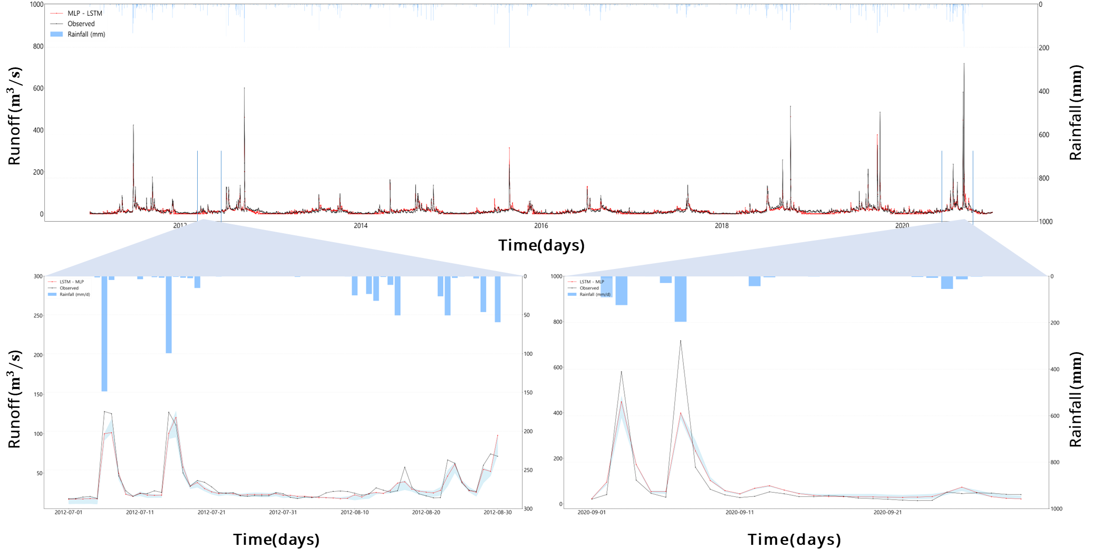
3. Application and Analysis
3.3 LSTM – MLP Ensemble Model Learning and Results (Simulation)
Daily runoff hydroplot

Slide 36
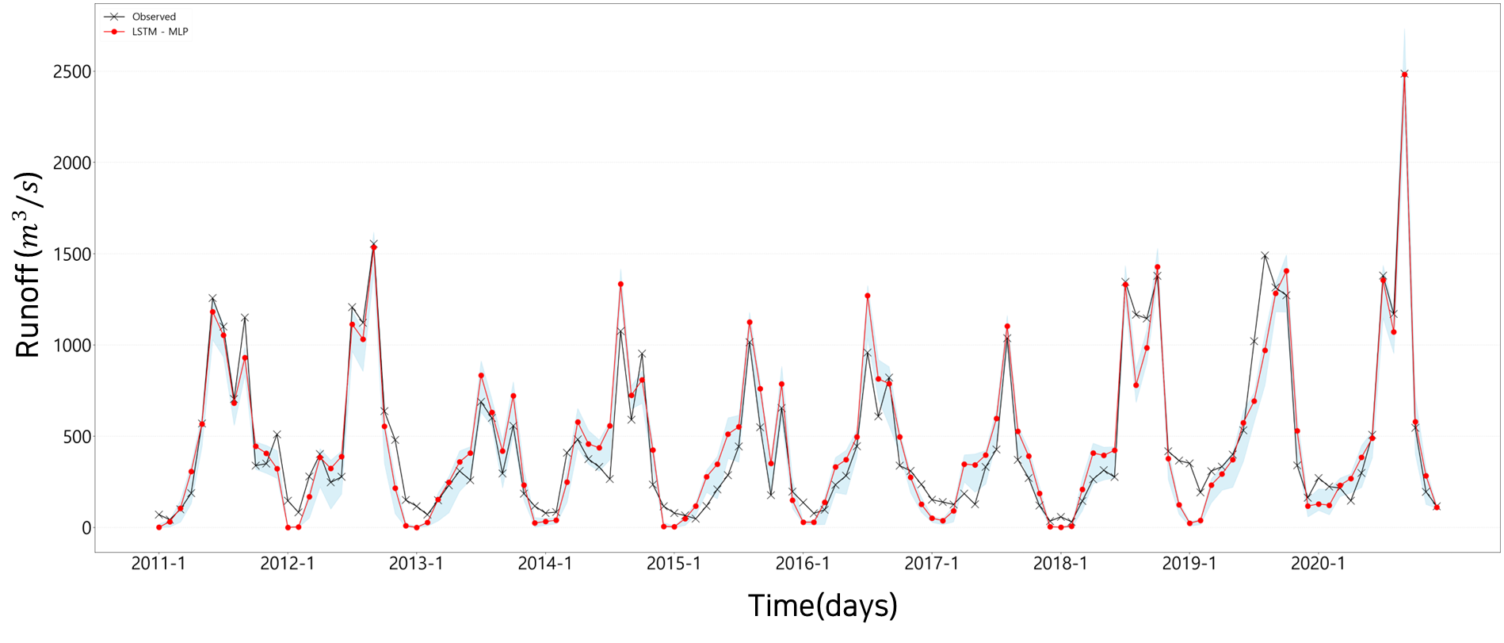
3. Application and Analysis
3.3 LSTM – MLP Ensemble Model Learning and Results (Simulation)
Pbb(Probability-based band partitioning ) and boxplot have similar historical runoff and ensemble results.
In LSTM – MLP Q – Q plot, R2 was 0.85, so it is judged that ensemble models will be available.
<LSTM - MLP>
<Observed>

Slide 37
4. Conclusion

Slide 38
4. Conclusion
The potential evaporation was calculated using the Hargreaves & Angstrom formula using the Thiessen area method by collecting runoff data and weather data from five stations (2011–2020).
As a result of learning six weather observation factors,PET (daily rainfall, potential evaporation), and P-ET (daily rainfall-daily potential evaporation), NSE of Model 1, 2, and 3 were the same, but Model 1 had the lowest RMSE and PBIAS, so the optimal model of LSTM Model 1, 2, and 3 was selected as Model 1.
After training ensemble model(LSTM – model 1 and MLP), the overall error was reduced as a result of simulating and comparing the entire period.
The error was reduced, but it was a slight difference. However, the dispersion of the low-flow portion was noticeably reduced.
Research using various LSTM ensemble models will be conducted in the future, and high LSTM utilization can be expected in the runoff simulation.
Acknowledgements
This research was supported by a grant(2022-MOIS61-001) of Development Risk Prediction Technology of Storm and Flood For Climate Change based on Artificial Intelligence funded by Ministry of Interior and Safety(MOIS, Korea).

Slide 39
Thank you

