Slide 1
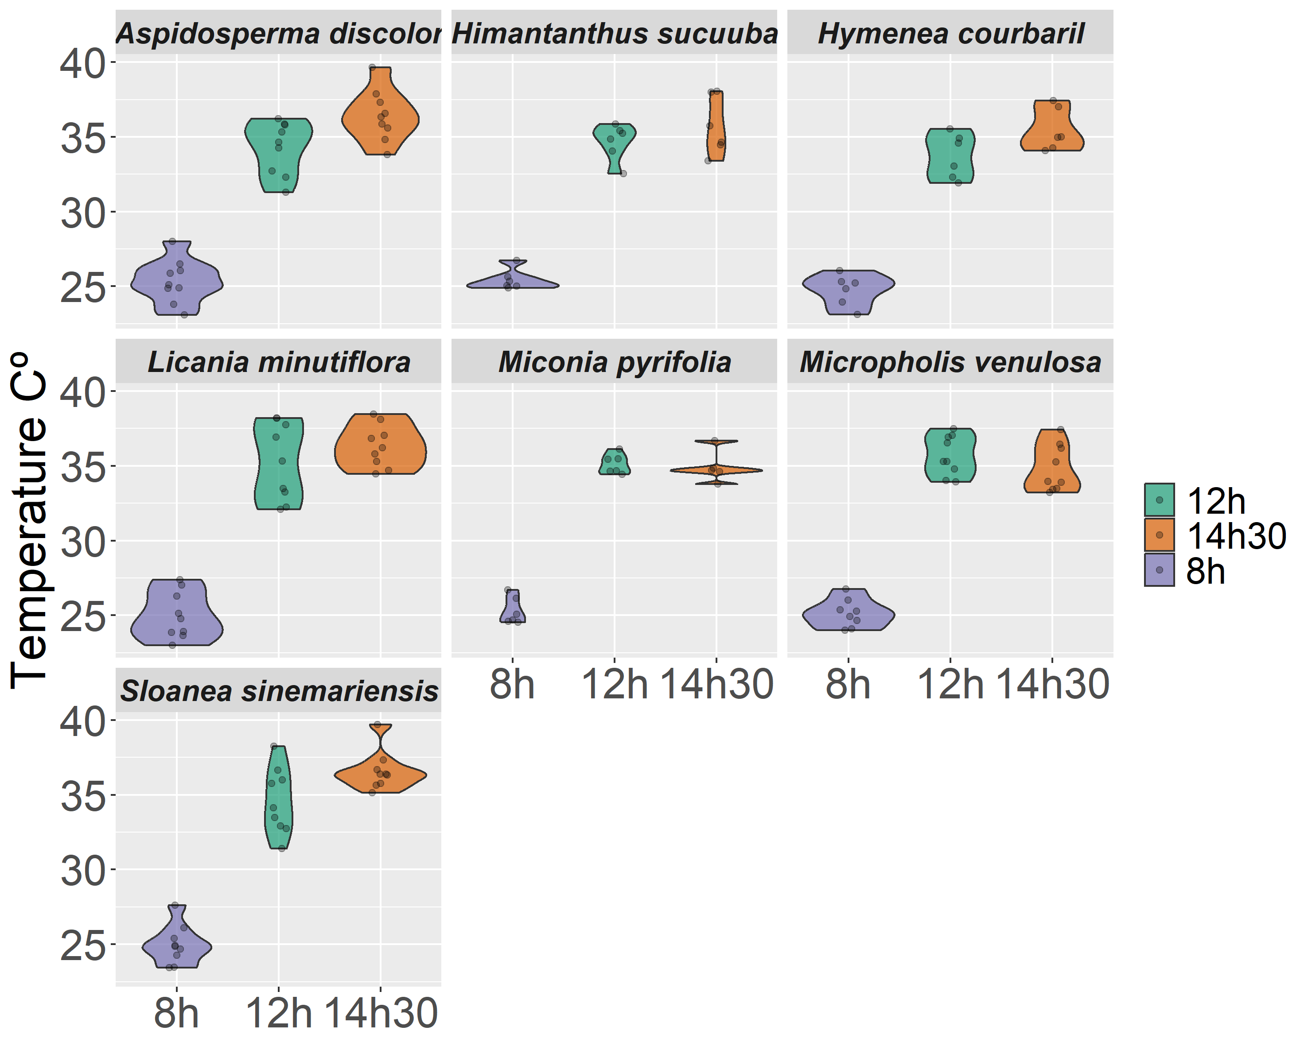
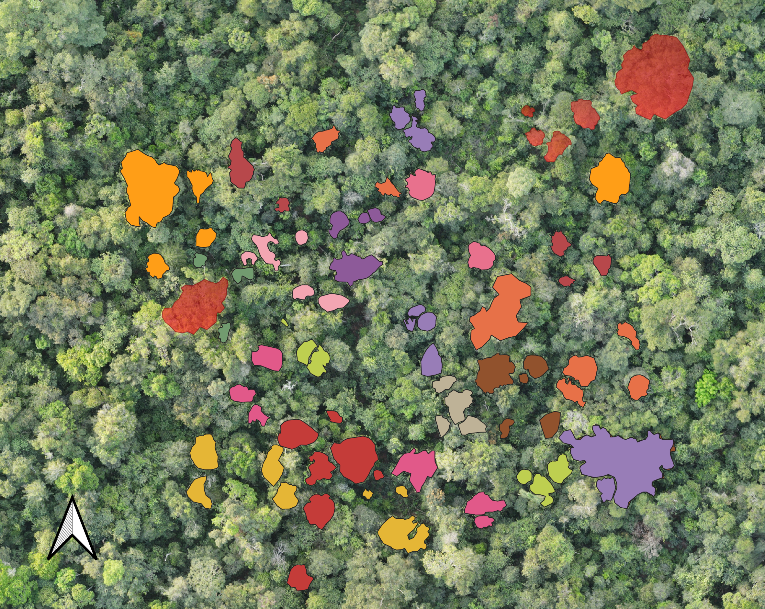
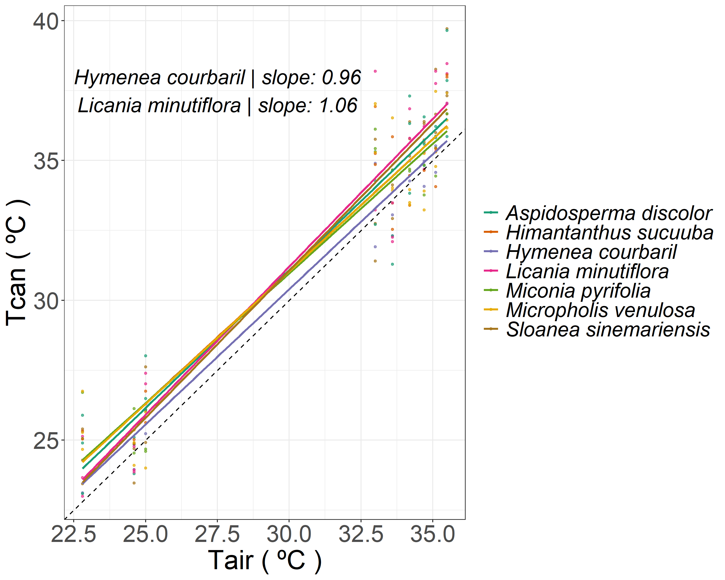
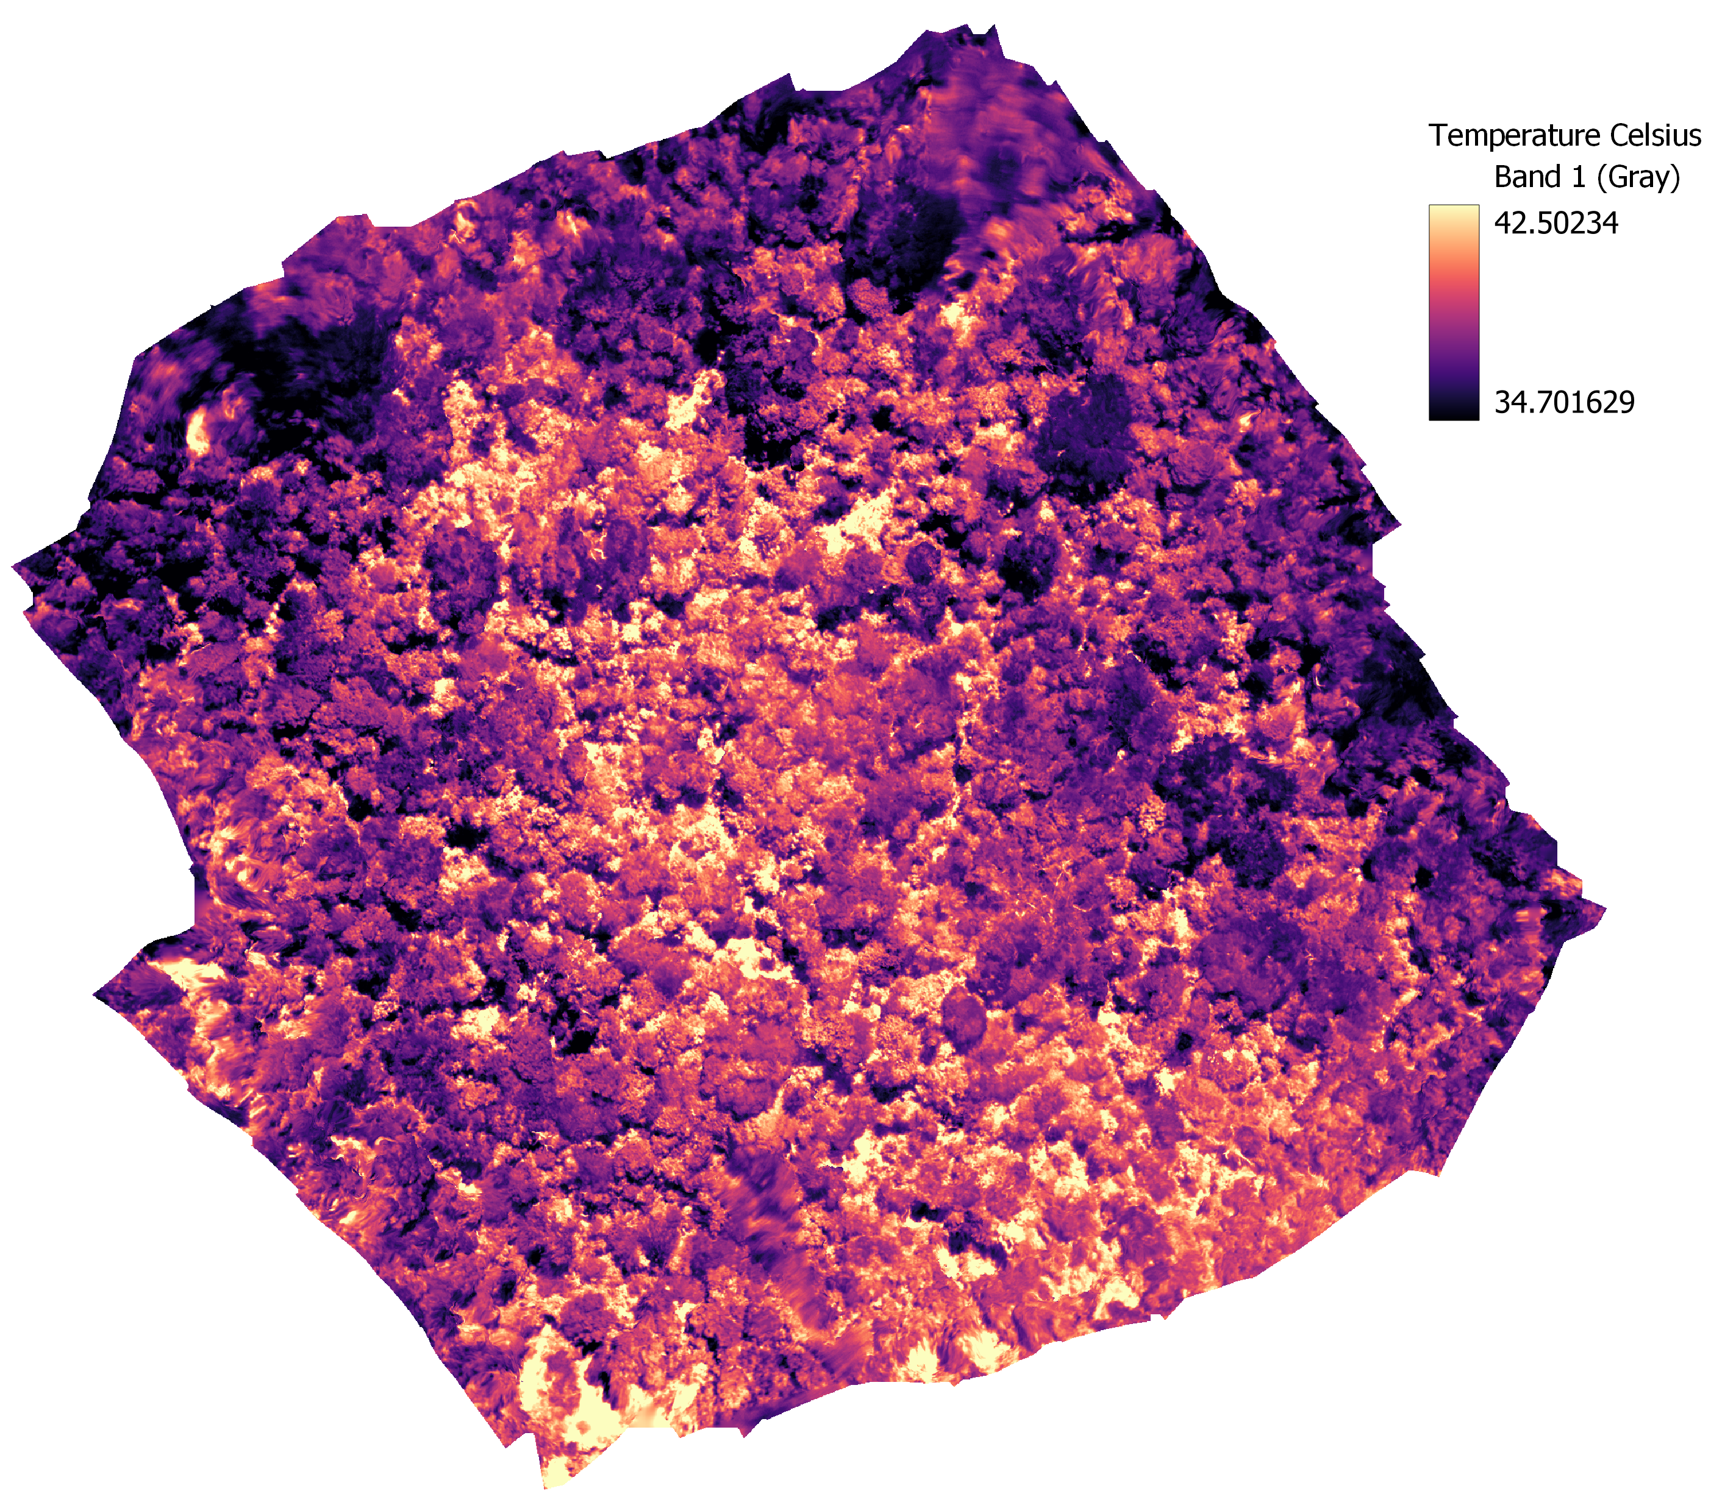
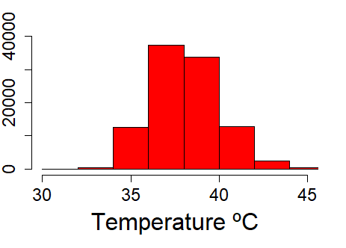
Investigating thermal sensitivity of southern Amazonian forests with UAV thermal images
Calil Torres Amaral¹, Emma Docherty², Emanuel Gloor², David Galbraith²
¹Universidade do Estado de Mato Grosso (UNEMAT); ²University of Leeds
MOTIVATION
PRELIMINARY RESULTS
.
Species identification
crossing orthomosaics and plot XY data
Tropical forests are at risk of surpassing their thermal thresholds for carbon assimilation due to ongoing global warming.
The limited leaf homeothermy hypothesis proposes that leaves can maintain their temperature near the photosynthetic optimum during daylight hours, while also avoiding damage caused by excessively high temperatures.
This study aims to investigate whether this thermoregulatory behavior occurs in the canopies of the southern Amazon forests, which are the hottest and seasonally driest forests in Amazon.
Canopy leaves in the hottest Amazon forests are not mitigating temperature increases by leaf cooling
Tcanopy by species: p-value = 0.9565
Tcanopy by time: p-value < 2.2e-16
NEXT STEPS
Link canopy temperatures to functional traits already collected in situ ( e.g tree growth rates, stomatal conductance and P50).
Examine seasonal variation in canopy temperatures.
METHODS
3 forest plots (edaphoclimatic differences)
Diurnal cycle (8 am- 5:30 pm) - flights using Mavic Entrerprise Advanced 2
85 flights – Wet season
102 flights – Dry season
Air temperature + relative humidity + soil moisture – in situ
Thermal camera calibration in laboratory
Thermal image processing
* All the results showed here are from only one seasonal evergreen forest in southern amazon in the dry season
This work is part of Calil Torres Amaral PhD thesis.
Email: calil.torresmaral@gmail.com
Acknowledgments: Work funded by Coordernação de Aperfeiçoamento de Pessoal de Nível Superior (CAPES) and ARBOLES Project. We thank ForestPlot and all the researchers from Laboratório de Ecologia Vegetal of UNEMAT (LABEV).
This presentation applied for the OSPP.

