Slide 1
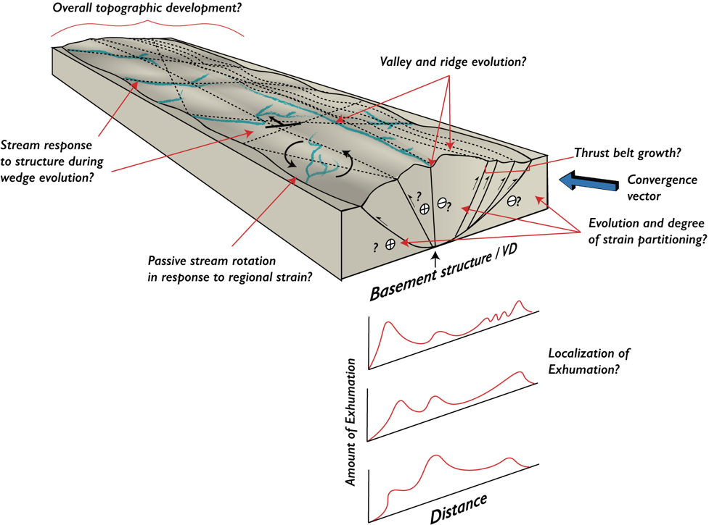
Erosion-Tectonic Sandbox Models of the Structural and Fluvial Evolution of Transpressional Systems
Ethan M. Conrad^{1,2}, Riccardo Reitano³, Claudio Faccenna^{3,4}, Thorsten W. Becker^{1,2,3}
1
2
3
4
5
Objective: To investigate fault and drainage reorganization and their linked roles in the topographic and deformational evolution of transpressional systems
Deutscher Akademischer Austauschdienst
German Academic Exchange Service
Conrad et al. (2023, under review in Tectonics)
Table
of
contents
European Geosciences Union | PICO Presentation | April 25th, 2023

Slide 2
EGU GA 2023 | PICO Presentation | April 25th, 2023
Table of Contents
Title slide
Experimental set-up
Top view videos of experiments
Digital elevation models and mapped structures
Oblique view and cross-sectional photos
Extracted wedge slices and internal deformation
Particle image velocimetry
u component and dilatational strain rate
Shear strain rate and active structures
Shear strain rate videos
Topographic development and critical taper
Stream Evolution
High vs. low erosion systems
Evolution mechanisms
Schematic synthesis model
Stages 1-3
Stage 4 onward
Natural prototypes
Abstract link for
OSPP judges
Preprint
Conrad et al. (2023,
under review for Tectonics)

Slide 3
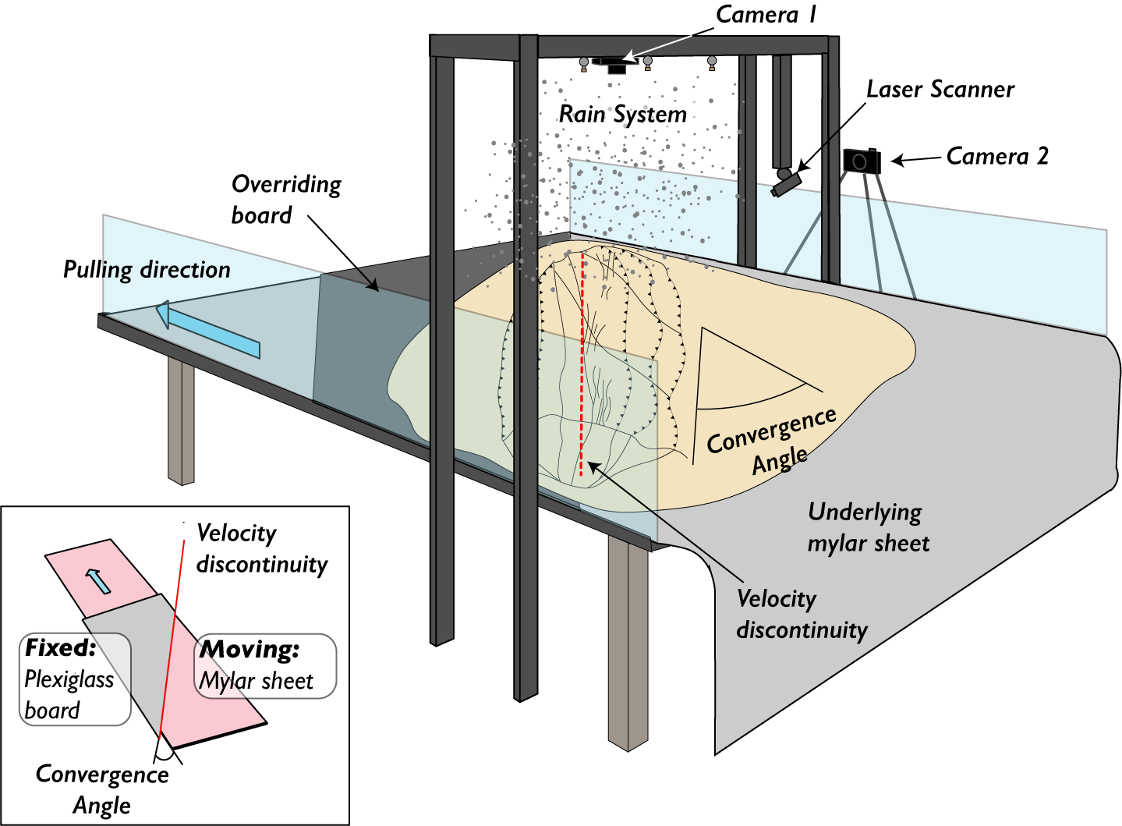
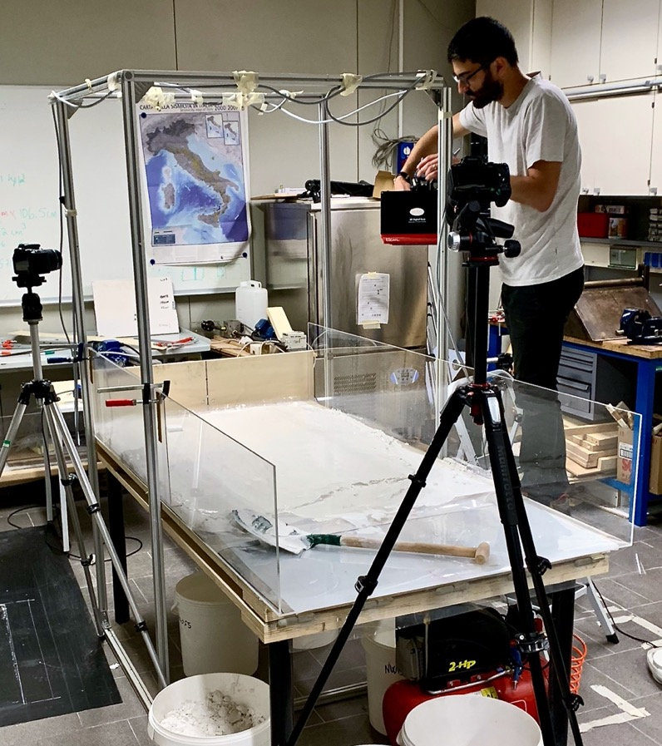
EGU GA 2023 | PICO Presentation | April 25th, 2023
Experimental set-up
Table
of
contents
Next
(Above) schematic of experimental set-up. Inset illustrates the velocity discontinuity approach, where a moving sheet moves below a fixed board to generate deformation
(Above) photograph showing the experimental set up
Conrad et al. (2023, under review in Tectonics)

Slide 4
EGU GA 2023 | PICO Presentation | April 25th, 2023
Top view videos of experiments
Dry
Table
of
contents
Observations:
Diamond-shaped landform
No erosion/incision
Wider and more massive
Videos created from the photos taken during each model run.
Photos taken at 1-minute intervals.
Videos will autoplay, and loop but feel free to stop, fast forward, reverse at will!
Low Erosion
Diamond-shaped landform
Pronounced thrust propagation
Erosion/incision along faults
Formation of inboard valley
X section: CR2
High Erosion
Diamond-shaped landform
Erosion/incision along faults
More apparent || inboard valley
More strike-slip partitioning
Next
Prev

Slide 5
EGU GA 2023 | PICO Presentation | April 25th, 2023
Digital elevation models and mapped structures
Table
of
contents
Click here for details
Conrad et al. (2023, under review in Tectonics)
Next
Prev

Slide 6
EGU GA 2023 | PICO Presentation | April 25th, 2023
Digital elevation models and mapped structures
Table
of
contents
Upper panels: Digital elevation models produced from laser scans.
Vertical and horizontal resolutions for the laser are 0.07 mm and 0.05 mm, respectively.
Scans are taken at 10 cm, 15 cm, 25 cm, and 35 cm of convergence. This much convergence creates sufficient relief (~1 cm) for realistic drainages to develop.
We use the MATLAB software TopoToolbox (Schwanghart & Scherler, 2014) to analyze DEMs and the corresponding stream networks across the experimental stages.
Lower panels: Structural maps
Structural interpretations are made of each stage by pairing DEMs with photographs, which more clearly display structures lacking sufficient vertical offset to be resolved by the laser scanner.
Structural terminology from Naylor (1986)
Go back
Next
Prev

Slide 7
EGU GA 2023 | PICO Presentation | April 25th, 2023
Oblique view and cross-sectional photos
Table
of
contents
Upper panels:
Contrast enhanced oblique images of experiments.
Lower panels:
Contrast enhanced images of uninterpreted (left) and interpreted (right) cross sections.
Conrad et al. (2023, under review in Tectonics)
Next
Prev

Slide 8
EGU GA 2023 | PICO Presentation | April 25th, 2023
Extracted wedge slices and internal deformation
Table
of
contents
Left panel:
Slices of thrust-bounded extent of topography stacked on previous experimental stages.
Right panel:
Polar histograms of fault trace orientation grouped in 15º bins. The high erosion experiment has more faults in the 0-15º bin.
Middle panel:
Extracted traces of strike-slip faults within the wedge across experimental stages. The bubble below each stage shows the average orientation.
Conrad et al. (2023, under review in Tectonics)
Next
Prev

Slide 9
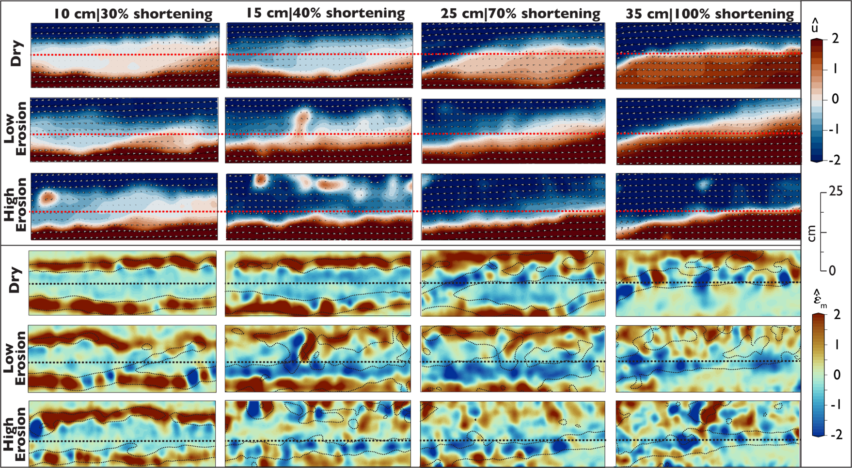
EGU GA 2023 | PICO Presentation | April 25th, 2023
STD-normalized u - component of velocity field and dilatational strain rate
Table
of
contents
Click here for details
Conrad et al. (2023, under review in Tectonics)
Next
Prev

Slide 10
EGU GA 2023 | PICO Presentation | April 25th, 2023
STD-normalized u - component of velocity field and dilatational strain rate
Table
of
contents
^
Go back
Upper panels: Normalized u (right-left) -component of normalized horizontal velocity (u)
Horizontal velocity field, u, normalized by standard deviation in each frame to enhance data visibility within frames.
Sharp color contrast indicates locations of strike-slip deformation. Irregular red blobs show locations of land sliding or noise caused by mist interference. The dashed red line indicates the velocity discontinuity.
Lower panels: Normalized dilatational strain-rate, (ε_{m}).
Positive values (red) indicate compression, negative values (blue) indicate extension.
Dry experiments characterized by more restraining bends along master fault strike.
.
^
Next
Prev

Slide 11
EGU GA 2023 | PICO Presentation | April 25th, 2023
Shear strain rate and active structures
Table
of
contents
Click here for details
Conrad et al. (2023, under review in Tectonics)
Next
Prev

Slide 12
EGU GA 2023 | PICO Presentation | April 25th, 2023
Shear strain rate and active structures
Table
of
contents
Upper panels: The normalized maximum horizontal shear strain-rate at each stage (ε_{s}).
white dotted lines are superimposed ε­_{s} = 1.5­ contours. The dashed white line indicates the VD.
Lower panels: Active faults determined by interpreting fault locations with respect to ε­_{s}.
The dashed red line indicates the VD. The evolution is broken into four stages of strain partitioning:
Distributed strain and en-echelon R-shear formation
Oblique slip on bivergent thrusts
Transitional strain partitioning
Full partitioning to throughgoing structure (s).
Go back
.
^
.
^
.
^
.
^
Next
Prev

Slide 13
EGU GA 2023 | PICO Presentation | April 25th, 2023
Shear strain rate videos
Table
of
contents
Dry
Videos will autoplay, and loop but feel free to stop, fast forward, reverse at will!
Low Erosion
X section: CR2
High Erosion
Next
Prev

Slide 14
EGU GA 2023 | PICO Presentation | April 25th, 2023
Topographic development and critical taper
Table
of
contents
Swath profiles taken across the section shown in the inset.
Estimated values:
RU – rock uplift
E – exhumation
SU – surface uplift
Next
Prev
Conrad et al. (2023, under review in Tectonics)

Slide 15
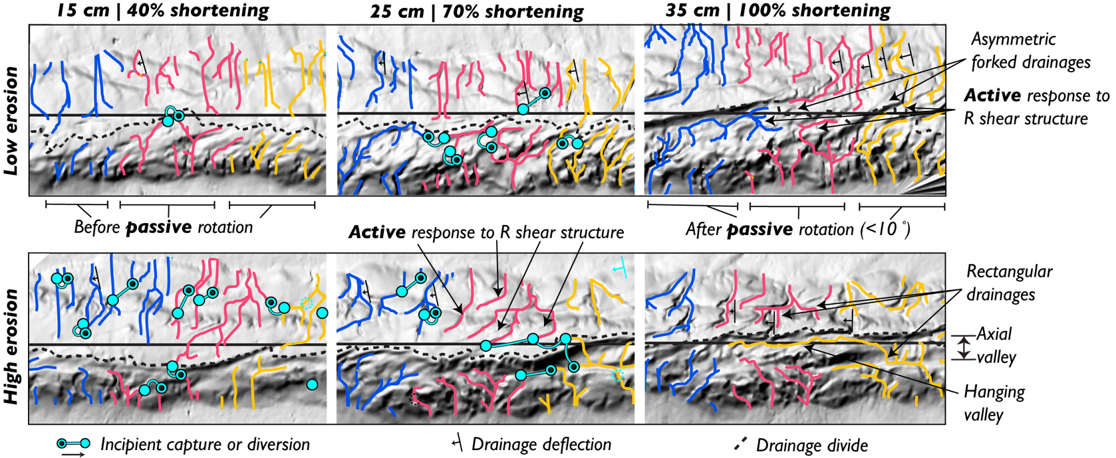
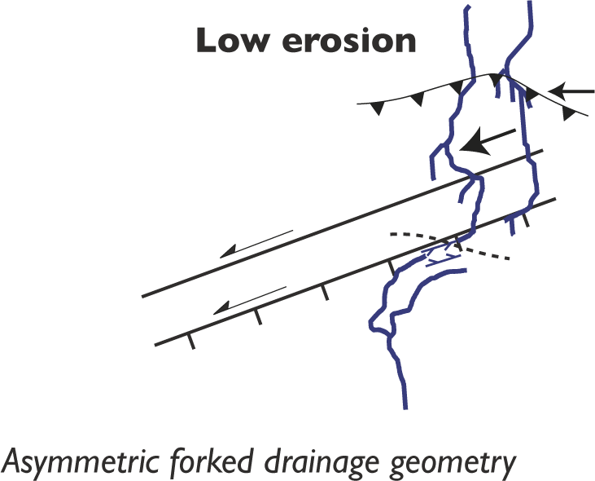
EGU GA 2023 | PICO Presentation | April 25th, 2023
Stream evolution – high vs. low erosion systems
Table
of
contents
Next
Prev
Conrad et al. (2023, under review in Tectonics)
Notes:
Particularly, we find more asymmetric-forked drainage geometries in the low erosion models and rectangular drainages comprising transverse+Velocity discontinuity parallel stream channels in the high erosion model

Slide 16
EGU GA 2023 | PICO Presentation | April 25th, 2023
Stream evolution mechanisms
Table
of
contents
Next
Several examples of drainage rearrangement mechanisms and their superposition to form complex drainage patterns.
Examples include capture, diversion/offset, beheading, structural entrainment, passive rotation
Prev
Conrad et al. (2023, under review in Tectonics)

Slide 17
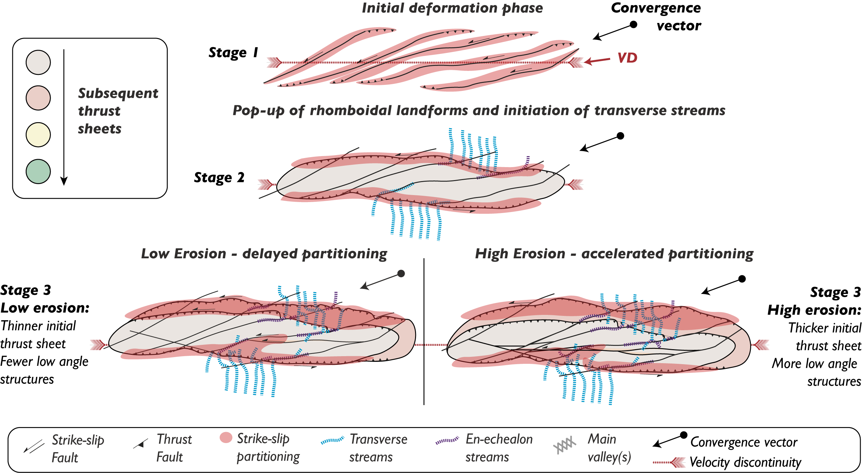
EGU GA 2023 | PICO Presentation | April 25th, 2023
Schematic synthesis: stages 1-3
Table
of
contents
Next
Prev
Conrad et al. (2023, under review in Tectonics)

Slide 18
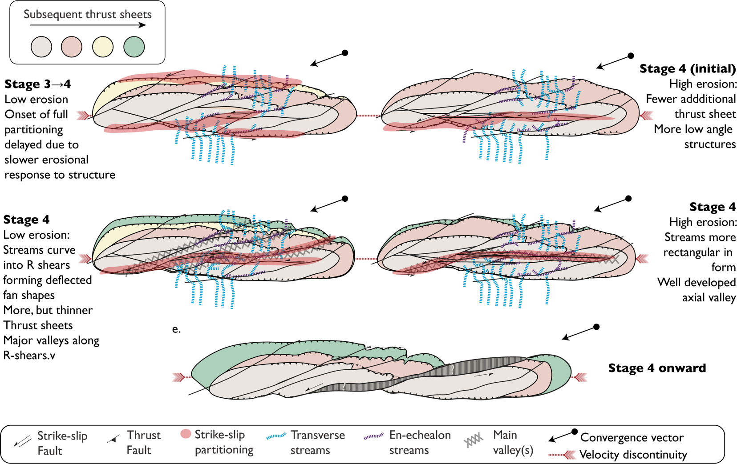
EGU GA 2023 | PICO Presentation | April 25th, 2023
Schematic synthesis: stage 4 onward
Table
of
contents
Next
Prev
Conrad et al. (2023, under review in Tectonics)

Slide 19
EGU GA 2023 | PICO Presentation | April 25th, 2023
Natural prototypes
Key similarities
Key similarities
Next
Table
of
contents
Prev
Key similarities
Conrad et al. (2023, under review in Tectonics)

Slide 20
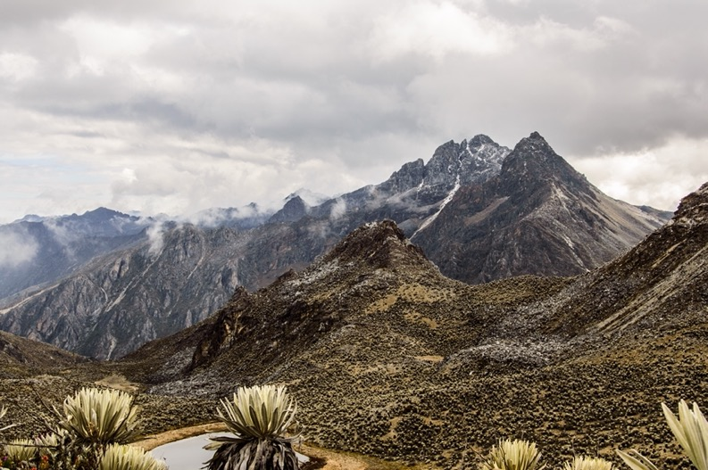
EGU GA 2023 | PICO Presentation | April 25th, 2023
Natural prototypes – Merida Andes
Key similarities: Merida Andes Venezuela
Thrust-bounded wedge
Highly partitioned strike-slip fault coincident with main axial valley (Bocono fault)
Axial valley subparallel to trend of range (Bocono-Chama)
Local extension along axial valley forming endorheic basins at R-shear-master fault intersection (Apartaderos basin)
Deflected, entrained and potentially rotated drainages
Precipitation: ~50 - 250 cm yr ⁻¹
Go back
Next
Prev
Wikimedia commons – user content: Adolfo

Slide 21
EGU GA 2023 | PICO Presentation | April 25th, 2023
Natural prototypes – Central Transverse Ranges
Key similarities: Central Transverse Ranges, CA. Thrust-bounded wedge
Partitioned strike-slip fault coincident with major drainage networks (San Andreas).
Deflected, entrained and potentially rotated drainages.
Kinematically offset rhomboidal landforms.
Precipitation: ~25-100 cm yr ⁻¹
Next
Go back
Prev

Slide 22
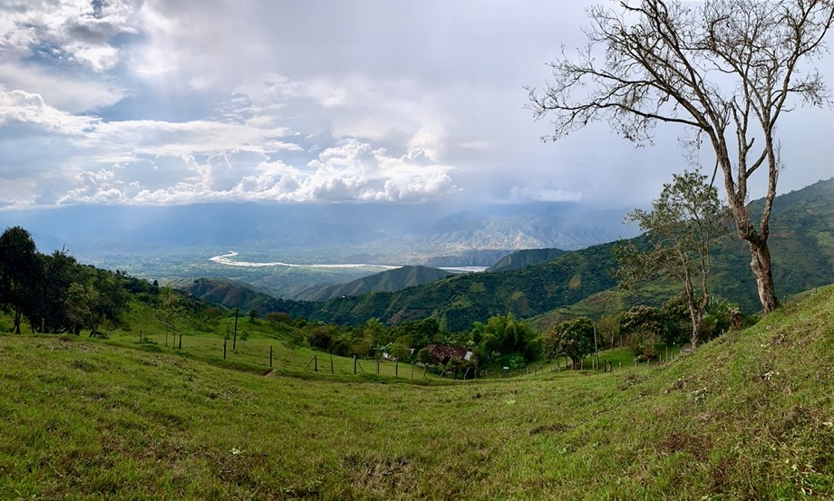
EGU GA 2023 | PICO Presentation | April 25th, 2023
Natural prototypes – Central and Western Colombian Andes
Key similarities: Central and Western Colombian Andes
Thrust-bounded wedge
Main strike-slip faults coincident with major drainage networks (Cauca and Romeral faults)
Axial valley subparallel to trend of range (Cauca Valley)
Axial valley under extension
Deflected, entrained and potentially rotated drainages.
Map scale R-shear structures and corresponding valleys (e.g., Espiritu Santo fault)
Precipitation: ~200-300 cm yr ⁻¹
Go back
Prev

