Slide 1
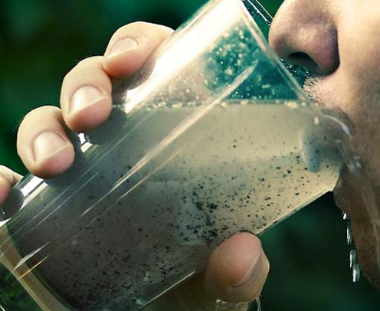
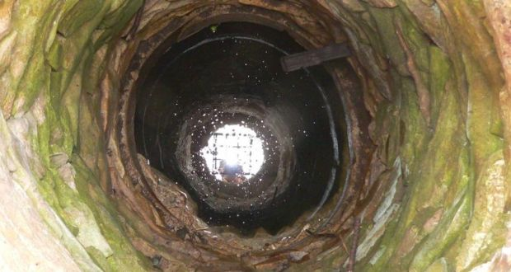
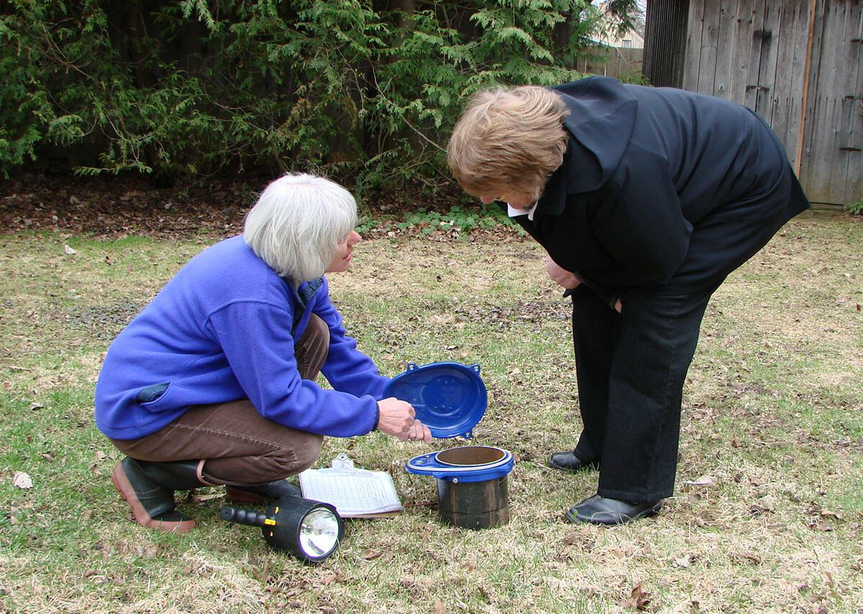





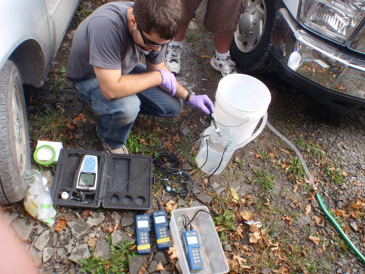
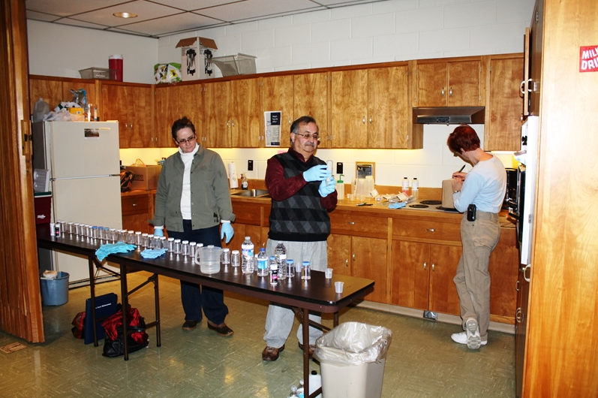
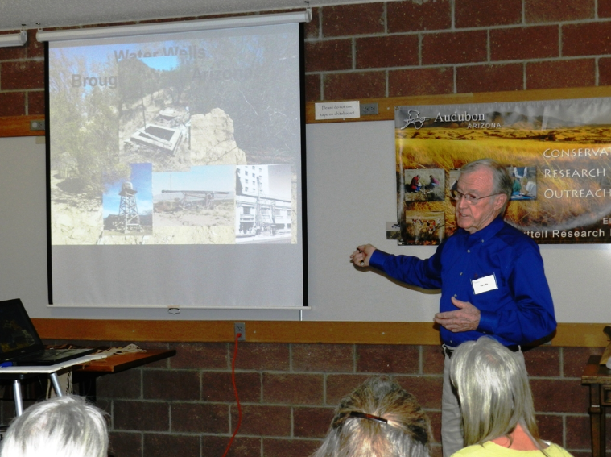
Private groundwater contamination and risk management:
A scoping review of similarities, drivers and challenges in two developed regions
Mooney, S., O’Neill, E. & Hynds, P.
EGU Conference Vienna 27 April 2023

Slide 2
INTRODUCTION

Slide 3
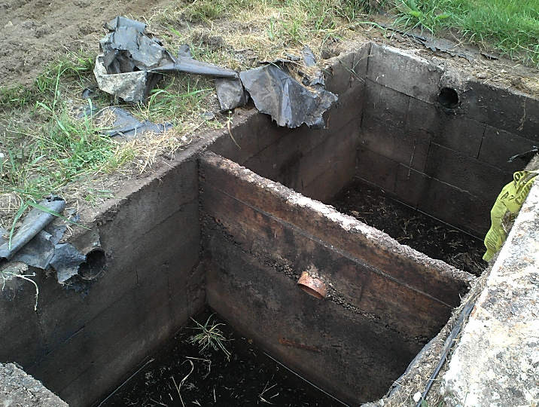
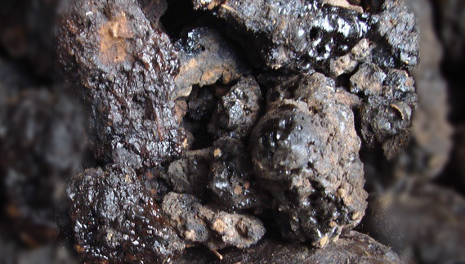
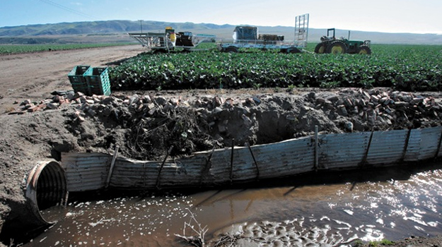
Overview
Groundwater constitutes almost 50% of the global volume of water used for domestic purposes.
Subsurface supplies exposed to natural and synthetic contaminants via agro-industrial activity and extreme weather events (EWEs).
Management of groundwater drinking supplies important in both developed and developing nations.

Slide 4




Private groundwater management
INFORMATION SEEKING
SUPPLY INSPECTION
Contamination risk prevention achieved at the bottom-up (end-user) level.
Groundwater system characterisation and risk assessment should be followed by public engagement and behaviour promotion.
Syntheses of research findings can contribute to top-down preventive strategies.
Engineering contractors
Accredited laboratories
Local authority services
Hazard proximity
Well casing integrity
Wellhead security
SUPPLY TESTING
SUPPLY TREATMENT
Microbial parameters
Chemical parameters
Chemical/UV disinfection
Reverse osmosis
Point-of-entry/use
Well owner maintenance responsibilities and considerations
PAGE 3

Slide 5
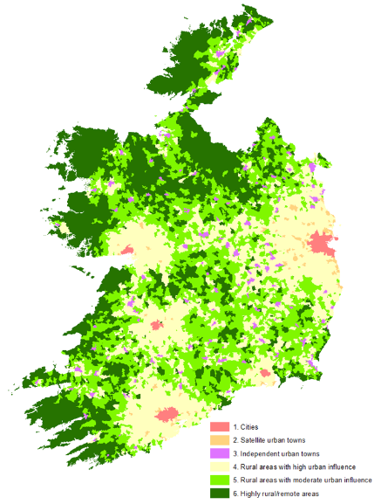
Case study: Ontario and the ROI
Both developed regions characterised by centralised urban core, largely rural topography and high private well reliance.
Population distribution in the ROI by urban/rural classification (CSO, 2016).

Slide 6
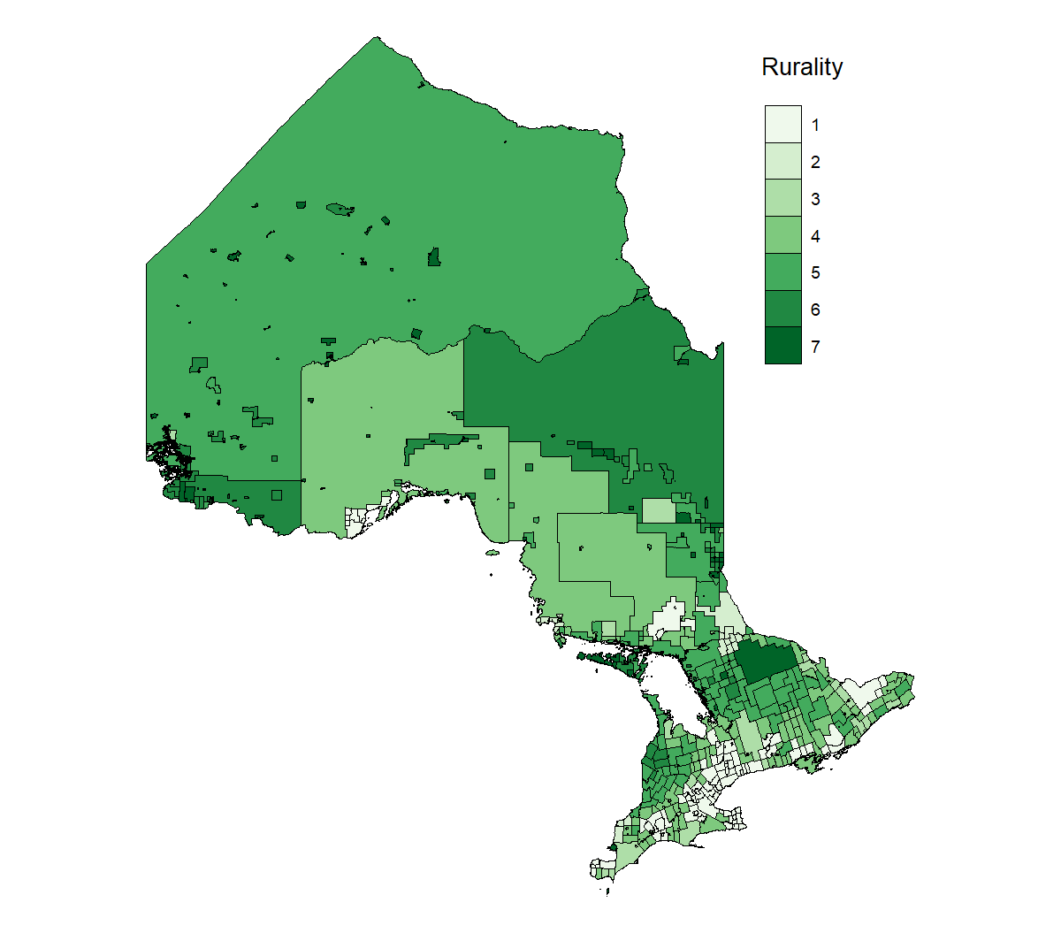
Case study: Ontario and the ROI
Both developed regions characterised by centralised urban core, largely rural topography and high private well reliance.
Rurality by census division in Ontario, 2016 (Statistics Canada, 2016).

Slide 7

INTRODUCTION
Case study: Ontario and the ROI
Both developed regions characterised by centralised urban core, largely rural topography and high private well reliance.
Ontario contains approx. 500,000 private wells serving 1.5m people (10% of the provincial population).
The ROI contains approx. 180,000 private wells serving 800,000 people (16% of the national population).
Estimated private groundwater reliance in Ontario
Estimated private groundwater reliance in the ROI
PAGE 5

Slide 8
INTRODUCTION
Case study: Ontario and the ROI
Regions distinguished by physical and administrative geography as well as several regulatory parameters.
 | Ontario | Republic of Ireland
Land area (km²) | 1,076,000 | 70,273
Population | 14,200,000 | 5,100,000
Climate | Humid continental | Cool temperate oceanic
Lowest tier of government | Municipal | County
Threshold for water supply regulation | > 50m³ water per day or ≥ 5 properties | > 10m³ water per day or > 50 people
Supply regulatory requirements | Well driller licensing, bacterial testing during property transactions | -
Supply maintenance incentivisation | Free bacterial water testing | -
Both regions characterised by increasing rates of supply contamination and associated waterborne illness.
PAGE 6

Slide 9
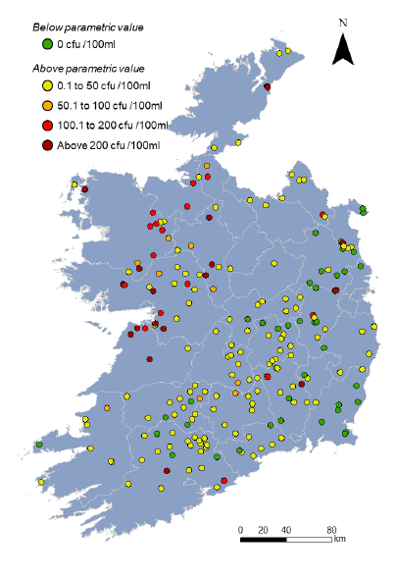
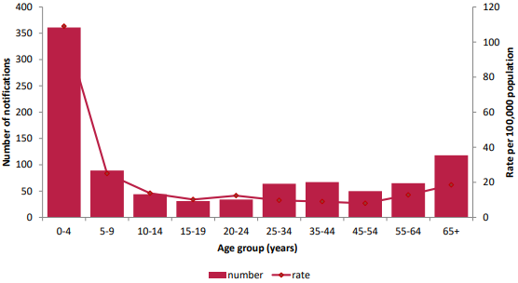
Case study: Ontario and the ROI
Number of cases of VTEC (and percentage where information available) for selected risk factors in the ROI, 2017 (n = 923).
Consumption of private well water contributes to approximately 4,800 annual cases of AGI in Ontario.
As many as 80% of annual cases of verotoxigenic E.coli (VTEC) in the ROI linked with private well water exposure.
Risk communication interventions required to promote private well maintenance.
Risk factor | Yes (% of known) | No | Unknown/not reported
Food suspected | 48 (8.3%) | 528 | 347
Exposure to farm animals or their faeces | 283 (36.0%) | 495 | 145
Exposure to private well water | 288 (41.0%) | 414 | 221
Travel-associated | 40 (4.6%) | 825 | 58
Attendance at a childcare facility | 160 (20.0%) | 632 | 131
Attendance at a childcare facility | 143 (47.0%) | 162 | 56
Mean faecal coliform concentrations in groundwater samples from stations monitored by the EPA in the ROI from 2014 to 2019 (Andrade et al., 2021).
Age-specific incidence rates of VTEC notifications in the ROI in 2017 (HPSC, 2019).
PAGE 7

Slide 10
INTRODUCTION
Research objectives
Examine the landscape of peer-reviewed academic research investigating private well contamination and management between 1990-2022.
Determine the extent of similarities between drivers and management of private domestic well contamination in Ontario and the ROI.
PAGE 8

Slide 11
INTRODUCTION
Research objectives
Examine the landscape of peer-reviewed academic research investigating private well contamination and management between 1990-2022.
Determine the extent of similarities between drivers and management of private domestic well contamination in Ontario and the ROI.
Identify significant control points for future top-down risk prevention interventions.
INFORMATION SEEKING
!
SUPPLY TESTING
POST-EWE ACTIONS
CONTAMINATION SOURCES
SUPPLY TREATMENT
SUPPLY AGE
SUPPLY DEPTH
PAGE 8

Slide 12
METHODOLOGY

Slide 13
Research Question
‘In the ROI and Ontario (S), to what extent is private groundwater contamination (P) addressed in current peer-reviewed research (I) and characterised by similarities in causality and management (C) with respect to measured outcomes (E)?’

Slide 14
Literature search
Evaluation
Principle study outcomes and measures of success forever
Intervention
Investigation adopted to study and reduce private groundwater contamination
Setting
Ontario and the Republic of Ireland forever
Perspective
Private domestic groundwater wells and supply users
Comparison
Differences in investigative approach and studied phenomena

Slide 15
METHODOLOGY
Articles identified through Scopus
(n = 739)
Literature screening
Articles identified through legacy searches
(n = 20)
Articles identified through Web of Science
(n = 2,600)
Identification
Duplicate article removal
(n = 1,117)
Articles excluded based on title and abstract
(n = 1,812)
Articles after duplicate removal
(n = 2,222)
Screening
Eligibility assessment
(n = 410)
Full text articles removed
(n = 331)
Eligibility
Relevant studies
(n = 89)
PAGE 12

Slide 16
RESULTS

Slide 17
RESULTS
Article characteristics
A total of 89 relevant articles identified.
Considerable increase in research output post-2000.
51 articles identified in Ontario; 38 in the ROI.
Only 3 articles address risk communication responses to private well contamination; 59 groundwater quality characterisation and risk assessment studies.
1990-1994:
Ontario = 0 articles
ROI = 0 articles
2000-2004:
Ontario = 1 article
ROI = 0 articles
2010-2014:
Ontario = 11 articles
ROI = 10 articles
1990
2022
2000
2010
2020
1995
2005
2015
1995-1999:
Ontario = 6 articles
ROI = 0 articles
2004-2009:
Ontario = 6 articles
ROI = 0 articles
2014-2019:
Ontario = 15 articles
ROI = 9 articles
PAGE 14

Slide 18
RESULTS
Policy analyses
Section 2: ROI | Study characteristics
Article | Type | Scale | Data analysis methods | Phenomena of focus | Principal themes
Brady & Gray (2010) | Discussion | National | - | Community water scheme sector | Institutional resources, supply management structures, technical resources
Deane & Mac Dohmnaill (2021) | Discussion | National | - | Community water scheme sector | Institutional resources, risk management strategies, risk management responsibilities, supply management structures, technical resources
Section 1: Ontario | Study characteristics
Article | Type | Scale | Data analysis methods | Phenomena of focus | Principal themes
Baird et al. (2013) | Discussion | Provincial | - | Water protection policy | Risk management evaluation mechanisms, risk management strategies
Chappells et al. (2014) | Discussion | Provincial | - | Arsenic mitigation strategies, maximum permitted contaminant levels (μg/L) in drinking water. | Risk communication, risk management evaluation mechanisms, supply testing support,
de Loë & Kreutzwiser (2005) | Discussion | Provincial | - | Regulatory management initiatives, top-down groundwater management | Financial resources, institutional resources, political resources, risk management strategies, social resources, technical resources
Roth (2008) | Discussion | Municipal | - | Groundwater management responsibilities, historical water protection policy initiatives | Financial resources, institutional resources, political resources, risk management strategies, social resources, technical resources
PAGE 15

Slide 19
RESULTS
Risk communication studies
Section 1: ROI | Study characteristics
Article | Type | Scale | Data analysis methods | Phenomena of focus | Principal themes
Mooney et al. (2020) | Expert interview | International | One-way ANOVA test, Pearson Chi-squared test, t-test | Risk communication, behavioural promotion strategies | Behavioural science, engineering/ science, expert preferences, policy, public communication
Section 1: Ontario | Study characteristics
Article | Type | Scale | Data analysis methods | Phenomena of focus | Principal themes
Di Pelino et al. (2019) | Framework development | Provincial | - | Risk communication, socio-hydrogeology, | Behavioural science, environmental modelling, socio-ecology
Section 1: Ontario | Study characteristics
Article | Type | Scale | Data analysis methods | Phenomena of focus | Principal themes
Di Pelino et al. (2019) | Framework development | Provincial | - | Risk communication, socio-hydrogeology, | Behavioural science, environmental modelling, socio-ecology
Hexemer et al. (2008) | Intervention evaluation | Municipal | Descriptive | Supply testing | Behavioural, resource, socio-demographic
PAGE 16

Slide 20
Global distribution of evaluated educational interventions
Country development status
Developed
Developing
Interventions included
1
2-5
6-9
10-19
Contaminants of concern
Geogenic: 38 Microbial: 1
Source: Mooney et al. (2020).

Slide 21
RESULTS
Audience analyses
Qualitative studies
Section 1: Ontario | Study characteristics
Article | Type | Scale | Data analysis methods | Phenomena of focus | Code categories
Imgrund et al. (2011) | Interview | Municipal | Causal network analysis, thematic analysis | Supply testing frequency | Affective, behavioural, cognitive, experiential, normative, resource
Jones et al. (2005) | Focus group | Municipal | Thematic analysis | Alternative water source use, contamination risk perception, information needs, supply testing, supply treatment, water quality perception | Affective, behavioural, belief, cognitive, experiential, resource, socio-demographic
Section 2: ROI | Study characteristics
Article | Type | Scale | Data analysis methods | Phenomena of focus | Code categories
Hooks et al. (2019) | Interview | National | Thematic analysis | Contamination risk perception, supply testing | Affective, behavioural, cognitive, experiential, geographical, normative, resource, supply characteristic
McDowell et al. (2021) | Focus group | Municipal | Thematic analysis | Alternative water source use, contamination risk perception, information needs, supply testing, supply treatment, water quality perception | Affective, behavioural, belief, cognitive, experiential, resource, socio-demographic
PAGE 18

Slide 22
Quantitative studies
Section 1: Ontario | Study characteristics
Article | Type | Scale | Data analysis methods | Phenomena of focus | Independent variable categories
Jones et al. (2006) | Survey | Municipal | Descriptive | Alternative water source use, information needs, supply testing, supply treatment, water quality perception | Affective, behavioural, cognitive, experiential, resource, socio-demographic
Kreutzwiser et al. (2011) | Survey | Municipal | Binary logistic regression, Pearson Chi-squared test | Attitude towards supply decommissioning, general supply maintenance, information needs, supply testing frequency, wellhead maintenance | Behavioural, cognitive, experiential, geographical, resource, socio-demographic, supply characteristic
Lavallee et al. (2021a) | Survey | Provincial | Kruskal-Wallis test, Mann-Whitney U test, one-way ANOVA test, Pearson Chi-squared test, t-test | General attitude towards supply, general groundwater beliefs, general supply knowledge, general supply risk perception | Behavioural, cognitive, experiential, geographical, socio-demographic, supply characteristic
Lavallee et al. (2021b) | Survey | Provincial | Pearson Chi-squared test | Alternative water source use, water consumption | Behavioural, experiential, geographical, socio-demographic, supply characteristic
Ugas et al. (2019) | Survey | Regional | Binary logistic regression | Supply testing frequency | Behavioural, socio-demographic, supply characteristic

Slide 23
Section 2: ROI | Study characteristics
Article | Type | Scale | Data analysis methods | Phenomena of focus | Independent variable categories
Andrade et al. (2019) | Survey | National | Binary logistic regression | Post-flood supply maintenance | Affective, cognitive, experiential, normative, resource
Hynds et al. (2012) | Survey | National | One-way ANOVA test, Pearson Chi-squared test, Spearman’s Rho test, t-test | Water consumption | Behavioural, experiential, physiological, socio-demographic, supply characteristic
Hynds et al. (2013) | Survey | National | One-way ANOVA test, Pearson Chi-squared test, Spearman’s Rho test, t-test | General supply knowledge, general supply maintenance, information seeking | Behavioural, cognitive, experiential, geographical, socio-demographic, supply characteristic
Hynds et al. (2014) | Survey | National | Mann-Whitney U test, one-way ANOVA test, Pearson Chi-squared test, Spearman’s Rho test, t-test, two-step cluster analysis | General supply knowledge | Behavioural, cognitive, experiential, socio-demographic, supply characteristic
McDowell et al. (2020) | Survey | National | Binary logistic regression, one-way ANOVA test, Pearson Chi-squared test | Attitude towards post-flood supply maintenance, barriers to supply testing, perceived self-efficacy in undertaking supply testing, post-flood supply maintenance, supply maintenance knowledge | Affective, behavioural, cognitive, experiential, geographical, normative, resource, socio-demographic

Slide 24
Section 2: ROI | Study characteristics
Article | Type | Scale | Data analysis methods | Phenomena of focus | Independent variable categories
Mooney et al. (2021a) | Survey | National | Binary logistic regression, Kruskal-Wallis test, Mann-Whitney U test, Pearson Chi-squared test, two-step cluster analysis | General supply knowledge | Affective, cognitive, experiential, geographical, socio-demographic, supply characteristic
Mooney et al. (2021b) | Survey | National | Binary logistic regression, Kruskal-Wallis test, Mann-Whitney U test, Pearson Chi-squared test, two-step cluster analysis | Extreme weather event risk perception | Affective, behavioural, cognitive, experiential, geographical, socio-demographic, supply characteristic
Mooney et al. (2022) | Survey | National | Structural equation modelling | Information seeking, post-extreme weather event supply maintenance, supply testing | Affective, cognitive, experiential, geographical, socio-demographic, supply characteristic
Musacchio et al. (2021) | Survey | National | Binary logistic regression, Kruskal-Wallis test, multiple linear regression, multinomial logistic regression, one-way ANOVA test, Pearson Chi-squared test, | Flood risk perception, general supply maintenance, post-flood supply maintenance | Behavioural, cognitive, experiential, geographical, normative, resource, socio-demographic, supply characteristic
Schuitema et al. (2020) | Survey | National | Kruskal-Wallis test, Mann-Whitney U test, ordinary least squares linear regression | General supply maintenance, perceived control over water quality, water quality perception | Affective, cognitive, socio-demographic, supply characteristic

Slide 25


RESULTS
Supply stewardship
WELL TESTING
WELL TREATMENT
SUPPLY KNOWLEDGE
RISK PERCEPTION
ONTARIO
Mean rate = 87.2%
Principal determinants
Financial cost, inconvenience, organoleptics, risk perception, supply knowledge, supply type (dug or drilled)
ONTARIO
Mean rate = 42.3%
Principal determinants
Organoleptics
ONTARIO
Mean rate = 71.0%
Principal determinants
Age, residence during supply construction
ONTARIO
Mean rate = 94.0%
Principal determinants
Gender, supply maintenance history
WELL TESTING
WELL TREATMENT
SUPPLY KNOWLEDGE
RISK PERCEPTION
REPUBLIC OF IRELAND
Mean rate = 69.1%
Principal determinants
Financial cost, inconvenience, perceived self-efficacy, organoleptics, social norms, supply knowledge
REPUBLIC OF IRELAND
Mean rate = 35.4%
Principal determinants
Household income, organoleptics, perceived self-efficacy
REPUBLIC OF IRELAND
Mean rate = 66.7%
Principal determinants
Age, household composition, residence during supply construction
REPUBLIC OF IRELAND
Mean rate = 53.5%
Principal determinants
Gender

Slide 26
Conclusions
Greater attention towards risk characterisation than risk prevention strategies in both Ontario and the ROI.
Only three risk communication studies (and one intervention evaluation) documented.
Gender, organoleptics and perceived self-efficacy key determinants of well stewardship behaviours.
Similarities documented in behavioural determinants among both Irish and Ontarian private well users.
Audience-focused, incentivised strategies may determine the success of future behaviour promotion interventions.
PAGE 20

