Slide 1
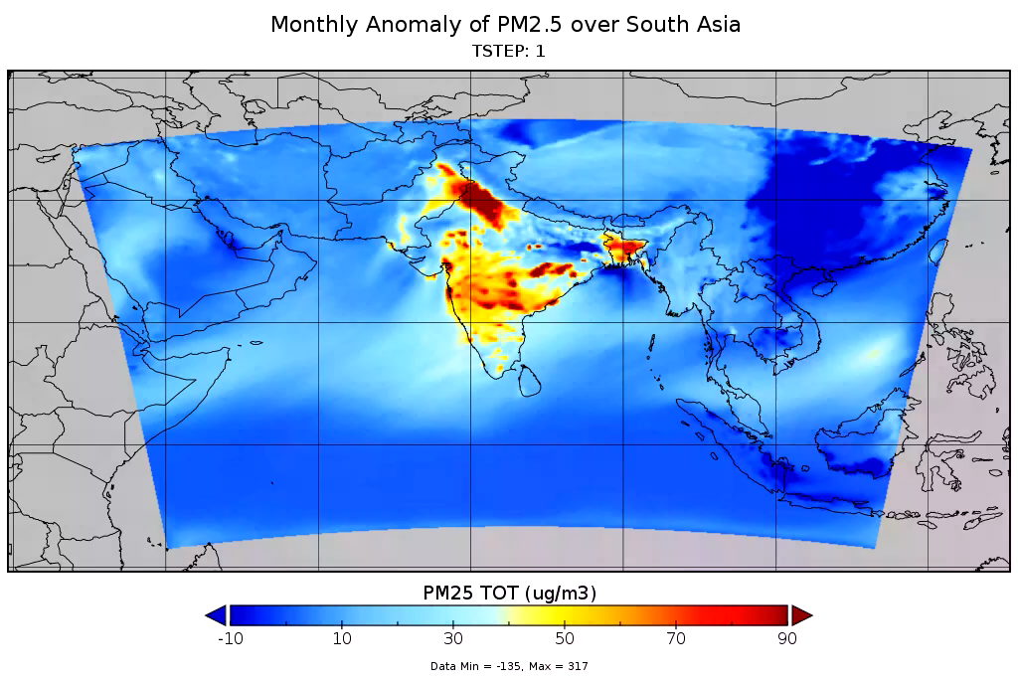
High-resolution dynamical downscaling of present and future air quality over the South Asia-Cordex domain with a focus on the megacity Delhi, India
Ummugulsum Alyuz¹, Ranjeet Sokhi¹, Kester Momoh¹, Vikas Singh², Chandra Venkataraman³, Arushi Sharma³, Ganesh Gupta³, Kushal Tibrewal³, Ravindra Khaiwal⁴, Suman Mor⁵, and Gufran Beig⁶ and the PROMOTE Team
(1) Centre for Climate Change Research (C3R), University of Hertfordshire, U.K., (2) National Atmospheric Research Laboratory, Gadanki, Andhra Pradesh, India , (3) Indian Institute of Technology Bombay, India , (4) Post Graduate Institute of Medical Education & Research (PGIMER), Chandigarh. India, (5) Department of Environment Studies, Panjab University, Chandigarh, India , (6) National Institute of Advanced Studies (NIAS), Indian Institute of Science (IISc) Campus, Bangalore, India
SCOPE
Results and discussion
How air quality changes in South Asia in a changing climate under SSP245 (middle of the road scenario) ?
What is the impact of the road transport emissions on air quality over Delhi ?
CMAQ model predicted monthly means of PM_{2.5} anomalies (2050-2015) range over India between 8 to 41 μg/m³.
Significant change is PM_{2.5}, PM₁₀, NO_{x} and O₃ anomalies, especially in the urban regions of India, such as Delhi, before and after the Monsoon months (June to October).
Although averaging ten years around the desired year suppresses the diurnal variations, it provides an indication of monthly changes in climate and air quality variables.
In the hypothetical scenario (Scenario1) where road transport emissions were absent in 2018, annual mean of PM₁₀ and PM_{2.5} concentrations would decrease by 3%, NO_{x} by 32%, CO by 35%, and O₃ would increase by 9%. Additionally, both SO₂ and NH₃ would also decrease by 3%.
MONTH:
METHODOLOGY
*
Delhi
1st set of runs :
Bias-corrected CMIP6 data for WRF
For South Asia-Cordex domain, 27 km grid resolution
2015 (representative of 2011-2020) 2050 (representative of 2046-2055)
Future land use land cover, initial and boundary conditions, and future emissions for India were used to drive CMAQ model.
2nd set of runs :
45km x15 km x 5 km x 1.6 km nested run for 2018.
Baseline and Scenario 1 (no road transport in the 5km domain covering Delhi)
High resolution OSCAR4 model for road transport contribution
PM2.5 monthly anomaly plot for 2050-2015 for South Asia predicted by CMAQ model with CMIP6 SSP245 scenario
Notes:
What's causing the poles to warm faster than the rest of Earth?
https://www.nasa.gov/topics/earth/features/warmingpoles.html

