Slide 1

Addition of biochar as thin preamble layer into sand filtration columns could improve the microplastics removal from water
Lichun Hsieh, Meiping Tong
College of Environmental Sciences and Engineering,
Peking University, P.R. China
E-mail: lichun@stu.pku.edu.cn (L. Hsieh), tongmeiping@pku.edu.cn (M. Tong)
Notes:
Good morning ladies and gentlemen, I’m Lichun Hsieh from the College of Environmental Sciences and Engineering at Peking University.
My report topic is Addition of biochar as thin preamble layer into sand filtration columns could improve the microplastic removal from water.

Slide 2
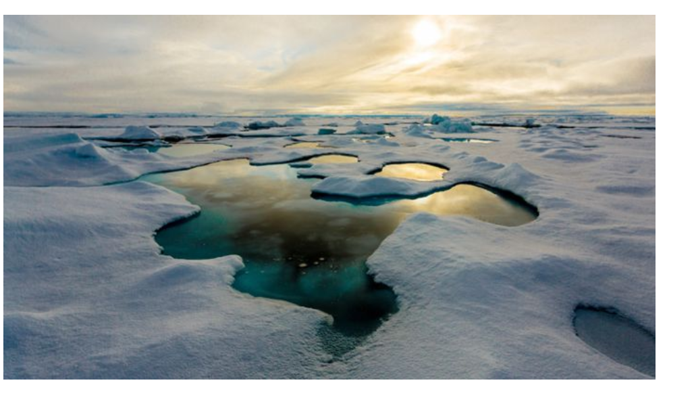
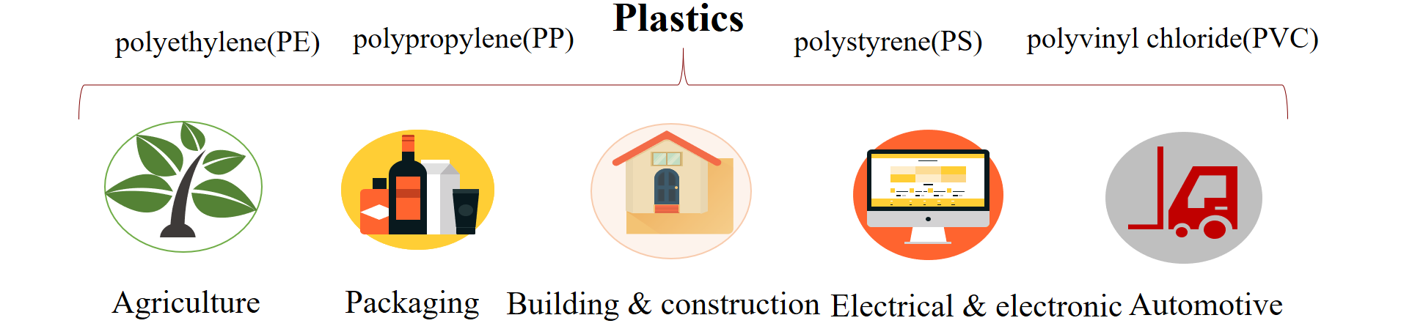
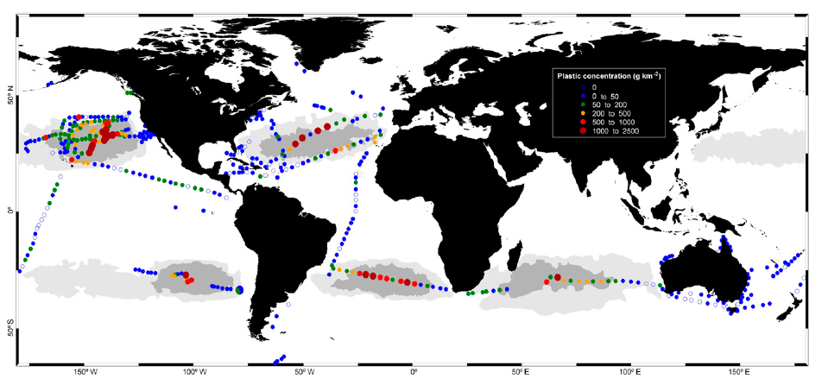
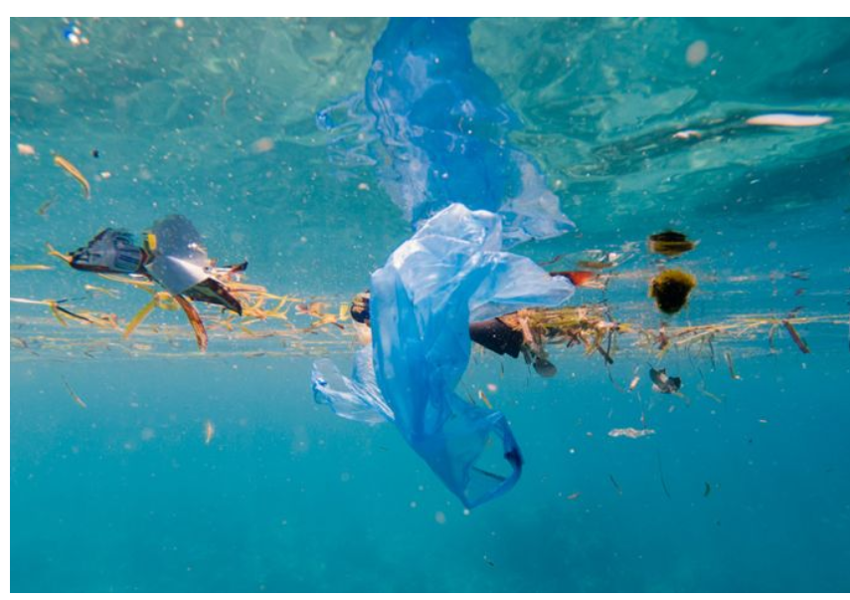
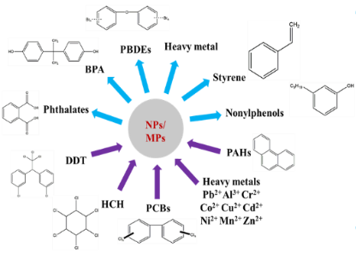
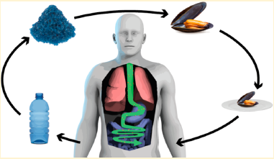
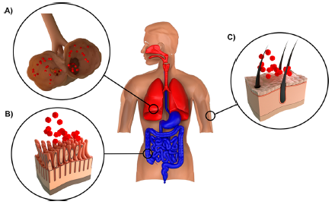
Background: Damage of Microplastic
Widely used to produce different products
Nature, 2018
Proc Natl Acad Sci U S A 2014, 111, (28), 10239-44,
Nature, 2019
Plastics have been present in natural environment systems such as marine, surface water, sediment, soil, and even arctic ice
Environ. Sci. Technol. . 2018, 52, 1704-1724,
Environ. Sci. Technol. 2019, 53, (4), 1748-1765,
interact with different pollutants and serve as the mobile phase
accumulate in the food chain result in human exposure
Notes:
Plastic particles especially microplastics have recently caused global concerns owing to their ubiquitous presence in natural environments and their potential risks to ecosystems and human health.
The microplastic could interact with different pollutants and serve as the mobile phase for pollutants, moreover, microplastic would accumulate in the food chain resulting in human exposure, posing threat to human health.

Slide 3
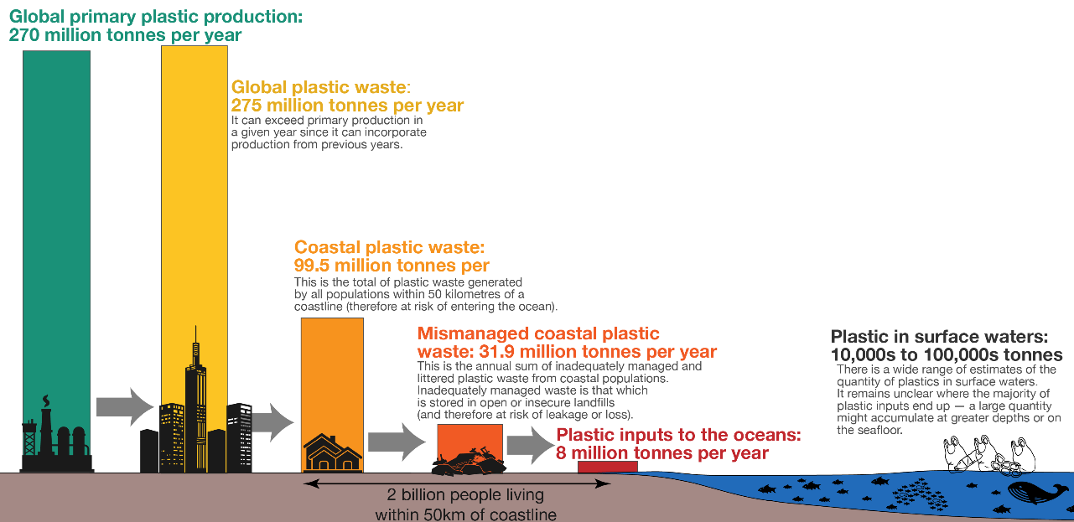
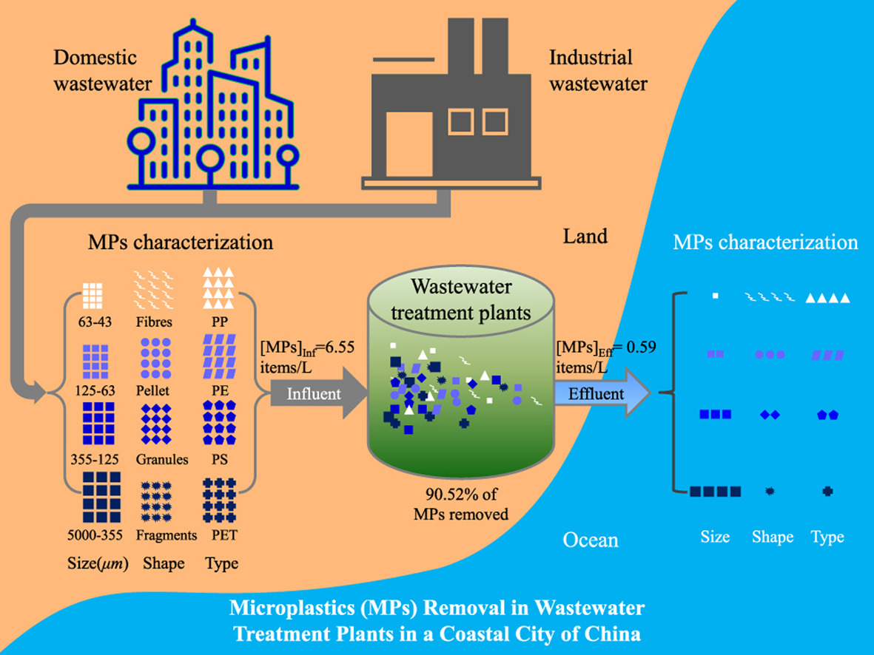
Background: Sources of Microplastic
80% of the microplastic in ocean originates from land-based sources, related to sewage, wastewater treatment plants and urban runoff discharges .
The removal efficiency of Waste water treatment plants (WWTPs) is mostly above 90%, majority of MPs remains in the sludge.
Despite the high efficiency of the treatment systems in WWTP, the quantity microplastic particle released is still of great concern due to the significant volume of wastewater treated on a daily base.
Improving the effectiveness of microplastic removal is therefore of high importance to minimize the release of microplastics.
Notes:
It’s reported 80% of the microplastic in the ocean originates from land-based sources, related to wastewater treatment plant discharges.
Although the majority of plastics could be retained via different water treatment processes in WWTPs, the amounts of microplastic discharged into aquatic environment from WWTPs are of great concern owing to the significant volumes of daily treated wastewater
For example, it had been reported that about 10 million MPs were discharged into local water every day from the municipal WWTPs in Jiangsu province, China.
Thus, improving the effectiveness of microplastic removal is of high importance to minimize the release of microplastics into the environment.

Slide 4
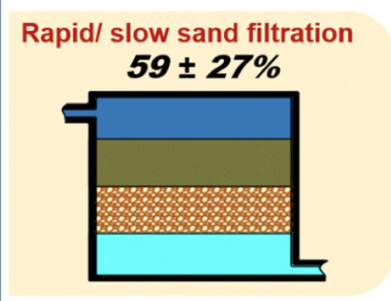
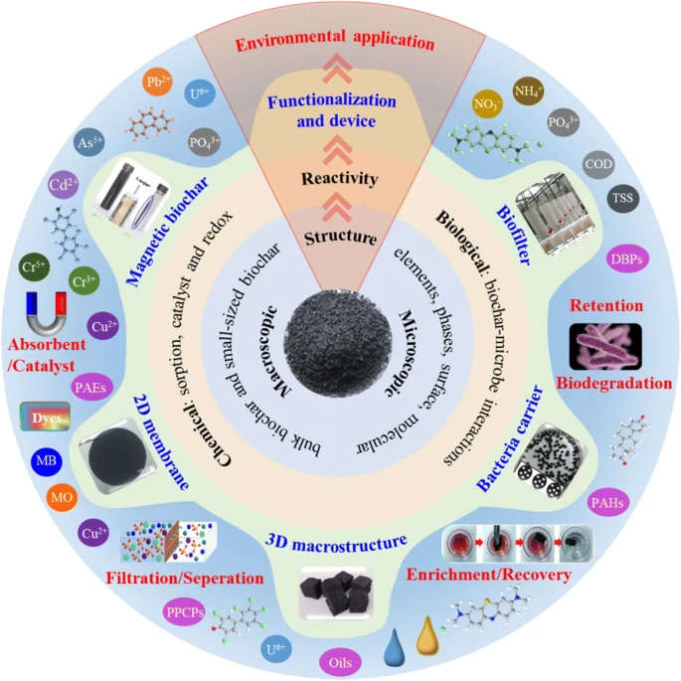
Background: Biochar improved Sand filters
Environmental Technology & Innovation, 2020
Biochar, 2020
Sand filters
Easy operation and relatively low-cost
Applied in WWTPs to remove colloidal particles
Yet, the removal rates of plastics were limited
Biochar layer improved Sand filters
to testify the removal performance of small-sized MPs with thin biochar layer added into sand filtration systems
Biochar
with large surface area, porosity, functional groups
high adsorption capacity
eco-friendly, low manufacture cost, potential for local production
Notes:
Owing to easy operation and relatively low cost, sand filtration systems were commonly applied in WWTPs to remove colloidal particles.
Yet, the removal rates of plastics by sand filtration systems were limited.
Biochar The eco-friendly nature, low manufacturing cost and extensive potential for local production make it a perfect solution for pollutant treatment.
Previous research showed that biochar, with large surface area, porosity, and great adsorption capacity, could be added into sand filtration systems to increase the removal efficiencies of multiple pollutants such as organic, inorganic, and microbial contaminants
Therefor in this study, we use biochar to propose an economical biochar-improved Sand filters to further improve the microplastic particle removal ability.

Slide 5
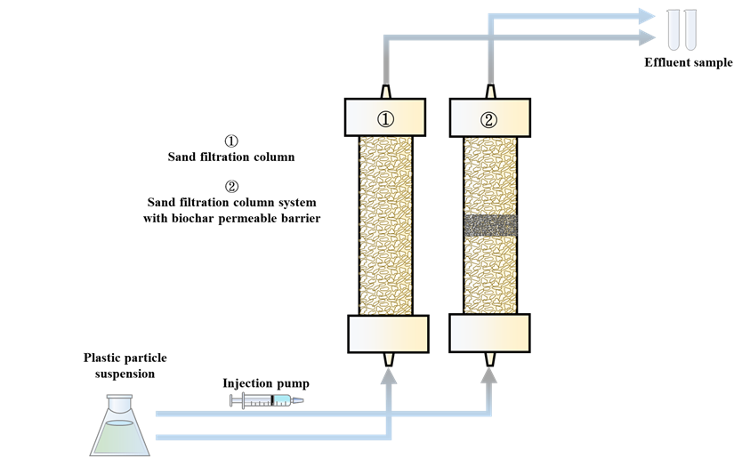
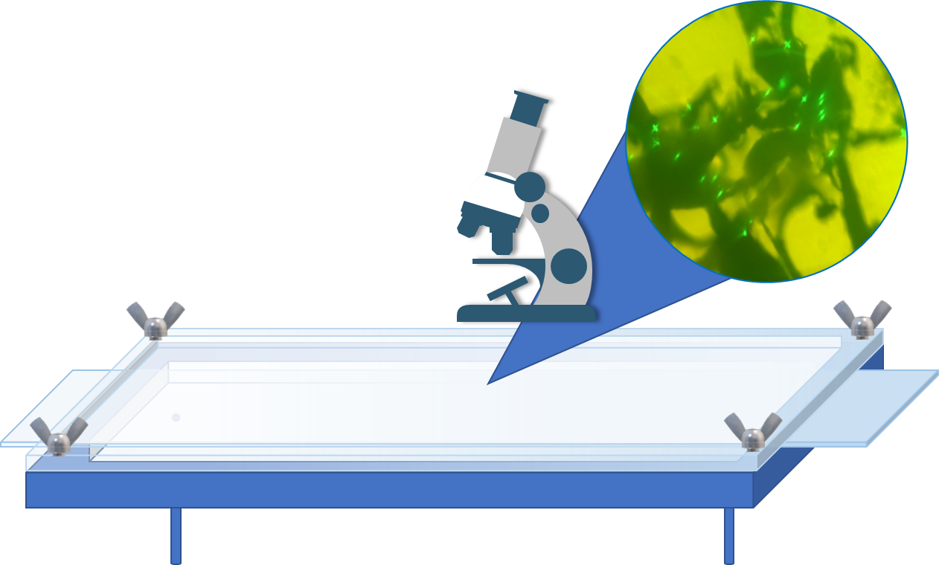
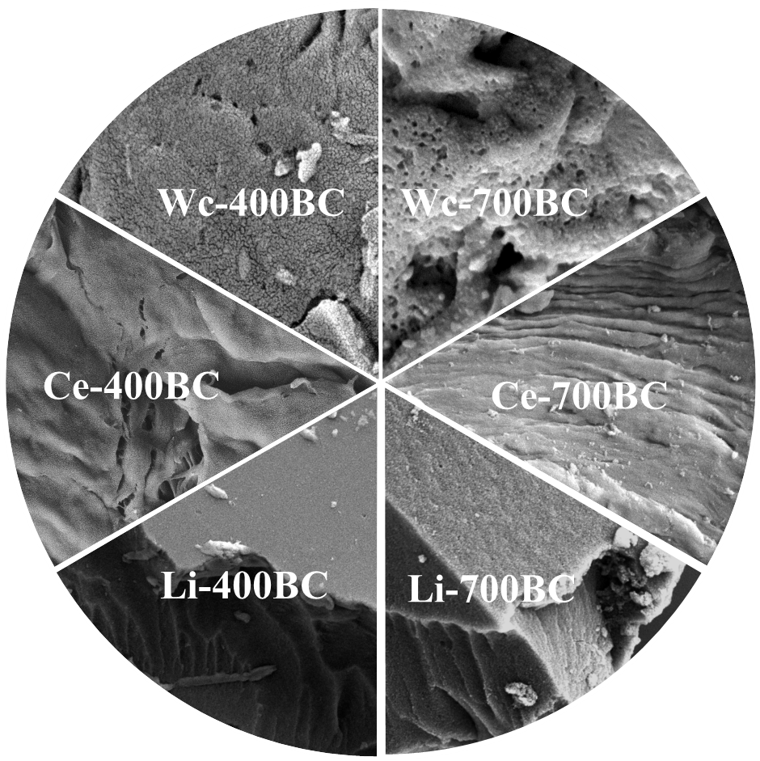
Materials & Methods
Column experiments
Mechanism analysis
6 Biochar
Lignin 400 / 700
Effluent property alternation
Cellulose 400/ 700
Breakthrough curves
Wood chips 400 / 700
Tracer experiment and column porosity changes
+
Real-time observation of dynamic retention process
Batch adsorption experiment
Slow filtration: 4 m/d
Fast filtration: : 160 m/d
Retained profiles
Different application conditions
Real river water, actual sewage water / in multiple removal cycles
Interval operating conditions / Longtime filtration / Recycling and reuse
Notes:
In this study, we systematically investigated the removal efficiencies of microplastic with the diameter of 1 μm in sand columns with the addition of six types of thin biochar permeable layer under either slow or fast filtration rates (4 and 160 meter per day).
Six types of biochar, added as thin biochar permeable layer to sand column were derived from three raw biomass materials, including lignin, cellulose, and woodchips, synthesized at two different temperatures (400 and 700 Celsius degrees).
Besides, the possible mechanisms contributing to the enhanced MPs removal were systematically explored. The visible flow chamber was also employed to directly observe the real-time plastics retention processes on different types of biochar.
More importantly, we also examined the MPs removal performance of biochar added columns in real river water, actual sewage water, in multiple removal cycles, with interval operating conditions as well as longtime filtration duration. Besides, we also explored the MPs removal performance in sand columns with addition of recollected biochar (recovered and treated after use) as thin permeable layer.

Slide 6
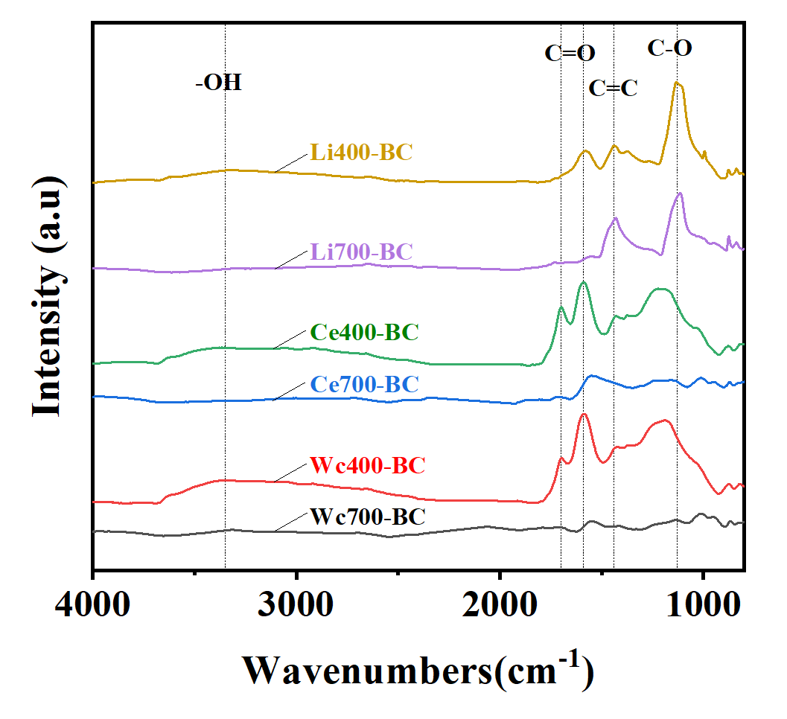
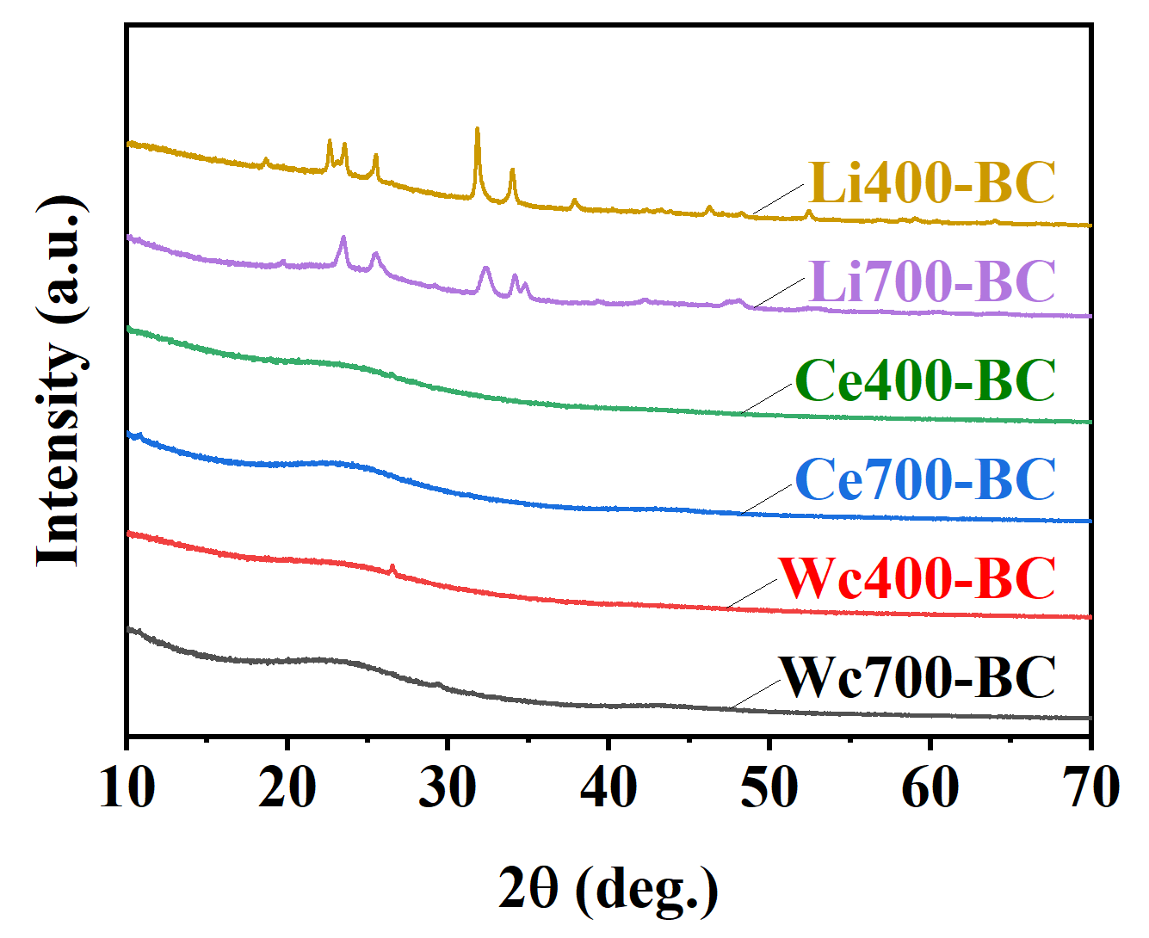
Result: Properties and characterization of biochar
400 °C
700 °C
Lignin
Smooth surface
Fractured edges
Cellulose
BET surface area enhanced with increasing pyrolysis temperature, Li400 < Ce400 < Wc400 < Li700 < Ce700 < Wc700.
Zeta potential became less negative with increasing charring temperature due to the decline or loss of negatively charged functional groups on the surface (such as –COOH) at higher temperature.
Surface morphology properties of biochar were also closely correlated to the source of raw biomass and pyrolysis temperature.
Fiber-structure
Wrinkled surface
Wood chips
Sponge-like textures
Strip-shaped
Curly flakes
Notes:
The characterization of six different types of biochar found that the feature of raw biomass and pyrolysis temperature would affect the properties of biochar.
Briefly, we found the pyrolysis temperature of biochar had a great influence on the surface properties of biochar, specifically the BET surface area would increase significantly as the pyrolysis temperature rises from 400-celsius degrees to 700 degrees. And the surface zeta potential would become less negative as the pyrolysis temperature increased.
Moreover, the biomass sources would result in different particle shapes and surface morphology. The biochar would remain part of the feature of biomass,
for instance, due to the recalcitrance of lignin, the microstructure of lignin-derived biochar was less-developed with a relatively smooth surface yet fractured edges
And Cellulose-derived biochar would keep the origin fiber-structure and had relatively wrinkled surfaces
Besides, the woodchip-derived biochar also preserved the contour of the original biomass, appearing with sponge-like textures and strip-shaped with small branches and curly flakes on the edge

Slide 7
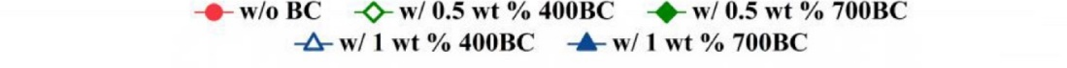
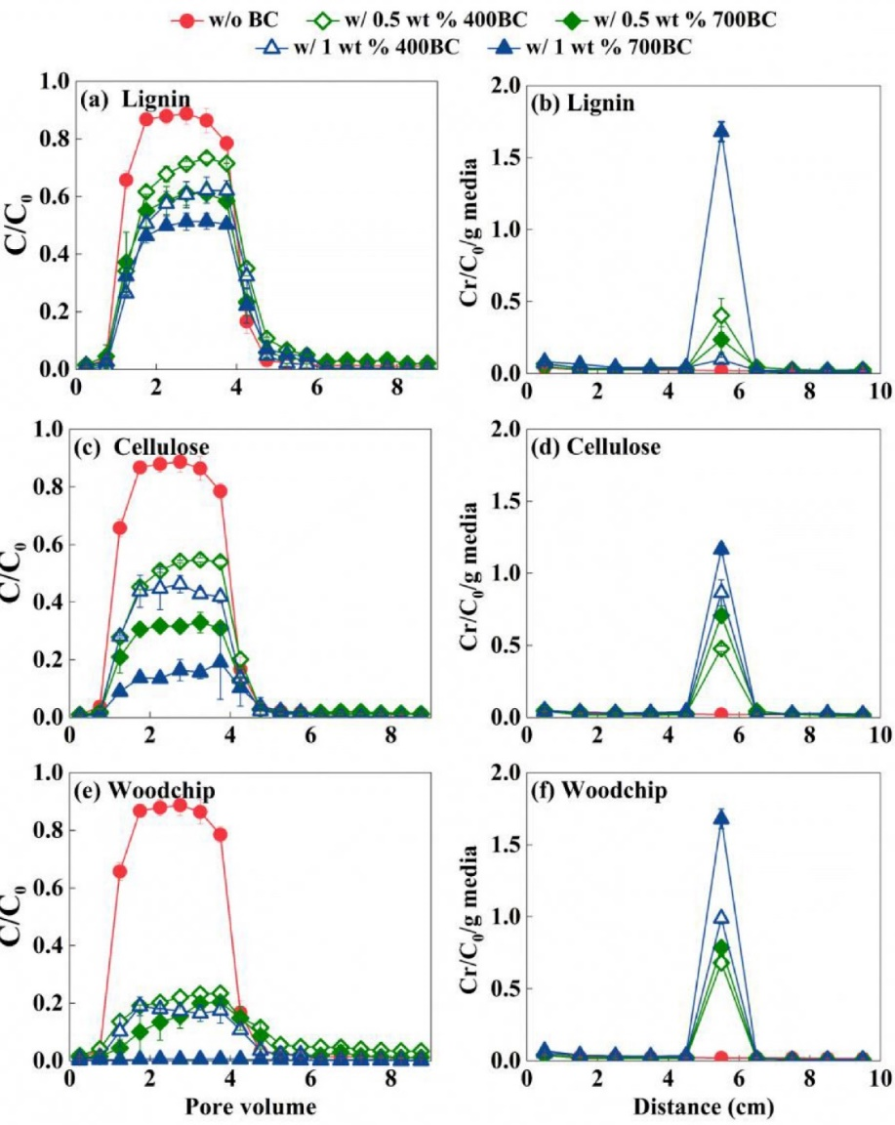
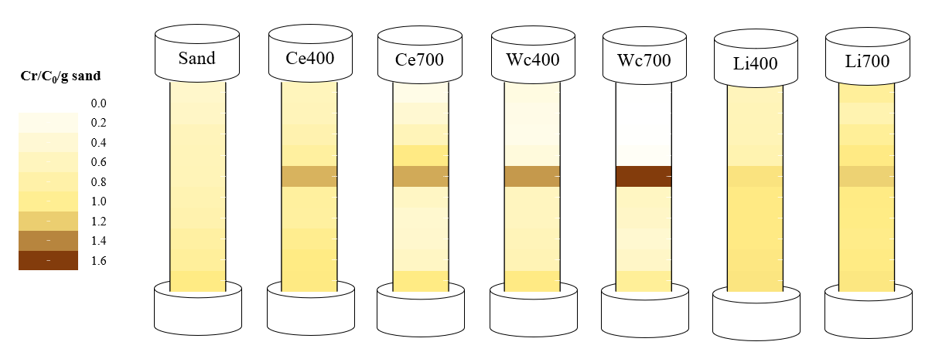
Result: MPs Removal performance
4m/d
160 m/d
Biochar added into sand columns as thin biochar layer could enhance MPs retention in sand columns
Retain profile shows MPs retained in biochar layer
Lignin
Cellulose
Removal performance of MPs
High pyrolysis temperature (700 ℃) >low temperature (400 ℃)
Wood chips > cellulose > lignin biochar
Wood chips
Woodchip-derived biochar synthesized at 700 °C (Wc-700BC) with 1 wt% application rate exhibited the best MPs immobilization performance at either low (4 m/d) or high flow rate (160 m/d).
Notes:
Further testified the microplastic removal performance from sand filtration columns with biochar layer and without biochar layer as control under slow and fast filtration rate
We found that the addition of Biochar layer can significantly improve the removal effect of sand filter, as indicated by lower breakthrough curves. Retained profiles also confirmed that the plastic particles were fixed within the biochar layer.
Besides, biomass material and Pyrolysis temperatures have a great influence on the performance of the biochar, shows the removal order as
High pyrolysis temperature (700 ℃) better than low temperature (400 ℃)
Wood chips better than cellulose better than lignin biochar
According to our research the woodchip biochar pyrolysis at 700 Celsius degrees with 1 wt% application rate exhibited the best MPs immobilization performance at either low (4 m/d) or high flow rate (160 m/d).

Slide 8
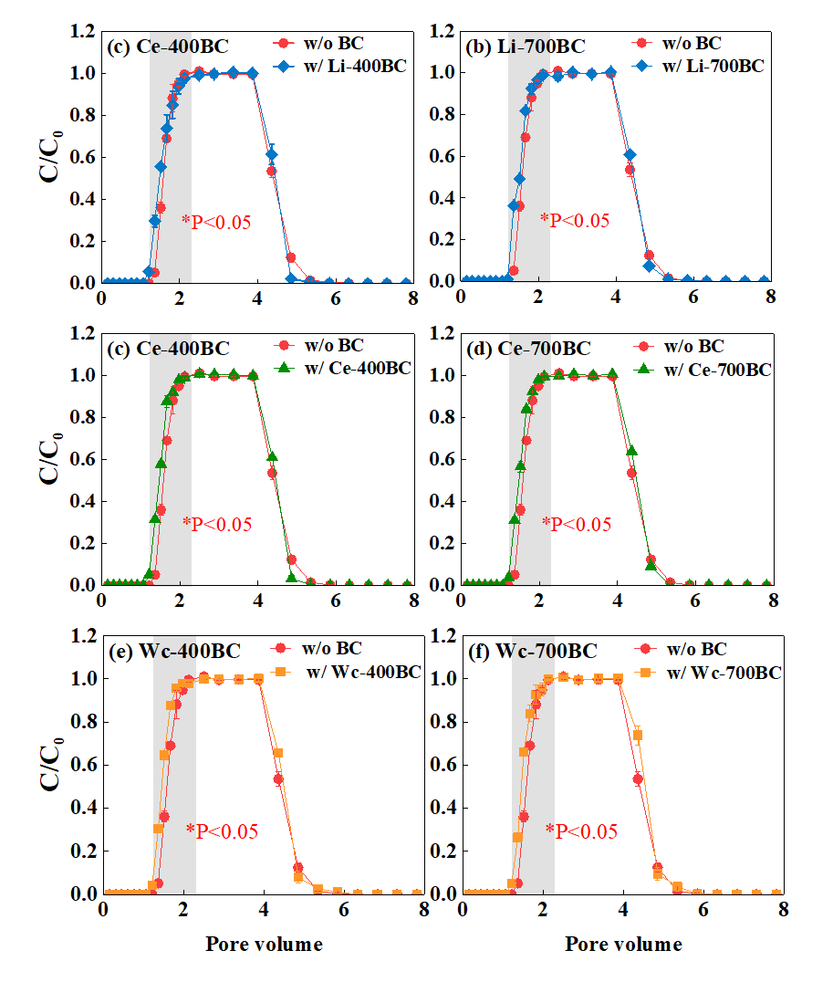
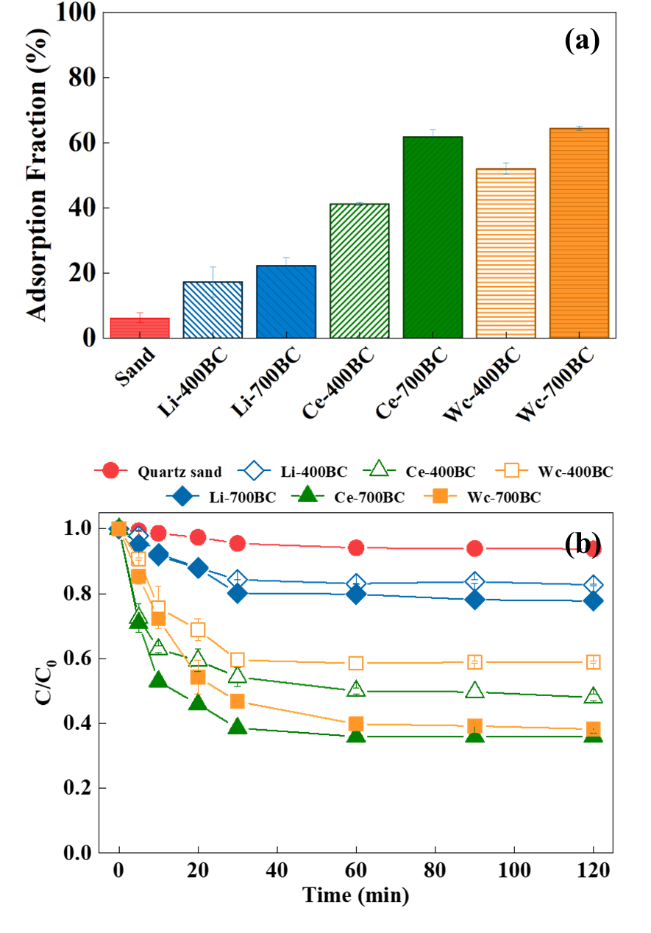
Discussion: Removal mechanisms of MPs
(1) Altering effluent property
(2) Decreasing porosity
(3) Enhancing adsorption
Addition of biochar layer :
pH value (↑) , Conductivity (↑)
Concentrations of (K⁺, Ca²⁺ , Mg²⁺ , NO₃⁻ and SO₄²⁻) (↑)
Repulsive electrostatic interaction (↓)
High specific surface area (related to pyrolysis temperature)
Provide rich adsorption sites
Increase the pore throats
More tortuous flow paths
Increase the deposition sites
Notes:
To explore the removal mechanism and difference among different biochar, we further examine the columns effluent proprieties, porosity and the adsorption capacities of biochar.
Firstly, we found that the addition of biochar layer could alter the effluent property, by increase the pH values, and the solution Conductivity, as well as the Concentrations of main cations and anionic ions. While , the properties of the suspension did not change during its passage through the quartz sand columns. The alternation resulting in the decrease of the microplastic surface negative zeta potential, leading to the reduction of repulsive electrostatic interaction between MPs and porous media, resulting in the higher MPs retention in columns with thin biochar layer than in bare sand columns.
Secondly, the tracer experience found that the tracer would breakthrough the columns earlier in the columns with biochar amended, suggest the overall porosity had decrease as the addition of biochar layer, accounting for the Increase the pore throats, tortuous flow paths and deposition sites for microplastic.
Thirdly, the further examine the capacities of different biochar, and found they would quite different, as would close related to the pyrolysis temperature and biomass source of biochar. As they can had great influence on the size of biochar’s specific surface area.

Slide 9
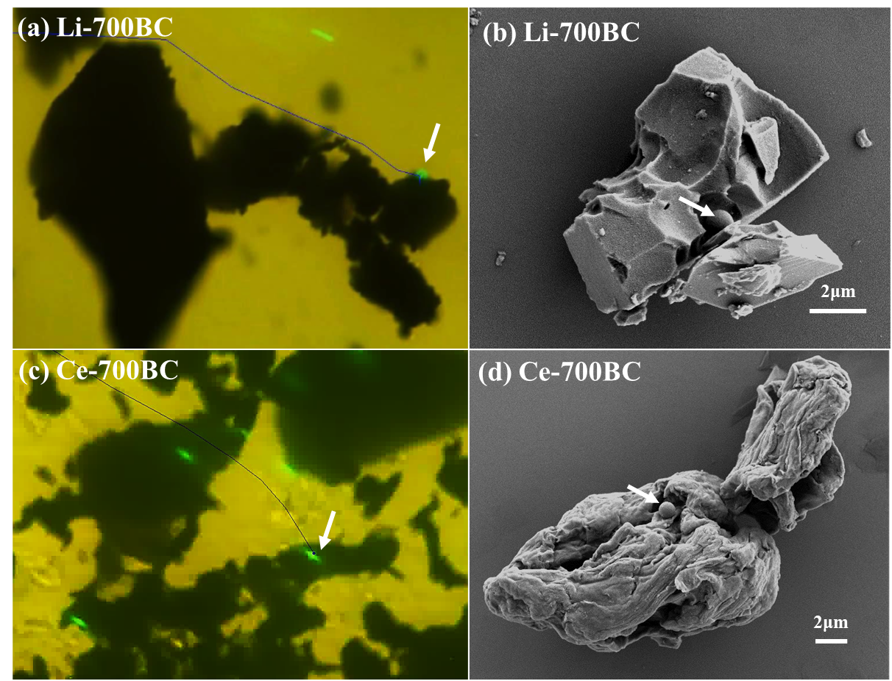
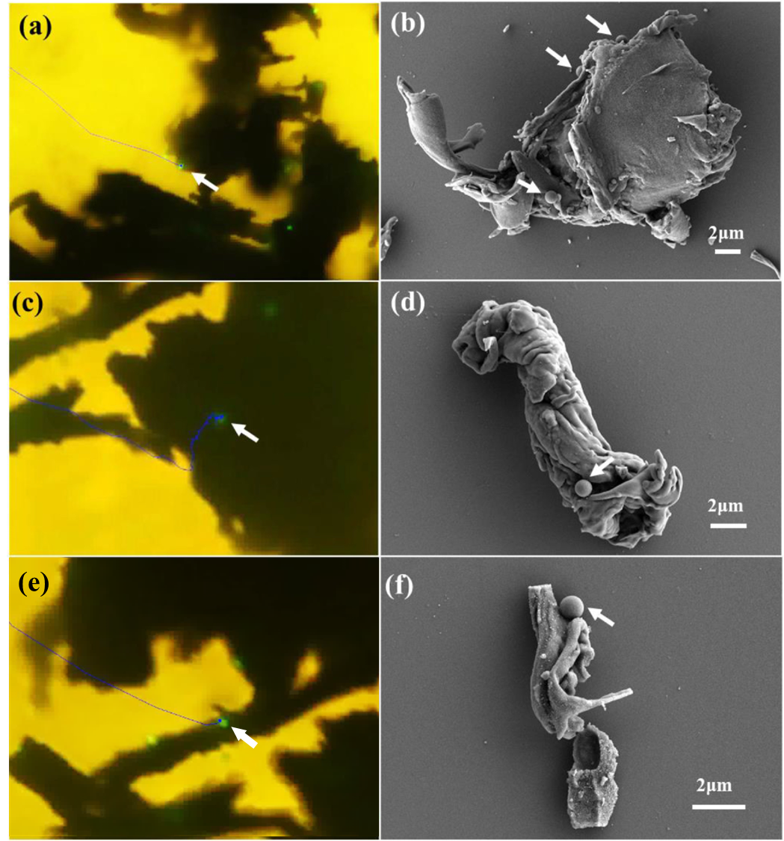
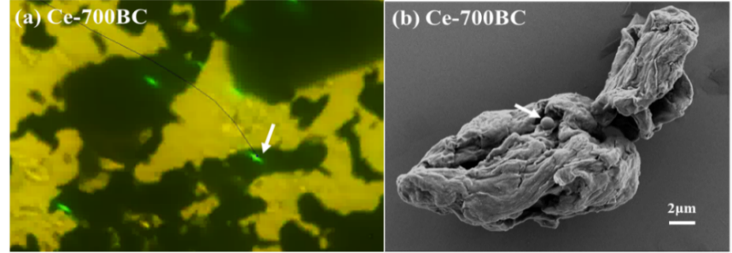
Discussion: Removal mechanisms of MPs
(4) Contribution of biochar morphology and shape
MPs could be retained onto different raw biomass-derived biochar by different processes.
Back-flushing experiments MPs released from woodchip-derived biochar was the lowest.
Woodchip-derived biochar with relatively complex surface morphology and irregular shape could bound MPs more tightly relative to lignin and cellulose-derived biochar
Different morphology and shape might induce different retention processes of MPs in biochar added sand columns.
Notes:
Last, the biochar morphology and shape might also contribute to the removal of microplastic.
The real-time transport and retention processes of MPs onto representative biochar (Li-700BC, Ce-700BC, and Wc-700BC) were directly observed via using a visible flow chamber.
For lignin-derived biochar, the plastic particles moving speed decelerated via the friction resistance and then would either slide or roll on the surface of Li-700BC, finally being trapped onto the uneven locations of Li-700BC or flushed away by water flow. SEM image of Li-700BC after MPs transport and retention experiments in columns with Li-700BC amendment also showed that MPs could be trapped onto concave of Li-700BC
For cellulose-derived biochar ，MPs would be immediately captured by cellulose-derived biochar (Ce-700BC) right after they hit onto biochar during the transport process.
And for woodchip derived biochar, the retention of MPs occurred on the edge of Wc-700BC immediately after collision with biochar or would slowly slide on the surfaces of Wc-7000BC and then were trapped onto the uneven locations of Wc-700BC. Moreover, the irregular branch structure present on Wc-700BC could also capture MPs passing through from water flow. SEM images further verified the above-mentioned MPs capture patterns by Wc-700BC, i.e. captured on the edge of WC-700BC , trapped onto the uneven locations of Wc-700BC as well as captured by irregular branch.
Moreover, back-flushing experiments showed that compared to those in lignin and cellulose-derived biochar added columns, the percentage of MPs released from woodchip-derived biochar added columns (based on the amounts of MPs retained in columns) was the lowest, indicating that woodchip-derived biochar with relatively complex surface morphology and irregular shape could bound MPs more tightly relative to lignin and cellulose-derived biochar.
Clearly, the shape and morphology of biochar derived from different biomasses would affect the retention processes of MPs in biochar added columns.
Note that among all three biomass-derived biochar, woodchip-derived biochar especially Wc-700BC exhibited more complex surface morphology and more irregular shape with the largest BET surface area. Via more trapping processes relative to lignin and cellulose-derived biochar as stated above, sand columns with woodchip-derived biochar especially Wc-700BC amendment thus exhibited the highest MPs retention performance.

Slide 10
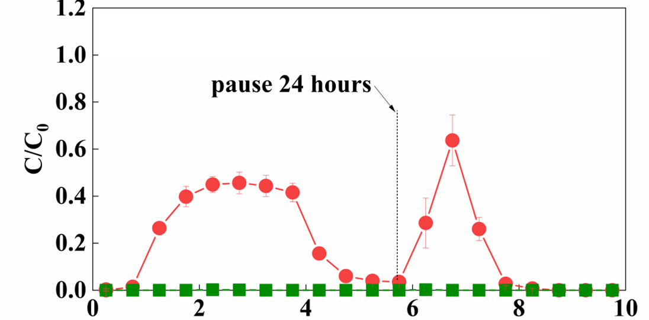
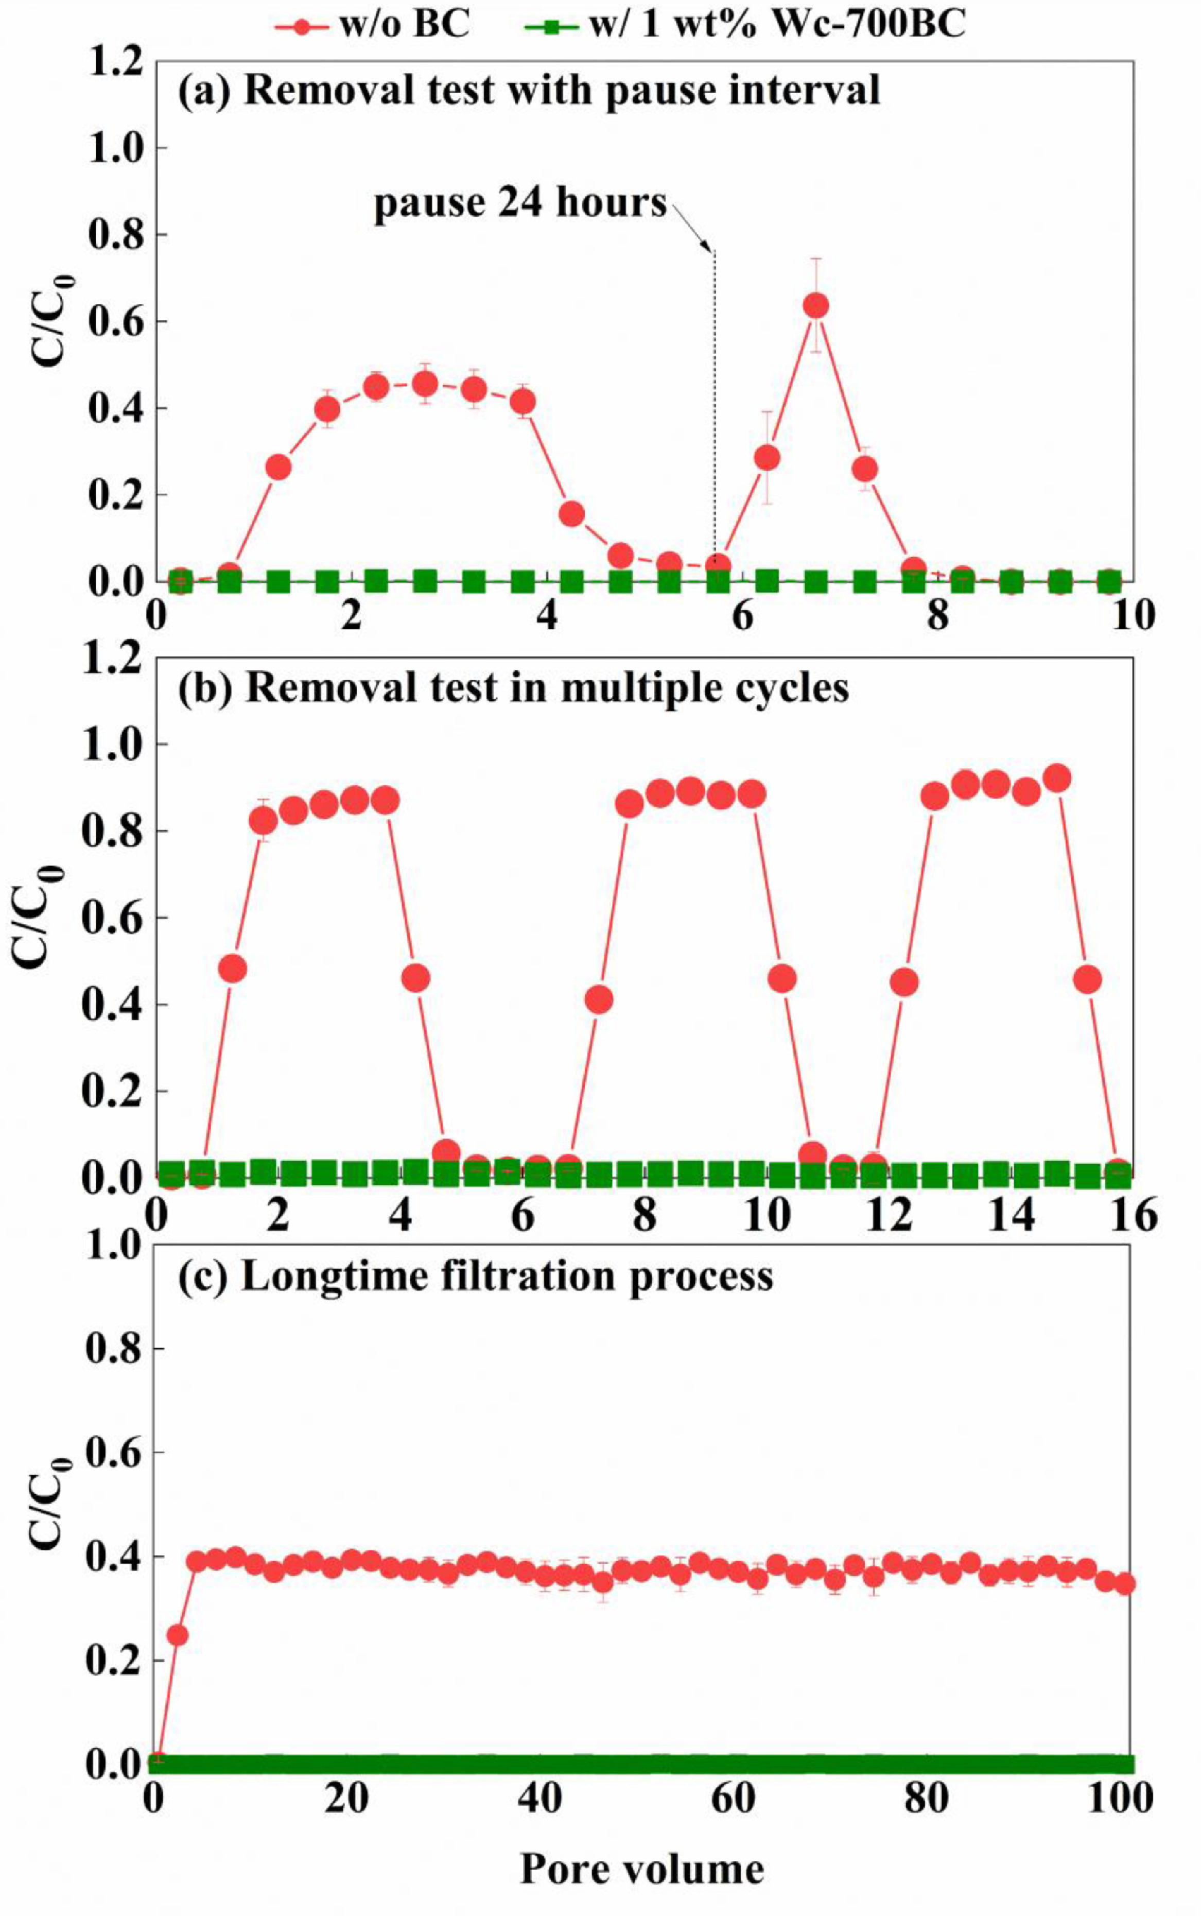
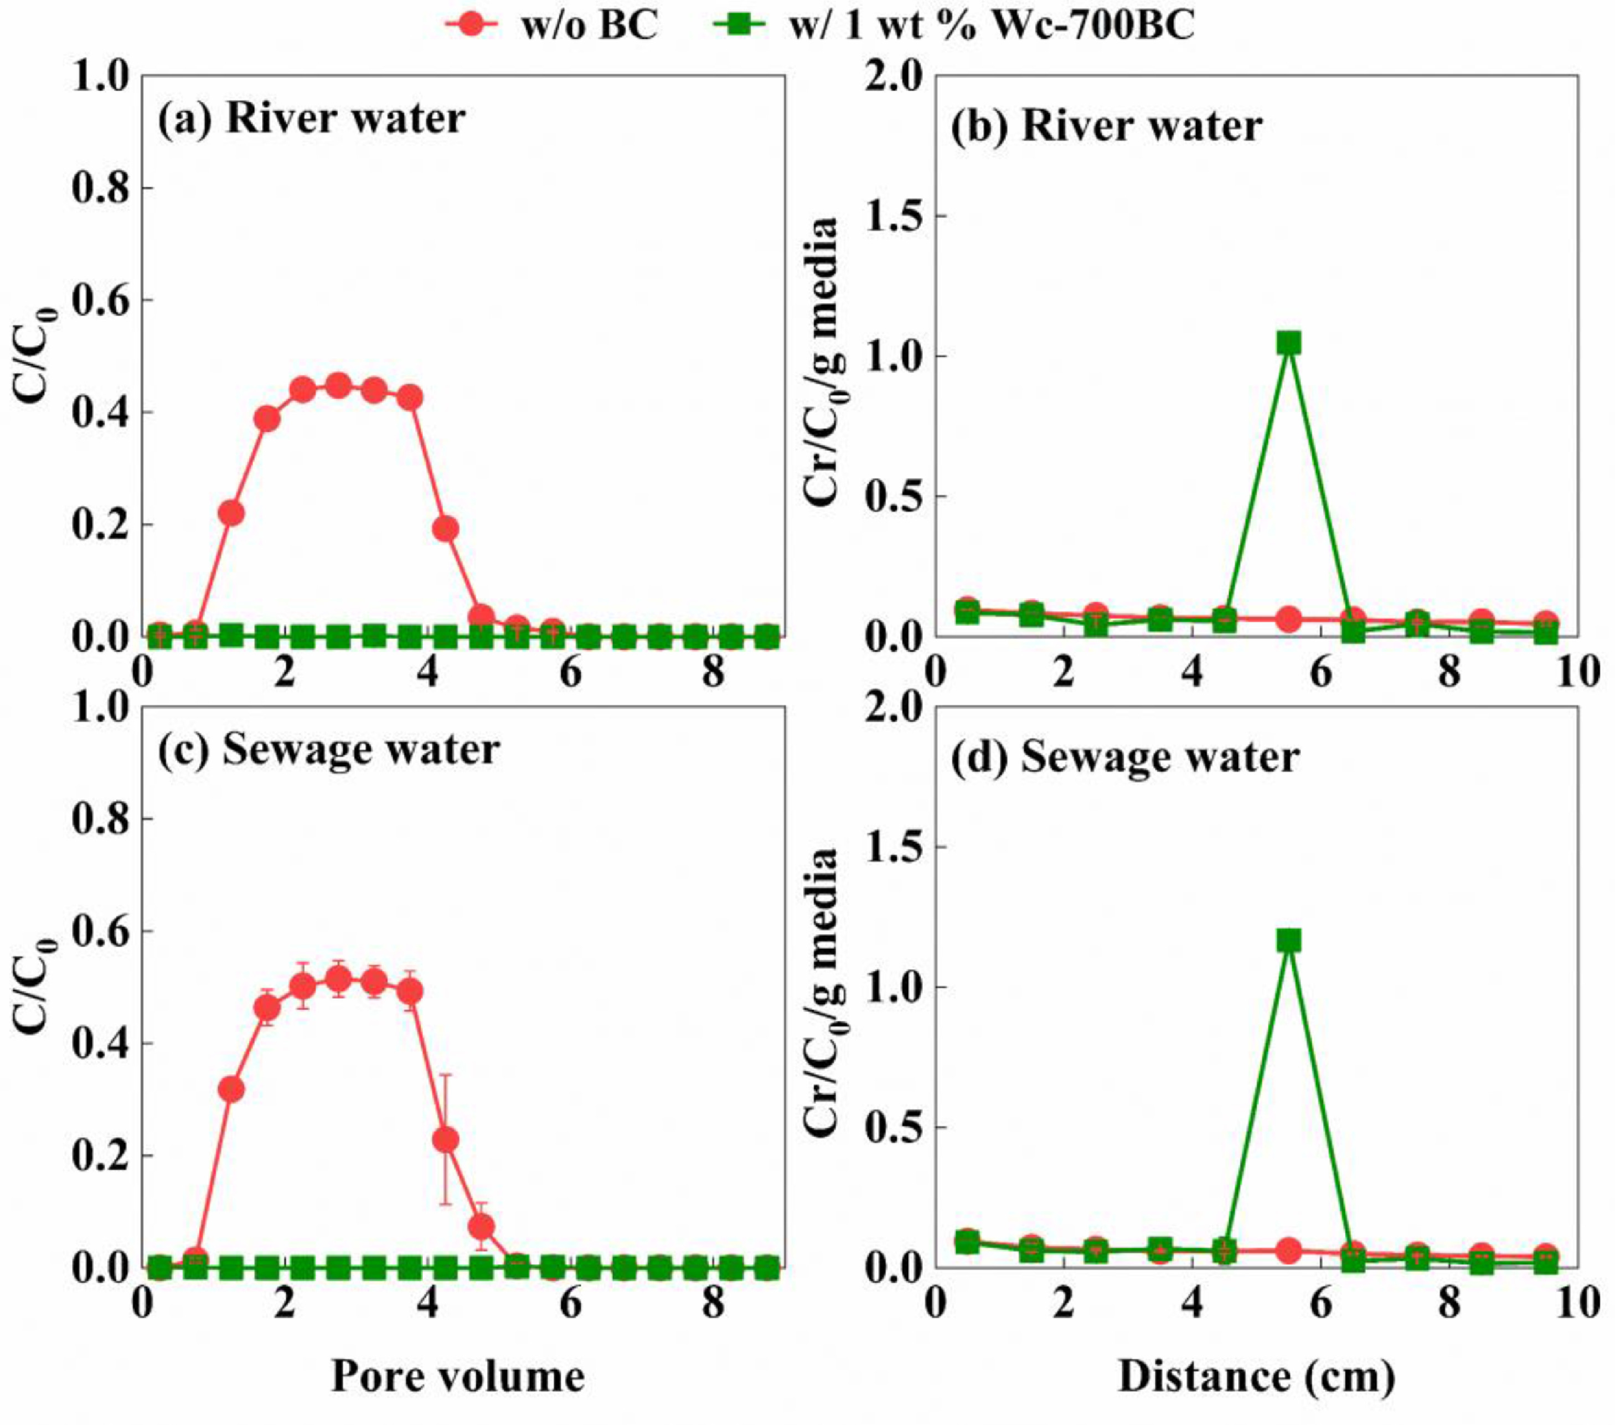
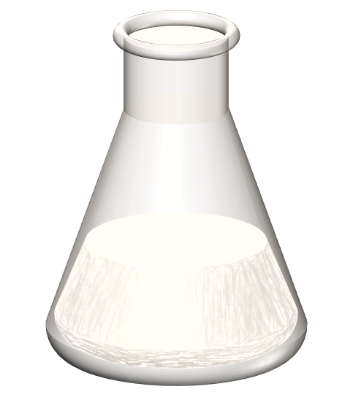
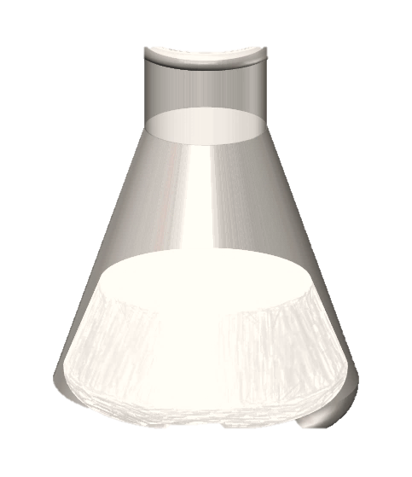
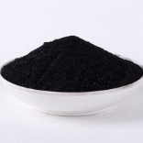
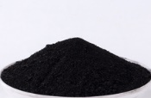
MPs removal performance under different operating conditions
With pause interval
In multiple cycles
In longtime filtration
Recycle and Regenerate
In actual river/sewage water samples
MPs
Biochar
∼90% of biochar could be recycled
Notes:
Besides, we had further testified MPs removal performance of the woodchip derived biochar under different operating conditions, including the removal performance with pause interval, as well as the multiple cycles, longtime filtration process.
Furthermore, To save cost, it is critical to recycle and reuse biochar during the practical application of biochar amended columns to remove MPs. Therefore, we had successfully recycled the biochar after both 1st and 2nd -three transport-elution cycles, and regenerate them by density separation method, and fond the complete MPs removal was also achieved with the recycled biochar under slow flow rates, which indicating that after use, Wc-700BC could be recycled and regenerated for the subsequent use in sand filtration system for effective MPs removal.
In addition, The MPs removal performance in real river water and actual sewage water samples by biochar layer amended columns were also tested. And found the biochar amended sand filter remained high removal efficiency, despite of the existence of organic matter, which could compete for attachment sites as well as dispersing MPs, organic matters could decrease the retention of MPs onto sand surfaces.

Slide 11
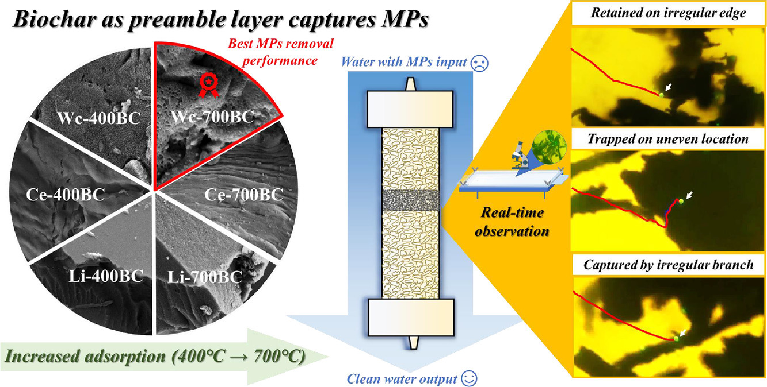
Conclusions
Notes:
In present study, to boost the removal performance of MPs in sand filtration systems (units that commonly employed in WWTPs to remove colloidal pollutants), six types of biochar fabricated from three raw biomass materials (i.e. lignin, cellulose, and woodchips) at two pyrolysis temperatures (400 °C and 700 °C) was respectively amended into sand columns as thin permeable layer. We found that adding all six types of biochar into sand columns as thin permeable layer could greatly improve the retention of MPs with the diameter of 1 μm under either slow (4 m/d) or fast flow rates (160 m/d) due to the high adsorption capability of biochar. Woodchip-derived biochar exhibited the highest MPs retention performance, which was followed by cellulose-derived biochar and then lignin-derived biochar. Moreover, for biochar derived from three raw biomasses, increasing pyrolysis temperature could improve MPs retention performance. The direct observation of real-time plastics retention processes on different types of biochar via a visible flow chamber showed that woodchip-derived biochar especially that fabricated at 700 °C exhibited more MPs trapping processes relative to lignin and cellulose-derived biochar due to their more complex surface morphology. Thus, the highest MPs retention performance was achieved in sand columns with amendment by 1 wt% woodchip-derived biochar fabricated at 700 °C. More importantly, we found that for these modified sand filtration column systems, complete MPs removal could be achieved in real river water and actual sewage water, in multiple filtration cycles, longtime filtration process (100 pore volumes injection) as well as with interval flow conditions. Moreover, biochar could be regenerated and reused as thin permeable layer to effectively remove MPs. The results of this study clearly showed that biochar especially woodchip-derived biochar fabricated at 700 °C had the potential to immobilize MPs especially those with small sizes in WWTPs.

Slide 12
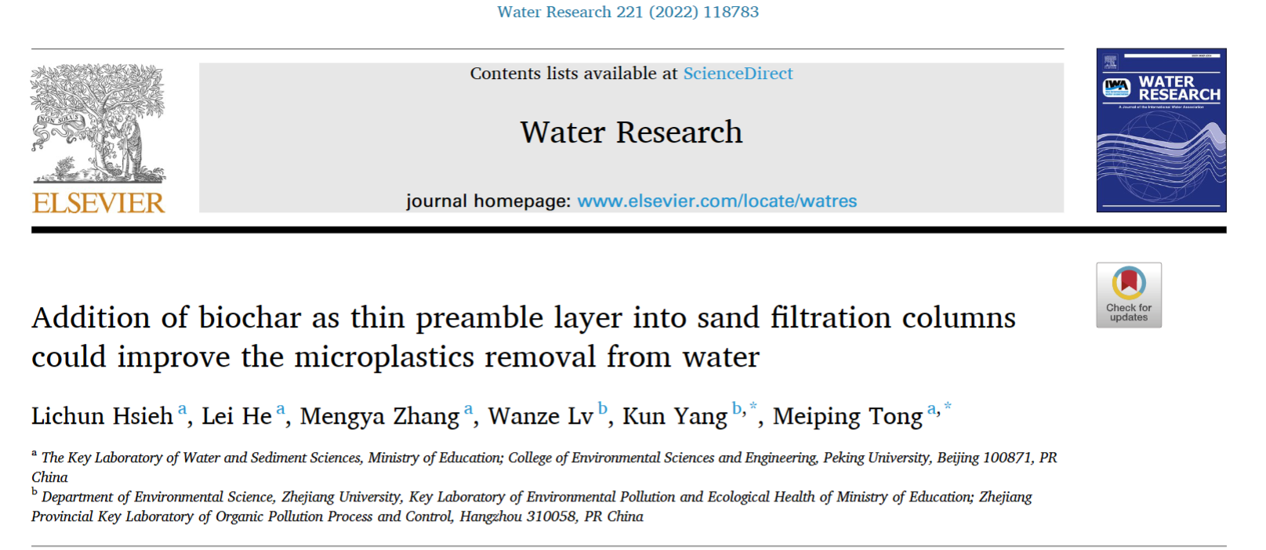
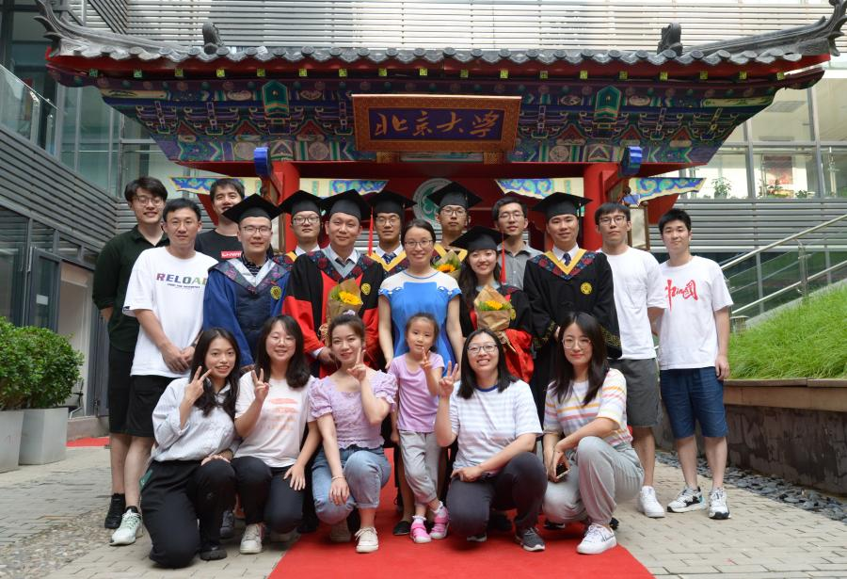
Acknowledgment
This work was supported by the National Natural Science Foundation of China under Grant No. 42025706, Fund for Innovative Research Group of NSFC under Grant No. 51721006, National Natural Science Foundation of China under Grant 51779001, as well as Beijing Natural Science Foundation under Grant No. JQ18030.
Water Research, 2022, 221: 118783.
Tong’s Lab
Notes:
Tong’s Lab

Slide 13
Thank you !
Speaker：Hsieh Lichun (Master student) 丨 Email: lichun@stu.pku.edu.cn

