Slide 1
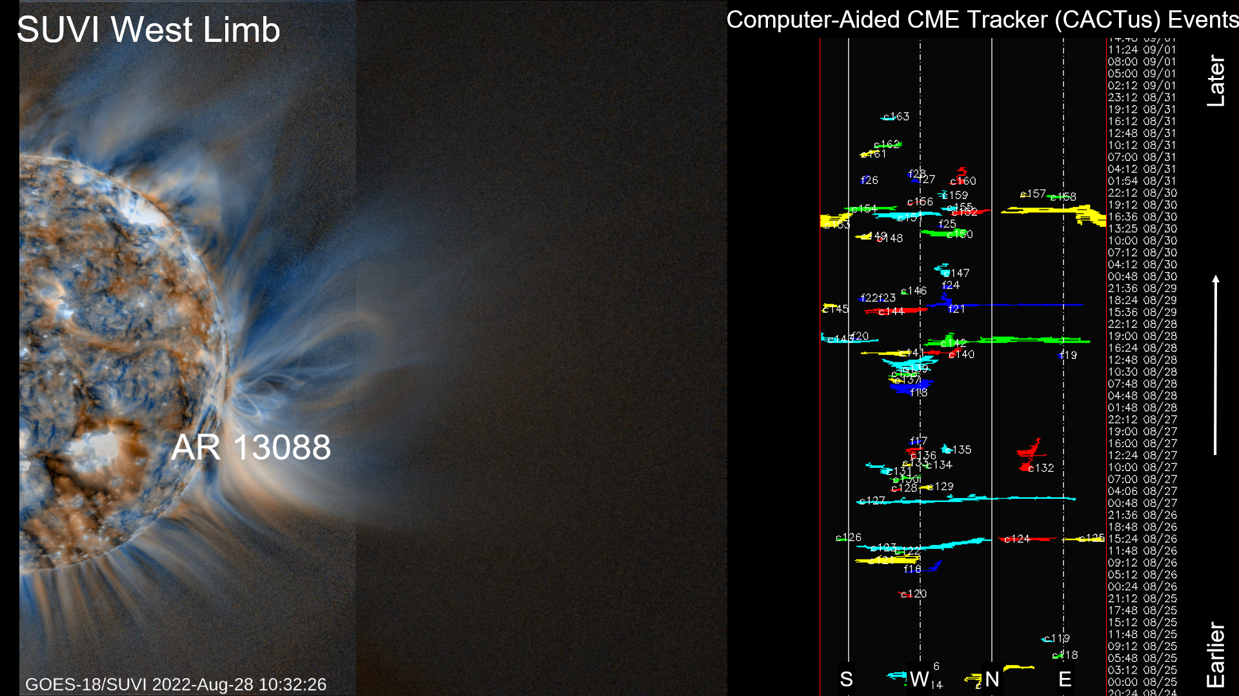
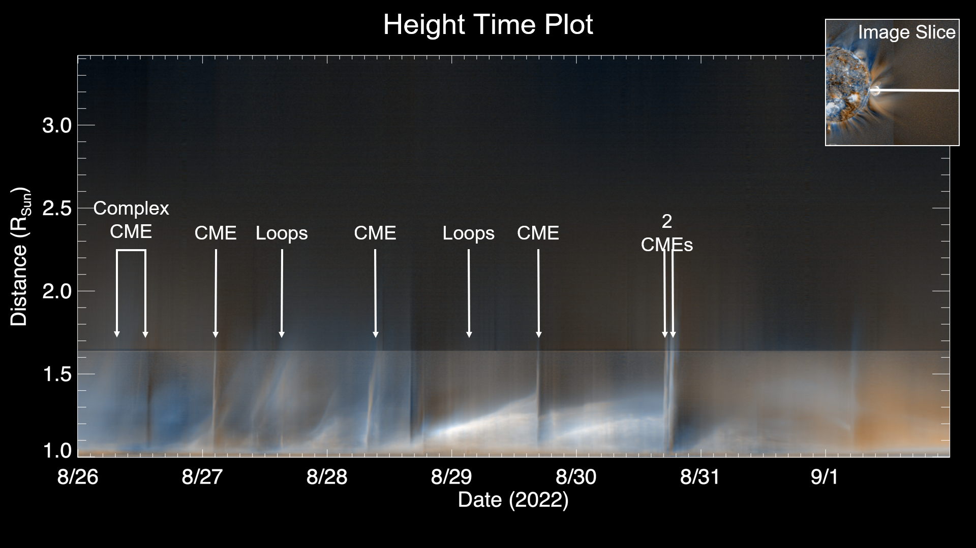
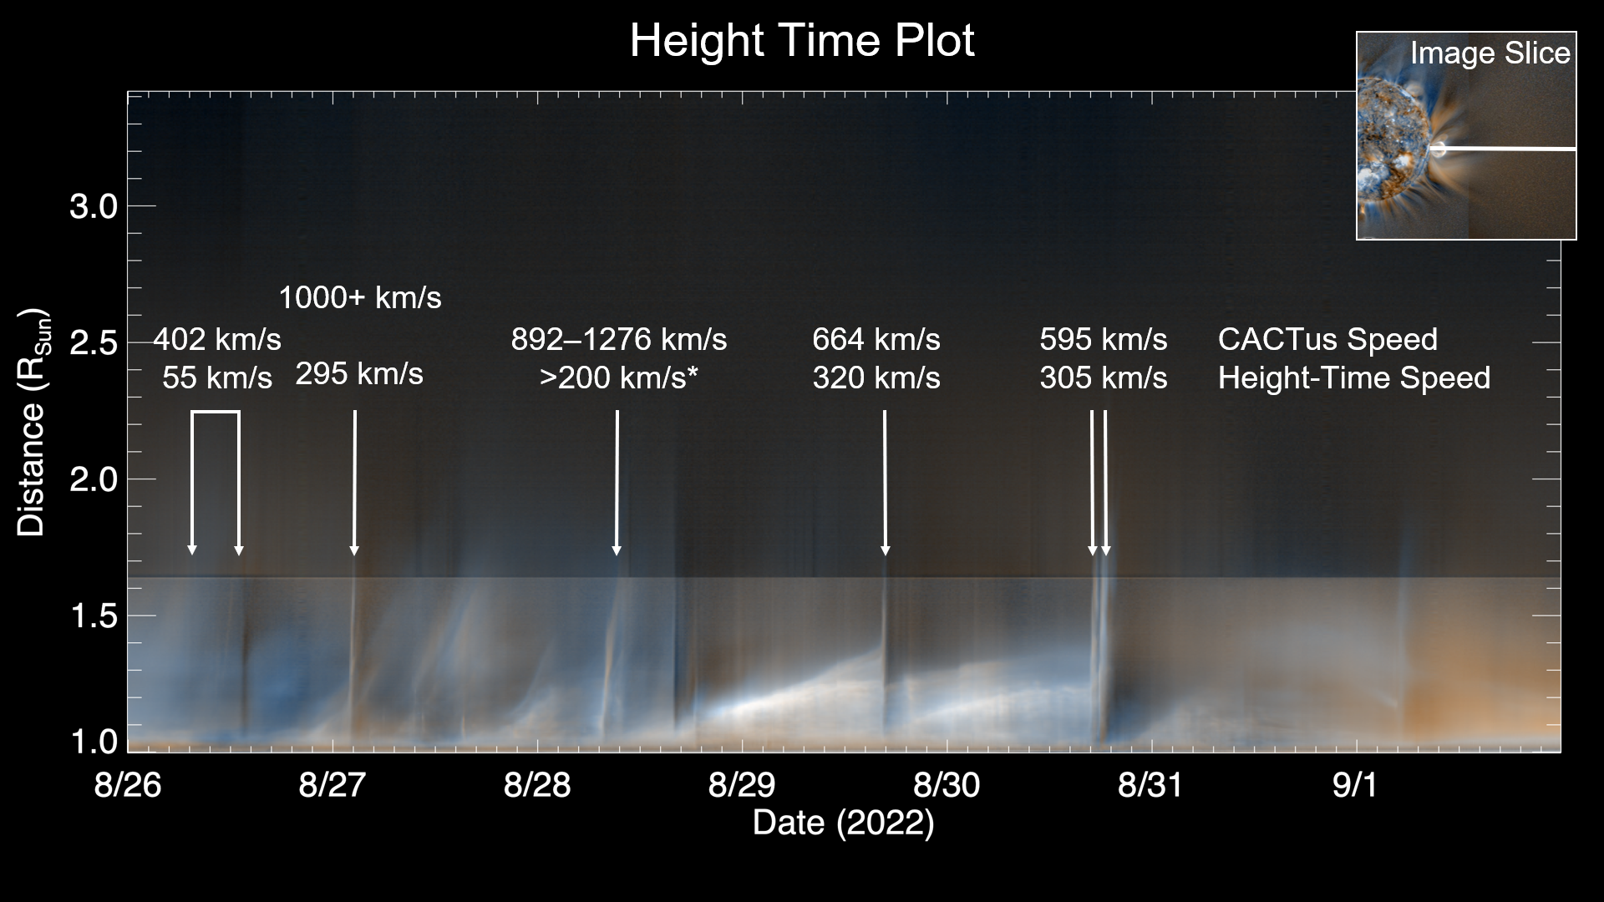
From the Solar Limb and Out: Results from the Wide-Field EUV Image Campaigns with GOES/SUVI
S. K. Tadikonda, D. B. Seaton, C. Bethge, A. Caspi, M. Dahya, C. DeForest, M. P. Garhart, J. M. Hughes, A. Krimchansky, P. C. Sullivan, M. Todirita, M. West
EGU 2023 Session: ST 1.1, EGU23-1807
Computing CME Velocities
Computer Aided CME Tracker US
(CACTus) Late August CMEs
8/26 13:36 - 402 km/s
8/27 02:24 - 1000+ km/s
8/28 15:15 - 892 km/s
8/28 15:48 - 1276 km/s
8/29 16:48 - 664 km/s
8/30 17:36 - 595+ km/s
Diagonal upwards features are outflows
Steeper slope Faster velocity

