Slide 1
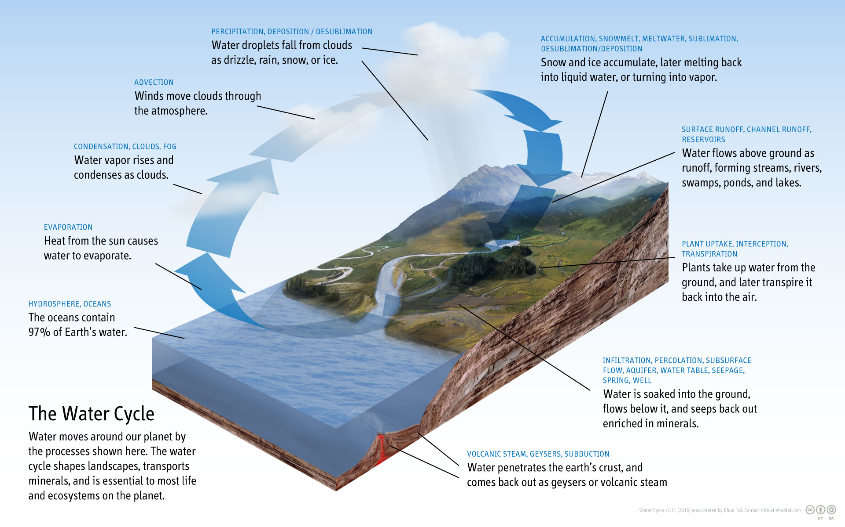
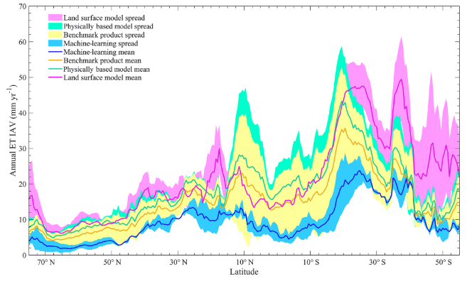
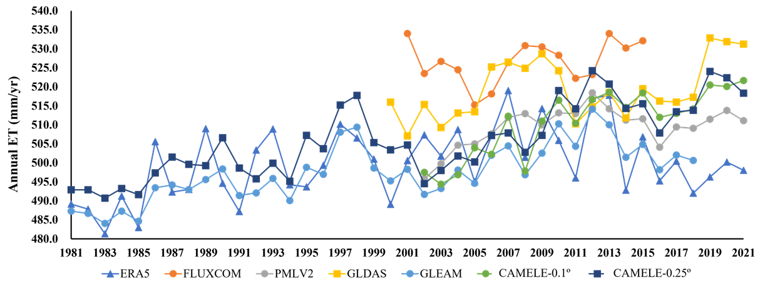
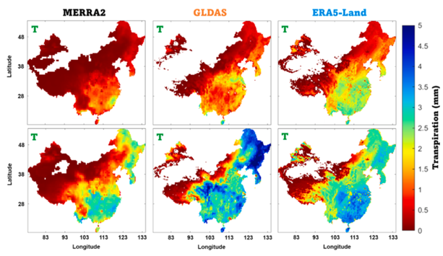
Error Characterization and Multi-source Merging of
Global Land Evapotranspiration Products: Collocation-based approach
Changming Li, Hanbo Yang*, Wencong Yang, Ziwei Liu, Yao Jia, Sien Li, Dawen Yang
Address: Department of Hydraulic Engineering, Tsinghua University, China; Email: licm2022@mail.tsinghua.edu.cn
ET: Important Link
Large discrepancies
Data Fusion
Our objectives:
1. Conduct a global evaluation of multiple ET products without relying on flux station data
In Africa and East Asia, reliable flux stations are scarce; some stations have short observation durations
2. Merge based on product errors to obtain more reliable ET data.
Our process:
Evaluation: Triple Collocation and its related methods
Fusion Linear Merging
(Pan et al., 2020)
Land evapotranspiration, including soil evaporation, vegetation transpiration, canopy interception, snow evaporation and open-water evaporation is the key component of the global terrestrial water and energy cycle. It plays a central role in linking the energy, water, and carbon cycles. Thus, accurate estimation at site-based, gridded and regional scales are of great importance for hydrological research.
The conclusions derived from different products could vary significantly.
(Park et al., 2023)
Notes:
New edition

Slide 2
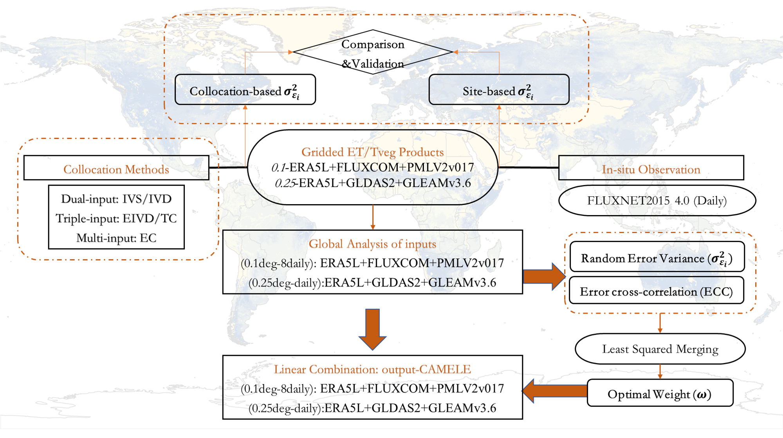
Error Characterization and Multi-source Merging of
Global Land Evapotranspiration Products: Collocation-based approach
Changming Li, Hanbo Yang*, Wencong Yang, Ziwei Liu, Yao Jia, Sien Li, Dawen Yang
Address: Department of Hydraulic Engineering, Tsinghua University, China; Email: licm2022@mail.tsinghua.edu.cn
Method-Collocation Analysis
Flowchart
$$i=α_{i}+β_{i}θ+ε_{i}$$
$$σ_{ij}=\left\{\begin{aligned}&β_{i}β_{j}σ_{Θ}^{2} \\ &β_{i}β_{j}σ_{Θ}^{2}+σ_{ε_{i}ε_{j}}\end{aligned} \begin{matrix}∀i,j with σ_{ε_{i}ε_{j}}=0 \\ ∀i,j with σ_{ε_{i}ε_{j}}≠0\end{matrix}\right.$$
$$y=\left(\begin{aligned}&σ_{i}^{2} \\ &σ_{ij} \\ &\frac{σ_{jl}σ_{jk}}{σ_{lk}} \\ &\frac{σ_{ij}σ_{kl}}{σ_{jl}}\end{aligned}\right) A=\left(\begin{matrix}1 & 0 & 1 & 0 \\ 0 & 1 & 0 & 1 \\ 1 & 0 & 0 & 0 \\ 0 & 1 & 0 & 0\end{matrix}\right) x=\left(\begin{aligned}&β_{i}^{2}σ_{Θ}^{2} \\ &β_{i}β_{j}σ_{Θ}^{2} \\ &σ_{ε_{j}}^{2} \\ &σ_{ε_{i}ε_{j}}\end{aligned}\right)$$
$$x={\left(A^{T}A\right)}^{−1}A^{T}y$$
$$E({εε}^{T})=\left(\begin{matrix}σ_{ε_{X}}^{2} & σ_{ε_{XY}} & σ_{ε_{XZ}} \\ σ_{ε_{YX}} & σ_{ε_{Y}}^{2} & σ_{ε_{YZ}} \\ σ_{ε_{ZX}} & σ_{ε_{ZY}} & σ_{ε_{Z}}^{2}\end{matrix}\right)$$
$$u={\left(I^{T}×E\left({ϵϵ}^{T}\right)×I\right)}^{−1}×E{\left({ϵϵ}^{T}\right)}^{−1}×I$$

Slide 3
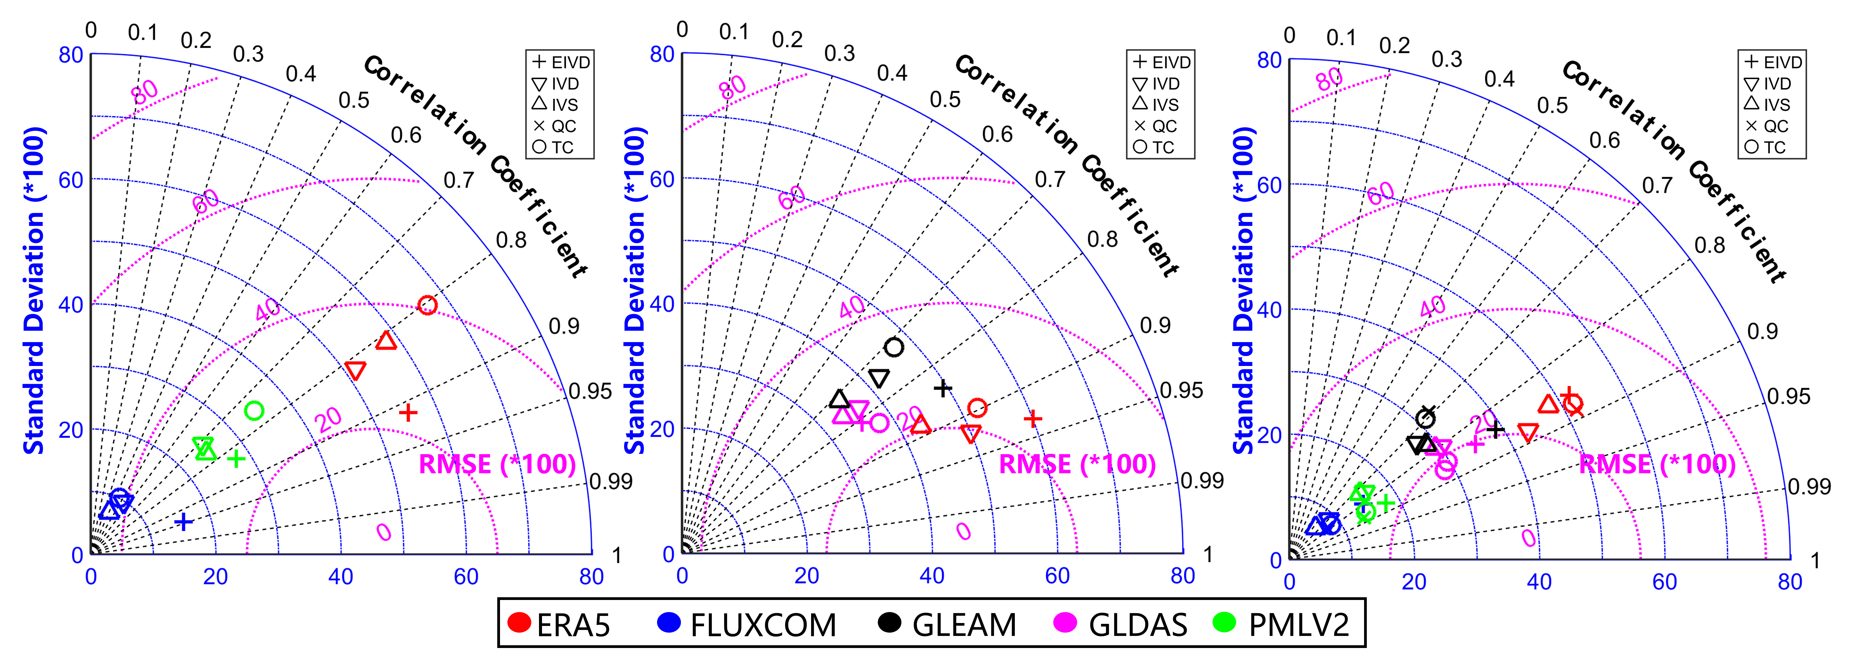
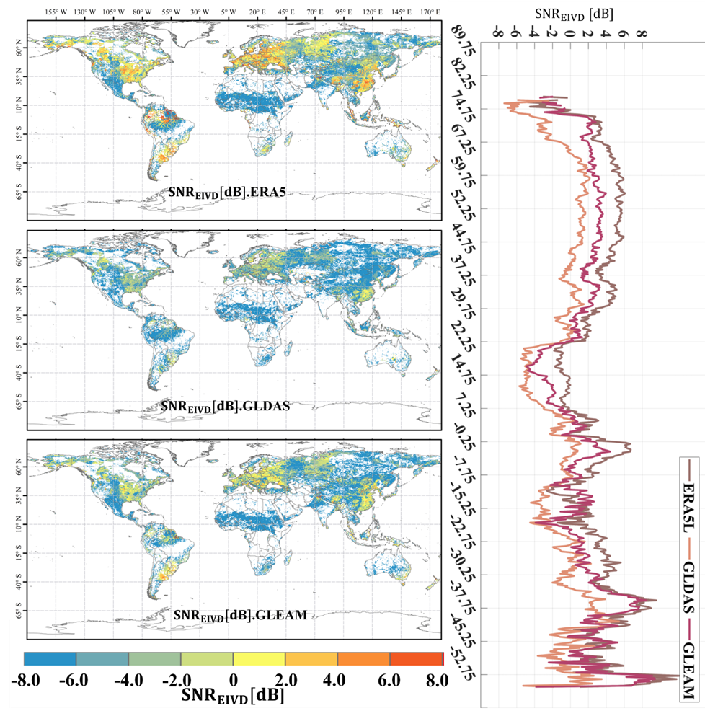
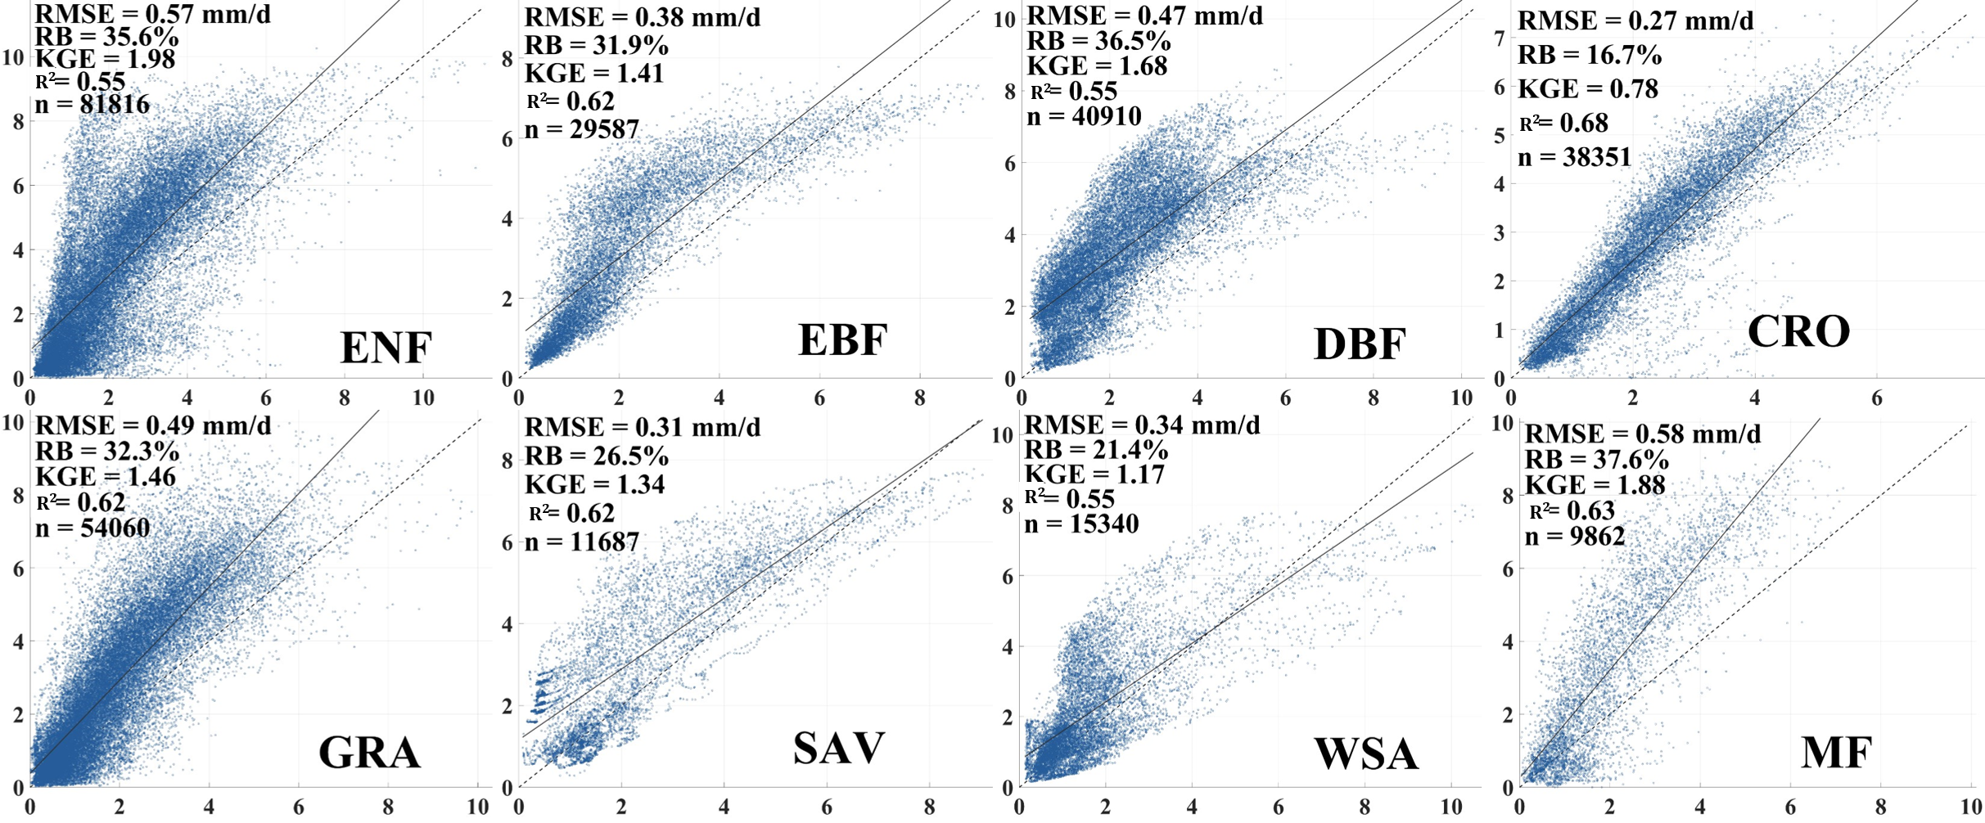
Error Characterization and Multi-source Merging of
Global Land Evapotranspiration Products: Collocation-based approach
Changming Li, Hanbo Yang*, Wencong Yang, Ziwei Liu, Yao Jia, Sien Li, Dawen Yang
Address: Department of Hydraulic Engineering, Tsinghua University, China; Email: licm2022@mail.tsinghua.edu.cn
Result
A. Obtained error information for multiple products.
B. Confirmed that the Collocation methods can be applied to ET.
FIGURE Taylor diagram for average collocation-based results vs. tower observations of five products.
Merged (mm/d) (0.25-daily)
C. Merged results turn out quite well.
$$\overline{R^{2}}:(0.68\sim 0.73)$$
FLUXNET 4.0 (mm/d) (0.25-daily)
FIGURE Validation of Merged product for PFTs against FLUXNET.

Slide 4
Error Characterization and Multi-source Merging of
Global Land Evapotranspiration Products: Collocation-based approach
Changming Li, Hanbo Yang*, Wencong Yang, Ziwei Liu, Yao Jia, Sien Li, Dawen Yang
Address: Department of Hydraulic Engineering, Tsinghua University, China; Email: licm2022@mail.tsinghua.edu.cn
Take-home messages
Our findings:
Validating Collocation method for ET and T product error analysis
Evaluating global gridded ET and T products, with PMLv2 and GLEAMv3.6 performing optimally
Obtaining ET products for 1950-2022 (0.25-daily) and 2000-2020 (0.1-8daily) using least squares weighting
Recommending EIVD & IVD among other five Collocation algorithms (TC/EIVD/IVS/IVD/EC)
Discussion Topics:
Considering systematic errors in Collocation method
Exploring alternative calculation methods of weights like SNR-opt
Validating fusion results for 1950-1979

Slide 5
Thank you for your time and attention
My booth is at 4.4, welcome to have in-depth discussions, and I look forward to all suggestions
Changming Li, Ziwei Liu, Wencong Yang, Hanbo Yang
Address: Department of Hydraulic Engineering, Tsinghua University, China; Email: licm2022@mail.tsinghua.edu.cn
4/26/2023

Slide 6
Collocation Analysis
TCA-Triple Collocation
As example
$$X=α_{X}+β_{X}Θ+ε_{X}$$
Which indicator?
IVs
$$fMSE_{i}=\frac{σ_{ε_{i}}^{2}}{σ_{i}^{2}}=\frac{σ_{ε_{i}}^{2}}{β_{i}^{2}σ_{Θ}^{2}+σ_{ε_{i}}^{2}}=\frac{1}{1+SNR_{i}}$$
$$\begin{matrix}X=α_{X}+β_{X}Θ+ε_{X} \\ Y=α_{Y}+β_{Y}Θ+ε_{Y} \\ Z=α_{Z}+β_{Z}Θ+ε_{Z}\end{matrix}$$
Single Instrumental Variable (IVS)
(Su et al., 2014, WRR)
$$SNR_{i}=\frac{β_{i}^{2}σ_{Θ}^{2}}{σ_{ε_{i}}^{2}}∈\left[0,1\right]$$
$$I_{t}=β_{x}P_{t−1}+B_{x}+ε_{x,t−1}$$
$$\left\{\begin{aligned}σ_{ε_{x}}^{2}=C_{xx}−C_{xy}s_{ivs} \\ σ_{ε_{y}}^{2}=C_{yy}−\frac{C_{xy}}{s_{ivs}}\end{aligned}\right.\left\{\begin{aligned}R_{Px}^{2}=\frac{C_{xy}s_{ivs}}{C_{xx}} \\ R_{Py}^{2}=\frac{C_{xy}}{C_{xx}s_{ivs}}\end{aligned}\right.$$
rescale
$$Y^{X}=β_{Y}^{X}\left(Y−\overline{Y}\right)+\overline{X}$$
$$Z^{X}=β_{Z}^{X}\left(Z−\overline{Z}\right)+\overline{X}$$
$$R_{i}^{2}=\frac{β_{i}^{2}σ_{Θ}^{2}}{β_{i}^{2}σ_{Θ}^{2}+σ_{ε_{i}}^{2}}=\frac{SNR_{i}}{1+SNR_{i}}=\frac{1}{1+NSR_{i}}$$
covariance
$$R_{i}^{2}=1−fMSE_{i}$$
$$\left\{\begin{aligned}&σ_{ε_{X}}^{2}=<\left(X−Y^{X}\right)\left(X−Z^{X}\right)> \\ &σ_{ε_{Y}^{X}}^{2}={β_{Y}^{X}}^{2}σ_{ε_{Y}}^{2}=<\left(Y^{X}−X\right)\left(Y^{X}−Z^{X}\right)> \\ &σ_{ε_{Z}^{X}}^{2}={β_{Z}^{X}}^{2}σ_{ε_{Z}}^{2}=<\left(Z^{X}−X\right)\left(Z^{Y}−Y^{X}\right)> \end{aligned}\right.$$
Assumptions
Linearity
Stationarity
Error orthogonality
Zero error cross-correlation
Double Instrumental Variable (IVD)
(Dong et al., 2019, RSE)
$$I_{t}=β_{x}P_{t−1}+B_{x}+ε_{t−1}$$
$$J_{t}=β_{y}P_{t−1}+B_{y}+ε_{t−1}$$
$$\left\{\begin{aligned}σ_{x}^{2}=C_{xx}−C_{xy}s_{ivd} \\ σ_{y}^{2}=C_{yy}−\frac{C_{xy}}{s_{ivd}}\end{aligned}\right.\left\{\begin{aligned}R_{Px}^{2}=\frac{C_{xy}s_{ivd}}{C_{xx}} \\ R_{Py}^{2}=\frac{C_{xy}}{C_{xx}s_{ivd}}\end{aligned}\right.$$
$$\left\{\begin{aligned}&σ_{ε_{X}}^{2}=σ_{X}^{2}−\frac{σ_{XY}σ_{XZ}}{σ_{YZ}} \\ &σ_{ε_{Y}}^{2}=σ_{Y}^{2}−\frac{σ_{YX}σ_{YZ}}{σ_{XZ}} \\ &σ_{ε_{Z}}^{2}=σ_{Z}^{2}−\frac{σ_{ZX}σ_{ZY}}{σ_{XY}} \end{aligned}\right.$$

Slide 7
Collocation Analysis
Extended Collocation
EIVD
$$σ_{ij}=\left\{\begin{aligned}&β_{i}β_{j}σ_{Θ}^{2} \\ &β_{i}β_{j}σ_{Θ}^{2}+σ_{ε_{i}ε_{j}}\end{aligned} \begin{matrix}∀i,j with σ_{ε_{i}ε_{j}}=0 \\ ∀i,j with σ_{ε_{i}ε_{j}}≠0\end{matrix}\right.$$
$$s_{ij}≡\frac{β_{i}}{β_{j}}=\sqrt{\frac{L_{ii}}{L_{jj}}}$$
Extended Instrumental (EIVD)
(Dong et al., 2021, JOH)
$$β_{j}^{2}σ_{Θ}^{2}=σ_{ij}\sqrt{\frac{L_{ii}}{L_{jj}}} σ_{ε_{j}}^{2}=σ_{ij}\sqrt{\frac{L_{ii}}{L_{jj}}}−σ_{i}^{2}$$
$$y=\left(\begin{aligned}&σ_{i}^{2} \\ &σ_{ij} \\ &\frac{σ_{jl}σ_{jk}}{σ_{lk}} \\ &\frac{σ_{ij}σ_{kl}}{σ_{jl}}\end{aligned}\right) A=\left(\begin{matrix}1 & 0 & 1 & 0 \\ 0 & 1 & 0 & 1 \\ 1 & 0 & 0 & 0 \\ 0 & 1 & 0 & 0\end{matrix}\right) x=\left(\begin{aligned}&β_{i}^{2}σ_{Θ}^{2} \\ &β_{i}β_{j}σ_{Θ}^{2} \\ &σ_{ε_{j}}^{2} \\ &σ_{ε_{i}ε_{j}}\end{aligned}\right)$$
$$y={\left(\begin{aligned}σ_{X}^{2} \\ σ_{Y}^{2} \\ σ_{Z}^{2} \\ σ_{W}^{2} \\ σ_{XY} \\ \frac{σ_{XZ}σ_{XW}}{σ_{ZW}} \\ \frac{σ_{YZ}σ_{YW}}{σ_{ZW}} \\ \frac{σ_{ZX}σ_{ZW}}{σ_{XW}} \\ \frac{σ_{ZY}σ_{ZW}}{σ_{YW}} \\ \frac{σ_{WX}σ_{WZ}}{σ_{XZ}} \\ \frac{σ_{WY}σ_{WZ}}{σ_{YZ}} \\ \frac{σ_{XW}σ_{YZ}}{σ_{WZ}} \\ \frac{σ_{XZ}σ_{YW}}{σ_{ZW}}\end{aligned}\right)}_{13x1}A={\left(\begin{matrix}I_{5x5} & I_{5x5} \\ {\left(\begin{matrix}1 & 0 & 0 & 0 & 0 \\ 0 & 1 & 0 & 0 & 0 \\ 0 & 0 & 1 & 0 & 0 \\ 0 & 0 & 1 & 0 & 0 \\ 0 & 0 & 0 & 1 & 0 \\ 0 & 0 & 0 & 1 & 0 \\ 0 & 0 & 0 & 0 & 1 \\ 0 & 0 & 0 & 0 & 1\end{matrix}\right)}_{8x5} & 0_{8x5}\end{matrix}\right)}_{13x10}x={\left(\begin{aligned}β_{X}^{2}σ_{Θ}^{2} \\ β_{Y}^{2}σ_{Θ}^{2} \\ β_{Z}^{2}σ_{Θ}^{2} \\ β_{W}^{2}σ_{Θ}^{2} \\ β_{X}β_{Y}σ_{Θ}^{2} \\ σ_{ε_{X}}^{2} \\ σ_{ε_{Y}}^{2} \\ σ_{ε_{Z}}^{2} \\ σ_{ε_{W}}^{2} \\ σ_{ε_{X}ε_{Y}}\end{aligned}\right)}_{10x1}$$
$$y={\left(\begin{aligned}&σ_{X}^{2} \\ &σ_{Y}^{2} \\ &σ_{Z}^{2} \\ &σ_{XY} \\ &σ_{XZ}\sqrt{\frac{L_{XX}}{L_{ZZ}}} \\ &σ_{YZ}\sqrt{\frac{L_{YY}}{L_{ZZ}}} \\ &σ_{ZX}\sqrt{\frac{L_{ZZ}}{L_{XX}}} \\ &σ_{ZY}\sqrt{\frac{L_{ZZ}}{L_{YY}}} \\ &σ_{XZ}\sqrt{\frac{L_{YY}}{L_{ZZ}}} \\ &σ_{YZ}\sqrt{\frac{L_{XX}}{L_{ZZ}}}\end{aligned}\right)}_{10x1}A={\left(\begin{matrix}I_{4x4} & I_{4x4} \\ {\left(\begin{matrix}1 & 0 & 0 & 0 \\ 0 & 1 & 0 & 0 \\ 0 & 0 & 1 & 0 \\ 0 & 0 & 1 & 0 \\ 0 & 0 & 0 & 1 \\ 0 & 0 & 0 & 1\end{matrix}\right)}_{6x4} & 0_{6x4}\end{matrix}\right)}_{10x8}x={\left(\begin{aligned}&β_{X}^{2}σ_{Θ}^{2} \\ &β_{Y}^{2}σ_{Θ}^{2} \\ &β_{Z}^{2}σ_{Θ}^{2} \\ &β_{X}β_{Y}σ_{Θ}^{2} \\ &σ_{ε_{X}}^{2} \\ &σ_{ε_{Y}}^{2} \\ &σ_{ε_{Z}}^{2} \\ &σ_{ε_{X}ε_{Y}}\end{aligned}\right)}_{8x1}$$
$$x={\left(A^{T}A\right)}^{−1}A^{T}y$$
QC-p=4

Slide 8
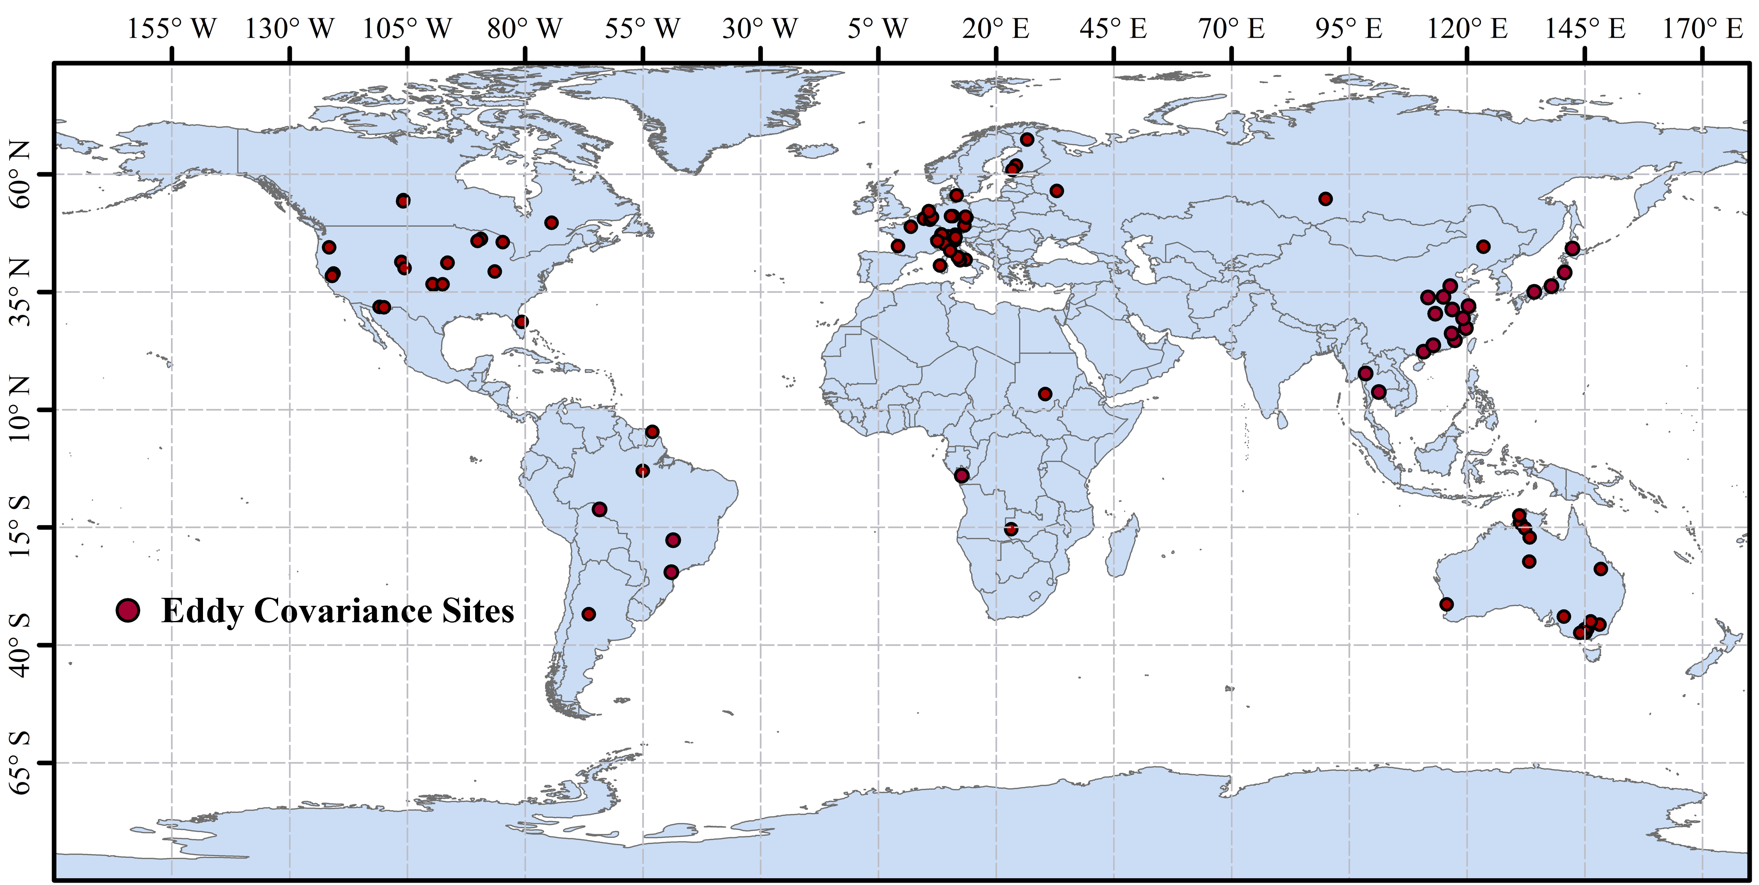
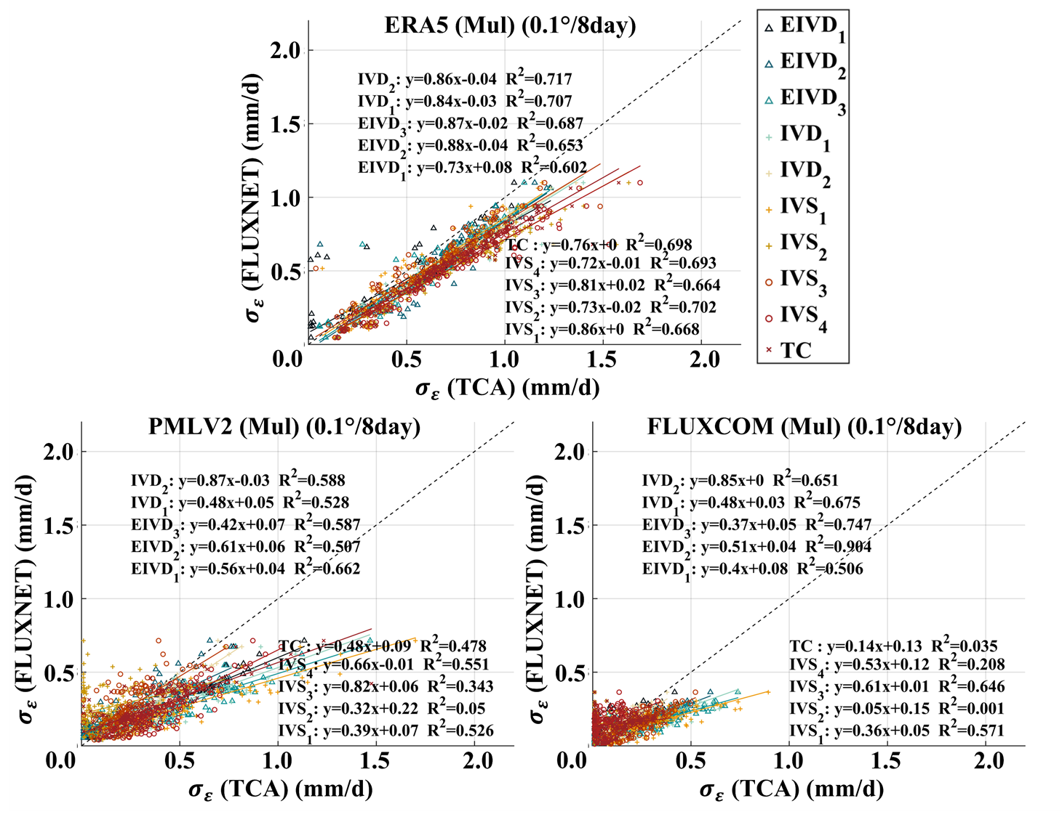
Validation of Collocation methods：Is it reliable?
Validation Results:
Benchmark: Site-based error results (FLUXNET-82sites)
$\overline{R^{2}}:(0.72\sim 0.83)$ | $RMSE:\left(0.12\sim 0.43\right) mm/d$
Comparison of 5 collocation algorithms:
EIVD>QC>IVD>TC>IVS
Changing of combination: Little impact
Reliable Alternative

Slide 9
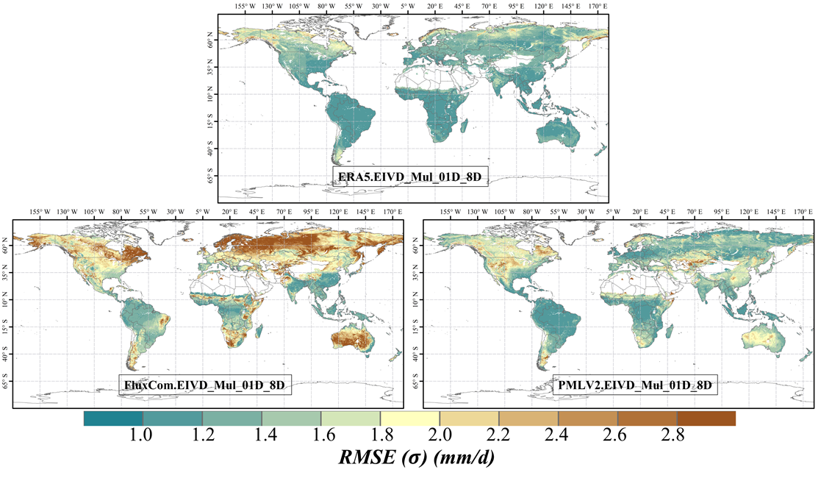
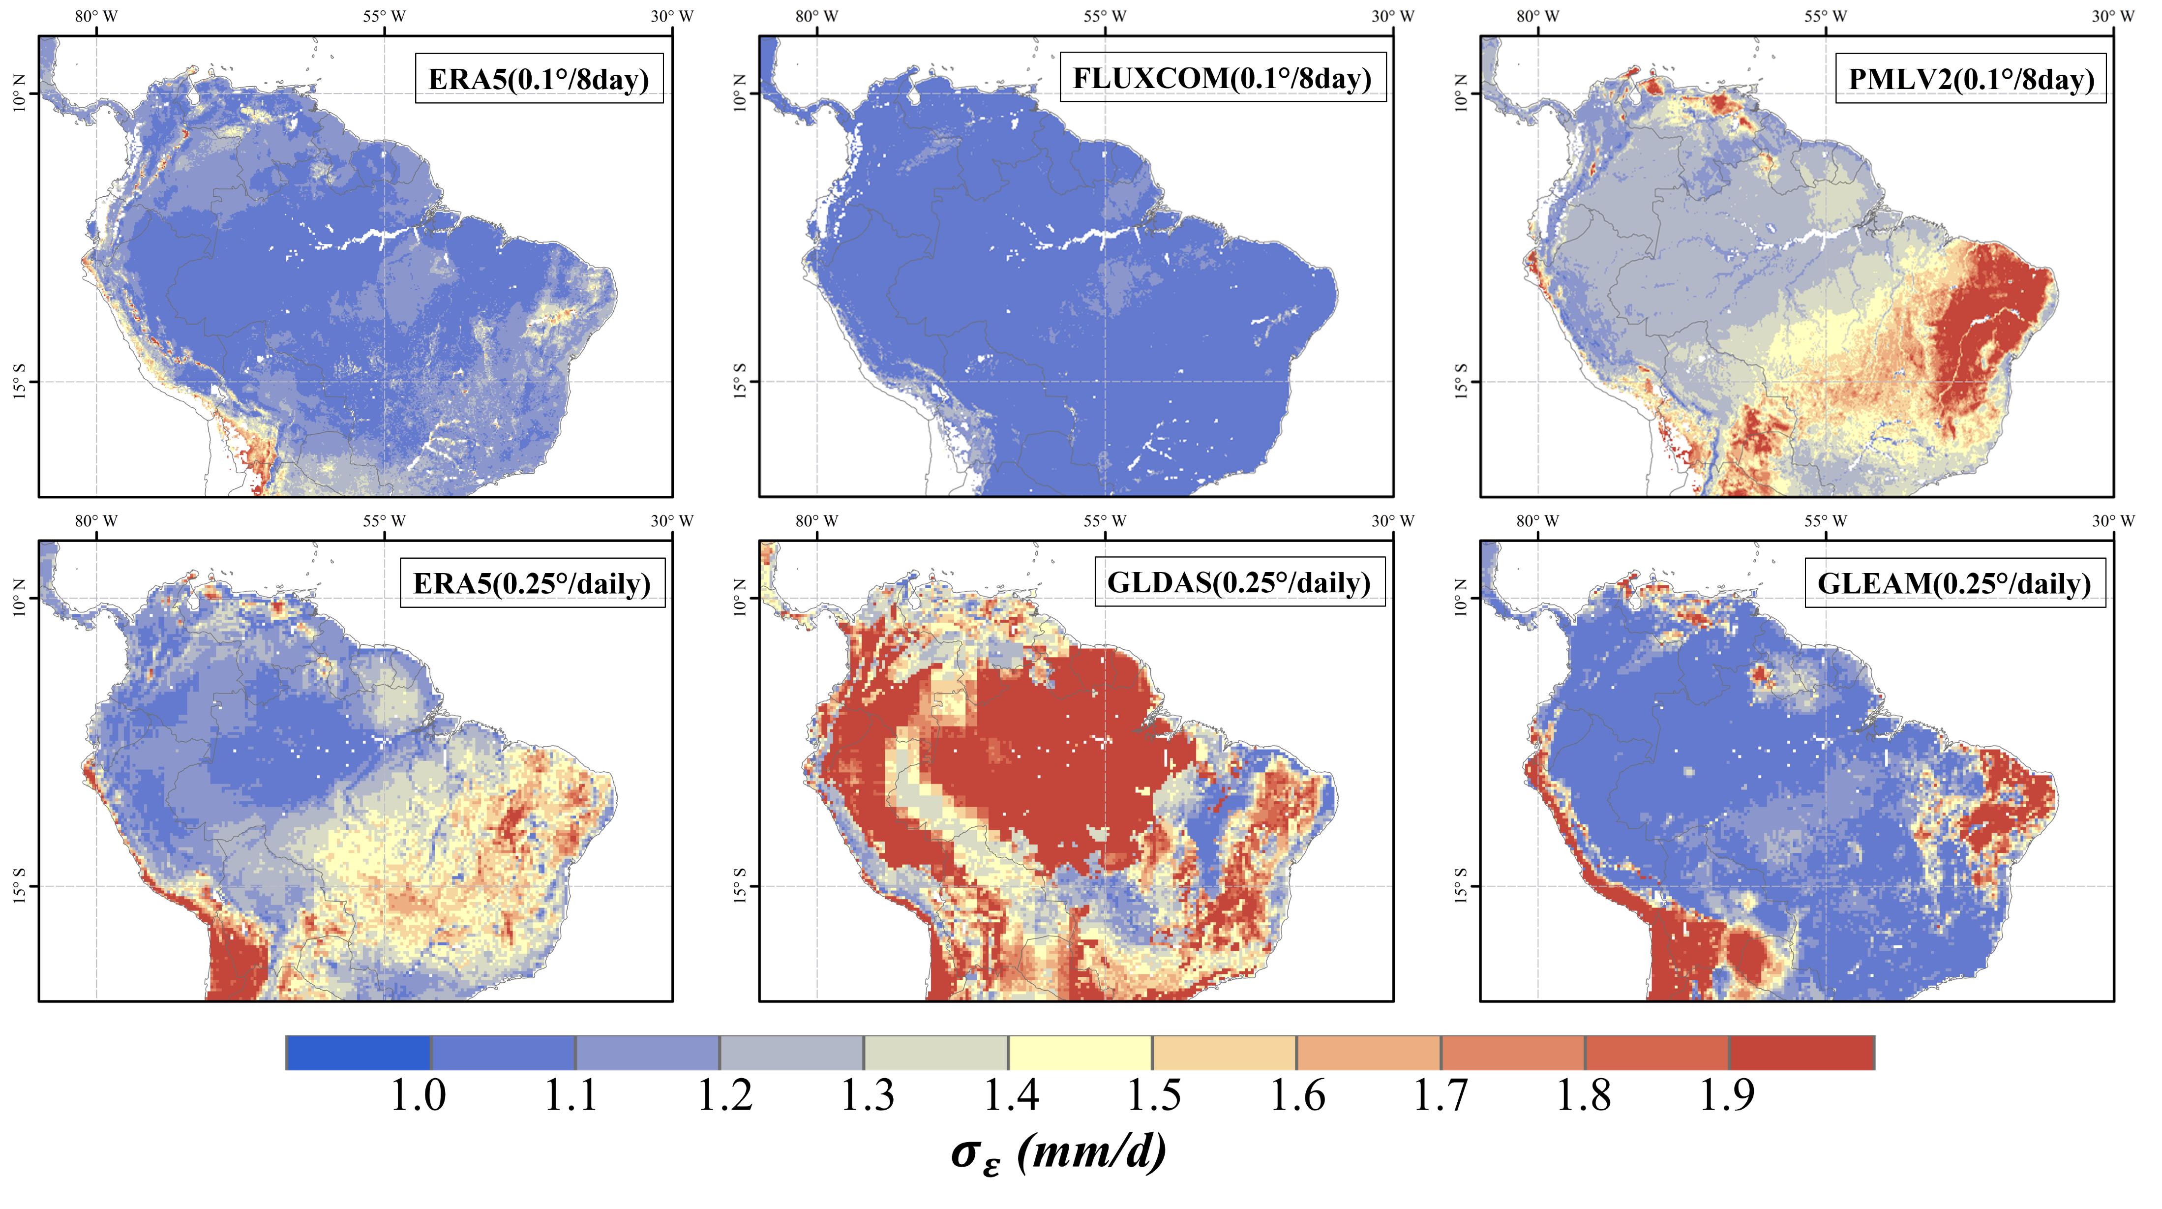
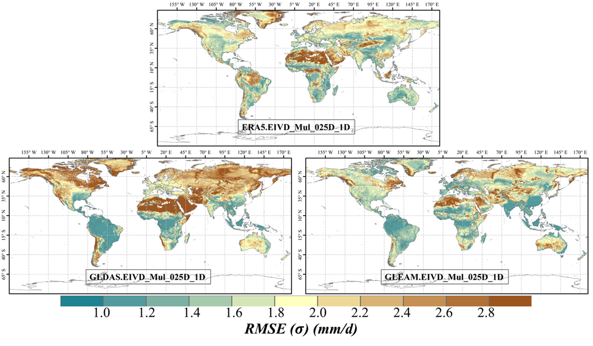
Errors: 5 Global ET products
A:0.1º-8D
$$\overline{σ_{ERA5}}=0.45$$
$$\overline{σ_{PMLV2}}=0.53$$
$$\overline{σ_{FLUXCOM}}=0.68$$
Error Characterization of 5 ET products
0.1º-8D: ERA5≈PMLV2>FLUXCOM (global average)
0.25º-D: GLEAM>ERA5>GLDAS (global average)
Amazon: GLEAM>FLUXCOM>PMLV2>ERA5>GLDAS
The evaluation results are consistent with previous studies
Further Validation
B:0.25º-D
$$\overline{σ_{GLEAM}}=1.24$$
$$\overline{σ_{ERA5}}=1.44$$
$$\overline{σ_{GLDAS}}=1.83$$

Slide 10
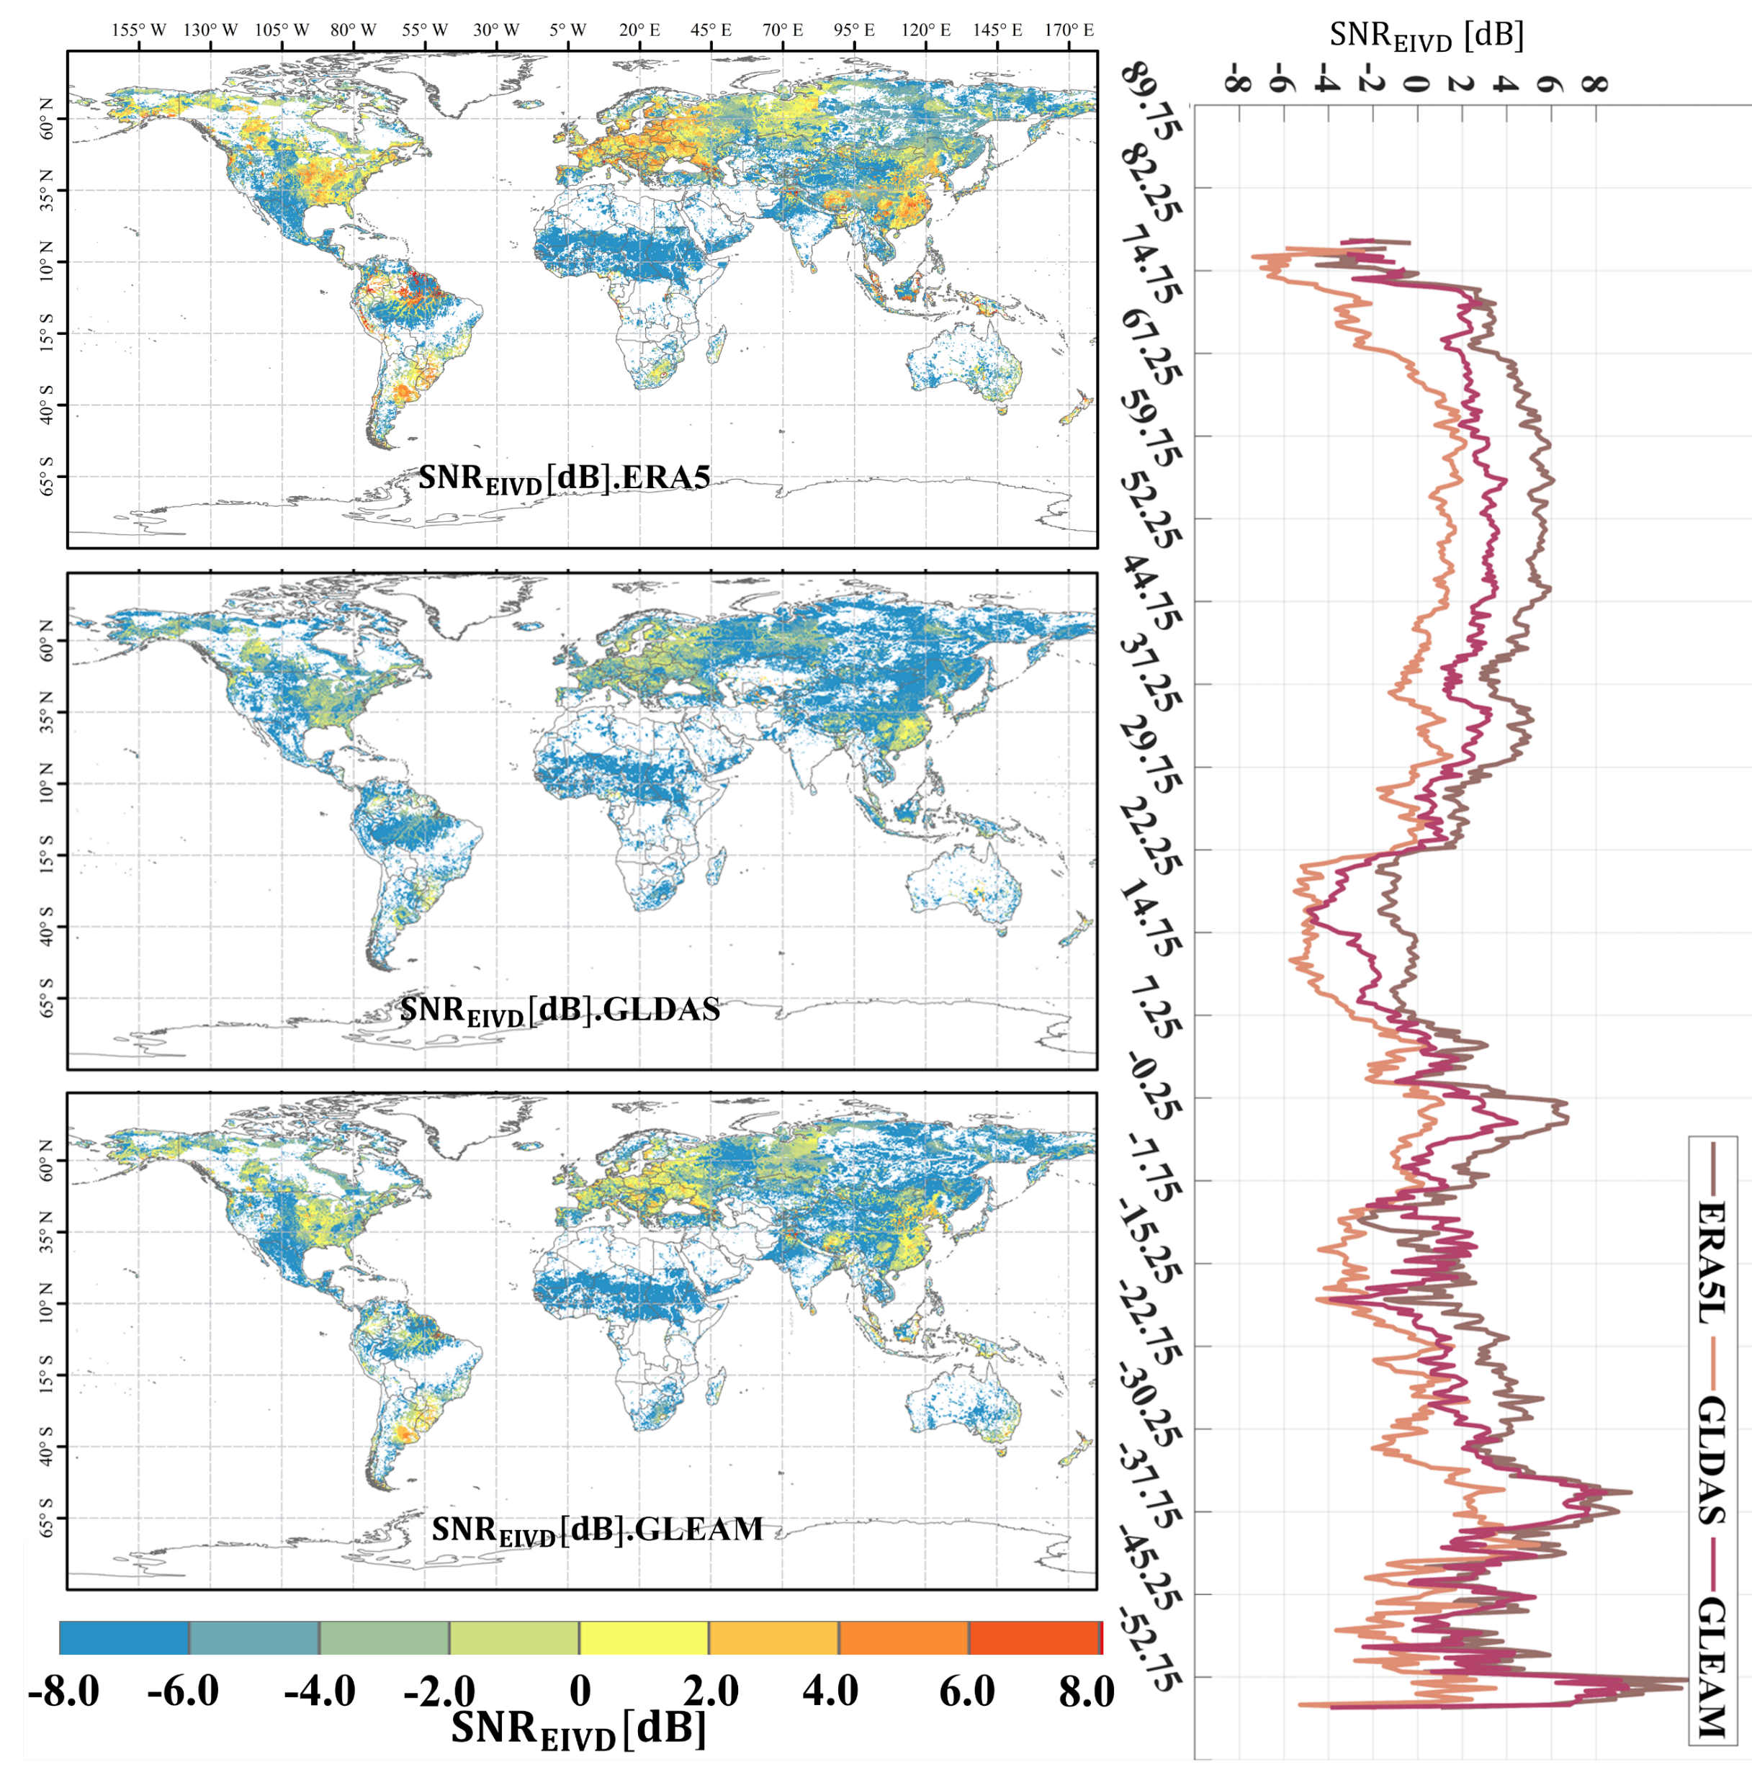
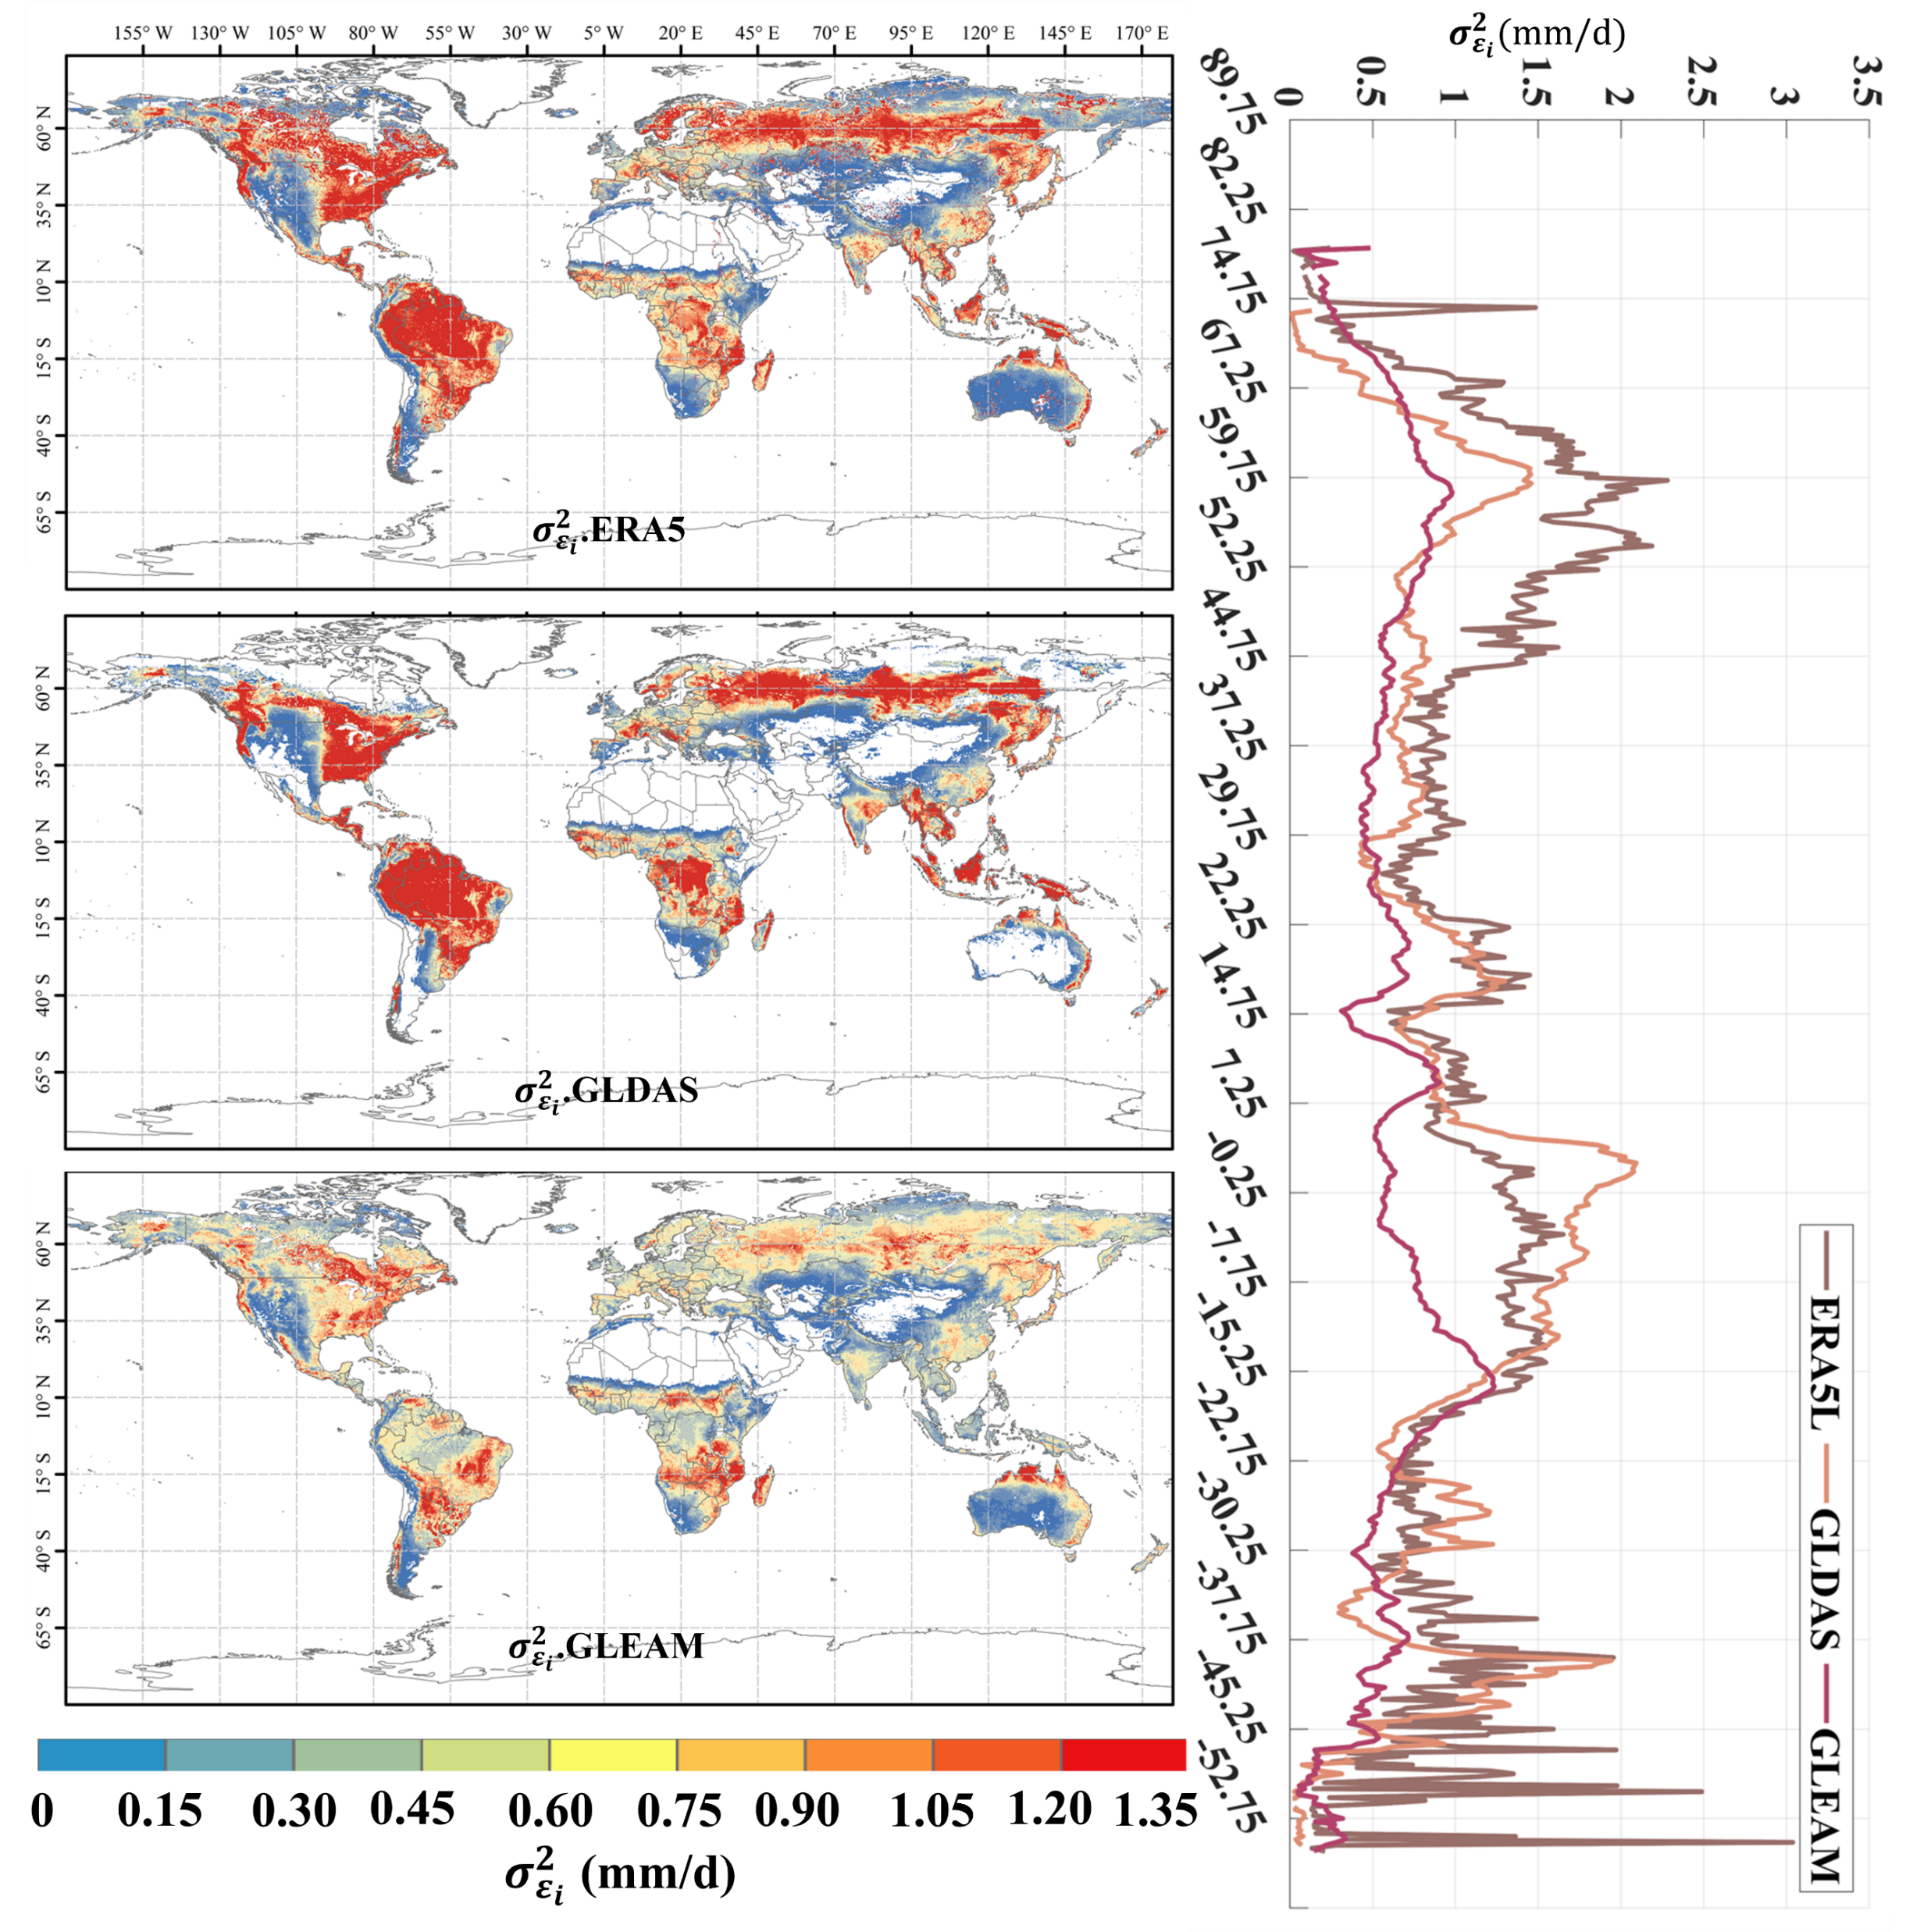
$$\overline{{SNR}_{GLEAM}}=−4.23±4.96$$
$$\overline{{SNR}_{ERA5L}}=−3.16±5.54$$
$$\overline{{SNR}_{GLDAS}}=−5.07±4.75$$
$$σ_{ε_{GLEAM}}^{2}=\text{0.67}\text{±}\text{0.39}$$
$$σ_{ε_{ERA5L}}^{2}=\text{1.21}\text{±}\text{2.07}$$
$$σ_{ε_{GLDAS}}^{2}=\text{0.98}\text{±}\text{0.82}$$
Gridded-T

Slide 11
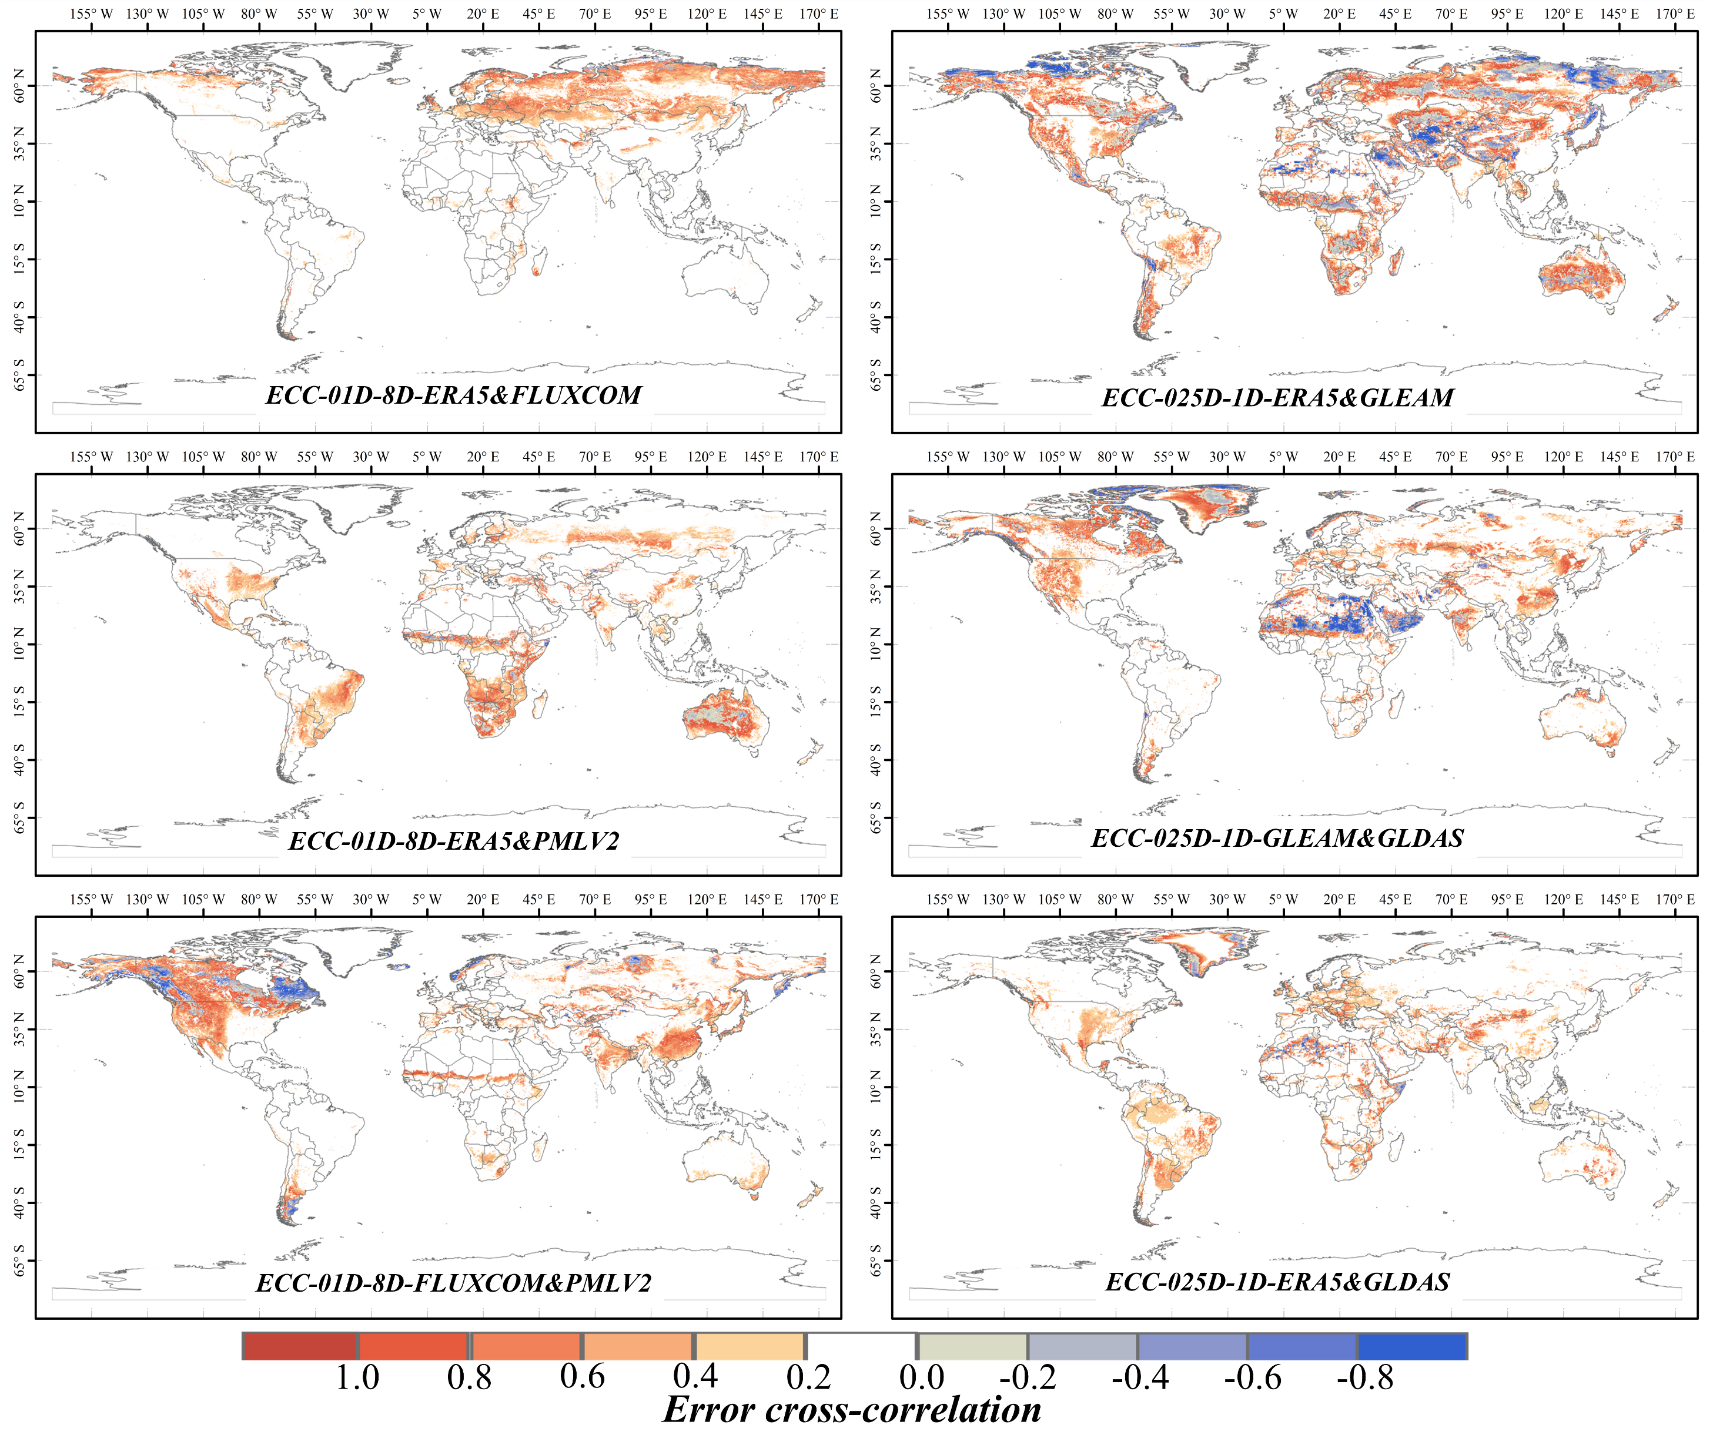
MERGE: 0.1º-8D (2000-2022)/ 0.25º-D (1950-2022)
Collocation-based Merging
0.1º-8D: ERA5L & PMLV2 & FLUXCOM
0.25º-D: GLEAMv3.6 & ERA5L & GLDAS2
Optimal weight: Linear Merging
TABLE Combination of inputs and accessible methods
Scenario 1 (0.1º-8Daily)
Period | Available Products | Method
（2000.01.01-2002.02.25) | ERA5L/ FLUXCOM | IVD
（2002.02.26-2015.12.27) | ERA5L/ FLUXCOM/ PMLV2 | EIVD
（2015.12.28-2020.12.26) | ERA5L/ PMLV2 | IVD
Scenario 2 (0.25º-Daily)
Period | Available Products | Method
（1950.01.01-1979.12.31) | ERA5L/ GLDAS2 | IVD
（1980.01.01-2021.12.31) | ERA5L/ GLEAM/ GLDAS2 | EIVD
（2022.01.01-2022.12.31) | ERA5L/ GLDAS2 | IVD
Average value below 0.5
High correlation: ERA5L & GLEAM (same meteorological input)

Slide 12
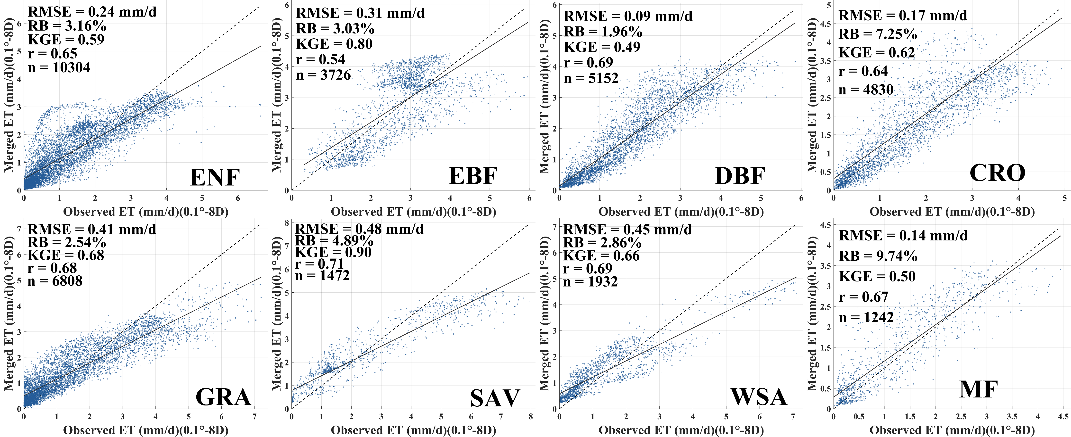
Site-based Evaluation (FLUXNET)
FLUXNET (82 sites) – 0.1º-8D
(1) 𝑅2&𝑅𝑀𝑆𝐸:0.1-8D (0.68/0.84 mm/d) (2) Good performance over 8 PFTs

Slide 13
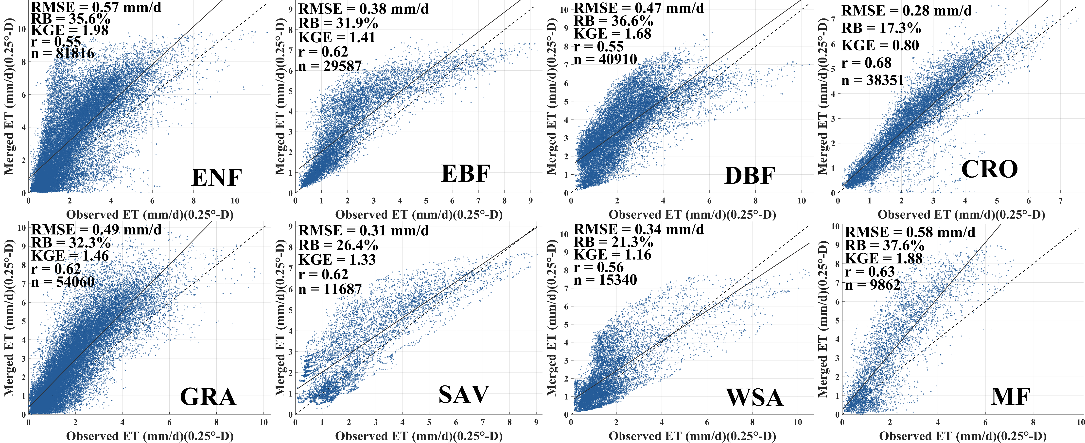
Site-based Evaluation (FLUXNET)
FLUXNET (82 sites) – 0.25º-D
(1)𝑅2 &𝑅𝑀𝑆𝐸:0.1-8D (0.62/1.03 mm/d) (2) Higher Uncertainty (Representative Error?)

Slide 14
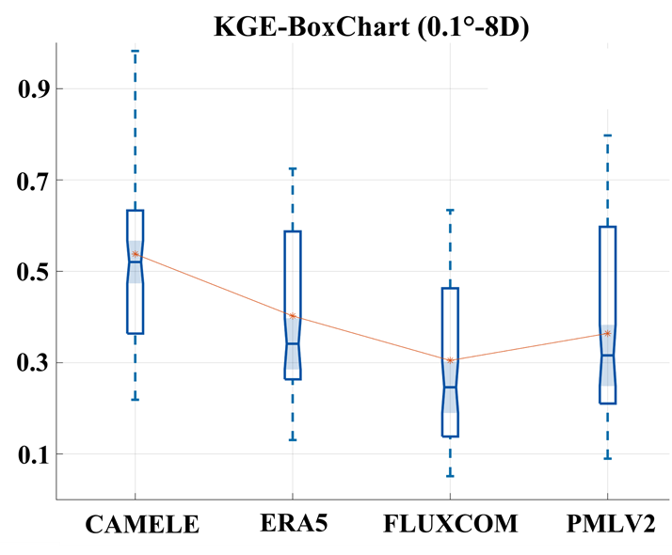
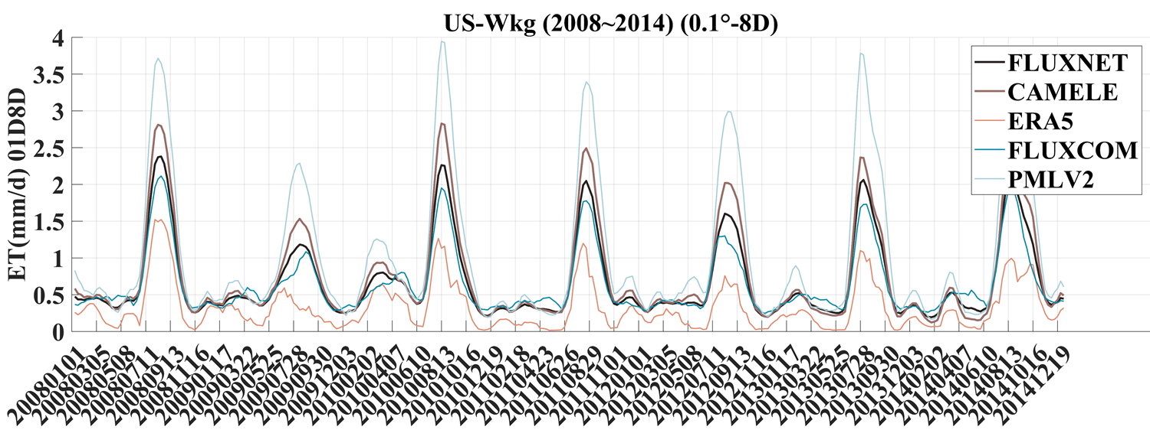
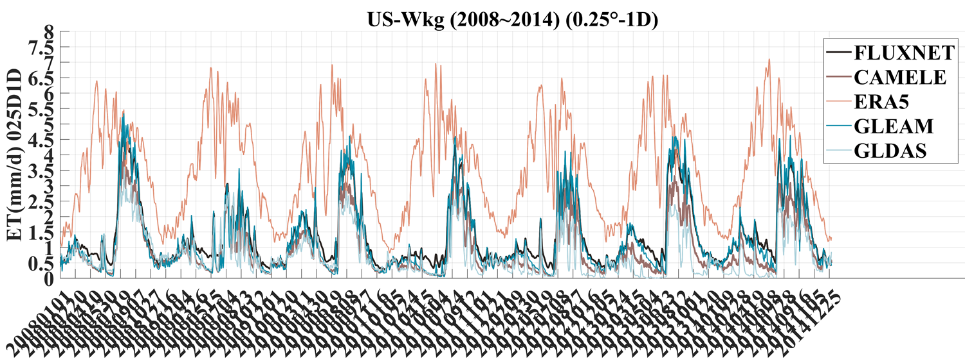
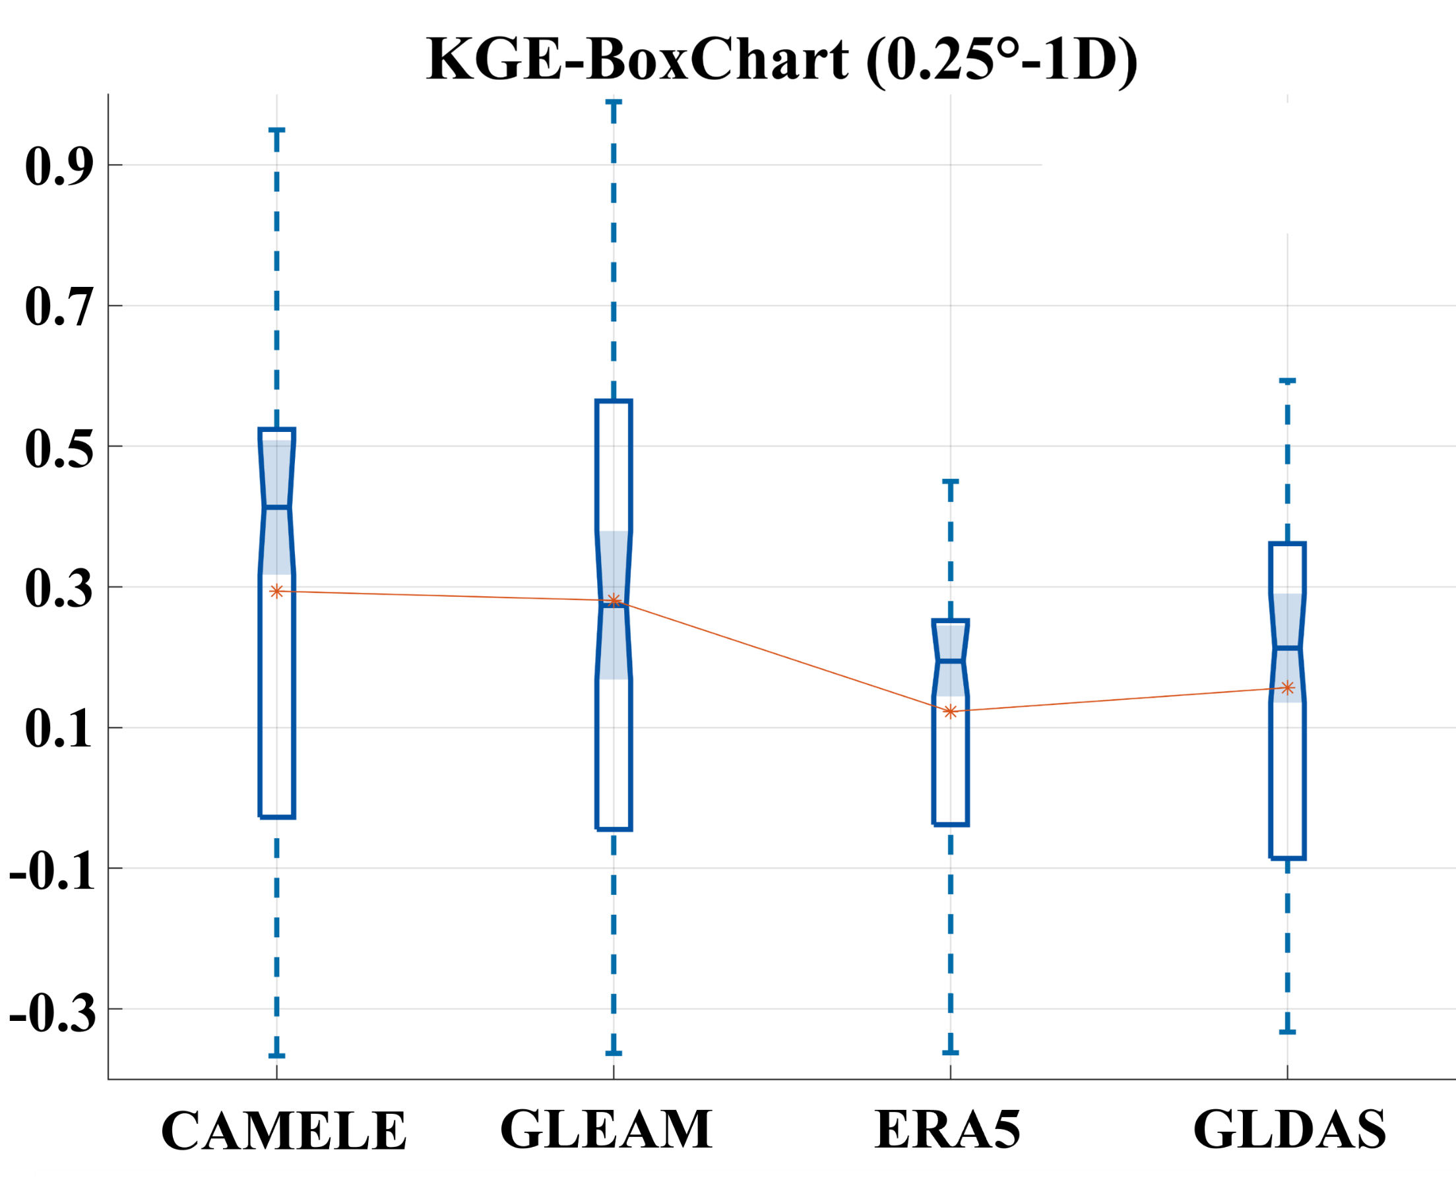
Performance of estimating ET variation: KGE
FLUXNET (82 sites) – Kling-Gupta Efficiency
Significant improvement against existing products : Higher KGE and better fitness
$$\overline{KGE_{CAMELE}}=0.52$$
$$\overline{KGE_{ERA5}}=0.44$$
$$\overline{KGE_{PMLV2}}=0.42$$
$$\overline{KGE_{FLUXCOM}}=0.32$$
Just one example

Slide 15
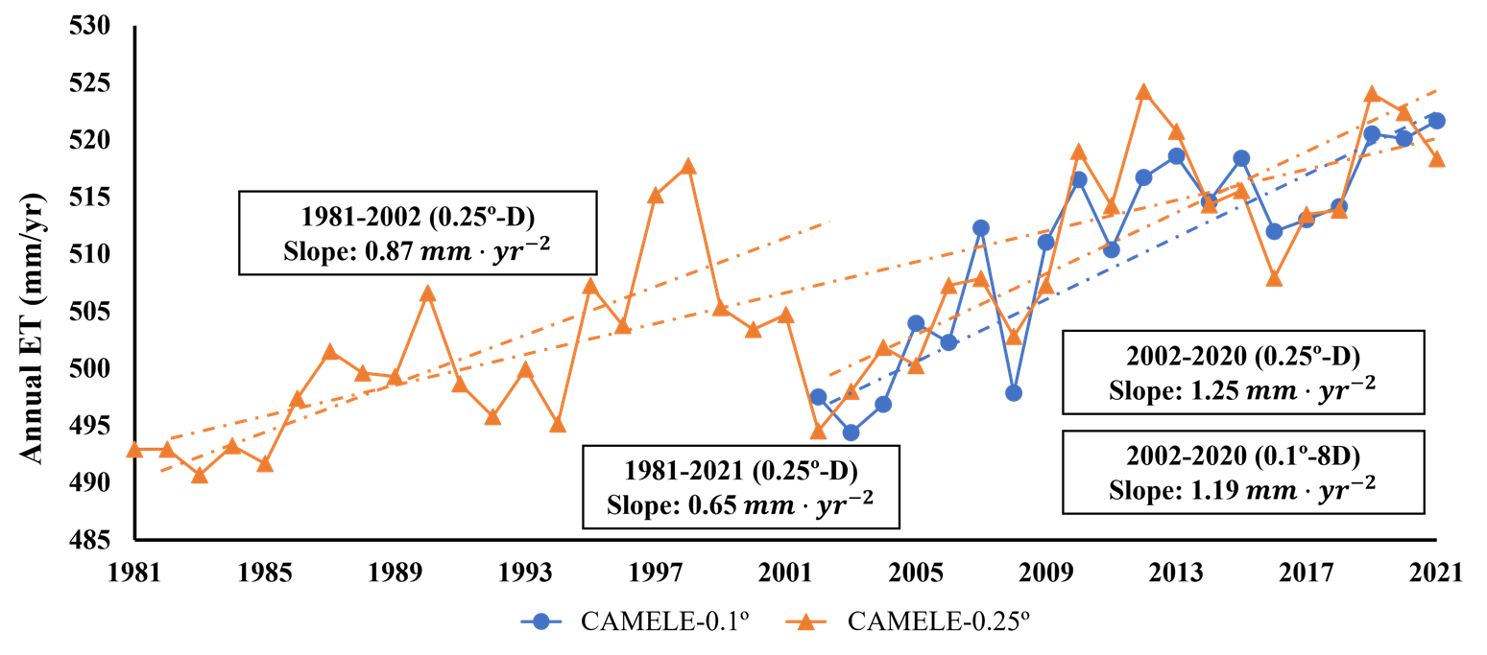
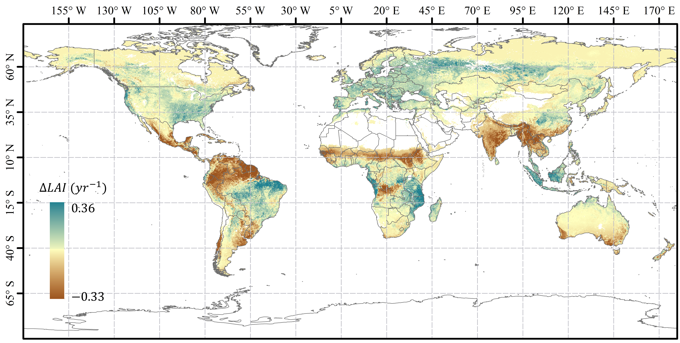
Interannual variation: Interesting
Annual ET variation
High estimates: FLUXCOM/GLDAS
Abnormal variation: ERA5
Interesting finding
1981-2021: Upward trend
Speed: (2002-2020) > (1981-2002)
Possible reasons
LAI induced increasing transpiration?
Global Greening?
Ongoing Work
FIGURE Global trend of LAI from 2000-2018 (GLASS)

