Slide 1



Pinhas Alpert and Joseph Barkan
Dept. of Geophysics, Tel-Aviv University, ISRAEL
Session CL5.02, WED 10 April
The Red Snow Event in Eastern Europe: Study of its peak development on 23 March 2018
J. Barkan and P. Alpert, "Rare Red Snow occurrence in SouthEastern Europe on March 2018- A synoptic case study", Weather, (accepted March 2019).
To download my Publications go to : http://www.tau.ac.il/~pinhas/publications.htm

Slide 2
Overview
Motivation & Data
Our earlier studies of long-range dust trajectories; Norway, Atlantic circular, Italy, Israel
Movie/Pictures of the Red Snow
Maps and trajectories of the event 20-27 March 2018
Potential causes of Red Snow
Conclusions
How difficult is it to predict snow? (Science Advances,2019)

Slide 3

LAST WEEK: Astronomers spy an iron planet stripped of its crust around a burned-out star
By Daniel Clery Apr. 4, 2019 , 2:00 PM
If the team’s calculations are correct, the orbiting object may be the iron core of a small planet that had its outer layers ripped off by the white dwarf’s intense gravity. Finding the planetesimal, 400 light-years from Earth, wasn’t easy. A team of astronomers, led by Christopher Manser of the University of Warwick in Coventry, U.K., had been watching this particular white dwarf for 15 years.
Astronomers have discovered a small planet around a white dwarf, which in this artist’s conception is plowing through a disk of dust and leaving a trail of gas in its wake; University of Warwick/Mark Garlick. News from Science Magazine April 4 2019

Slide 4
Methodology & Data
NCEP/NCAR reanalysis (Kalnay et al 1996)- Synoptic maps
MODIS (Moderate Resolution Imaging Spectroradiometer) on board the TERRA satellite- Aerosol Optical Thickness
Hysplit back trajectory model for 60 hours to point to the dust origin

Slide 5
Motivation
Explain the outstanding red snow event over southeastern Europe on 23 March 2018
The special synoptic features and the associated long-range trajectories from the Sahara

Slide 6
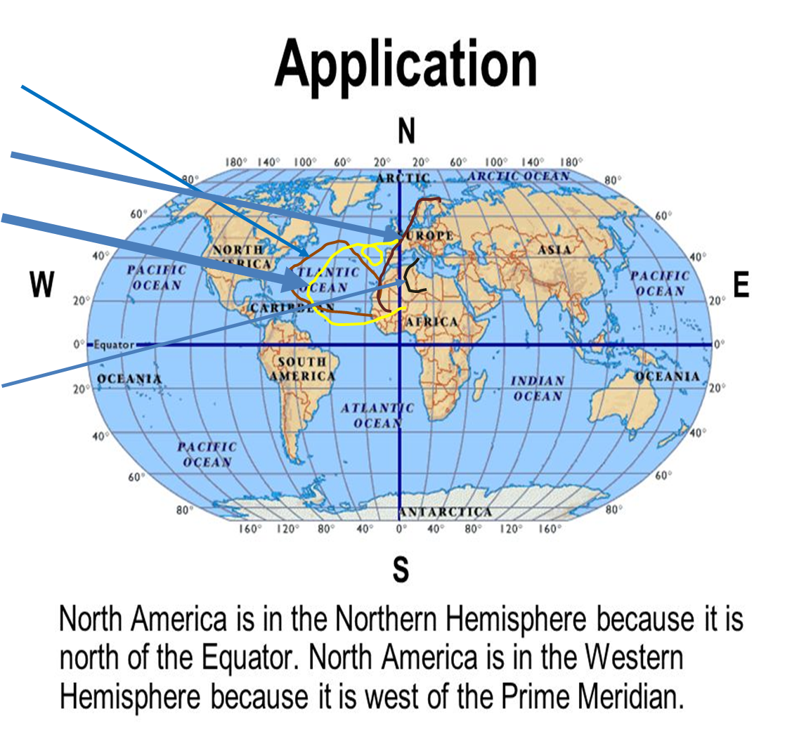
Our Earlier long-rage transport studies with J. Barkan
J. Barkan and P. Alpert, "A unique case-study of near-circular Saharan dust transport over the Atlantic Ocean", Atmospheric and Climate Sciences (ACS), 4, 164-170, 2014.
J. Barkan and P. Alpert, "Synoptic analysis of a rare event of Saharan dust reaching
the Arctic Region'', Weather, 65:8, 208-211, 2010.
Y. Barkan, P. Kishcha, H. Kutiel, and P. Alpert, "The Synoptics of Dust Intrusion Days from the African Continent into the Atlantic Ocean", J. Geophys. Res., Vol. 109, No. D8, D08201=2010.1029/2003JD004416=20, 2004.
J. Barkan, H. Kutiel and P. Alpert, "Climatology of dust sources over the North African region, based on TOMS data", Indoor-Built Environ., Vol. 13, 407-419, 2004
J. Barkan, P. Alpert, H. Kutiel, and P. Kishcha,"The Synoptics of dust transportation
days from Africa toward Italy and Central Europe", J. Geophy. Res., 110,
doi:10.1029/2003 JD004416, 2005.
Wishing Joseph Barkan, full recovery!!

Slide 7
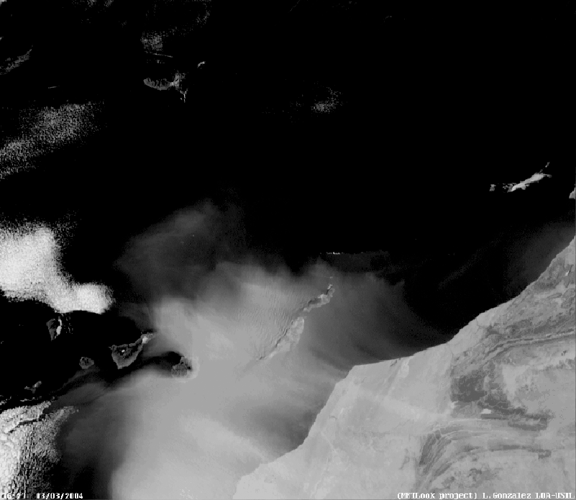
The dust circumvents Tenerife 16:27
P. Alpert and J. Barkan, "Dust as a potential tracer for the flow over topography", IJG, 6, 42-50, 2015.

Slide 8
Chiu A., Orange Snow Blankets Eastern Europe. There is an Explanation,
The Washington Post, 26 March 2018
Figure 2: As in Fig. 1 another E. Europe location. The Washington Post 26 March 2018 (Chiu A. 2018).

Slide 9
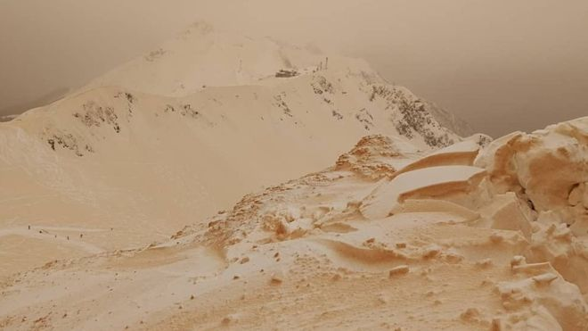
MARGARITA ALSHINA
The Russian Caucasus. The phenomenon has been seen across several countries
'Orange snow' baffles eastern Europeans 25 March 2018 BBC

Slide 10
BBC 25 Mar 2018
People in eastern Europe have been wondering at the appearance of orange-tinted snow.
Pictures of the snow have been posted on social media from Russia, Bulgaria, Ukraine, Romania and Moldova.
Meteorologists say the phenomenon is caused by sand from Sahara desert storms mixing with snow and rain.
It occurs roughly once every five years but concentrations of sand are higher than usual this time. People have complained of sand in their mouths.
Skiers and snowboarders from resorts near the Russian city of Sochi sent pictures of the unusual scenes.

Slide 11
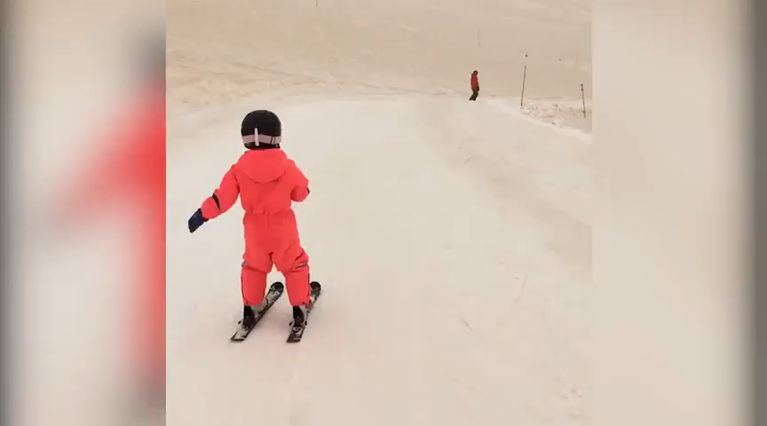
Orange snow blanketed parts of Russia, Bulgaria, Ukraine, Romania and Moldova. The colored
snow is sand from Sahara desert storms mixing with snow and rain. (nazd1234/Instagram); The Washington Post

Slide 12
Figure 3: Orange snow blanketed parts of Russia, Bulgaria, Ukraine, Romania and Moldova. The colored snow is due to sand from Sahara desert storms mixing with snow and rain.

Slide 13
Figure 4: Satelite picture of dust transport from N. Africa to Greece corresponding Fig. 6. The image is from MODIS-Terra on 26 March 2018.

Slide 14
MODIS AOT Average over 30-40°E, 40-50°N
1 Jan-31 Mar 2018 PEAK-23 MAR 2nd max 26-27 MAR
Date
Figure 5: MODIS Aerosol Optical Thickness (AOT) average over 30-40ºE, 40-50ºN during 1-31 Mar 2018. Peak AOD is on 23 MAR while 2nd maximum is on 26-27 MAR.

Slide 15
Geopotential 700 hPa, 20 March 2018

Slide 16
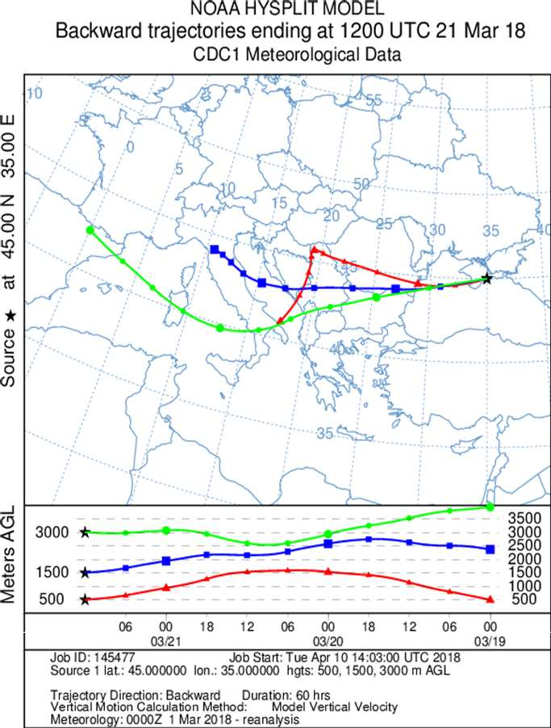
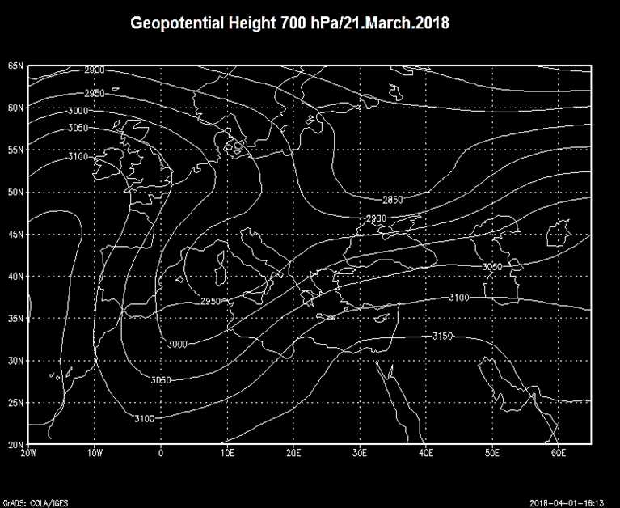
Geopotential 700 hPa, 21 March 2018

Slide 17
Figure 7: Satellite picture of dust transport from N. Africa to Greece corresponding Fig. 6d on 26 March 2018.

Slide 18
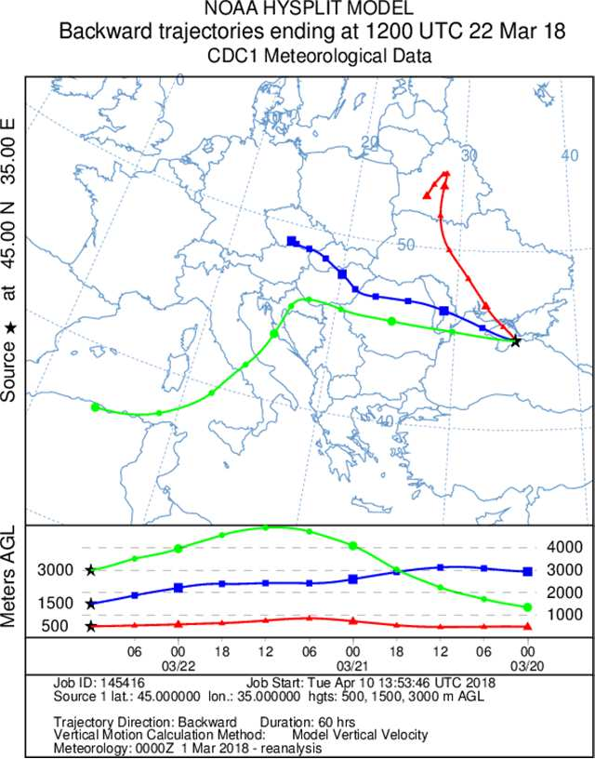
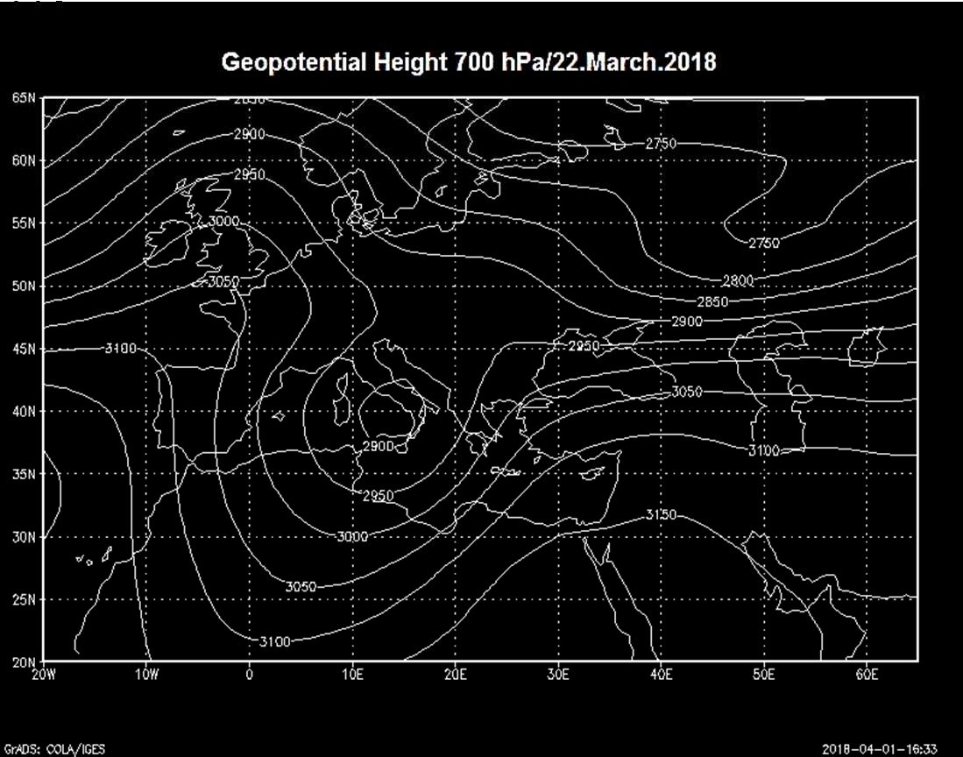
Geopotential 700 hPa, 22 March 2018

Slide 19
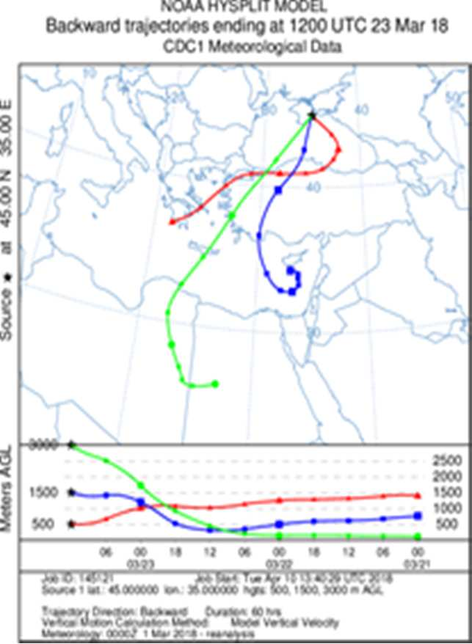
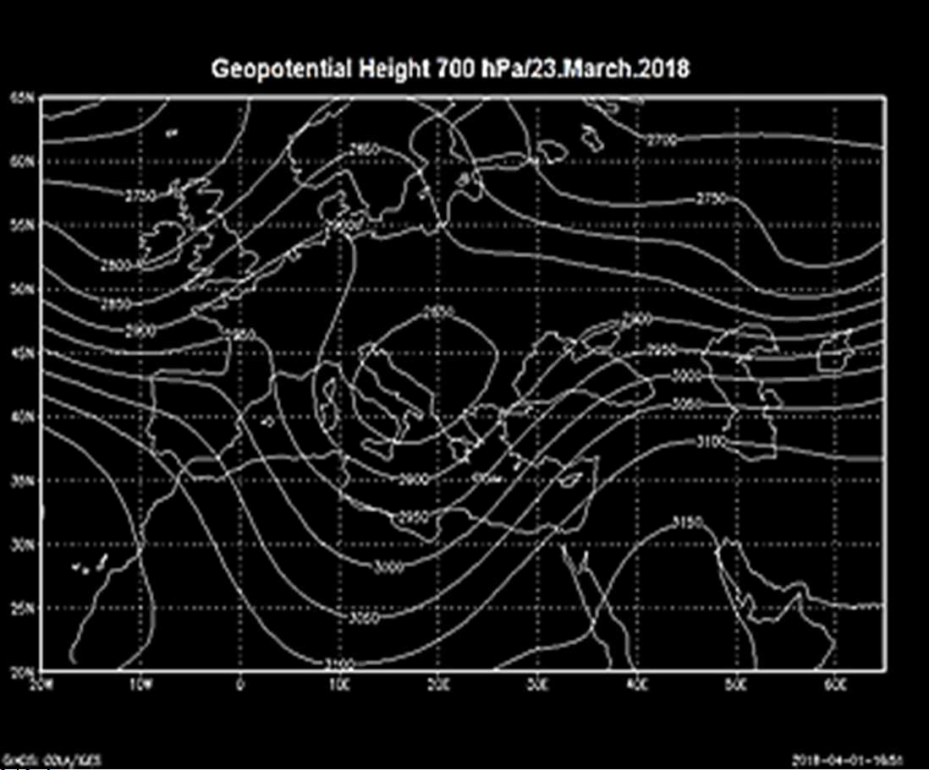
Geopotential 700 hPa, 23 March 2018
23 March 2018- Peak of AOD in the Red Snow square.
Green back trajectory from Saharan surface to 700 mb within 60 h

Slide 20
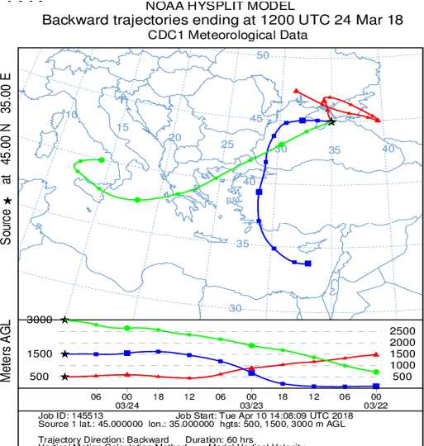
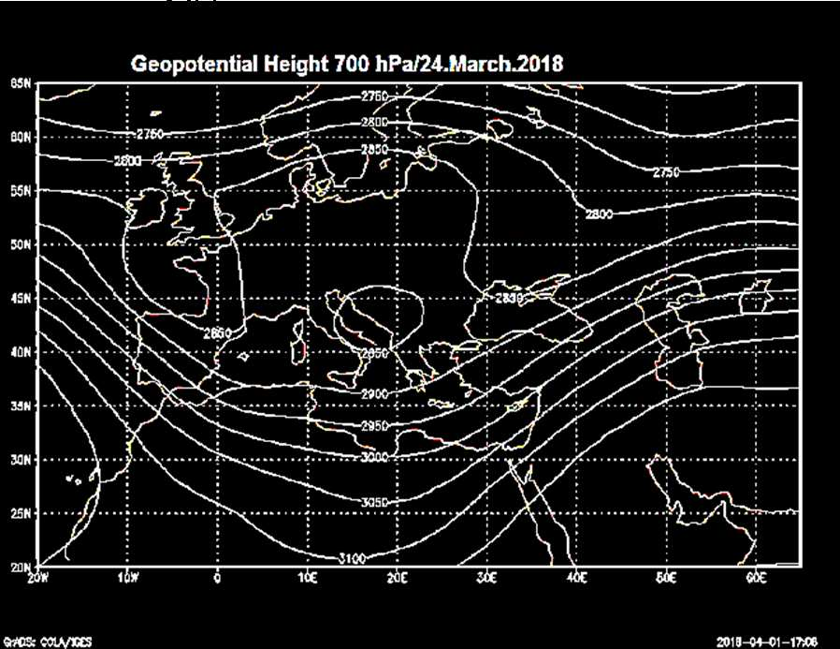
Geopotential 700 hPa, 24 March 2018

Slide 21
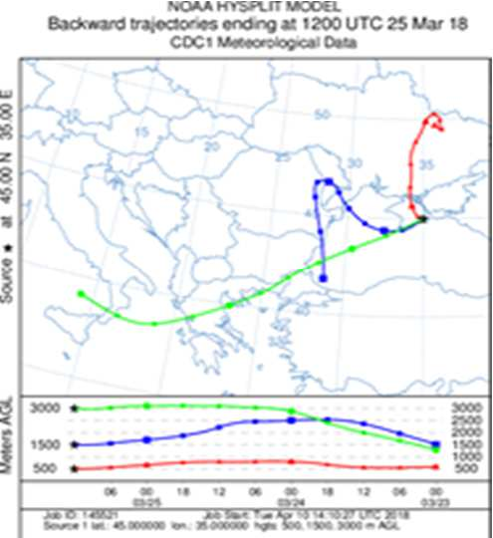
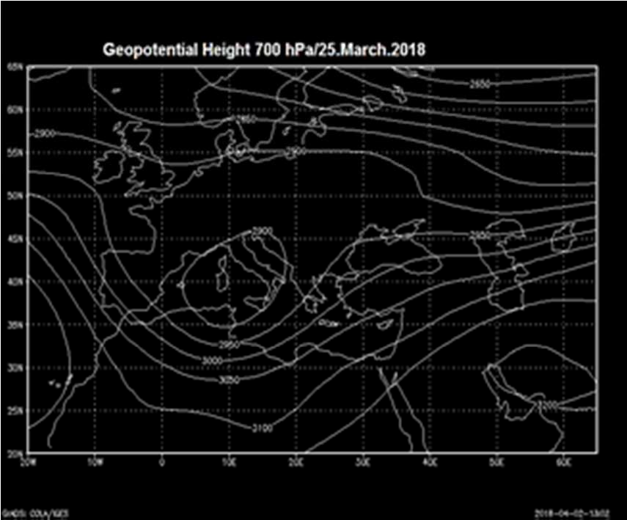
Geopotential 700 hPa, 25 March 2018

Slide 22
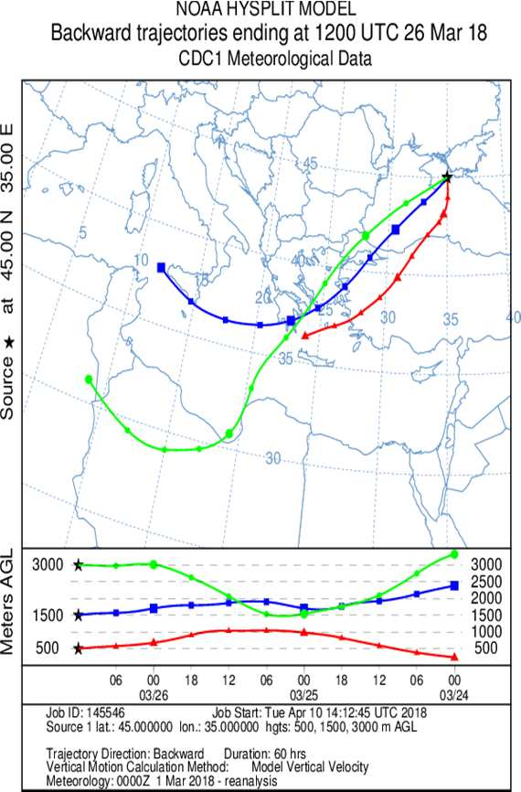
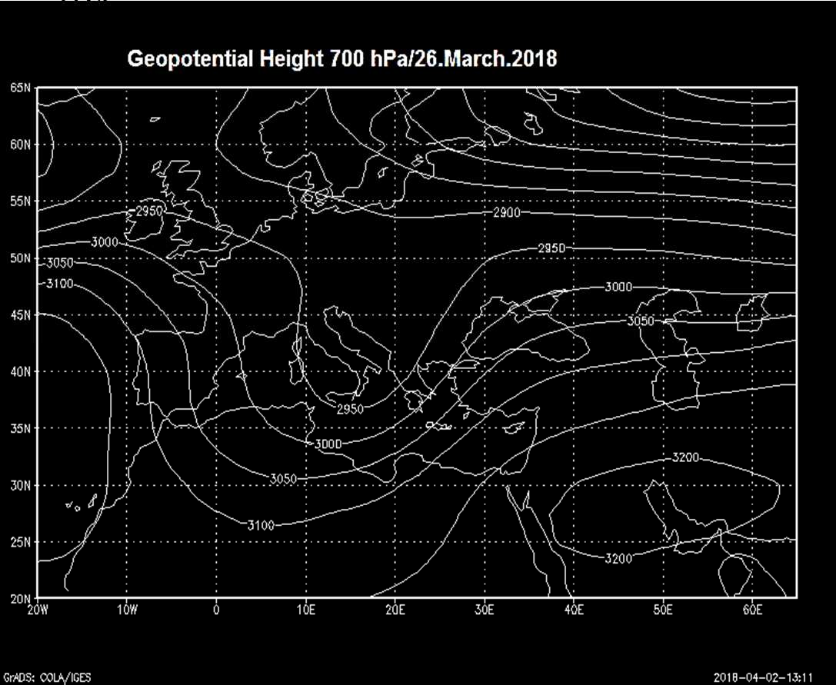
Geopotential 700 hPa, 26 March 2018

Slide 23
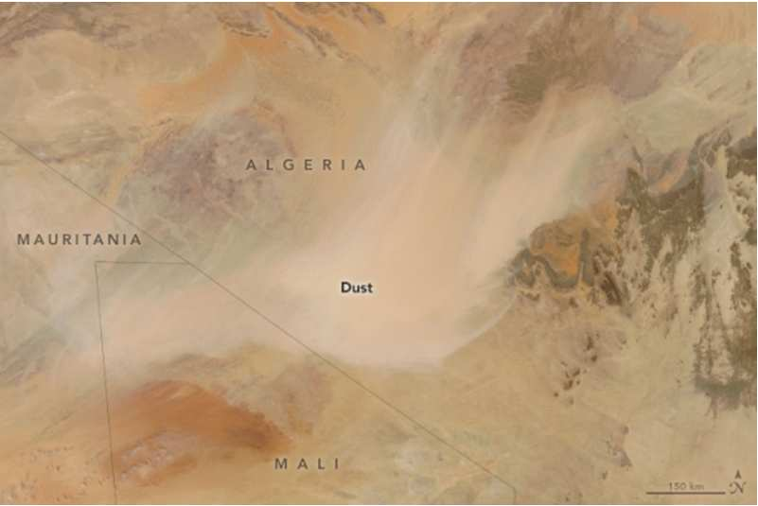
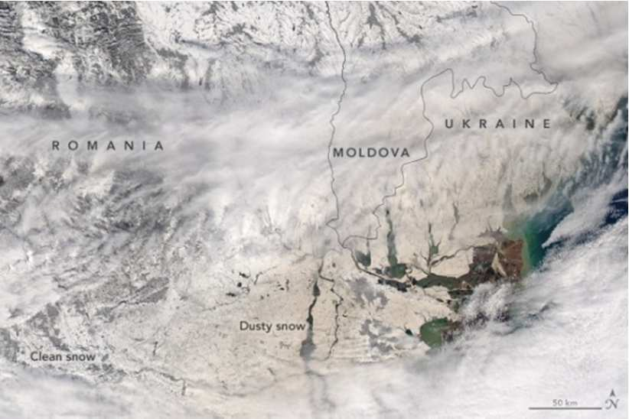
At the origin site in the Sahara
& as dropped over E. Europe

Slide 24
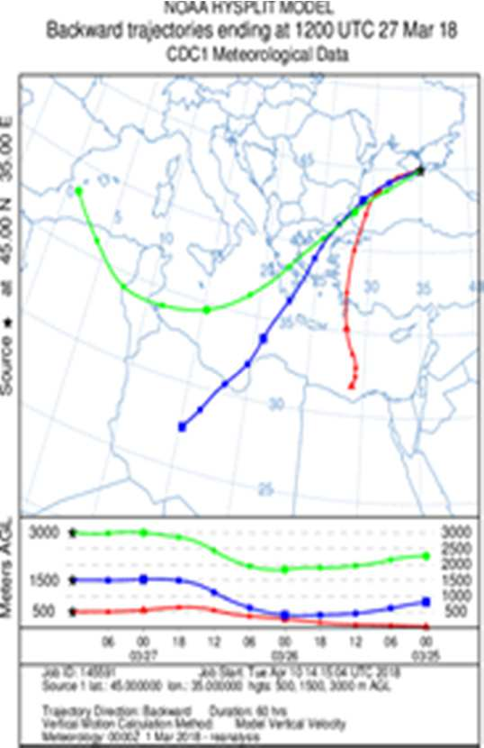
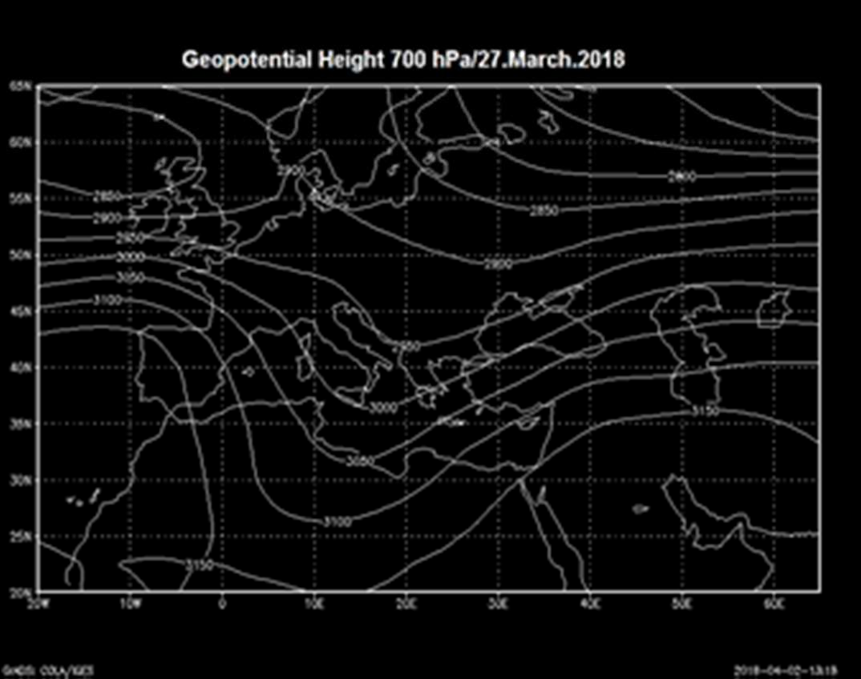
Geopotential 700 hPa, 27 March 2018

Slide 25
Potential causes of Red Snow
Activity of green algae which occurs, usually in summer at high latitudes (Mancini, 2018) - not the topic here.
The second is red snow as result of Saharan dust storms which can occur at every season.

Slide 26
Take-away message
Deep cold trough penetrating from high latitudes southward toward W. Africa is a common event occurring nearly each year.
At the eastern flank of the trough a strong S-SW flow develops which transports the Saharan dust to the north & Europe.
Penetration depth fits the trough’ depth and its strength
Trough’s development & its penetration SW can occur along Europe ‘s W. shores or further east. Then……

Slide 27
Take-away message(cont.)
Dust is then transported into western/central Europe & Mediterranean which are relatively warm and snow is rare.
In this event, the trough developed further east which is not common. This caused heavy dust storms over central Sahara near the most ample dust sources.
The strong SW flow at the E. flank of the trough reached E. Europe which is colder and snowier.
So, it is with higher probability that the transported dust reached E. Europe jointly with snow flakes and painted them with its color, red or brown.

Slide 28
More details
J. Barkan and P. Alpert, "Rare Red Snow occurrence in SouthEastern Europe on March 2018- A synoptic case study", Weather, (accepted March 2019).
To download my Publications go to : http://www.tau.ac.il/~pinhas/publications.htm
Thank you for listening!

Slide 29
Our last week (accepted) snow related paper
Hochman A, Alpert P, Harpaz T, Saaroni H, Messori G. 2019, A new dynamical systems perspective on atmospheric predictability: eastern Mediterranean weather regimes as a case study. Science Advances (in press).

Slide 30
Dynamical systems theory predictability proxies
(d and ϴ)
ϴ = 1/persistence
d = Local dimension - The number of degrees of freedom

Slide 31
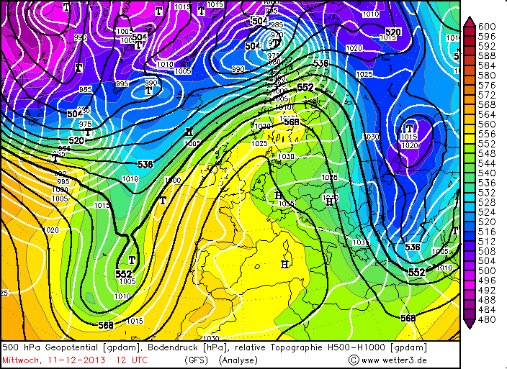
Beginning December 11th there was a big anticyclone over Europe, whose eastern edge drew cold air southwards from the Arctic. This polar outbreak then spread over the EM pushing ahead of it moist air associated with a cold front and causing heavy snow over higher grounds and heavy precipitation and flooding peaking on December 13th.

Slide 32
Snow Storm “Alexa” 11-14.12.2013
Costliest natural disaster ever recorded in Israel. Damage was estimated at ~100 million dollars.
4 people were killed.
35,000 homes were disconnected from electricity for about a week.
Roads were blocked for more then 48 hours.
9000 flights were cancelled.
This storm is considered an exceptional and rare event; the weather forecasters in the region struggled to predict its extent, especially concerning snow cover and depth at such an early stage in winter. (http://www.ims.gov.il/IMS/CLIMATE/ClimateSummary/2013/dec10-14+event.htm)

Slide 33
ECMWF prediction for Jerusalem
initialized on 11th December at 00UTC
Observed Jerusalem
Precipitation = ~227mm
Snow depth = ~50-70cm
Wind speed = ~14-17m/s
Wind gusts = ~25m/s
Precipitation = ~50mm
Snow depth = ~10cm
Wind speed = ~7m/s
Snow forecast failure!!

Slide 34
Snow
Event
Low predictability
d = The Local
dimension
or the number
of degrees
of freedom

