Slide 1
Using hydrodynamic flood modelling to support impact-based forecasting: a case study for Super-Typhoon Haiyan in the Philippines
Asha Barendregt, Irene Benito Lazaro, Sanne Muis, Marc van den Homberg and Aklilu Teklesadik
sanne.muis@vu.nl
Source: Bryan Denton for The New York Times

Slide 2
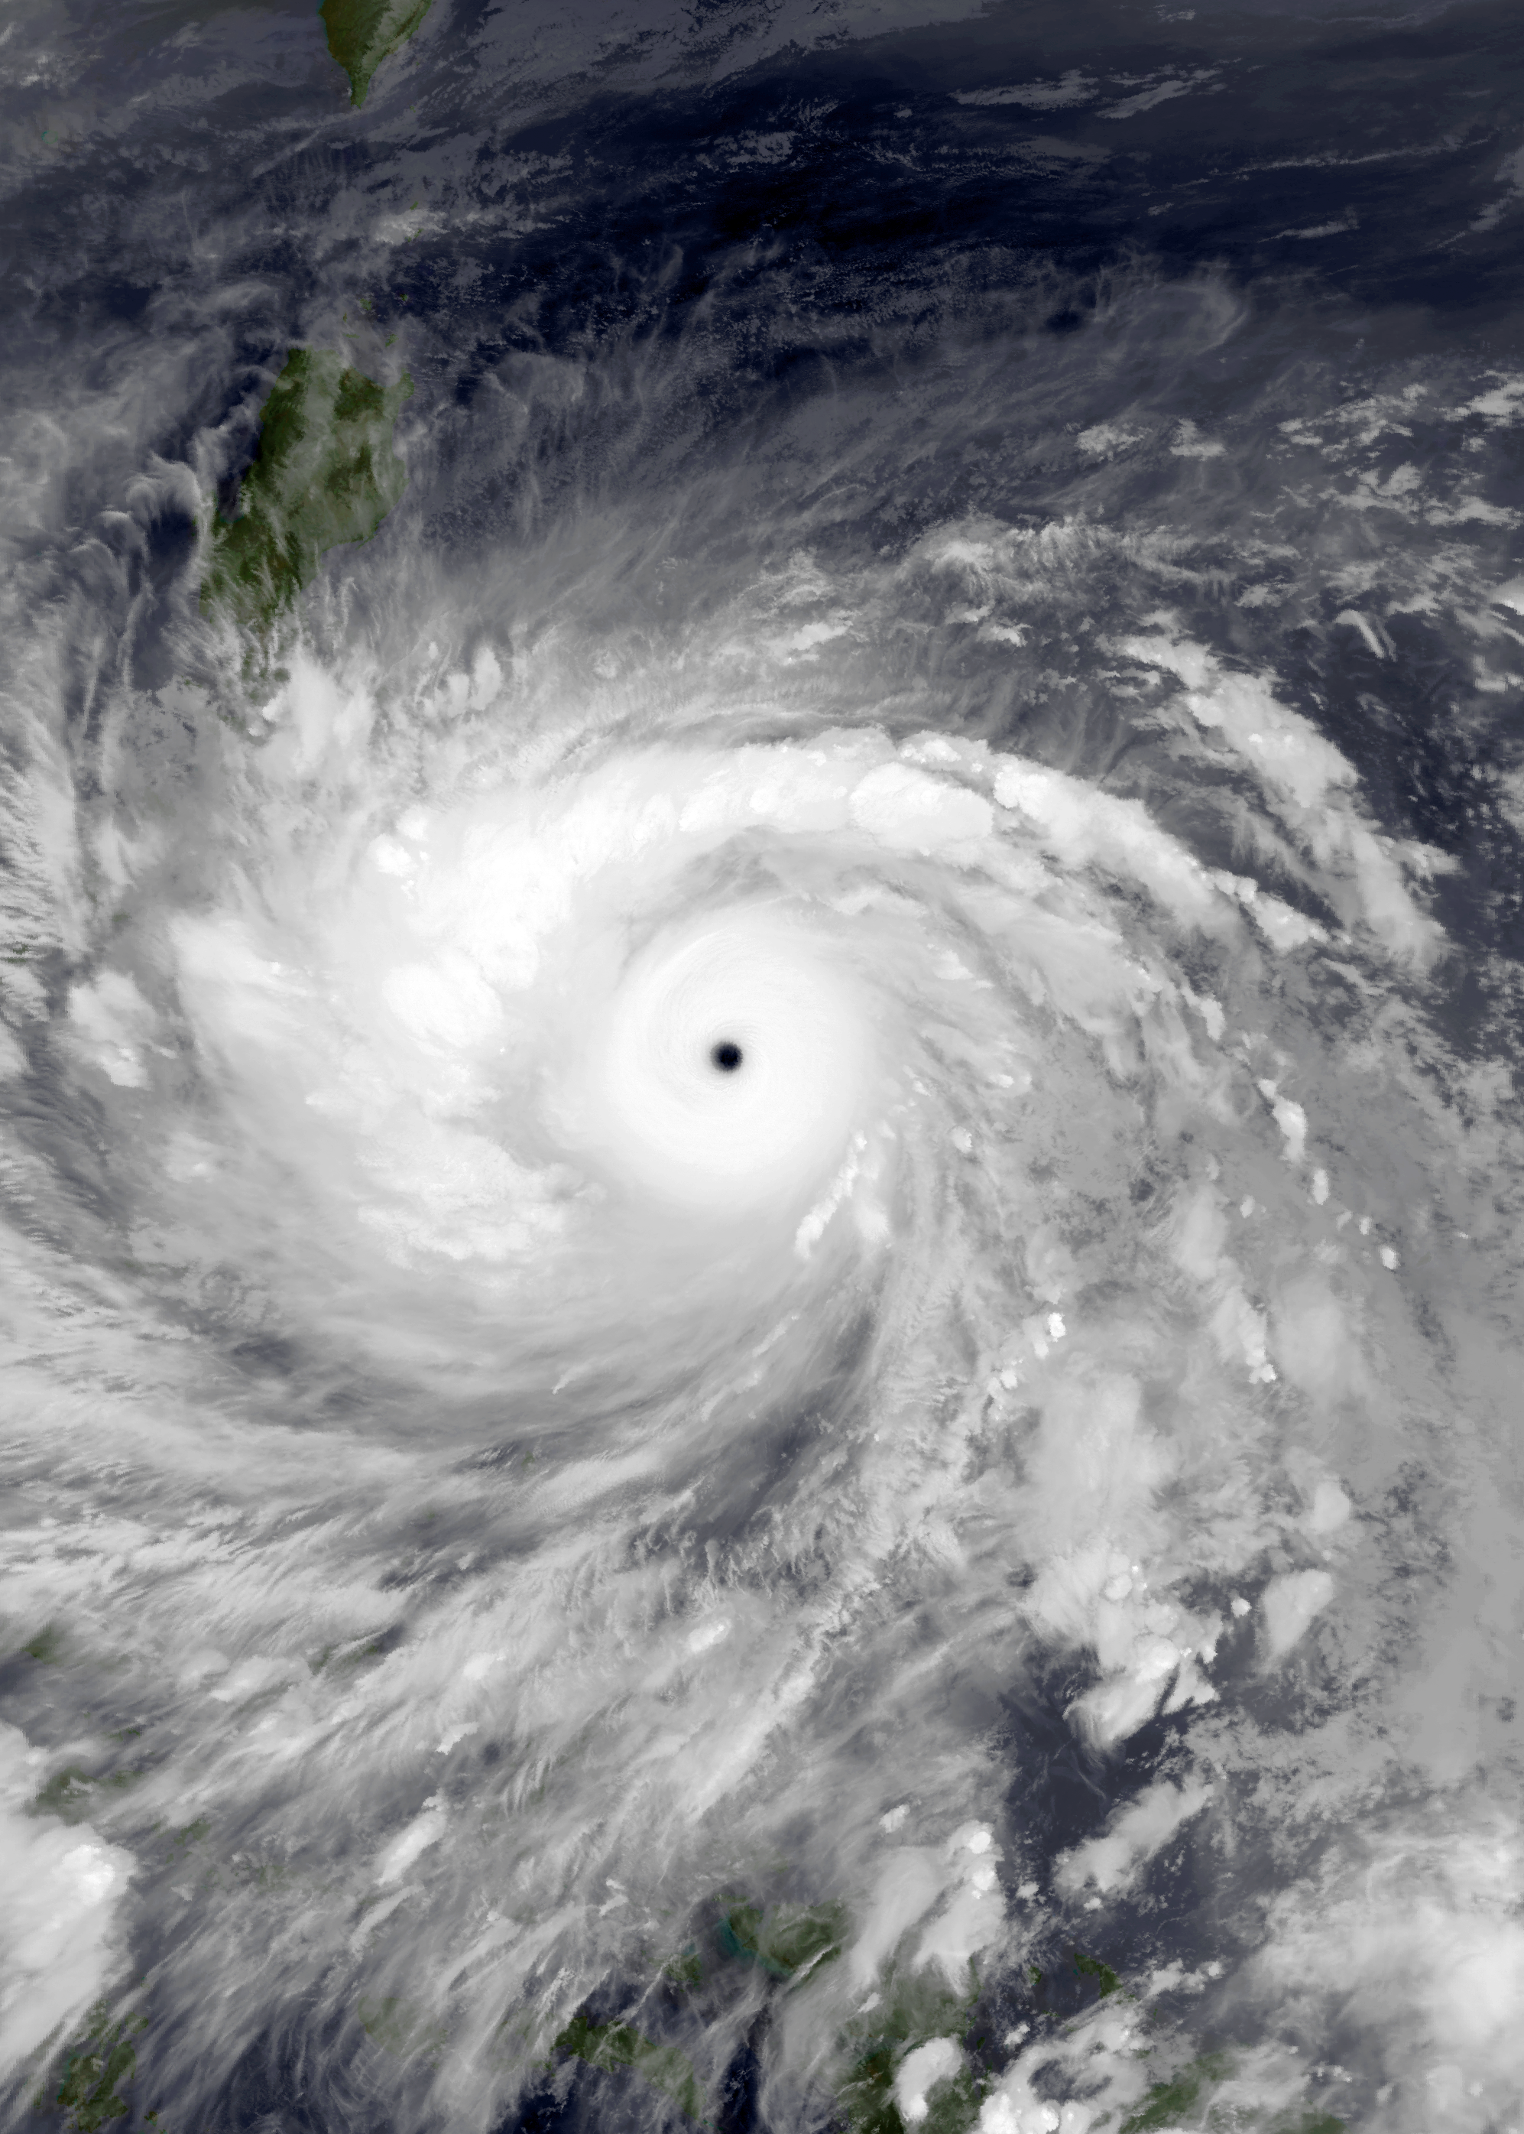
Impact-based forecasting for the Philipinnes
On average 19 tropical cyclones per year
ML model is used to estimate impacts based on TC track forecast and take anticipatory action
Low performance Super-Typhoon Haiyan (2013)
Mean absolute error >10%
Associated with storm surge heights > 5 m
Hydrodynamic modelling approach tested for Haiyan (2013) in San Pedro Bay

Slide 3
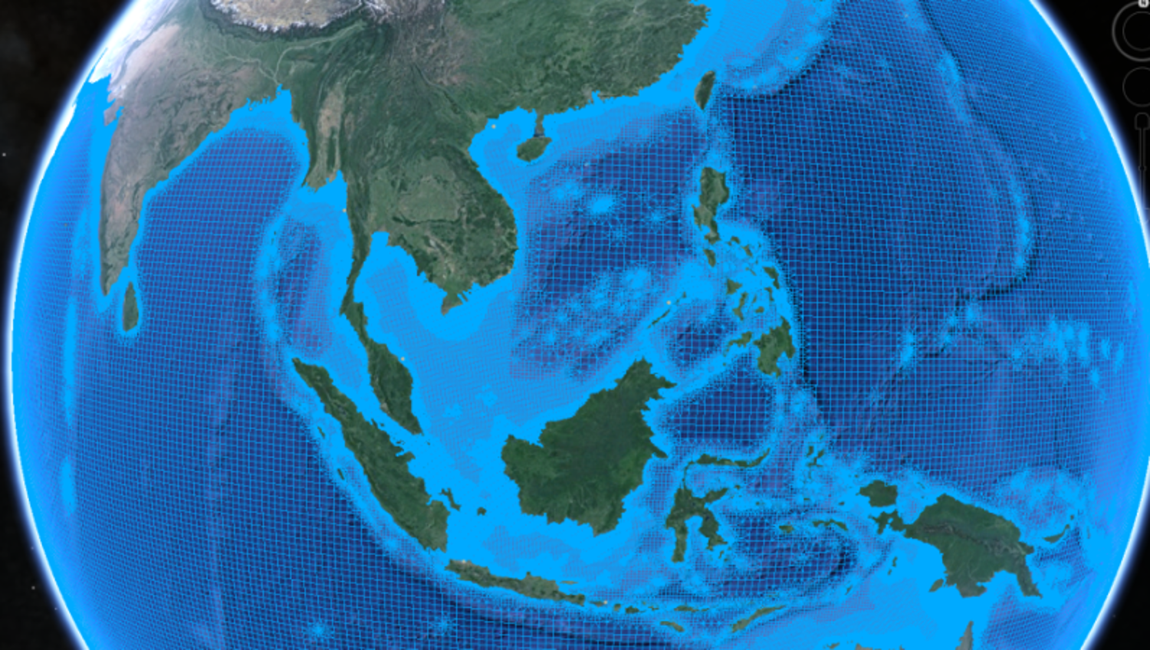
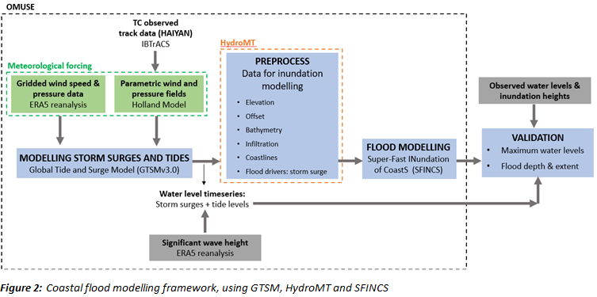
Methods
Modelling extreme sea levels using the Global Tide and Surge Model and ERA5 significant wave heights
Flood modelling using the Super-Fast Inundation of CoastS (SFINCS)
Validation with reported water levels and observed inundation heights

Slide 4
Results
Conclusions
Global reanalysis have insufficient resolution for TC impacts in complex regions like the Philippines
Use of parametric tropical cyclone models results in higher accuracy
GTSM forced with ERA5 does not lead to flooding
GTSM forced with parametric wind model leads to more accurate flood maps
Temporal resolution influences the flood simulation significantly

Slide 5
Using hydrodynamic flood modelling to support impact-based forecasting: a case study for Super-Typhoon Haiyan in the Philippines
Asha Barendregt, Irene Benito Lazaro, Sanne Muis, Marc van den Homberg and Aklilu Teklesadik
sanne.muis@vu.nl
Source: Bryan Denton for The New York Times

Slide 6
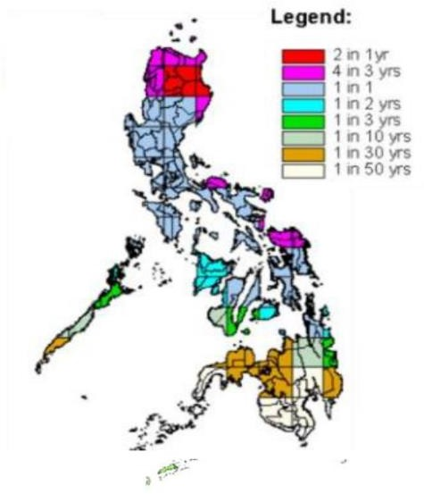
Introduction: The Philippines
The third country most at risk to natural disasters [1]
Tropical cyclones are causing the largest societal impacts [1]
On average 19 tropical cyclones cross the country annually [2]
In addition to strong winds and rainfall, tropical cyclones drive storm surges and waves which lead to coastal flooding
Figure 1: Tropical cyclone frequency in the Philippines [2]

Slide 7
Introduction: Anticipatory actions for typhoons in the Philippines
Anticipatory action implemented by the Philippine Red Cross:
Typhoon Early Action Protocol:
Triggered by an Impact-Based Forecast
Set into motion once: the impact is predicted to cause 10% of the houses to be completely damaged, in more than 3 municipalities, 72 hours before landfall [3]
Impact-Based Forecasting Model developed by 510 [4]
Based on Machine Learning to link tropical cyclone forecast to damage
Sets Forecast based Financing (FbF) into motion for:
Early harvesting of mature crops
Evacuation of livestock and assets
Installation of house strengthening kits

Slide 8
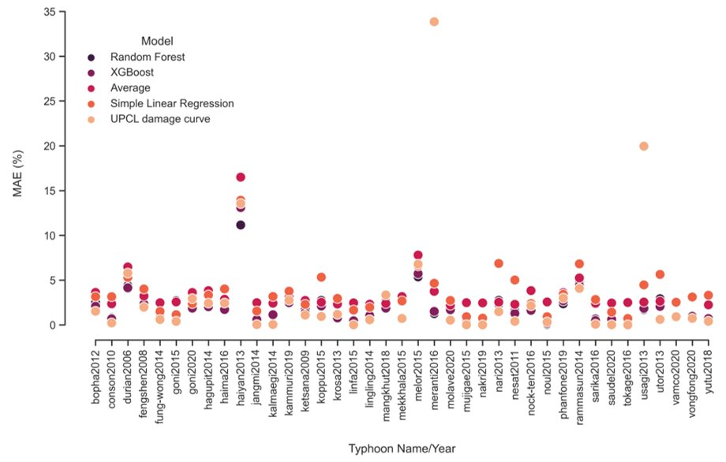
Introduction: Poor performance of IBF model for coastal flood events
Impact-Based Forecasting Model developed by 510
Static input is used for storm surges with fixed susceptibility values
Good performance for 31 out of 39 typhoons that struck the Philippines (Mean Absolute Error <5%)
Poor performance for regions susceptible to storm surges (Mean Absolute Error>10%)
Low performance for Super-Typhoon Haiyan (2013)
Figure 2: Performance machine learning model used for Impact Based forecasts [5]

Slide 9
Research question
“To what extent is a hydrodynamic modelling approach able to indicate coastal floods due to storm surges to help support operational impact-based forecasting for humanitarian aid in the Philippines?”
Methodology
Examining the applicability of a hydrodynamic modelling framework
Modelling extreme sea levels
Using the Global Tide and Surge Model (GTSM)
Water levels above Mean Sea Level (m-MSL)
Significant wave heights ERA5
Flood modelling
The Super-Fast Inundation of CoastS (SFINCS)
Inundation heights above land surface (m)
Validation
Reported maximum water levels
Observed flood depths
Figure 3: Coastal flood modelling framework, using GTSM, HydroMT and SFINCS

Slide 10
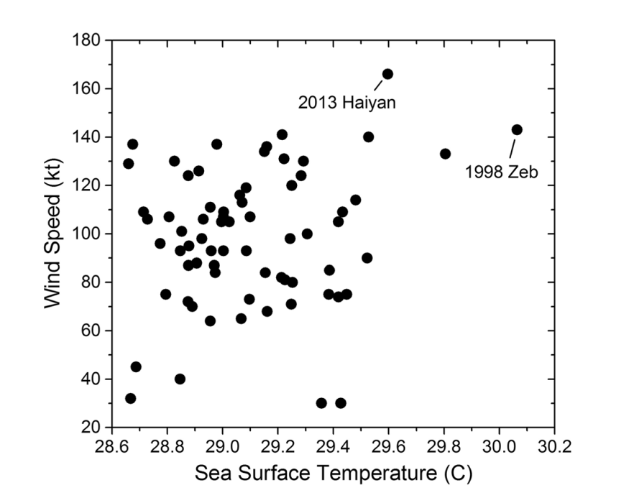
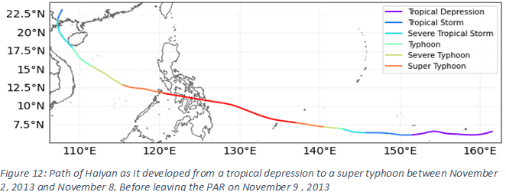
Methodology: Case study
Super-Typhoon Haiyan (2013)
One of the most powerful typhoons to strike the Philippines in recorded history
The strongest winds speed as well as the fastest forward moving speed amongst 400 storms observed in the Philippines between 1945 to 2013 [6]
6300 fatalities [7]
802 million US dollars in economic damage [7]
Made landfall on November 8, 2013[6]
Sustained windspeeds > 242 km/h
Minimum central pressure ~895 hPa
Caused a widespread coastal flood in San Pedro Bay [8]
Destroying houses in Tacloban City
Storm surges reach up to over 5 m high
Inundation heights of 6 m were observed
Figure 4: Relation between wind speeds and SSTs of the typhoon season from 1945 to 2013, demonstrating that two strongest typhoons occurred during seasons of remarkably warm SSTs [6]
Figure 5: Super-Typhoon Haiyan as it developed from a tropical depression to a super typhoon between November 2, 2013 and November 8, Before leaving the PAR on November 9 , 2013

Slide 11
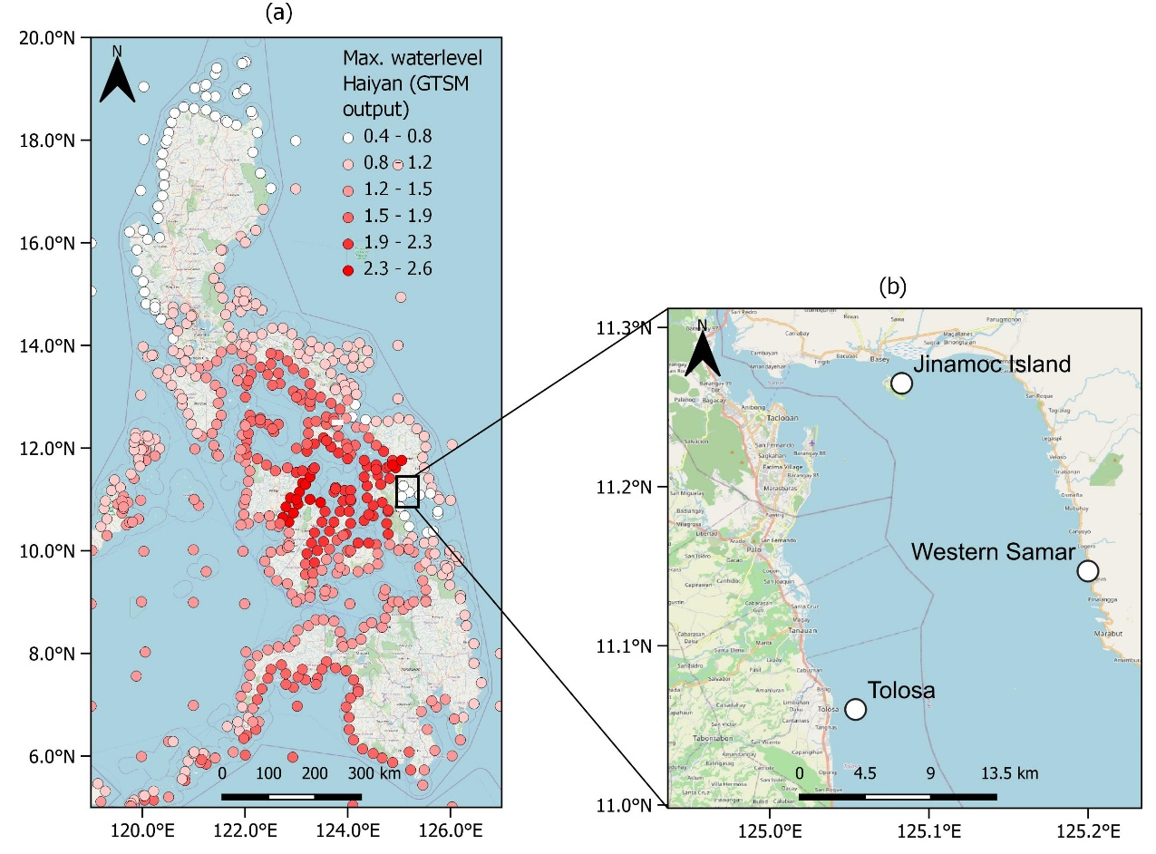
Results: Validation of GTSM with ERA5
San Pedro bay | Maximum Storm Tide level Haiyan (m-MSL)
 | Modelled (without wave contribution) | Modelled (with wave contribution) | Observed
Tolosa | 0.65 m | 1.25 m | 4.00 - 4.50 m
Western Samar | 0.66 m | 1.27 m | 2.80 - 4.00 m
Jinamoc Island | 0.67 m | 1.38 m | 5.00 - 6.00 m
Figure 6: GTSM output showing the maximum water levels that were generated within Haiyan’s timeframe (a) and the GTSM output locations in San Pedro Bay (b)

Slide 12
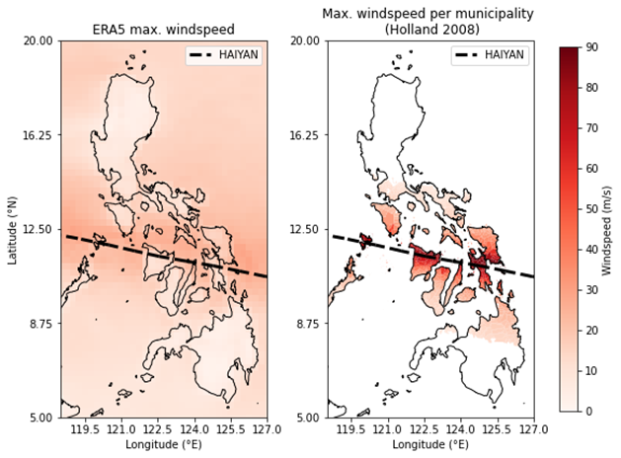
Results: accuracy of ERA5 for wind speed
ERA5 underestimated Haiyan’s wind speeds by ~60 m/s
Unable to represent Haiyan’s extreme conditions
Gridded climate models such as ERA5 are often unable to represent small size and fast forward moving typhoons
Higher spatial resolution required
Figure 7: Maximum windspeeds from the ERA5 dataset during Typhoon Haiyan’s timeframe (left) and the maximum windspeed per municipality calculated from the Holland parametric wind field model (right)

Slide 13
Results: GTSM with Holland parametric wind field model
Using the Holland parametric wind field model
More accurate waterlevel simulations
The temporal resolution influences model results
30 min. resolution indicates a slight overestimation
30 min. resolution better represents the time of peak surge
The inclusion of the significant wave height caused an overestimation
Noticably: 3.20 m overestimation near Jinamoc Island
Table 2: Bias (m) between maximum modelled water level with and without the wave contribution when applying wind speed and pressure fields from the Holland model
Mean bias (m)
San Pedro Bay | GTSM (1h resolution) |  | GTSM (30 min. resolution)
 | Without wave setup | With wave setup | Without wave setup | With wave setup
Tolosa | -0.8 | -0.4 | -0.3 | -0.5
Western Samar | -0.8 | -0.1 | 1.9 | 2.6
Jinamoc Island | 0.0 | 0.3 | 2.6 | 3.2
Figure 8: Simulated water levels in San Pedro Bay during Haiyan when using ERA5, Holland (1h resolution) and Holland (30 min. resolution) without wave setup (a) and with wave setup (b) with the horizontal dotted line indicating the maximum observed water levels

Slide 14
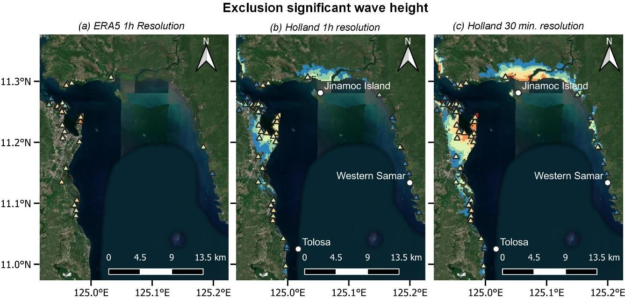
Results: Flood simulation
With ERA5, Haiyan’s flood in San Pedro Bay could not be indicated
With Holland, flood modelling becomes more accurate
Temporal resolution influences the flood simulation significantly
Table showing SFINCS accuracy when forcing GTSM with Holland (2008) using a 1 hour and 30 min. temporal resolution
Performance | Without wave setup |  | With wave setup
 | 1h | 30 min. | 1h | 30 min.
RMSE (m) | 1.4 | 1.8 | 1.6 | 2.0
Mean bias (m) | -0.8 | 0.5 | -0.9 | 1.1
Mean absolute error (m) | 1.1 | 1.7 | 1.3 | 1.7
Hit Rate (%) | 33.6 | 49.5 | 38.8 | 51.8
Figure 9: SFINCS simulations San Pedro Bay indicating the flood extent without the inclusion of wave setup (a, b,
c) and with the inclusion of the wave setup (d, e, f)

Slide 15
Conclusions and Recommendations
Further research is required to examine results when doing dynamic downscaling of storm surges and waves
Evaluate influence of the precipitation and rivers on model accuracy
Analyze accuracy during other events in the Philippines that involved storm surges; Rammasun (2014), Ruby (2014) and Nina (2016)
Further test applicability in operational forecasting mode

Slide 16
References
[1] UN Office for Disaster Risk Reduction & Asian Disaster Preparedness Center. (2019, October 16). Disaster Risk Reduction in the Philippines, Status Report (July 2019) - Philippines. ReliefWeb. Retrieved 3 June 2022, from https://reliefweb.int/report/philippines/disaster-risk-reduction-philippines-status-report-july-2019
[2] Cinco, T. A., de Guzman, R. G., Ortiz, A. M. D., Delfino, R. J. P., Lasco, R. D., Hilario, F. D., Juanillo, E. L., Barba, R., & Ares, E. D. (2016). Observed trends and impacts of tropical cyclones in the Philippines. International Journal of Climatology, 36(14), 4638– 4650. https://doi.org/10.1002/joc.4659
[3] Philippines Red Cross. (2019, October). Forecast-Based Financing Early Action Protocol TYPHOON Philippines.
[4] Bierens, S., Boersma, K., & Van den Homberg, M. J. C. (2020). The Legitimacy, Accountability, and Ownership of an Impact-Based Forecasting Model in Disaster Governance. Politics and Governance, 8(4), 445–455. https://doi.org/10.17645/pag.v8i4.3161
[5] Teklesadik, A. and Riquet, D. (2021). Forecasting the humanitarian impact of typhoons with machine learning; The Philippines. Dutch Red Cross 510; Philippines Red Cross; German Red Cross
[6] Takagi, H., & Esteban, M. (2015). Statistics of tropical cyclone landfalls in the Philippines: unusual characteristics of 2013 Typhoon Haiyan. Natural Hazards, 80(1), 211–222. https://doi.org/10.1007/s11069-015-1965-6
[7] Lagmay, A. M. F., Agaton, R. P., Bahala, M. A. C., Briones, J. B. L. T., Cabacaba, K. M. C., Caro, C. V. C., Dasallas, L. L., Gonzalo, L. A.
L., Ladiero, C. N., Lapidez, J. P., Mungcal, M. T. F., Puno, J. V. R., Ramos, M. M. A. C., Santiago, J., Suarez, J. K., & Tablazon,
J. P. (2015). Devastating storm surges of Typhoon Haiyan. International Journal of Disaster Risk Reduction, 11, 1–12. https://doi.org/10.1016/j.ijdrr.2014.10.006
[8] Soria, J. L. A., Switzer, A. D., Villanoy, C. L., Fritz, H. M., Bilgera, P. H. T., Cabrera, O. C., Siringan, F. P., Maria, Y. Y. S., Ramos, R. D., & Fernandez, I. Q. (2016). Repeat Storm Surge Disasters of Typhoon Haiyan and Its 1897 Predecessor in the Philippines.
Bulletin of the American Meteorological Society, 97(1), 31–48. https://doi.org/10.1175/bams-d-14-00245.1

Slide 17
Want to know more? Reach out to us!
sanne.muis@vu.nl / i.benito.lazaro@vu.nl
Source: Bryan Denton for The New York Times

