Slide 1
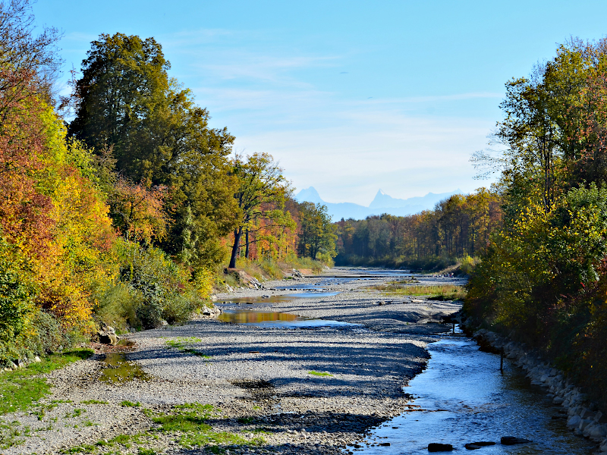
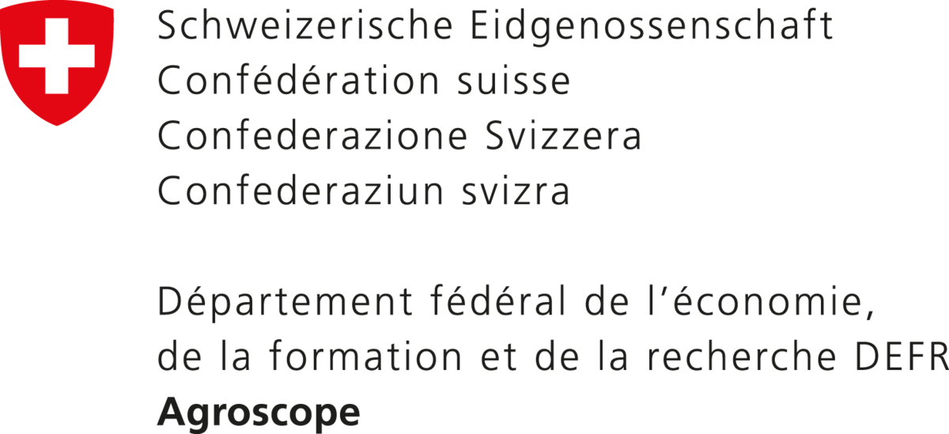
Modeling the potential of management options to reduce irrigation demand in Western Switzerland ${\text{Malve} \text{Heinz}}^{1,2,3}$,${ \text{Annelie} \text{Holzk}\text{ä}\text{mper}}^{1,2}$ , ${\text{Bettina} \text{Schaefli}}^{2}$ , ${\text{Christoph} \text{Raible}}^{2,4}$
1 Agroscope Reckenholz, Water Protection and Substance Flows
2 Oeschger Centre for Climate Change Research
3 Institute of Geography, University of Bern
4 Institute of Physics, University of Bern
link to
abstract:
@Agroscope
@FOEN
Rising temperatures and altered precipitation patterns lead to an increasing need for irrigation to reduce yield losses during droughts.
Low flows in mid-sized streams especially in summer, are increasing, leading to temporary irrigation bans and reduced yield quality and quantity
PICO 4.3

Slide 2
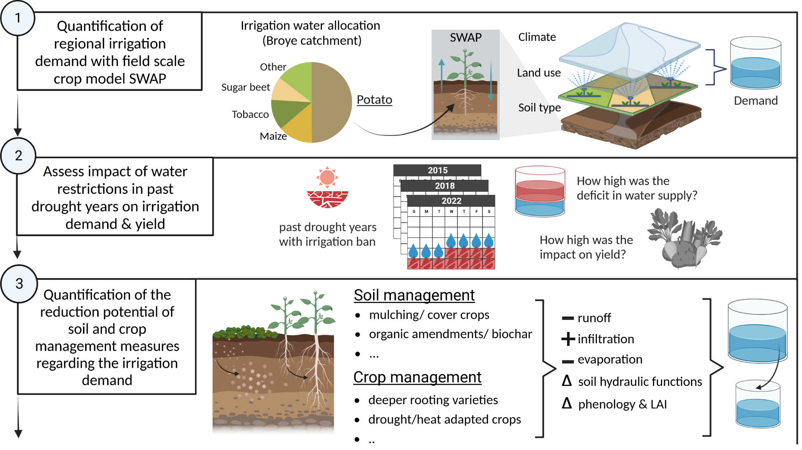
Modeling the potential of management options to reduce irrigation demand in Western Switzerland ${\text{Malve} \text{Heinz}}^{1,2,3}$,${ \text{Annelie} \text{Holzk}\text{ä}\text{mper}}^{1,2}$ , ${\text{Bettina} \text{Schaefli}}^{2}$ , ${\text{Christoph} \text{Raible}}^{2,4}$
link to
abstract:
PICO 4.3
PICO 4.3

Slide 3
Modeling the potential of management options to reduce irrigation demand in Western Switzerland ${\text{Malve} \text{Heinz}}^{1,2,3}$,${ \text{Annelie} \text{Holzk}\text{ä}\text{mper}}^{1,2}$ , ${\text{Bettina} \text{Schaefli}}^{2}$ , ${\text{Christoph} \text{Raible}}^{2,4}$
link to
abstract:
PICO 4.3
PICO 4.3

Slide 4
Introduction
Sugar beet field in Switzerland, Summer 2018
Setting
Rising temperatures and altered precipitation patterns lead to an increasing need for irrigation to reduce yield losses during droughts.
Low flows in mid-sized streams especially in summer, are increasing, leading to temporary irrigation bans and reduced yield quality and quantity
@Agroscope

Slide 5
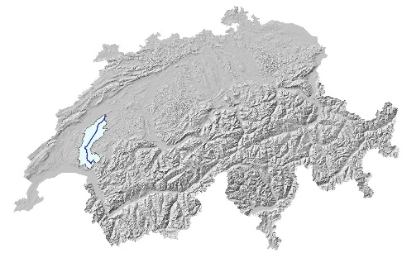
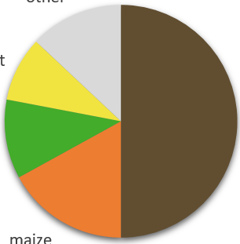
Case study: Broye
Irrigation water allocation (to irrigated crops in the Broye catchment)
Prealpine, midsized catchment (630 ${km}^{2}$)
Midsized stream (mean daily discharge: 8 $m^{3}$/s)
temperate climate (mean annual temperature: 9.6°C, annual precipitation: 865mm)
Intensive agricultural use (67% cropland + meadows)
In past drought years always subject to temporary irrigation bans
other
sugar beet
potato
tobaco
maize

Slide 6
Research aims
Hypothesis
Instead of only relying on (unsustainable) irrigation systems, adapted management measures can reduce the irrigation demand and also mitigate hydrological extremes such as peak and low flows
Missing link
The large-scale reduction potential of management measures, as well as their feedbacks on catchment hydrology have hardly been explored
Objective
Identify regionally optimal soil and crop management options from an agricultural and water cycle perspective
Notes:
Objectives of this work are to

Slide 7
Methodological approach
1
2
Notes:
Quantifying the regional (baseline) agricultural water demand with a field scale agro-hydrological model.
Representing soil and crop management measures in that model in order to quantify their reduction potential
Finding a way to couple the field scale model with a catchment-scale hydrological model to simulate the impact of management decisions on the water cycle
Identifying optimal soil and crop management decisions from a water cycle perspective under future climates

Slide 8
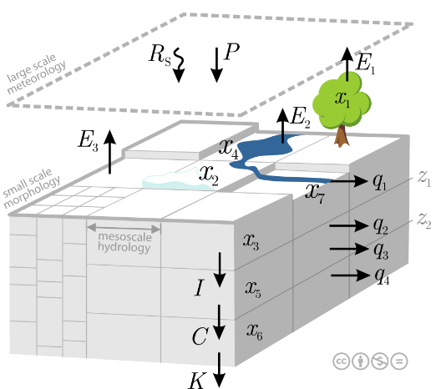
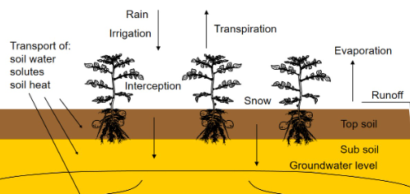
Modeling
SWAP (Soil Water Atmoshpere Plant model)
Field-scale agro-hydrological model
1-dimensional (vertical)
Continuous (possible for several decades)
Physically based (Richards equation at heart)
Simulates vertical soil water movement, heat and solute flux
Employs detailed crop growth module from WOFOST
mHM (mesoscale Hydrologic Model)
Meso-scale (distributed) hydrological model
3-dimensional
Continuous
Physically based
Simulates hydrological processes like infiltration, runoff evapotranspiration etc.
Coupling mechanism?
https://www.swap.alterra.nl/
https://www.ufz.de/index.php?en=40114

Slide 9
Methodological approach
1
2
Notes:
Quantifying the regional (baseline) agricultural water demand with a field scale agro-hydrological model.
Representing soil and crop management measures in that model in order to quantify their reduction potential
Finding a way to couple the field scale model with a catchment-scale hydrological model to simulate the impact of management decisions on the water cycle
Identifying optimal soil and crop management decisions from a water cycle perspective under future climates

Slide 10
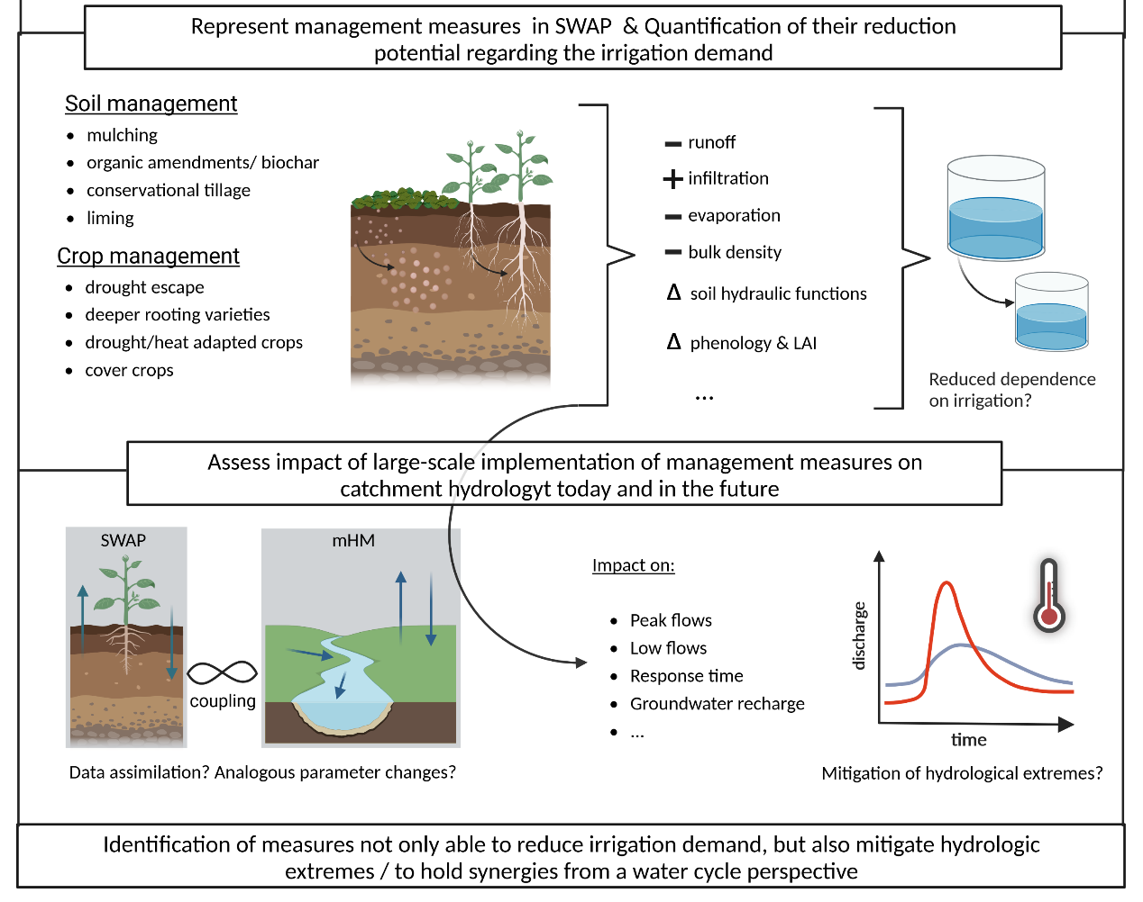
Methodological approach
3
4
Notes:
Quantifying the regional (baseline) agricultural water demand with a field scale agro-hydrological model.
Representing soil and crop management measures in that model in order to quantify their reduction potential
Finding a way to couple the field scale model with a catchment-scale hydrological model to simulate the impact of management decisions on the water cycle
Identifying optimal soil and crop management decisions from a water cycle perspective under future climates

Slide 11
Managegement representation and feedback
Soil and crop management
Changes in crop, soil and hydraulic parameters
Changes in catchment hydrology
Mulching
Conversational tillage
Deeper rooting varieties
Early maturing crops
…
+ Infiltration
- runoff
- evaporation
- bulk density
…
+ response time
- peak flows
…

Slide 12
Modeling
SWAP (Soil Water Atmoshpere Plant model)
Field-scale agro-hydrological model
1-dimensional (vertical)
Continuous (possible for several decades)
Physically based (Richards equation at heart)
Simulates vertical soil water movement, heat and solute flux
Employs detailed crop growth module from WOFOST
mHM (mesoscale Hydrologic Model)
Meso-scale (distributed) hydrological model
3-dimensional
Continuous
Physically based
Simulates hydrological processes like infiltration, runoff evapotranspiration etc.
Coupling mechanism?
https://www.swap.alterra.nl/
https://www.ufz.de/index.php?en=40114

Slide 13
SWAP model results in comparison to observational data
Irrigation depth rather overestimated
Yield is slightly underestimated
Timing of irrigation fits well
Irrigation amount [mm]
Observational data by:
measured soil moisture over different depth for different irrigated potato fields in the Broye catchment, as well as irrigation application and yield data.

Slide 14
SWAP model results in comparison to observational data
Irrigation depth rather overestimated
Yield is slightly underestimated
Timing of irrigation fits well
Irrigation amount [mm]
Observational data by:
measured soil moisture over different depth for different irrigated potato fields in the Broye catchment, as well as irrigation application and yield data.

Slide 15
SWAP model results in comparison to observational data
Irrigation depth rather overestimated
Yield is slightly underestimated
Timing of irrigation fits well
Irrigation amount [mm]
Observational data by:
measured soil moisture over different depth for different irrigated potato fields in the Broye catchment, as well as irrigation application and yield data.

Slide 16
For questions, feedbacks or collaborations please dont hesitate to contact me: Malve Heinz (University of Bern / Agroscope) malve.heinz@unibe.ch malvemaria.heinz@agroscope.admin.ch
Modeling the potential of management options to reduce irrigation demand in Western Switzerland
${\text{Malve} \text{Heinz}}^{1,2,3}$,${ \text{Annelie} \text{Holzk}\text{ä}\text{mper}}^{1,2}$ , ${\text{Bettina} \text{Schaefli}}^{2}$ , ${\text{Christoph} \text{Raible}}^{2,4}$
link to
abstract:
PICO 4.3
PICO 4.3

