Slide 1
Foam Composition and Surfactant Sources in an Urban Foaming Lake: A Comprehensive Analysis
Reshmi Das
Centre for Sustainable Technologies
IISc Bangalore, India

Slide 2
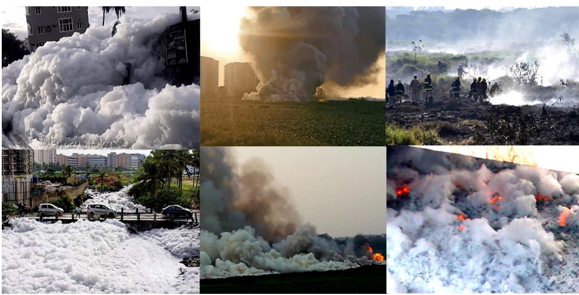
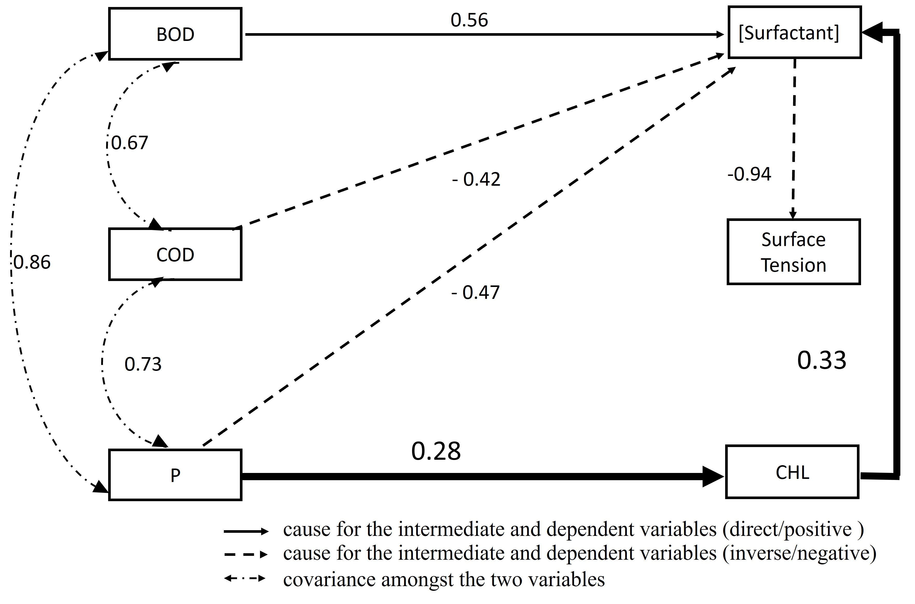
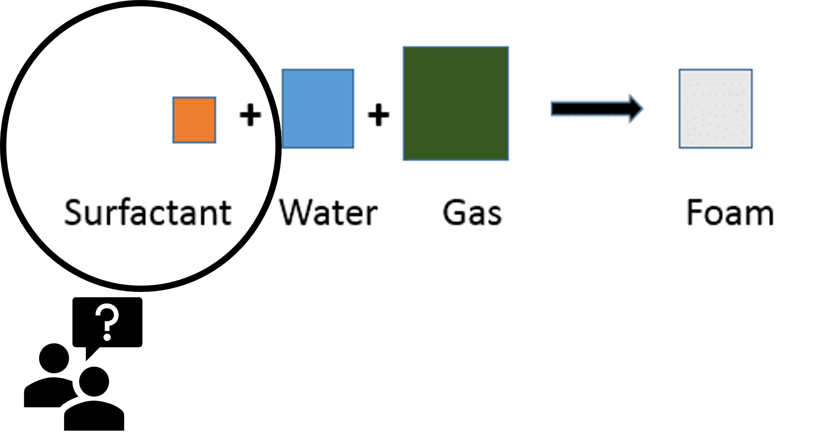
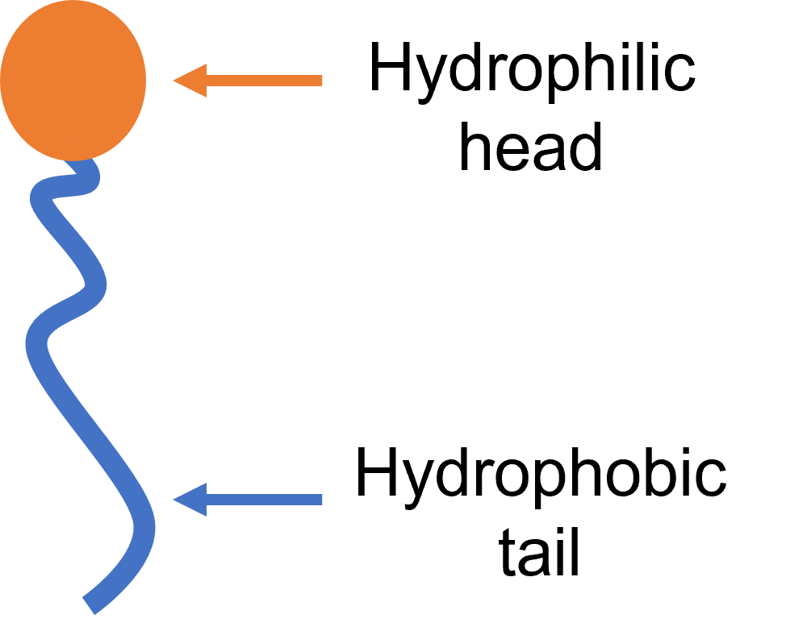
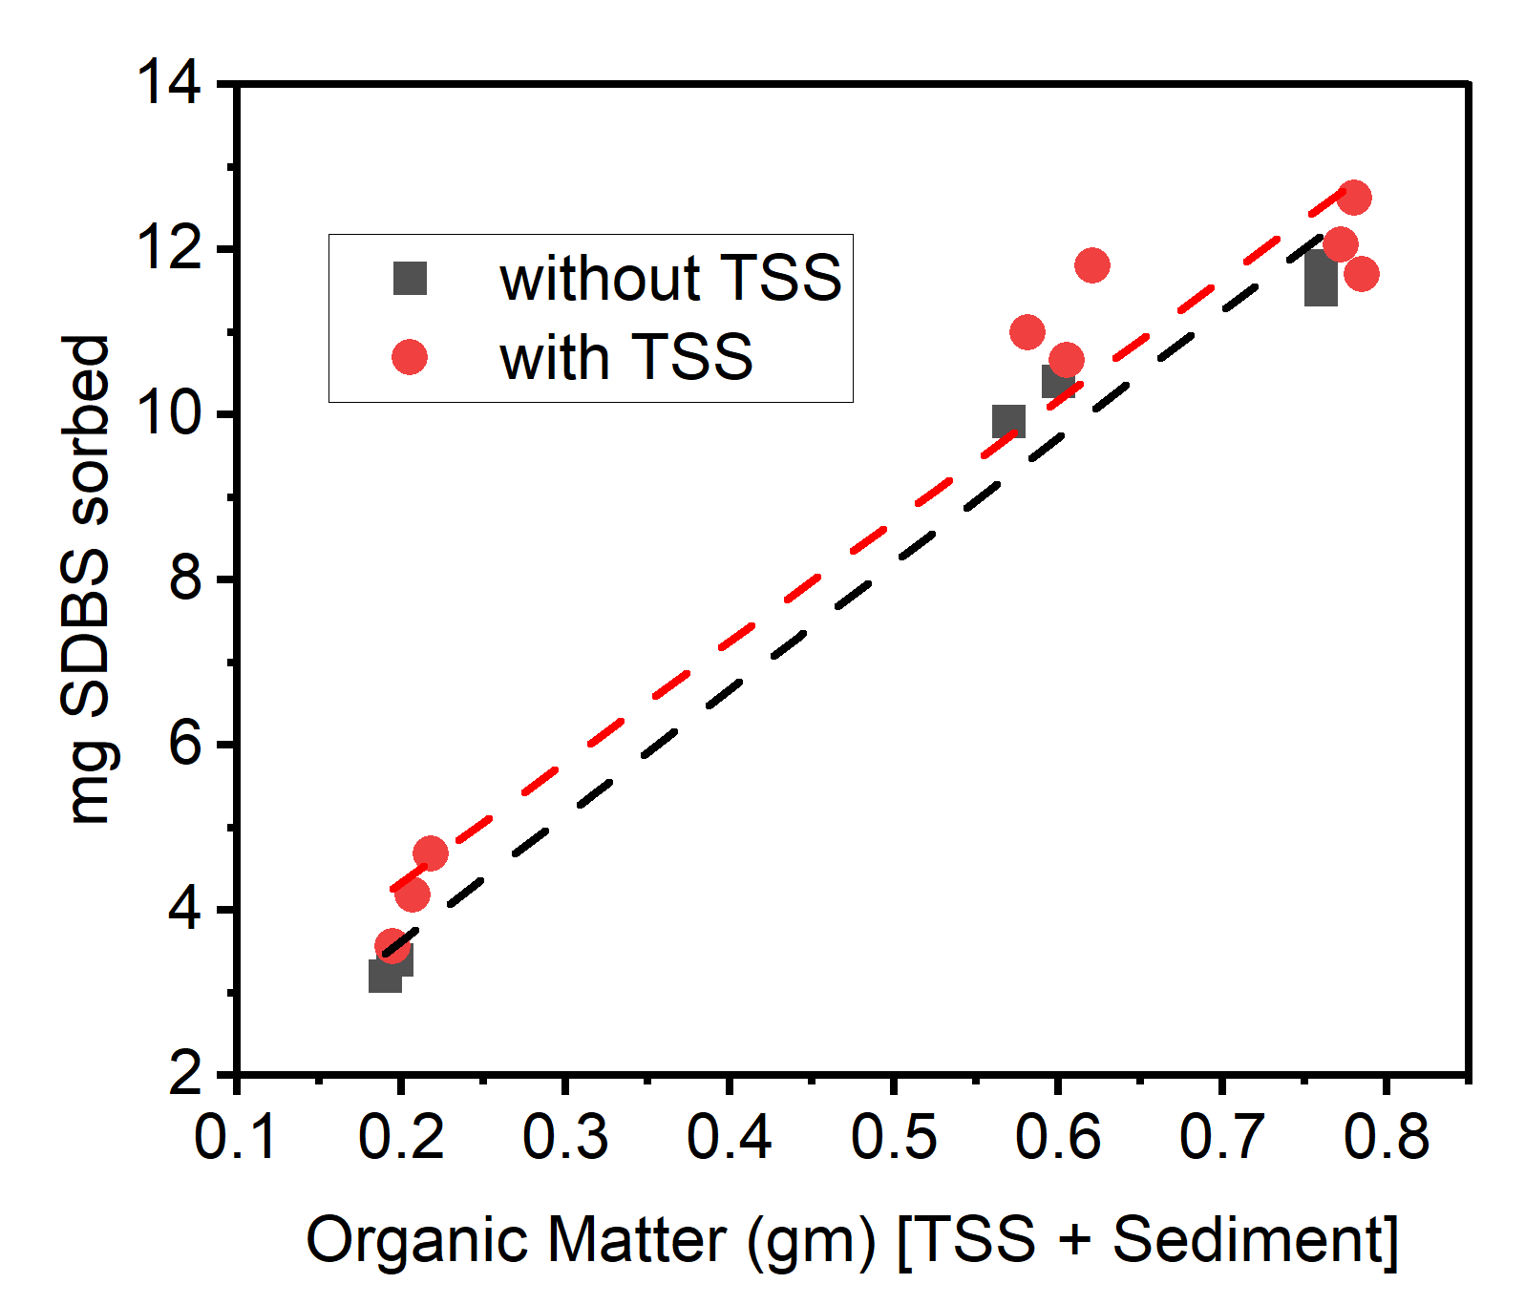
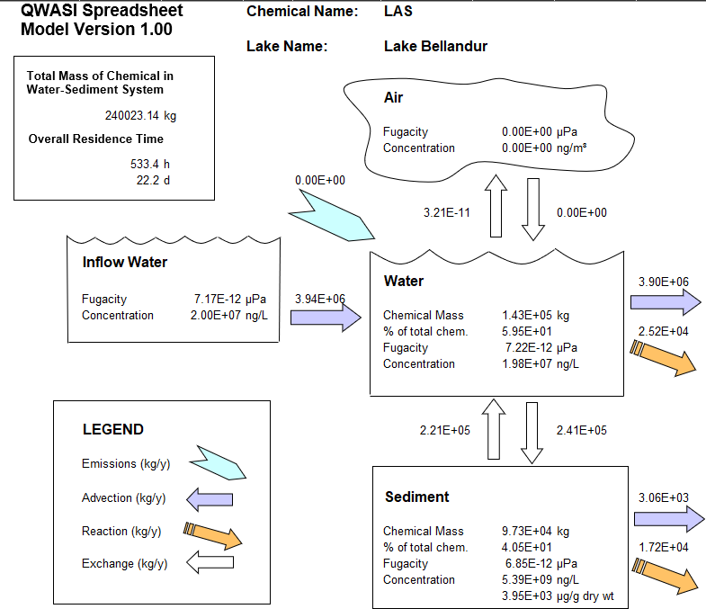
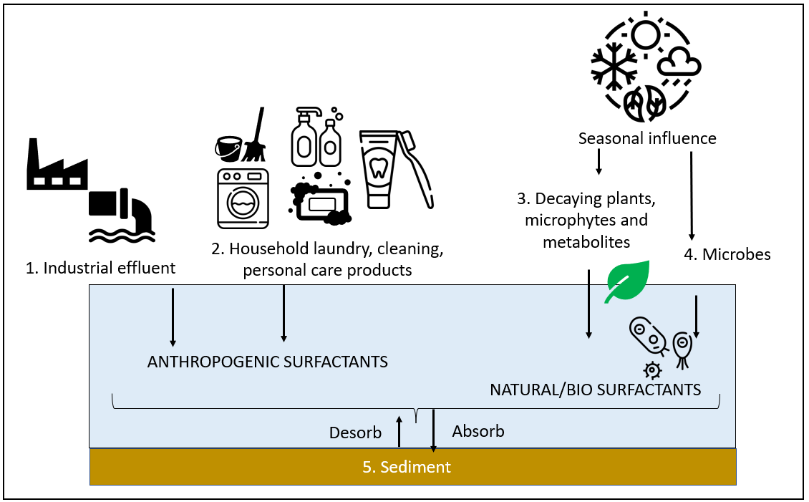
Foam Composition and Surfactant Sources in an Urban Foaming Lake: A Comprehensive Analysis
Reshmi Das , Chanakya Hoysall , Lakshminarayana Rao
Centre for Sustainable Technologies , Indian Institute of Science (IISc), Bangalore, India
1. What causes foam?
2.1 Untreated discharge- direct & indirect source of surfactant
2.3 Bacterial Biosurfactant – sediment and water
Direct source: Loaded with surfactants from personal care products like shampoo, hand and body washes , toothpaste , Laundry detergents and room cleaner
Indirect source: Phosphorus(P) in sewage acts as nutrient to aquatic plants that produce biosurfactants
Bacterial genus | Population % |  | Biosurfactant
 | soil | water
Pseudomonas | 19.2 | 23.5 | Glycolipipeptide/Rhamnolipid by Pseudomonas aeruginosa Viscosin by Pseudomonas florescens
Rhodococcus |  | 0.03 | Trehalose lipids by Rhodococcus erythropolis
Arthrobacter | 0.06 | 0.54 | Trehalose lipids Lipopeptide by Arthrobacter oxydans LBBMA 201
Bacillus | 0.03 | 0.01 | Lipopeptide by Bacillus sp. LBBMA 111A, LBBMA 155 Surfactin by Bacillus subtilis Lichenysin by Bacillus licheniformis Lipopeptide by Bacillus circulans
Gordonia | 0.02 |  | Lipopeptide
Nocardia | 0.02 |  | Glycolipids/ Trehalose Lipids by Nocardia erythropolis
Leuconostoc | 0.16 |  | Viscosin by Leuconostoc mesenteoids
Dietzia |  | 0.11 | Glycolipid by Dietzia maris LBBMA 191
Flavobacterium | 0.11 | 5 | Mixed flavolipids by Flavobacterium sp. LBBMA 168
Acinetobacter | 2.2 |  | Emulsan by Acinetobacter lwoffii
Weissella | 0.01 |  | Glycolipid by Weissella cibaria PN3
Halomonas | 0.01 |  | Exopolyschharide/Glycolipipeptide by Halomonas sp. ANT-3B
Sewage
Phosphorus
Personal care
products
Algae &
Aquatic Plant
Up to 20 mg/ l of surfactant in lake water
Algae and Aquatic Plants
Bio-surfactant
Synthetic Surfactant
2. Sources of Surfactant?
2.2 Desorption of surfactant by Sediment & suspended solids (TSS)
3. Conclusion
mg of surfactant sorbed
Anthropogenic source→ sewage /industrial effluents
Naturogenic sources → Bacteria , Plants
$$foam formation= ⅀{ (mixture of various surfactants present in the water from different sources )}$$
Sorption:
< 3.5 mg surfactant / g Sediment
53.5 ± 4 mg surfactant/g TSS
More organic matter more sorption
Surfactant in aquatic system can originate from anthropogenic and naturogenic sources
Untreated sewage is a direct source of surfactant
Phosphorus in untreated sewage is an indirect source of bio-surfactant
Sediment and suspended solids has sorbed surfactants , which desorbs to cause foam
Sediment and water has as high as 23% of surfactant producing bacteria
Solution : Preventing ingress of untreated sewage and Sediment dredging/desilting
Desorption:
73% surfactant →TSS
53% surfactant →sediment
Reference:
"Study towards understanding foaming and foam stability in urban lakes."
Das, Reshmi, H. N. Chanakya, and Lakshminarayana Rao.
Journal of Environmental Management 322 (2022): 116111.
Reshmi Das | Ph.D. Student, Senior Research Fellow, IISc
Research Areas | Wastewater , Soil biogeochemistry, Microbiology, Environmental Chemistry , Water quality modelling & Waste management.
Contact | reshmidas@iisc.ac.in

Slide 3
EXPLANATION

Slide 4
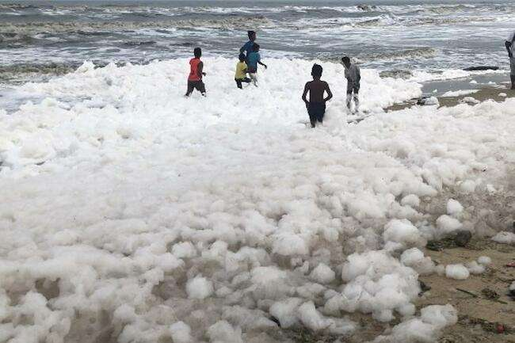
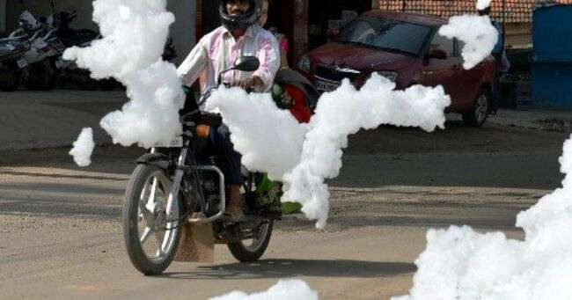
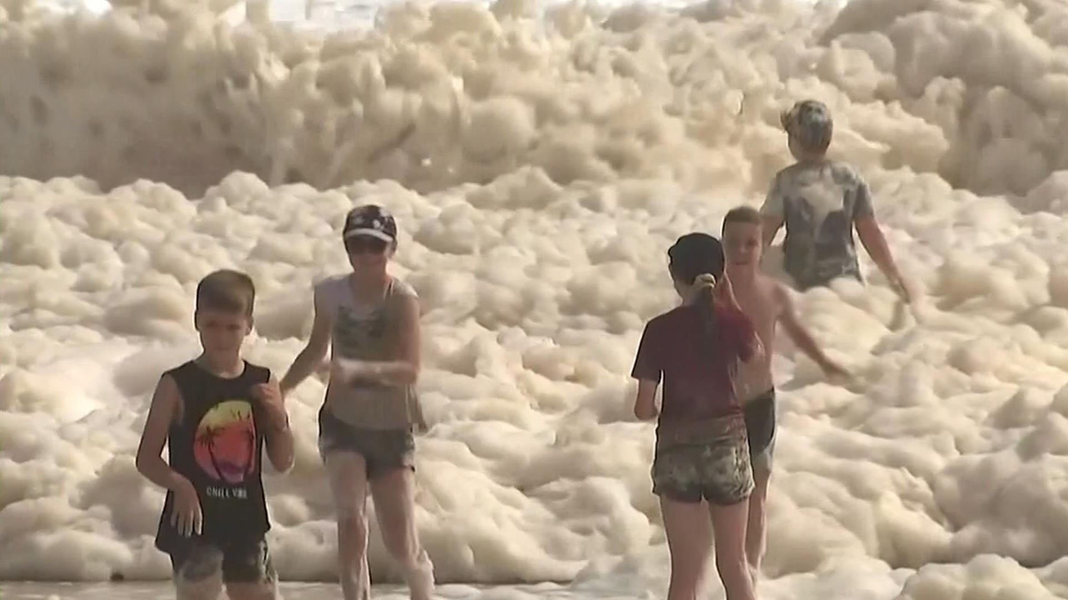
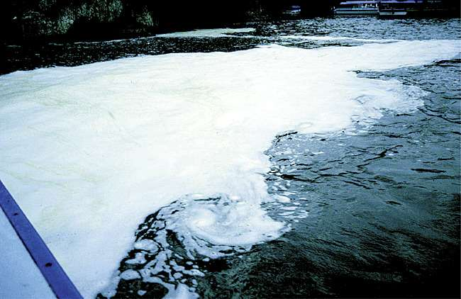
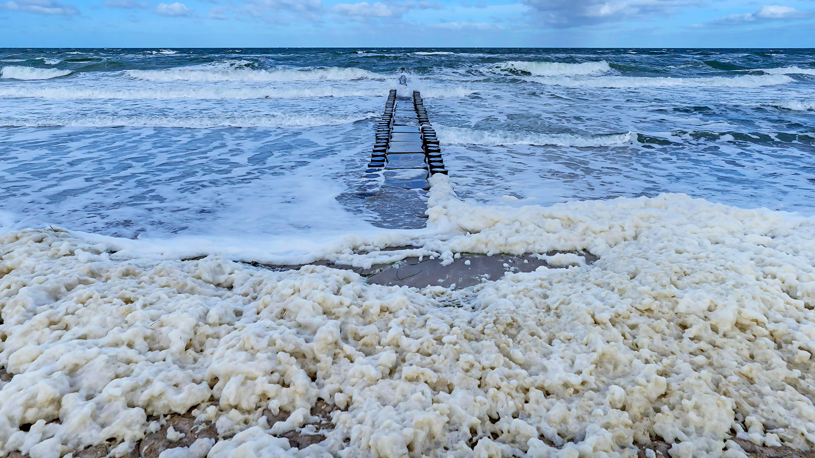
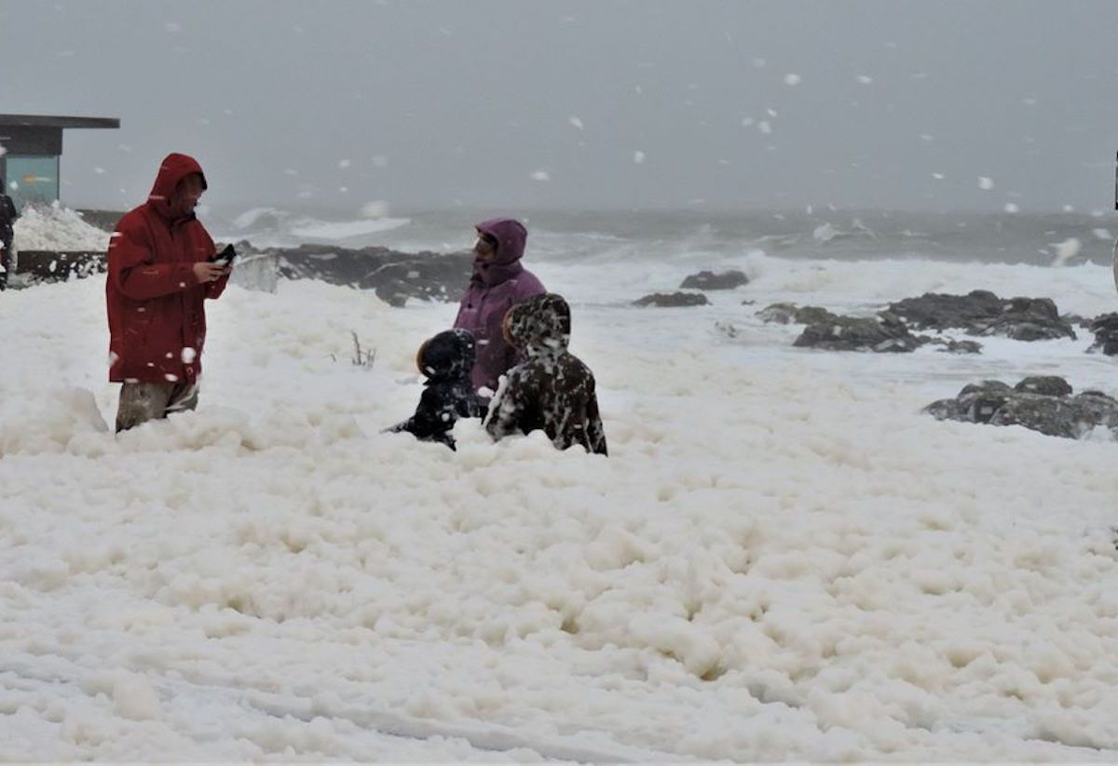
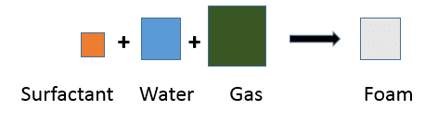
INTRODUCTION
BELLANDUR LAKE, BANGALORE
MARINA BEACH, CHENNAI
FIRE
SMELL
AUSTRALIA
RHINE RIVER, SWITZERLAND
DISRUPT TRAFFIC
FISH KILL
SPAIN
FRANCE

Slide 5
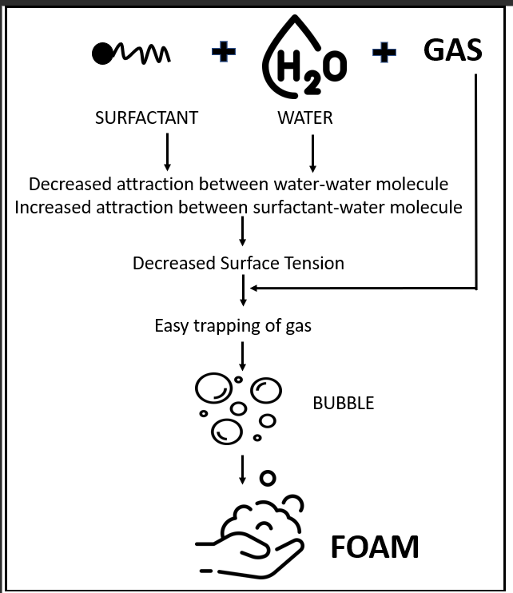
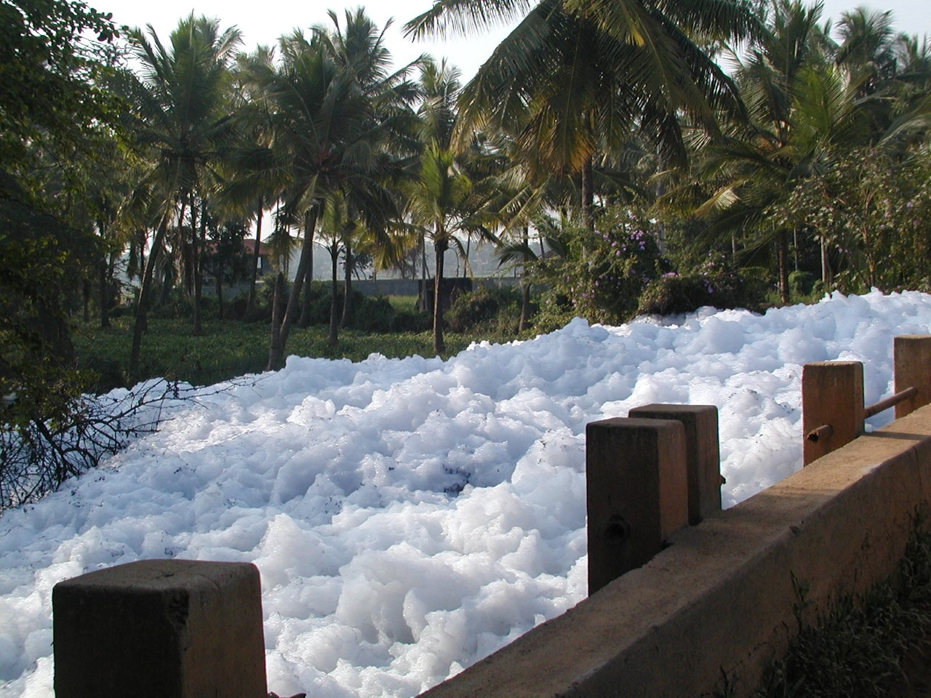
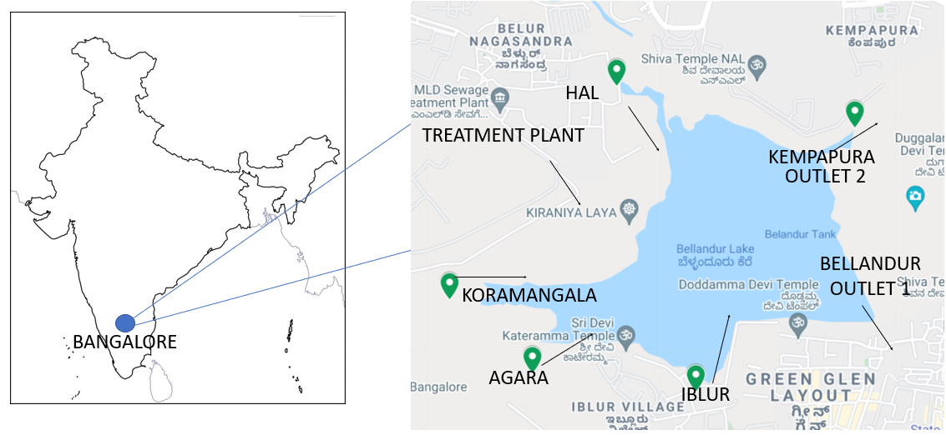
SURFACTANT
Source?????
Notes:
The central unexplored question in this domain is - what compounds make up a foam? Foam is caused by surface-active compounds called surfactants.. We try to comprehensively identify all the sources of surfactants in foaming waterbody of Bellandur

Slide 6
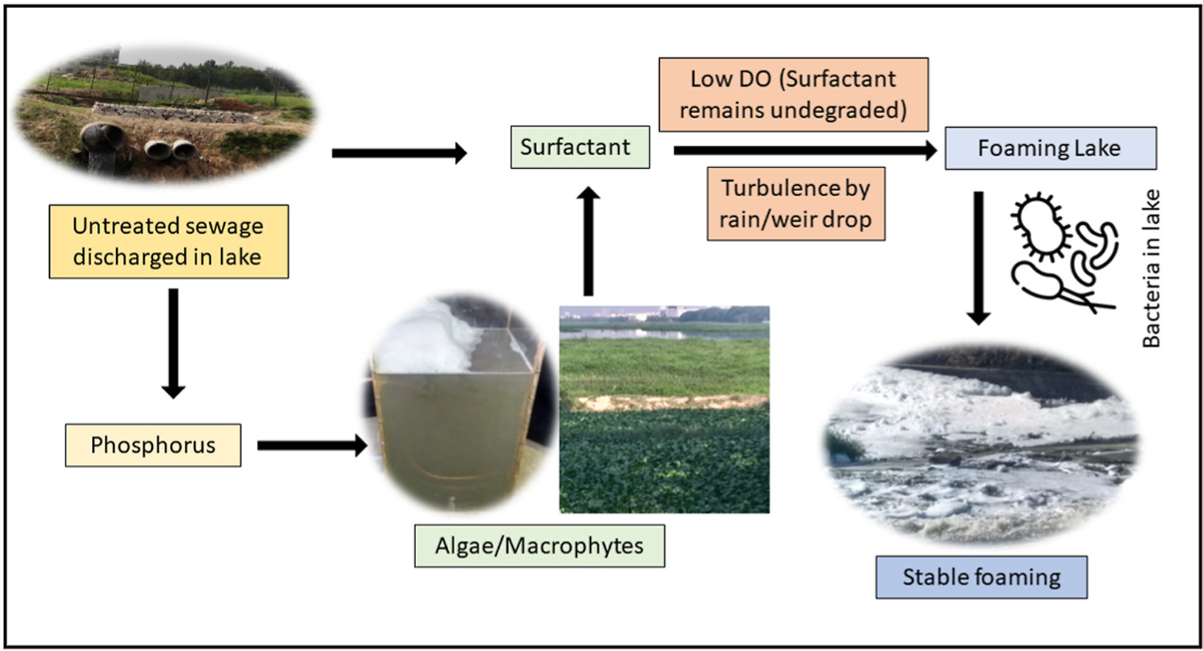
SURFACTANT SOURCES
1. Untreated sewage as direct and indirect source of surfactant

Slide 7
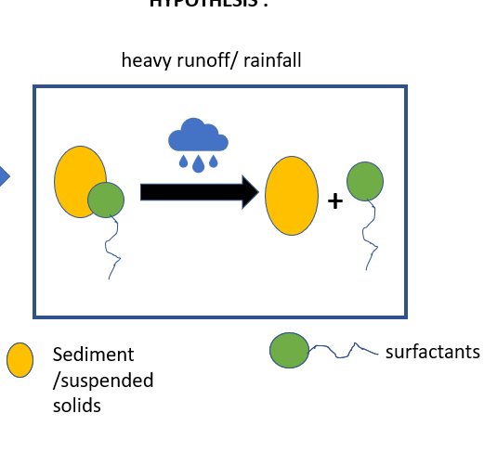
SURFACTANT SOURCES
2. Desorption from sediment and suspended solid
More Organic Matter , More sorption
More Suspended solid (TSS) , more sorption
Particle size analysis shows that TSS had D60 of 1877 nm
Sorption by TSS is 53.5±4 mg SDBS/ g TSS
Maximum sorption by sediment is 5.3 mg SDBS /g sediment
During RAIN : Desorption of surfactant from TSS, increases foaming potential
TSS: up to 75 % desorption

Slide 8
SURFACTANT SOURCES
3. From bacteria in water and sediment
Bacterial genus | Population % |  | Biosurfactant
 | soil | water
Pseudomonas | 19.2 | 23.5 | Glycolipipeptide/Rhamnolipid by Pseudomonas aeruginosa Viscosin by Pseudomonas florescens
Rhodococcus |  | 0.03 | Trehalose lipids by Rhodococcus erythropolis
Arthrobacter | 0.06 | 0.54 | Trehalose lipids Lipopeptide by Arthrobacter oxydans LBBMA 201
Bacillus | 0.03 | 0.01 | Lipopeptide by Bacillus sp. LBBMA 111A, LBBMA 155 Surfactin by Bacillus subtilis Lichenysin by Bacillus licheniformis Lipopeptide by Bacillus circulans
Gordonia | 0.02 |  | Lipopeptide
Nocardia | 0.02 |  | Glycolipids/ Trehalose Lipids by Nocardia erythropolis
Leuconostoc | 0.16 |  | Viscosin by Leuconostoc mesenteoids
Dietzia |  | 0.11 | Glycolipid by Dietzia maris LBBMA 191
Flavobacterium | 0.11 | 5 | Mixed flavolipids by Flavobacterium sp. LBBMA 168
Acinetobacter | 2.2 |  | Emulsan by Acinetobacter lwoffii
Weissella | 0.01 |  | Glycolipid by Weissella cibaria PN3
Halomonas | 0.01 |  | Exopolyschharide/Glycolipipeptide by Halomonas sp. ANT-3B

Slide 9
CONCLUSION
Surfactant in aquatic system can originate from anthropogenic and naturogenic sources
Untreated sewage is a direct source of surfactant
Phosphorus in untreated sewage is an indirect source of bio-surfactant
Sediment and suspended solids has sorbed surfactants , which desorbs to cause foam
Sediment and water has as high as 23% of surfactant producing bacteria
Solution : Preventing ingress of untreated sewage and Sediment dredging/desilting

