Slide 1
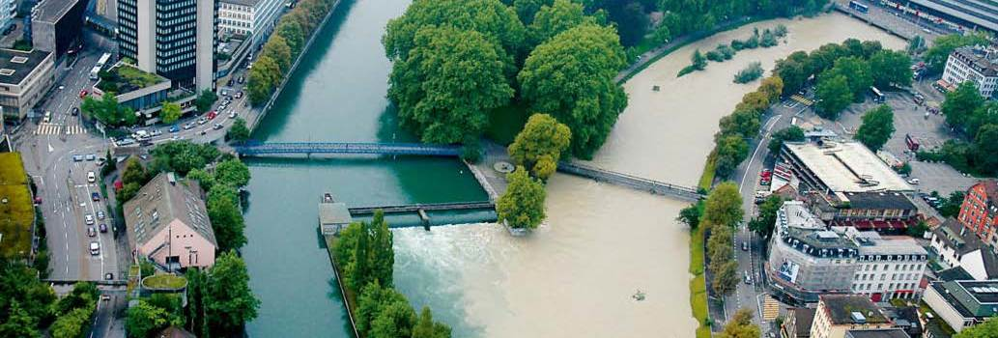
Foreseeing the propensity of rivers to extreme floods
Stefano Basso
Ralf Merz, Larisa Tarasova, Arianna Miniussi
Notes:
Thank you Francesco / Elena for the introduction. (and greetings to all of you)
(Since there have already been 8 presentations before this one, let’s start with some interesting pictures to wake up the attention)

Slide 2
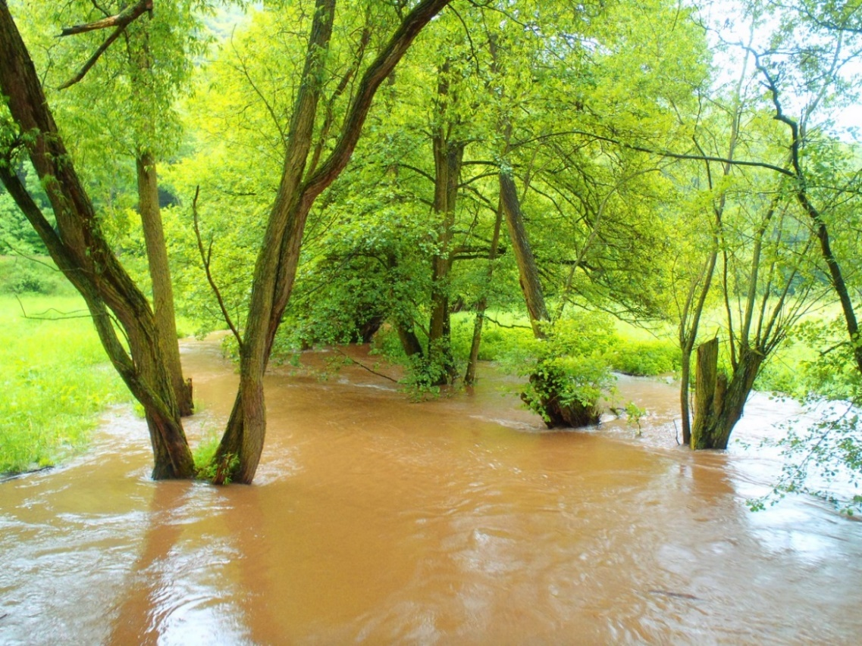
Extreme flooding controlled by stream network organization and flow regime,
Nature Geoscience, 2023.
Blame the river not the rain,
Nature Geoscience, 2023.
New way to predict river flood risk could help prepare for disasters,
New Scientist, 2023.
Want to talk more?
Would you like to collaborate?
Get in touch!
stefano.basso@niva.no
Notes:
With this, I thank you for your attention and I am happy to discuss questions from your side.
Thank you very much!

Slide 3
take home message
Common hydrologic dynamics
tell us a lot about
extreme floods
Session HS2.4.3: Space-time dynamics of floods
Wang, Wed 26 April, 15:05
Common flow dynamics reveal heavy-tailed flood distributions
Mushtaq, Wed 26 April, 15:25
Combining runoff types and MEV to predict extreme floods
Notes:
If you would like to hear more about how to use common hydrologic dynamics to predict floods, do not miss the talks of my colleagues Hsing-Jui Wang and Sumra Mushtaq on Wednesday afternoon.

