Slide 1
Data-driven simulation of the coronal mass ejection of October 28 2021: from the magnetogram to the CME
B. Schmieder, JinHan Guo, S. Poedts, (KU Leuven, BE)
Yang Guo, P.F. Chen, (Nanjing University, CN)
P. Devi, R. Chandra, University of Kumaun(IN), R. Joshi (ROCS)
Observations (Devi+ 2022) and Simulations (Guo+2023)

Slide 2
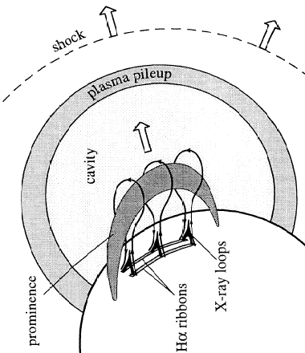
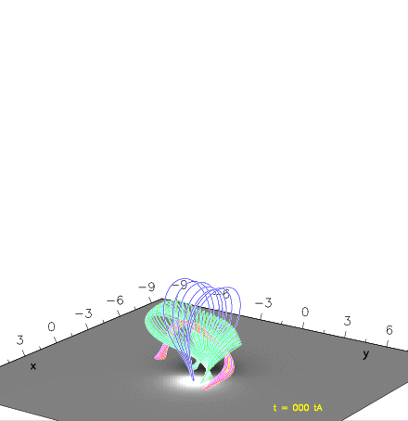
From the Observations to the
Modelization
The so-called standard flare model
(1960-90)
=
OHM / MHD simulations
(2008-09))
from a ideal bipole
Active region: filament (dark) eruption, EUV wave, flare ribbon, loops

Slide 3
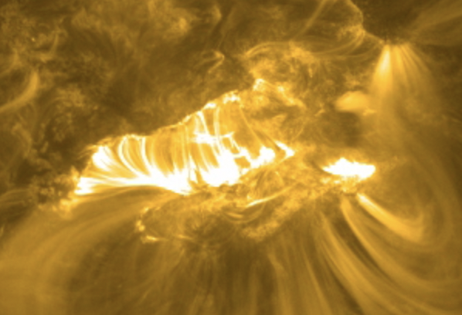
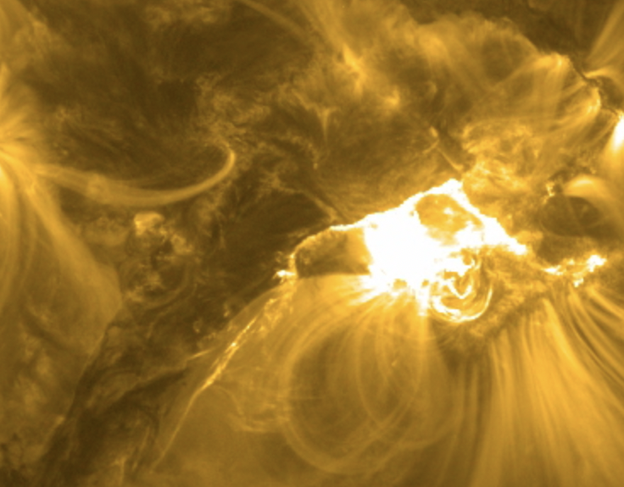
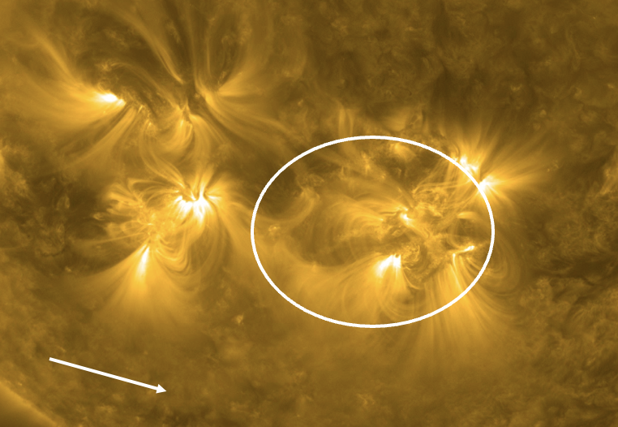
Can we simulate the flare ribbons, the filament eruption and the EUV wave?
4
3
28 October 2021 (Devi et al 2022)
1
2

Slide 4
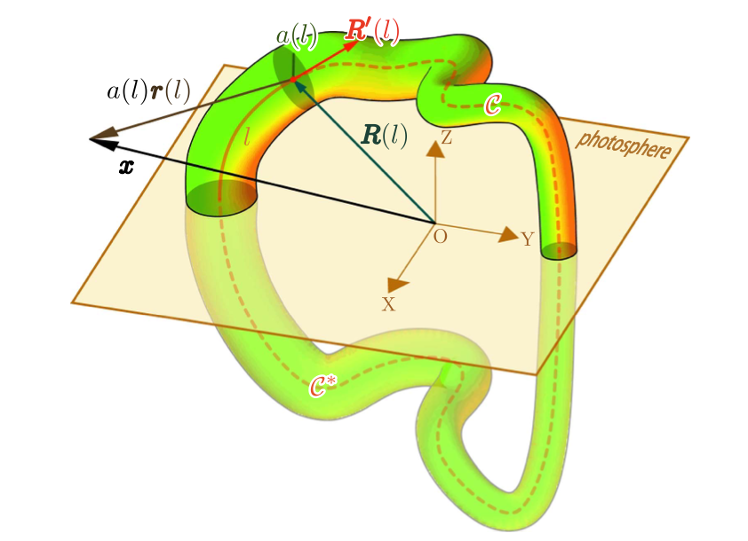
Numerical models
Initial magnetic fields for the MHD simulation: NLFFF model:
NLFFF model can serve as the initial magnetic field condition for data-driven simulations.
Which contains two steps:
Constructing the flux rope with the Regularized Biot-Savart Laws (RBSL):
RBSL is a method to construct the force-free flux rope with an arbitrary path (Titov et al., 2018).
We construct the flux rope according to the morphology of the observed filament and then insert it into the extrapolated potential field.
Magnetofrictional (MF) relaxation:
We relax the superposed magnetic fields that are composed of the RBSL flux-rope fields and potential fields to a force-free state with the MF method (Guo et al., 2016a, b).
Titov et al. (2018)

Slide 5
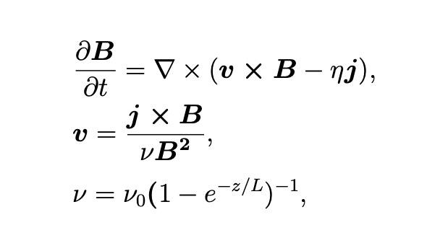
Numerical models
Time-dependent magnetofrictional (TMF) model:
This model is a simplified version of the full MHD equations, which evolves the coronal magnetic fields by solving the magnetic induction equation, where the velocity is proportional to the local Lorentz force.
This approach allows for a faster computation time compared to full MHD models while still can capture the 3D magnetic field evolution.
We utilize the TMF model to reproduce the long-term evolution of the active region and the formation of flux ropes.
We adopt a radiative MHD model including gravity, field-aligned thermal conduction, optically thin radiative losses and an empirical background heating to study the eruption process of flux ropes.

Slide 6
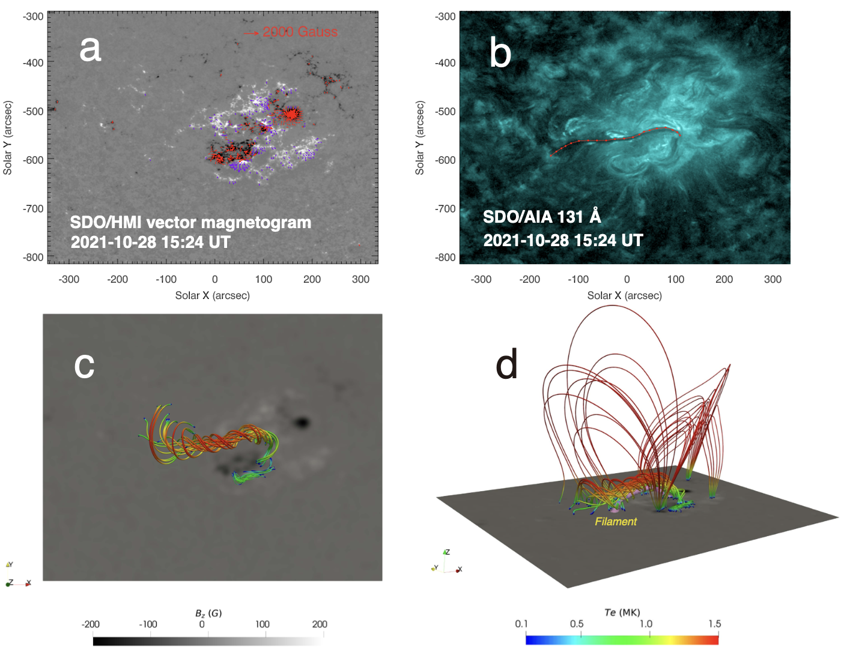
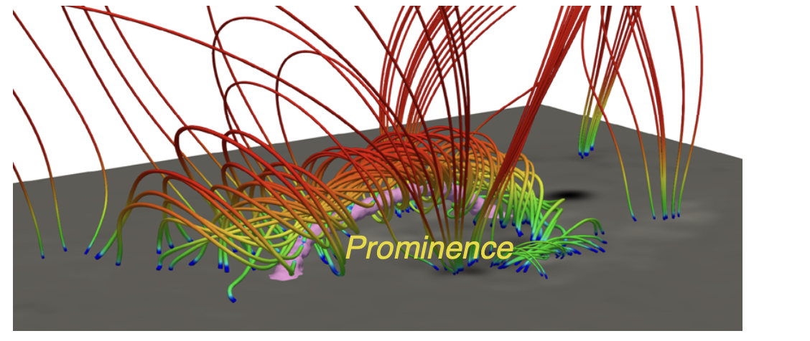
Numerical results
Event 1: X1.0 eruptive flare on 2021 October 28
Initial magnetic field model:
The initial magnetic fields are provided by the NLFFF model.
The combinations of the RBSL and MF methods successfully reproduce the magnetic fields in line with observations.

Slide 7
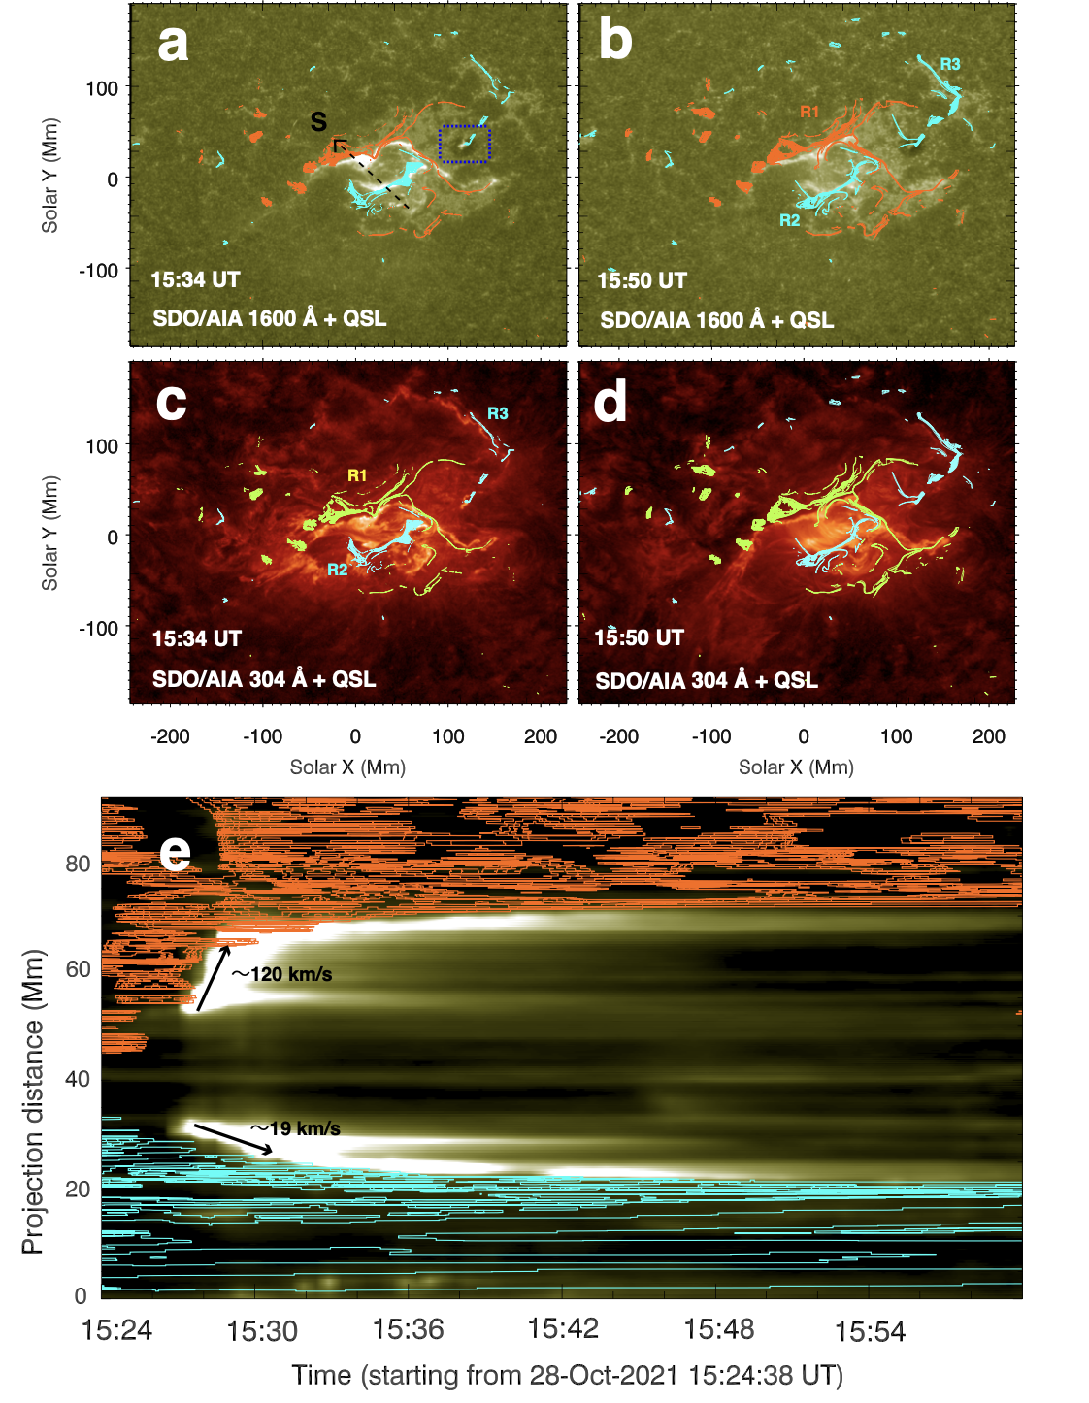
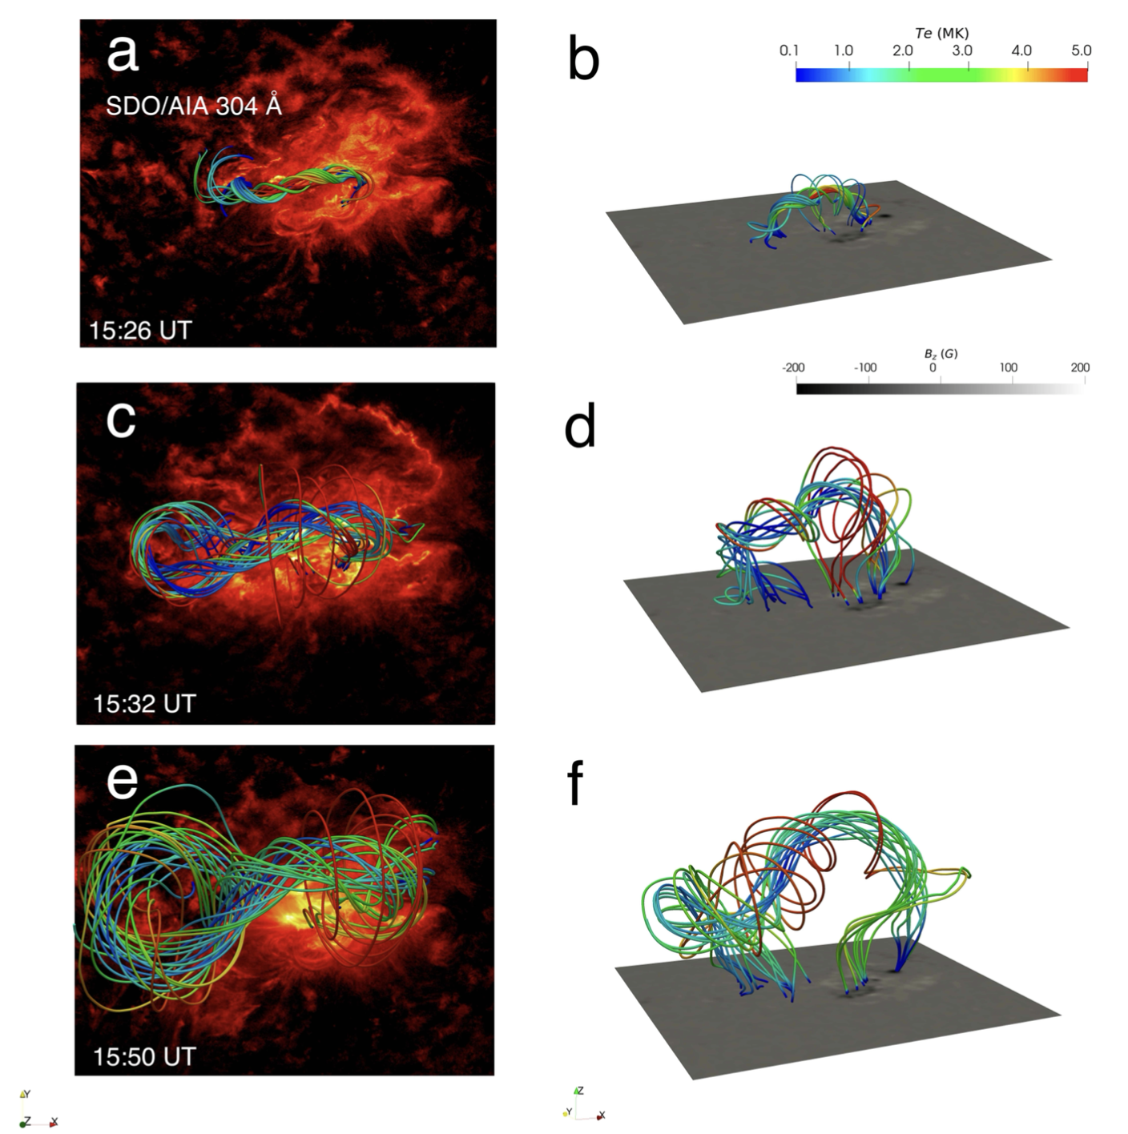
Numerical results
Event 1: X1.0 eruptive flare on 2021 October 28
Eruption process (Evolution of the flux rope and ribbons):

Slide 8
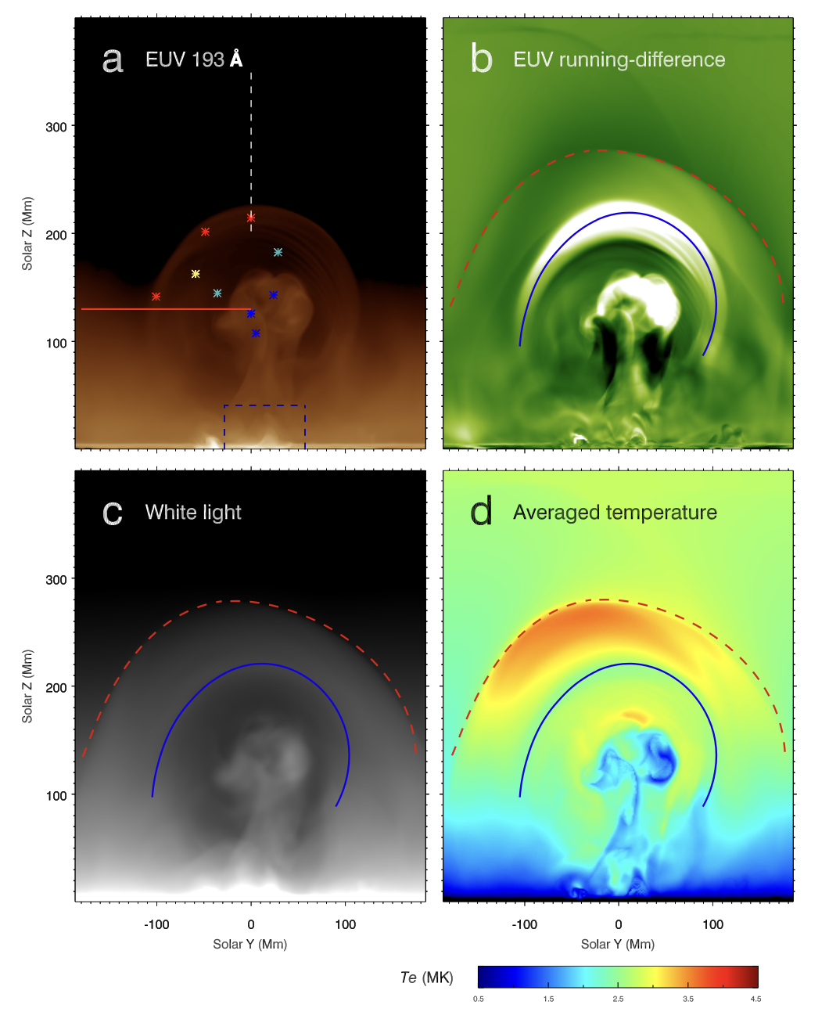
Numerical results. similar to the Observations
Event 1: X1.0 eruptive flare on 2021 October 28
Eruption process (Evolution of the flux rope and ribbons):

Slide 9
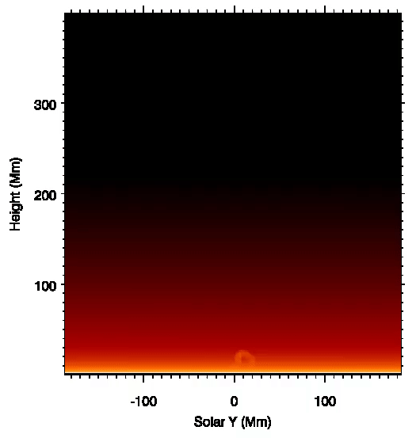
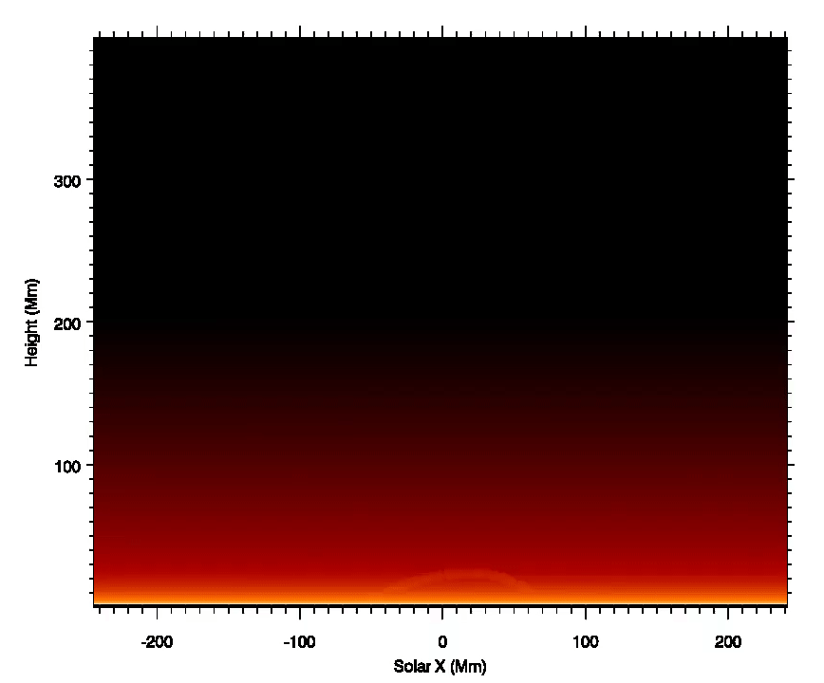

Slide 10
Relationships between CMEs observed with STEREO and EUV wave
SIMULATION OBSERVATION
Our simulation reproduces two components of EUV waves in observations, i.e,
-- the leading fast-mode wave
– the following slow non-wave component.
The bright leading front is roughly cospatial with the slow component of the EUV wave.
Our data-driven model reinforces the
magnetic field-line stretching model for EUV waves (Chen et al 2009).
STEREO
CONCLUSION:
With a magnetogram + FR+
MHD equations + heating law
we retrieve the observations

Slide 11
More informations on the screen and in
JinHan Guo et al 2023
Devi et al 2022

Slide 12
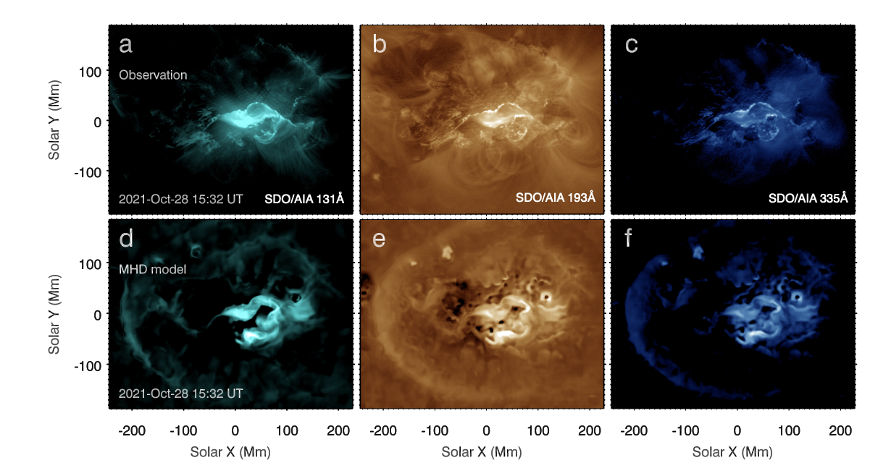
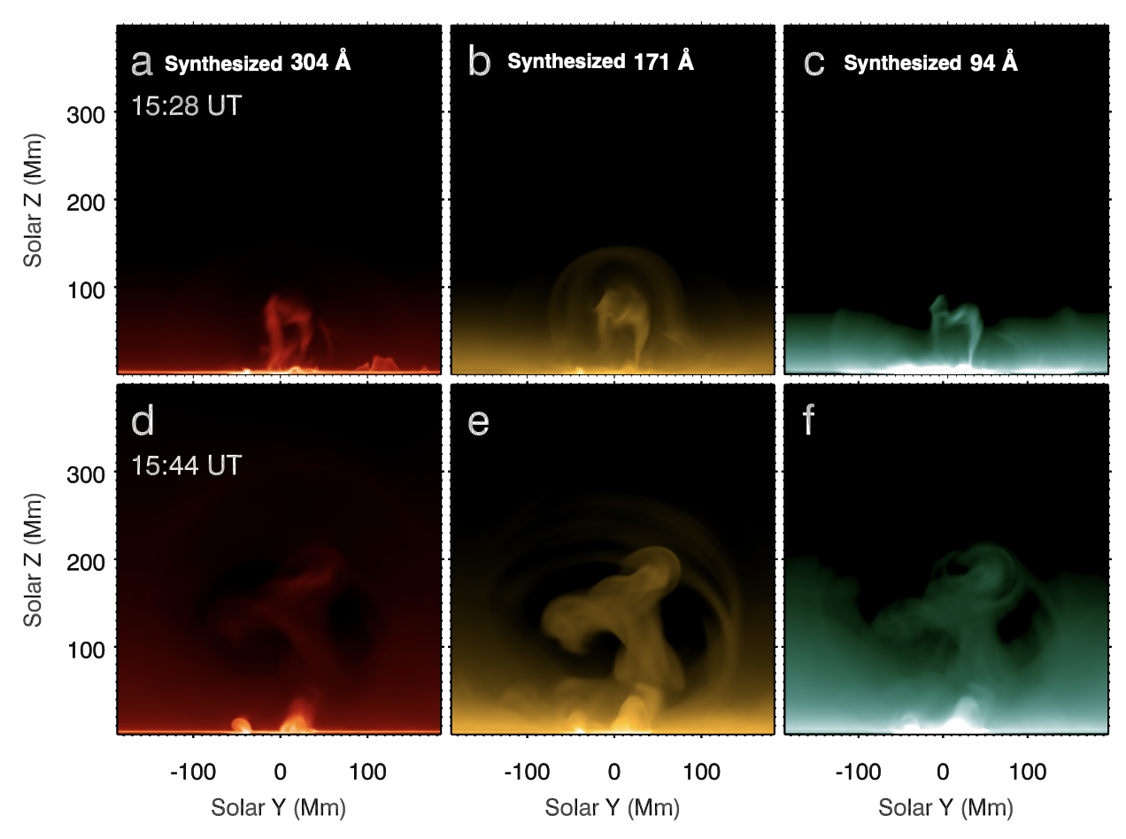
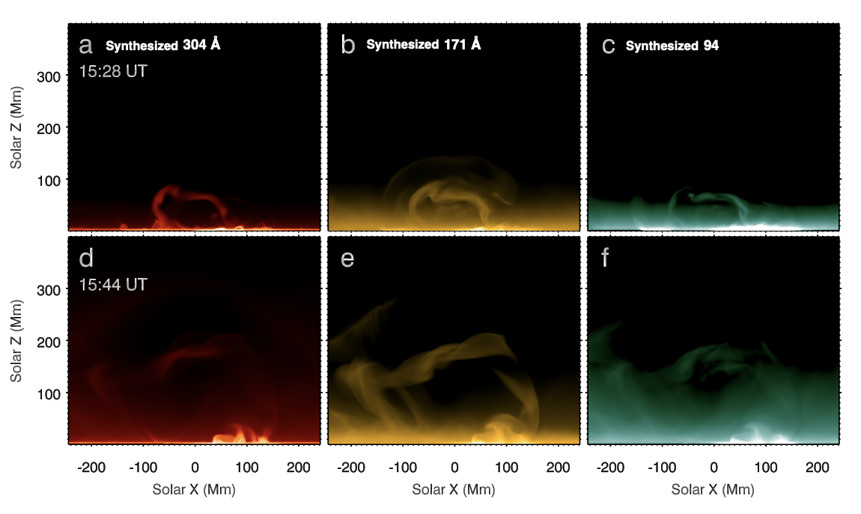
Numerical results
Event 1: X1.0 eruptive flare on 2021 October 28
Eruption process (Synthesized radiation):

Slide 13
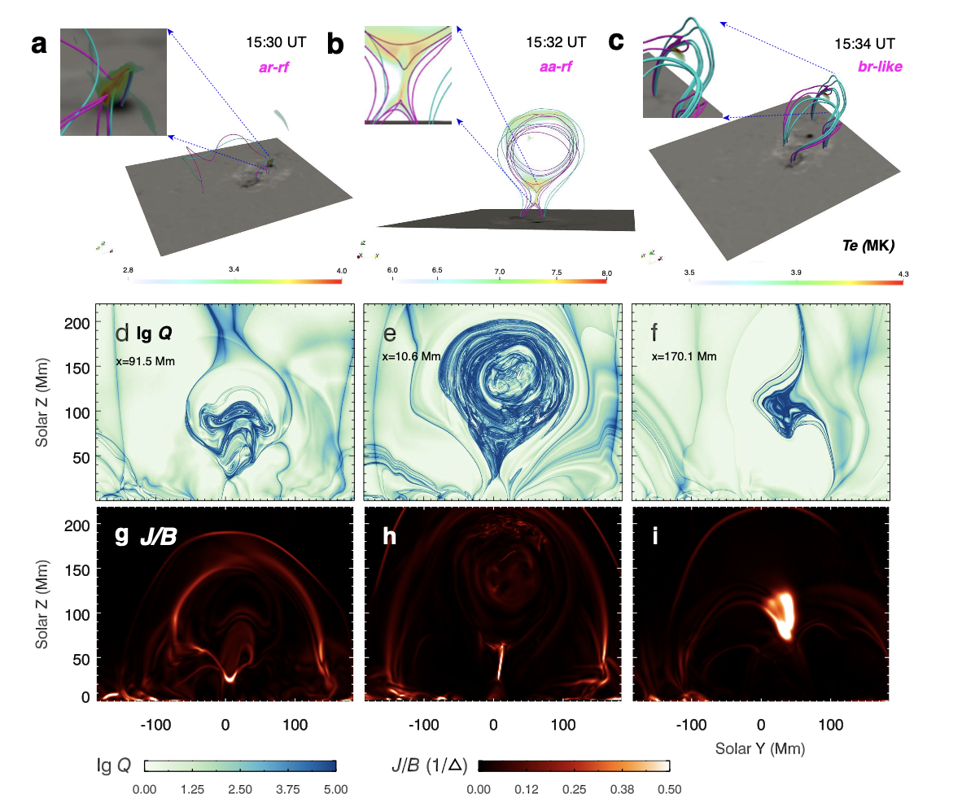
Numerical results
Event 1: X1.0 eruptive flare on 2021 October 28
Magnetic Reconnection during the eruption:
Three reconnection geometries are characterized by the connectivity of field lines, heating, QSLs and J/B distributions.
aa-rf: reconnection in overlying arcades.
ar-rf: reconnection between the flux rope and ambient arcades.
breakout-like reconnection: reconnection above the flux rope.
Using a magnetogram + MHD equations
we retrieve the observations

Slide 14
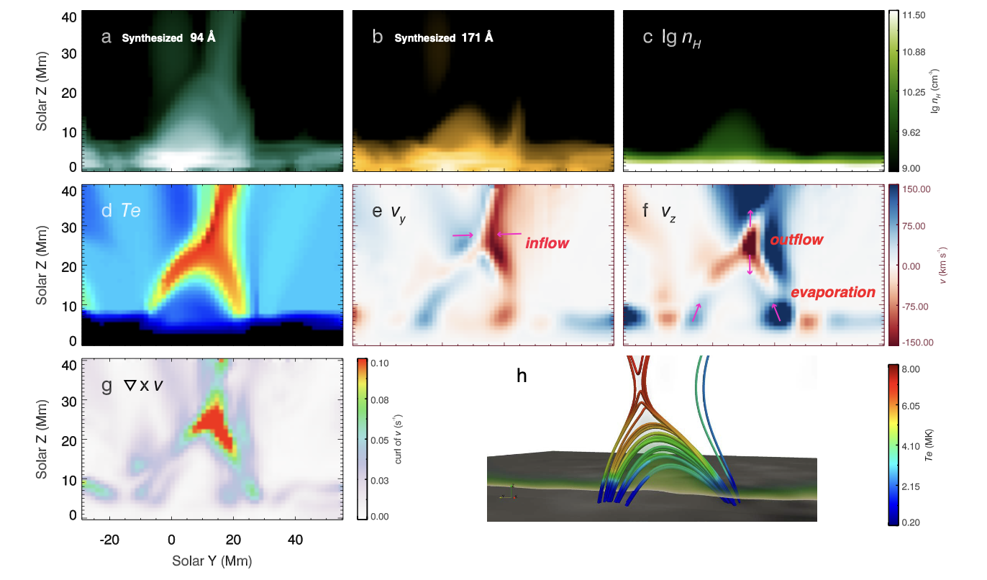
Numerical results
Event 1: X1.0 eruptive flare on 2021 October 28
CME three-part structure and post-flare loops:
CME three-part structures, including a bright core, dark cavity and bright leading front are reproduced in EUV and white-light synthesized images.
Hot cusp-like structures, round flare loops and chromosphere evaporation are also retrieved.
Using a magnetogram + MHD equations
we retrieve the observations

