Slide 1
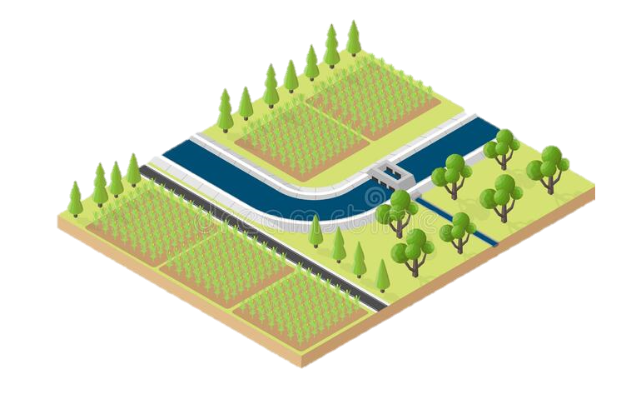
Non-Transboundary Basin
Communication
Human
Component
Ministries & Managers
Policy Makers
Drinking Water
Extreme Events
Land Management
Climate Conditions
Management Strategies
Food Security
Water Availability
Environment
Component
Infrastructure
Component
Page 1/3
Hydropower Generation
Start to Navigate

Slide 2
Transboundary
Basin
Co
operation
Communication
Communication
Cooperation
Human
Component
Ministries & Managers
Policy Makers
Policy Makers
Ministries & Managers
Drinking Water
Extreme Events
Land Management
Climate Conditions
Management Strategies
Food Security
Water Availability
Water Availability
Environment
Component
Infrastructure
Component
Page 2/3
Hydropower Generation
Downstream Country
Upstream Country
Start to Navigate

Slide 3
Transboundary
Basin
Framework
Knowledge sharing
(transparency)
Hydrological modelling
Remote Sensing
Communication
Human
Component
Ministries & Managers
Policy Makers
Drinking Water
Extreme Events
Land Management
Climate Conditions
Management Strategies
Food Security
Water Availability
Water Availability
Environment
Component
Infrastructure
Component
Page 3/3
Hydropower Generation
Downstream Country
Upstream Country
Start to Navigate

Slide 4
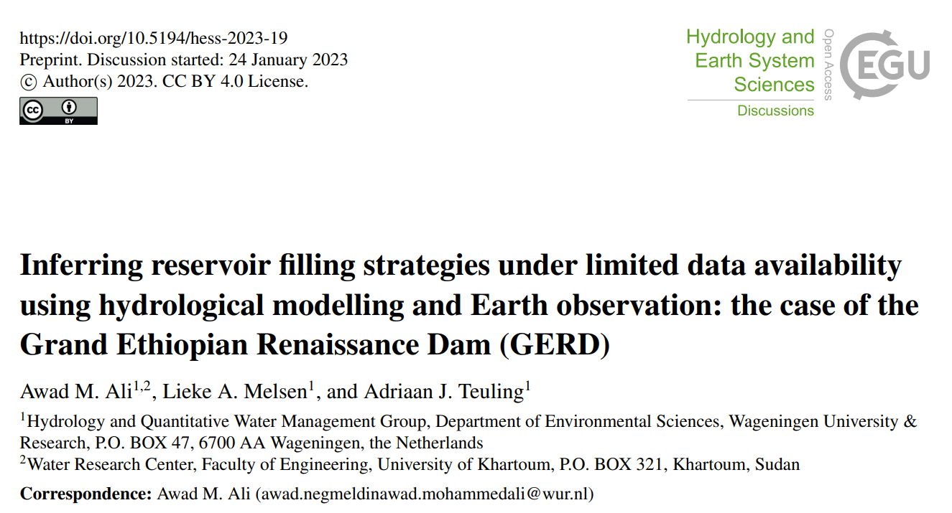
Inferring reservoir filling strategies under limited data availability using hydrological modelling and Earth observation:
the case of the Grand Ethiopian Renaissance Dam (GERD)
Inferring reservoir filling strategies
Ali et al.
Awad M. Ali, Lieke A. Melsen, and Adriaan J. Teuling
Introduction: Madness
Preprint
Abstract
Study Area
Data
Methodology
Results
Conclusion

Slide 5
Abstract
Problem:
The filling of the Grand Ethiopian Renaissance Dam (GERD) started in 2020, posing additional challenges for downstream water management in Sudan, which is already struggling to cope with the effects of climate change. This is also the case for many transboundary rivers that observe a lack of cooperation and transparency during the filling and operation of new dams. Without information about water supply from neighbouring countries, it is risky to manage downstream dams as usual and operation information is needed to apply modifications.
Inferring reservoir filling strategies
Ali et al.
Aim:
This study aims to test the applicability of using lumped hydrological modelling coupled with remote sensing data in retrieving reservoir filling strategies in regions with limited data availability.
Introduction: Madness
Methodology:
Firstly, five rainfall products (namely; ARC2, CHIRPS, ERA5, GPCC, and PERSIANN-CDR) were evaluated against historical measured rainfall at ten stations. Secondly, to account for input uncertainty, the best three performing rainfall products were forced in the conceptual hydrological model HBV-light with potential evapotranspiration and temperature data from ERA5. The model was calibrated during the period 2006–2019 and validated during the period 1991–1996. Thirdly, the parameter sets that obtained very good performance (NSE > 0.75) were utilized to predict the inflow of GERD during the operation period (2020–2022). Then, from the water balance of GERD, the daily storage was estimated and compared with the storage derived from Landsat observations to evaluate the performance of the selected rainfall products. Finally, three years of GERD filling strategies were retrieved using the best-performing simulation of CHIRPS with RMSE of 1.7 billion cubic meters (BCM) and NSE of 0.77 when compared with Landsat-derived reservoir storage.
Preprint
Abstract
Study Area
Data
Methodology
Results
Conclusion
Results:
It was found that GERD stored 14 % of the monthly inflow of July 2020, 41 % of July 2021, and 37 % and 32 % of July and August 2022, respectively. Annually, GERD retained 5.2 % and 7.4 % of the annual inflow in the first two filling phases and between 12.9 % and 13.7 % in the third phase. The results also revealed that the retrieval of filling strategies is more influenced by input uncertainty than parameter uncertainty. The retrieved daily change in GERD storage with the measured outflow to Sudan allowed further interpretation of the downstream impacts of GERD.
Conclusion:
The findings of this study provide systematic steps to retrieve filling strategies for data-scarce regions, which can serve as a base for future development in the field. Locally, the analysis contributes significantly to the future water management of the Roseires and Sennar dams in Sudan.

Slide 6
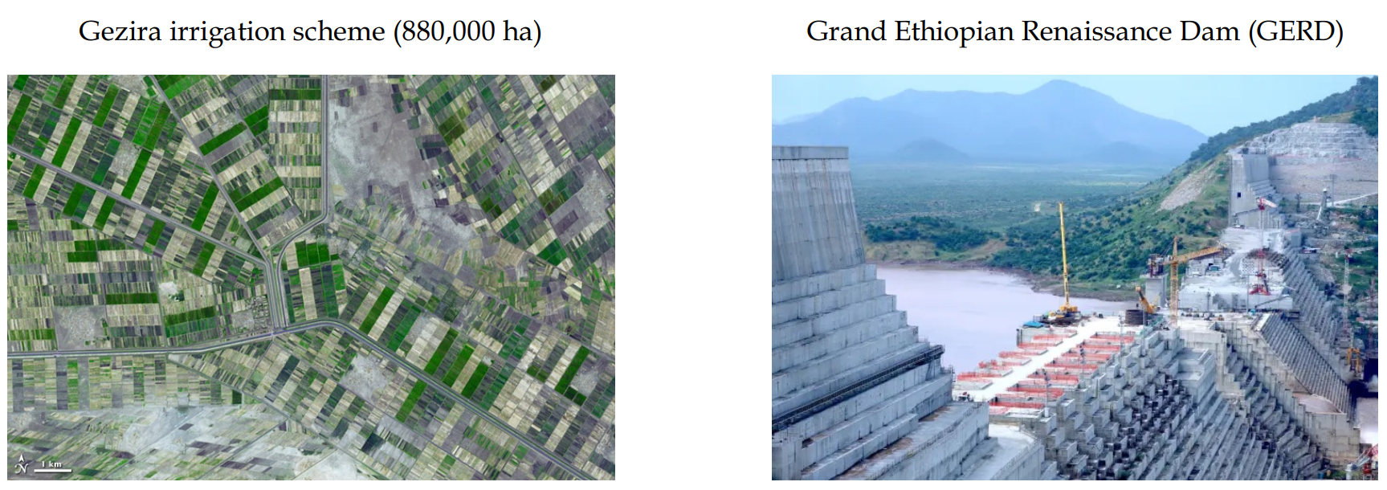
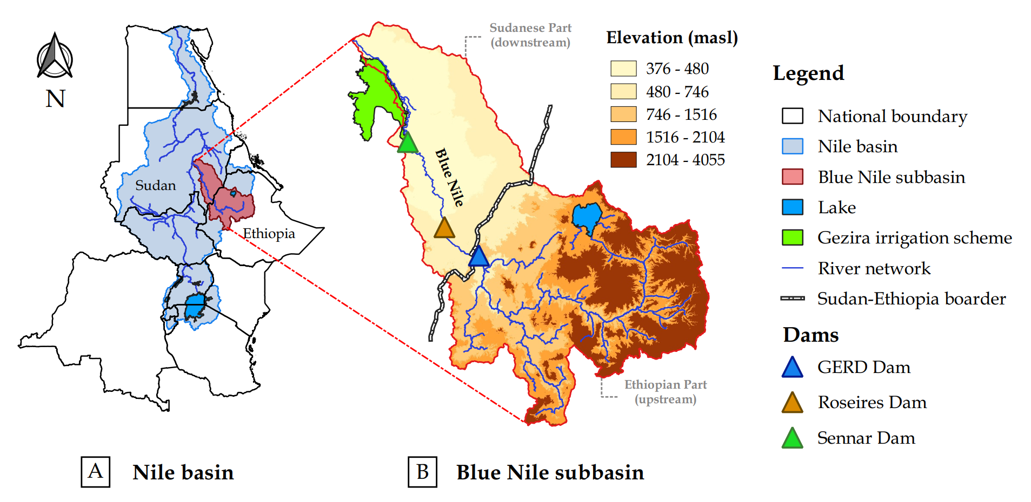
Study Area
Inferring reservoir filling strategies
Nile River shared by 11 countries, longest in Africa
Blue Nile contributes 60% of Nile's flow, shared by Ethiopia, Sudan, and Egypt
GERD construction since 2011 resulted in hydro-political tension
Lack of transparency in GERD management affects management of Roseires and Sennar dams in Sudan
Ali et al.
Introduction: Madness
Preprint
Abstract
Study Area
Data
Methodology
Results
Conclusion

Slide 7
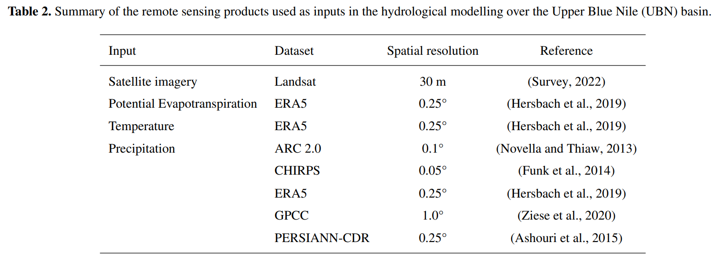
Data
(A) Ground Measurements
Inferring reservoir filling strategies
Ali et al.
Introduction: Madness
Preprint
Abstract
Study Area
Data
(B) Remote Sensing Products
Methodology
Results
Conclusion

Slide 8
Methodology
Step 1: validate (5) remote sensing rainfall products using measured data
Inferring reservoir filling strategies
Step 2: calibrate and validate (HBV-Light) hydrological model (before dam filling)
Ali et al.
Step 3: predict the inflow to dam during the filling period (2020 – 2022)
Introduction: Madness
Step 4: estimate the stored water using calibrated model and validate it against Earth observations (Landsat)
Preprint
Abstract
Study Area
Data
Step 5: retrieve dam filling strategies based on best-performing parameters
Methodology
Results
Conclusion

Slide 9
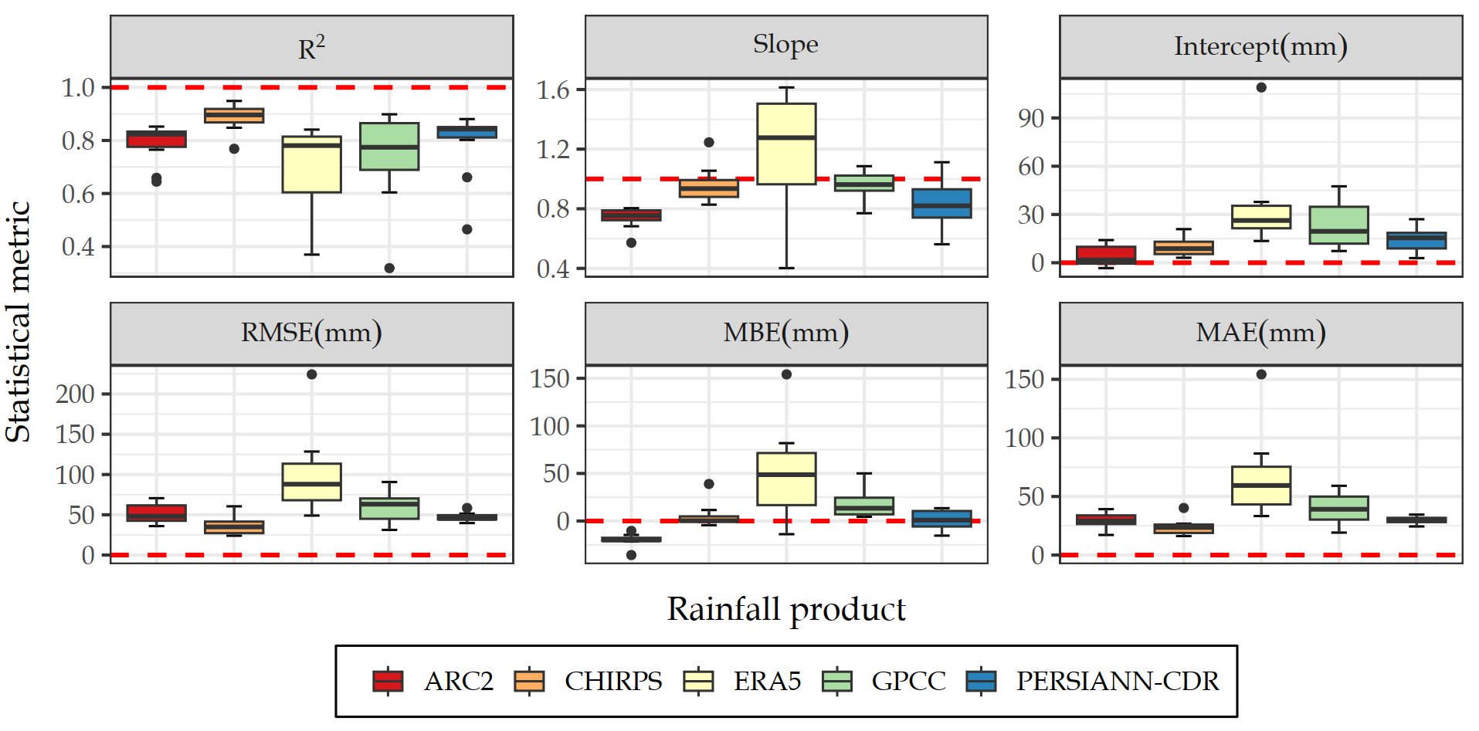
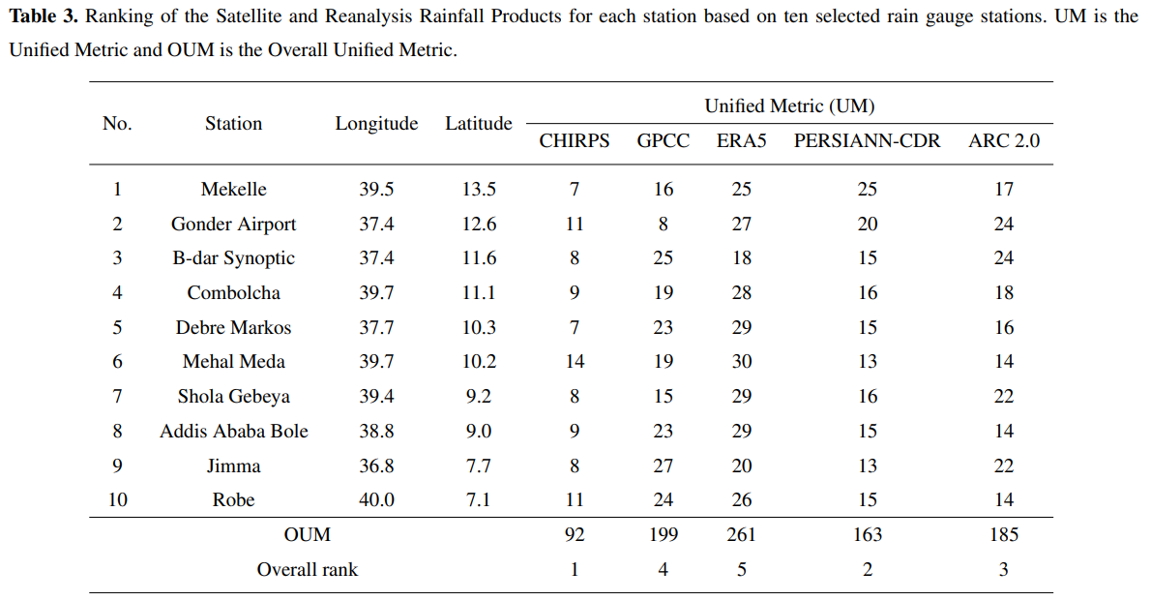
Results: Performance of the rainfall products
Inferring reservoir filling strategies
CHIRPS has the most accurate estimates
ERA5 shows the highest overestimation and the highest error values
The performance of the rainfall products also varied spatially at the different stations
The overall best performing product is CHIRPS followed by PERSIANN-CDR, ARC2, GPCC, and ERA5
Ali et al.
Introduction: Madness
Preprint
Abstract
Study Area
Data
Methodology
Results
Conclusion
Page 1/5
Notes:
consistent performance of CHIRPS over the spatial extent and high spatial variation of ERA5

Slide 10
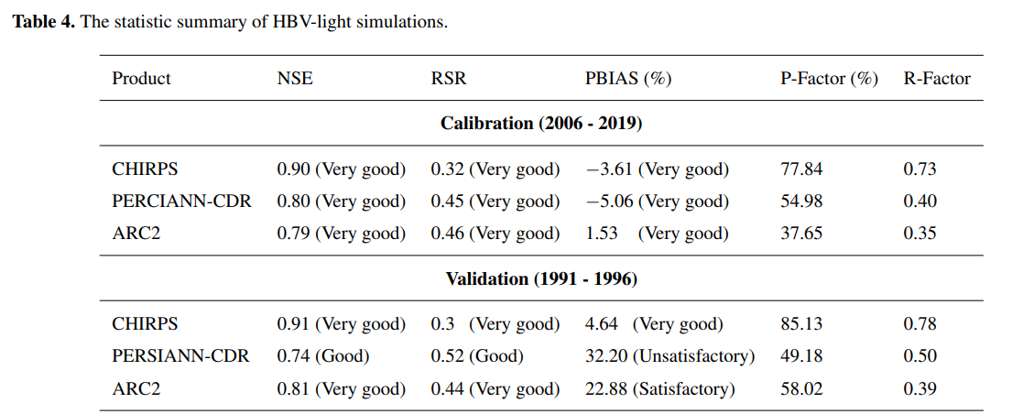
Results: HBV-Light calibration and validation
Inferring reservoir filling strategies
The model was run with 10,000 randomly generated parameter sets to account for uncertainty
% Prediction Uncertainty (PPU) displays simulations with NSE values greater than 0.75
Ali et al.
Introduction: Madness
Preprint
Abstract
Study Area
Data
Methodology
Results
Conclusion
Page 2/5

Slide 11
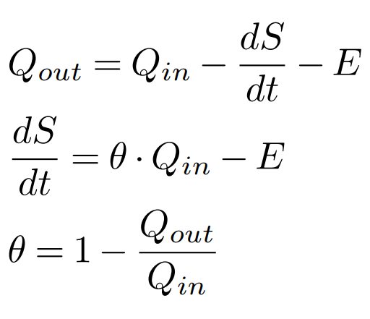
Results: Inflow prediction
Outflow
Inflow
Inferring reservoir filling strategies
Ali et al.
Introduction: Madness
Preprint
Abstract
Outflow
Inflow
Storage
Evap. From Surface Water
HBV-light was run using optimized parameter sets to estimate inflow after reservoir filling began in 2020.
Estimated monthly average evaporation data from Khairy et al. (2019) was used to calculate the evaporation of reservoir surface (E)
After estimate daily storage per timestep, reservoir area was estimated using the Area-Storage relationship.
Study Area
Data
Methodology
Results
Conclusion
Khairy, W., El-Motasem, M., Mehanna, A., and Hefny, K.: Estimation of evaporation losses from water bodies in the Sudan and Ethiopia, International Journal of Energy and Water Resources, 3, 233–246, https://doi.org/10.1007/s42108-019-00031-x, 2019
Page 3/5

Slide 12
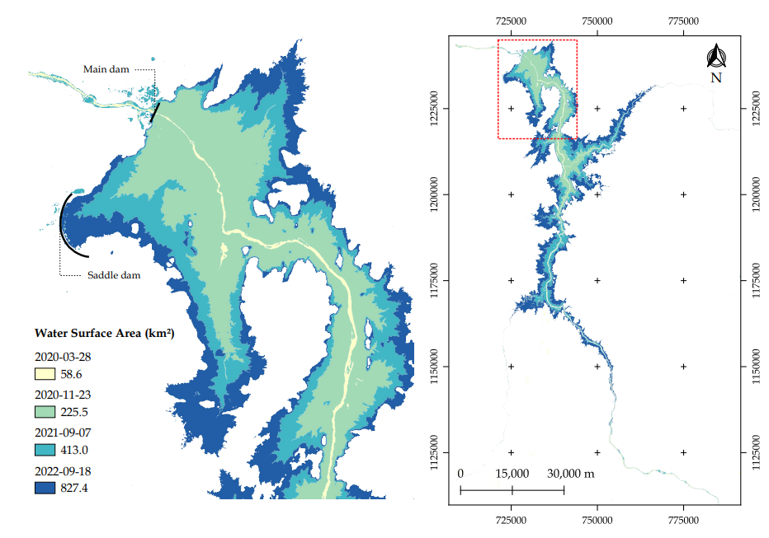
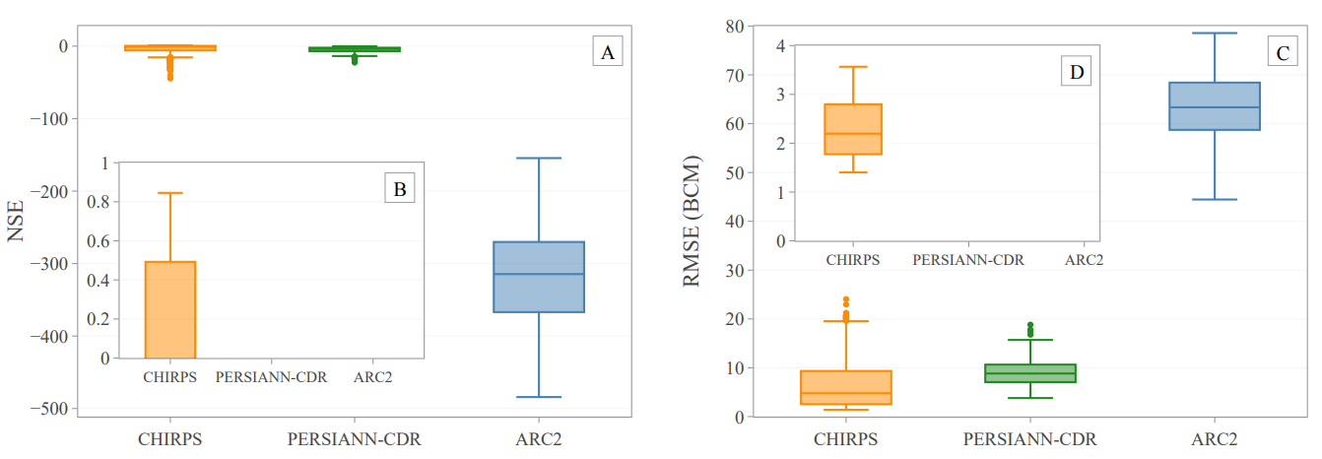
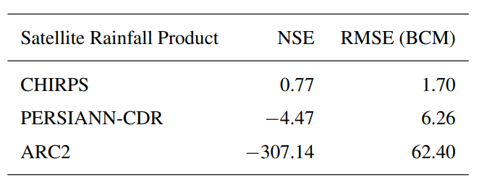
Results: Model- vs Landsat-derived storage
Landsat-derived storage
Performance results
Inferring reservoir filling strategies
Ali et al.
Introduction: Madness
Preprint
Abstract
Study Area
Data
Methodology
Results
Model-derived storage
Table 5. Performance in retrieving reservoir storage volume of GERD (compared with Landsat)
Conclusion
Page 4/5

Slide 13
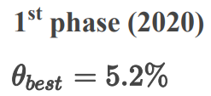
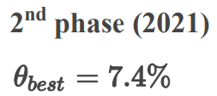
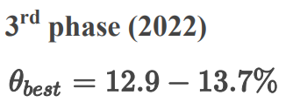
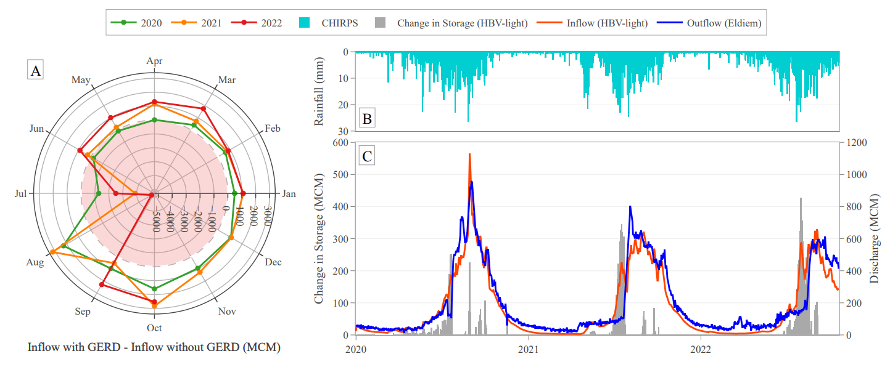
Results: GERD strategies and impact on Sudan
(A) Monthly & annual inflow volume retained by the dam
2020 (5.2%)
July: 14%
2021 (7.4%)
July: 41%
2022 (12.9 – 13.7%)
July: 37%
August: 32%
Inferring reservoir filling strategies
Ali et al.
Introduction: Madness
Preprint
Abstract
(B) Impact of GERD on flow to Sudan
(1) Low outflows during filling days are followed by a sudden and steady increase in the outflow.
(2) The monthly discharge to Sudan after 2020 showed a notable increase throughout the year except in the filling months.
Study Area
Data
Methodology
Results
Conclusion
Page 5/5

Slide 14
Conclusion
Inferring reservoir filling strategies
Limited ground measurements with HBV-light inferred GERD filling strategies using available Earth observation data.
CHIRPS showed superior performance in rainfall representation and capturing filling properties compared to other products.
The choice of rainfall product had a greater impact on inferring GERD filling strategies than parameter uncertainty.
Inflow to Sudan significantly decreased below average during filling months, indicating the need to adjust reservoir management of Roseires and Sennar dams, in Sudan, to meet downstream demands.
Ali et al.
Introduction: Madness
Preprint
Abstract
Study Area
Data
Methodology
Results
Conclusion

