Slide 1
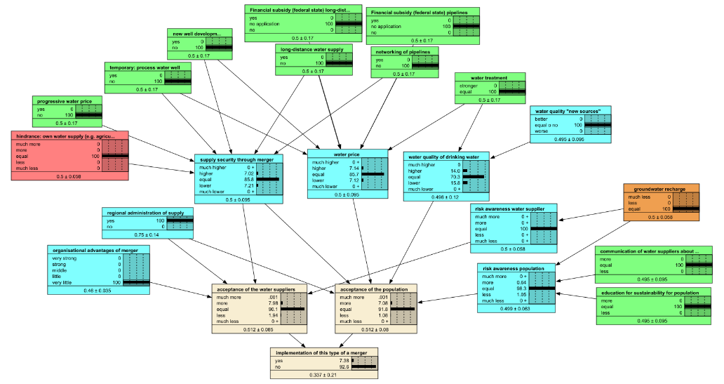
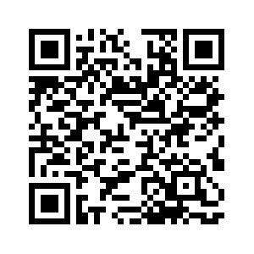
Transdisciplinary knowledge integration with Bayesian Belief Networks in water management Laura Müller and Petra Döll
Background
Stakeholders’ and scientific knowledge should be integrated to develop adaptation measures and to find strategies how to implement them. …
Sensitivity Analysis
Measures: the longer the distance to goal, the less impact
…
Bayesian Belief Network
Goal: implementation of an adaptation measure
With stakeholders: set up network structure and identified weights
…
Contents
…
Conclusions
Set up process was well feasible with stakeholders
Better to keep distances in network structure short
…
Evaluation
Great majority of stakeholders: understood the Bayesian Belief Network, displaying the complex interactions, and found it helpful
…
Find the abstract here!
la.mueller@em.uni-frankfurt.de
Notes:
PICO session "HS1.1.4 Elevating practice in the science-policy-practice nexus: highlights from operationalization of hydrological research and interdisciplinary collaborations" co-sponsored by UNESCO and WMO.

Slide 2
Contents
Background
Bayesian Belief Network
Evaluation
Sensitivity Analysis
Conclusions
Idea
Motivation
Structure Sensitivity
Development
Project KlimaRhön
Parameter Sensitivity
Characteristics
Overview
Background
Bayesian Belief Network
Evaluation
Sensitivity Analysis
Conclusions

Slide 3
Background
Motivation
Climate change alters the hydrological regimes globally.
Integration of scientific and stakeholder knowledge
Project KlimaRhön
Assessing water-related risks due to climate change and developing adaptation measures in water management in a participatory process
Overview
Background
Bayesian Belief Network
Evaluation
Sensitivity Analysis
Conclusions

Slide 4
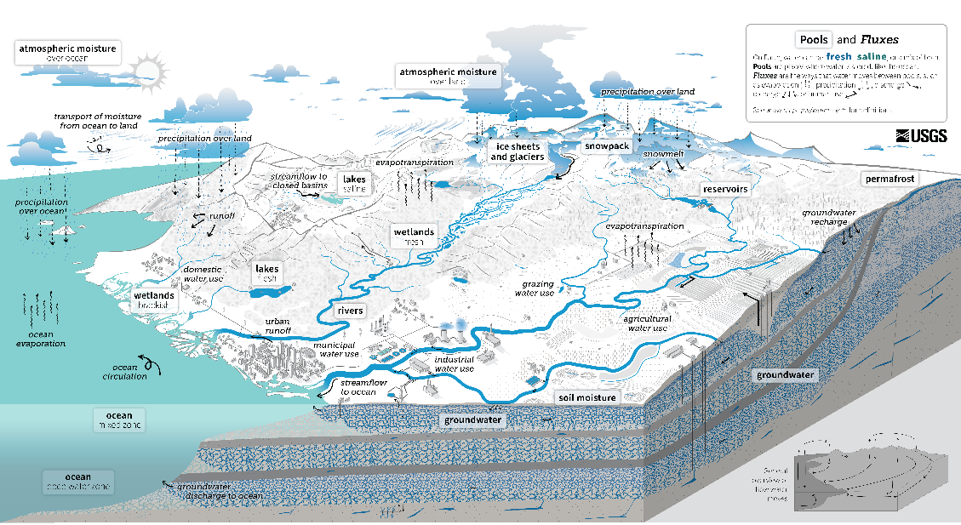
Background Motivation
Climate change changes the water cycle.
Water management was developed with the stationarity of hydrological conditions of the past¹.
Water management needs to be adapted^{2,3,4,5,6}.
Adaptation strategies should be developed by integrating scientific and stakeholders’ knowledge^{2,3,4,5,6}. This can be done in transdisciplinary projects like the project KlimaRhön…
¹Milly et al., 2008; ² Daniels et al., 2020; ³Döll & Romero-Lankao, 2017; ⁴Krueger et al., 2016; ⁵Scrieciu et al., 2021; ⁶Strasser et al., 2014
https://www.usgs.gov/special-topics/water-science-school/science/water-cycle-diagrams
Overview
Background
Bayesian Belief Network
Evaluation
Sensitivity Analysis
Conclusions

Slide 5
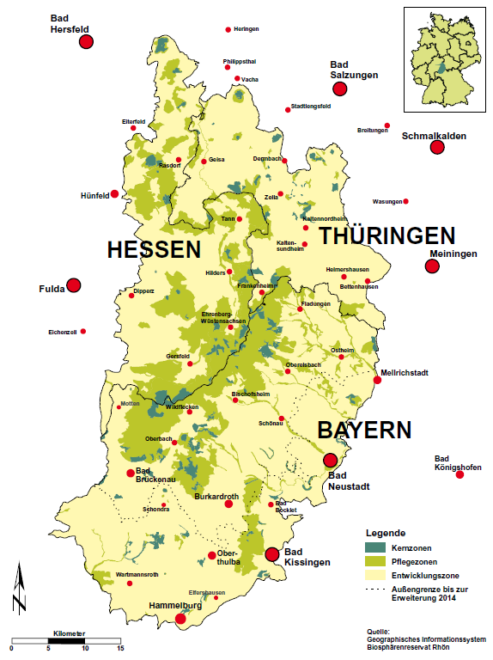
Background Project KlimaRhön
Aim: assess water-related risks due to climate change and develop adaptation strategies in water management (water supply and aquatic ecosystems)
Study area: UNESCO biosphere reserve Rhön in Central Germany
Interdisciplinary research team (sociologists and hydrologists)
Transdisciplinary: stakeholder dialogue
Zaenker & Reiss (2015)
Overview
Background
Bayesian Belief Network
Evaluation
Sensitivity Analysis
Conclusions

Slide 6
Bayesian Belief Network
Idea
Aim: assess conditions for implementing climate change adaptation measures
Characteristics
Components
Relative
Weights
Uncertainty
Development
Participatory Development of Bayesian Belief Network
Overview
Background
Bayesian Belief Network
Evaluation
Sensitivity Analysis
Conclusions

Slide 7
Bayesian Belief Network Idea
Stakeholders identified many adaptation measures.
It was not clear, how they can be implemented, thus, we wanted to overcome the know-do gap⁷.
“Clumsy Solutions”⁸: identify whose acceptance we need for the implementation and how we can enhance their acceptance(s).
Participatory modelling is a method to integrate knowledge⁵ and shows the relationships and trade-offs between system components⁹.
Participatory development of a Bayesian Belief Network with which the conditions for implementing climate change adaptation measures can be assessed.
⁵Scrieciu et al., 2021; ⁷Bammer, 2013; ⁸Verweij et al., 2006; ⁹Hedelin et al, 2021
Overview
Background
Bayesian Belief Network
Evaluation
Sensitivity Analysis
Conclusions

Slide 8
Bayesian Belief Network Idea
Stakeholders identified many adaptation measures.
It was not clear, how they can be implemented, thus, we wanted to overcome the know-do gap⁷.
“Clumsy Solutions”⁸: identify whose acceptance we need for the implementation and how we can enhance their acceptance(s).
Participatory modelling is a method to integrate knowledge⁵ and shows the relationships and trade-offs between system components⁹.
Clumsy solution: a combination of different measures to address “various ways of organizing, perceiving and justifying social relations” (Verweij et al., 2006, p. 818)
Participatory development of a Bayesian Belief Network with which the conditions for implementing climate change adaptation measures can be assessed.
⁵Scrieciu et al., 2021; ⁷Bammer, 2013; ⁸Verweij et al., 2006; ⁹Hedelin et al, 2021
Overview
Background
Bayesian Belief Network
Evaluation
Sensitivity Analysis
Conclusions

Slide 9
Bayesian Belief Network Idea
Stakeholders identified many adaptation measures.
It was not clear, how they can be implemented, thus, we wanted to overcome the know-do gap⁷.
“Clumsy Solutions”⁸: identify whose acceptance we need for the implementation and how we can enhance their acceptance(s).
Participatory modelling is a method to integrate knowledge⁵ and shows the relationships and trade-offs between system components⁹.
Participatory development of a Bayesian Belief Network with which the conditions for implementing climate change adaptation measures can be assessed.
⁵Scrieciu et al., 2021; ⁷Bammer, 2013; ⁸Verweij et al., 2006; ⁹Hedelin et al, 2021
Overview
Background
Bayesian Belief Network
Evaluation
Sensitivity Analysis
Conclusions

Slide 10
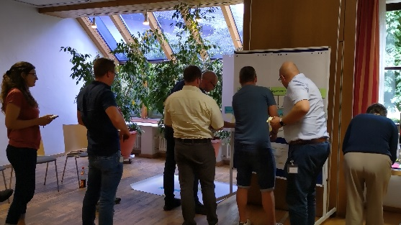
Bayesian Belief Network Development
Participatory
Scientists
Step 1
Identify relevant actors and network structure
Step 2
Adapt relevant actors and network structure
Weight factors that influence the acceptance of relevant actors
Identify measures that influence the factors
Integration of stakeholders’ and scientific knowledge
Step 3
Translate weights and structure (with factors and measures) to Bayesian Belief Network
Identify weights for relationships that were not participatorily weighted
Step 4
Explore the Bayesian Belief Network
Discuss weights
Step 5
Update weights in Bayesian Belief Network
Sensitivity Analysis
Characteristis of the Bayesian Belief Network …
Overview
Background
Bayesian Belief Network
Evaluation
Sensitivity Analysis
Conclusions

Slide 11
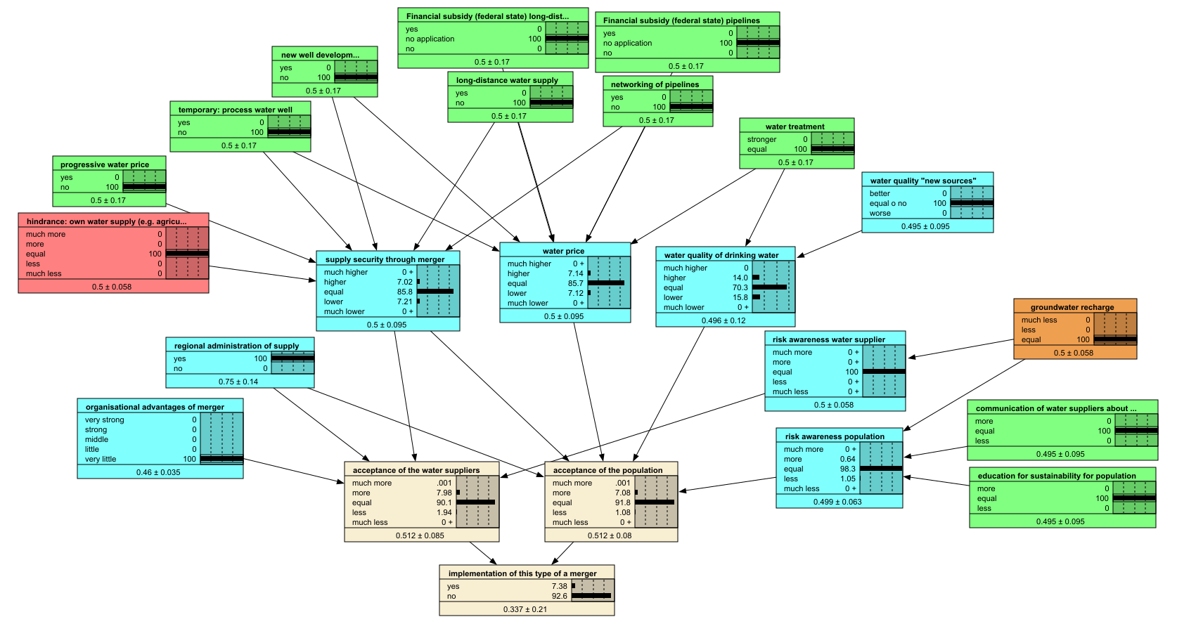
Bayesian Belief Network Characteristics
Components
Relative
Weights
Uncertainty
Overview
Background
Bayesian Belief Network
Evaluation
Sensitivity Analysis
Conclusions

Slide 12
Bayesian Belief Network Characteristics
Components
Relative
Weights
Uncertainty
Overview
Background
Bayesian Belief Network
Evaluation
Sensitivity Analysis
Conclusions

Slide 13
Bayesian Belief Network Characteristics
4. Measures (green), hindrances (red), external factors (orange), and factors (blue), which influence factors
Components
Causal network structure helps stakeholders to understand and keep the overview of the complex interdependencies.
Relative
Weights
3. Factors, which influence acceptances
Uncertainty
2. Acceptances of relevant actors
1. Goal: Implementation of an adaptation measure
Overview
Background
Bayesian Belief Network
Evaluation
Sensitivity Analysis
Conclusions

Slide 14
Bayesian Belief Network Characteristics
Components
The nodes’ states are relative, so that the Bayesian Belief Network can be used at any time with different boundary conditions and is not limited for use in the present state.
Relative
Weights
Uncertainty
Overview
Background
Bayesian Belief Network
Evaluation
Sensitivity Analysis
Conclusions

Slide 15
Bayesian Belief Network Characteristics
Components
Stakeholders identified weights, which were then used to calculate the conditional probability tables. We find this easier and less time consuming than directly filling out the conditional probability tables with the stakeholders.
Relative
Weights
Uncertainty
Overview
Background
Bayesian Belief Network
Evaluation
Sensitivity Analysis
Conclusions

Slide 16
Bayesian Belief Network Characteristics
Components
Uncertainty of possible future conditions: different combinations of measures can be explored by turning on and off or inserting probability distributions in the measures and factors.
Relative
Weights
Uncertainty is propagated through the Bayesian Belief Network with the probability distributions of the states. Uncertainty due to the sampling process of the software is also taken into account.
Uncertainty
Overview
Background
Bayesian Belief Network
Evaluation
Sensitivity Analysis
Conclusions

Slide 17
Evaluation
Stakeholders evaluated the Bayesian Belief Network after it was presented.
Majority of stakeholders understood the Bayesian Belief Network and the complex interactions that it displays, and found it helpful for identifying first steps to implementation.
Overview
Background
Bayesian Belief Network
Evaluation
Sensitivity Analysis
Conclusions

Slide 18
Sensitivity Analysis
Structure Sensitivity
Analysis how the model reacts if a node is deleted or if nodes are added.
Parameter Sensitivity
Analysis how the model reacts if other weights were chosen.
Overview
Background
Bayesian Belief Network
Evaluation
Sensitivity Analysis
Conclusions

Slide 19
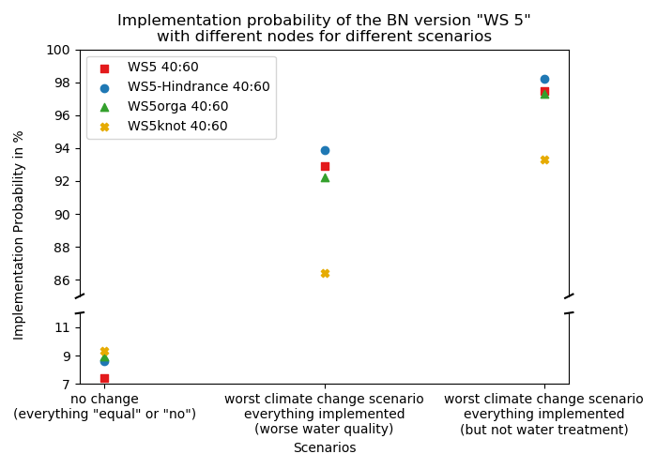
Sensitivity Analysis Structure Sensitivity
The standard Bayesian Belief Network is WS5 (red square).
If a node is deleted…
If nodes are added…
More …
Parameter Sensitivity …
Overview
Background
Bayesian Belief Network
Evaluation
Sensitivity Analysis
Conclusions

Slide 20
Sensitivity Analysis Structure Sensitivity
The standard Bayesian Belief Network is WS5 (red square).
If a node is deleted…
If nodes are added…
More …
Parameter Sensitivity …
Overview
Background
Bayesian Belief Network
Evaluation
Sensitivity Analysis
Conclusions

Slide 21
Sensitivity Analysis Structure Sensitivity
The standard Bayesian Belief Network is WS5 (red square).
If a node is deleted (WS5-Hindrance, blue point), the other nodes have a higher weight leading to higher implementation probabilities, if the nodes are activated.
If nodes are added…
More …
Parameter Sensitivity …
Overview
Background
Bayesian Belief Network
Evaluation
Sensitivity Analysis
Conclusions

Slide 22
Sensitivity Analysis Structure Sensitivity
The standard Bayesian Belief Network is WS5 (red square).
If a node is deleted…
If nodes are added (WS5orga, green triangle; WS5knot, yellow cross), the results are buffered (not so extreme).
In case of WS5knot (yellow cross), summarizing nodes were introduced between some measures and the influenced factor to get a better overview. This strongly decreased the implementation probability. It resulted in decreased influence of the measures on the goal, thus the distance between the measures and the goal should be the same for all measures.
More …
Parameter Sensitivity …
Overview
Background
Bayesian Belief Network
Evaluation
Sensitivity Analysis
Conclusions

Slide 23
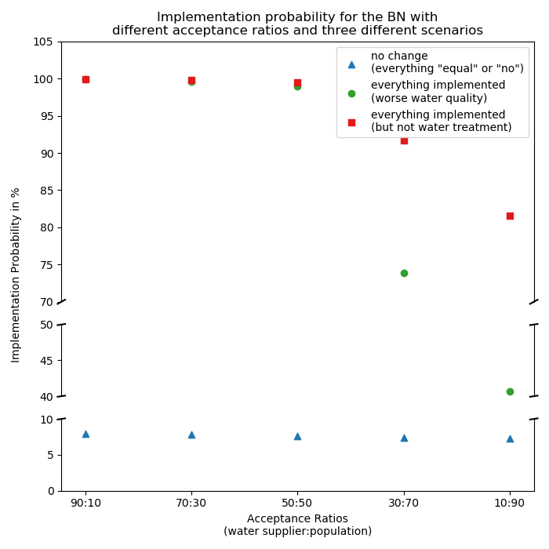
Sensitivity Analysis Parameter Sensitivity
To implement the adaptation measures (= goal), the acceptance of the water suppliers and the population is needed. Here, the weights of their acceptance influencing the implementation is varied to evaluate the sensitivity.
The higher the influence of the population, the lower the implementation probability.
Structure Sensitivity …
More …
Overview
Background
Bayesian Belief Network
Evaluation
Sensitivity Analysis
Conclusions

Slide 24
Sensitivity Analysis Parameter Sensitivity
To implement the adaptation measures (= goal), the acceptance of the water suppliers and the population is needed. Here, the weights of their acceptance influencing the implementation is varied to evaluate the sensitivity.
The higher the influence of the population, the lower the implementation probability.
Structure Sensitivity …
More …
Overview
Background
Bayesian Belief Network
Evaluation
Sensitivity Analysis
Conclusions

Slide 25
Conclusions
Set up network structure and weights with stakeholders Understandable and quick way to participatorily set up a Bayesian Belief Network is by developing network structure and identify weights for the relationships between the components with the stakeholders.
The longer the distance in the network to goal, the less impact The chains in the network structure should be short, because the inputs are buffered, the longer the chains are. Moreover, for all measures, the distance between them and the goal should be the same.
Overview
Background
Bayesian Belief Network
Evaluation
Sensitivity Analysis
Conclusions

Slide 26
Thank you…
…to the Hessian Agency for Nature Conservation, Environment and Geology (HLNUG) and its Centre on Climate Change and Adaptation (FZK) for funding the project KlimaRhön, the Biosphere reserve Rhön for the good collaboration and the stakeholders for their lively engagement.
…to you for your interest!
I’m happy for your comments, suggestions and questions. You can contact me via
la.mueller@em.uni-frankfurt.de
Overview
Background
Bayesian Belief Network
Evaluation
Sensitivity Analysis
Conclusions

Slide 27
References
⁷Bammer, G. (2013). Disciplining interdisciplinarity: Integration and implementation sciences for researching complex real-world problems. ANU Press.
²Daniels, E., Bharwani, S., Swartling, A. G., Vulturius, G., & Brandon, K. (2020). Refocusing the climate services lens: Introducing a framework for co-designing “transdisciplinary knowledge integration processes" to build climate resilience. Climate Services, 19(100181). https://doi.org/10.1016/j.cliser.2020.100181
³Döll, P., & Romero-Lankao, P. (2017). How to embrace uncertainty in participatory climate change risk management - A roadmap. Earth's Future, 5(1):18-36. https://doi.org/10.1002/2016EF000411
⁹Hedelin, B., Gray, S., Woehlke, S., BenDor, T. K., Singer, A., Jordan, R., Zellner, M., Giabbanelli, P., Glynn, P., Jenni, K., et al. (2021). What's left before participatory modeling can fully support real-world environmental planning processes: A case study review. Environmental Modelling & Software, 143:105073.
⁴Krueger, T., Maynard, C., Carr, G., Bruns, A., Mueller, E. N., & Lane, S. (2016). A transdisciplinary account of water research. Wiley Interdisciplinary Reviews: Water, 3(3):369-389. https://doi.org/10.1002/wat2.1132
¹Milly, P. C., Betancourt, J., Falkenmark, M., Hirsch, R. M., Kundzewicz, Z. W., Lettenmaier, D. P., & Stouffer, R. J. (2008). Stationarity is dead: Whither water management? Science, 319(5863):573-574.
⁵Scrieciu, A., Pagano, A., Coletta, V. R., Fratino, U., & Giordano, R. (2021). Bayesian Belief Networks for Integrating Scientific and Stakeholders' Knowledge to Support Nature-Based Solution Implementation. Frontiers in Earth Science, 9:674618. https://doi.org/10.3389/feart.2021.674618
⁶Strasser, U., Vilsmaier, U., Prettenhaler, F., Marke, T., Steiger, R., Damm, A., et al. (2014). Coupled component modelling for inter- and transdisciplinary climate change impact research: Dimensions of integration and examples of interface design. Environmental modelling & software, 60:180-187. https://doi.org/10.1016/j.envsoft.2014.06.014
⁸Verweij, M., Douglas, M., Ellis, R., Engel, C., Hendriks, F., Lohmann, S., Ney, S., Rayner, S., & Thompson, M. (2006). Clumsy solutions for a complex world: the case of climate change. Public administration, 84(4):817-843.
Zaenker, S. & Reiss, M. (2015). Quellen der Rhön - Ein bedrohter und schützenswerter Lebensraum. Hessische Verwaltungsstelle Biosphärenreservat Rhön.
Overview
Background
Bayesian Belief Network
Evaluation
Sensitivity Analysis
Conclusions

Slide 28
Graphics
Light bulb: <a href="https://www.flaticon.com/de/kostenlose-icons/idee" title="idee Icons">Idee Icons erstellt von Pixel perfect - Flaticon</a>
Gears: <a href="https://www.flaticon.com/de/kostenlose-icons/die-einstellungen" title="die einstellungen Icons">Die einstellungen Icons erstellt von Icon Mart - Flaticon</a>
Characteristics: <a href="https://www.flaticon.com/free-icons/details" title="details icons">Details icons created by Freepik - Flaticon</a>
Photo of dry soil: Anna-Lena Bieneck
Photo of spring: Stefan Zaenker
Overview
Background
Bayesian Belief Network
Evaluation
Sensitivity Analysis
Conclusions

Slide 29
Sensitivity Analysis Structure Sensitivity
The standard Bayesian Belief Network is WS5 (red square).
If a node is deleted…
If nodes are added…
Parameter Sensitivity …
Overview
Background
Bayesian Belief Network
Evaluation
Sensitivity Analysis
Conclusions

Slide 30
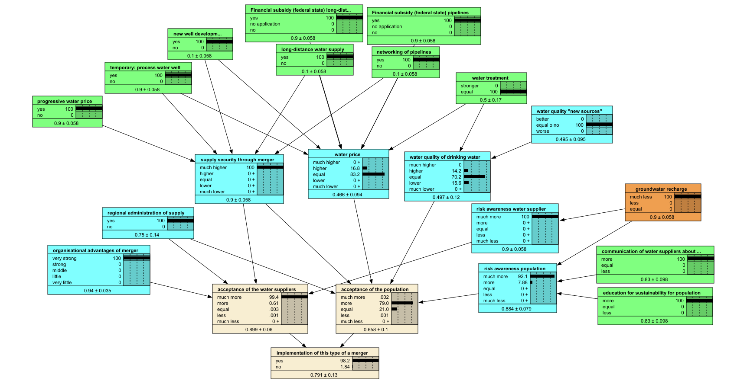
Sensitivity Analysis Structure Sensitivity
The standard Bayesian Belief Network is WS5 (red square).
If a node is deleted…
If nodes are added…
Parameter Sensitivity …
Overview
Background
Bayesian Belief Network
Evaluation
Sensitivity Analysis
Conclusions

Slide 31
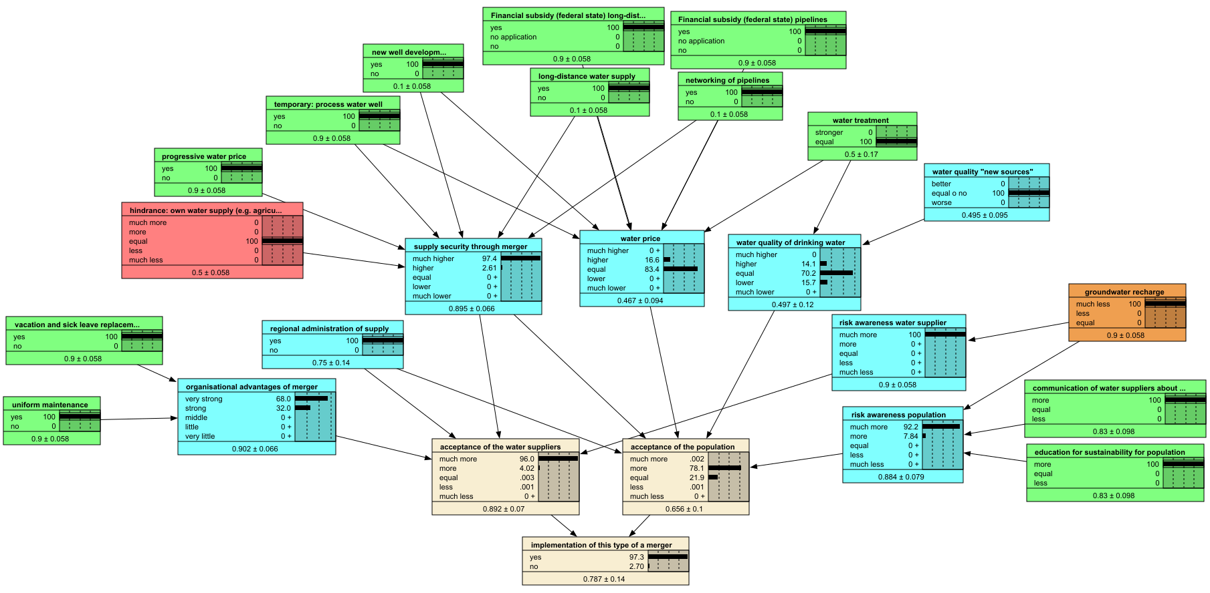
Sensitivity Analysis Structure Sensitivity
The standard Bayesian Belief Network is WS5 (red square).
If a node is deleted…
If nodes are added…
Parameter Sensitivity …
Overview
Background
Bayesian Belief Network
Evaluation
Sensitivity Analysis
Conclusions

Slide 32
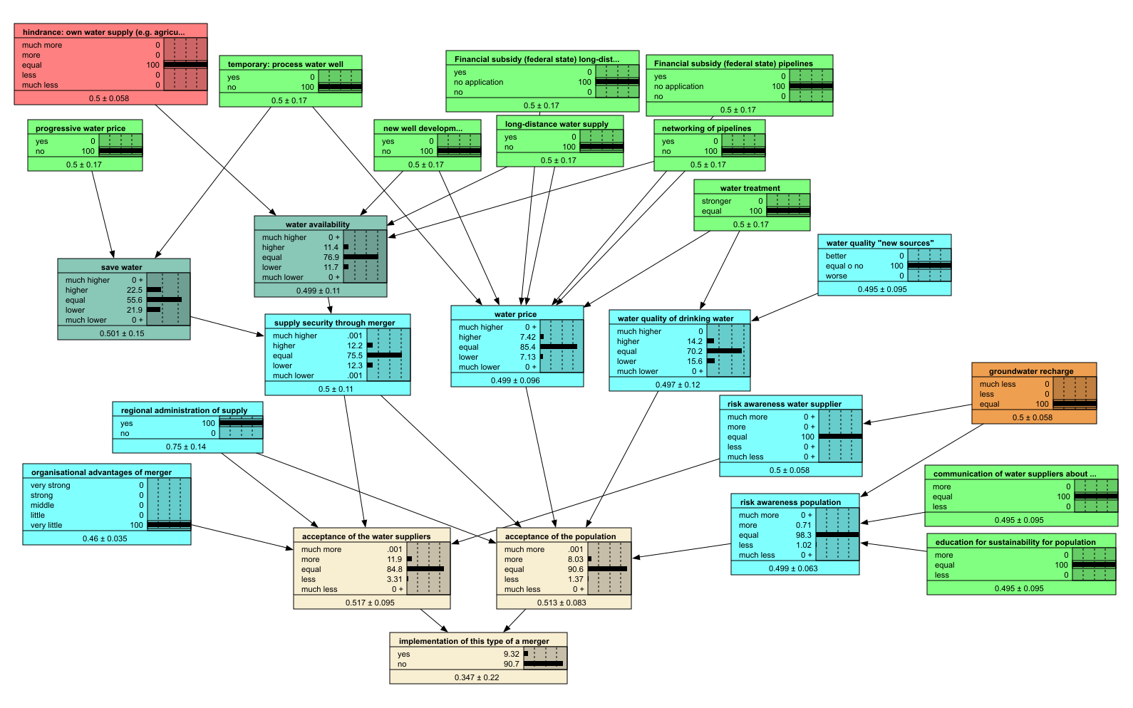
Sensitivity Analysis Structure Sensitivity
The standard Bayesian Belief Network is WS5 (red square).
If a node is deleted…
If nodes are added…
Parameter Sensitivity …
Overview
Background
Bayesian Belief Network
Evaluation
Sensitivity Analysis
Conclusions

Slide 33
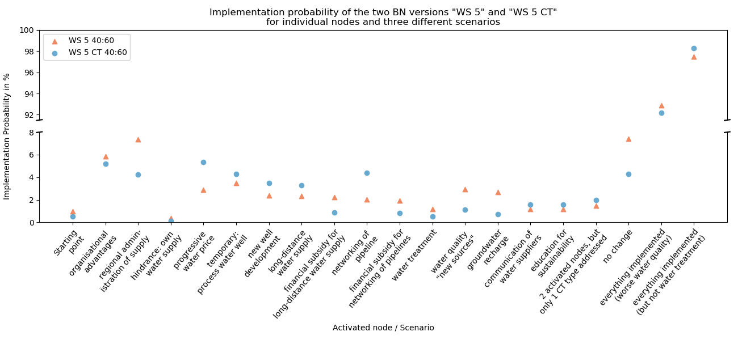
Sensitivity Analysis Structure Sensitivity
The implementation probabilities calculated by “WS 5 CT” are higher than “WS 5”, when nodes are activated that influence the Cultural Theory (CT)-node.
Overview
Background
Bayesian Belief Network
Evaluation
Sensitivity Analysis
Conclusions

Slide 34
Sensitivity Analysis Structure Sensitivity
The sociologists in the project KlimaRhön conducted research on the Cultural Theory (CT), which implies that different measures address different types of people. According to the Cultural Theory, there are four types of people, namely hierarchical, egalitarian, individualistic, and fatalistic, who prefer different strategies. The more types are addressed by measure(s), the more clumsy is a solution and the more implementable.⁸
⁸Verweij et al., 2006
The implementation probabilities calculated by “WS 5 CT” are higher than “WS 5”, when nodes are activated that influence the Cultural Theory (CT)-node.
Overview
Background
Bayesian Belief Network
Evaluation
Sensitivity Analysis
Conclusions

Slide 35
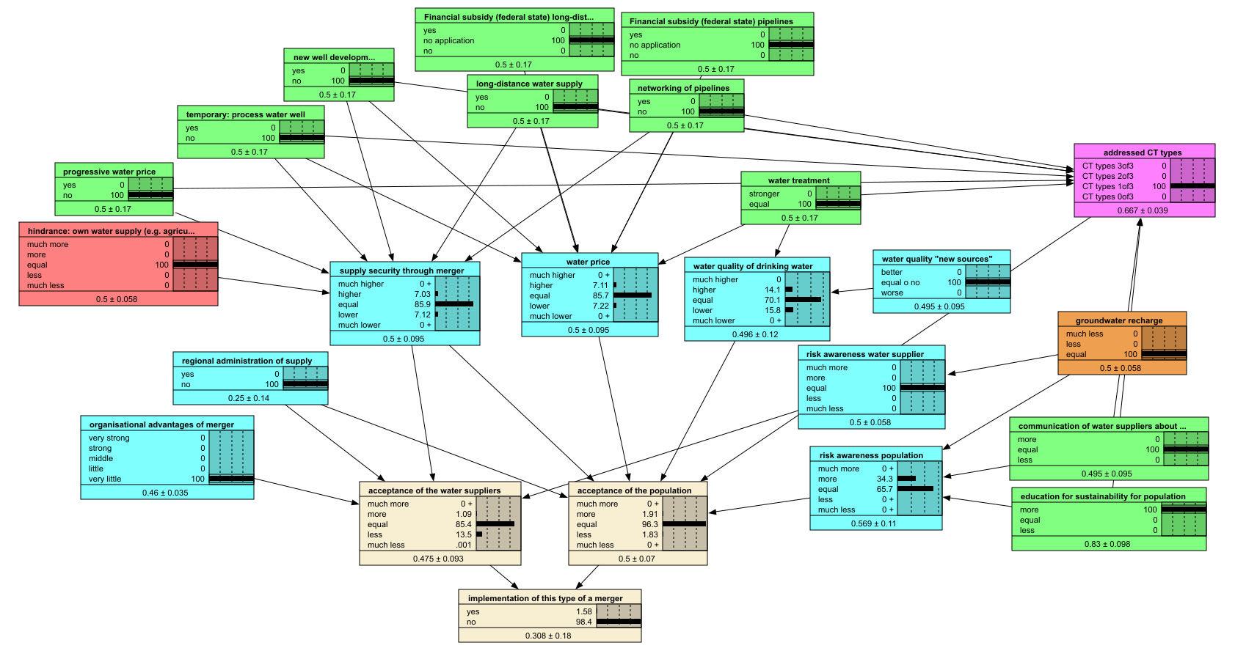
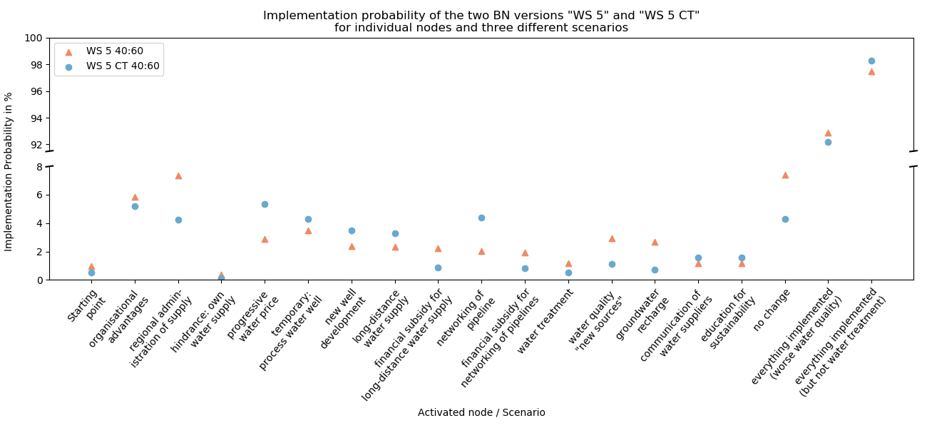
Sensitivity Analysis Structure Sensitivity
Overview
Background
Bayesian Belief Network
Evaluation
Sensitivity Analysis
Conclusions

Slide 36
Sensitivity Analysis Parameter Sensitivity
The stakeholders identified weights, which were build to conditional probability tables. The implementation probability varies (range of ~15%), depending on which weights (mean weights or individual stakeholder weights) are used.
Overview
Background
Bayesian Belief Network
Evaluation
Sensitivity Analysis
Conclusions

