Slide 1


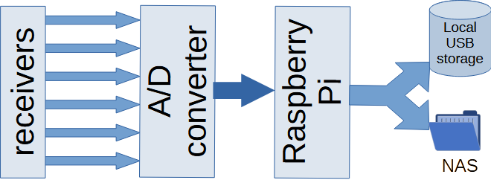
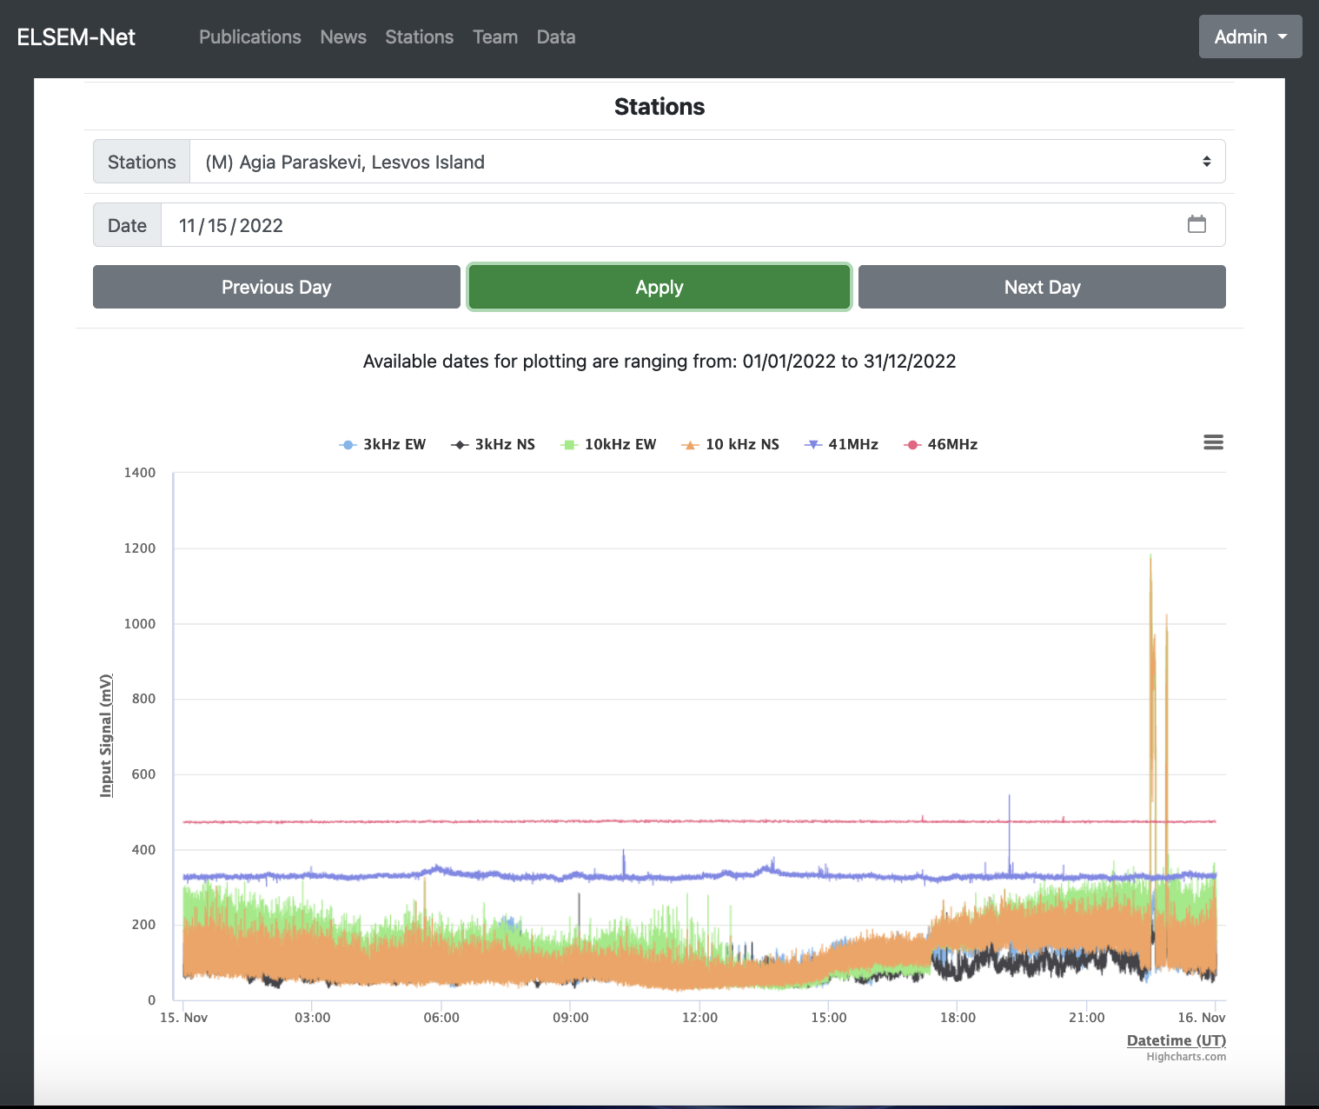
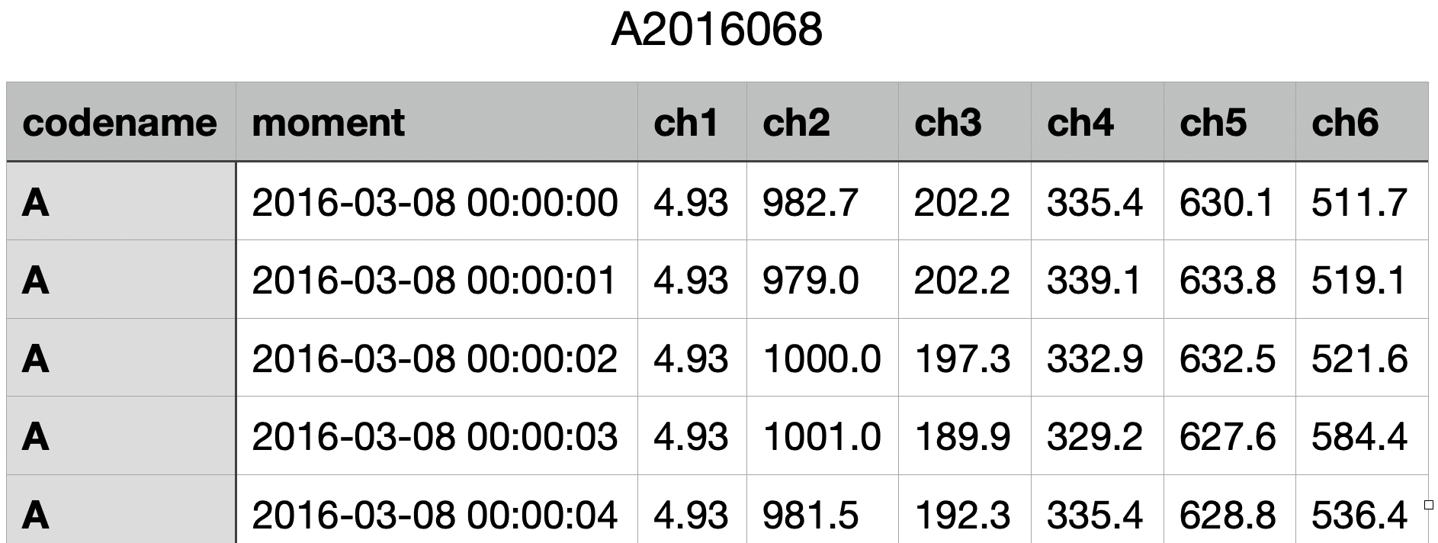

New features of the ELSEM-Net electromagnetic monitoring stations network and analysis of recent data associated with strong earthquakes.
Dimitrios Z. Politis, Stelios M. Potirakis, Philopimin Malkotsis, Nikolaos Papadopoulos, Dionysios Dimakos, Michael Exarchos, Efstratios Liadopoulos, Yiannis F. Contoyiannis, Angelos Charitopoulos, Kyriakos Kontakos, Dimitrios Doukakis, Grigorios Koulouras, Nikolaos Melis, and Konstantinos Eftaxias
Abstract
The ELSEM-Net (hELlenic Seismo-ElectroMagnetics Network, http://elsem-net.uniwa.gr) is a telemetric network of ground-based monitoring stations for the study of fracture-induced electromagnetic emissions. It comprises 11 telemetric stations, spanning all over Greece, and has continuously been operated for almost 30 years. In this paper we present the new, custom designed, instrumentation of the telemetric stations. Specifically, we present both the hardware and the firmware/software used, from antennae to data acquisition and data management. Finally, we present recent recordings prior to significant strong earthquakes (EQs) that have happened in Greece, as well as the obtained analysis results, using nonlinear time series analysis methods, indicating that the acquired signals embed important features associated with the impending EQ.
2. The standard recording system of a typical station
Comparing simultaneously acquired signals by a legacy (Campbell CR10X) datalogger and the new Raspberry Pi-based datalogger:
4. Analysis of MHz data prior to recent EQs
Architecture:
A new Raspberry Pi-based datalogger:
Besides a time shift, due to the poorly synchronized internal clock of the legacy datalogger, and the better accuracy of the new datalogger, the two recordings are practically identical.
1. The ELSEM-Net network
3. Web (http://elsem-net.uniwa.gr) data access and new form of daily files
Each station has four small loop antennas and two λ/2 electric dipole antennas which captures the kHz and MHz signals, respectively.
The MHz and kHz ELSEM-Net receivers’ output voltage signal lies in the range 0V – 2V.
The new datalogger can record up to 8 single-ended analog inputs (currently, only 6 used in ELSEM-Net stations).
The precision of A/D is 24 bit and it is based on the ADS1256 IC. The digitization of the analog signals is performed with $fs = 1 Hz$.
The new datalogger stores locally the data into daily files by using external USB storage device for data security reasons.
Also, by an appropriate script (written in Python), all previous daily files are once per day transferred from the new datalogger to the NAS device located in ECTLab of UniWA.
A new nonlinear analysis methodology based on SSB (spontaneous symmetry breaking) theory
One possibility is the red and blue excerpt “organized” the 4.9 M_{L} EQ and the green the 3.5 M_{L} EQ .
Another possibility is the green and the blue excerpt “organized” the 4.9 M_{L} EQ and the red the 3.5 M_{L} EQ
1. The ELSEM-Net network
5.Conclusion
This work presents the new features of ELSEM-net by introducing a new Raspberry Pi-based datalogger. Upgrades have also been made in data management, improving accessibility (web download), introducing a new daily files format, while new features such as visualization and preliminary analysis results are available in a specially designed web platform. Finally, analysis of MHz recordings reveals the presence of SSB during the preparation of two recent EQs (one small and one medium magnitude EQ) .
11 telemetric stations spanned all over Greece.
Data end-up to two locations in Athens (Greece): (a) (for legacy dataloggers) at the National Observatory of Athens, (b) (for new Raspberry Pi-based dataloggers) at the University of West Attica (ECTLab/UniWA).
All data are finally stored at a NAS device in ECTLab.
K. Eftaxias, S. M. Potirakis and Y. Contoyiannis (2018). Meas. App.
Y. Contoyiannis and S. M. Potirakis (2018). J. Stat. Mech., 083208

