Slide 1
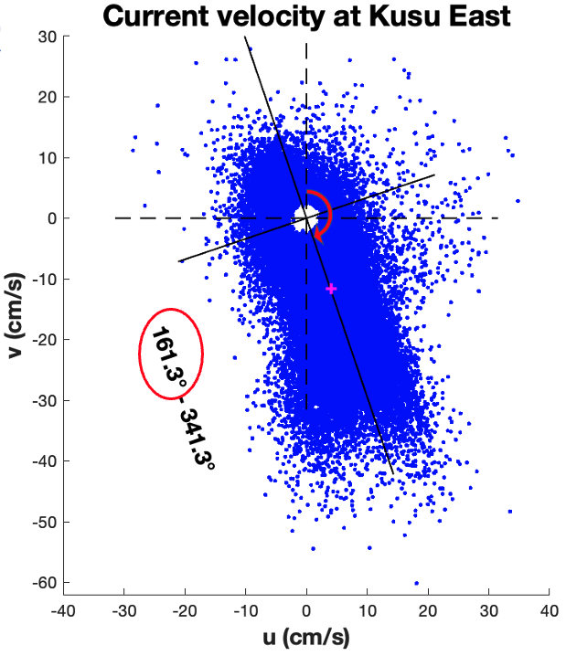
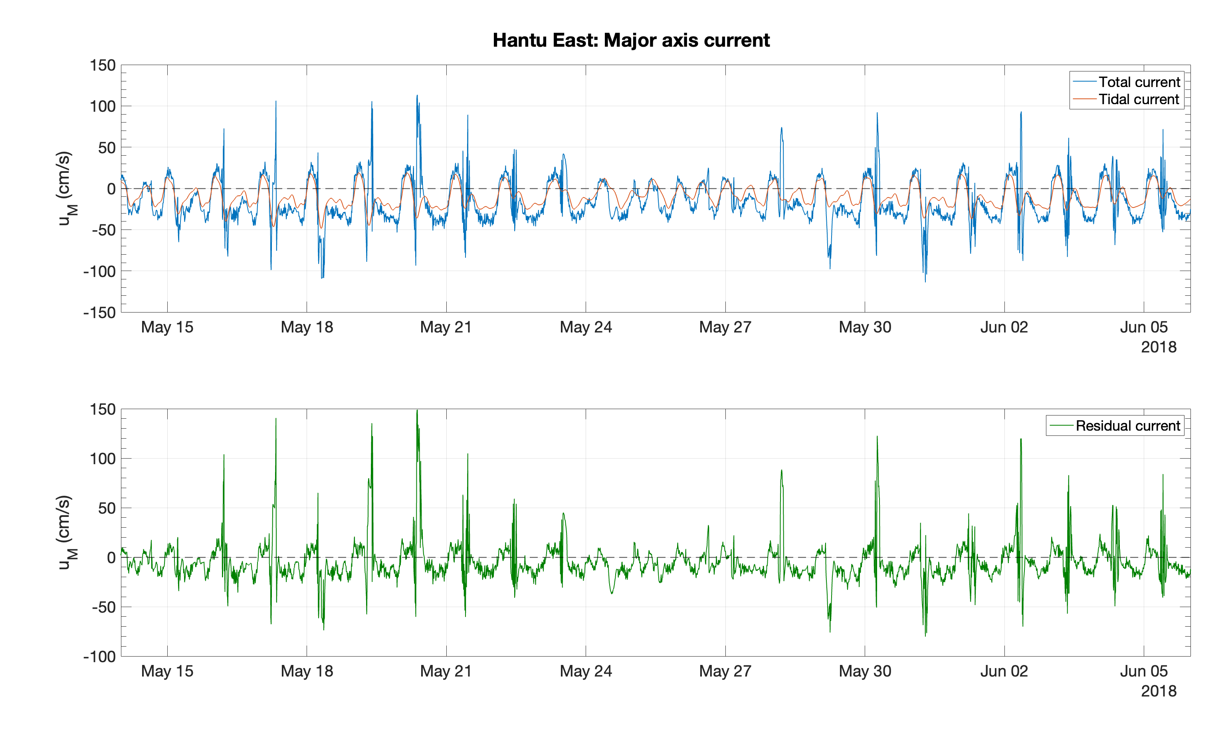
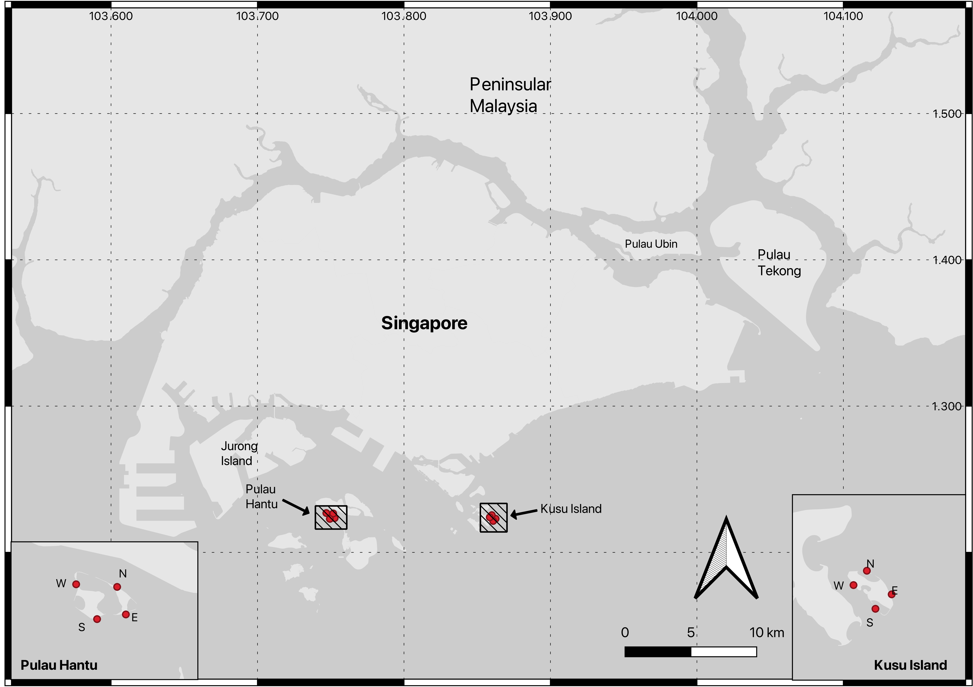
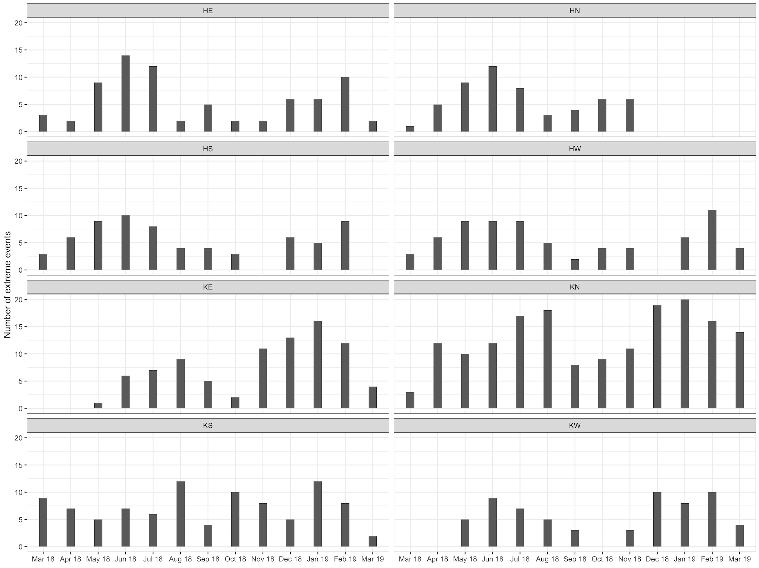
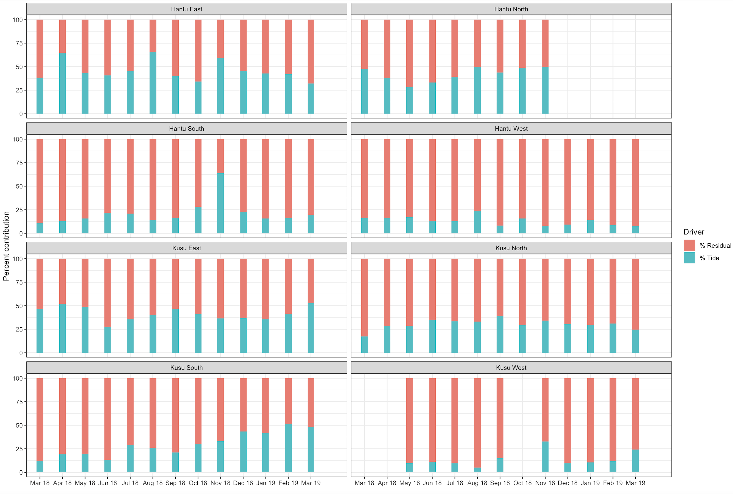
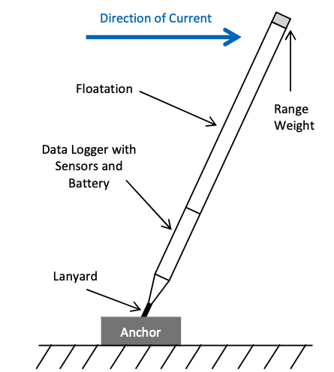
Coastal Currents and their Extremes in Singapore
Jun Yu Puah^{*1}, David Lallemant^{1,2}, Ivan Haigh³, Kyle Morgan^{1,2}, Dongju Peng², Adam Switzer^{1,2}
¹Asian School of the Environment, Nanyang Technological University, Singapore | ²Earth Observatory of Singapore, Nanyang Technological University, Singapore | ³National Oceanography Centre Southampton, University of Southampton, Southampton, UK
Importance of extreme currents
Research question
Data collection
Harmonic Analysis
Regression of residual currents on winds
Predicting extreme currents requires a thorough analysis of all individual drivers
Practical applications include: public safety, marine engineering, coral ecosystems, sediment transport
Principal component analysis (PCA) first applied to total currents (Fig 2).
Tidal current and residual current obtained using MATLAB Utide (Fig 3) (Codiga, 2011).
n_{total} = n_{tidal} + n_{residual}
Velocities are then transformed to major and minor axes components
Overall, tides account for about 13-49% of total current variance across all sites (Table 1).
Seiche: a standing wave in a body of water usually caused by meteorological effects
Characterised by sudden high-frequency oscillations of considerably high amplitudes
Duration can last from minutes to days
10m northward and eastward wind velocities obtained from ERA5 Reanalysis dataset.
u = u₀ + aU + bV + 𝜺
Correlation between observed and regressed residual current weak but significant.
What are the drivers and trends of extreme surface currents in Singapore?
Table 1. Model coefficients, correlation, R² (proportion of variance in residual current explained by winds) for each site are shown. Tidal variance for each site is also listed here.
Fig 2: Scatterplot of northward against eastward total current at Kusu East. The major and minor axes obtained from PCA are also shown. The pink cross represents the mean current velocity. The direction of the current is measured clockwise from north.
Fig 3: 3-week plot of the unfiltered major axis total current velocity at Hantu East in May 2018, decomposed into tidal and residual components using MATLAB Utide (Codiga, 2011).
Drivers and trends of extreme events
Key takeaways
Extreme event definition: residual current velocity of any axis component exceeding the threshold of 99% quantile.
Each extreme event lasts at least 1 hour, and separated by at least 12 hours to prevent duplicate counting
Southwest monsoon: during June to September; Northeast monsoon: during December to March
Tides contribute more to extreme events in both the North and East sides of the two islands (Fig 5, Table 1).
Number of extreme events seem to increase during the monsoon seasons (Fig 4), and so does the percentage residual contribution (Fig 5).
This could suggest the importance of monsoonal winds in driving extreme currents.
However, winds are shown to be generally weakly correlated with residual current velocity (Table 1).
Analyzing extreme currents in Singapore remains complex since many drivers besides tides and winds may be at play, such as surface air pressure, wave set-up, and the local bathymetry.
Further analysis on the importance of seiching could be done as well, given its prominence at several sites (Fig 3).
4 sites each in Pulau Hantu and Kusu Island: 2 offshore islands in the Singapore Strait.
The Singapore Strait connects the Malacca Strait and the South China Sea. It experiences a mixed semidiurnal tidal regime.
Bearing, northward and eastward current velocities measured at 10-minute intervals.
Data collected from Mar 2018 to Mar 2019 (Dec 2018 for Hantu North) using a tilt current meter (TCM) (Fig 1).
Total currents found to be generally rectilinear and flow along the coastlines.
www.earthobservatory.sg
Fig 1: Schematic of a TCM from Lowell Instruments. TCMs operate by the drag-tilt principle, where the meter tilts in the direction of the current. Data was recorded at 8Hz for 15 seconds per minute and averaged (Lowell et al., 2015).
Fig 4: Monthly number of extreme events over the 1-year time period for all sites. The distribution appears to be bimodal across all sites, peaking during the monsoon seasons.
Fig 5: Mean percentage of tidal and residual contributions to all the extreme events that occurred within each month. The instantaneous breakdown of individual contributions for each event was recorded before calculating the mean.
Acknowledgement: This research/project is supported by the National Research Foundation, Singapore, the Ministry of National Development, Singapore, and National Environment Agency, Singapore, under the National Sea Level Programme initiative as part of the Urban Solutions & Sustainability – Integration Fund (Award No. USS-IF-2020-2).
Disclaimer: Any opinions, findings and conclusions or recommendations expressed in this material are those of the author(s) and do not reflect the views of National Research Foundation, Singapore, the Ministry of National Development, Singapore, and National Environmental Agency, Singapore.
References:
Codiga, D.L., 2011. Unified tidal analysis and prediction using the UTide Matlab functions.
Lowell, N.S., Walsh, D.R. and Pohlman, J.W., 2015, March. A Comparison of tilt current meters and an acoustic doppler current meter in Vineyard Sound, Massachusetts. In 2015 IEEE/OES Eleveth Current, Waves and Turbulence Measurement (CWTM) (pp. 1-7). IEEE.
Contact Jun Yu at A210012@e.ntu.edu.sg
Notes:
Recommended Typeface and Font Size
Header <Myriad Pro Bold ± 65 pt>
Investigators, Collaborators, etc. <Myriad Pro Regular ± 35 pt>
Abstract <Myriad Pro Bold Italic ± 43 pt>
Subhead <Myriad Pro Bold ± 40 pt>
Body Text <Myriad Pro Regular ± 18 pt>
Caption <Myriad Pro Italic ± 15 pt>
Note <Myriad Pro Italic ± 16 pt>
Acknowledgements, bibliography, etc. <Myriad Pro Regular ± 28 pt>
Recommended Minimum Image Resolution
Acutal size of the image on the poster: at least 150 dpi

