Slide 1
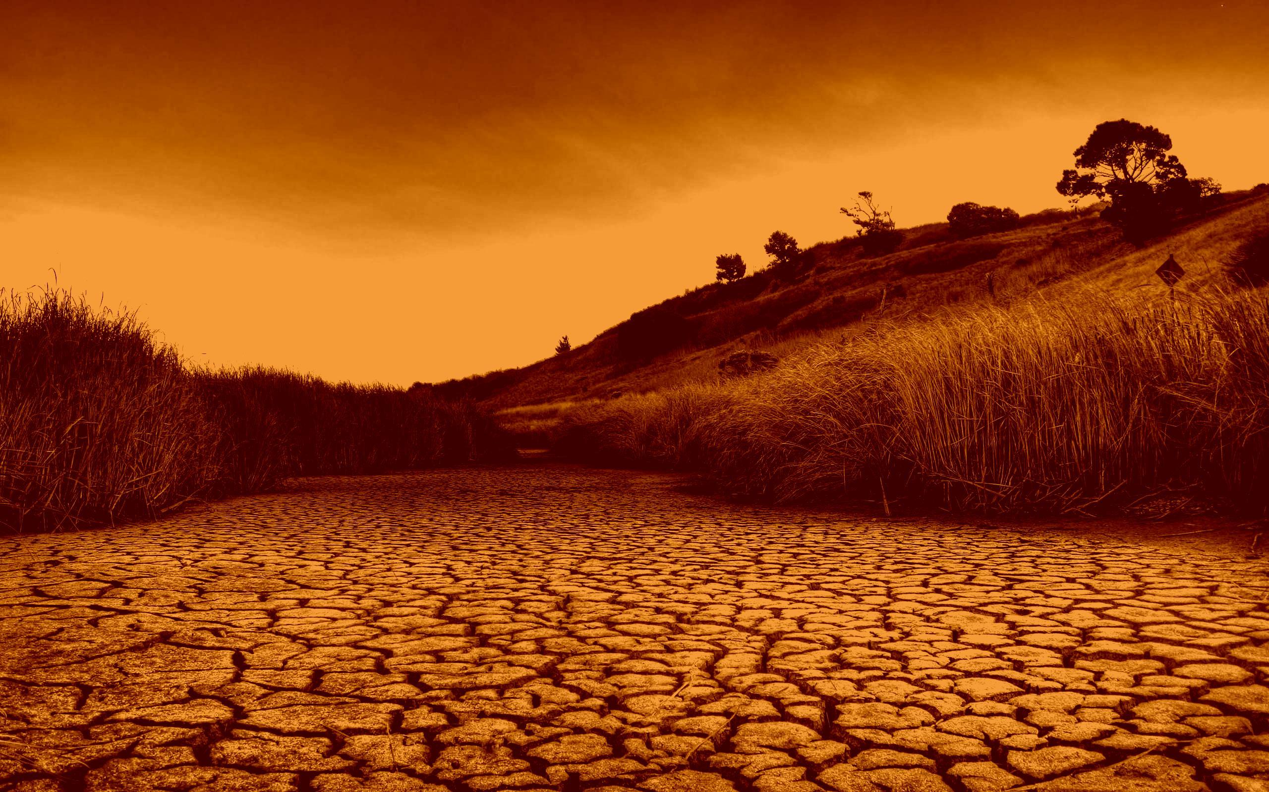


Towards Hazard, Vulnerability, and Resilience-based Assessment of Spatial-temporal Trends, Patterns, and Disparities in Drought Risk
SAJJAD Muhammad (PhD)
Res. Asst. Prof.
Environmental & Urban Systems,
@ Department of Geography & Centre for Geo-computation Studies,
Hong Kong Baptist University, Hong Kong SAR
Vienna, Austria 23-28 April 2023

Slide 2
Will talk about
01
Introduction and Background
Setting the case
02
Research Framework
Materials, Methods, Tools
03
Key Findings and Discussion
Results and their Implications
04
Take Home Message
Conclusions and Recommendations

Slide 3
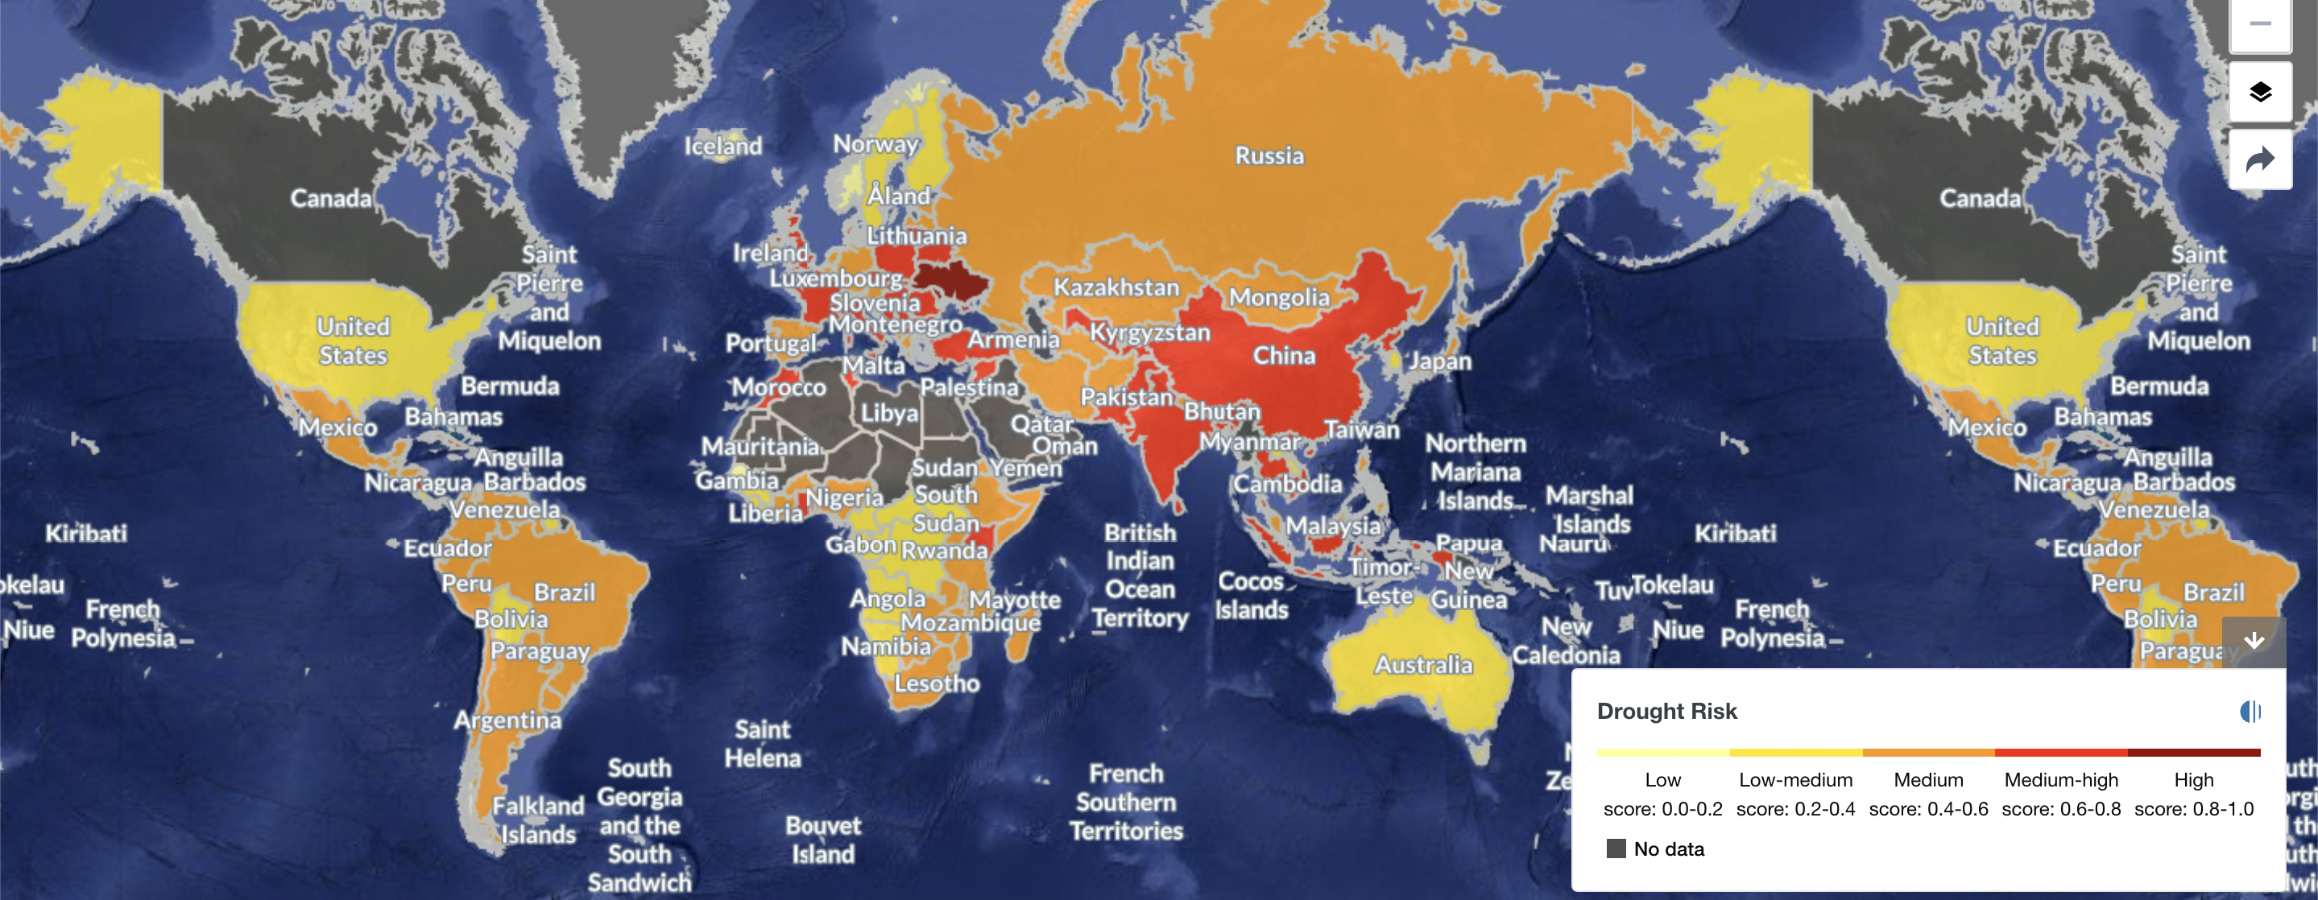

Introduction and Background
02
03
04
01
1900 to 2019, ~3 billion people have been affected by droughts
USD1.75 × 10¹² economic damages and ~11 million deaths (EMDAT, 2020)
Under Climate Change, droughts are further expected to worsen in developing countries

Slide 4
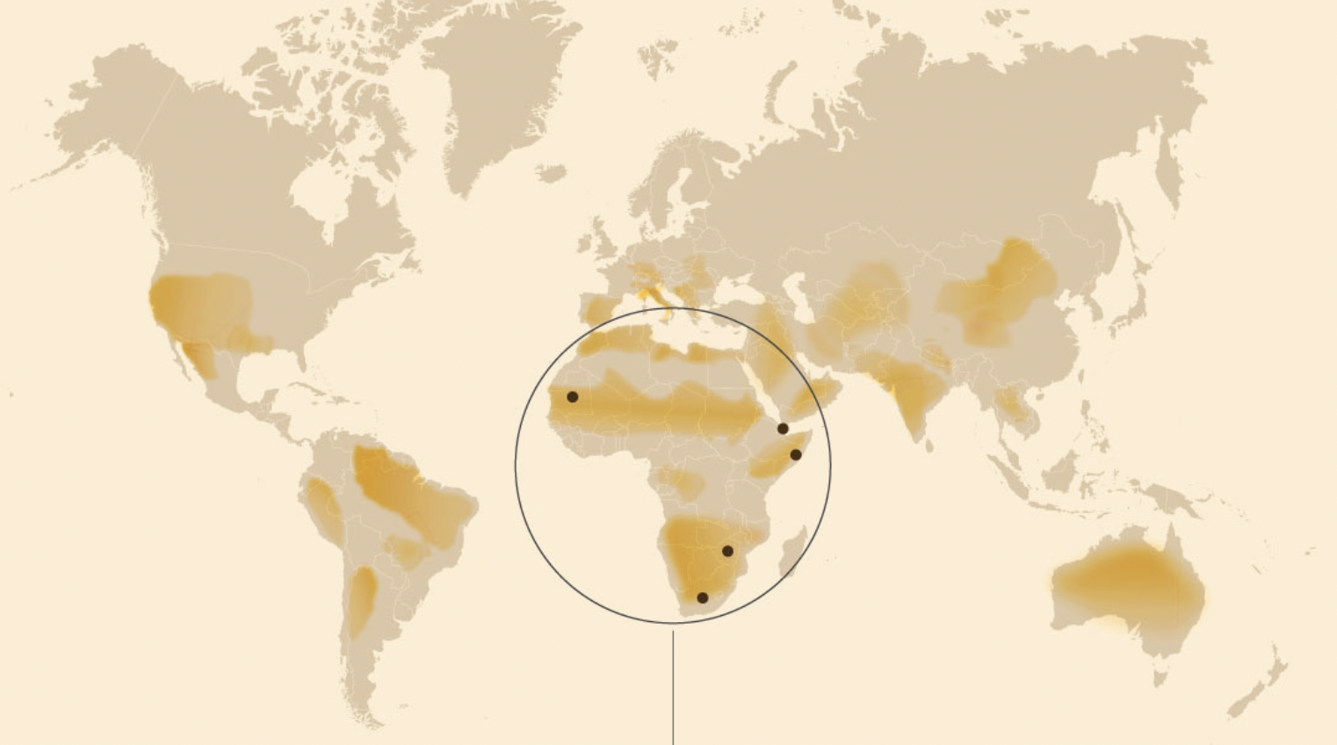
Introduction and Background
02
03
04
Since 2000, number, duration of droughts have risen 29%
More than 75% of world’s population is expected to be affected by 2050 (WMO)
The major emphasis of related literature has been “drought as a hazard”
What about the vulnerabilities and capabilities/resilience of communities facing droughts?
01
Regions Effected by Droughts (2020-2022)

Slide 5
Introduction and Background
02
03
04
Corrective decision-making, prioritization, and resources allocation requires reliable drought risk information
Considering Hazard in integration with vulnerabilities and resilience can help
01
Drought Risk
Hazard
Vulnerability
Resilience

Slide 6
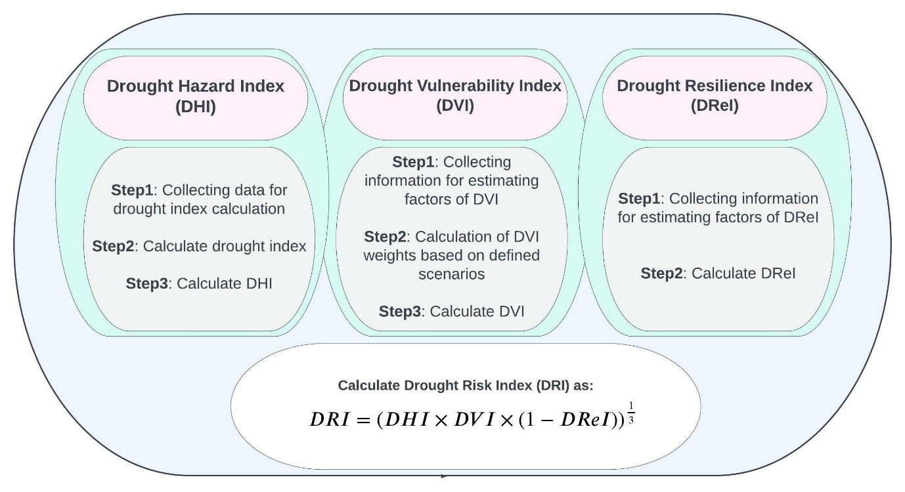
Research Framework
01
03
04
02
Drought (2000-2020)
Overall
Decade 1 (D1)
Decade 2 (D2)
Drought
3 Month
6 Month

Slide 7
Research Framework
01
03
04
02
Hazard
Standardized Precipitation Evapotranspiration Index (SPEI)
Vulnerability
Tendency of an area to disproportionally get affected by droughts
Resilience
Inherent characteristic of communities to deal with and bounce back from disasters

Slide 8
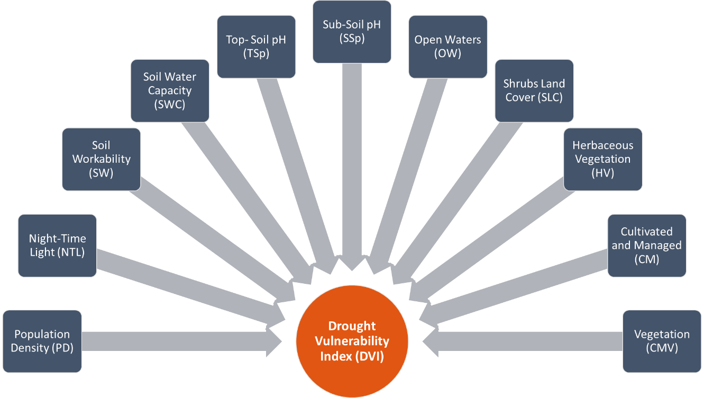
Research Framework
01
03
04
02

Slide 9
Research Framework
01
03
04
02

Slide 10
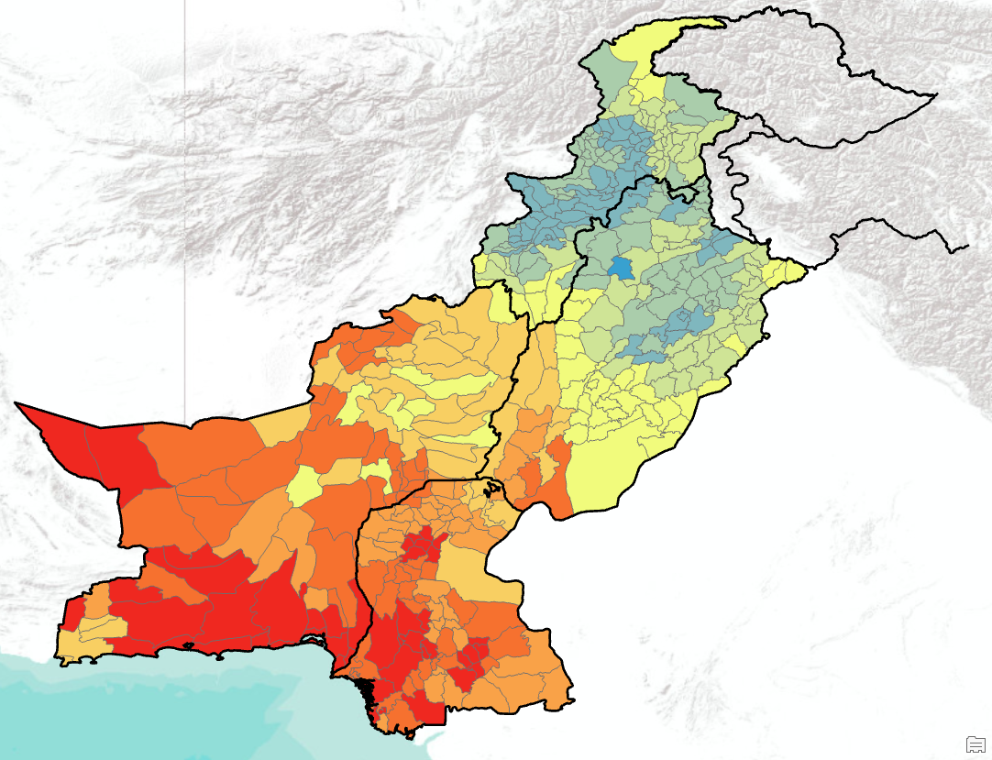
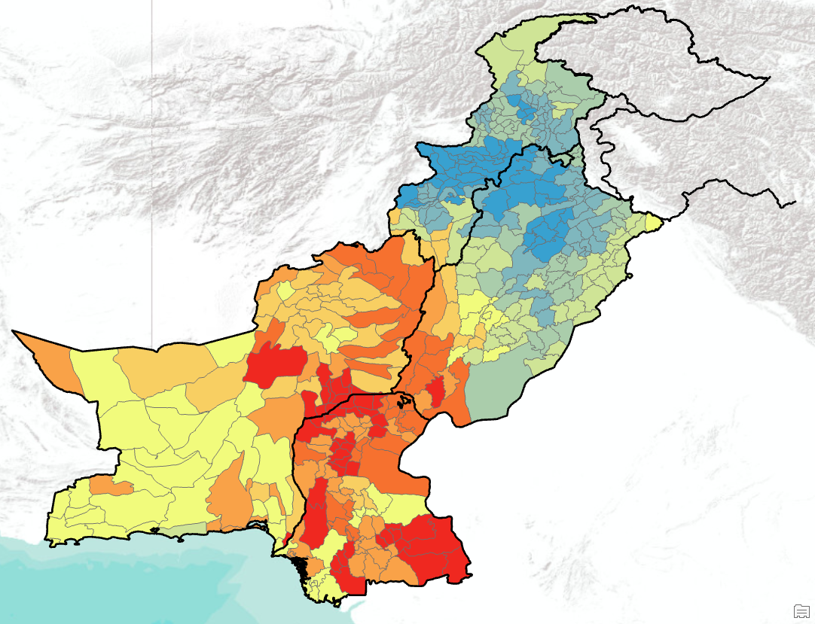
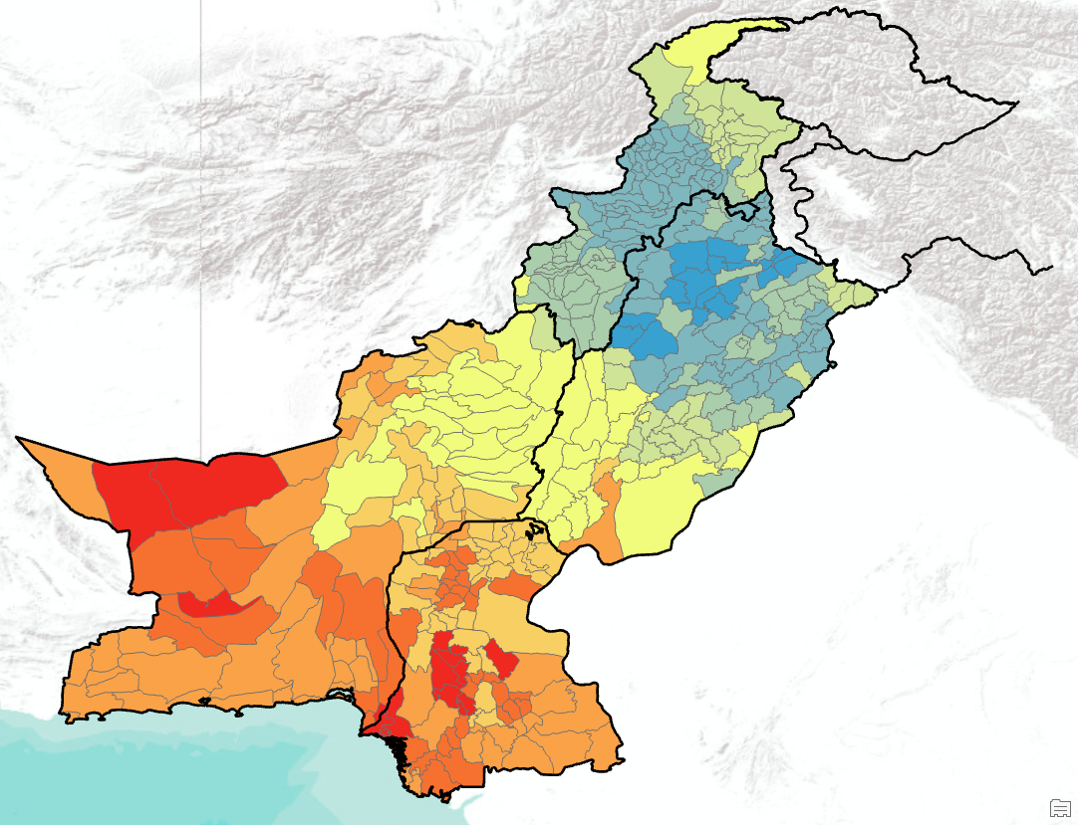
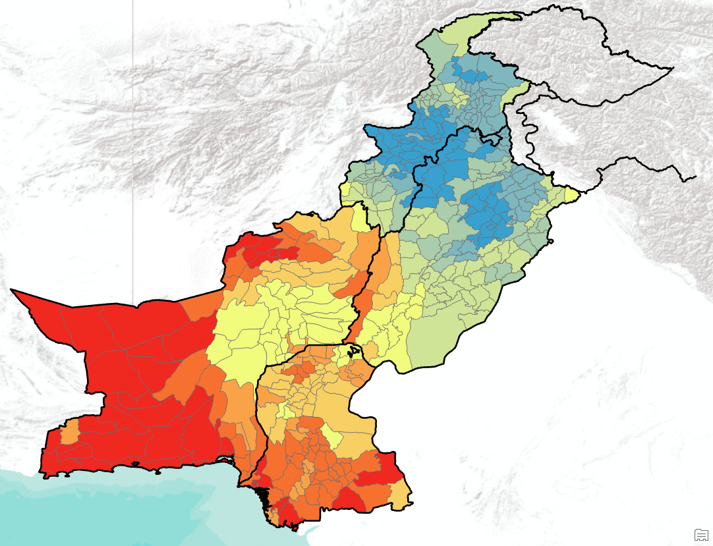
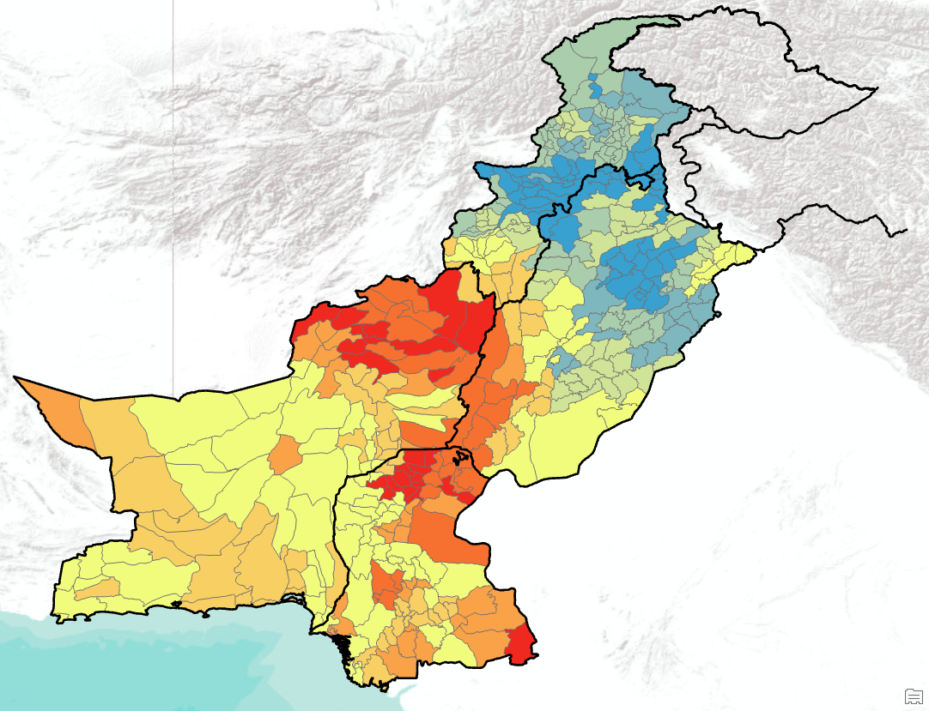
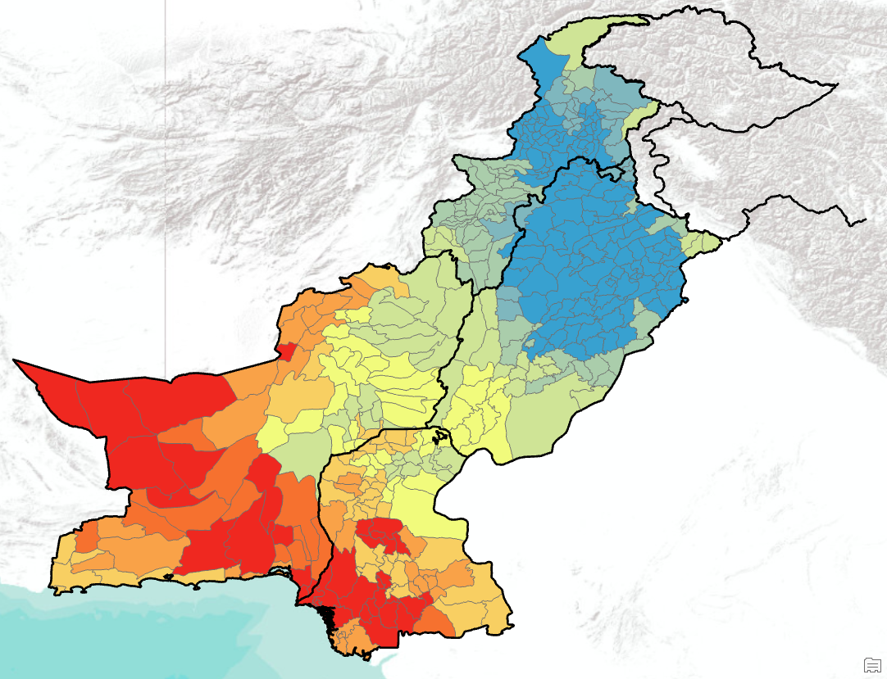


Key Findings and Discussion
01
02
04
03
T03
D103
D203
T06
D106
D206
Drought Hazard Index
0
0.5
1.0

Slide 11
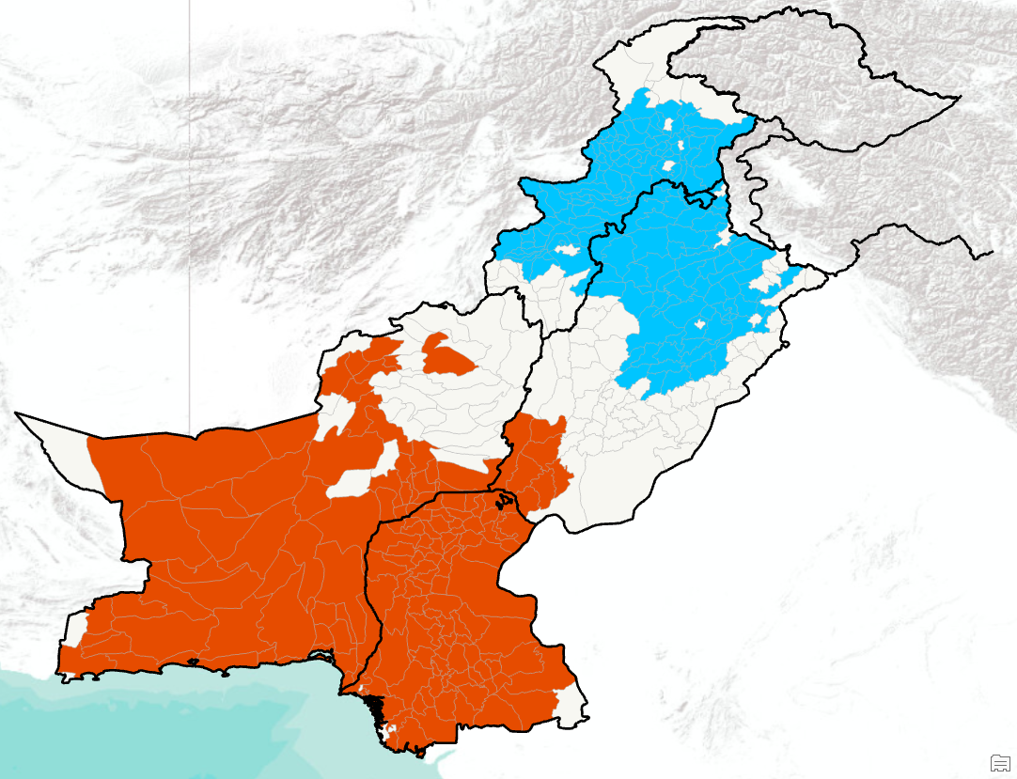
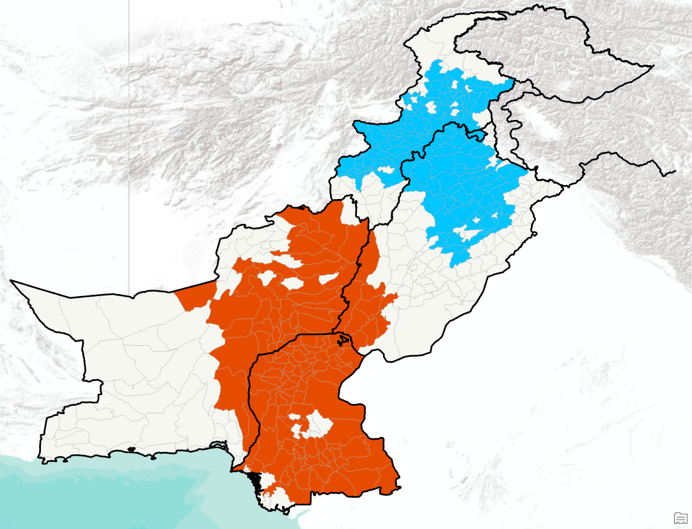
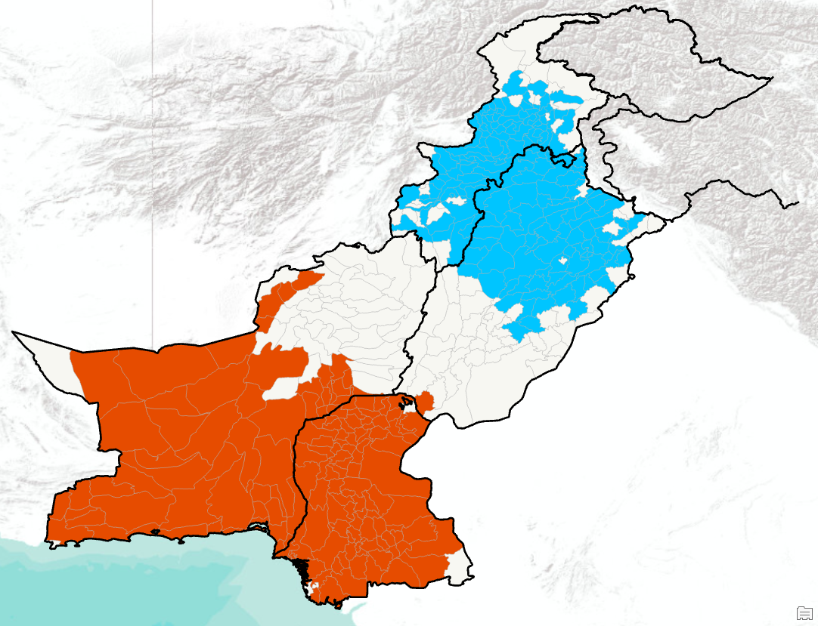
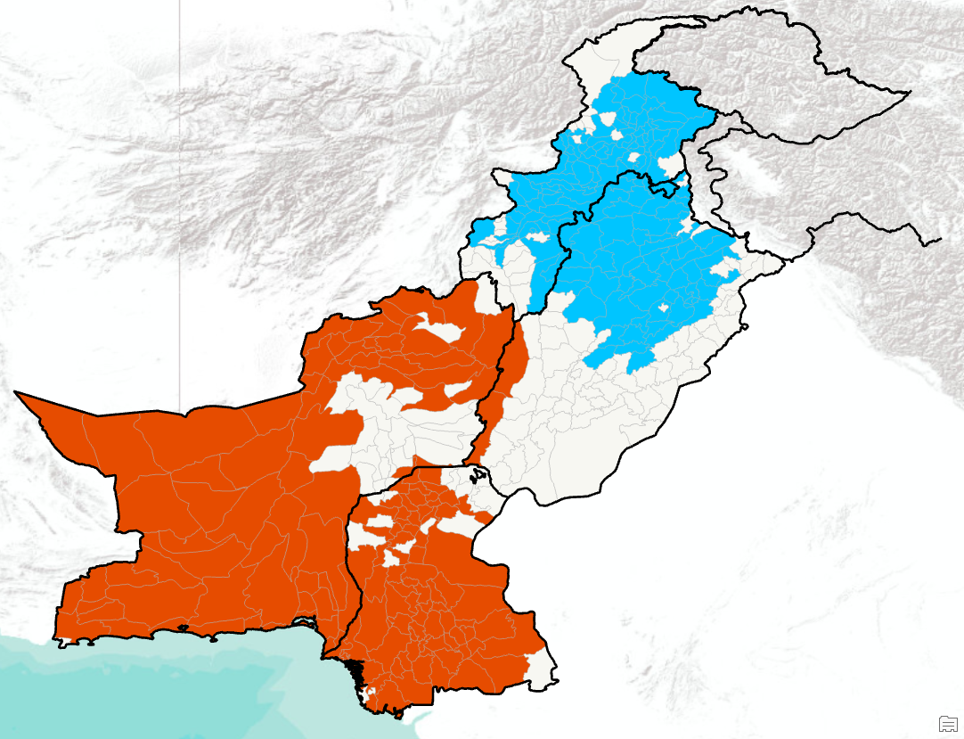
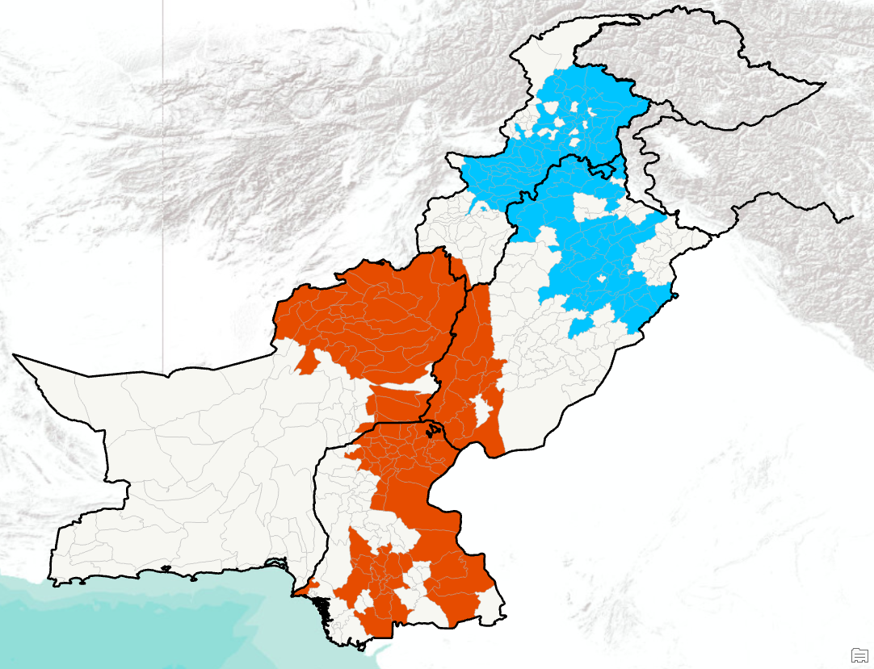
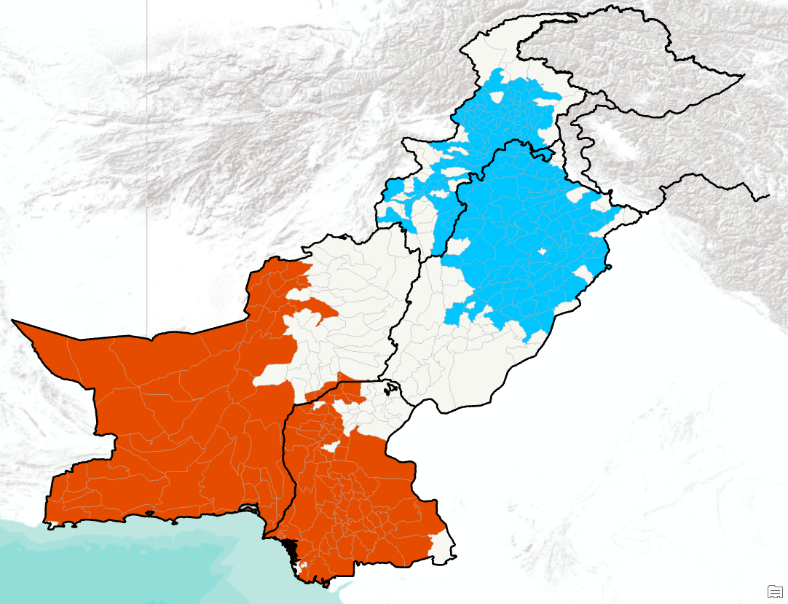
Key Findings and Discussion
04
01
02
T03
D103
D203
03
T06
D106
D206
DHI LISA
High-High Cluster
Clusters↓\ DHI → | T03 | T06 | D103 | D106 | D203 | D206
Cold-spots (low DHI) | 165 (38%) | 147 (34%) | 131 (30%) | 116 (27%) | 168 (39%) | 166 (38%)
Hotspots (high DHI) | 160 (37%) | 146 (33.72%) | 131 (30%) | 99 (23%) | 149 (34%) | 130 (30%)
Low-Low Cluster
Not Significant

Slide 12
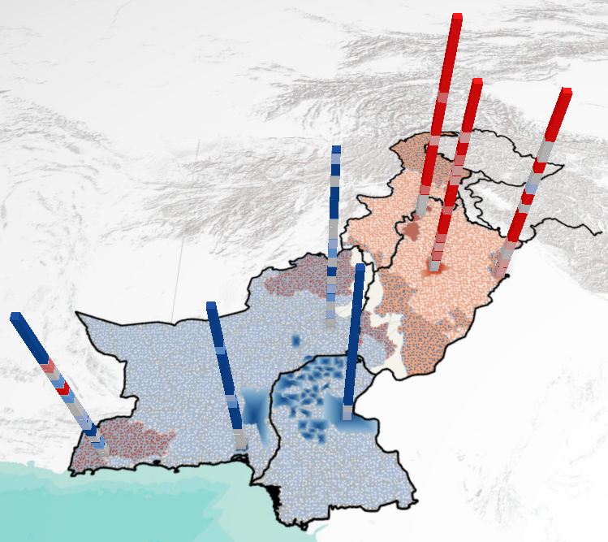
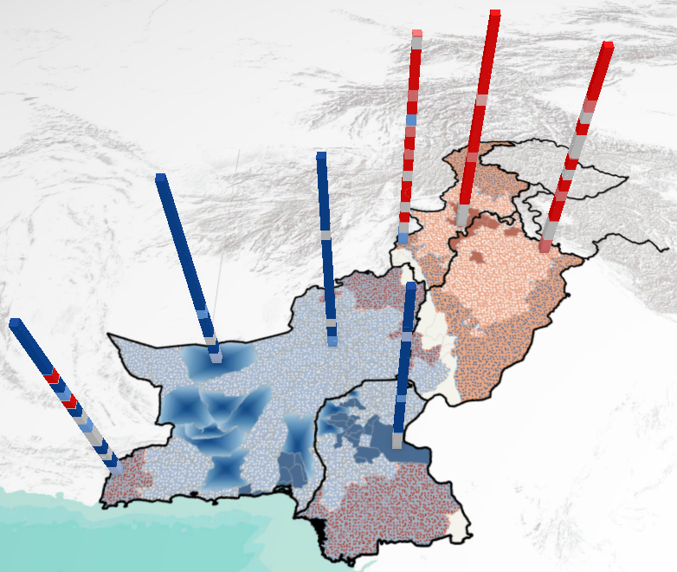
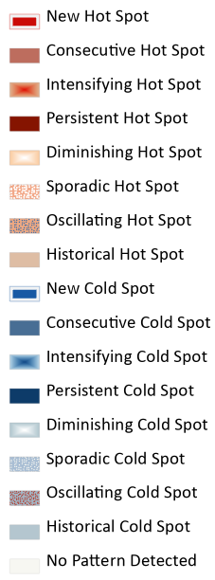
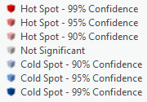
Key Findings and Discussion
04
01
02
SPEI - 03
03
Base Map Pattern
SPEI - 06
Statistical Significance

Slide 13
Key Findings and Discussion
04
01
02
03
Western regions across Pakistan are relatively more vulnerable to droughts
Most vulnerable province is KPK, followed by Balochistan and Punjab
Northern areas in Punjab are particularly resilient to natural hazards
Least resilient areas mainly belong to Balochistan and Sindh

Slide 14
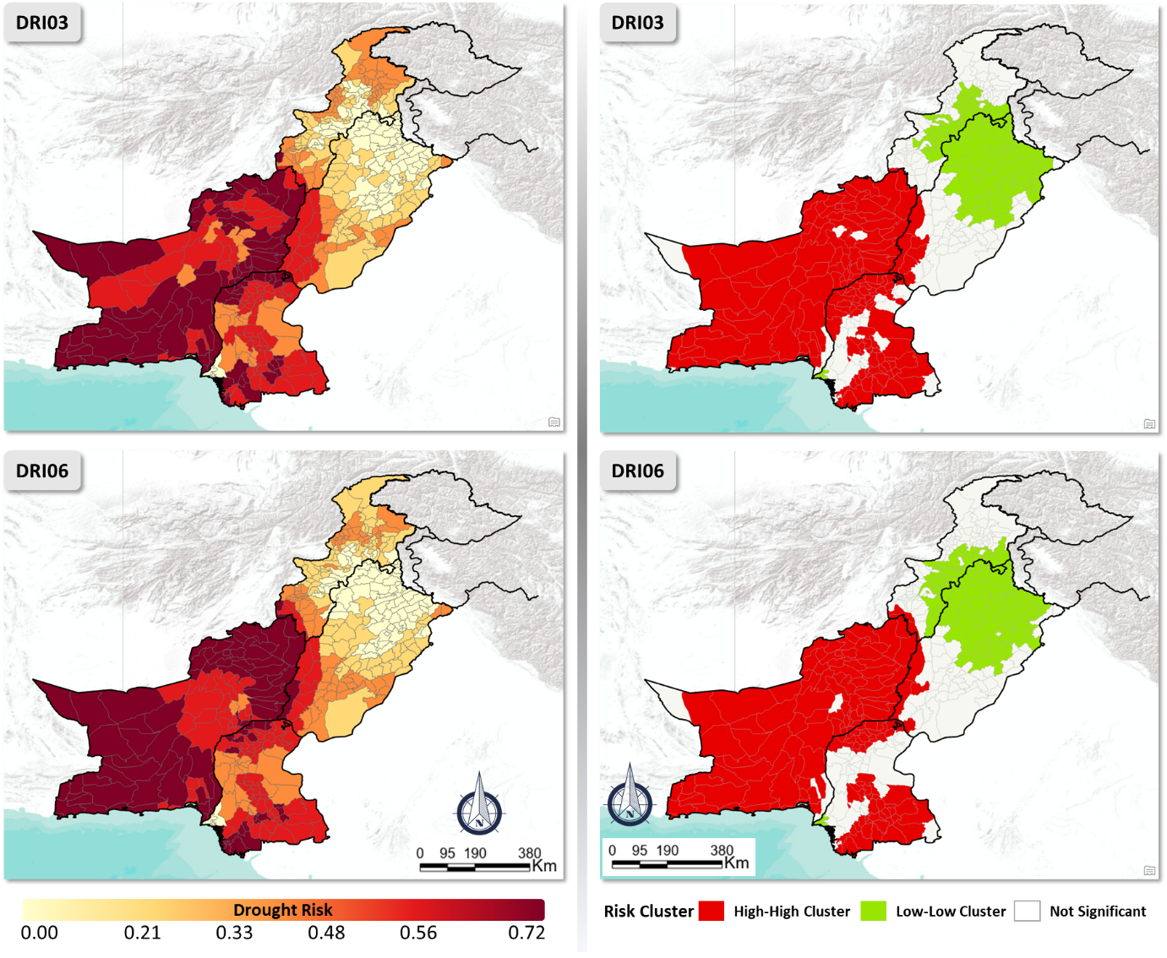
Key Findings and Discussion
04
01
02
03
Drought risk shows considerable geographical heterogeneity
Gradual increase in drought risk from north to south
Regions in southern Pakistan at higher risk of drought impacts
Most of the areas in Balochistan province are identified as high-risk clusters in terms of droughts
~35% areas are hotspots of drought risk in Pakistan

Slide 15
Take Home Message
01
02
03
04
North-south geographical disparity is observed in DHI, while the drought intensities were higher in southern regions
Balochistan and Sindh provinces faced higher drought intensity
There has been a slight increase in the proportion of hot spots in the recent decade

Slide 16
Take Home Message
01
02
03
04
Higher drought risk is dominant in regions with lower resilience, high-vulnerability, and highest drought hazard
While there has been a slight increase in the proportion of hot spots in the recent decade, ~35% regions being the hotspots should be a matter of concern for relevant authorities.
This research comes in handy for decision-making, policy responses, and resource allocation in Pakistan to reduce drought impacts

Slide 17
What next?
01
02
03
04
Climate Change influence on droughts across Pakistan
Localized factors driving drought risks (specific areas to focus)
Provide roadmap for drought mitigation and adaptation at higher resolution and assist local communities for better preparedness

Slide 18







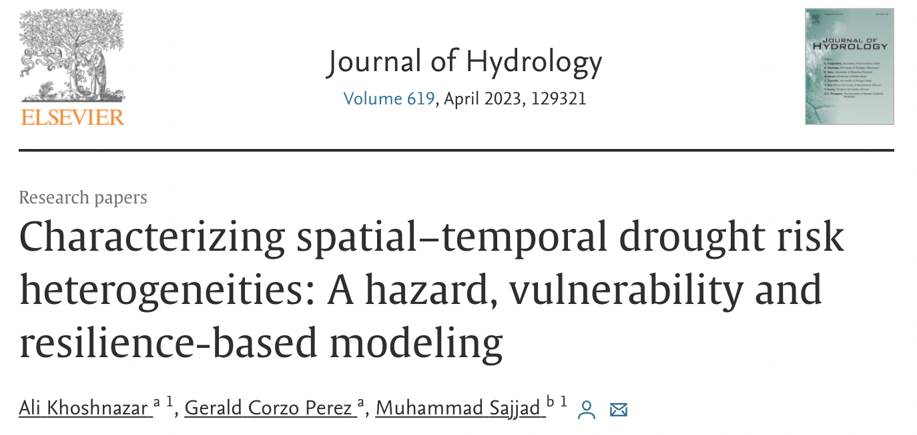
Thank You for Your Attention!
Q&A
Please reach out via:
HK Cell/WhatsApp: +852 56015377
Email: msajjad@hkbu.edu.hk
or mah.sajjad@hotmail.com

