Slide 1
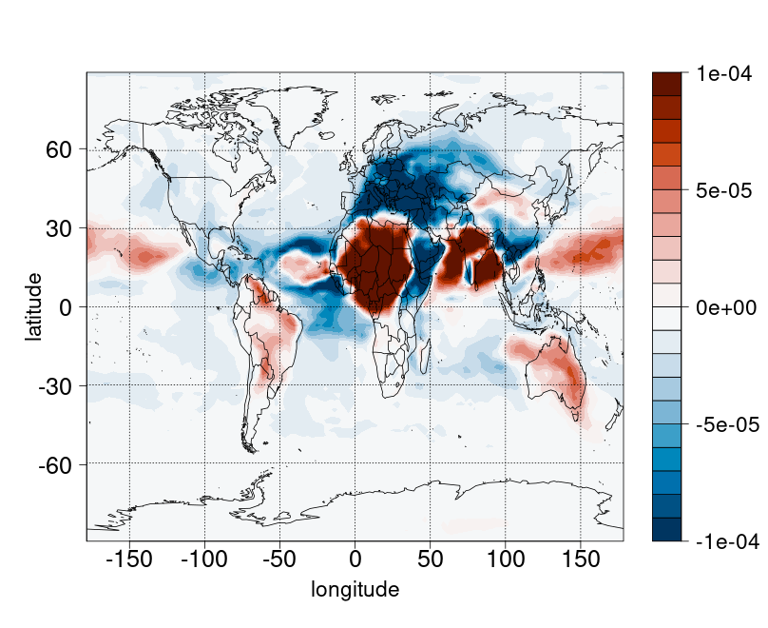
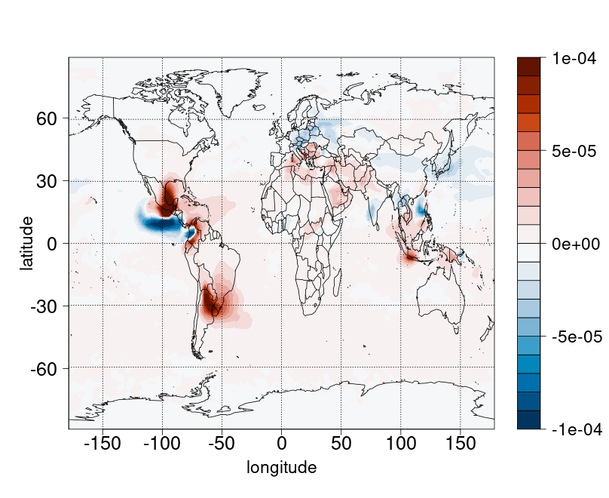
Step 1. TM5 (chemical transport model CTM) PPE solely includes aerosol parameters.
Step 2. EC-Earth (Earth system model) PPE includes aerosol-cloud interactions parameters to investigate their impact on RF.
To overcome the high computational cost of running the PPE, we will develop an emulator. This is a machine learning tool that simulates model outputs, based on outputs from a small number of training runs (Lee et al., 2013).
Difference in aerosol absorption optical thickness at 550m using default scaled emissions of seasalt and SOx in April 2016
Towards understanding the effect of parametric aerosol uncertainty on climate using a chemical transport model perturbed parameter ensemble
Meryem Bouchahmoud¹, Tommi Bergman¹, Christina J. Williamson^{1,2}
¹Finnish Meteorological Institute, Erik Palmenin Aukio 1, 00560 Helsinki, Finland
²Institute for Atmospheric and Earth System Research/Physics, Faculty of Science, University of Helsinki, P.O. Box 64, 00014 Helsinki, Finland
Email: meryem.bouchahmoud@fmi.fi.
LinkedIn: Meryem BOUCHAHMOUD
Perturbed Parameter Ensemble (PPE)
5seasalt-0.2seasalt
Perform multiple runs of the model while varying the aerosol parameters over their range of uncertainty.
Analyze the resulting changes in cloud condensation nuclei and aerosol absorption to understand how parametric uncertainties affect simulated climate.
What causes uncertainty in aerosol radiative forcing?
Aerosol parameters are inputs to climate models. Their uncertainty can cause uncertainty in the model outputs such as radiative forcing (RF).
Parametric aerosol uncertainty is as significant a source of RF uncertainty as inter-model one uncertainty (Lee et al., 2013).
2SOx-0.5SOx
Aerosols are a major cause of uncertainty in global climate models (IPCC,2014)
Figure 3. Difference in ambient aerosol absorption optical thickness at 550nm in April 2016 for emissions of sea-salt (top) and SOx (bottom) scaled up and down by factors of 5 and 2 respectively.
Current preliminary one-at-a-time studies of PPE parameters in TM5 show greater sensitivity of optical thickness to sea-salt emissions than SOx emissions.
Figure 1. Diagram of how aerosol affect climate
Table 1. Select aerosol parameters with their uncertainty ranges to be used in the PPE.
Figure 2. Schematic showing relationship between aerosol parameters, TM5 and EC-Earth
References
Andres, R. J., & Kasgnoc, A. D. (1998). A time-averaged inventory of subaerial volcanic sulfur emissions. J. Geophys. Res. Atmos.
IPCC, 2014: Climate Change 2014: Synthesis Report.
Lee, L. A., Pringle, K. J., Reddington, C. L., Mann, G. W., Stier, P., Spracklen, D. V., Pierce, J. R., & Carslaw, K. S. (2013). The magnitude and causes of uncertainty in global model simulations of cloud condensation nuclei. Atmos. Chem. Physics.
Spiro, P. A., Jacob, D. J., & Logan, J. A. (1992). Global inventory of sulfur emissions with 1°×1° resolution. J. Geophys. Res.
Watson-Parris, D., Williams, A., Deaconu, L., & Stier, P. (2021). Model calibration using ESEm v1.1.0 – an open, scalable Earth system emulator. Geosci. Model Dev.

