Slide 1



The Bow Shock and Magnetosheath Responses to Density Depletion Structures
Xi Lu¹, Antonius Otto¹, Hui Zhang¹, Terry Liu² and Xingran Chen¹
¹Geophysical Institute, University of Alaska Fairbanks, Fairbanks, AK, USA, ²University of California Los Angeles, Los Angeles, CA, USA
The work is supported by NASA award 80NSSC20K15113 and 80NSSC22K0377.
Notes:
The responses present another formation mechanism of hot flow anomalies.

Slide 2
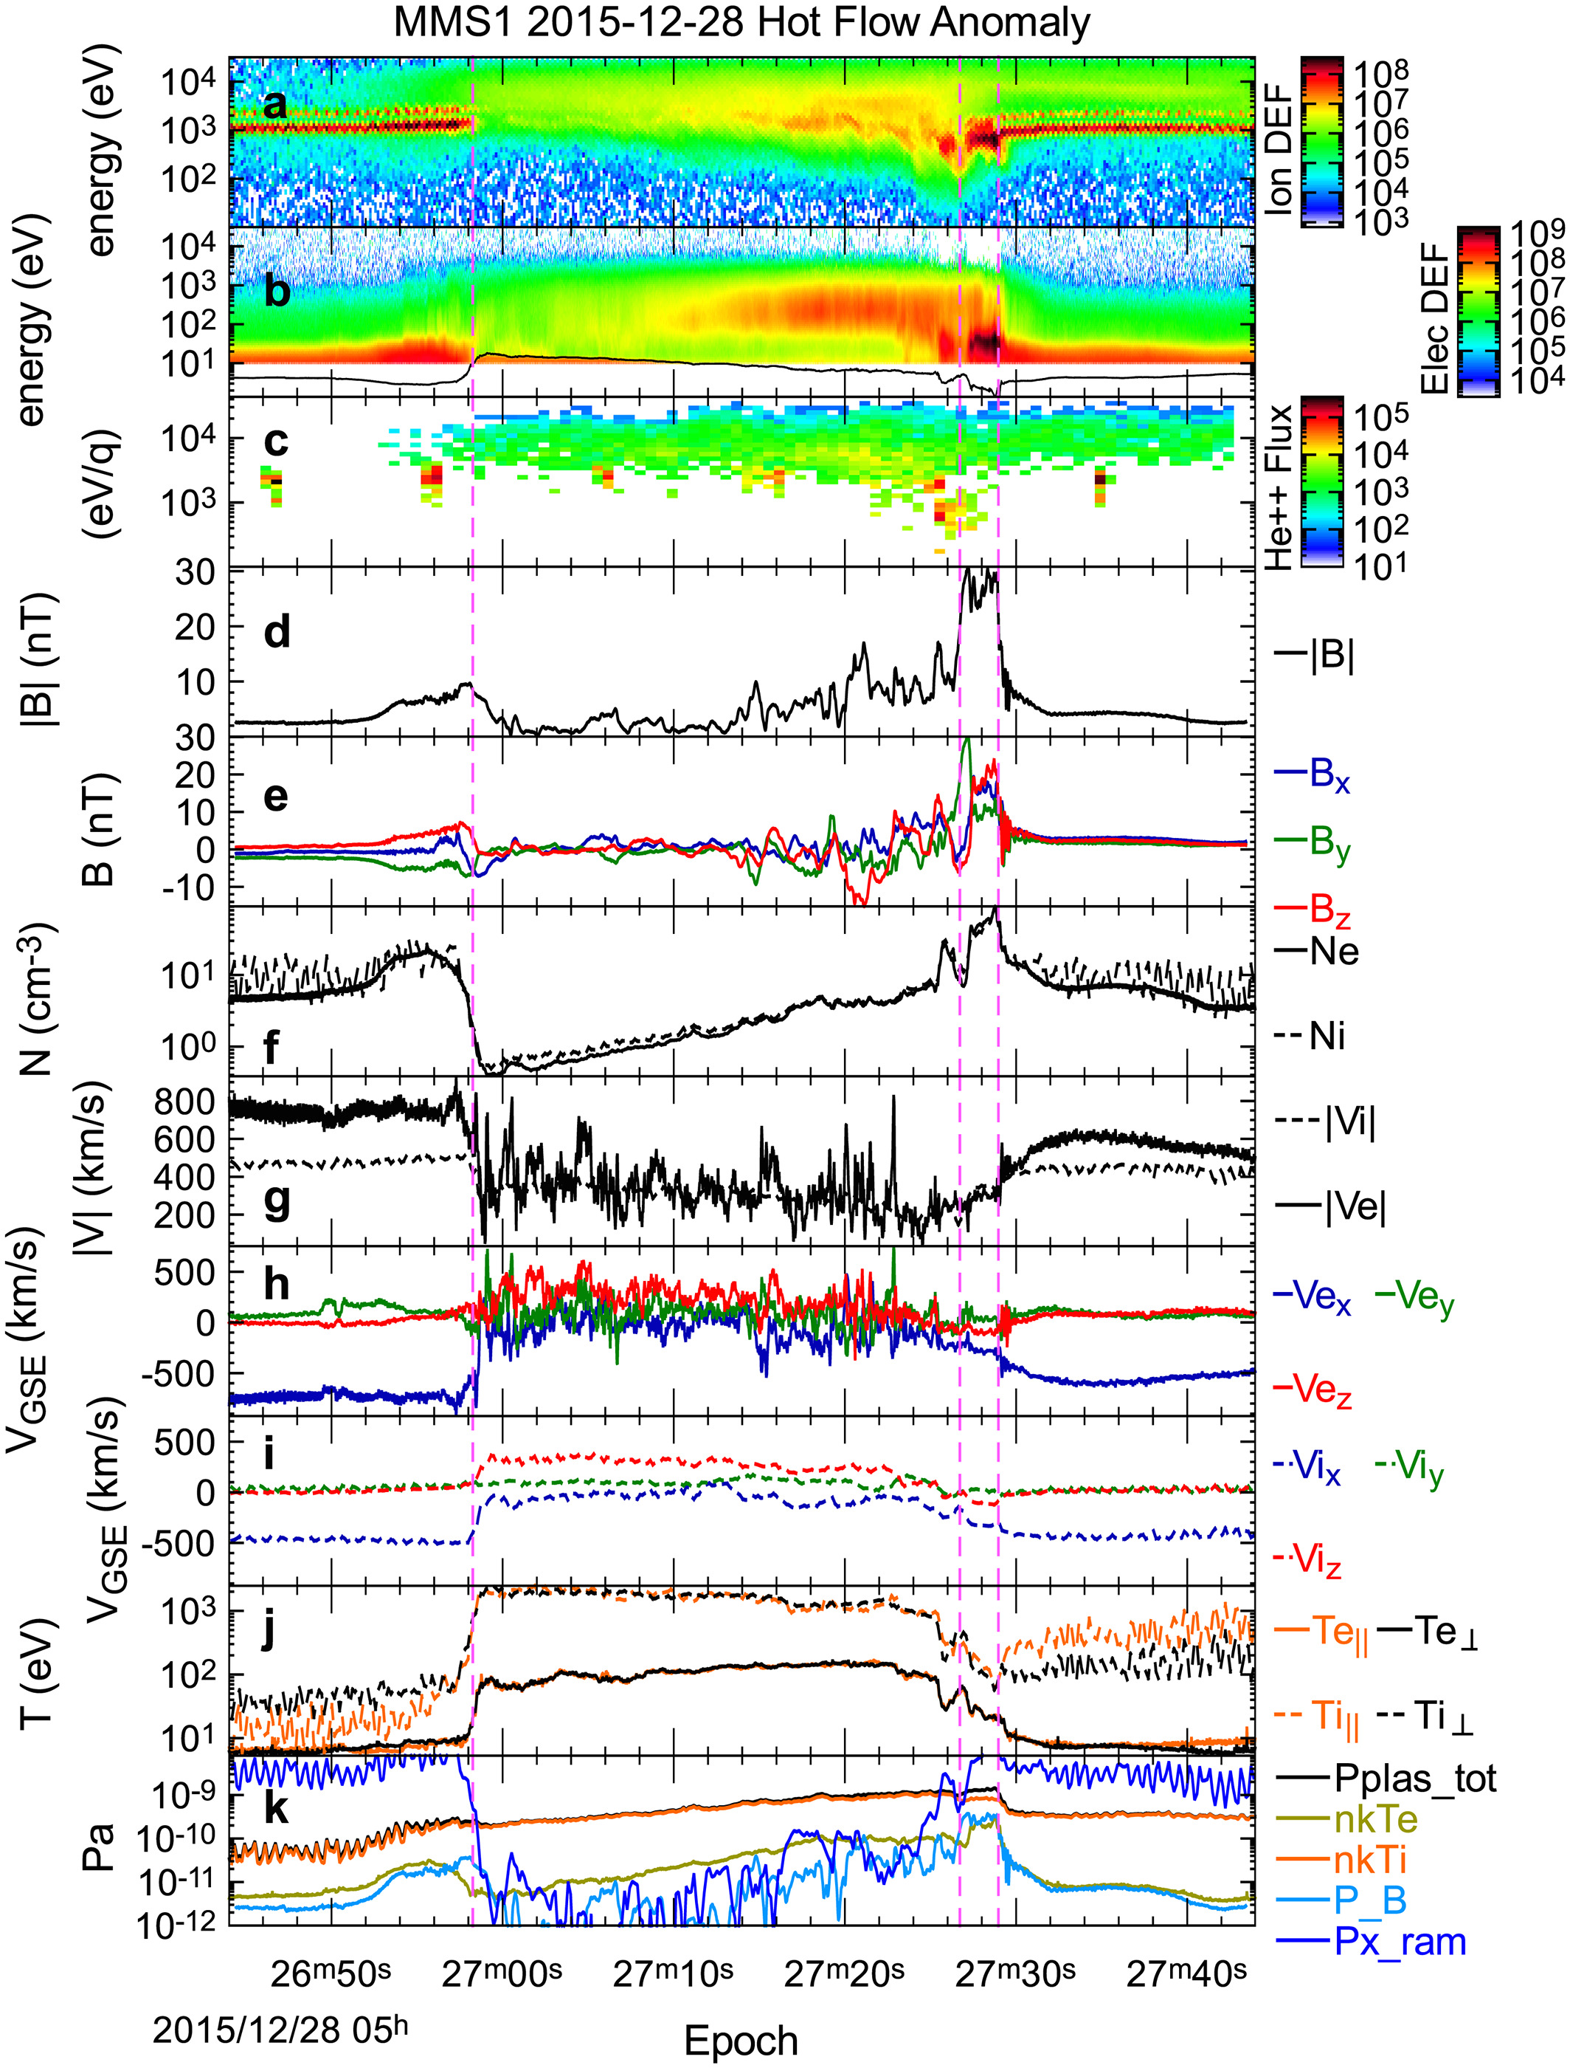
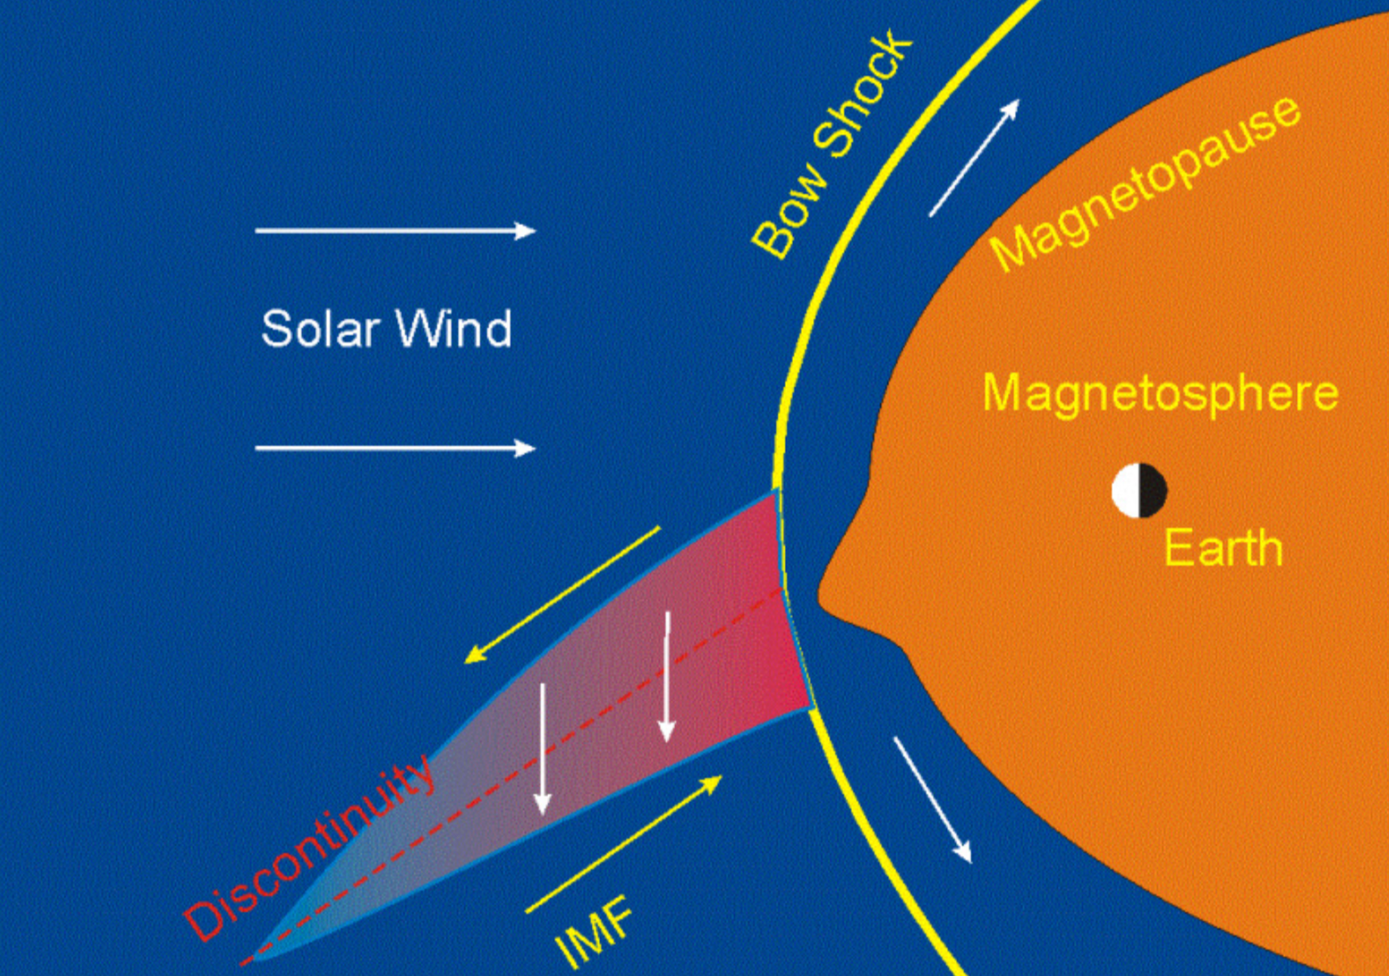
Hot Flow Anomalies (HFAs)
[Courtesy of H. Zhang]
[Schwartz et al., 2018]
Notes:
What is an HFA? Introduce some backgrounds here.

Slide 3
Motivation
HFA-like structures were simulated by a 2D MHD model [Otto and Zhang, 2021] without a discontinuity prerequisite.
We compared observations from MMS and THEMIS with the MHD simulations using density depleted solar wind flux tubes to investigate the physical process of HFA formation.
Notes:
We will show 3 different cases one by one.

Slide 4
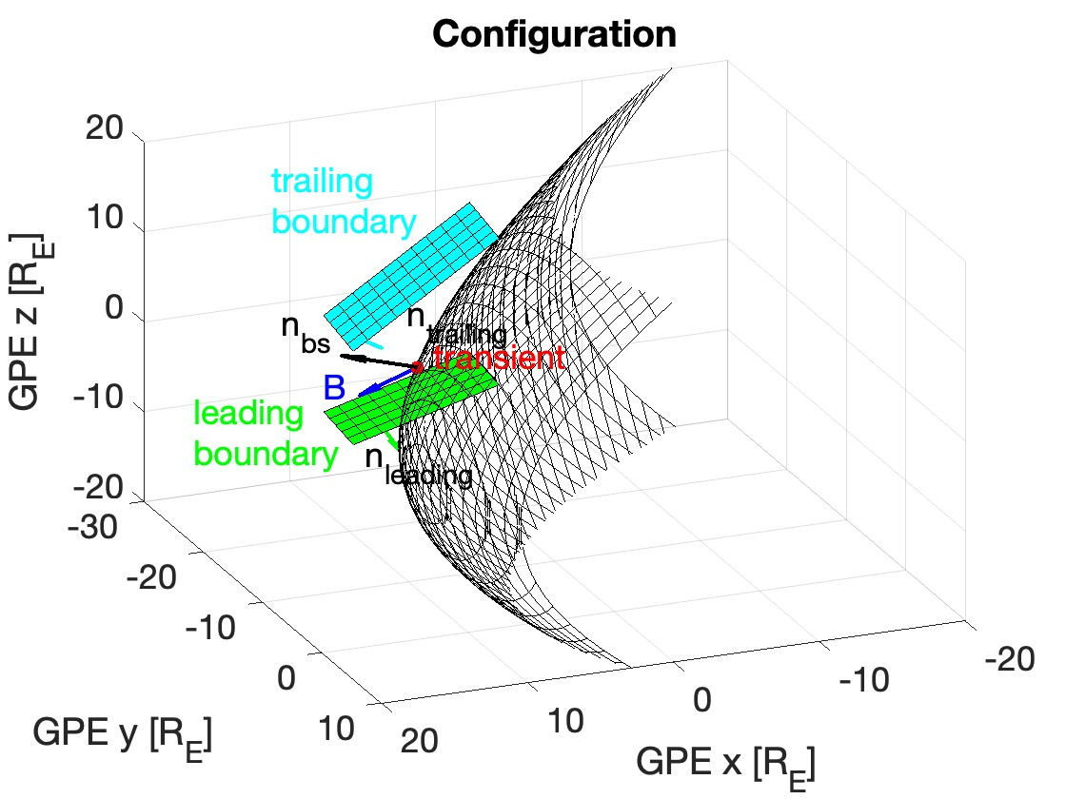
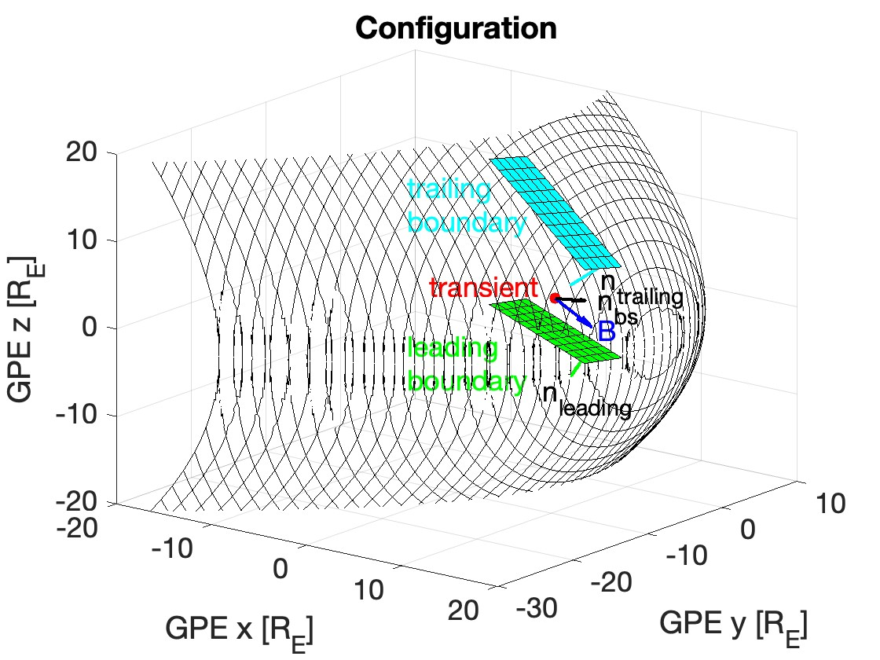
Case 1: 2019-12-25
Low-density flux tube (foreshock cavity) has been observed by THD
Notes:
THD: Nmin=0.402Nsw (ion), 0.447 (electron)
geocentric plasma ecliptic (GPE) coordinates
Timing: THB, THD, ACE, WIND

Slide 5
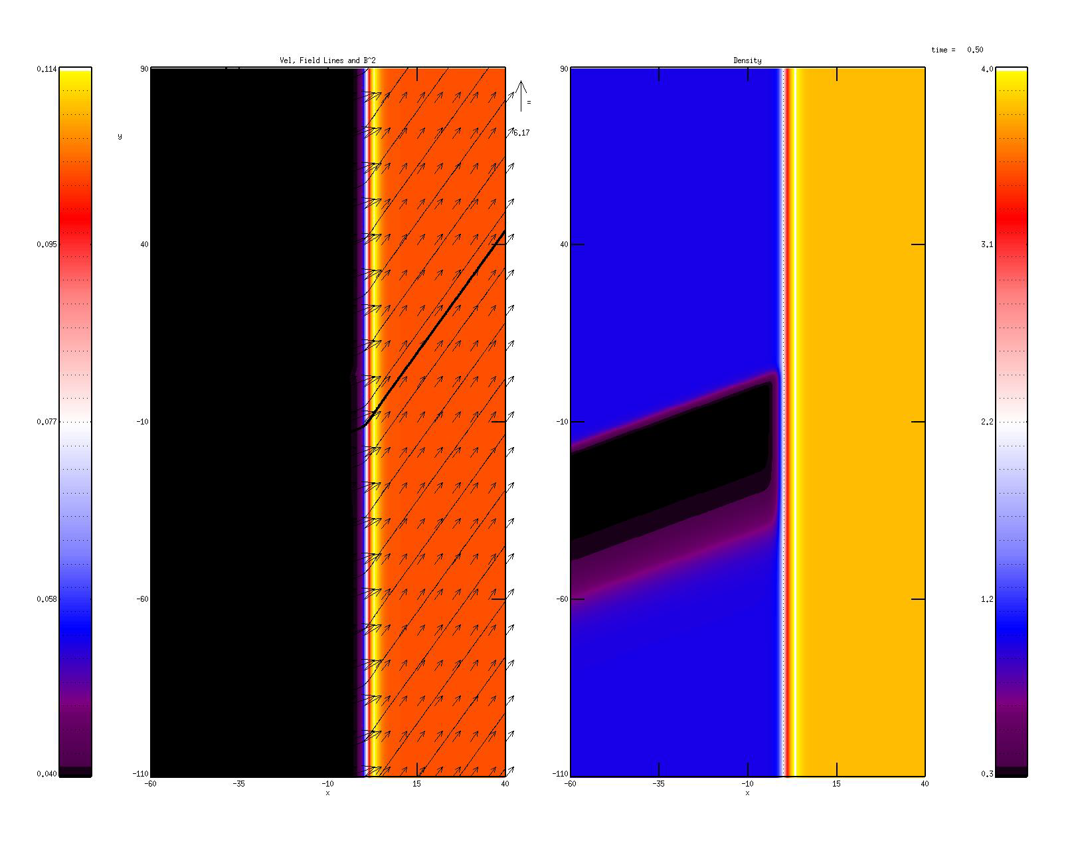
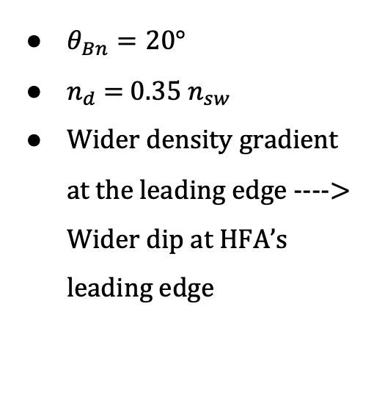
Case 1: 2019-12-25
Simulation
$θ_{Bn}=20°$
$n_{d}$ = 0.35 $n_{sw}$
Wider density gradient at the leading edge ----> Wider dip at HFA’s leading edge
B: solid line
V: arrow
N
Notes:
$θ_{Bn}=20°$
B = 2 nT
Fast Mach num = 6
Normal $V_{sw}$ = 400 km/s
Plasma $β=25$
Density dip = 0.35 $n_{sw}$

Slide 6
Case 1: 2019-12-25
Simulation cut
Low-density and hot core
Large flow deflection
Strong magnetic filaments
Ram pressure decrease
Entropy enhancement

Slide 7
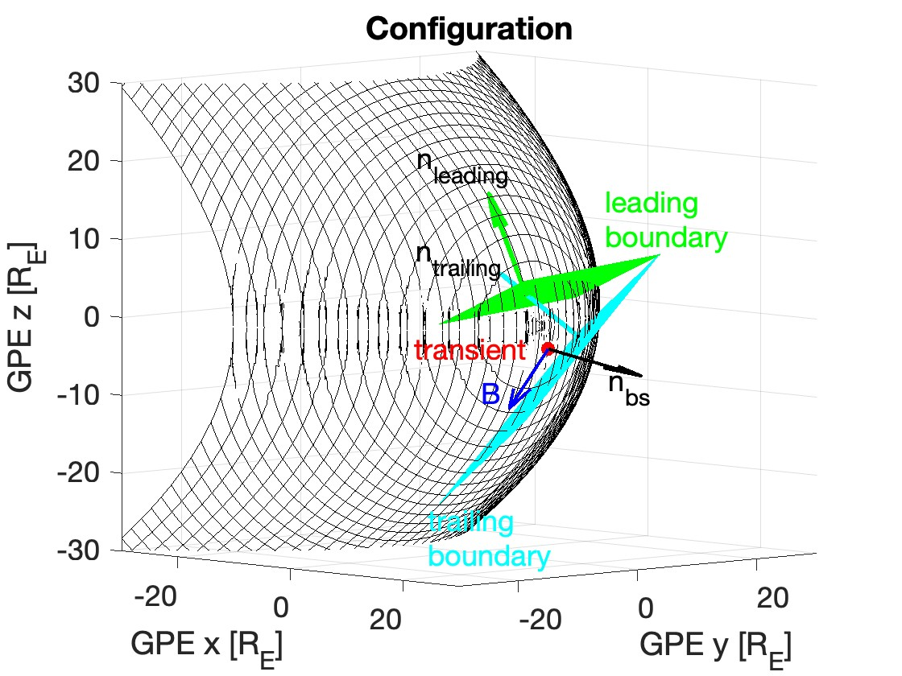
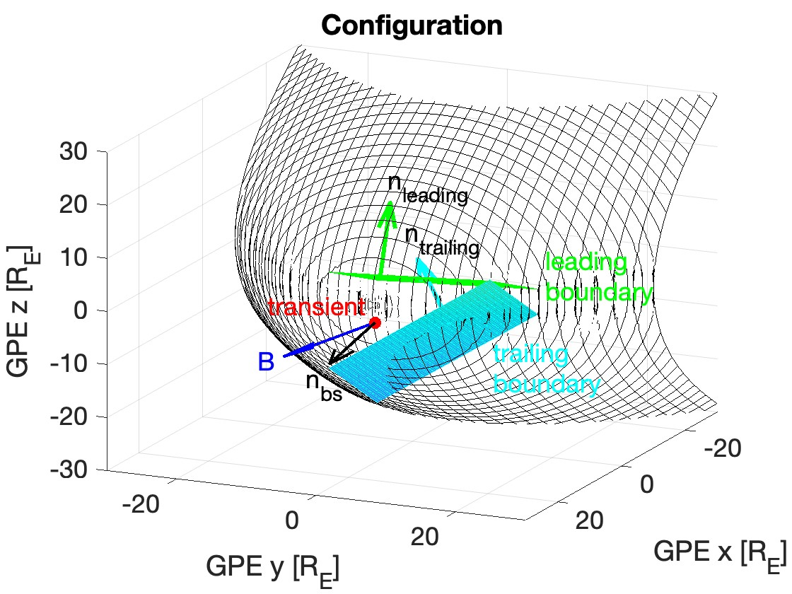
Case 2: 2020-02-21
Compressional
region
Core 1
Core 2
One extremely low-density core accompany with a moderately low-density core

Slide 8
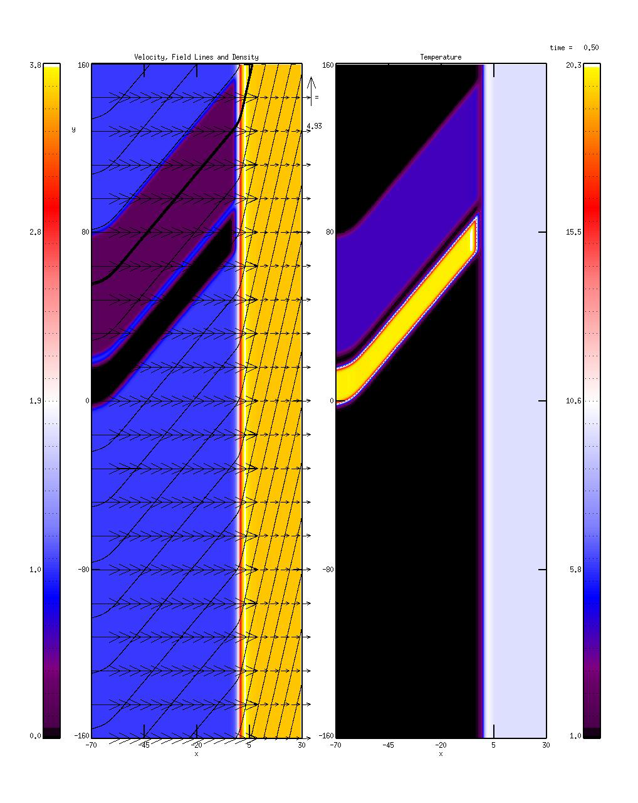
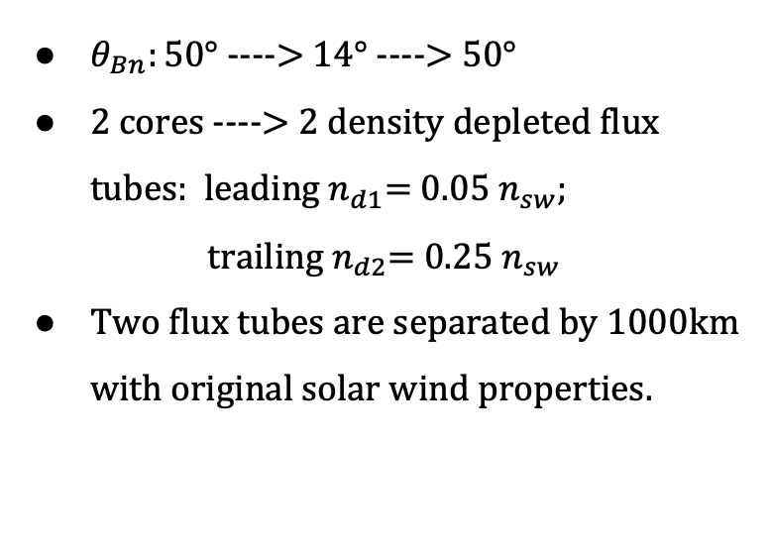
Case 2: 2020-02-21
Simulation
$θ_{Bn}:50°$ ----> 14$°$ ----> $50°$
2 cores ----> 2 density depleted flux tubes: leading $n_{d1}$= 0.05 $n_{sw}$;
trailing $n_{d2}$= 0.25 $n_{sw}$
Two flux tubes are separated by 1000km with original solar wind properties.
B: solid line
V: arrow
T
Notes:
M_{f} = 4.8
v_{f} = 95 km/s
plasma β=4.5
Normalization: v₀ = 95 km/s
n₀ = 8 cm⁻³, B₀ = 12 nT
L₀ = 300 km
t₀ = 3.2 s

Slide 9
Case 2: 2020-02-21
Simulation cut
Good consistency with observation
Differences:
Double peaked temperature in core 1;
Fairly brief trailing compression

Slide 10
Model comparison
Kinetic model | MHD model
A discontinuity is required | Does not need a discontinuity
Is formed due to the foreshock ion kinetic process | Is formed by the reformation of the fast shock geometry by a low-density flux tube
(Early stage) 2 populations (solar wind part & backstreaming ions from the bow shock) | 1 population (magnetosheath material)
Decrease of density and magnetic field strength in addition to temperature increase and flow deflection in core region | Core density lower than that in the magnetosheath, but not necessarily lower than the ambient solar wind density; decrease magnetic field strength with temperature increase and flow deflection in core region
They are different sturctures, but both are hot and have flow deflections.

Slide 11
Summary
Multi-points observations clearly present the process of a density dip (foreshock cavity) developing to an HFA with only one population of materials in its core region.
Multi-flux tubes reproduce an HFA with two different cores in density.
The total ram pressure may be an excellent diagnostic for HFAs both in the solar wind and in the magnetosheath.

