Slide 1
Planetary magnetic field without geodynamo

Slide 2
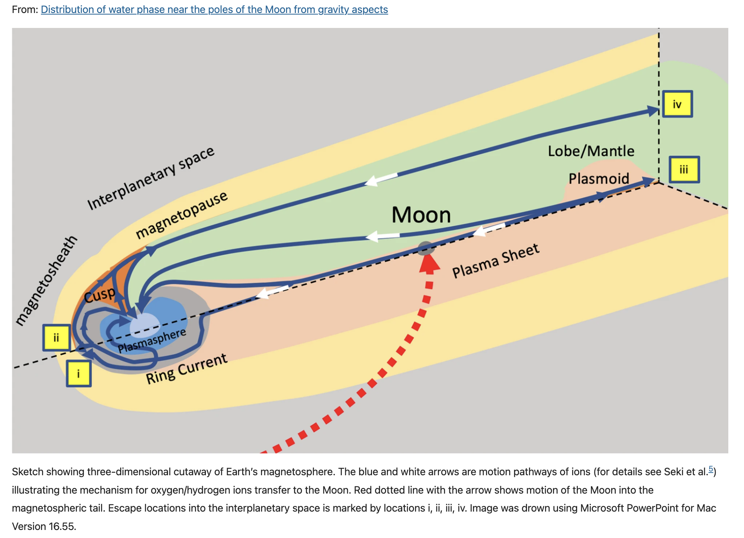
Planetary magnetic field production mechanism
A dominant dipole component of the planetary magnetic field has its source in the planets´s core (outer core in case of Earth), where heavy fluid motion in the core is subjected to the Earth’s spinning, where the field is “somehow” generated and lasted for more than 3.4 billion years (Landeau et al., 2022).
Precession (too weak for enough flux production),
Tides (may have played the role early when Earth span faster)
Convection combined with exsolution of light elements (motion of the highly conducting fluid), attempts towards its understanding and matching the geomagnetic and paleomagnetic observations (Landeau et al., 2022; Stevenson, 2010).

Slide 3
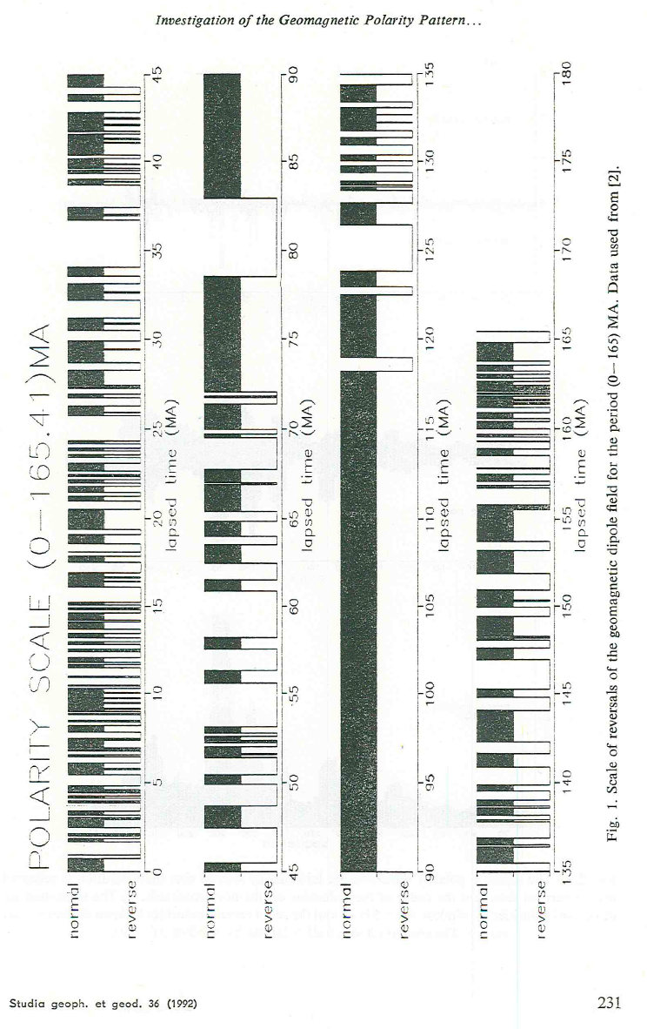
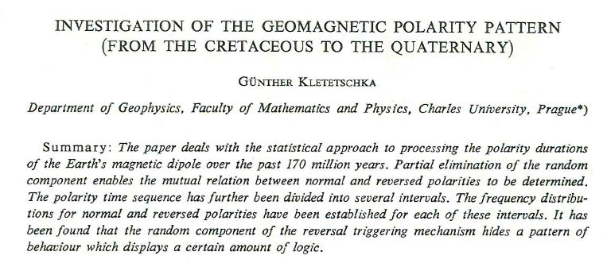
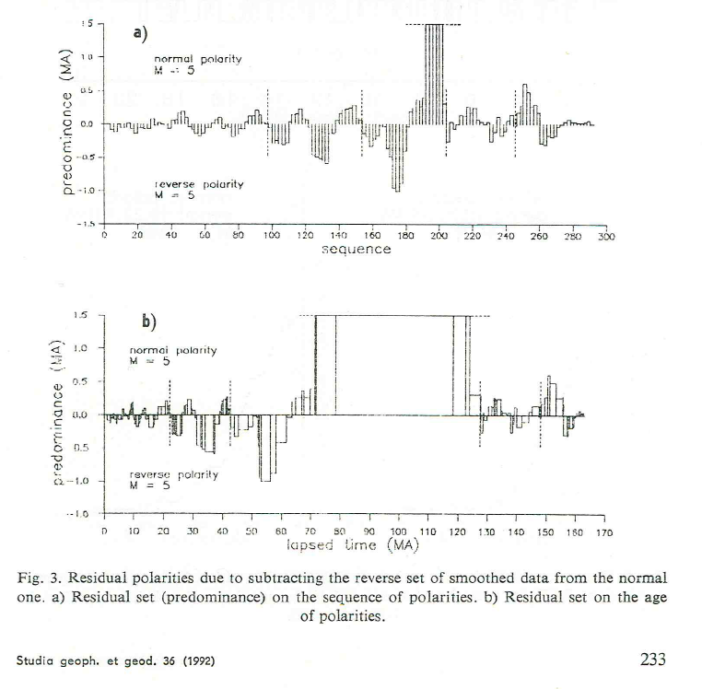

Slide 4
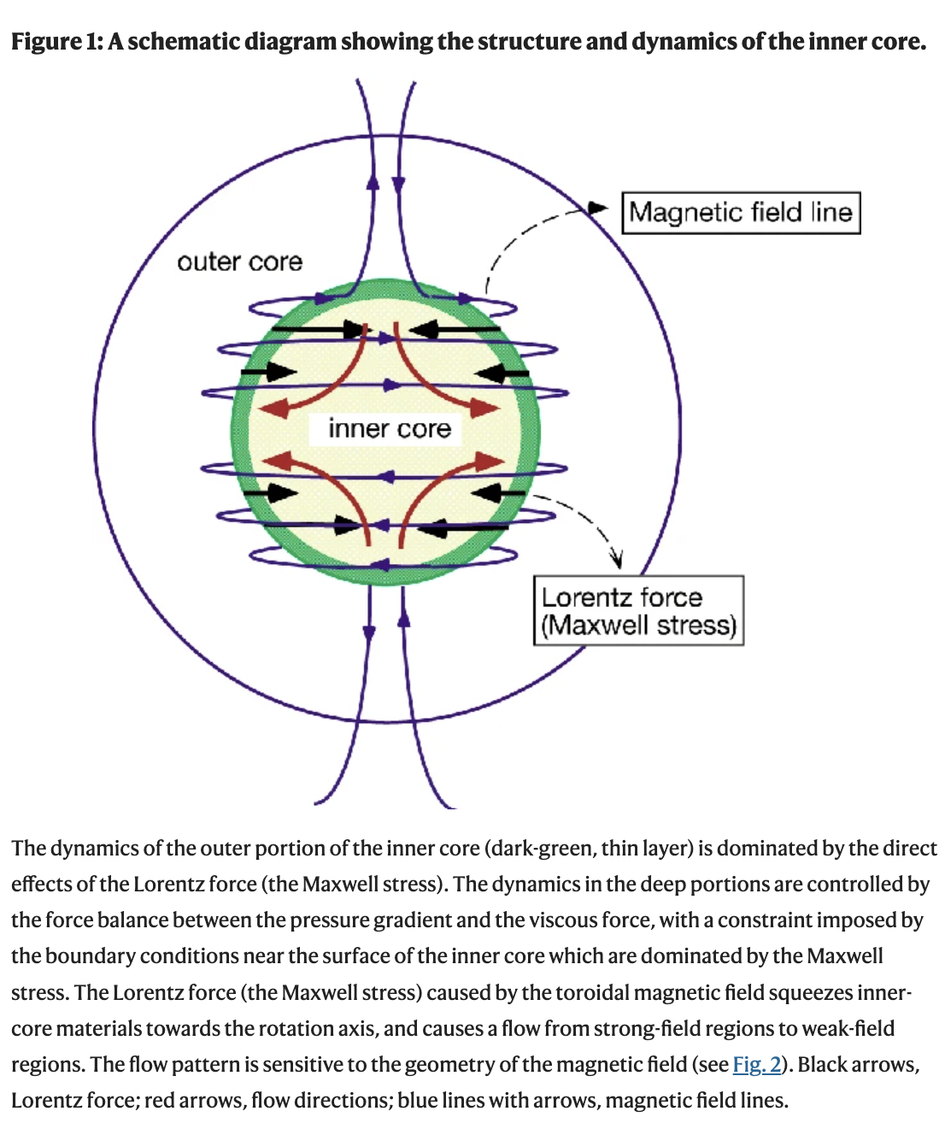
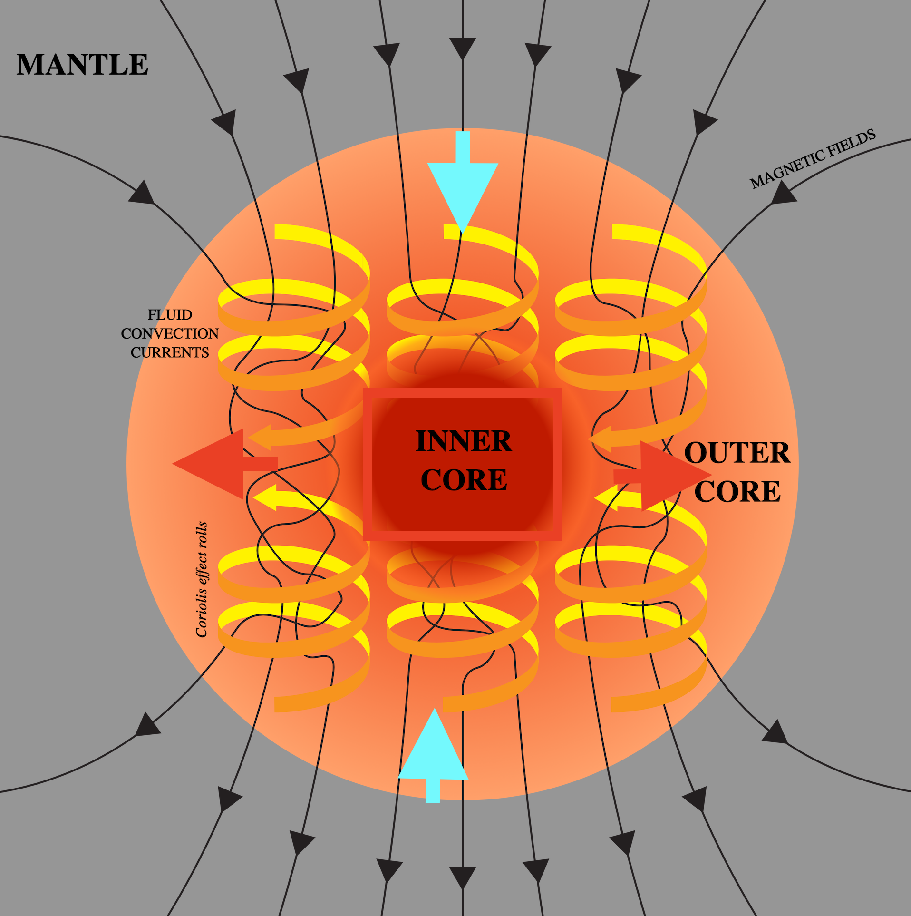
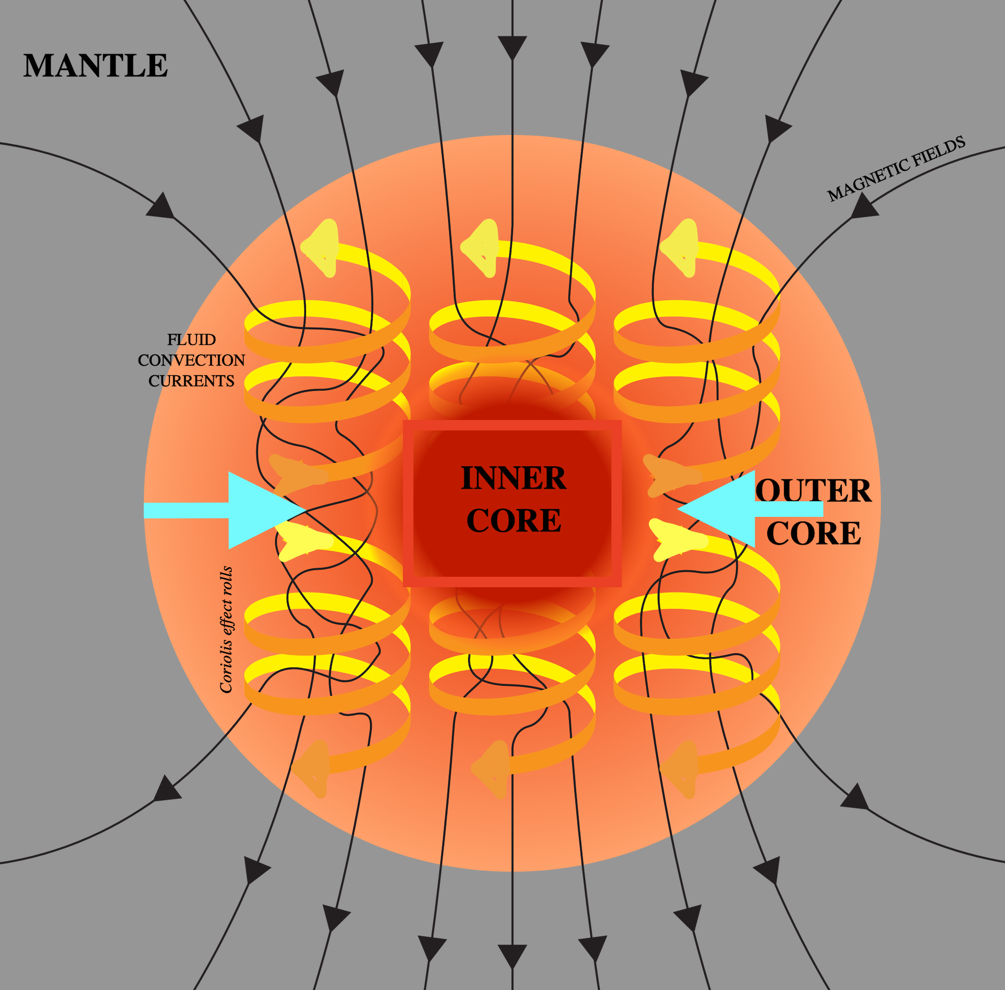
Numerical models are considering a geodynamo mechanism with a turbulent convection in a rotating fluid (Busse, 2000; Glatzmaier and Roberts, 1996; Kono and Roberts, 2002; Kuang and Bloxham, 1997; Landeau et al., 2022).
Ability to switch the magnetic field’s magnetic polarity, (Berhanu et al., 2007)

Slide 5
Degenerate fermi gas means that the gas is in a quantum regime
Perhaps the most important example²⁵ of the degenerate Fermi gas is the conduction electrons in metals
Degenerate gases are gases composed of fermions such as electrons, protons, and neutrons rather than molecules of ordinary matter.

Slide 6
Most models consider Boussinesq approximation: neglects density and temperature variations of the reference state (Gray and Giorgini, 1976).
Let’s consider a source material inside the core, where its electrons can acquire an approximation of a degenerate Fermi’s gas like state (Bologna and Tellini, 2014).
This is because the density of iron inside the core is about 10⁴ kg m⁻³ (de Wijs et al., 1998) pointing to the Fermi energy of ~2x10⁻¹⁸ J, corresponding to a Fermi temperature of 1.4x10 ⁵ K, higher than the Earth’s core temperature, thus supporting the Fermi’s electrons presence in the Earth’s core.
For a plasma state with a finite conductivity and constant density for the magnetic field we have (Jackson, 1998):
In plasma there is a balance between a diffusive magnetic flux and a flux maintaining term v×B balancing the diffusion term.
Many considered this balance as a key factor for magnetic field maintenance in the Earth’s core (Stevenson, 2010).

Slide 7
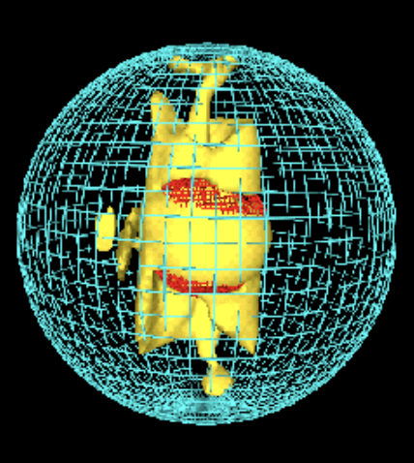
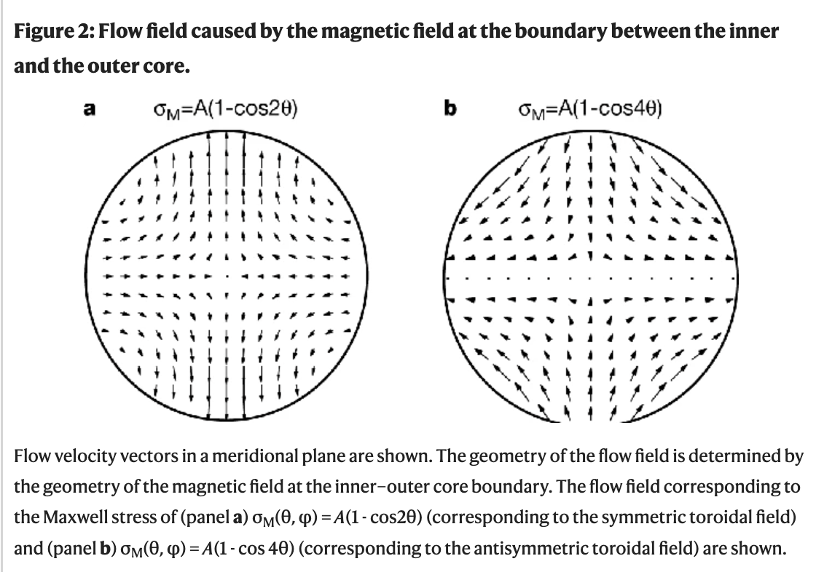
Can a sufficient magnetic flux be produced inside the core of the Earth from thermally induced electrical currents ?
This requires an internal source of heat energy to be utilized from the lateral temperature variation inside the core.
The transfer of this heat energy into electric currents would need to be proportional to the local temperature differences, via thermoelectric current generation.
Such thermoelectric current generation mechanism was already considered for Mercury (Giampieri and Balogh, 2002; Stevenson, 1987) via interaction between the Mercury’s core and mantle.
A thermoelectric current was considered both near an inner/outer core boundary (IOB) (Bologna and Tellini, 2014) and core/mantle boundary (Xu et al., 2021).
Glatzmaier and Roberts, 1996
Karato, 1999

Slide 8
The Fermi electrons’ approximation:
A material physics considers a quantum related thermal contribution α(T) inside the core (Bologna and Tellini, 2014; Landau and Lifshitz, 1981):
Where k_{B} is the Boltzmann constant, e is the electron charge, T is the temperature, and ε_{F} is the Fermi energy.
We add this thermal contribution to the total current $J$ in the core along with an electric, $σE$, and magnetic, $σv×B$, terms as:

Slide 9
Considering solely the thermal contribution to the total current generation (assuming, that neither the electric and magnetic terms do not significantly contribute) and using a Maxwell equation
(where μ0 is a vacuum magnetic permeability, subscript T stands for thermal contribution) we have:
Equation allows a scaling estimate for magnetic flux magnitude:

Slide 10
Enumerating for
μ₀=1.26e-6 NA⁻¹,
k_{B}=1.4x10⁻²³ m²kg s⁻² K⁻¹,
e=1.6e-19 C,
ε_{F}=2x10⁻¹⁸ J,
core temperature T_{c} = range of (6+/-2)x10 ³ K (Alfe et al., 2002)
core temperature gradient (∆T ~8x10 ² K (Alfe et al., 2002; Bologna and Tellini, 2014),
𝞼 conductivity ~10⁶ S m-¹ (Pozzo et al., 2012)
= thermal heat generated magnetic flux of the Earth core: 0.0002 T to 0.003 T.
Note that we don’t use the entire temperature difference of 2000 K for estimate scale of the magnetic field but 800 K. This is because the temperature difference between ICB and CMB is mostly isentropic (or adiabatic), lacking the sufficient degree of horizontal variation

Slide 11
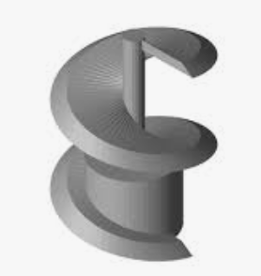
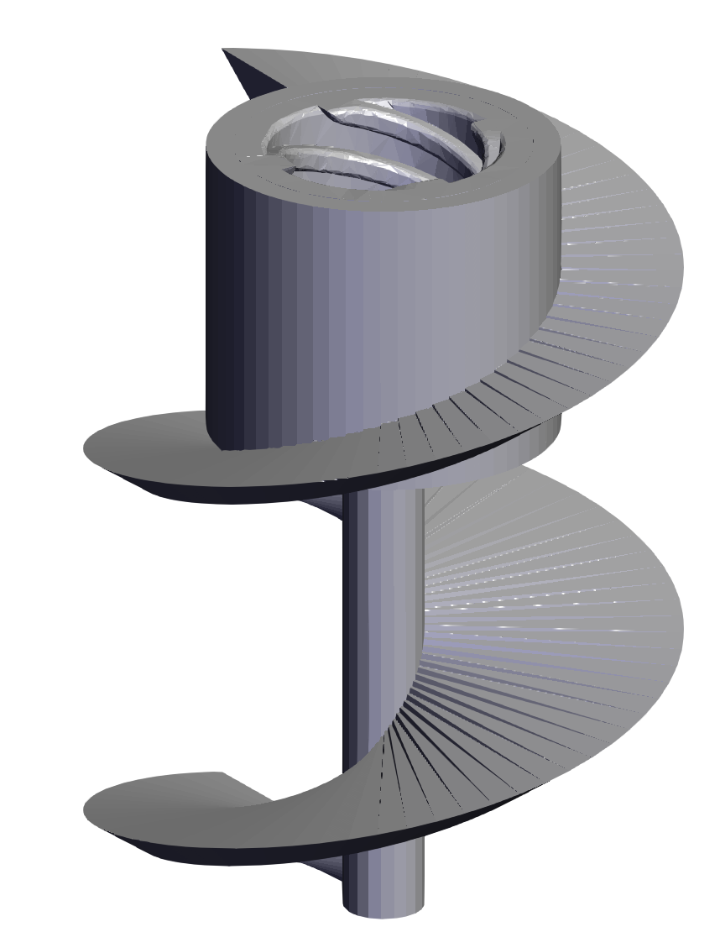
The thermal gradients in the core cause the heat exchange by convection.
In parallel, the thermal gradients in the dense liquid core allow for existence of Fermi electrons to flow in a direction of the convective flow.
Therefore, both the convective flows and Fermi currents need to obey a handedness of the geo-rotation system controlled by Coriolis force (Matsui et al., 2014)).
Then for a counterclockwise (CCW) earth’s spinning we have a prescribed handedness of the upwelling/downwelling of liquid masses in the Earth’s core.
This is supported by observation of the columnar structure from combinations of satellite magnetic data (Gillet et al., 2022).
Upwelling masses in the NH would spin clockwise (CW), while upwelling masses spin CCW in the southern hemisphere (SH) when looking towards the center of the spinning Earth.
Considering the higher temperature of the core upwelling masses, the resistance of these high temperature compositions is lower than the surrounding colder material (de Koker et al., 2012). This supports the notion that Fermi electrons follow the heat gradients (equations 3 and 4) and are directed via the upwelling plumes of lower density, lower resistance, and different composition (de Koker et al., 2012; Umemoto and Hirose, 2020), towards the maximum temperature gradients, and eventually towards the CMB.
Therefore, in the NH the Coriolis clockwise upwelling spiral would create conduit for clockwise moving Fermi electrons from the inner core to a cooler CMB, generating CCW electric current and thus upward directed magnetic flux forming a reversed magnetic polarity. Same logic goes for the SH where all upwelling conduits generate clockwise electric current generating downward directed flux, normal magnetic polarity, supporting our hypothesis.

Slide 12
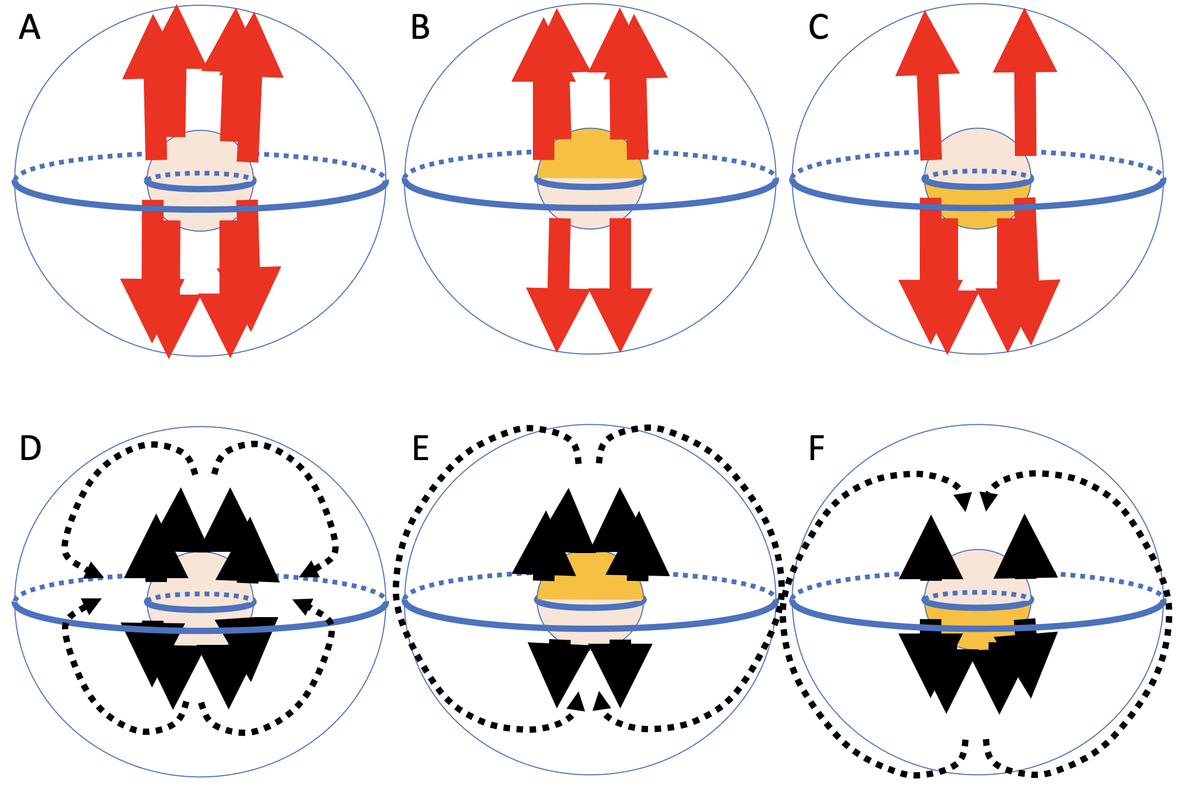

Slide 13
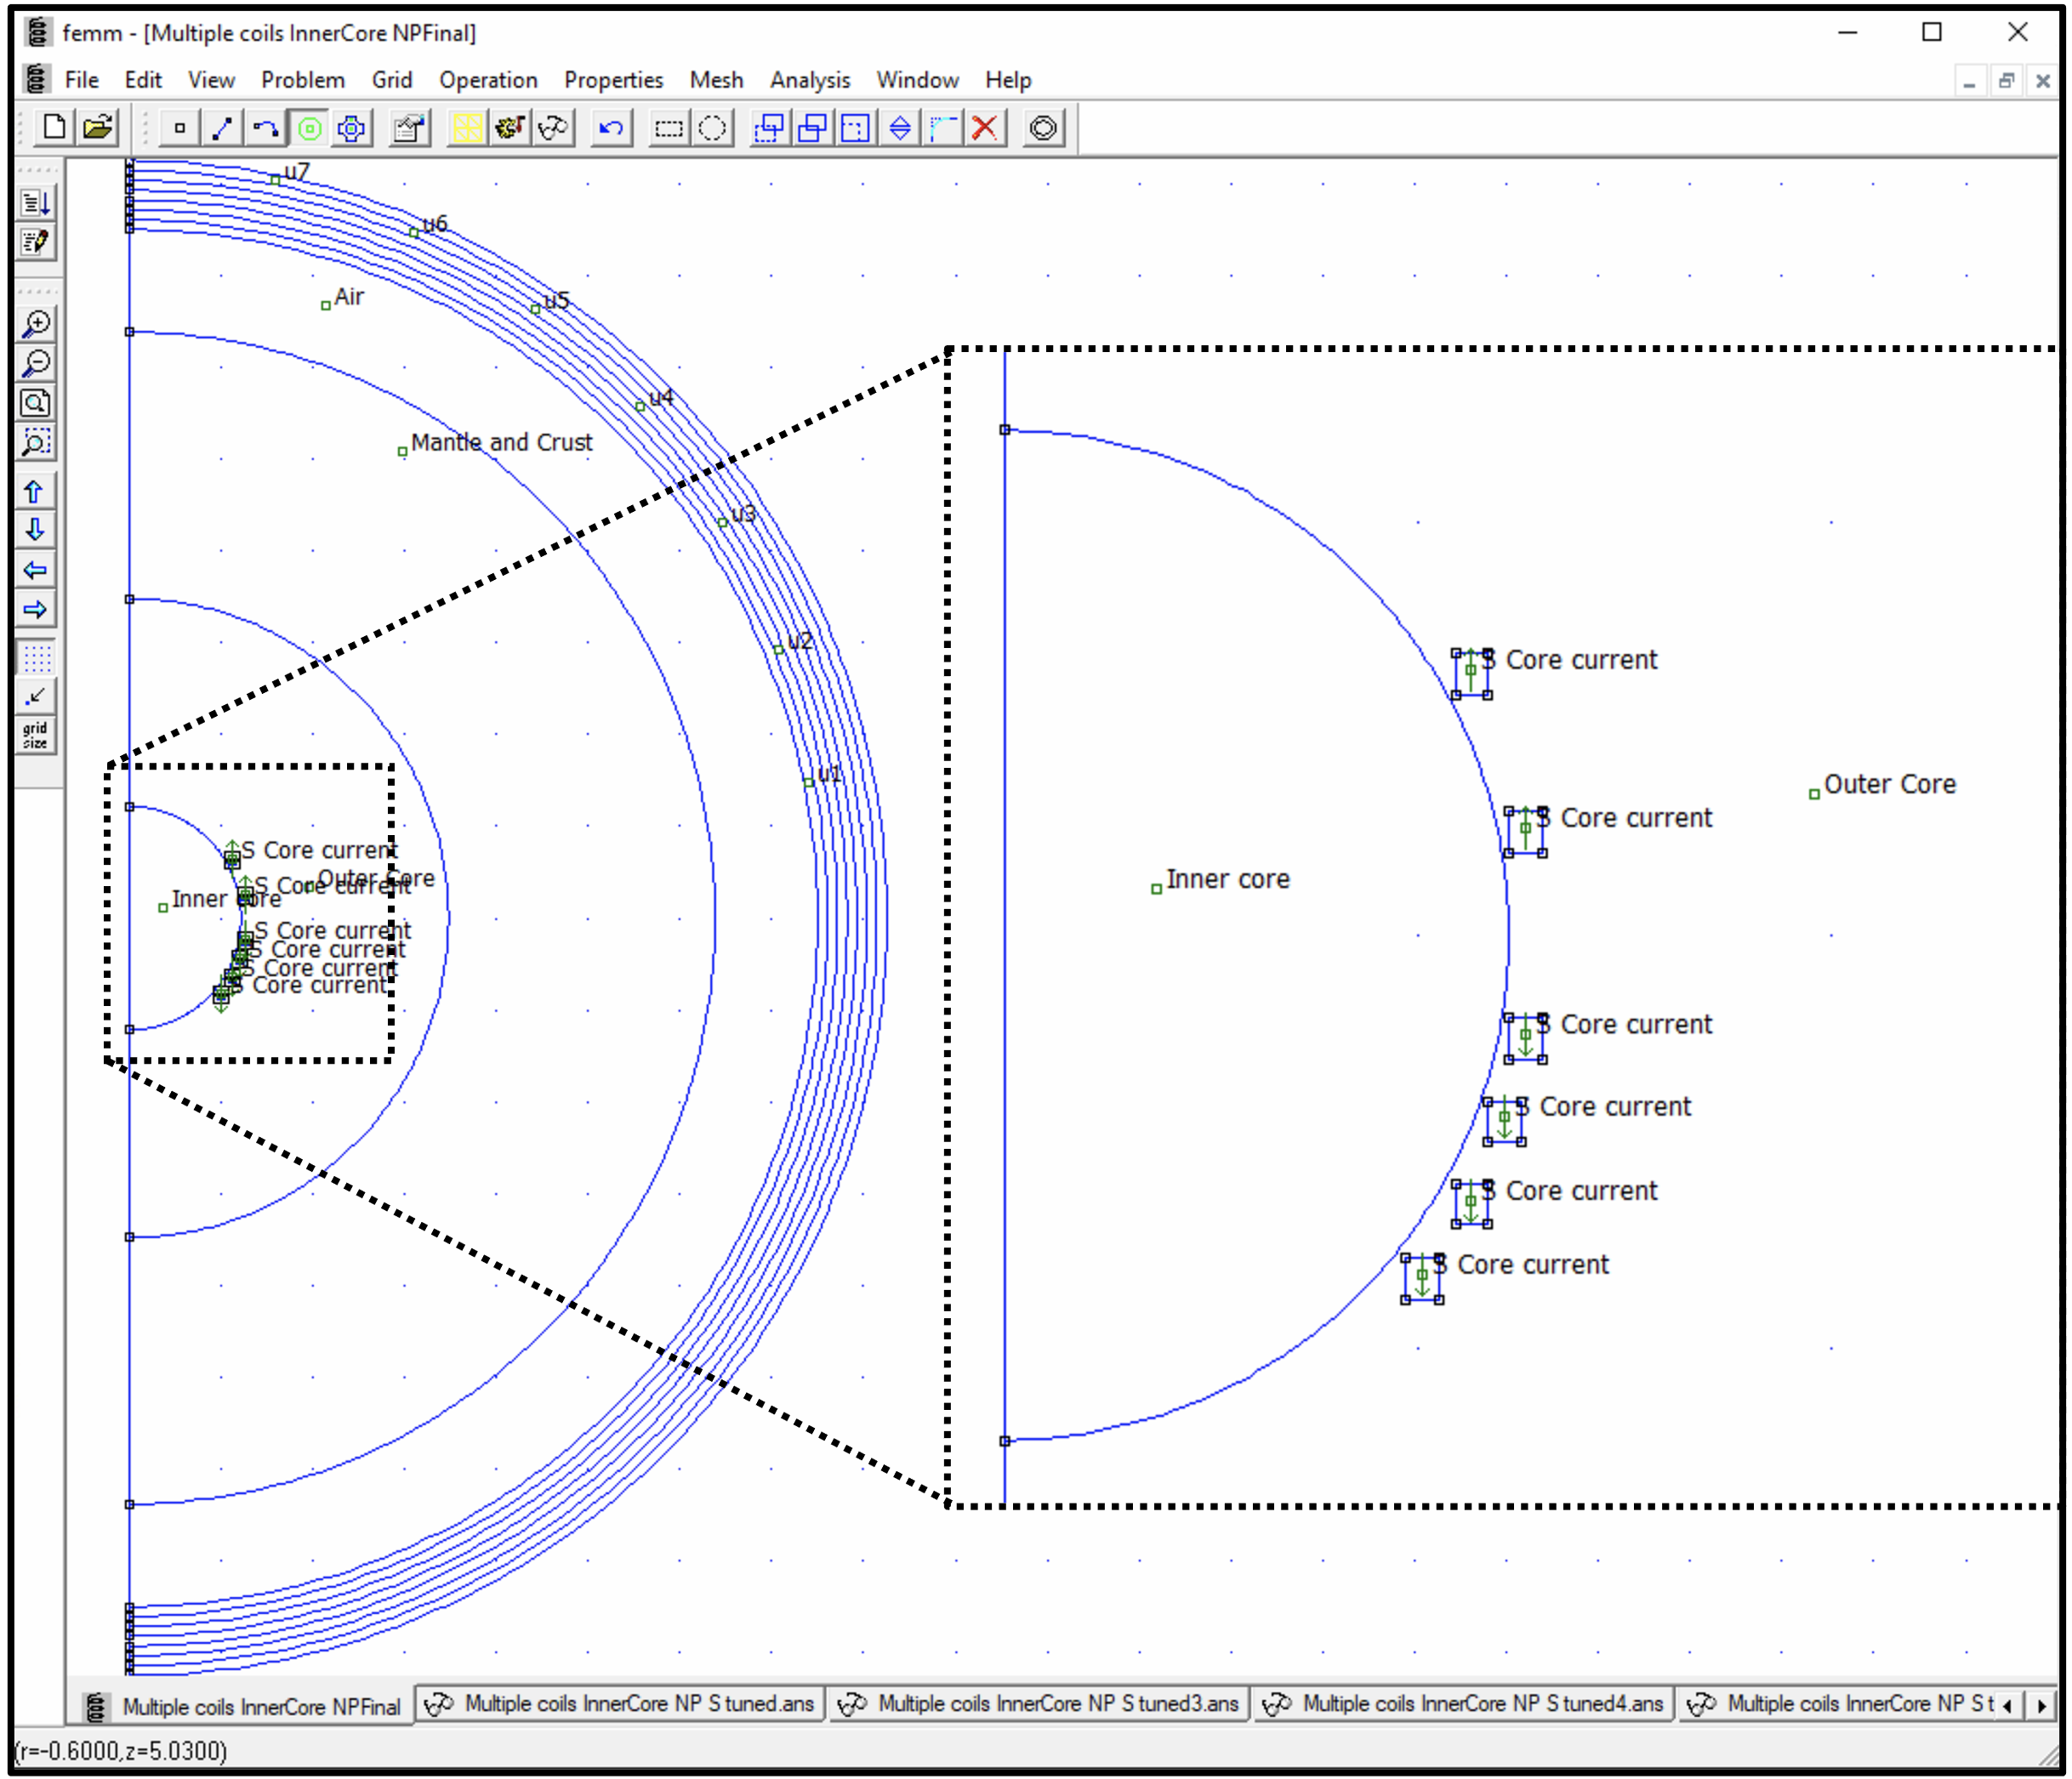
Screen shot from the FEMM software showing the initial setup of the core geomagnetic model with rotational symmetry around the vertical axis along the left edge of the image. Central region of the core is blown out for clarity. The smallest circle is inner/outer core boundary at 1220 km from the center, the next larger circle is outer core/mantle boundary at 3480 km from the center, the third circle is Earth’s surface at 6380 km from the center. The set of 7 largest circles at 7500 km, 7600 km, 7700 km, 7800 km, 7900 km, 8000 km, 8100 km, 8200 km is a Dirichlet boundary condition to satisfy the geometry of the infinite dipole field. The green arrows indicate the electric currents that contributes to the dynamo magnetic field, each of them has magnitude of 750 kA/m along the specified direction. The inner core has a prescribed relative magnetic permeability of 14.8. Outer core, mantle and crust, and air have a relative magnetic permeability of 1. Dirichlet condition layers outside have their relative magnetic permeability of 2.4.

Slide 14
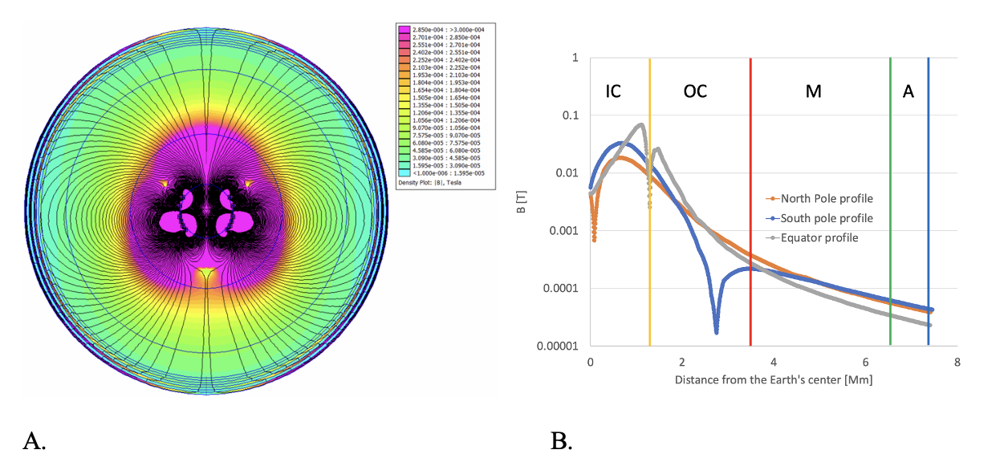

Slide 15
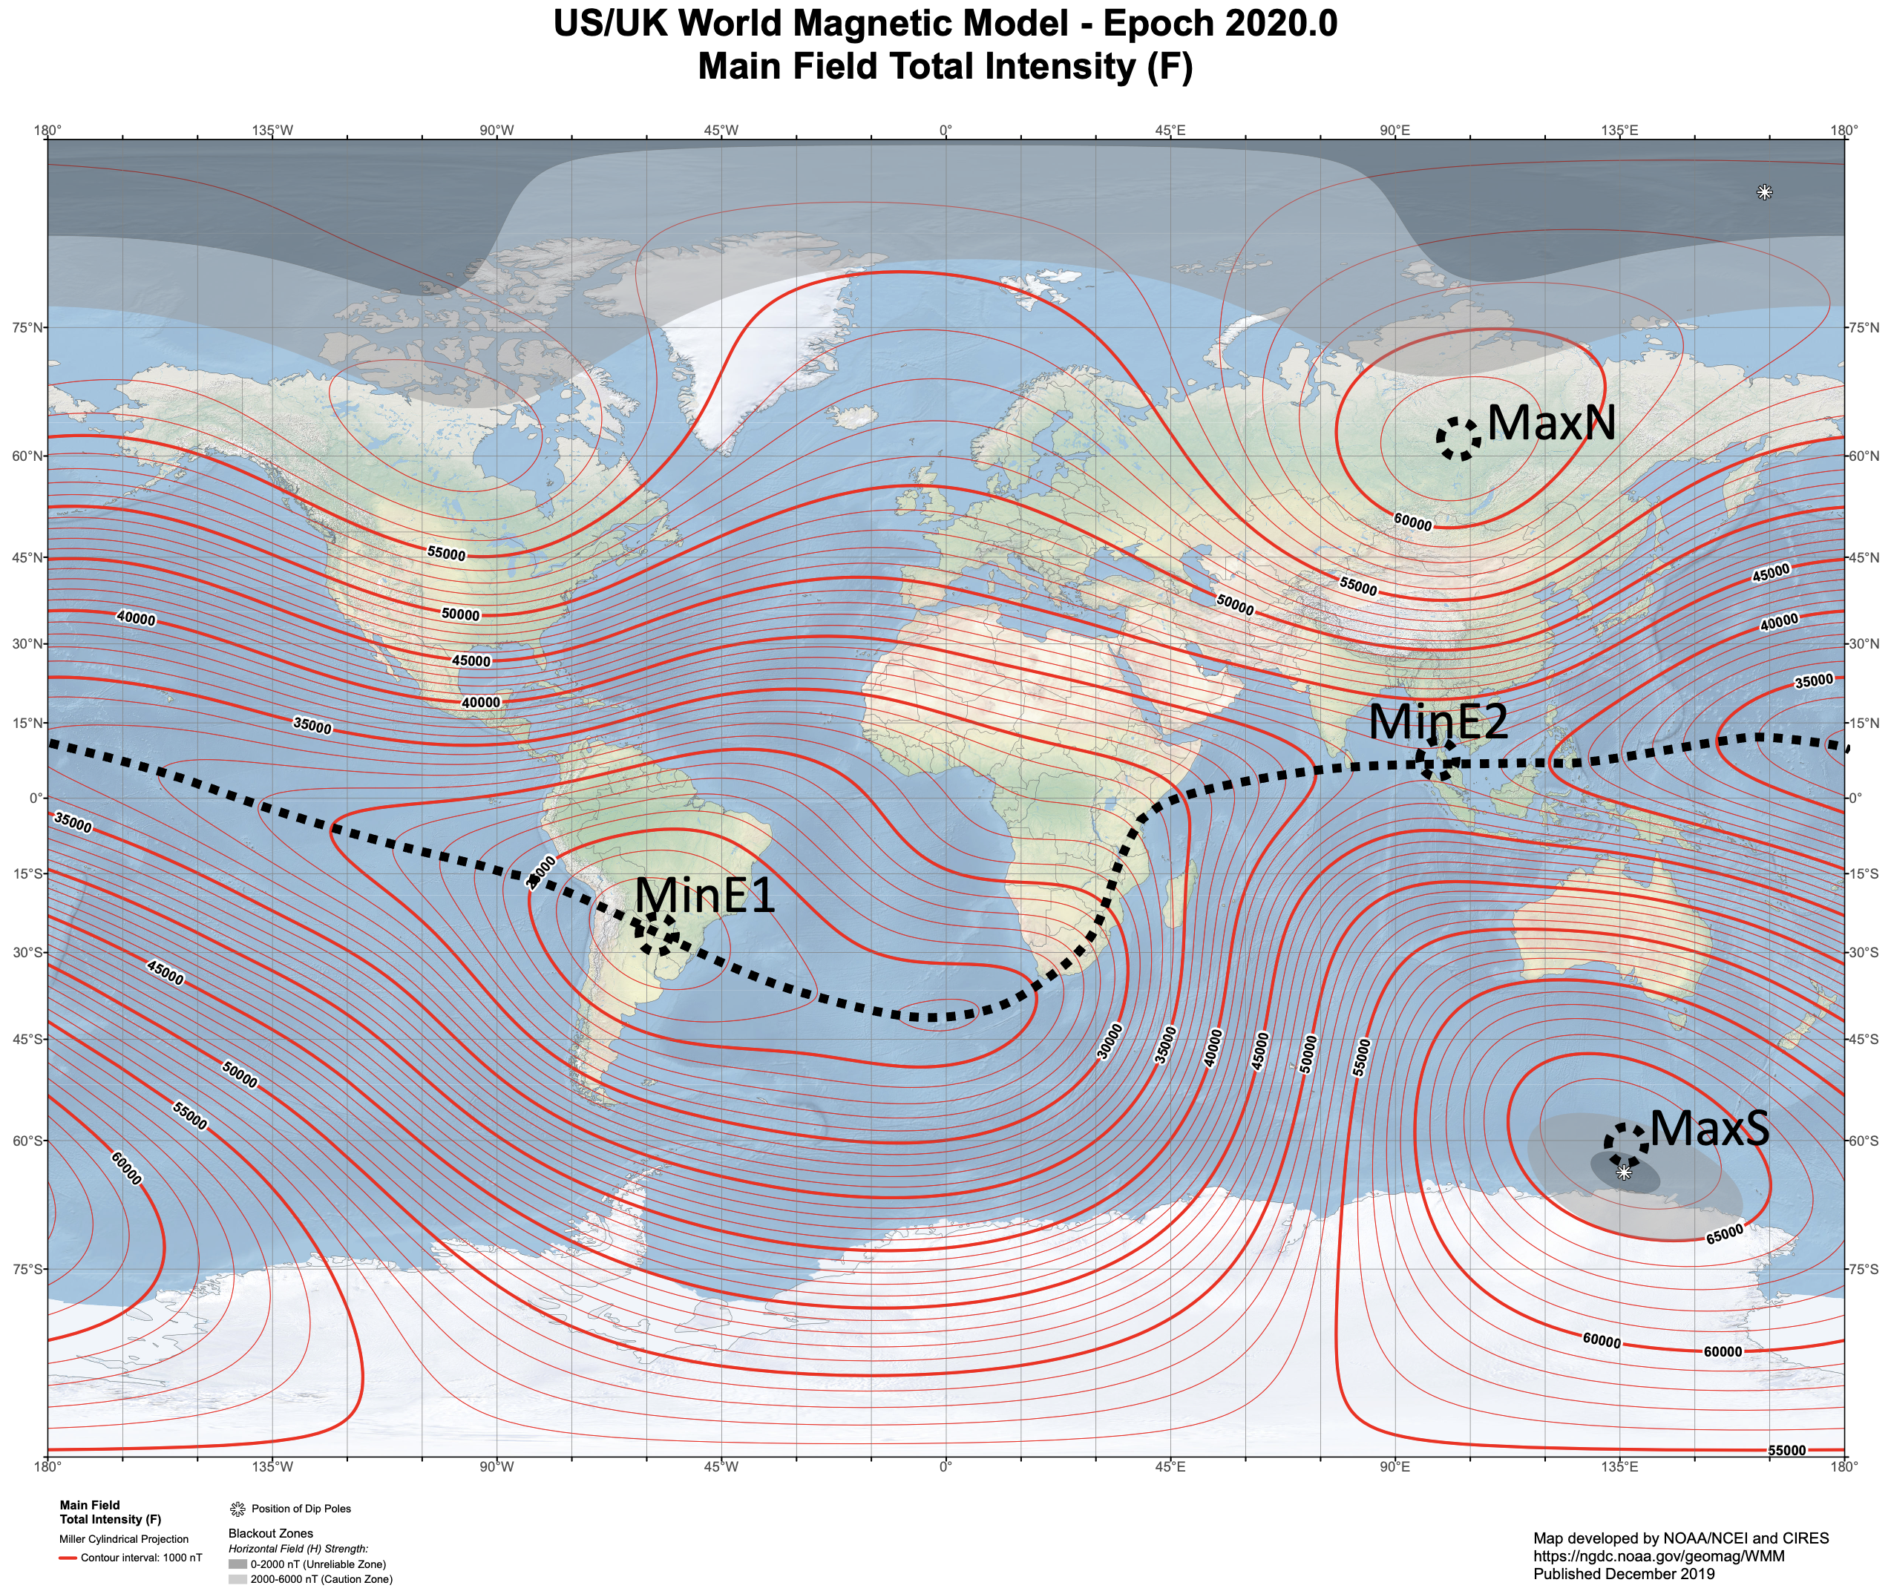
Image of the flux magnetic intensity at the Earth’s surface. Maximum magnetic intensity flux over the North pole is just over 61000 nT over the Siberia, Near Tunguska region, Russia, marked as MaxN. Maximum magnetic intensity flux over the South pole is just over 66000 nT, near a French Dumont d’Urville, Antarctica, Victoria Land Station, marked as MaxS. Minimum magnetic Intensity flux distribution over the Earth is marked by a black dotted line and ranges between just below 23000 nT (MinE1) to just below 42000 nT (MinE2).

Slide 16
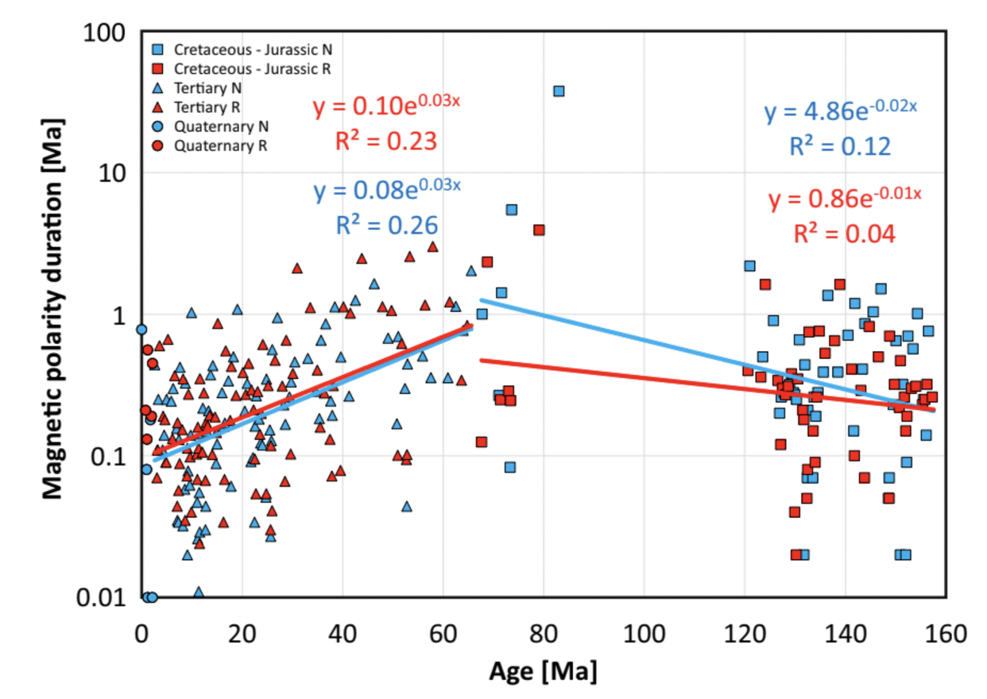

Slide 17
Thank you….
Can geomagnetic field be generated by Fermi electrons??
Do magnetic polarities present dominance of one hemisphere convection?
Are magnetic reversals controlled by arrival of cold subduction slabs to the CMB?

