Slide 1
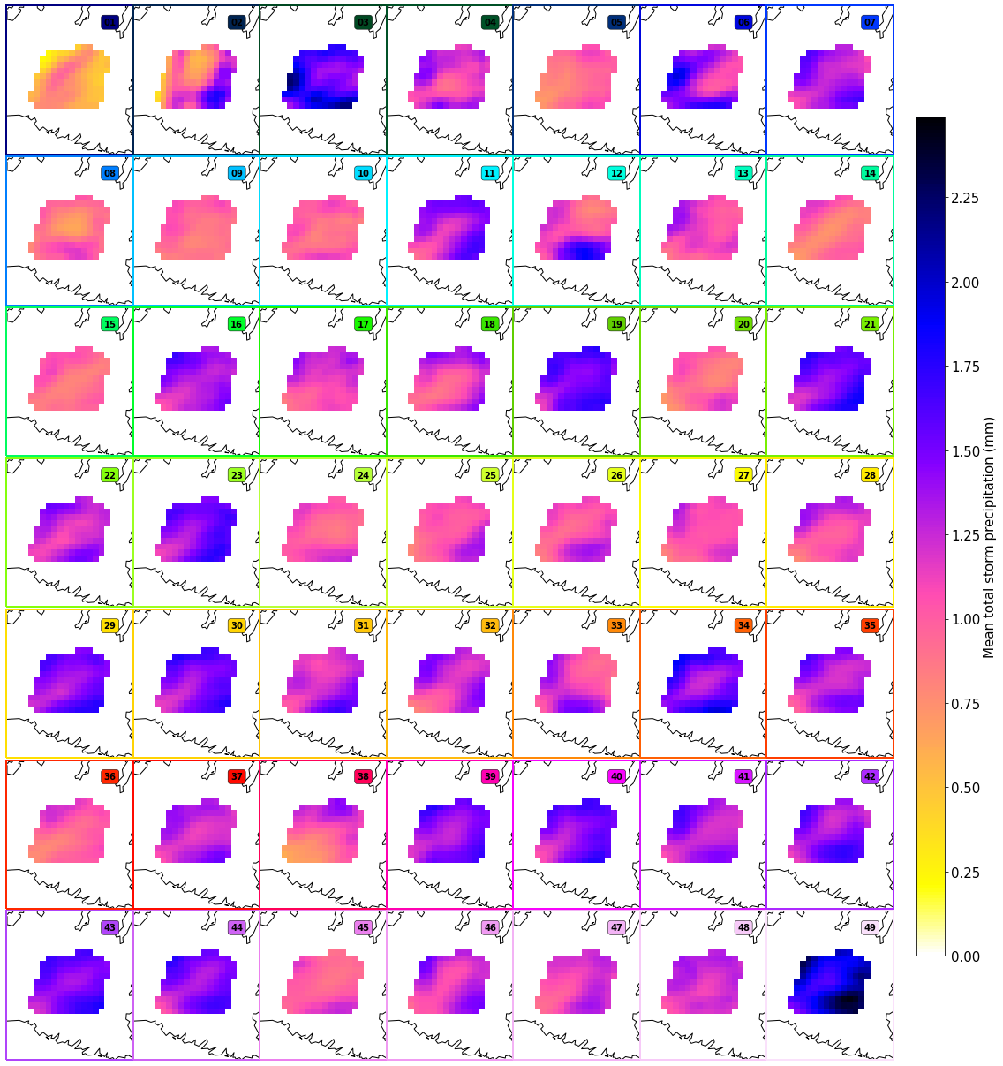
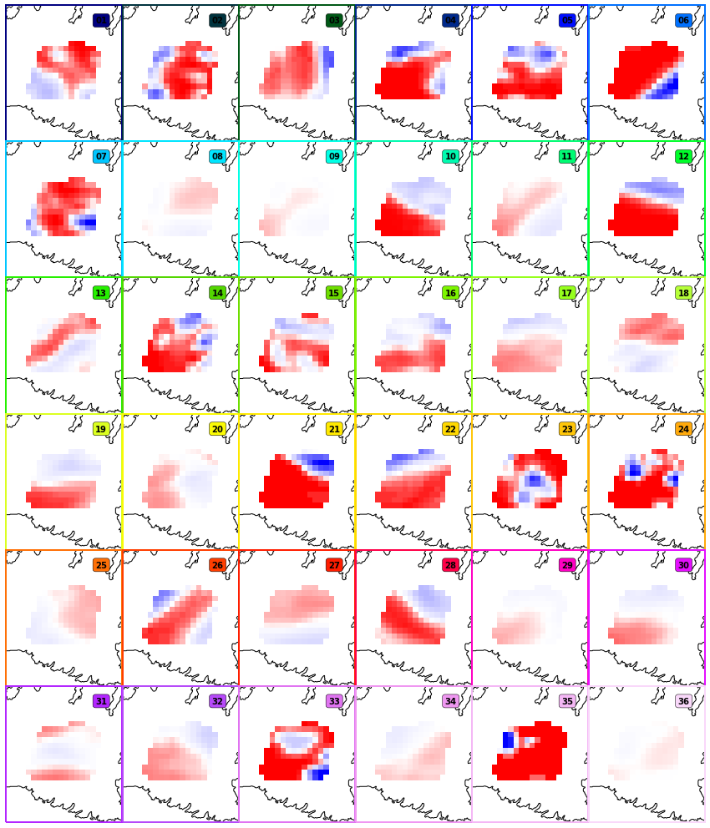
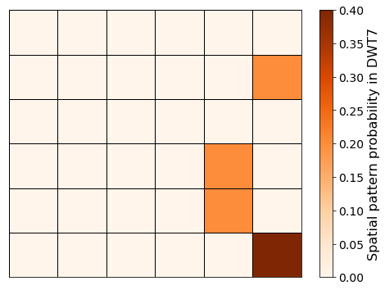
A. Link the spatial patterns and DWTs classifications
DWTs
Spatial patterns
DWT 7
dates
Spatial patterns probability for DWT 7
Compute probability of each spatial pattern
Spatial patterns 12, 23, 29 and 36

Slide 2
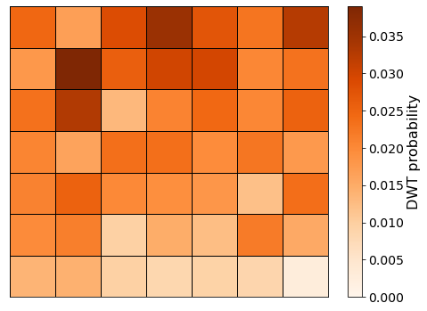
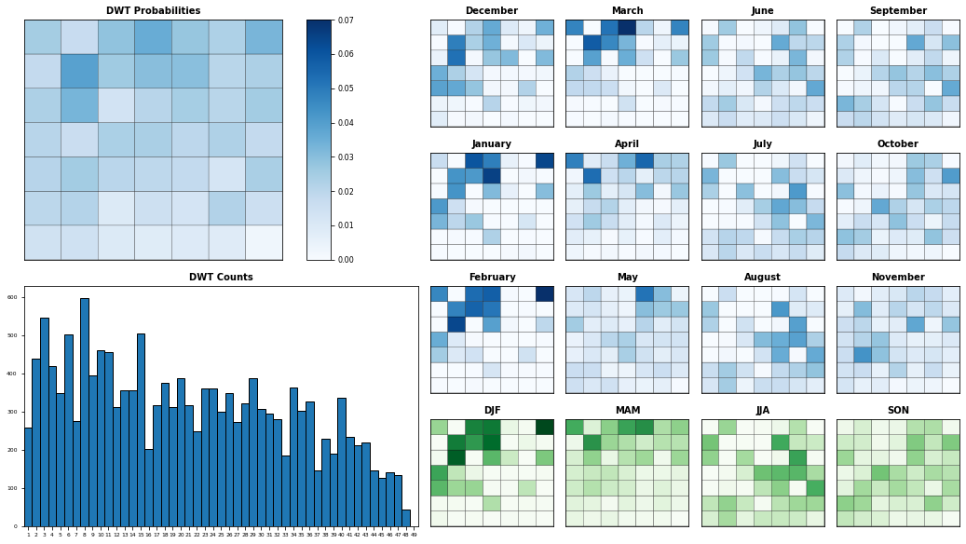
B. DWTs seasonality

Slide 3
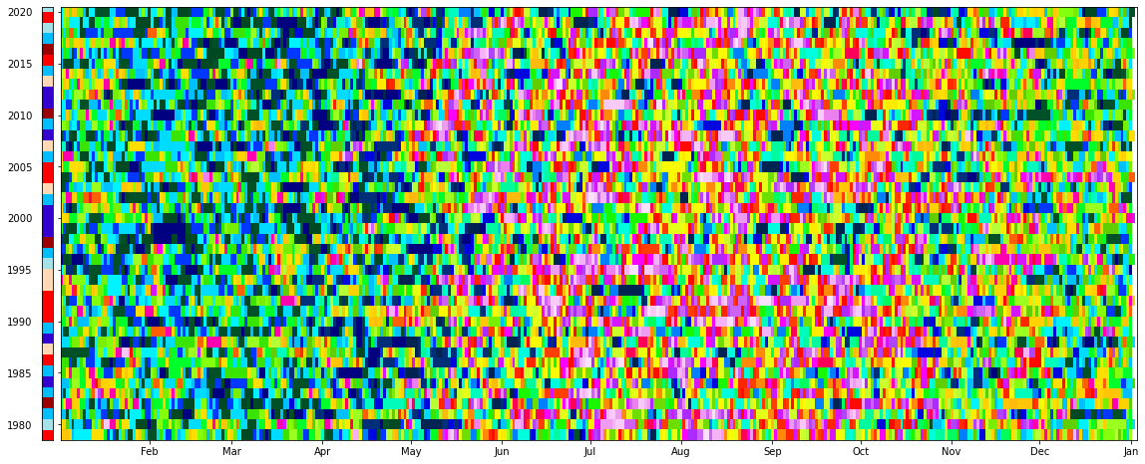
C. DWTs chronology

Slide 4
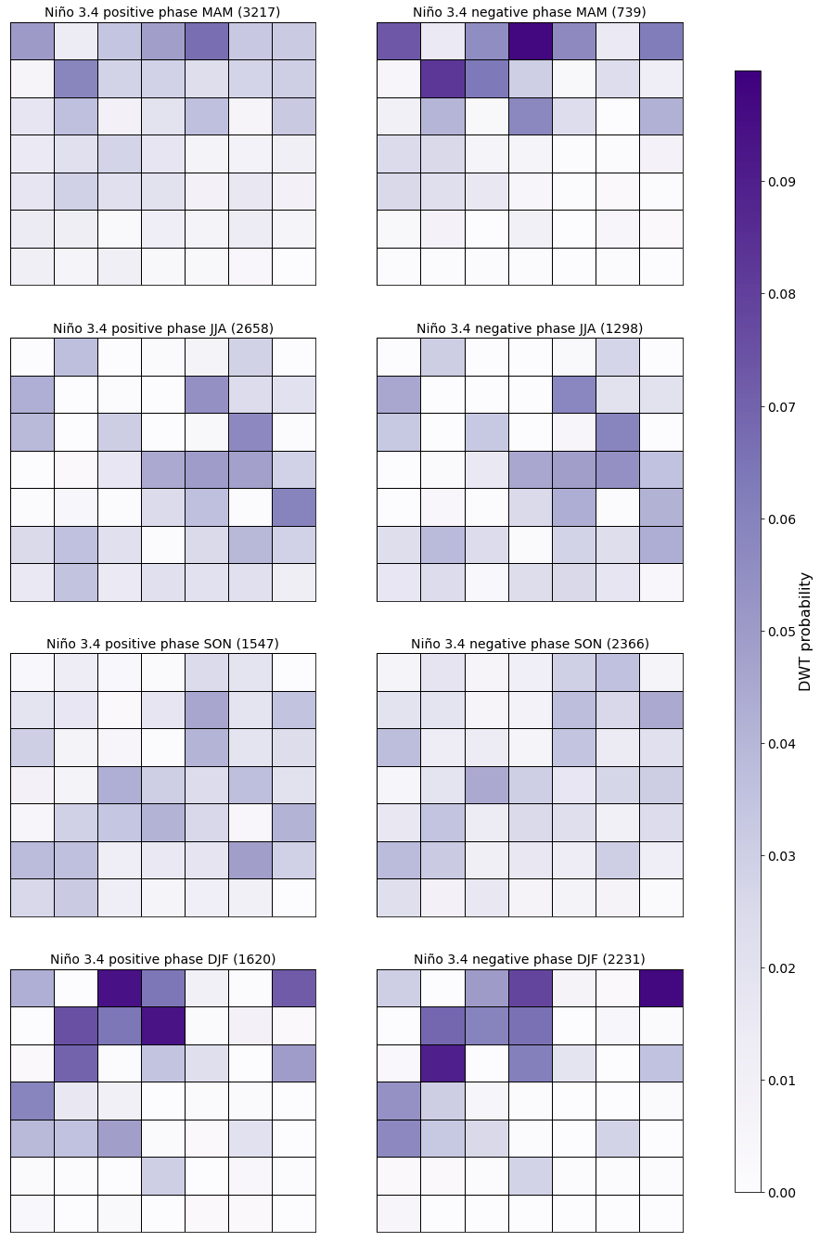
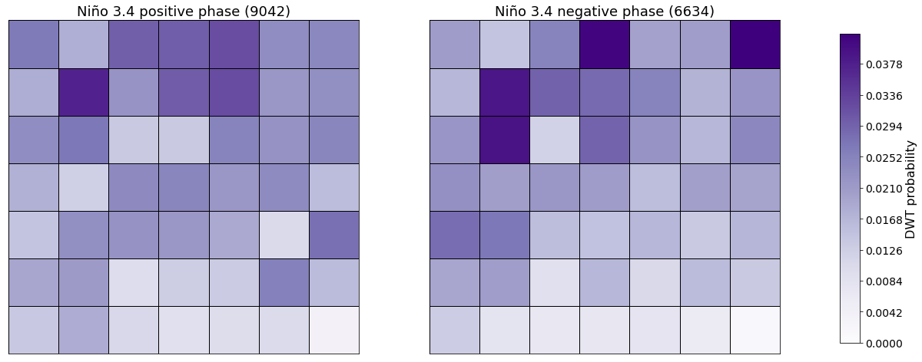
D. DWTs and large scale climatic patterns
ENSO → El niño 3.4 index

Slide 5
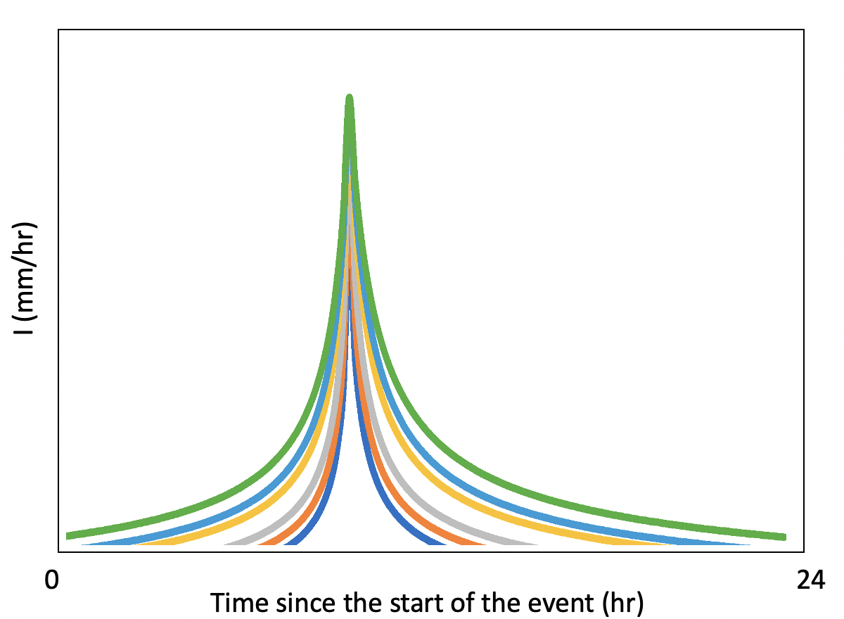
E. Storms temporal dimension, 𝑰 (𝒕)
A (Precipitation)
More parameters?
= $\int_{0}^{D}{I \left(t\right)dt}$
Ip
2 parameters: Ip and D
Area (A)
D

Slide 6
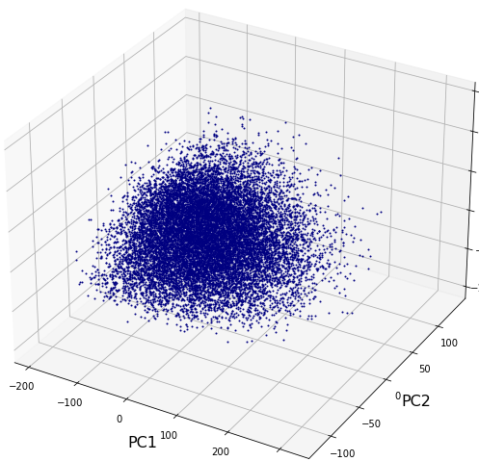
F. Generate and select
flooding scenarios
For simplicity this is a 3D representation of the parameters space
Parameters space
{Ip, D, L_{l} , f, PC1, PC2, PC3}
{Ip, D, L_{l} , f, 36 S(x)}
Sampling algorithm
Selection algorithm

