Slide 1
Middepth Zonal Velocity in the Southern Tropical Indian Ocean:Striation-Like Structures and Their Dynamics
YIFAN XIAª AND YAN DU^{a,b,c}
a State Key Laboratory of Tropical Oceanography, South China Sea Institute of Oceanology, Chinese Academy of Sciences,Guangzhou, China
b Southern Marine Science and Engineering Guangdong Laboratory (Guangzhou), Guangzhou, China
c University of Chinese Academy of Sciences, Beijing, China
Xia Yifan and Yan Du (2022), Middepth Zonal Velocity in the Southern Tropical Indian Ocean: Striation-like Structures and Their Dynamics. Journal of Physical Oceanography, DOI:10.1175JPO-D-21-0222.1

Slide 2
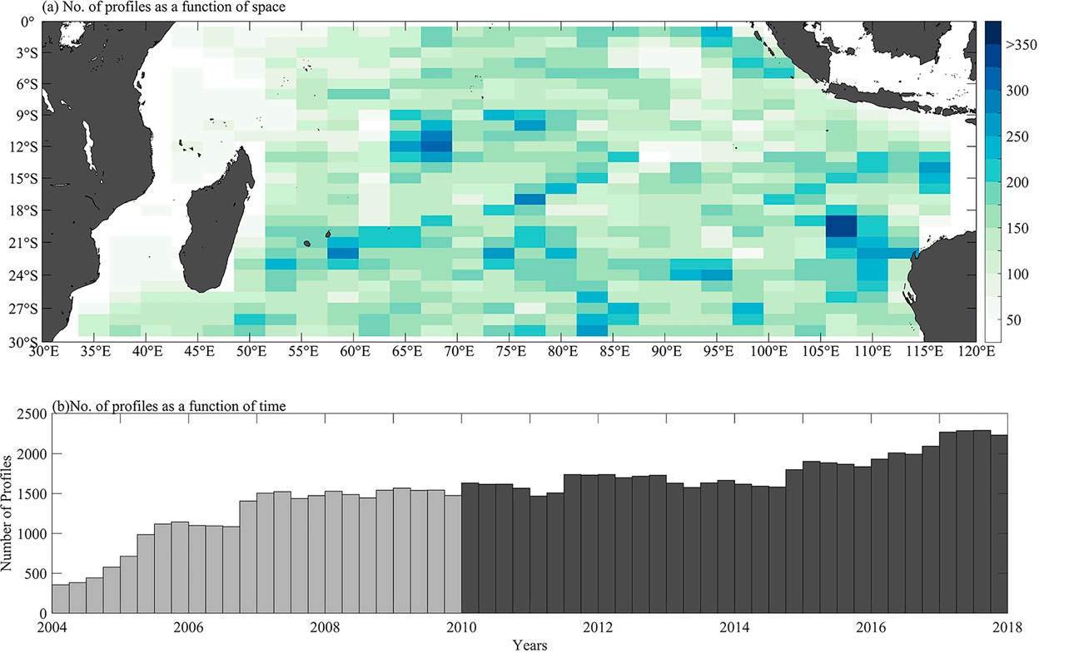
Middepth zonal velocity in the STIO
Middepth striations were detected in the equatorial and southeastern STIO with a meridional scale of ~300 km

Slide 3
Vertical structure
wind force driven？
The latitude–depth sections of the averaged zonal velocities show that the core depth of the zonal velocity shoal from south to north;
The middle layer is consistent with wind-driven Sverdrup transport , while the deeper layer shows quasi-zonal striations.

Slide 4
The zonal velocity (color shading) and time-mean PV gradient convergence
GPV gradient has a negative relationship with the strength of eddies, the EKE divergence is consistent with the GPV gradient convergence
the GPV gradient convergence edge is consistent with the eastward flow

Slide 5
Generation mechanism of the quasi-zonal striations: Eddies nonlinear interaction
Turbulent Sverdrup balance
Mean PV Adv
Eddy PV Flux Divergence
the consistance indicating that the mean flow is driven by eddy nonlinear interactions
Mean PV Adv
Eddy PV Flux Divergence
Mean PV Adv
Eddy PV Flux Divergence
Mean PV Adv
Eddy PV Flux Divergence
Mean PV Adv
Eddy PV Flux Divergence

Slide 6
what affect the structure of EKE high value in middepth?
The necessary conditions for the
baroclinic instability to occur are
Baroclinic instability may generate eddies!

Slide 7
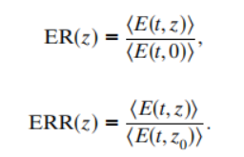
EKE increasing in middepth layer due to BCR
it is indicating that some mechanisms enhanced the EKE value at the middepth layer.
the baroclinic instability in the middepth zonal striations is strong and responsible for the high EKE value at middepth

Slide 8
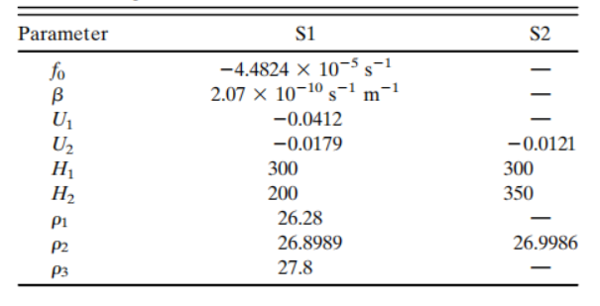
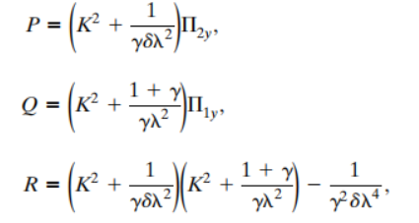
meridional scale of the quasi-zonal striations
the most unstable zonal wavelength is ~300 km in both scenarios
it is consistant with the meridional scale of the quasi-zonal striations.

Slide 9
Summary：
The results reveal alternating quasi-zonal striation-like structures of middepth zonal velocity
In the equatorial and southern tropical Indian Ocean, with a meridional scale of 300 km
The convergence/divergence of the eddy PV flux generates the quasi-zonal striations but generation mechanisms of the eddies differ between the near-equatorial and off equatorial regions.
In near-equatorial region, The triad of baroclinic Rossby wave instability plays a significant role; In the south, the strong baroclinic instability,which increases the eddy kinetic energy in the middepth layer, thus contributing to a turbulent PV gradient.

