Slide 1
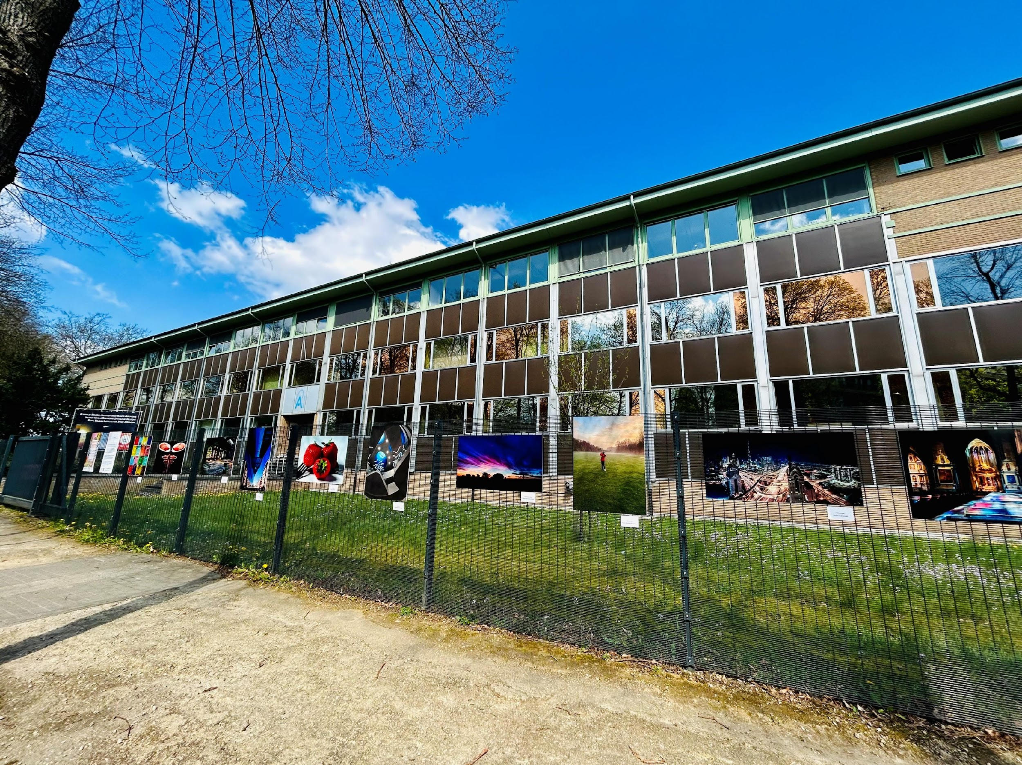
Seasonal, Inter-annual and Long-term Changes in the Middle Atmospheric
Carbon Monoxide Over the Tropics
Oindrila Nath^{1,2} , Jayanarayanan Kuttippurath² , S. Sridharan³ , Wuhu Feng⁴
¹Royal Belgian Institute for Space Aeronomy, Av. Circulaire 3, 1180 Uccle, Belgium
²CORAL, Indian Institute of Technology Kharagpur, 721302 Kharagpur, India
³National Atmospheric Research Laboratory, Gadanki, 517112 Tirupati, India
⁴National Centre for Atmospheric Science, University of Leeds, Leeds LS2 9PH,
U.K.; School of Earth and Environment, University of Leeds, Leeds LS2 9JT, U.K

Slide 2
Seasonal, Inter-annual and Long-term Changes in the Middle Atmospheric
Carbon Monoxide Over the Tropics
Dynamic tracer
Importance of CO in the middle atmosphere
Natural oscillations and their effects
Long-term CO trend
QBO, Solar Cycle, ENSO
Oindrila Nath^{1,2}, Jayanarayanan Kuttippurath², S. Sridharan³, Wuhu Feng⁴
¹Royal Belgian Institute for Space Aeronomy, Av. Circulaire 3, 1180 Uccle, Belgium
²CORAL, Indian Institute of Technology Kharagpur, 721302 Kharagpur, India
³National Atmospheric Research Laboratory, Gadanki, 517112 Tirupati, India
⁴National Centre for Atmospheric Science, University of Leeds, Leeds LS2 9PH,
U.K.; School of Earth and Environment, University of Leeds, Leeds LS2 9JT, U.K
MLR
PICO spot 5 I PICO Screen 5.4

Slide 3
Outline
Sources and sinks of CO in atmosphere
Present study
Data and Methodology
Results
Summary

Slide 4
Sources of CO in the atmosphere
In lower atmospheric heights, CO is produced by the oxidation of methane (CH₄) or Nonmethane hydrocarbons, such as isoprene. Other important sources of CO are biomass burning, and the combustion of fossil fuels.
CO is produced by the photodissociation of CO₂ in the lower thermosphere (Hays and Olivero, 1970; Solomon et al., 1985; Bates and Witherspoon, 1951):
CO₂+hν → CO+O (121 nm<λ<200 nm) (1)
The photolysis varies with solar intensity and thus, becomes a function of altitude. There are two other sources of CO in thermosphere: the photolysis of CO₂ and the reaction of CO₂ with atomic oxygen ion (Lee et al., 2018):
CO₂+hν → CO+O (λ<121 nm) (2)
CO₂+O⁺ → CO+O₂⁺ (3)
Reaction (1) is dominant below 100 km, and the reactions (2) and (3) in the thermosphere (Garcia et al., 2014).

Slide 5
Sinks of CO in the atmosphere
The dominant sink of CO in lower atmosphere is oxidation by hydroxyl radical (OH) (Wallace and Hobbs, 2006):
CO + OH→ H + CO₂ (4)
Above 100 km, loss of CO is governed by a three-body reaction involving atomic oxygen:
CO+O+M→CO₂+M (5)
In upper stratosphere and mesosphere, CO is dissociated by reaction with OH (Brasseur and Solomon, 2005; Ryan et al., 2018).
CO+OH→CO₂+H (6)
This is a daytime reaction and due to low amount of OH in stratosphere, the lifetime of CO (about 15–20 days in the upper stratosphere; Minschwaner et al., 2010) in this region is enough to be transported to mesosphere, which makes CO a good dynamic tracer there.

Slide 6
Previous studies
There are a few studies related to the seasonal and long-term variation of CO in troposphere based on the ground-based observations (e.g. Novelli et al., 1992; 1998). The studies reported highest VMRs in the northern winter (200-220 ppb) and lowest in southern summer (35-45 ppb). They also observed notable seasonal variability with higher values during February-March and less value during July-August.
Studies on CO have been limited to troposphere and extra-tropical atmosphere (Seiler et al., 1984; Brunke et al., 1990; Hoor et al., 2004; Folkin et al., 2006).
Lee et al. (2018) studied the effect of solar variability on CO using long-term satellite observations, and found that the mesospheric CO concentrations are largely driven by the solar cycle.

Slide 7
Objective for the present study
To investigate the seasonal variation of CO in the tropical middle atmosphere
To study the response of CO to natural oscillations viz. Quasi biennial Oscillation, Solar Cycle, ENSO
To study the long-term trend of CO in the tropical middle atmosphere

Slide 8
Data and Methodology
CO data: Aura-MLS
CO₂ data: CAMS reanalysis and TIMED-SABER
QBO: Free University of Berlin
Solar Cycle and SOI: NOAA PSL database

Slide 9
Multivariate Regression Analysis
We have used a multivariate linear regression model to find the signal and quantify the contribution of QBO, solar cycle and ENSO (Randel and Cobb, 1994) to the observed CO variation. The general expression for the regression at each altitude is
$CO(t)=α(t)+β(t)⋅t+γ_{1}(t)⋅QBO_{1}(t)+γ_{2}(t)⋅QBO_{2}(t)+δ(t)⋅solar(t)+ε(t)⋅Enso(t)+resid(t)$ where α(t) in the above equation have the form $α(t)=A_{0}+\sum_{i=2}^{12}{\left[A_{i}×Cosω_{i}t+B_{i}×Sinω_{i}t\right]}$, where $ω_{i}=\frac{2πi}{24}$
α(t) represents seasonal and intra-seasonal variations. If ‘S’ is the sum of square of residuals, ‘n’ is data length and ‘p+1’ is the number of coefficients to be determined, then the error in the estimation of coefficients are given by $σ_{}=\sqrt{\frac{S}{n−p−1}{\left(X^{T}X\right)}_{}^{−1}}$, where X is the matrix of the regressors.

Slide 10
Multivariate Regression Analysis
Proxies
For QBO proxies, we have followed Li et al. (2008) - the QBO₁ component is highly correlated with the zonal wind difference between 10 and 70 hPa, and the QBO₂ component is highly correlated with the zonal winds at 30 hPa. We consider F10.7 solar radio flux as solar proxy, and Southern Oscillation Index (SOI), which is the difference of the normalised monthly-mean sea-level pressures (hPa) between Tahiti (18°S, 150°W) and Darwin (13°S, 131°E), as ENSO proxy, corresponding to the months.

Slide 11
Results

Slide 12
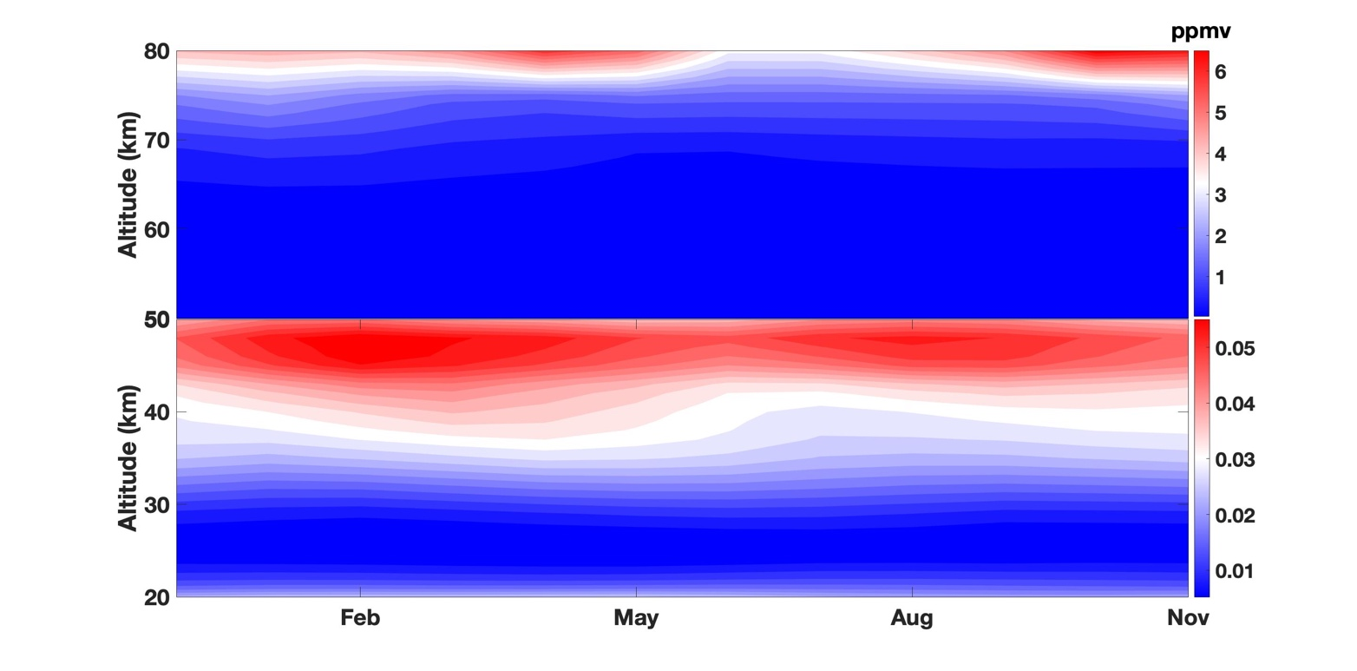
In the mesospheric heights (70-80 km), we can see higher CO values (around 0.05 ppmv) during the winter months (DJF) which is due to decrease in solar intensity during this time, for which the photolysis reactions get decelerated. There is an increase during summer months (MAM) which is attributed to vertical mixing due to tidal wave (Lee et al., 2018).
Seasonal variation of CO in the middle atmosphere

Slide 13
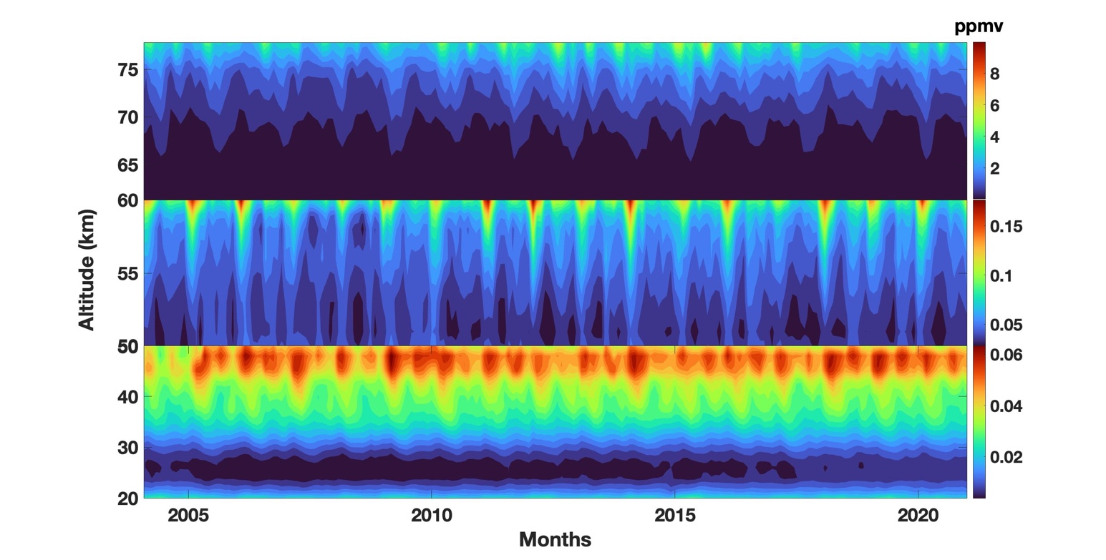
The figure shows interannual variation in the CO VMR in all the three height ranges (20-50km, 50-60km, and 60-80km). The CO minimum in the middle atmosphere is found in the altitude range of 20-25 km, where the values are around 0.01 ppmv. However, there is a slight increase in CO values in the lower stratospheric heights (20-30km) 2017 afterwards. Long-term studies by Chen et al. (2020) reveals a decline in tropospheric CO till 2017.
Distribution of CO in the middle atmosphere

Slide 14
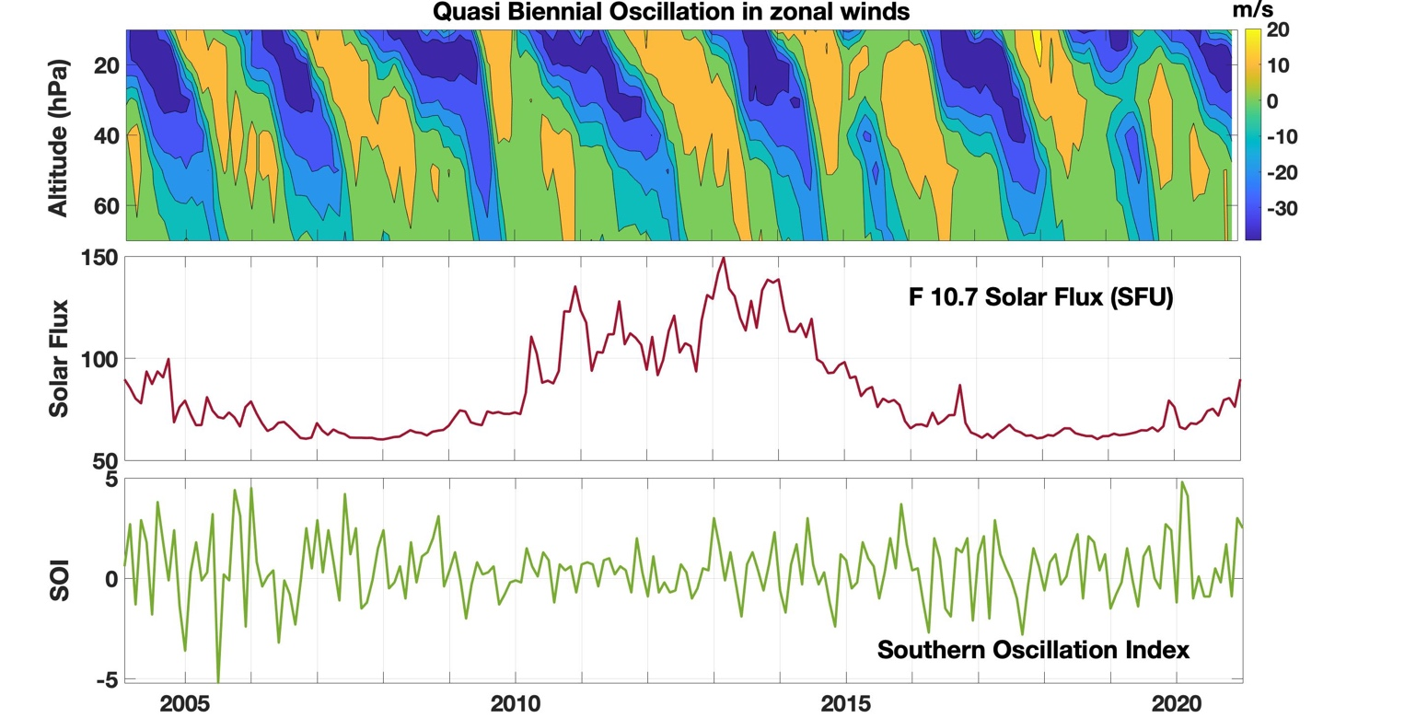
What drives changes in CO in the middle atmosphere??

Slide 15
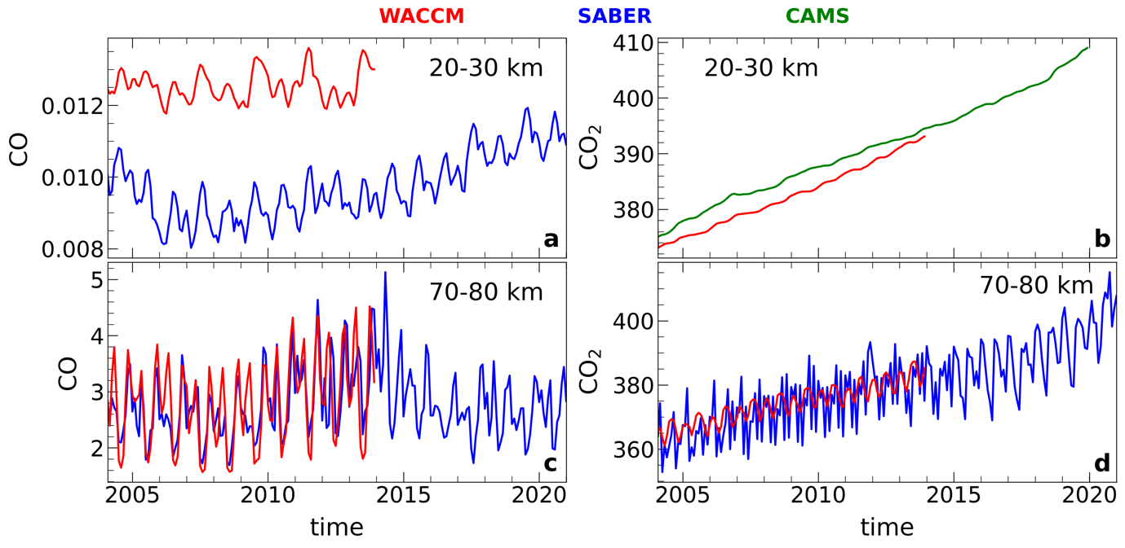
Simulation of CO in the middle atmosphere
satellite and model show similar type of variation for both the species, especially it is matching very well in the 70-80 km i.e. in mesosphere. In the stratospheric height range, the values differ by very small amount – in case of CO it is around 0.006 ppmv whereas in case of CO₂ it is around 5 ppmv.

Slide 16
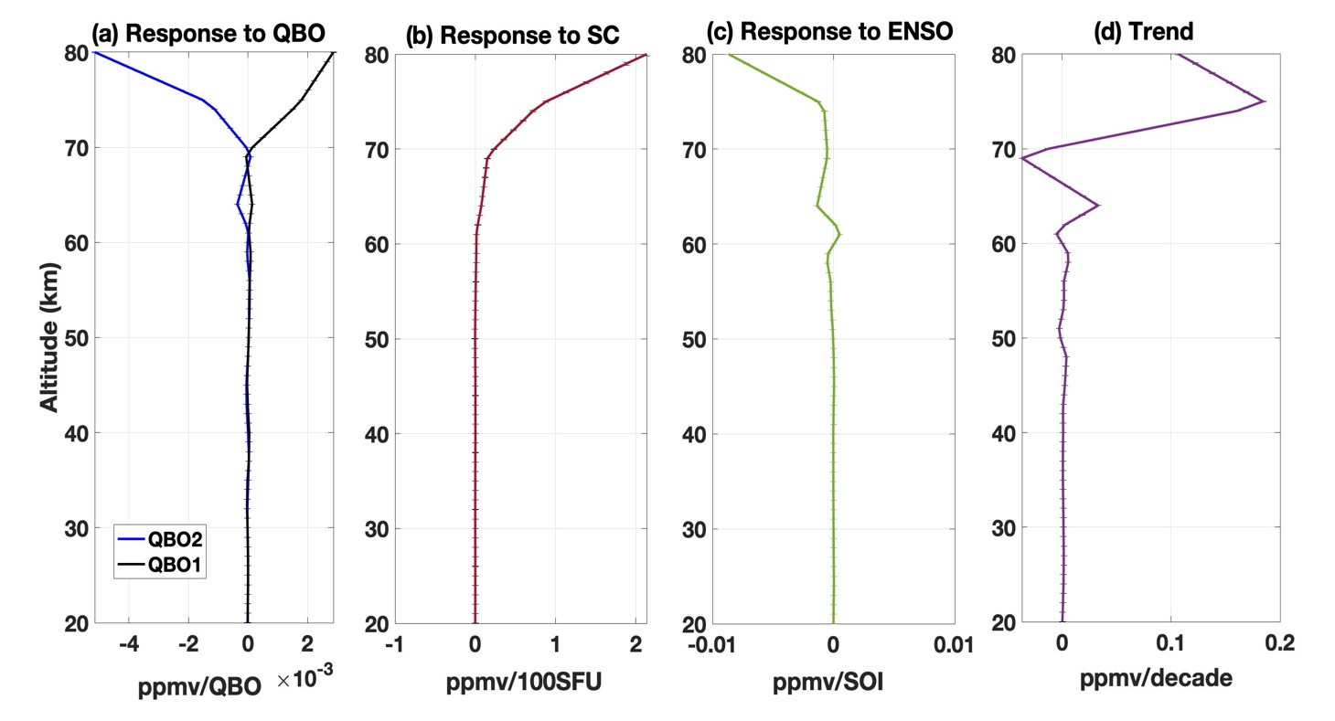
CO Response to the climate modes
The CO VMR shows insignificant response to QBO and ENSO up to 70 km. Above 70 km, QBO₁ and QBO₂ depict a positive and negative response respectively with increasing height.
According to Jones et al. (2001), during El Niño events, the CO₂ concentration in atmosphere increases due to decreased gross primary productivity and increased plant and soil respiration. Opposite occurs during La Nina events.
The CO VMR response to solar cycle is positive 65 km above and increasing with height. During more solar insolation the CO₂ photodissociation rate is increased which will result in more CO concentration in mesosphere (Lee et al., 2018). Increase in CO₂ trend has been reported throughout the middle atmospheric height region in recent studies (Puertas et al., 2017; Rezac et al., 2018).

Slide 17
Trend in CO
A positive trend of around 0.03 ppmv/decade is observed around 64 km whereas a negative trend (-0.03 ppmv/decade) around 69 km is found. The trend is highly positive in the upper mesosphere, peaking at 75 km (0.19 ppmv/decade).
Ruzmaikin et al. (2014) found that the major spatial-time structures (principal components) of the CO variability are localized in the 0.01–0.001 hPa range of the middle atmosphere (upper mesosphere to low thermosphere) with maxima in the low thermosphere at 0.002 hPa (near the mesopause, at about 90 km).

Slide 18
CO₂ response to climate modes
CO₂ response to QBO is highly positive in the stratosphere except in the upper stratosphere (45-50 km) where it is slightly negative. In mesosphere also it shows a positive response. QBO periods have been found to become longer due to a warmer climate due to CO₂ doubling (Kawatani et al., 2011).
CO₂ response to solar cycle is positive in the height range 30-40 km, negative in 40-62 km, again positive in 63-75 km and increasingly negative above that. Salinas et al. (2018) reported CO₂ decrease with solar max in MLT region. Doyennel et al. (2021) shown strong positive correlation between solar irradiance and CO.
CO₂ response to ENSO in negative throughout the entire height range. During an El Niño event, the upwelling in the equatorial Pacific is much reduced, thus reducing the amount of cold, carbon-rich deep water reaching the surface. This results not just in the familiar El Niño SST warming pattern, but also in a reduction of surface pCO₂ in that region, and hence a reduction in the normally large outgassing of CO₂ to the atmosphere (Jones et al. 2001).

Slide 19
Trend in CO₂
CO₂ trend is positive in middle atmosphere with the absolute value increasing with height.

Slide 20
Summary
CO VMR shows a distinct semi-annual oscillation in the middle atmosphere.
Higher CO values are observed during the winter months (DJF) which is due to decrease in solar intensity during this time, for which the photolysis reactions get decelerated; and during summer months (MAM) which is attributed to vertical mixing due to tidal wave (Lee et al., 2018).
Above 70 km, QBO₁ and QBO₂ depict a positive and negative response respectively with increasing height. The CO VMR response to solar cycle is positive 65 km above and increasing with height.
The trend is highly positive in the upper mesosphere, peaking at 75 km.

Slide 21
Questions/Suggestions
oindrila.nath@aeronomie.be

