Slide 1
Assessment of the impact of mesoscale eddies on the large-scale physical and biogeochemical responses under climate change
Xi Ruan, Damien Couespel, Marina Lévy, Jiying Li, Julian Mak, and Yan Wang
RUAN Xi Email: xruanaa@connect.ust.hk Supervisor: Julian Mak

Slide 2
Mesoscale eddies (10-100km)
Baroclinic instability
Release potential energy
Flatten isopycnals
Large-scale impact (nutrient stream, NPP)
Model resolution near 1˚ (100km)
Eddy induced velocity (GM scheme)
$u^{∗}=−∇×(κ_{gm}s)$
R1, R4 simulations
(Gent, & McWilliams, 1990)
$s=M^{2}/N^{2}$ – isopycnal slope
$M^{2}$ – horizonal buoyancy gradient
$N^{2}$ – buoyancy frequency
(Williams, & Follows, 2011)
Notes:
Gent, P. R., & Mcwilliams, J. C. (1990). Isopycnal mixing in ocean circulation models. Journal of Physical Oceanography, 20(1), 150-155.
Williams, R. G., & Follows, M. J. (2011). Ocean dynamics and the carbon cycle: Principles and mechanisms. Cambridge University Press.

Slide 3
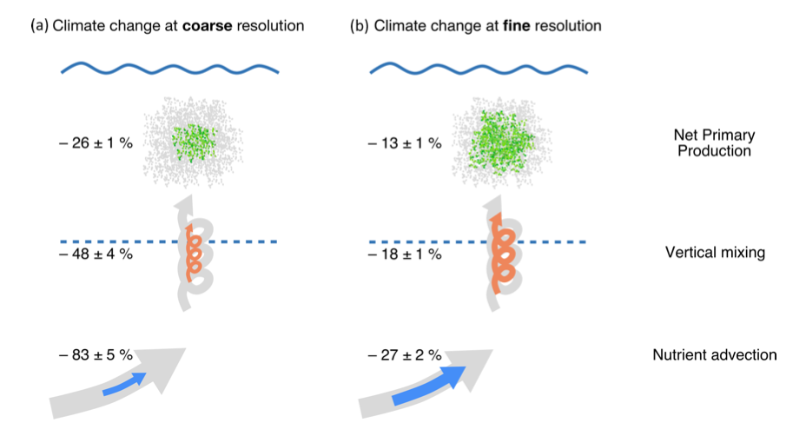
Parameterisation
GM-based GEOMETRIC parameterisation:
$κ_{gm}= α\frac{\int{E}dz}{\int{(M^{2}/N})dz}$
$\frac{∂}{∂t}\int{E}dz+ ∇_{H}∙\left(({\tilde{u}}^{z}−\left|c\right|e_{x})\int{E}dz\right)= \int{κ_{gm}\frac{M^{4}}{N^{2}}dz − λ\int{(E−E_{0})}dz+ η_{E}∇_{H}^{2}\int{E}dz }$
Standard GM parameterisation:
$κ_{gm}= κ_{0}=constant$
(Gent, & McWilliams, 1990)
E – total eddy energy
advection
source
dissipation
diffusion
(e.g., Marshall et al., 2012)
R12 (1/12˚), CONST (1˚) vs. GEOM (1˚)
advection
source
dissipation
diffusion
(Couespel et al., 2021)
$κ_{gm}=1000m^{2}s^{−1}$ ${ κ}_{gm}=$ $κ_{gm}(x, y,t)$
Notes:
Couespel, D., Lévy, M., & Bopp, L. (2021). Oceanic primary production decline halved in eddy-resolving simulations of global warming. Biogeosciences, 18(14), 4321-4349.
Marshall, D. P., Maddison, J. R., & Berloff, P. S. (2012). A framework for parameterizing eddy potential vorticity fluxes. Journal of Physical Oceanography, 42(4), 539-557.

Slide 4
Biogeochemical responses
z
y
x
 | R12 | CONST | GEOM
NPP ($mmol N m^{−2} {day}^{−1}$) | 3.67 | 2.76 | 2.91
NPP sensitivity | -13.8% | -22.9% | -23.6%
?
NEMO (v4.0.5) + LOBSTER (Lévy et al., 2012) (no physiological change)
Subpolar gyre region
Does the GEOMETRIC parameterisation do improve the physical responses?

Slide 5
Physical responses
 |  | R12 | CONST | GEOM
$Ψ_{MOC}$ $(Sv)$ ($L^{2}$ mismatch rel. R12) | CTL | -- | 2.29 | 1.99
 | CC | -- | 1.87 | 1.63
MLD $(m)$ | CTL (median) | 592 | 378 | 486
 | CC (median) | 388 | 234 | 296
 | 1-Wasserstein | 217 | 170 | 216
Physical responses employing GEOMETRIC parameterisation are improved, biophysical response?

Slide 6
Biophysical response
z
y
x
Not have the benefit of two ‘wrongs’ cancelling out as in the CONST

Slide 7
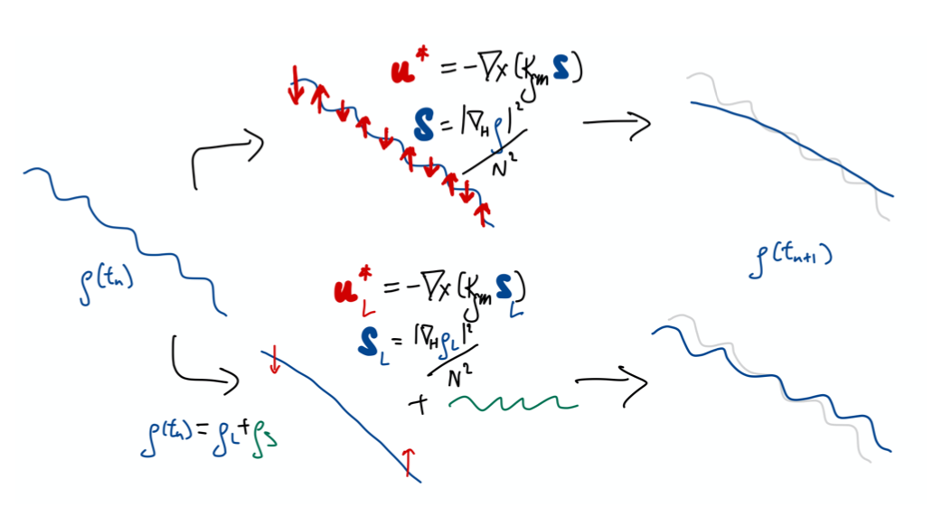
Eddy permitting models (1/4˚)
Increasing computational power
Parameterise or not? Under count / double-count the eddies
A field splitting approach
(Mak et al., in prep.)

Slide 8
Biogeochemical response
z
y
x
 | R12 | R4 | R4_GEOM | R4_split | R1_GEOM
NPP ($mmol N m^{−2} {day}^{−1}$) | 3.67 | 3.91 | 2.55 | 3.62 | 2.91
NPP sensitivity | -13.8% | -11.5% | -21.2% | -12.2% | -23.6%
R4 is too ‘good’ compared to the R1_GEOM
R4_GEOM damps the explicit eddies and acts like R1_GEOM
R4_split is improved over the R4 and R4_GEOM

Slide 9
Summary and outlooks
Spatially varying $κ_{gm}(x, y,t)$ in GEOM affords benefits to the responses
‘Better’ biogeochemical response in CONST arises from physically inconsistent response
Be careful when use a single metric to judge a parameterisation
The field splitting approach used in R4_split avoids damping of explicit mesoscale eddies
Use in conjunction with the backscatter approach (Bachman, 2019) ?
RUAN Xi Email: xruanaa@connect.ust.hk Supervisor: Julian Mak

