Slide 1
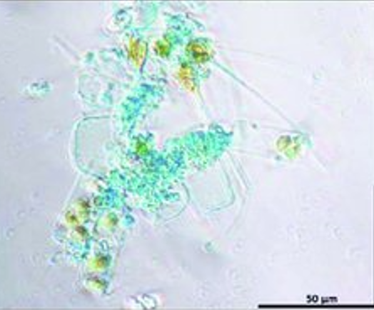
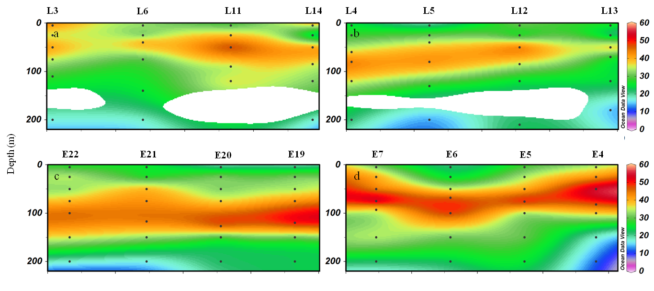
EGU23-2614: Distribution of transparent exopolymer particles and their role in the carbon export in the South China Sea and western tropical North Pacific
Shujin Guo¹, Mingliang Zhu¹, Xiaoxia Sun^{1*}
Institute of Oceanology, Chinese Academy of Sciences, Qingdao, China.
*Corresponding email: xsun@qdio.ac.cn
Research background and goal: Transparent exopolymer particles (TEP) are transparent polysaccharide-enriched particles in the ocean. It has high carbon content, and can increase aggregate formation with other organic particles. The role of TEP in the carbon cycle remains inadequately understood in oligotrophic tropical oceans. This study investigates TEP distribution and sinking fluxes in the South China Sea (SCS) and western tropical North Pacific (WTNP) to provide insight into the role TEP play in the carbon cycle in oligotrophic tropical oceans.
Study area and sampling stations
Results: TEP contribution to POC pool and POC flux
Fig.1 Study area and stations
Fig.2 TEP stained with Alcian Blue
Fig.4 Contributions of TEP, phytoplankton and bacteria to POC in the SCS (a) and WTNP (b).
Results: TEP distribution
Fig.5 Sinking flux of TEP and POC determined with sediment trap in the SCS (a) and WTNP (b).
Conclusion
Fig.3 Sectional distributions of TEP concentrations (μg Xeq. L⁻¹) in the SCS (a, b) and WTNP (c, d)
(1) TEP concentrations were higher in the epipelagic layer than in deeper layers in the SCS and WTNP.
(2) TEP, together with phytoplankton cells, constituted a major part of POC pool.
(3) The sinking flux of TEP constituted a mean of 61% and 46% of the total POC flux in the SCS and WTNP, respectively, indicating their important role in carbon export in these areas.
Table 1 Environmental parameters and TEP concentrations in the surface, DCM and bottom layers in the SCS and WTNP

