Slide 1
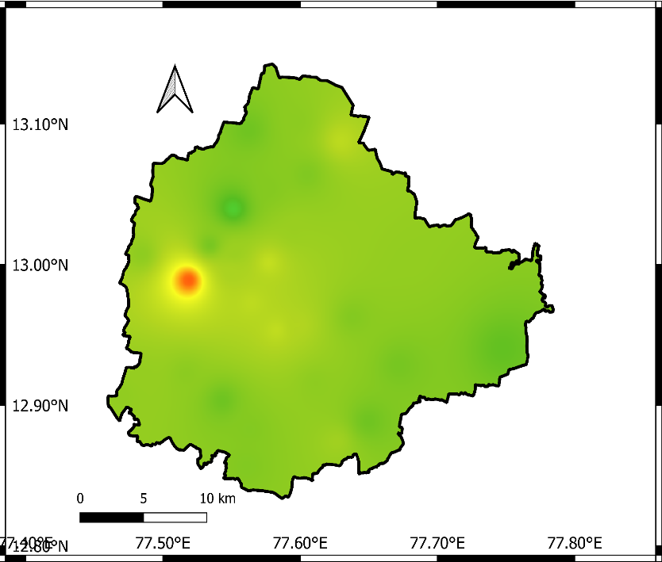
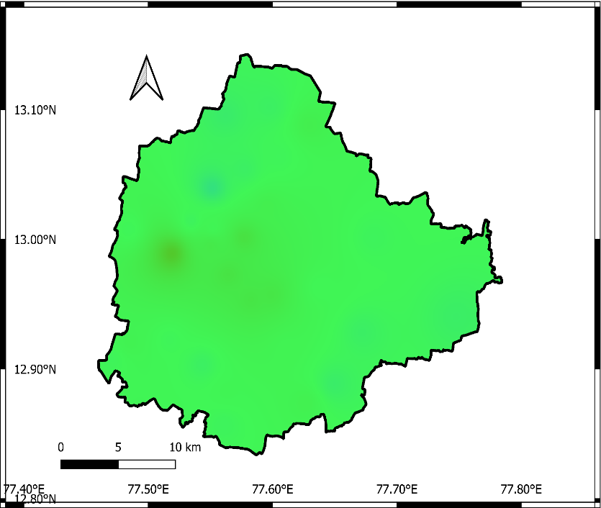
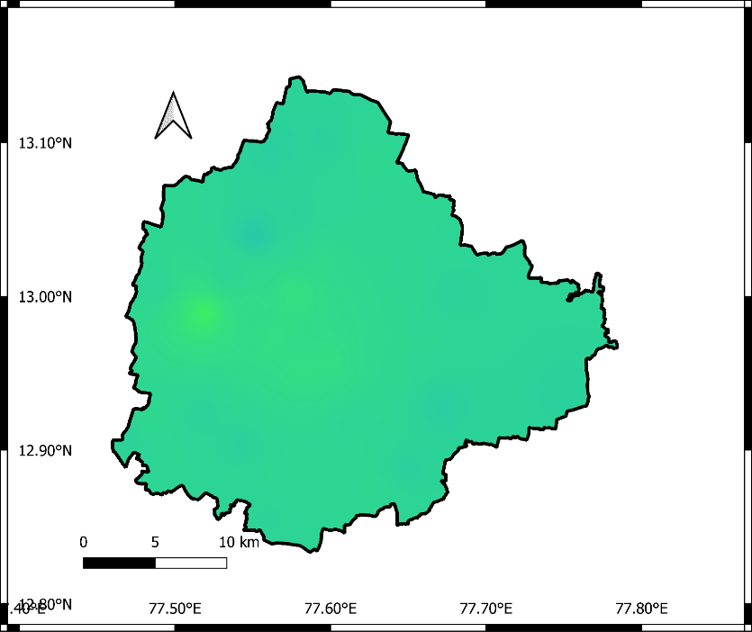
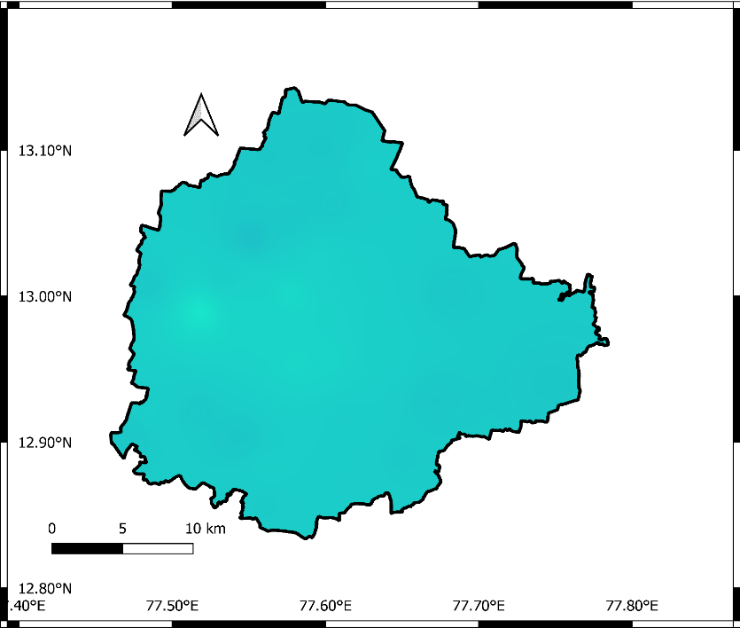
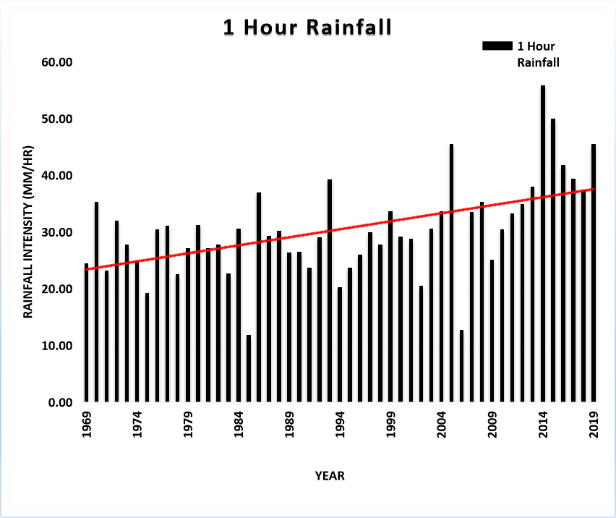
IMPACT OF CLIMATE CHANGE ON NON-STATIONARY INTENSITY-DURATION-FREQUENCY (IDF) CURVES FOR URBAN AREAS
Naman Kishan Rastogi¹, Abhinav Wadhwa², and Pradeep P. Mujumdar^{1,2}
¹Department of Civil Engineering, Indian Institute of Science, Bangalore, India
²Interdisciplinary Centre for Water Research, Indian Institute of Science, Bangalore, India
Introduction
Ranking of Climate Models
Spatial Distribution of Rainfall
In India, high- intensity short-duration rainfall events have become the major reason for flooding in urban areas.
It has been observed recently that there has been a sudden change in events which has rendered the hydrological and hydraulic structures incapable of handling flooding situations.
This study proposes a method for assessment of the non-stationary behavior of spatial and temporal rainfall patterns over urban areas under climate change.
The main aim is to quantify the effect of climate change on the rainfall pattern of urban areas, with the case study of one of the most populated cities in the world – Bangalore city, India.
START
Payoff matrix of GCMs versus Performance Indicators*
10-year Return Period
1hr Rainfall Intensity
10-year Return Period
2hrs Rainfall Intensity
10-year Return Period
6hrs Rainfall Intensity
Weights of Indicators
Preference ranking organization method for enrichment evaluation (PROMETHEE)-2
Pairwise difference between values of GCMs for each indicator
10-year Return Period
12hrs Rainfall Intensity
10-year Return Period
24hrs Rainfall Intensity
Bangalore Boundary
Methodology
Compute preference function
Return Levels (mm/hr)
High: 89
Observed Data (KSNDMC station data)
Identification of Non-Stationary stations
Interpolate IMD gridded data to KSNDMC Station points
IMD Gridded Data (0.25*0.25)
Climate Model Gridded Data
Compute net φ value for each GCM
Develop IDF Relationships
Most suitable GCM ⬄ Highest φ value
Low: 2.5
Ranking of Climate Models
Bi-Linear
Interpolation
Bi-Cubic
Interpolation
No
Yes
Another set of parameters? - Covariates
STOP
Fig. 7. The spatial distribution of rainfall across Bangalore city
Developing IDFs
Temporal disaggregation of Climate model data
Comparison with KSNDMC observed Data
Apply Bias Correction
Conclusions
The intensity of rainfall in Bangalore City has been observed to be increasing substantially.
The western and central region of Bangalore exhibits notable spatial heterogeneity in the occurrence of heavy rainfall events.
Anthropogenic activities like deforestation, construction, and industrialization worsen the impact of heavy rainfall events by affecting natural drainage systems in Bangalore, resulting in flooding.
Training Data
(KSNDMC - Hourly, IMD-15 minutes)
Time-based Split
Sequential Modeling
(LSTM)
Delta Method
Bias Factor
Empirical Quantile Mapping
Quantile
Mapping
Training
Validation
Testing
Generates Loss Function
Covariates Identification
Disaggregated Data
Develops Model
Comparing performance measures
R², MSE, MAE, RMSE, MAPE
Fig. 3. Ranking of Climate models using IMD Data
Fig. 4. Ranking of Climate models using KSNDMC Data
*Performance indicators used in Ranking the Climate Models are Correlation Coefficient, ANMBE, NRMSE & AARE
Acknowledgement
Study area
IDF Curves for IMD & TRG Stations
The authors express their gratitude for the financial support received from the National Supercomputing Mission (NSM) project "Urban Modelling: Development of Multi-sectorial Simulation Lab and Science-Based Decision Support Framework to Address Urban Environmental Issues (Project Sanction Number: MeitY/R&D/HPC/2(1)/2014))" through the Department of Science and Technology (DST) and the Ministry of Electronics and Information Technology (MeitY), which enabled their participation in EGU2023. The authors also acknowledge the support from DST and MeitY.
Additionally, the authors acknowledge the Ministry of Education for providing a stipend during the first author's M.Tech. program at IISc, and express their gratitude for the support.
INDIA
Fig. 1. Spatial distribution of 100 Telemetric Rain Gauge (TRG) stations
Fig. 2. Rainfall trend at TRG station- Vidyaranyapura
Source: IMD (1969-2019)
Source: KSNDMC (1969-2021)
Contact: Naman Kishan Rastogi
Master of Technology (M.Tech.)
Indian Institute of Science, Bangalore
Fig. 5. IDF Curve for IMD Station
Fig. 6. IDF Curve for Kottegepalya (TRG-99)
namanrastogi@iisc.ac.in, namanrastogiiisc@gmail.com

