Slide 1

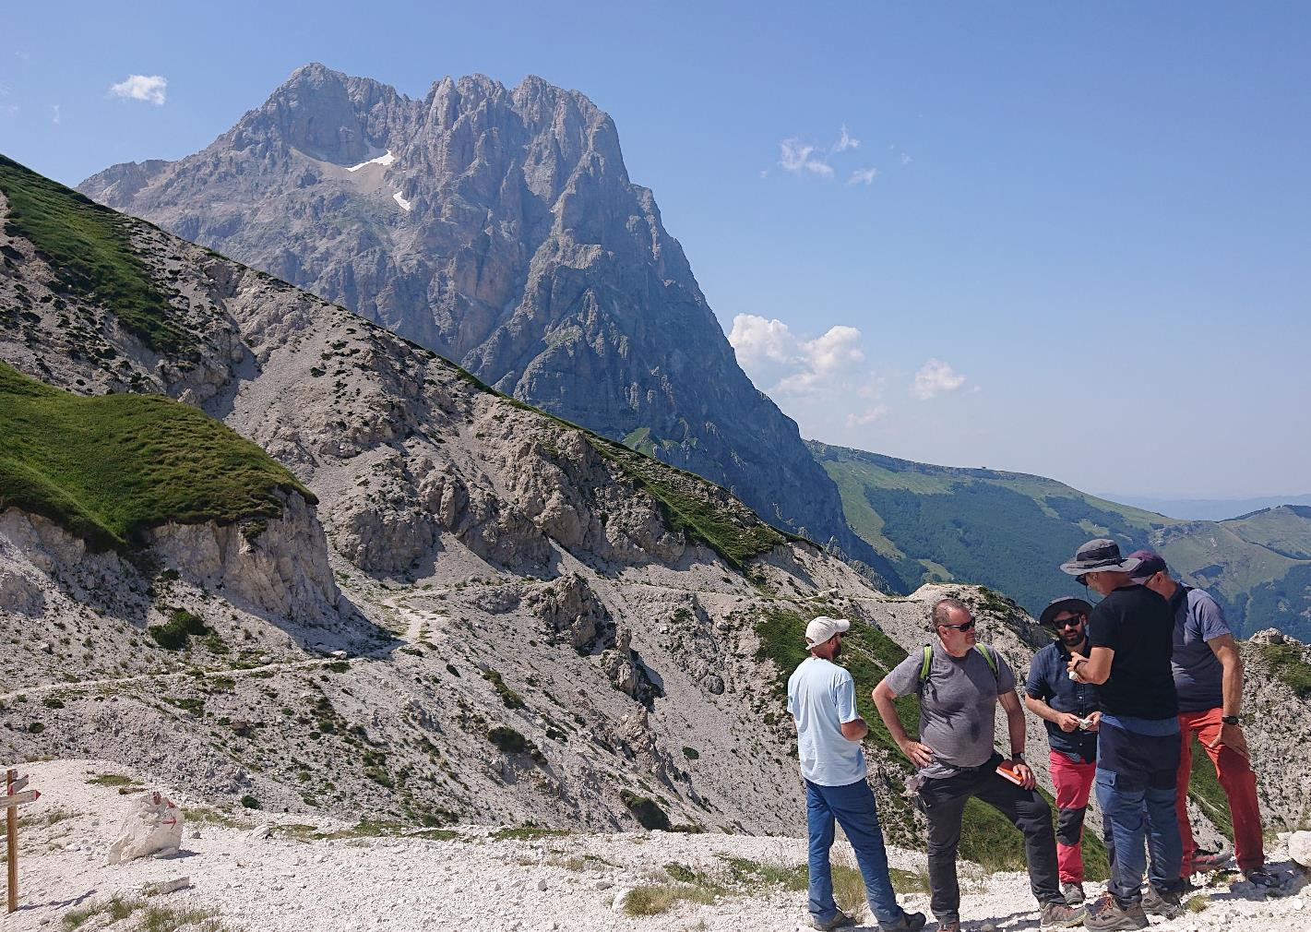




The role of rifting related structural inheritance on the Apennine belt development
PhD student: aAugusto Maresca
Tutor: a zProf. Stefano Tavani
Co-tutors:-- zDott. K. Ogata
Prof. G. Manatschal
Prof. J. A. Muñoz
Prof. P. M. Granado
EGU23 Supplementary Material

Slide 2
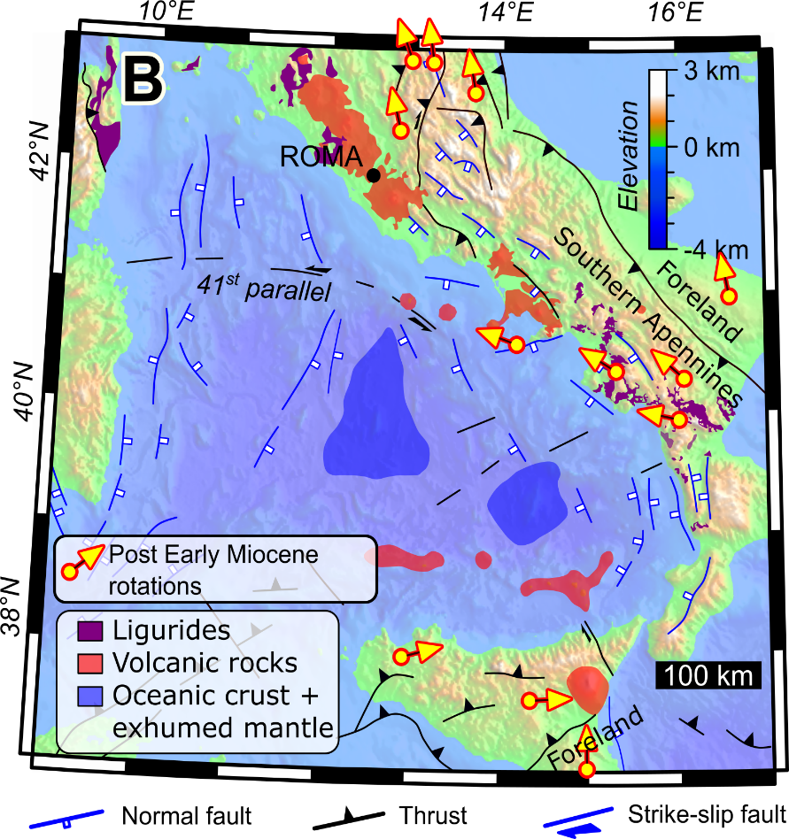
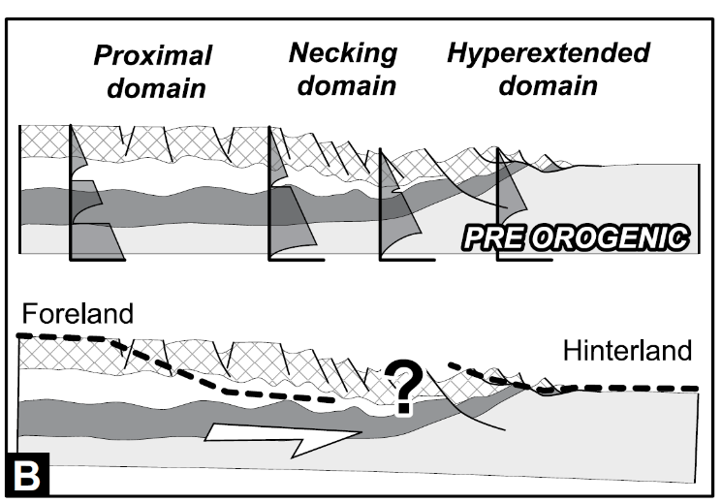

Introduction
Structural inheritance influences growth and development of an orogen
Balanced cross-section from Sardinia to Adriatic sea, divided in two main segments
The reliability of a balanced cross-section depends on the robustness of the database. Updated everyday.
A’’
A
A’
Vavilov Basin
Marsili Basin
Modified from Tavani et al., 2021a; Tavani et al., 2021b

Slide 3
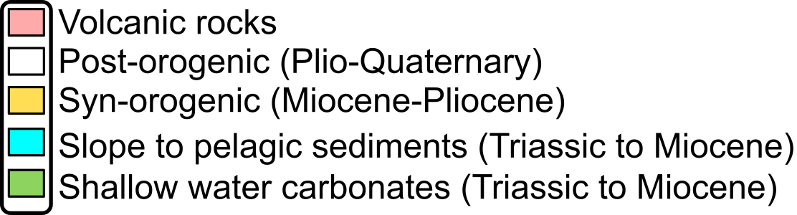
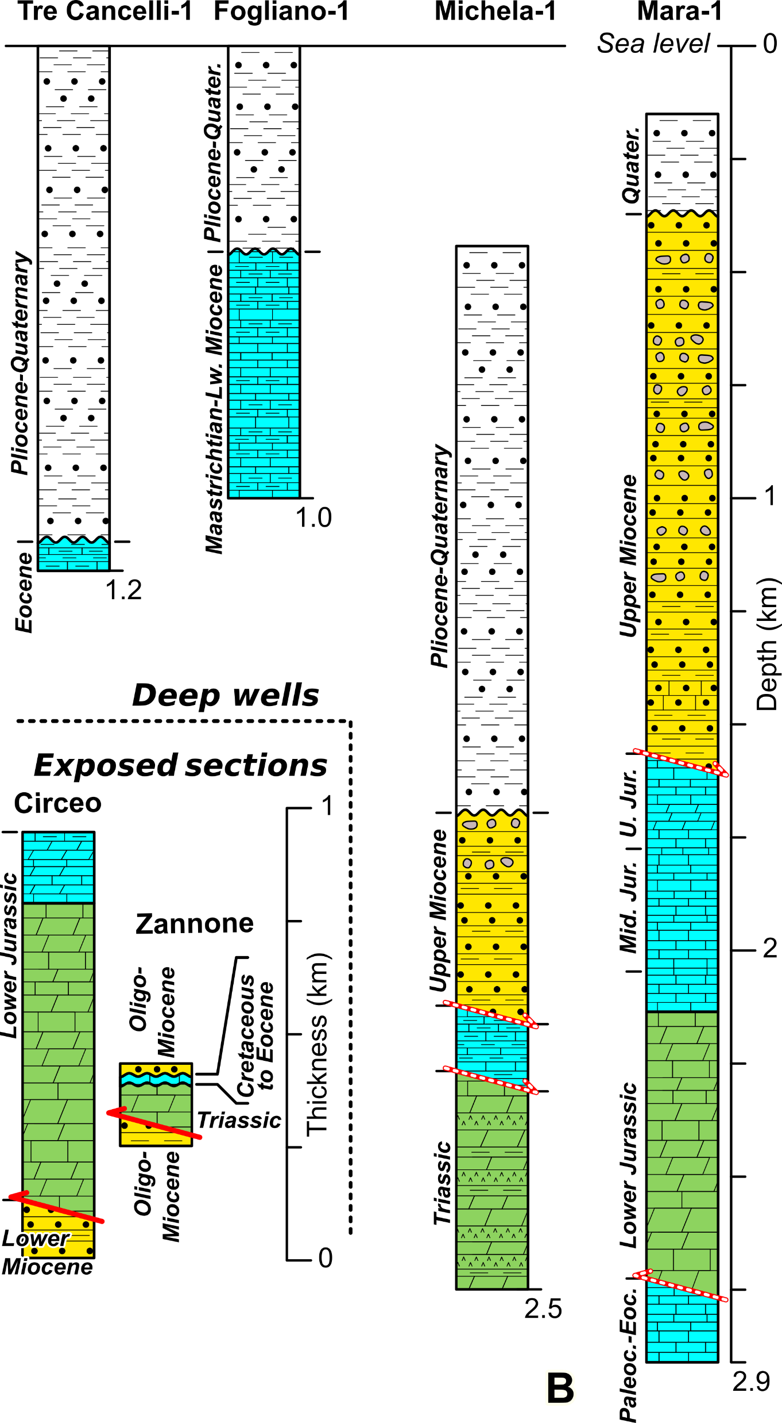
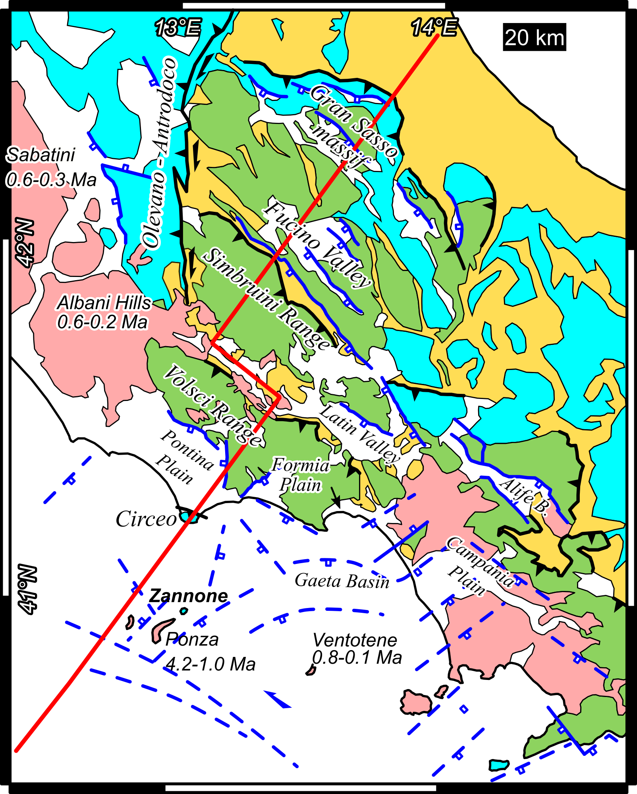
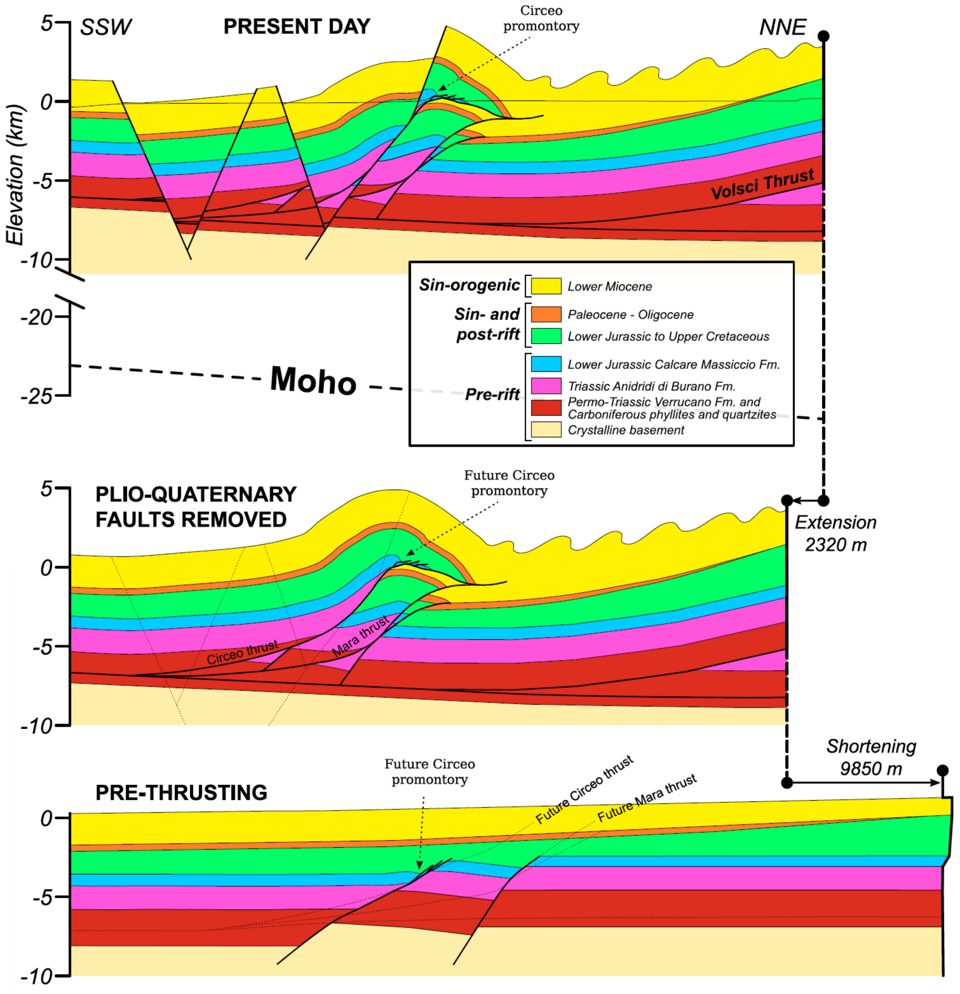
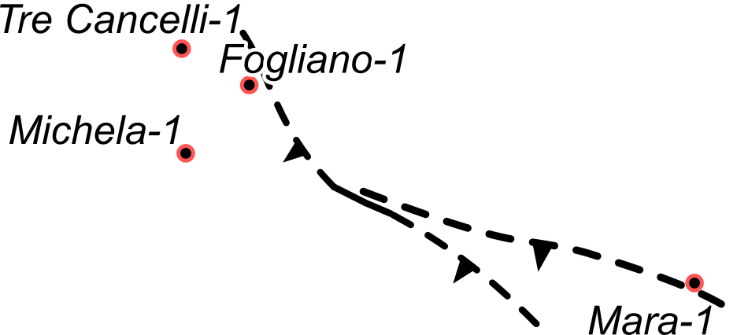
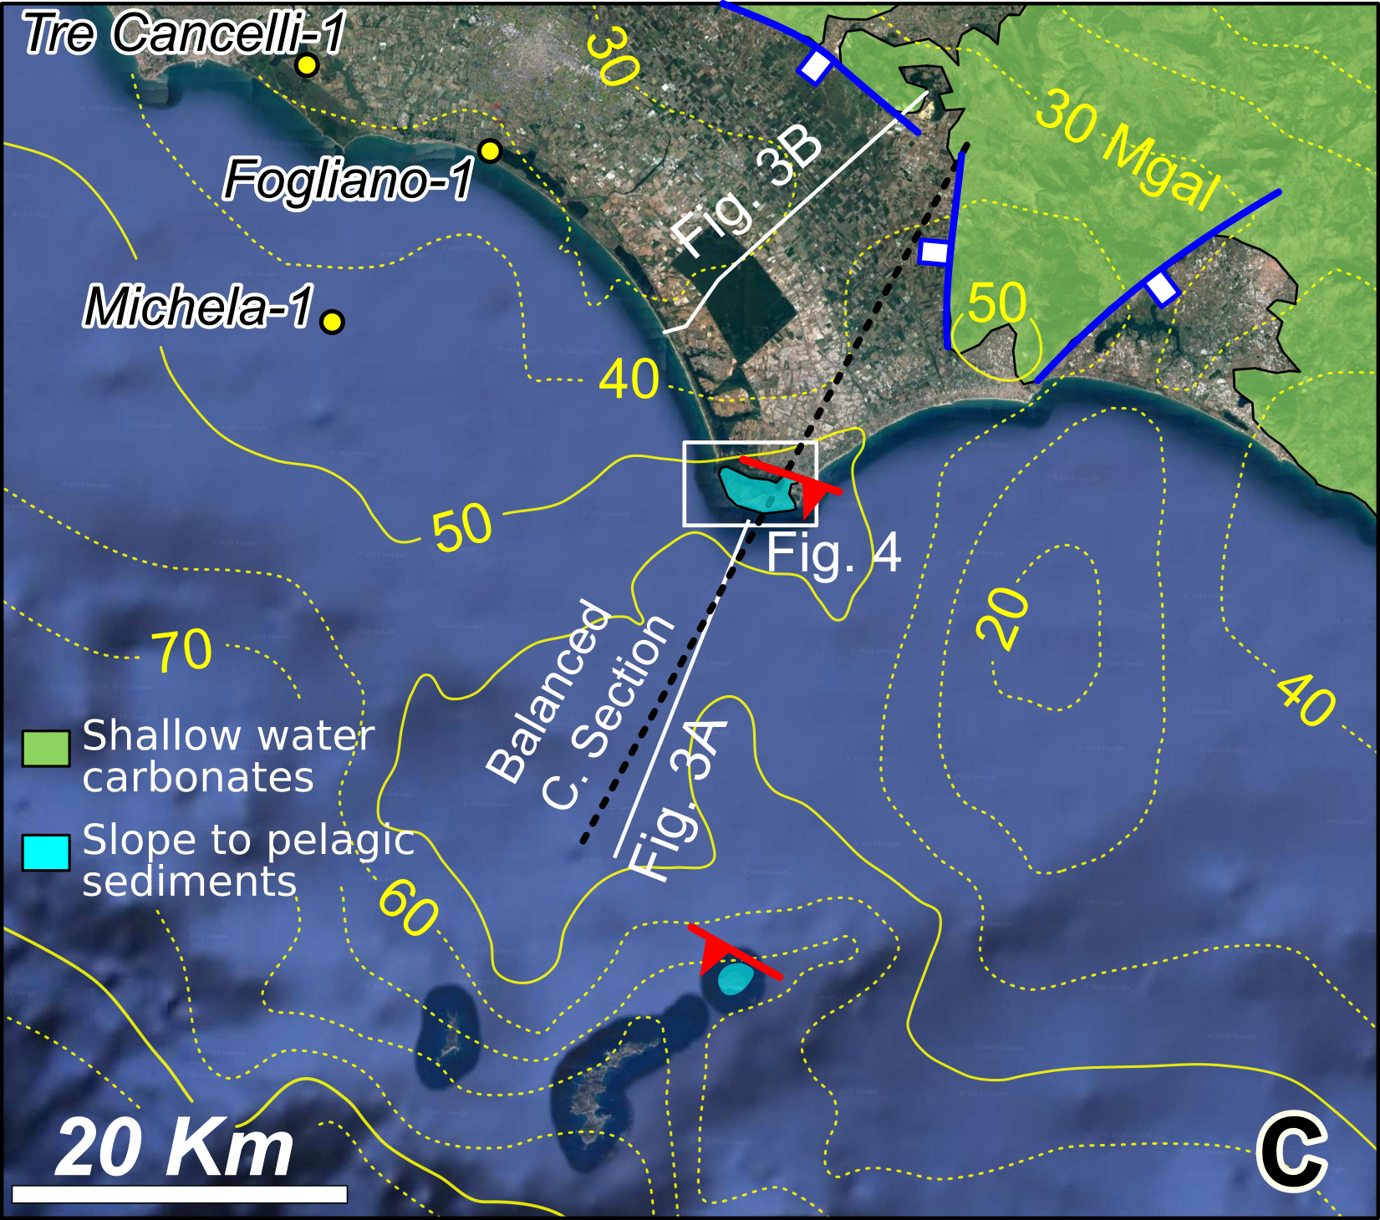

State of the art
Finishing to build onshore balanced cross-section of the sedimentary cover. Mixing forward modeling and trial and error with 3DMove algorithms.
Modified from Tavani et al. (under review); Tavani et. al, 2021b

Slide 4
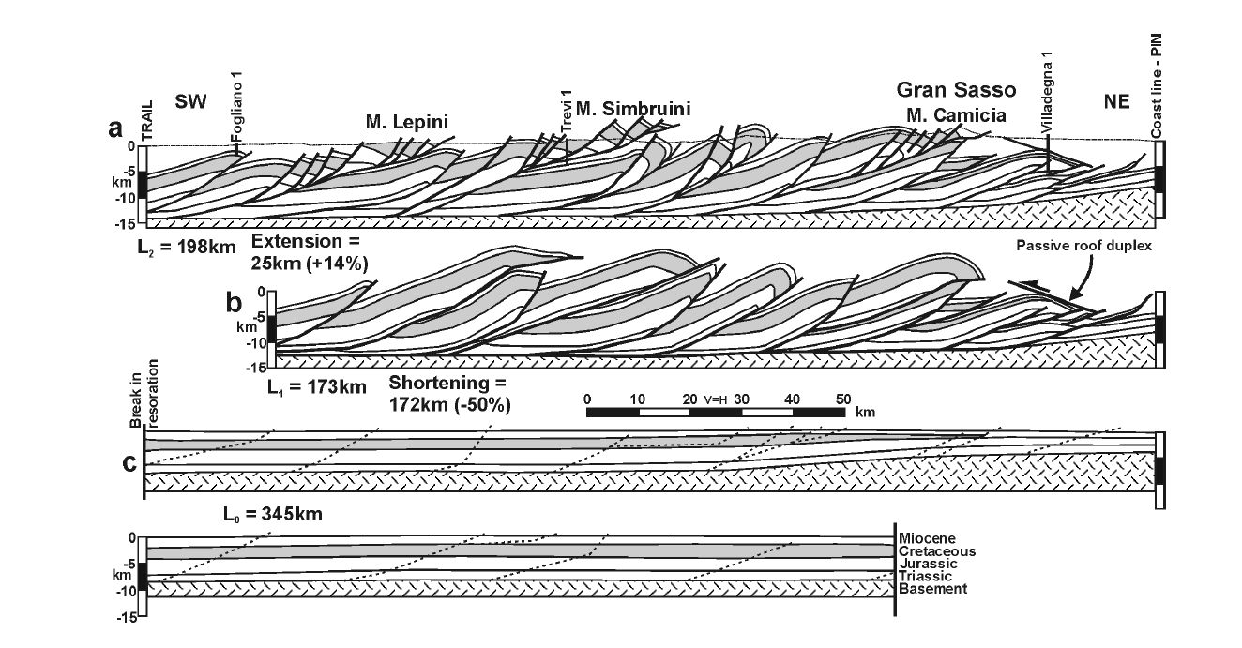
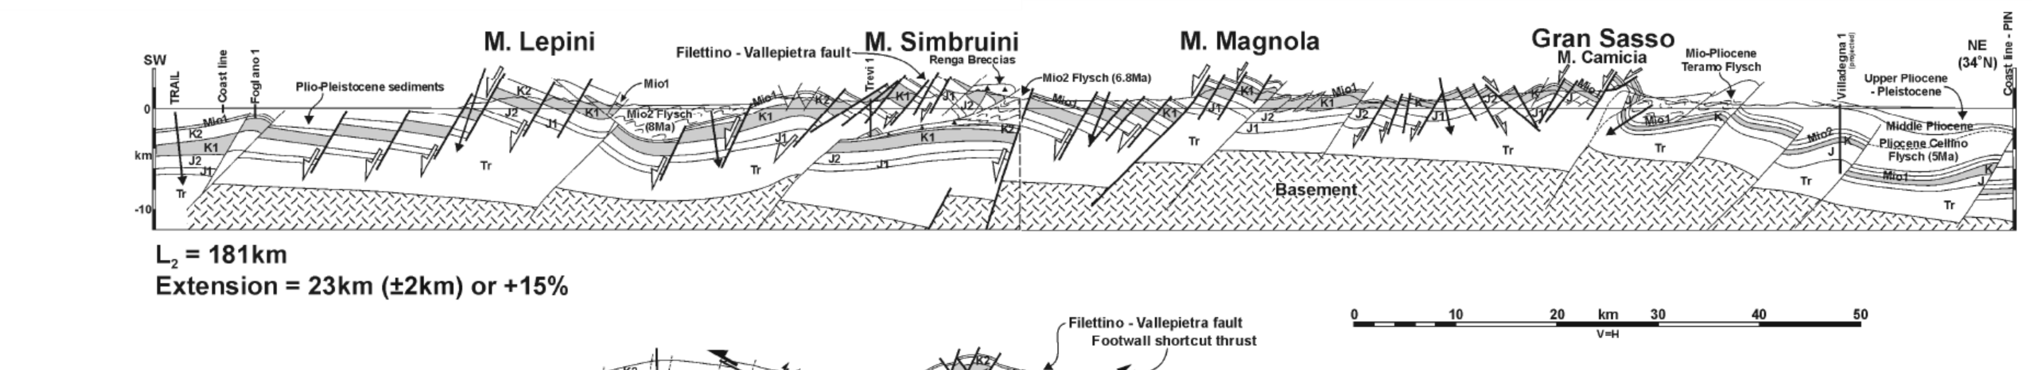
Previous interpretations
Thin-skinned deformation – Layer cake lithosphere
Shortening= 172km (-50%)*
Thick-skinned deformation – Rifted Passive Margin
Shortening= 37km (-19%)*
Ghisetti et al. 1993; Tozer et al. 2002
* Shortening calculated after extension restoration
Notes:
Many have been the attempts to draw a balanced cross section of the central apennines and here i show two completely divergent solutions with enourmously different shortening values, 50% for the thin skinned interpretation and 19% for the full thick skin version. Both were equally admissible by outcrop and subsurface data since a balanced cross section is not a unique solution. So additional studies must be carried out to provide the solution that could better fit the soft to hard collision theory.

Slide 5
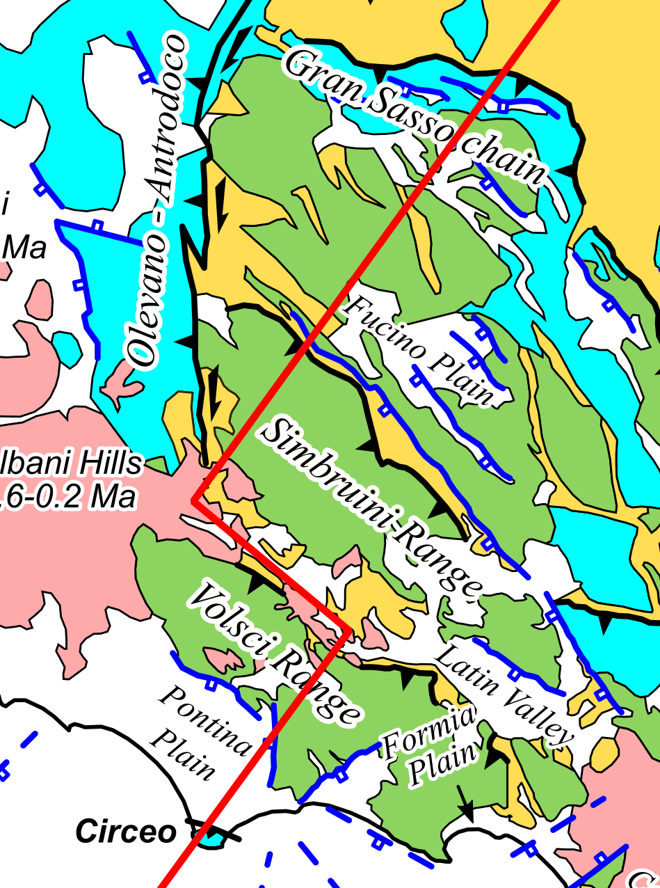
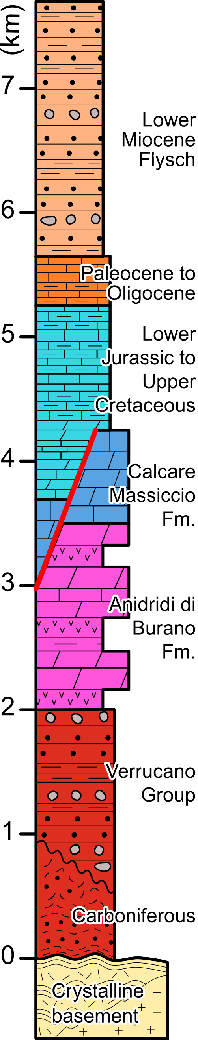
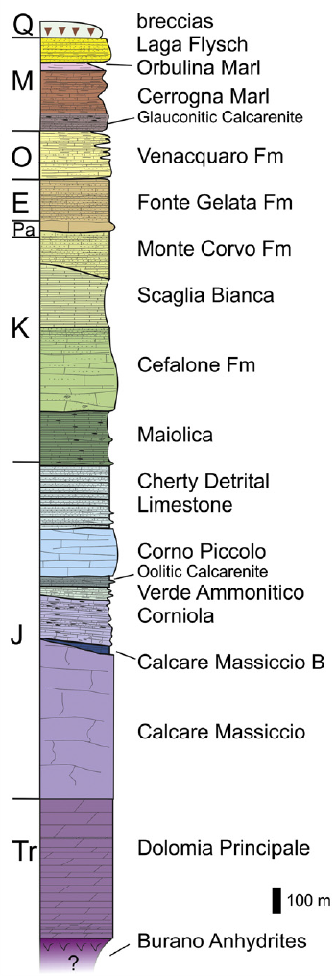
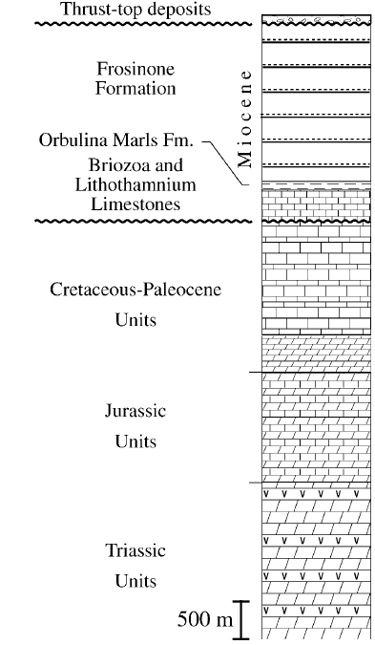
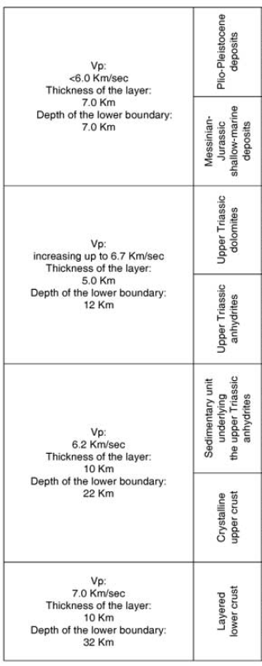
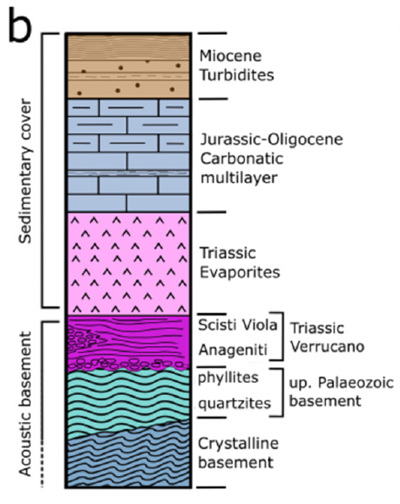
Stratigraphy - Central Apennines
SW
NE
Circeo Basin
Carbonate Platform
Slope to basin – Gran Sasso
Outcrop
Seismic
Flysch
Northern Apennines
Tuscany outcrops
?
?
Tavani et al. (under review); Sani et al., 2004; Patacca et al., 2008; Cardello et Doglioni, 2015; Volpe et al., 2022 (modified images)

Slide 6
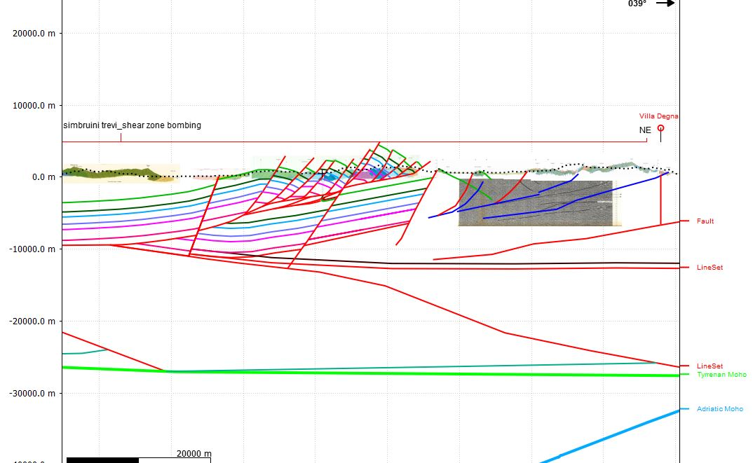
Crust Architecture and Inheritance - examples
Analogues:
Alto-tiberina fault
Zuccale fault

Slide 7
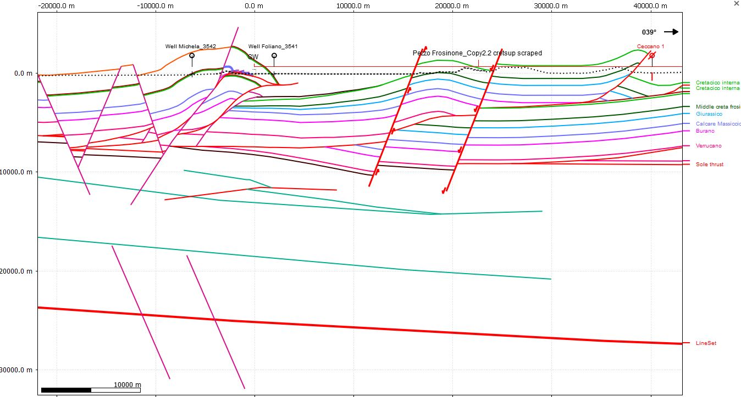
Crust Architecture and Inheritance - examples

Slide 8
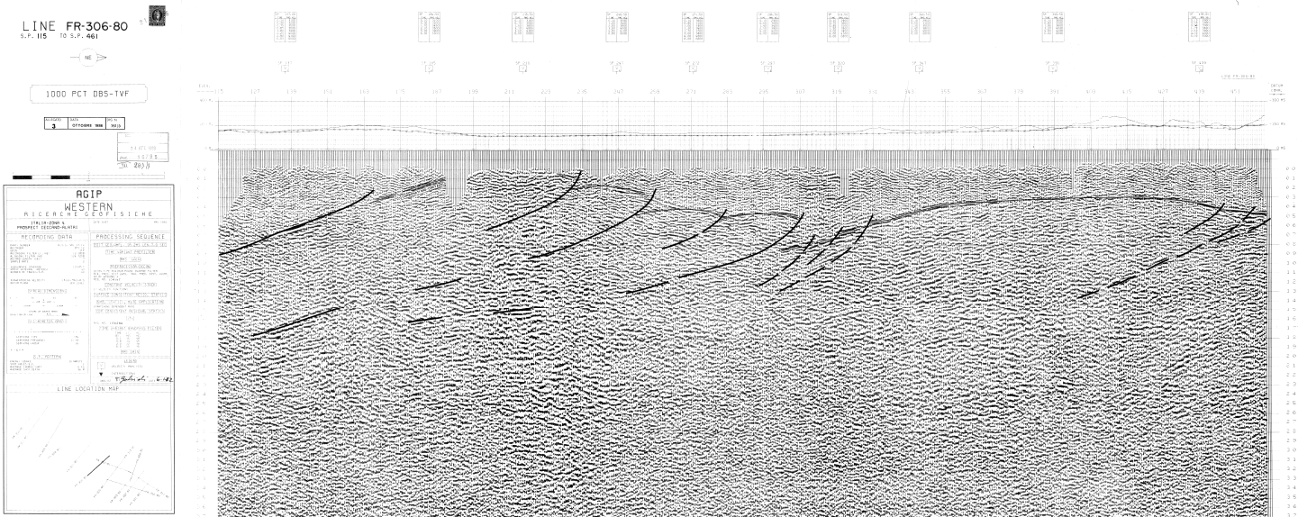
ViDEPI wells and sesismic lines
Notes:
vintage

Slide 9
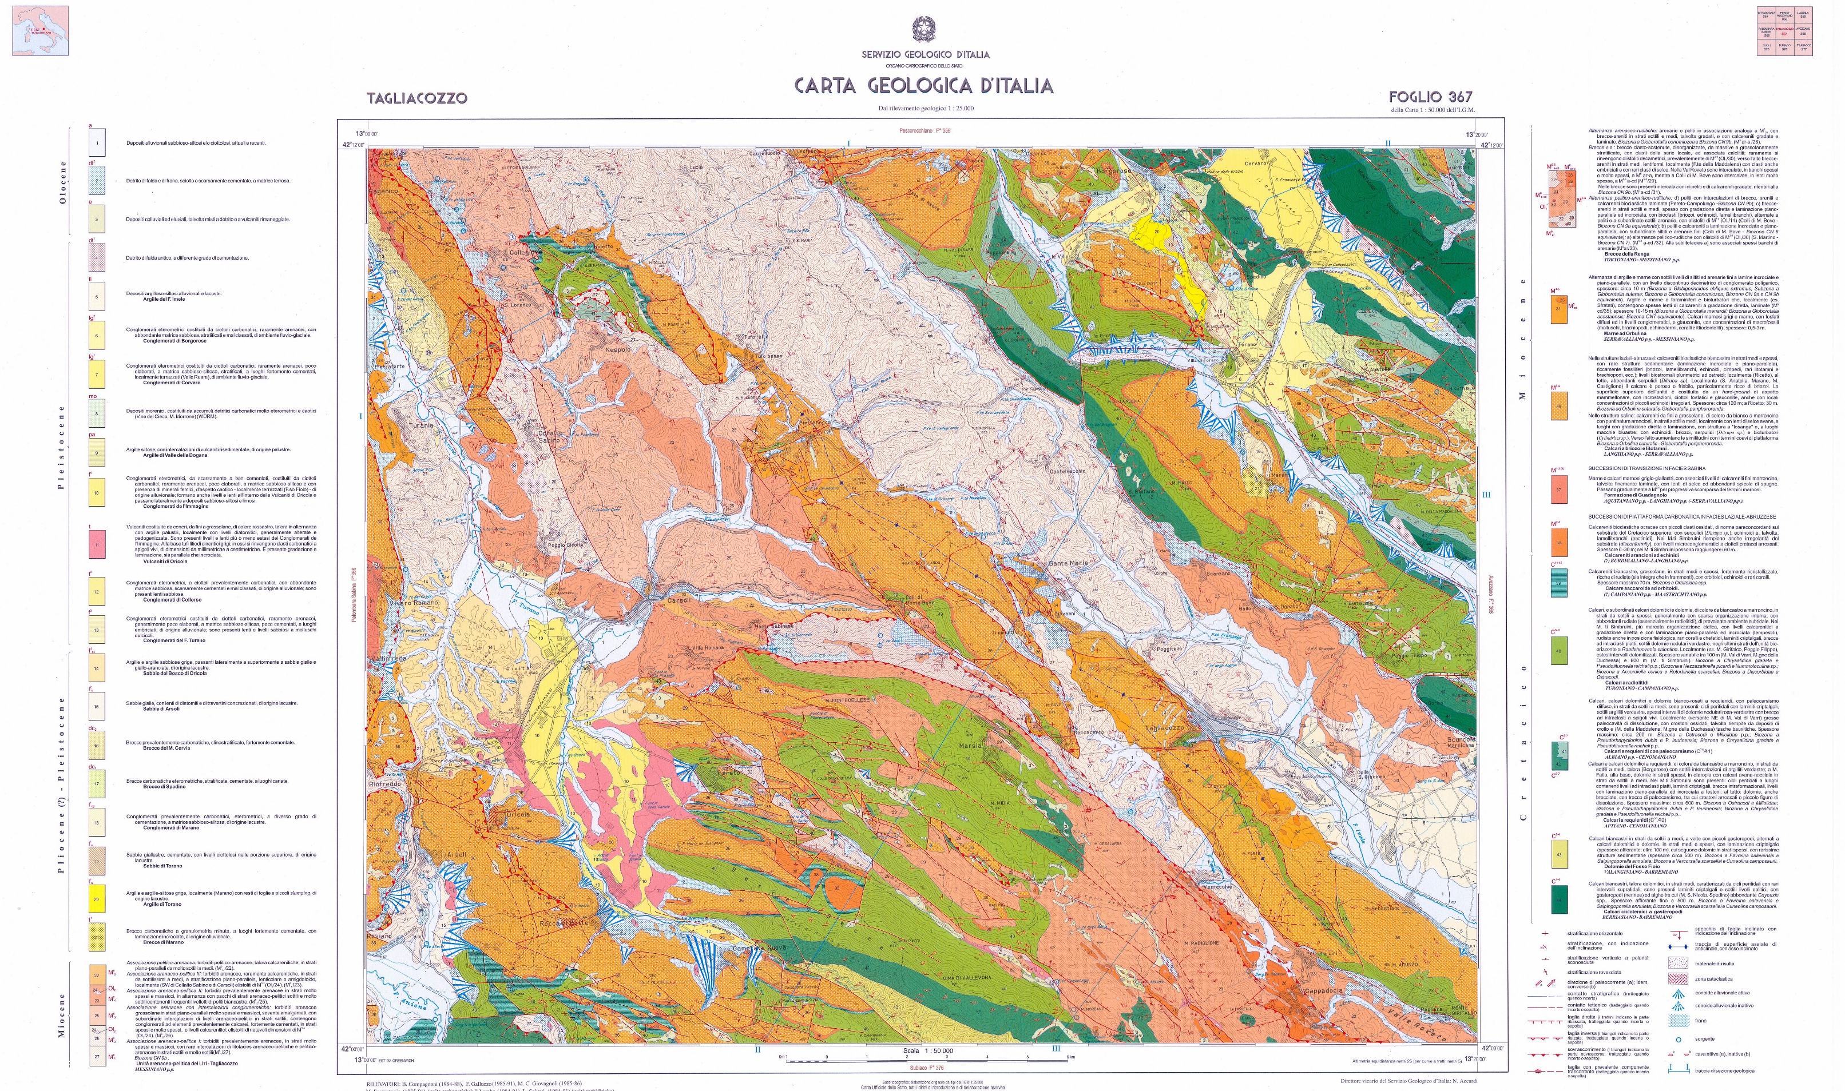
Published maps
Notes:
Ispra maps

Slide 10
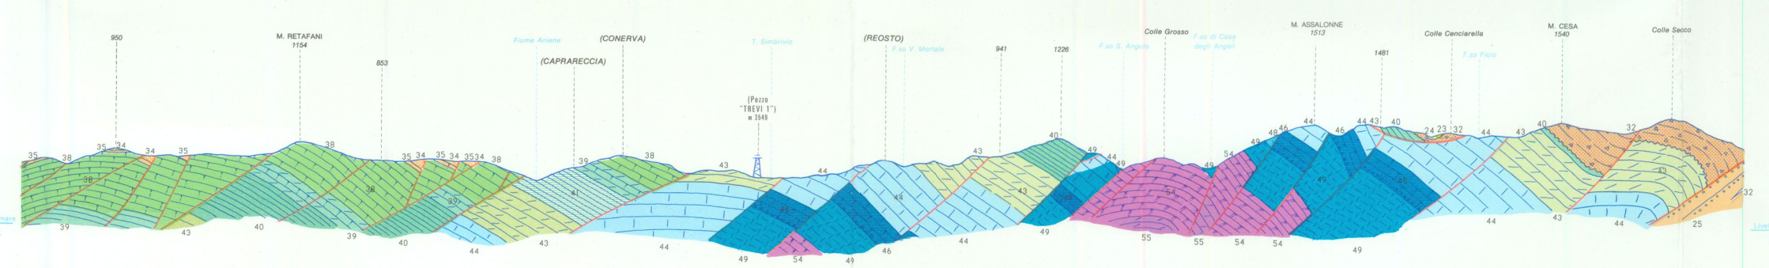
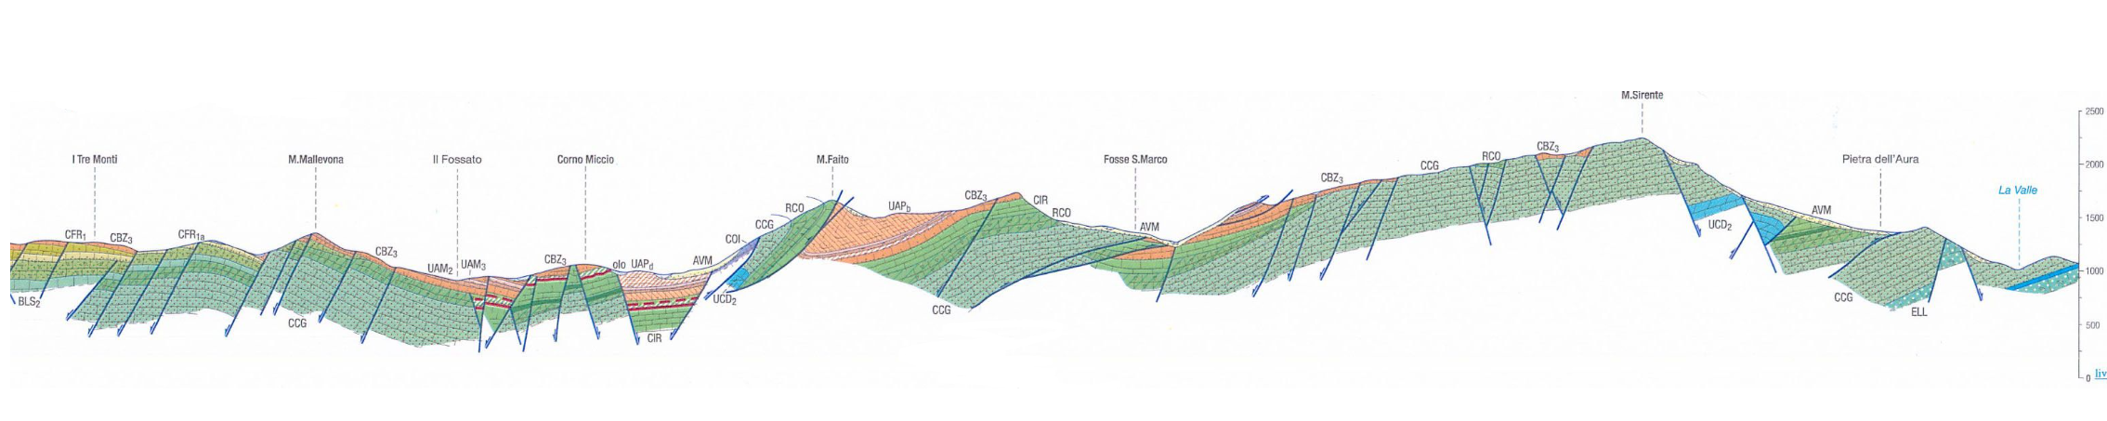
Published Surficial Sections
From Frosinone Ispra map 1:100000
From Subiaco Ispra map 1:50000
From Avezzano Ispra map 1:50000
Notes:
Ispra maps

Slide 11
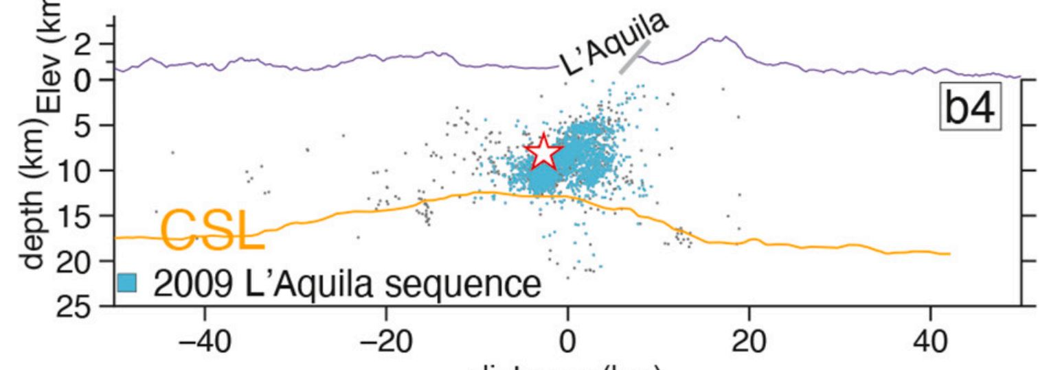
Seismicity
Chiaraluce et al., 2023
Notes:
Concluding, Input data include focal mechanism and seismicity ditribution which will allow us to define the thickness of the seismogenic layers
And the distribution of ductile crustal levels

Slide 12

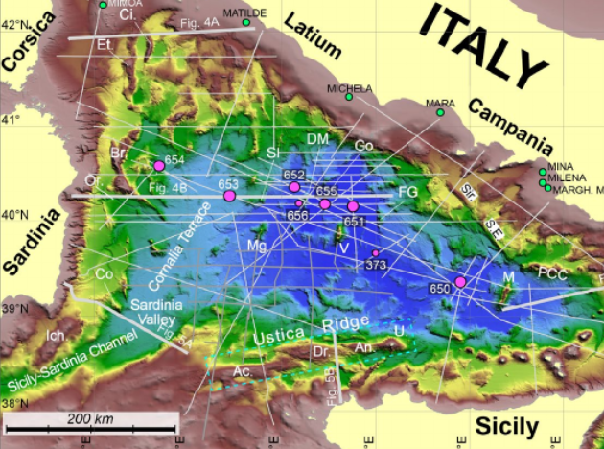
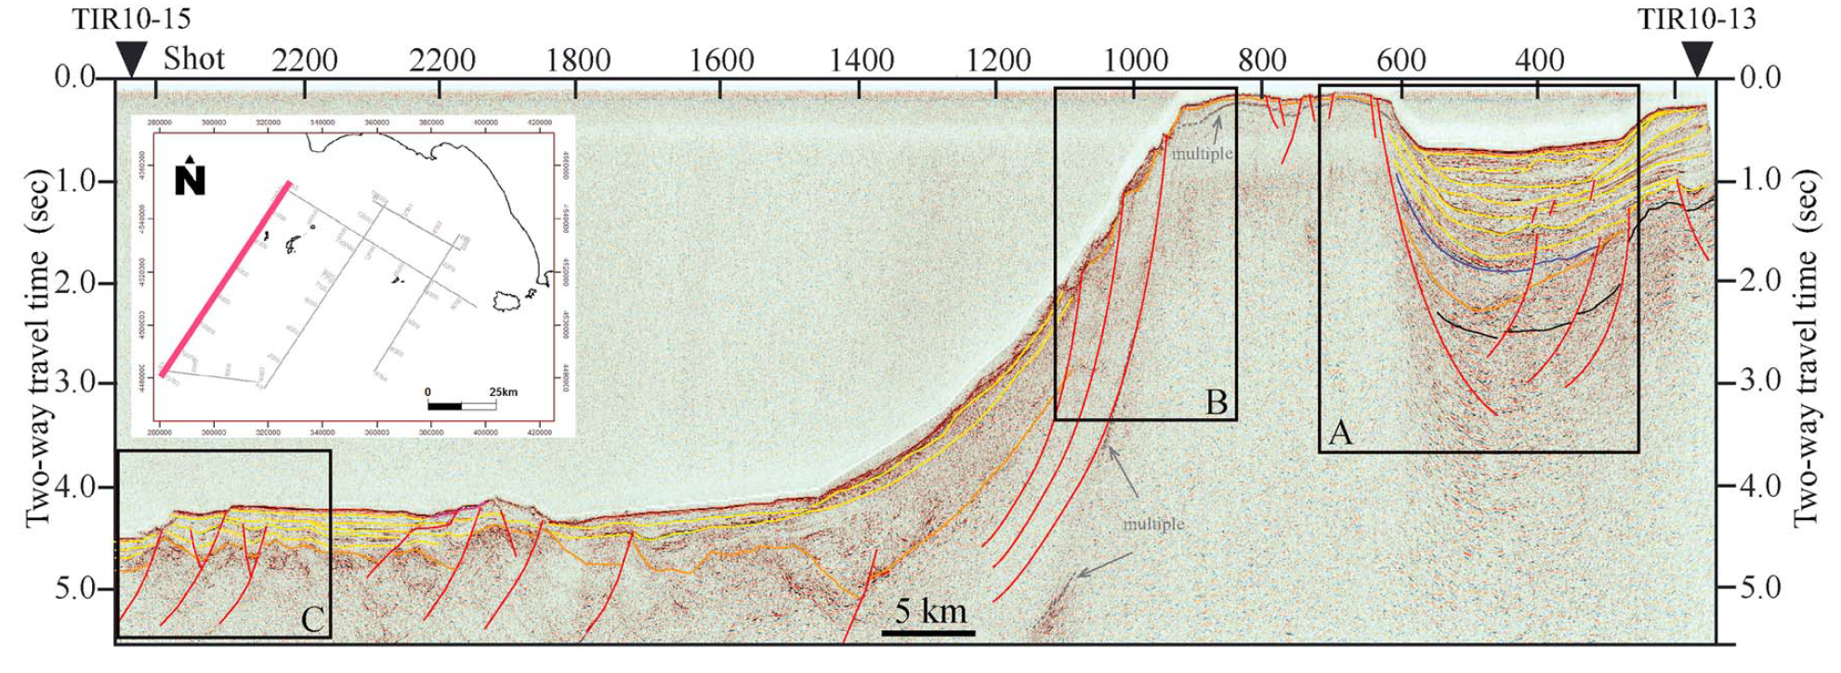
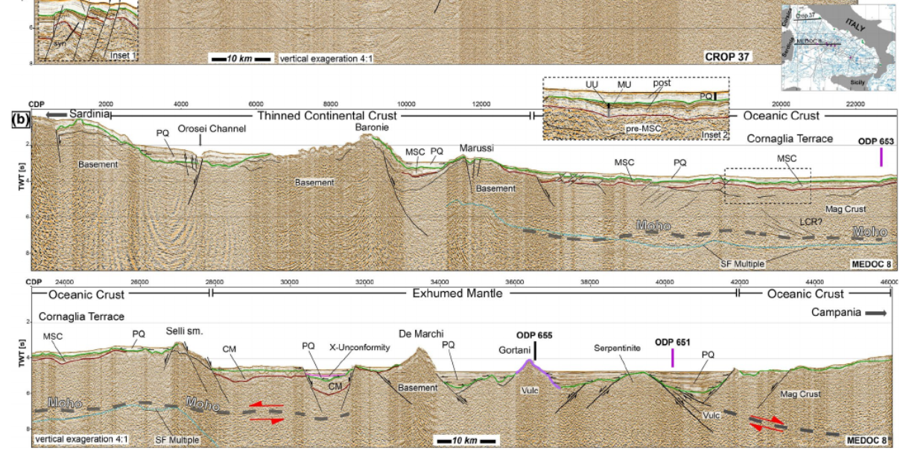

Offshore section
1
2
Loreto et al. 2020; Conti et al. 2017

Slide 13
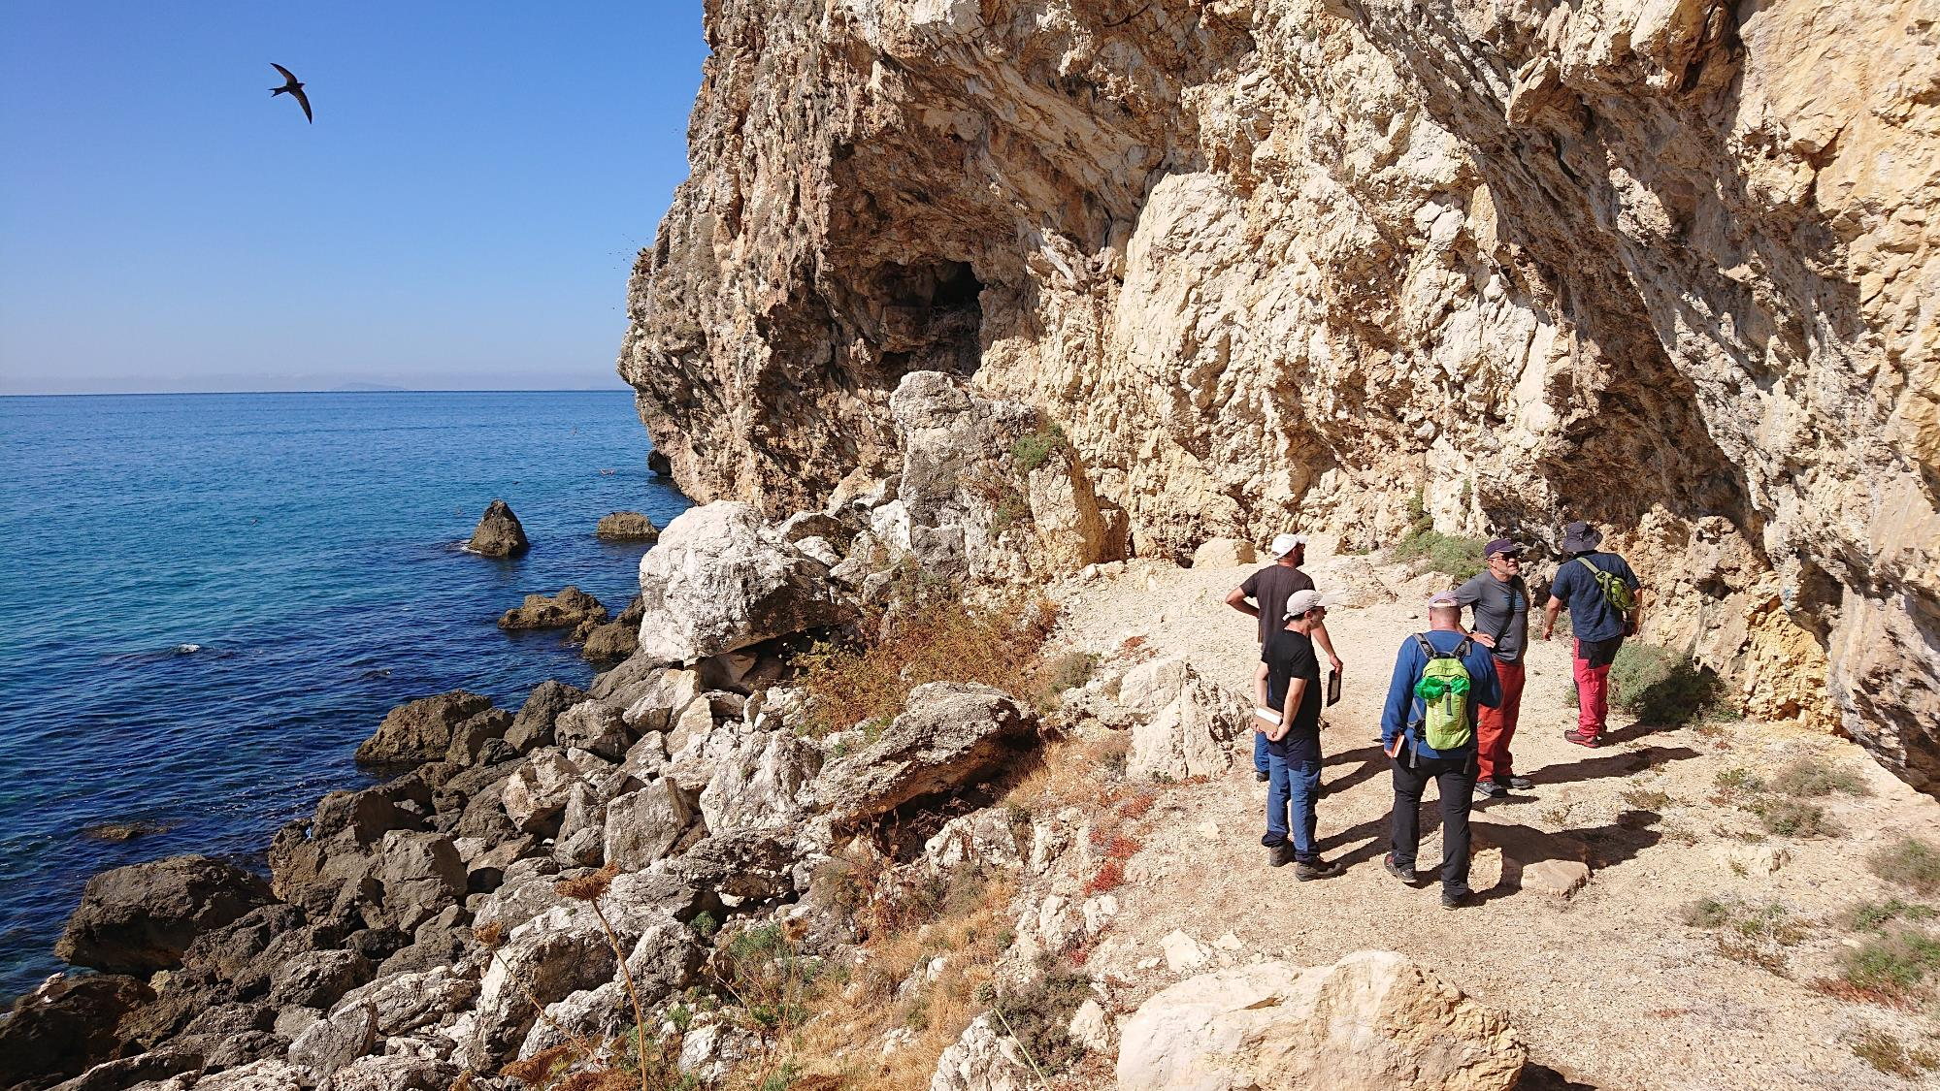

Grazie per l’attenzione!

