Slide 1





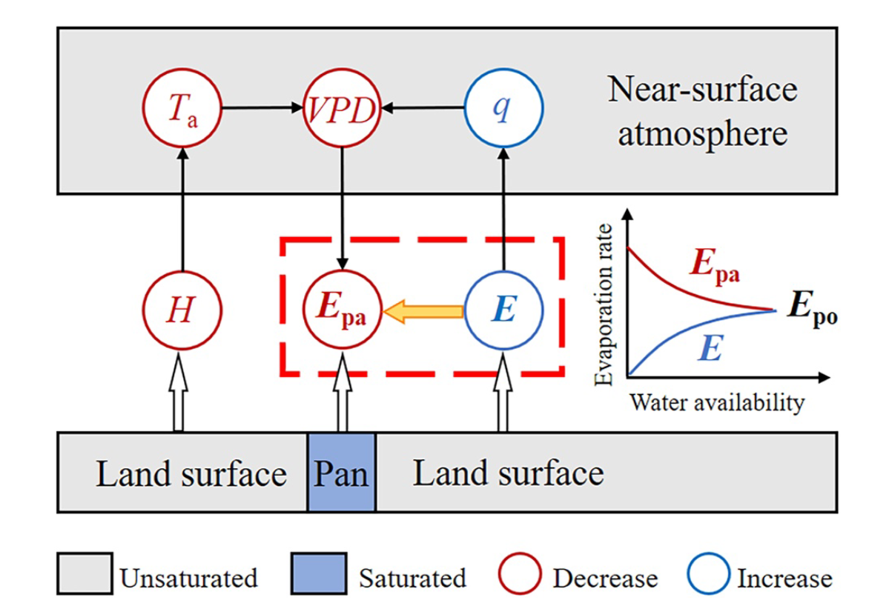
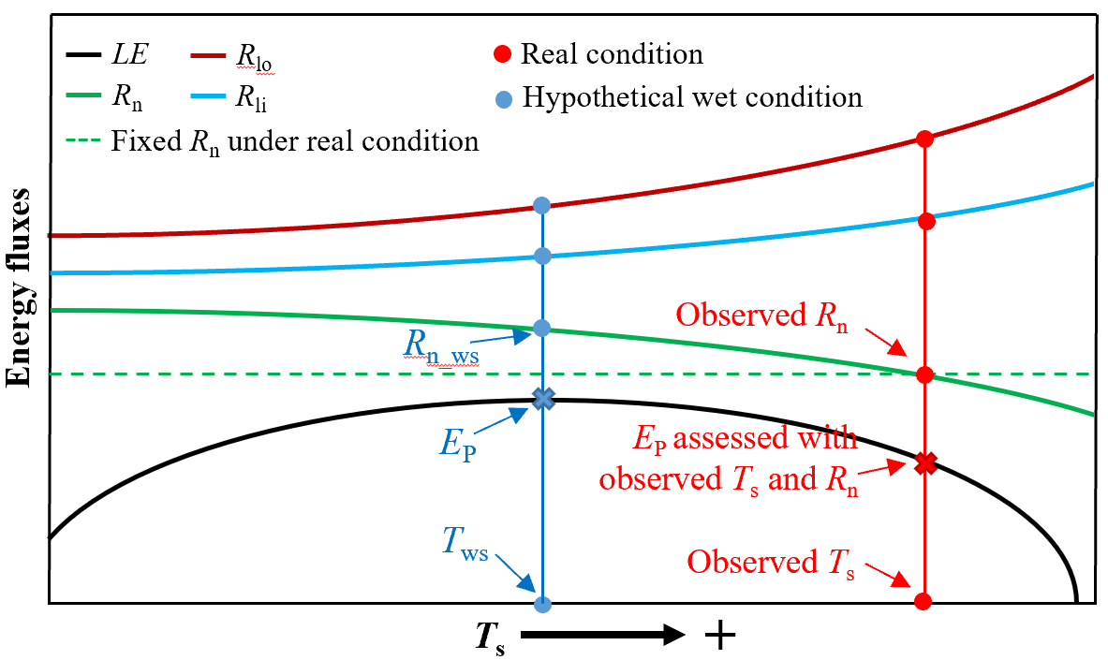
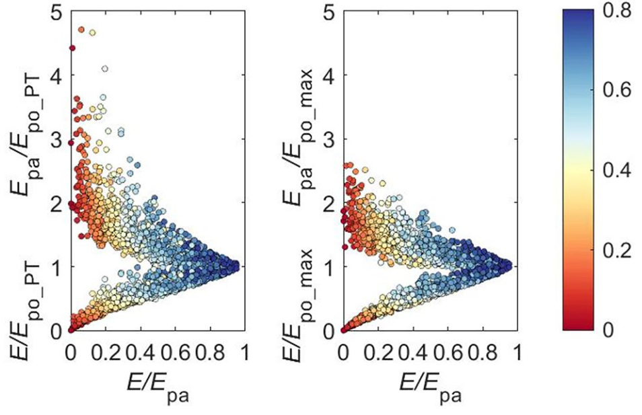

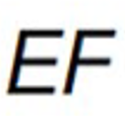
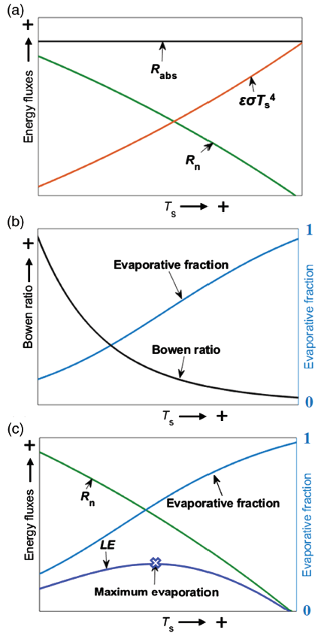



Potential Evaporation and the Complementary Relationship
Zhuoyi Tu, Yuting Yang*, Michael L. Roderick, and Tim R. McVicar
Address: Department of Hydraulic Engineering, Tsinghua University, China; Email: tuzy19@mails.tsinghua.edu.cn
Importance of E_{po}
Restoration of E_{po}
Implication for CR
The maximum evaporation theory
The complementary relationship (CR) provides a framework for estimating evaporation (E) based on the relationship between E, apparent potential evaporation (E_{pa}) and potential evaporation (E_{po}).
As a key variable in the CR, the calculation of E_{po} in practice has a long-standing problem conflicting with its physical definition: the evaporation that would occur with an unlimited supply of water.
Energy balance: R_{n} – G = H + LE
Bowen ratio: β = H / LE
E_{po} formulation: LE = (R_{n} –G) * 1 / (1 + β)
The lower values of E/E_{po_max} and E_{pa}/E_{po_max} reduce the asymmetry of the CR remarkably and constrain the points within much narrower ranges, compared with that when E_{po_PT} (Priestley-Taylor model) is used.
Adopting E_{po_max} to recover the E_{po} estimation, a physically based, calibration-free CR model was developed and validated to have an overall good performance in estimating actual evaporation globally.
E_{po_max}
T_{s} R_{n} 1/(1+β) E_{po_max} emerges
Previous models use observations over real surfaces that are generally not saturated, contradicting the definition of E_{po}. While the maximum evaporation method can recover all the variables to wet conditions.
* Please find more details in Yang and Roderick (2019); Tu et al. (2022); Tu and Yang (2022) and Tu et al. (2023) if you are interested in this work. Abstract ID: EGU23-2748ECS

Slide 2
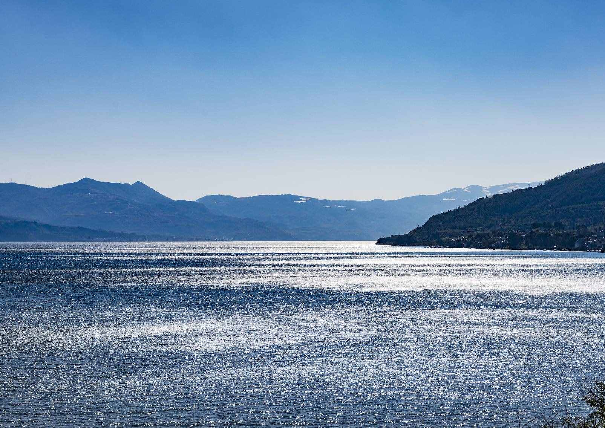
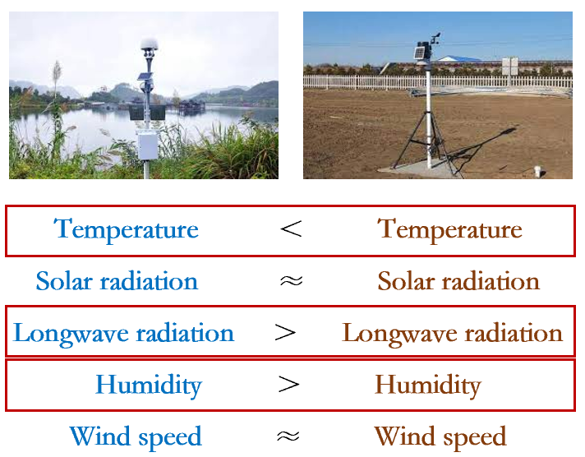
Potential Evaporation and the Complementary Relationship
Zhuoyi Tu, Yuting Yang*, Michael L. Roderick, and Tim R. McVicar
Address: Department of Hydraulic Engineering, Tsinghua University, China; Email: tuzy19@mails.tsinghua.edu.cn
Definition of Potential Evaporation
？
The evaporation that would occur with an unlimited supply of water
* Please find more details in Yang and Roderick (2019); Tu et al. (2022); Tu and Yang (2022) and Tu et al. (2023) Abstract ID: EGU23-2748ECS

Slide 3
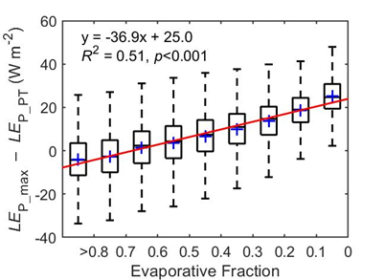
Potential Evaporation and the Complementary Relationship
Zhuoyi Tu, Yuting Yang*, Michael L. Roderick, and Tim R. McVicar
Address: Department of Hydraulic Engineering, Tsinghua University, China; Email: tuzy19@mails.tsinghua.edu.cn
Recover of Potential Evaporation
Maximum method
Priestley-Taylor model
Dry
390 mm/a
Wet
* Please find more details in Yang and Roderick (2019); Tu et al. (2022); Tu and Yang (2022) and Tu et al. (2023) Abstract ID: EGU23-2748ECS

Slide 4
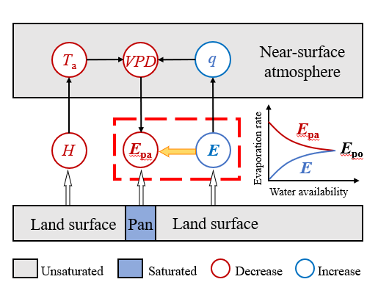
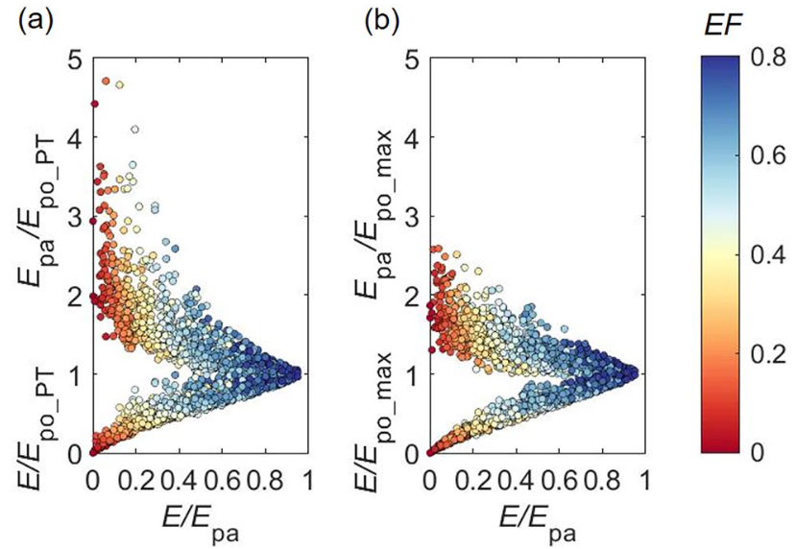
Potential Evaporation and the Complementary Relationship
Zhuoyi Tu, Yuting Yang*, Michael L. Roderick, and Tim R. McVicar
Address: Department of Hydraulic Engineering, Tsinghua University, China; Email: tuzy19@mails.tsinghua.edu.cn
Implication for Complementary Relationship
* Please find more details in Yang and Roderick (2019); Tu et al. (2022); Tu and Yang (2022) and Tu et al. (2023) Abstract ID: EGU23-2748ECS

Slide 5

Potential Evaporation and
the Complementary Relationship
Detailed Discussion
Zhuoyi Tu, Yuting Yang
Acknowledgment: Michael L. Roderick and Tim R. McVicar
4/26/2023

Slide 6

Potential Evaporation (E_{P}) is a key concept in many fields
Due to the high cost of site-scale evaporation observations, regional-scale evaporation is usually estimated by potential evaporation (Monteith, 1965; Bouchet, 1963).
Definition: The underlying idea of E_{P} is straightforward– it is the evaporation that would occur with an unlimited supply of water (Thornthwaite, 1948).
The concept of E_{P} has been widely used in the studies of meteorology, hydrology, agriculture, ecology and related fields (Maes et al., 2019; Wang & Dickinson, 2012).

Slide 7
Classic E_{P} models
Combination method（Penman, 1948） Energy-based method（Priestley & Taylor, 1972）
equilibrium evaporation
minimal advection
areodynamic term + radiative term
minimal areodynamic term + radiative term
Coupling the aerodynamic and radiative term, it is considered to be a more reliable model.
Simplifying aerodynamic term with minimum advection,
it has good performance in E_{P} estimation (Maes et al., 2019)

Slide 8
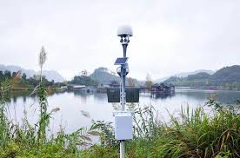
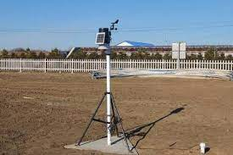
Problems of classic E_{P} models
Potential evaporation: The evaporation that would occur when the surface is saturated
Priestley-Taylor
Penman
Temperature ＜ Temperature
Solar radiation ≈ Solar radiation
Longwave radiation ＞ Longwave radiation
Humidity ＞ Humidity
Wind speed ≈ Wind speed
Meteorological forcing variables observed in real conditions do not necessarily represent that measured over hypothetical wet surfaces

Slide 9
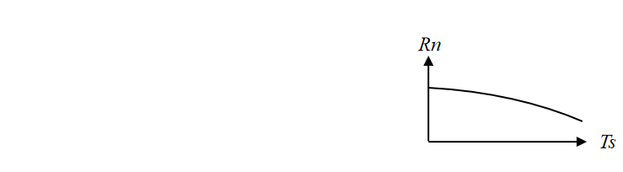
Problems of classic E_{P} models
Potential evaporation: The evaporation that would occur with an unlimited supply of water
Attempts to address the above-noted problem by estimating a wet surface temperature (T_{ws})
With the assumption of a constant R_{n} under both wet and dry conditions
(Szilagyi & Jozsa, 2008)
Energy Budget： R_{n}=R_{si}–R_{so}+R_{li}–R_{lo}
Stefan-Bolzmann law：R_{lo}=(1+ε) *R_{li}+εσT_{s}⁴
R_{n}
T_{s}
R_{n} and T_{s} are interdependent, thus both T_{s} and R_{n} need to be adjusted to saturated surfaces.

Slide 10
Problems of classic E_{P} models
Potential evaporation: The evaporation that would occur with an unlimited supply of water
Energy Budget： R_{n}=R_{si}–R_{so}+R_{li}–R_{lo}
Stefan-Bolzmann law：R_{lo}=(1+ε) *R_{li}+εσT_{s}⁴
R_{n}
T_{s}
R_{n} and T_{s} are interdependent, both T_{s} and R_{n} are need to be adjusted to saturated surfaces.
dsf
How to restore the meteorological variables to the wet conditions and consider the interdependence between all the relevant variables at the same time?

Slide 11
The maximum evaporation theory（Yang & Roderick, 2019）
Acknowledging the inter-dependence between evaporation, surface temperature and radiation
Energy balance: R_{n} – G = H + LE
Bowen ratio: β = H / LE
E_{P} formulation: LE = (R_{n} –G) * 1 / (1 + β)
T_{s} R_{n} 1/(1+β) LE_{max}
LE_{max} naturally emerges from the coupling of R_{n}-T_{s}-E
Energy balance： R_{n}=R_{si}–R_{so}+R_{li}–R_{lo}
Stefan-Bolzmann law：R_{lo}=(1+ε) *R_{li}+εσT_{s}⁴
11

Slide 12
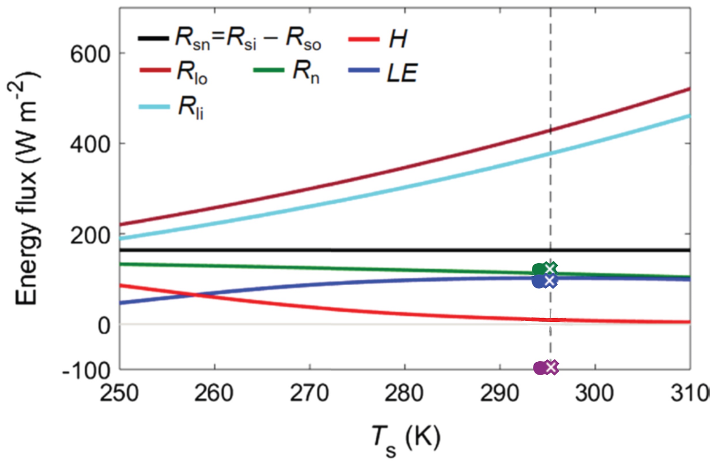
The maximum evaporation theory（Yang & Roderick, 2019）
This theory can restore E, R_{n} and T_{s} to water surface conditions.
This theory has the potential to estimate E_{P} over land surfaces!
Observed LE 102.7 W m⁻²
Observed T_{s} 293.8 K
Observed R_{n} 113.7 W m⁻²
Max. LE 102.3 W m⁻²
T_{s} at Max. LE 295.3 K
R_{n} at Max. LE 112.5 W m⁻²
Consistent！
12

Slide 13
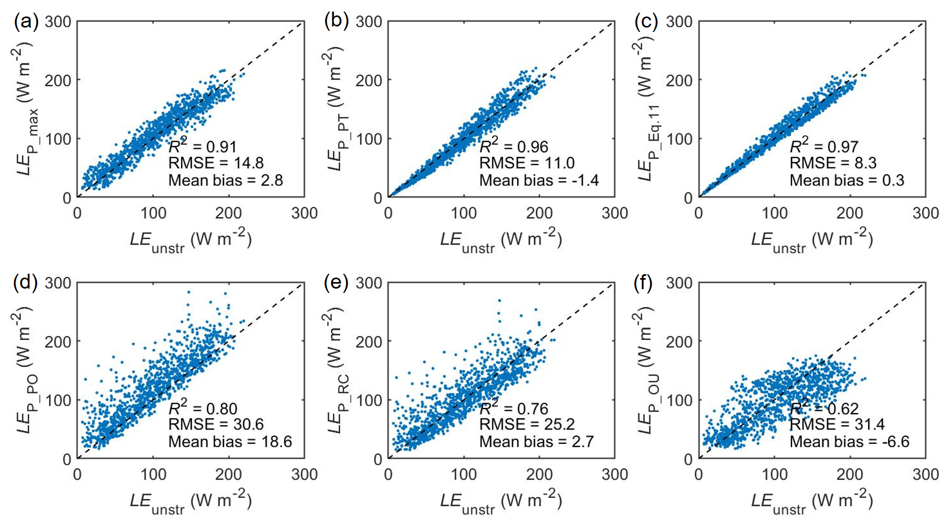
Performance of E_{P} models at flux sites in wet conditions
(Tu et al., 2022; HESS)
Maximum evaporation Priestley-Taylor Modified Priestley-Taylor
Penman open water Penman-Monteith FAO56 Temperature-based
The maximum evaporation model shows good performance in estimating E_{P} over land.

Slide 14
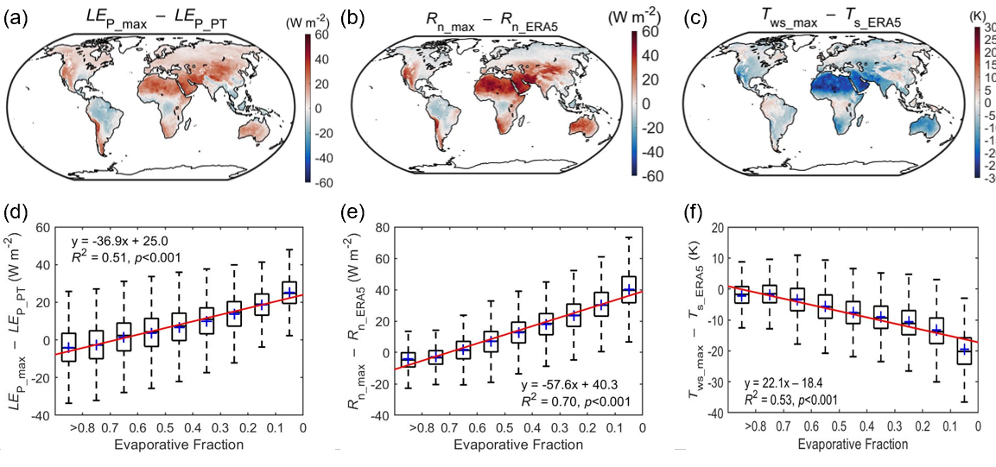
E_{P} estimates under both wet and dry conditions
(Tu & Yang, 2022; WRR)
The underestimation of E_{P_PT} is caused the observed higher T_{a} and lower R_{n} under dry conditions.

Slide 15
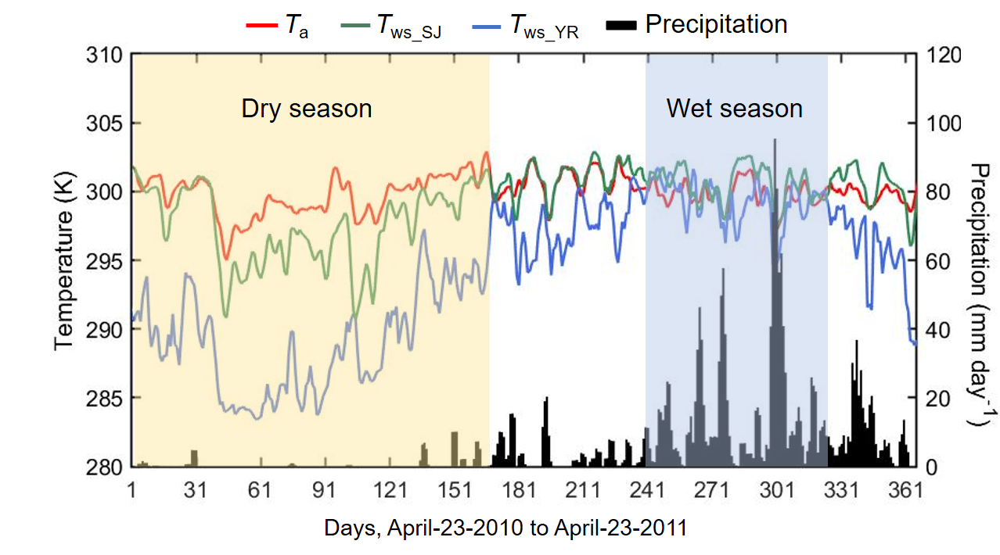
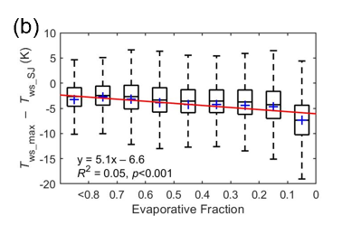
Comparison of wet surface temperature estimates
(Tu & Yang, 2022; WRR)
Attempts to address the above-noted problem by estimating a wet surface temperature (T_{ws})
With the assumption of a constant R_{n} under both wet and dry conditions
(Szilagyi & Jozsa, 2008)
Ignoring the R_{n}-T_{s} coupling leads to the overestimation of T_{ws} and thus an underestimation of E_{P}.

Slide 16
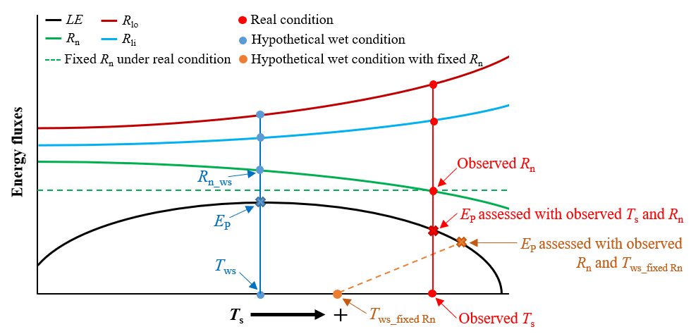
Conceptual plot of energy fluxes varying with T_{s}
(Tu & Yang, 2022; WRR)
It is crucial to restore all the relevant variables (T_{s}, R_{n}) to wet conditions in estimating E_{P}！

Slide 17
Implication for the complementary relationship (CR)
(Tu et al., 2023; WRR)
Adopting E_{po_max} considerably reduces the asymmetry of the complementarity in CR.

Slide 18

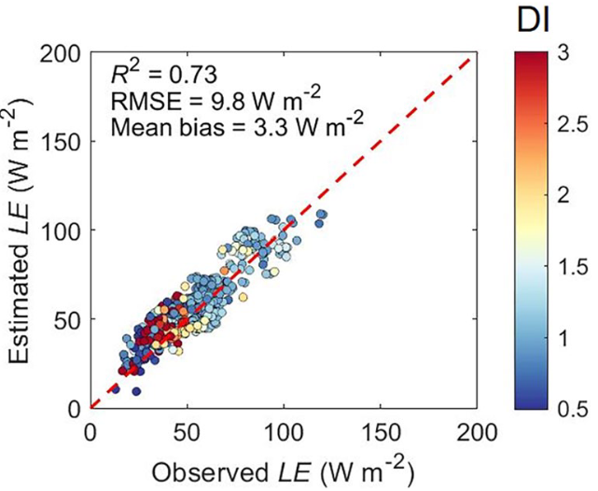
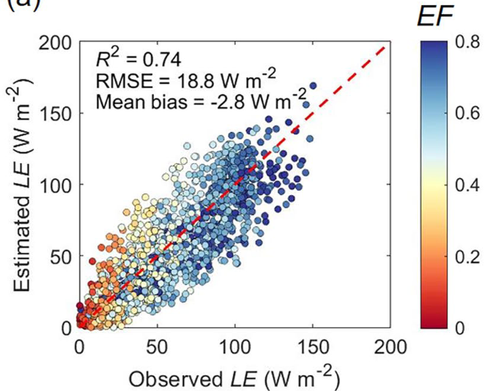
Implication for the complementary relationship
(Tu et al., 2023; WRR)
A physically based CR model with E_{po_max} was validated to have good performance in E estimation.

Slide 19
Take-home messages
It is crucial to restore all the relevant variables (T_{s}, R_{n}) to wet conditions in estimating E_{P}
The maximum evaporation method can recover the variables to a hypothetical wet condition
Adopting a measure of potential evaporation that conforms to its physical definition reduces the asymmetry of the complementary relationship (CR)

Slide 20
Related researches
Yang, Y., & Roderick, M. L. (2019). Radiation, surface temperature and evaporation over wet surfaces. Quarterly Journal of the Royal Meteorological Society, 145(720), 1118–1129.
Tu, Z., Yang, Y., & Roderick, M. L. (2022). Testing a maximum evaporation theory over saturated land: Implications for potential evaporation estimation, Hydrology and Earth System Sciences, 26, 1745–1754.
Tu, Z., & Yang, Y. (2022). On the estimation of potential evaporation under wet and dry conditions. Water Resources Research, 58, e2021WR031486.
Tu, Z., Yang, Y., Roderick, M. L., & McVicar, T. R. (2023). Potential evaporation and the complementary relationship. Water Resources Research, e2022WR033763.

