Slide 1
Coastal dynamics in middle-south Vietnam during a transition period of Asian monsoon, characterized by HF radar measurements and numerical modeling
Vienna, Austria & Online 23–28 April 2023
Session OS2.2
Oceanography at coastal scales. modelling, coupling, observations and applications
Thanh Huyen Tran^{1,2,*}, Duy Thai To³, Alexei Sentchev¹
* huyen-thanh.tran@univ-littoral.fr
¹ Laboratory of Oceanology and Geosciences, CNRS UMR 8187, ULCO, ULille, IRD, France
² Department of Water – Environment – Oceanography, Univ. Sci. Tech. Hanoi (WEO-USTH), Vietnam
³ Institute of Oceanography, Vietnam Academy of Science and Technology (IO-VAST), Vietnam
Vienna, Tuesday, 25 April 2023

Slide 2
OUTLINE
Ocean dynamics of the area of interest (AOI) –
What we’ve already known
From raw measurements to scientific information
Near-shore SSC variability –
What HF radar data and numerical model tell us
Conclusions and future work
Acknowledgement & references

Slide 3
Ocean dynamics of the area of interest
What we’ve already known

Slide 4
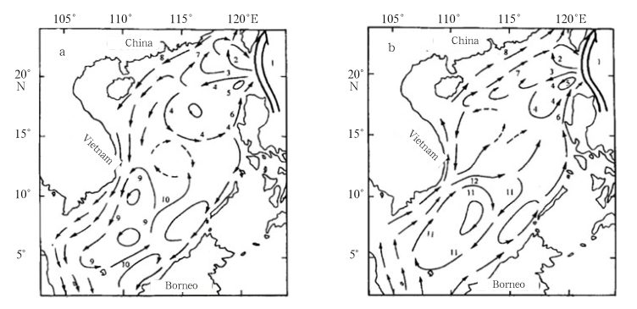
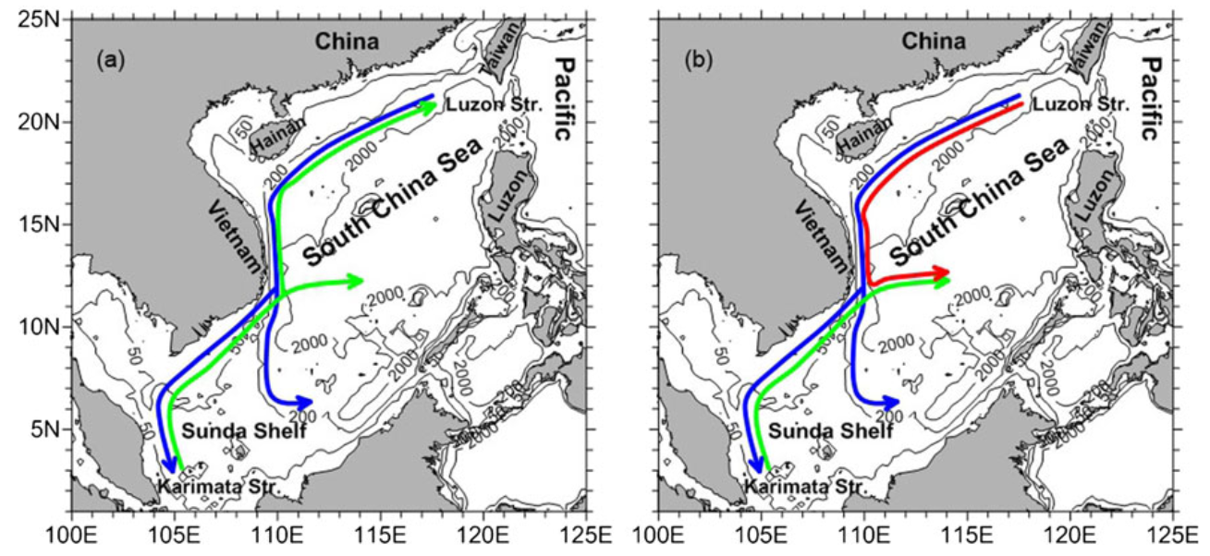
Featured dynamics in the area
Governed by Asian monsoon system with two wind regimes
SCS Western Boundary current (SCSWBC)
SE Vietnam Offshore Current
Large upwelling due to the persistent blow of SW monsoon wind and other meso-scale circulations (2 cyclonic and anti-cyclonic gyres where the current separation taking place) .
Fang et al., 2012
Winter
Summer
SCSWBC
SCSWBC
Offshore Current
Qi Quan et al, 2016

Slide 5
From raw measurements to scientific information

Slide 6
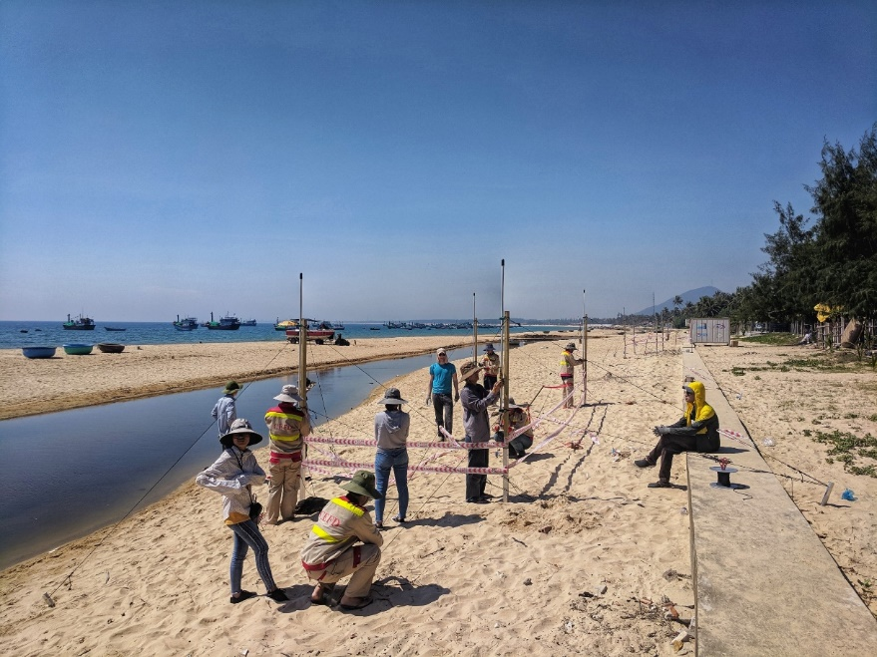
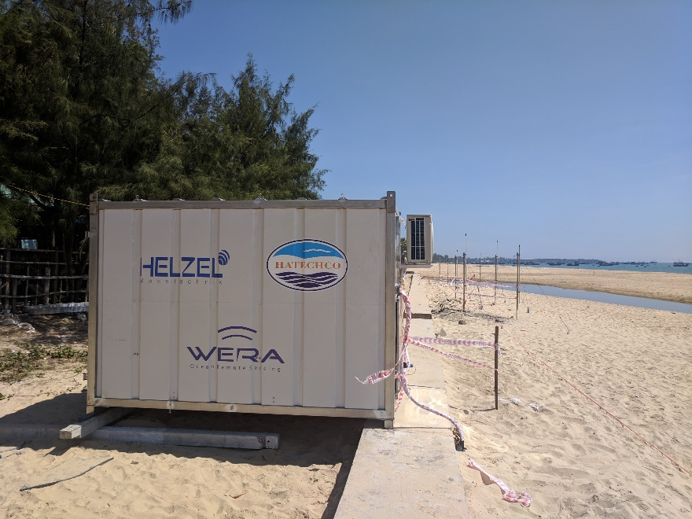
Measurement campaign
Location: Phu Yen, Vietnam
Period: April-May 2019
→ Transition period of the Asian monsoon
HF Radar (WERA)
Operating frequency: 16.15 MHz
Data integration: ~9 mins
Acq. Interval: 30 mins
Duration: 14/4-15/5/2019 (1 month)
AWAC
Duration: 16-22/4/2019 (7 days)
Time interval: 15 mins
SYMPHONIE model
Coverage: whole East Sea
Grid: ~1km nearshore, curvilinear
Comparison period: 14/4-15/5/2019, daily
Dual-frequency HFR system at 24.5&16.15 MHz

Slide 7
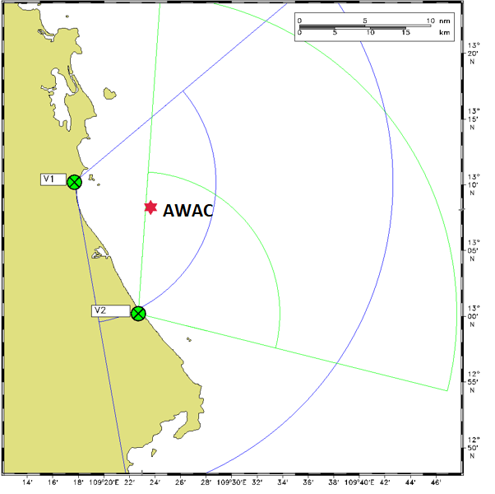
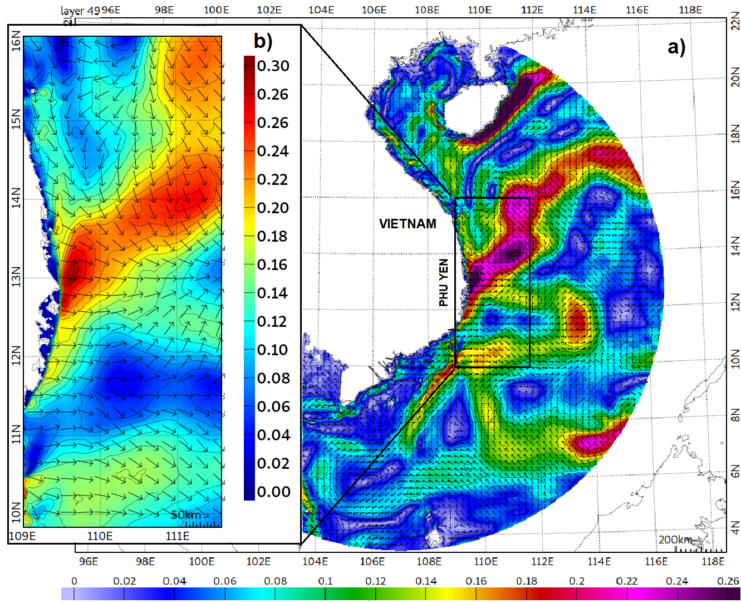
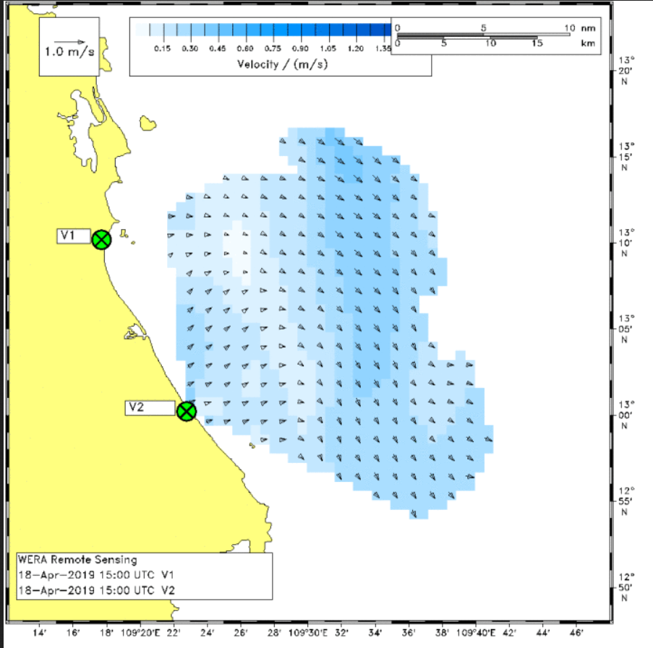
Model and HF Radar domains
Radar’s domain

Slide 8
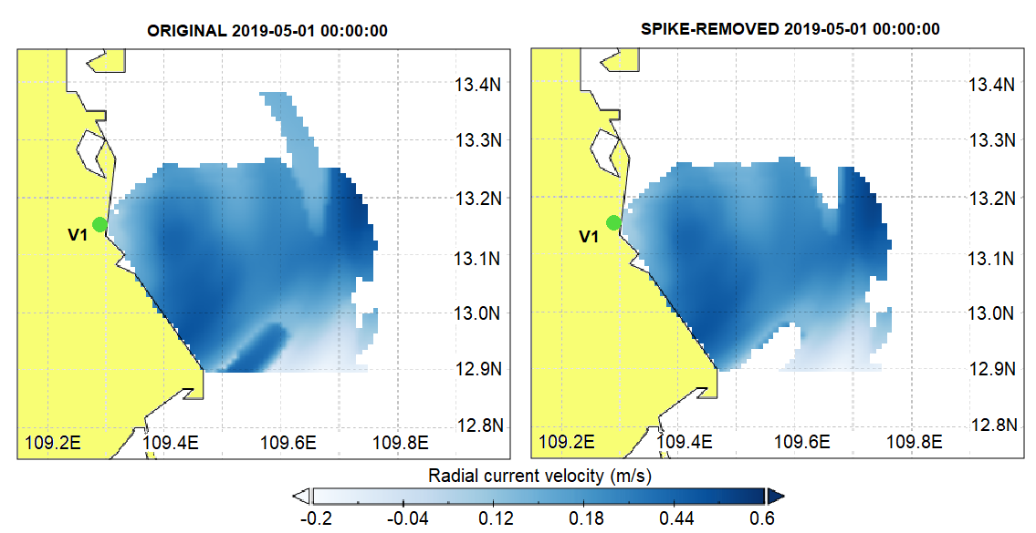
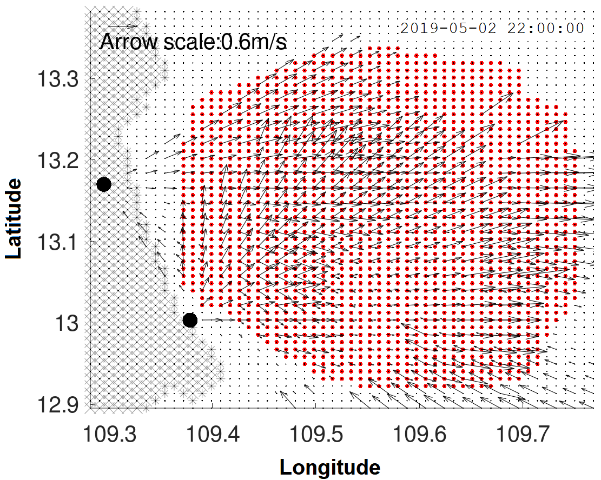
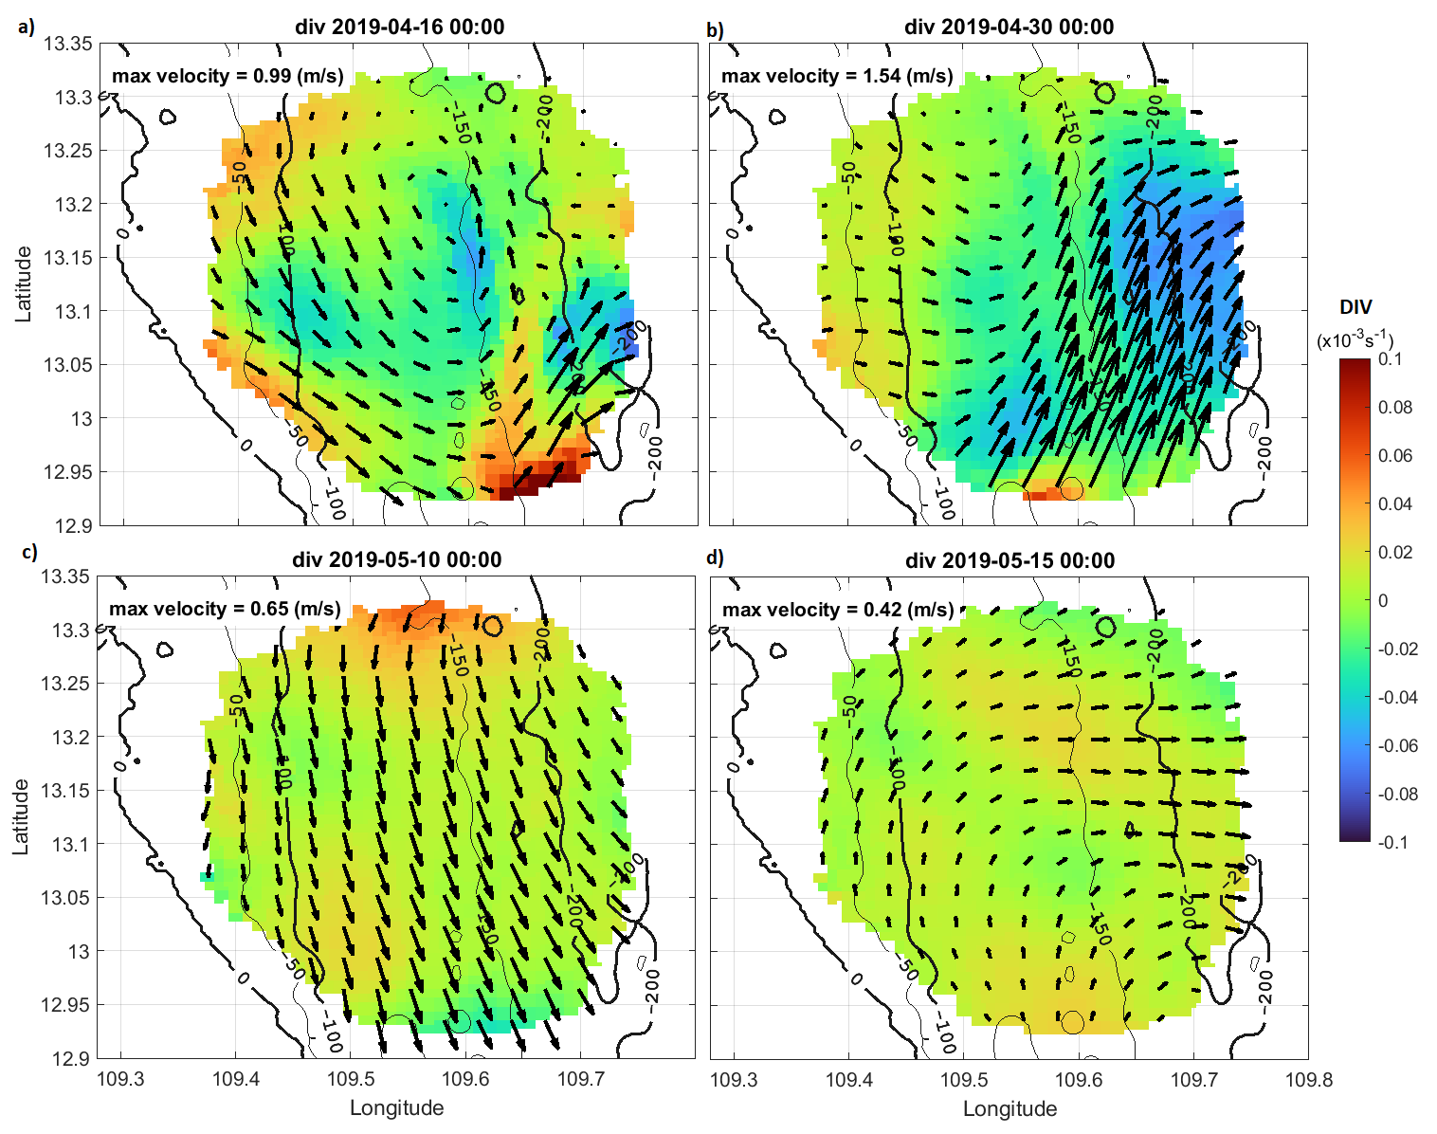
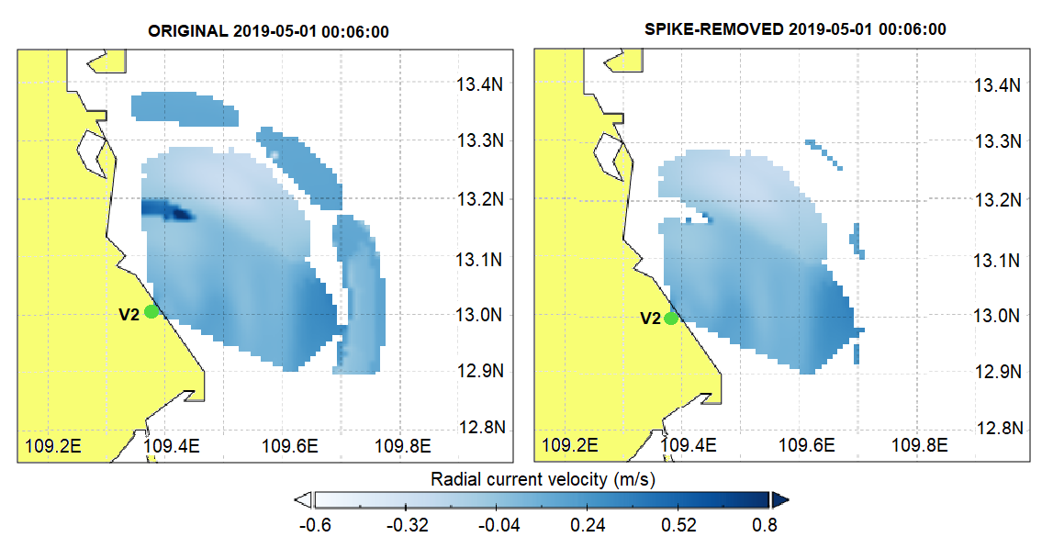
Preprocessing of HFR measurement data
Step 1: Noise removal
Step 2: Gap filling & interpolation
Surface current vectors
Vectors of the radial current velocities at two WERA stations after spike removal (black arrows) and the velocity interpolation grid used in 2dVar/EOF
Radial current velocities from the individual radar measurements before (left) and after (right) spike removal
Notes:
Cause of noise: radio frequency interference (RFI) from other radio band users and electronic equipment and low frequency interference typically from 50 Hz power lines
Method: outlier detection and RMSE threshold
RMSE upper threshold: 0.45 m/s for a distance >25km from the two radar stations.

Slide 9
Near-shore surface current variability
What HF radar data and numerical model tell us

Slide 10
HFR vs. AWAC comparison
Good agreement of HFR and AWAC in monitoring SSC during the period of measurement

Slide 11
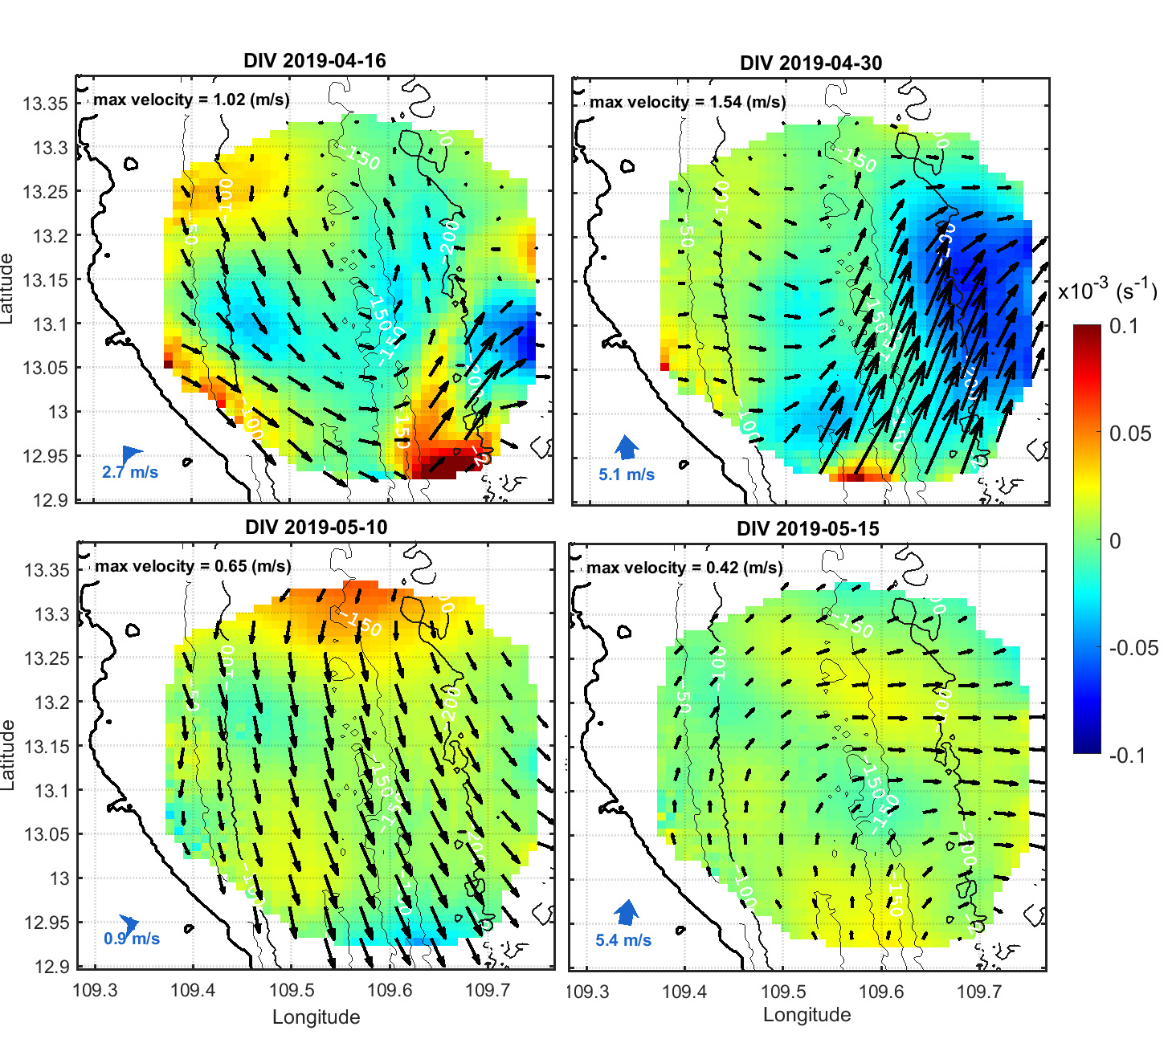
Featured dynamics in the area during the analysis period
A northern current intrusion as a result of the South China Sea Western Boundary Currents (Fig.2c)
A strong SE jet at ~30km from the coast (Fig.2b)
A seaward current appearing for several days (Fig.2d)
On April 16, an eddy-like structure appeared within the HF radar coverage area. (Fig.2a)
SSC m/s
a)
b)
c)
d)
Fig 1. 9-year averaged SSC during April-May from SYMPHONIE model
Fig 2. daily average SSC obtained from HF Radar superimposing divergence field

Slide 12
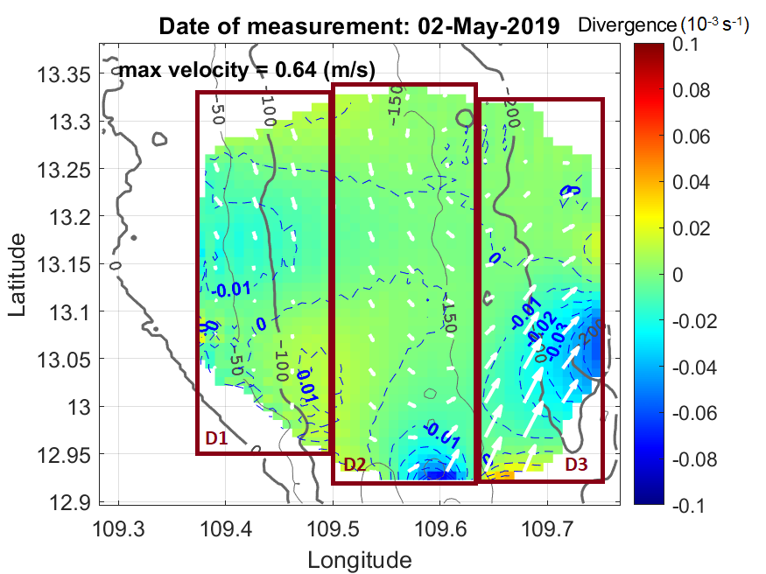
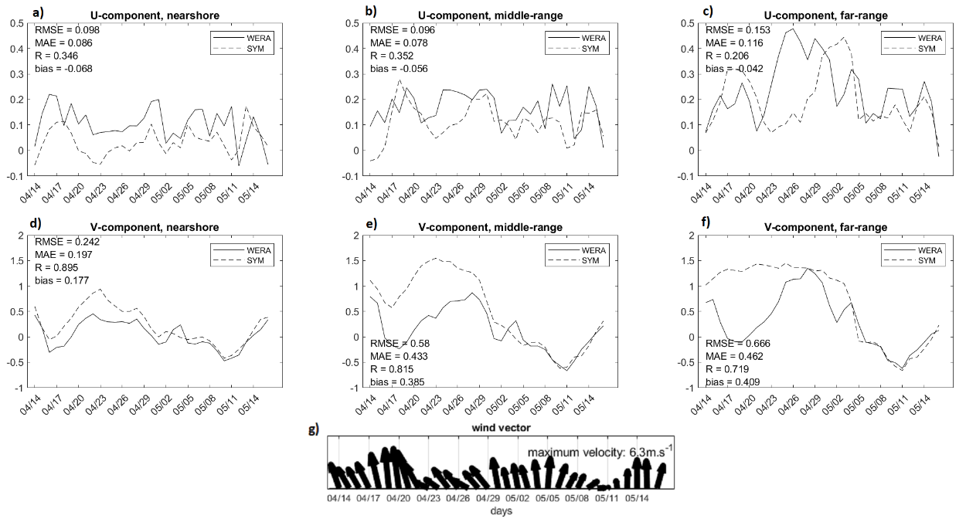
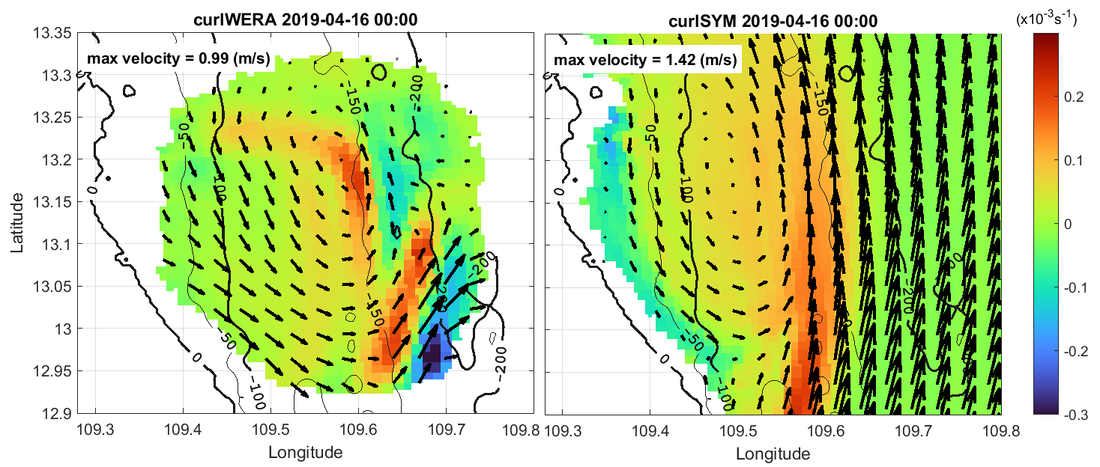
Comparison of HF radar measurements and modelling results
Fig 1.
Three subdomains : nearshore (D1), middle-range (D2) and far-range (D3)
SSC comparison between HFR and SYMPHONIE shows significant differences between two wind conditions (SE wind vs. S-SW wind)
Anti-clockwise eddy on April 16 was well presented in both model and HFR
Fig 3.
Fig 2.

Slide 13
Conclusions and future work
The coastal dynamics of the area has large variability both in time and space
Good agreements between HF Radar & AWAC show the reliability of HF Radar measurements during this period
Large discrepancies between model and HF radar during SE wind, however, model shows good agreements with HF radar when wind changed to S-SW direction
SYMPHONIE model demonstrated its capability to simulate the nearshore feature
The large errors at the far-range subdomain could be explained that the HF Radar azimuth errors become larger at far distance to radar locations; and also could be risen from interpolation procedure.
The uncertainties of modeled velocity fields can result from the uncertainty in forcing fields, i.e. winds.
➔ NEXT STEP: optimize wind forcing using HF radar data with an expectation to achieve better model results of SSC variability.

Slide 14
Acknowledgment
The WERA HF radar data were obtained from the measurement campaign in Vietnam, 2019 under the World Bank-funded project FIRST. We would like to express our thanks to the Center for Environmental Fluid Dynamics, Vietnam National University - University of Science (CEFD, VNU-HUS) in Hanoi, Vietnam for their contributions and for data provision.
References
THANK YOU FOR YOUR ATTENTION!

