Slide 1



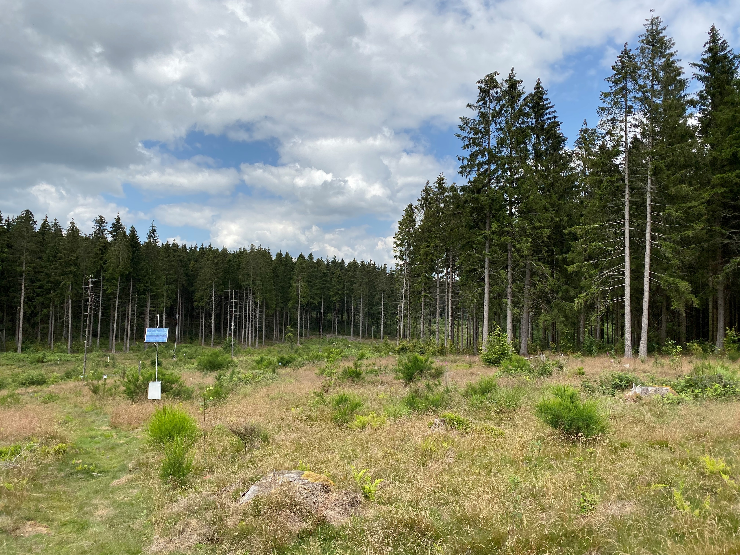
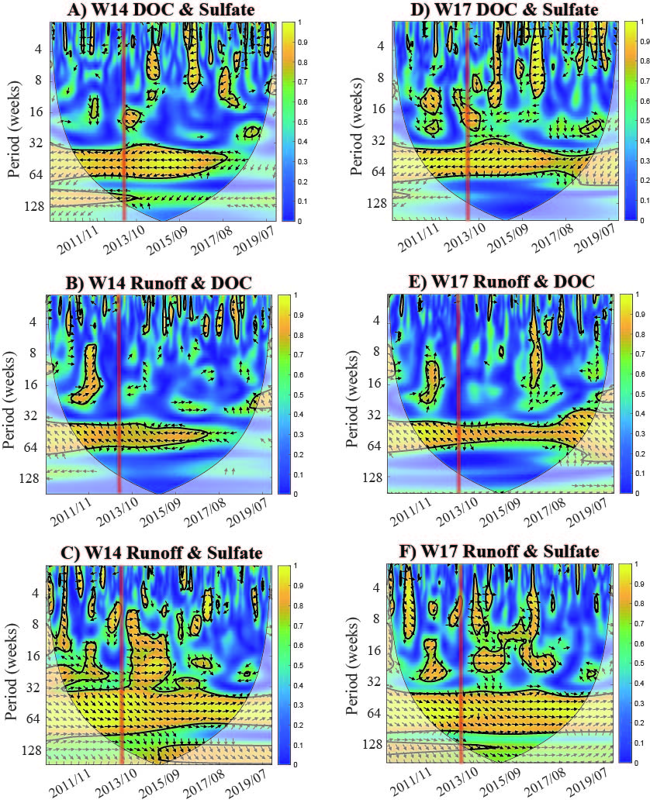
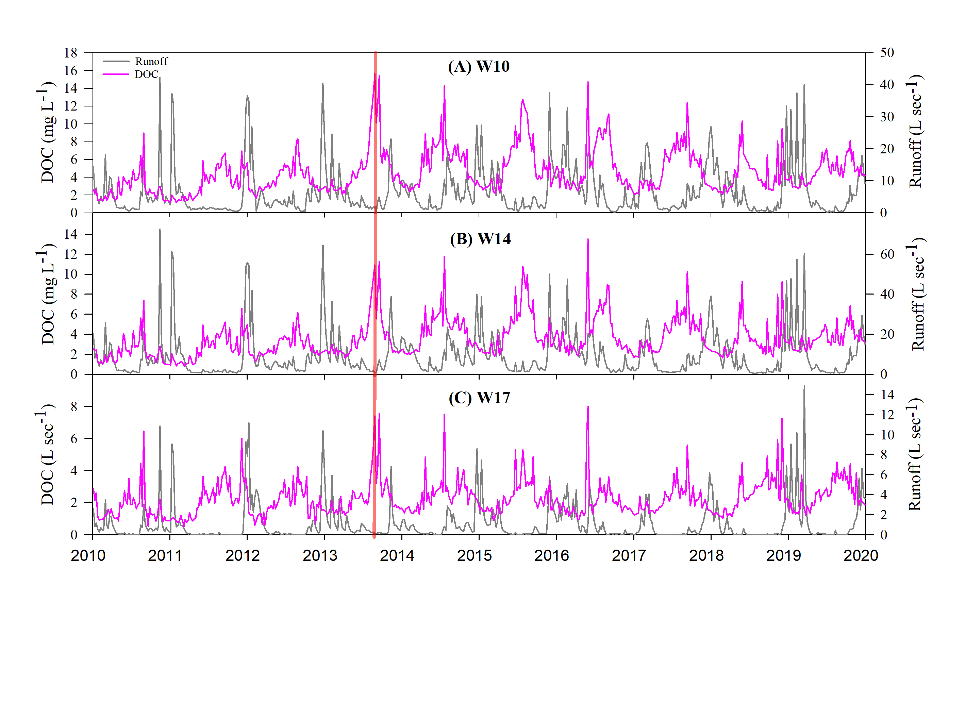
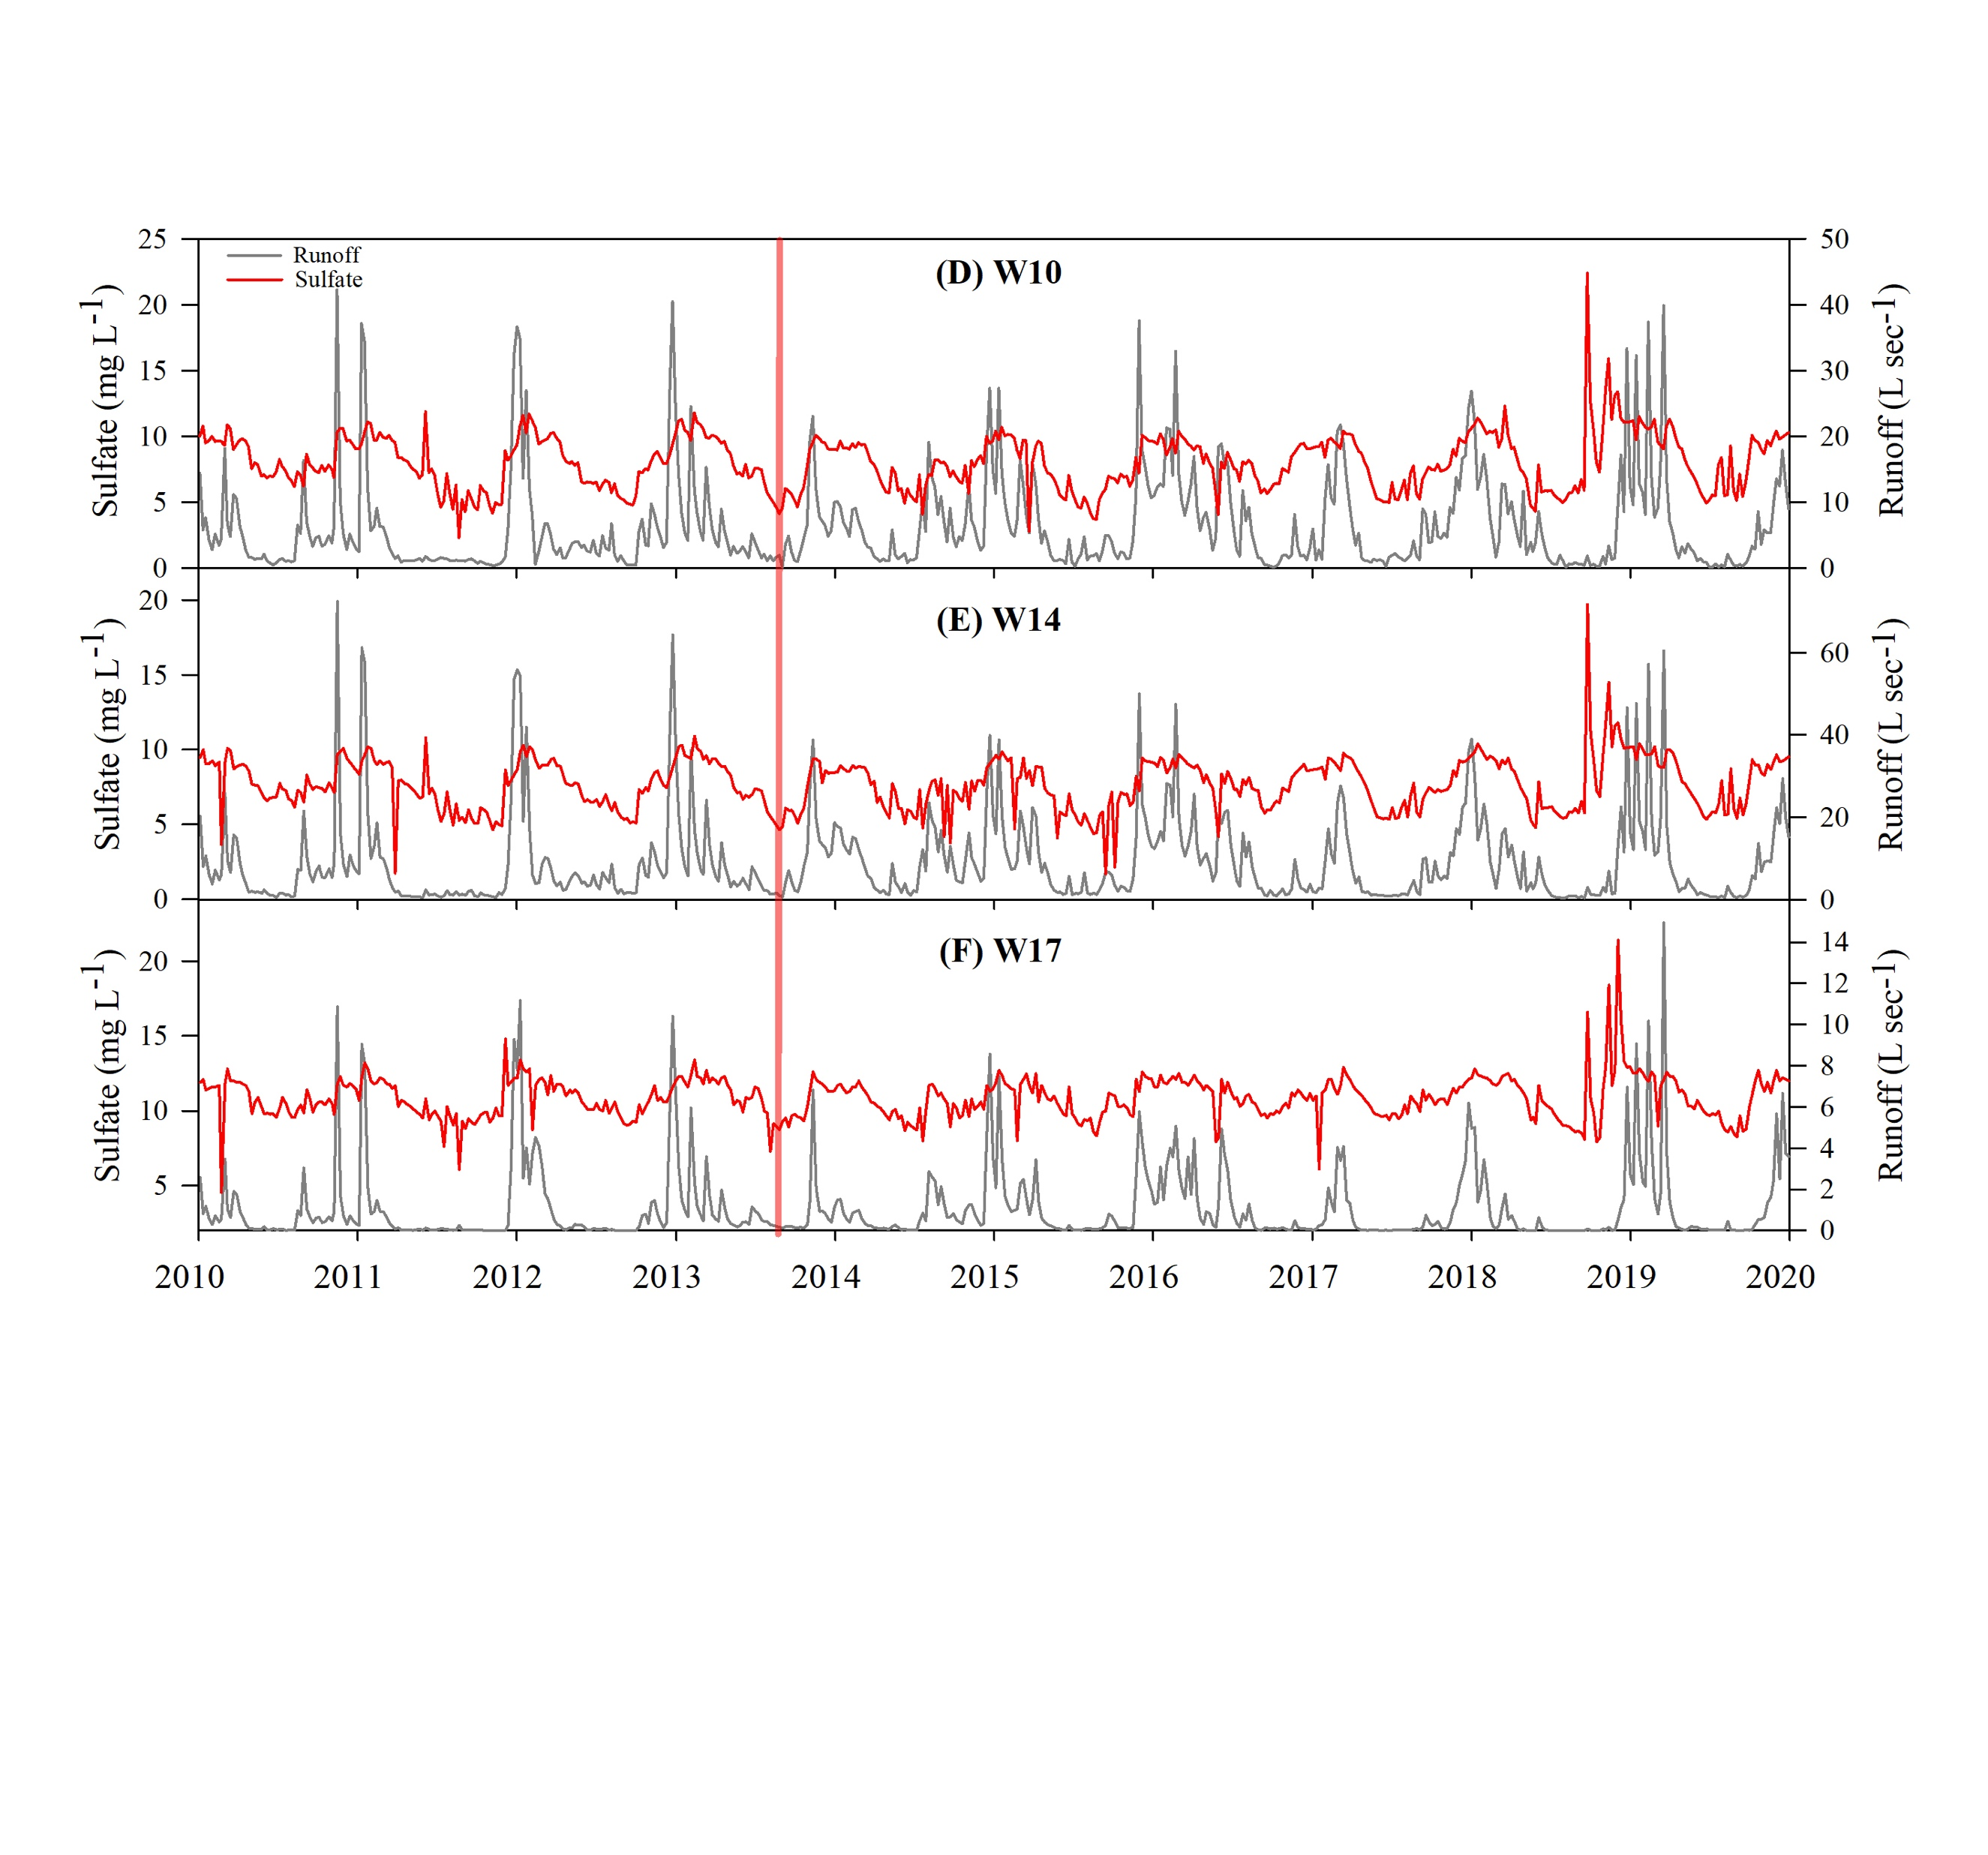
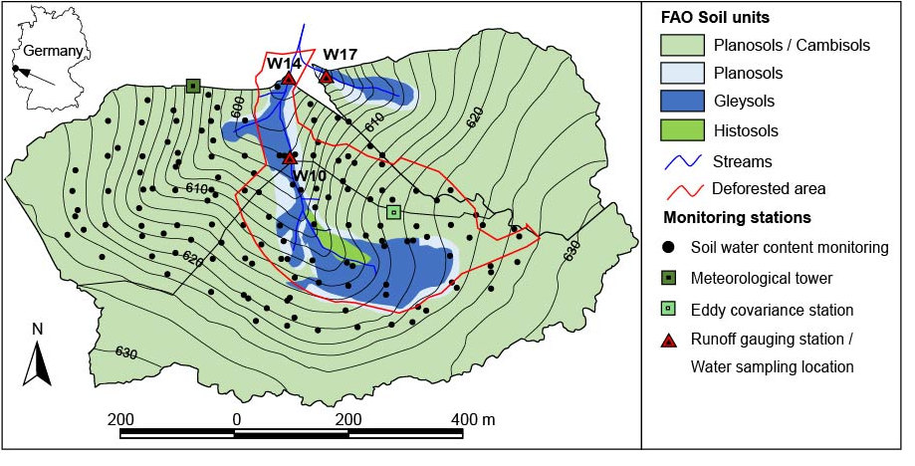
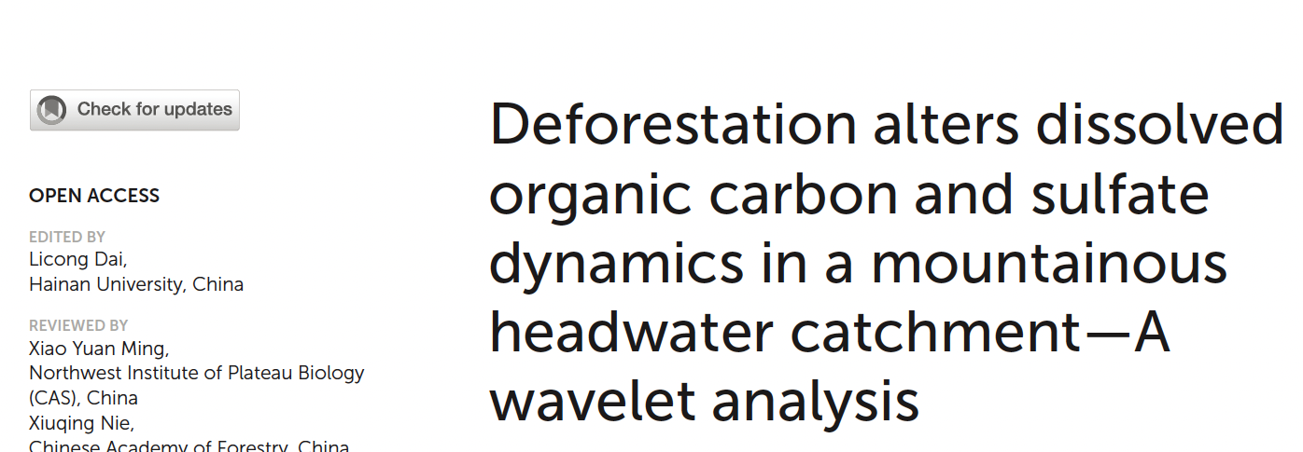
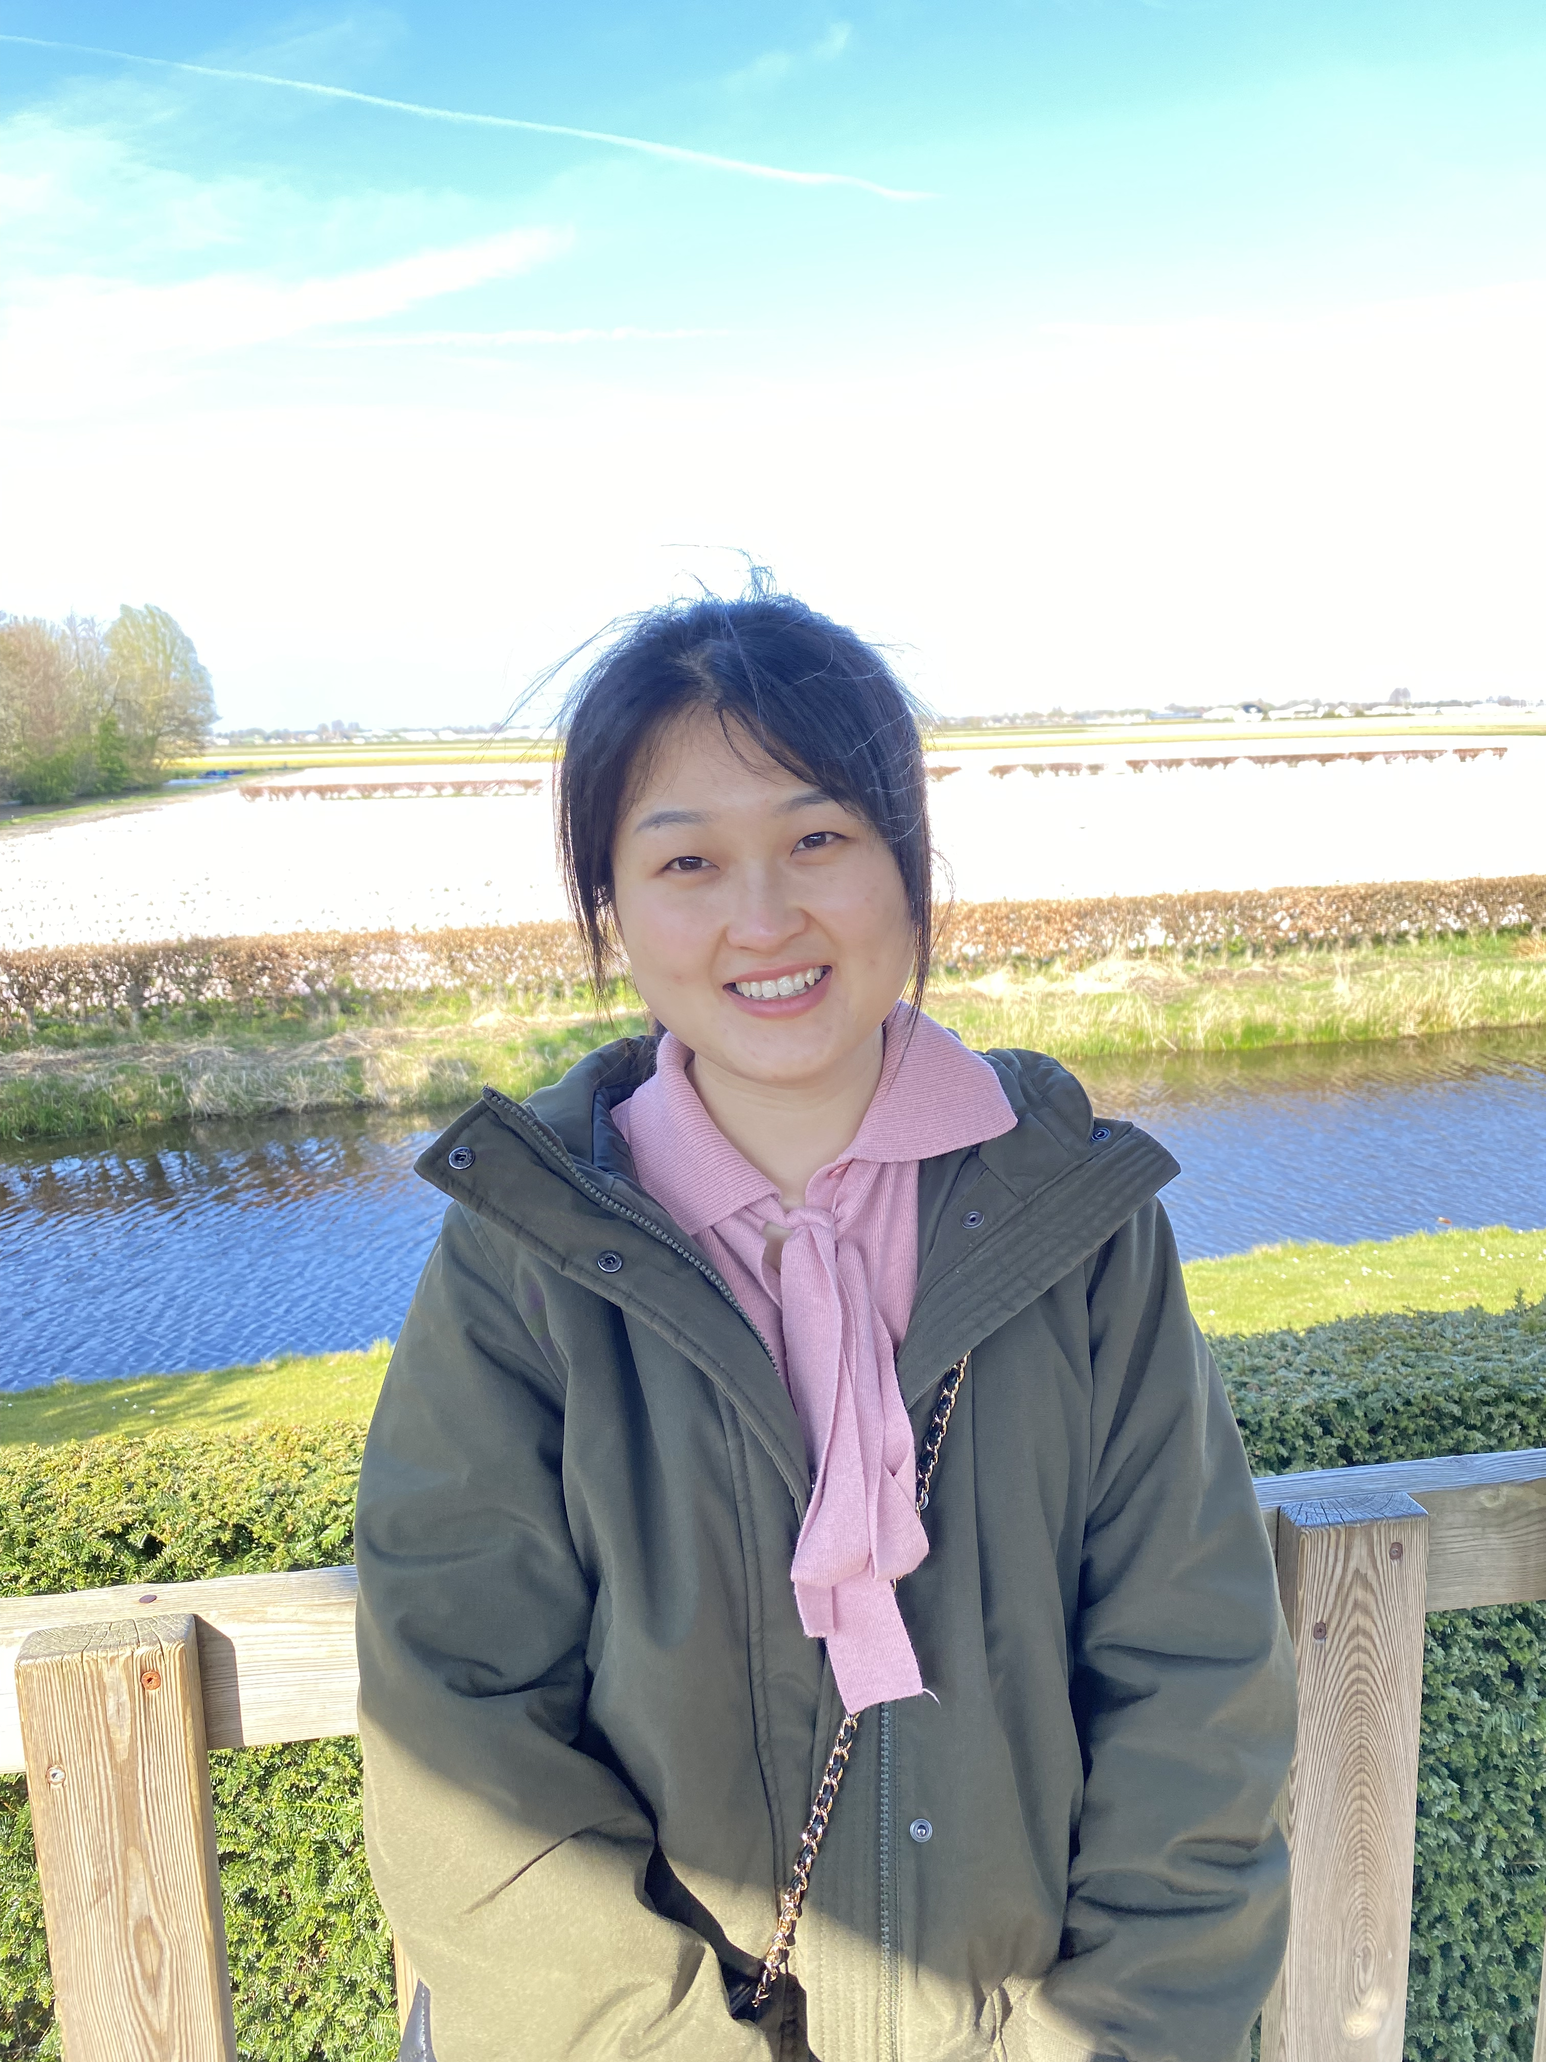
Deforestation alters dissolved organic carbon and sulfate dynamics*
Qiqi Wang^{1,2*}, Yuquan Qu¹, Kerri-Leigh Robinson², Heye Bogena¹, Alexander Graf¹, Harry Vereecken¹, Albert Tietema², and Roland Bol^{1,2}
¹Institute of Bio- and Geosciences, Agrosphere (IBG-3), Forschungszentrum Juelich, Germany
²Institute of Biodiversity and Ecosystem Dynamics (IBED), University of Amsterdam, Amsterdam, The Netherlands
Introduction
Results
Sulfur ‘deficiency’ scenario
Deforestation
W14
DOC
Runoff
+58%
Hydrological variables
Sulfate
DOC
Deforestation
W17
+26%
W14
Deforestation has a wide range of effects on hydrological and geochemical processes. Dissolved organic carbon (DOC) dynamics, a sensitive environmental change indicator, is expected to be affected by deforestation, with changes in atmospheric sulfur (S) deposition compounding this.
However, how precisely anthropogenic disturbance (deforestation) under a declining atmospheric sulfur input scenario affects the underlying spatiotemporal dynamics and relationships of river DOC and sulfate with hydro-climatological variables e.g., runoff remains unclear.
W17
DOC, sulfate concentrations showed distinct seasonal patterns, The average DOC concentrations were 2.23 in W17 and 3.52 mg L⁻¹ in W10. Sulfate concentrations were 8.04 in W10 and 10.58 mg L⁻¹ in W17. After clear-cut, DOC significantly increased by 58% in the mainstream W14, but only 26% in the reference stream (W17).
WTC results indicated that deforestation altered the relationships between DOC and sulfate, and runoff. DOC was negatively correlated with runoff and sulfate, The negative correlation between DOC with runoff and sulfate was apparent over the whole examined 10-year period in W17 but ended in W14 after the deforestation (Indicated by red boxes).
Materials and methods
Conclusion
Forest catchment deforestation levels over 25% (W10) affected the coupling of S and C cycling substantially more than ‘natural’ environmental changes as observed in W17. WTC analysis pinpoints the underlying catchment relationships between variables to anthropogenic impact.
The study site is part of the TERENO Wüstebach catchment (Eifel, Germany), where partial deforestation had taken place in 2013. Wavelet transform coherence (WTC) analysis was applied based on a 10-year time series (2010-2020) from three sampling stations, whose (sub)catchment areas have different proportions of deforested area (W14: 25%, W17: 3%).
For DOC, sulfate, and runoff, weekly data from 4th January 2010 to 30th December 2019 (522 weeks) were used for wavelet analysis.
Acknowledgement
We gratefully acknowledge the TERENO (Terrestrial Environmental Observatories) funded by the Helmholtz-Gemeinschaft.
Qiqi Wang acknowledges the Ph.D grant from China Scholarship Council (No.201903250108.)
*The paper was published on Frontiers in forests and global change,
more information can be found in doi: 10.3389/frwa.2022.1003693
*q.wang@fz-juelich.de

