Slide 1
New Representation of Synthetic Aperture Radar Images for Enhanced Ice-Sounding Interpretation
Alvaro Arenas-Pingarrón¹, Hugh Corr¹, Carl Robinson¹, Tom Jordan¹, Alex Brisbourne¹, Carlos Martín¹, Paul Brennan²
¹British Antarctic Survey, United Kingdom ²University College London, United Kingdom
28 April 2023

Slide 2
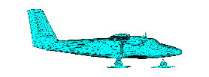
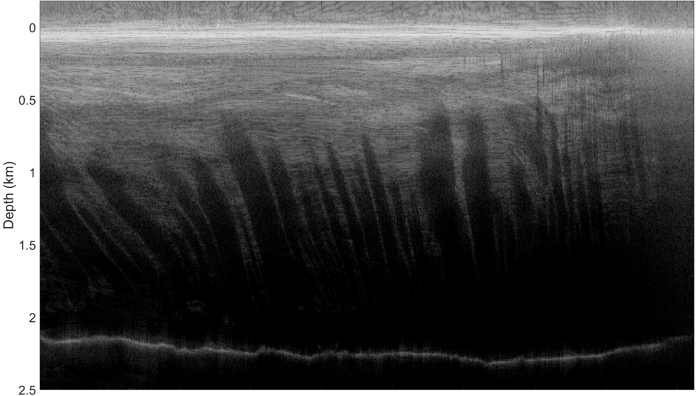
Rutford Ice Stream. Airborne SAR
center
margin
PASIN 2
diversity
integration
SUMM
≈ 9 km
REFs

Slide 3
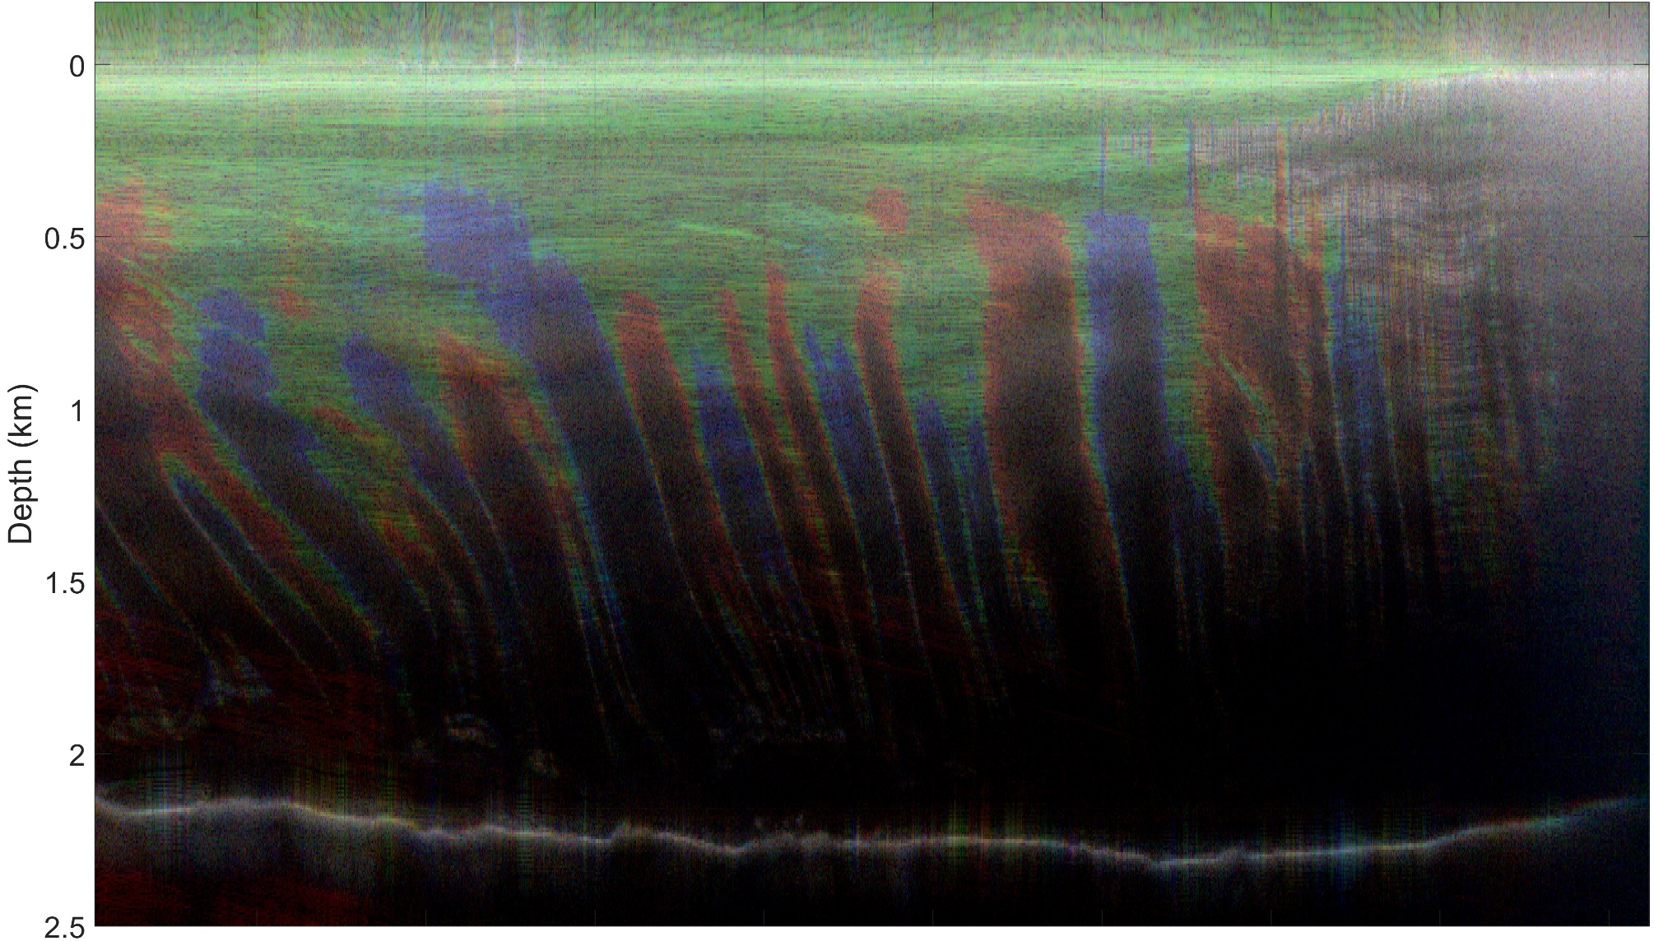
Rutford Ice Stream. Coloured SAR
R
G
B
center
margin
Red
+
Green
+
Blue
PASIN 2
integration
diversity
SUMM
≈ 9 km
REFs

Slide 4
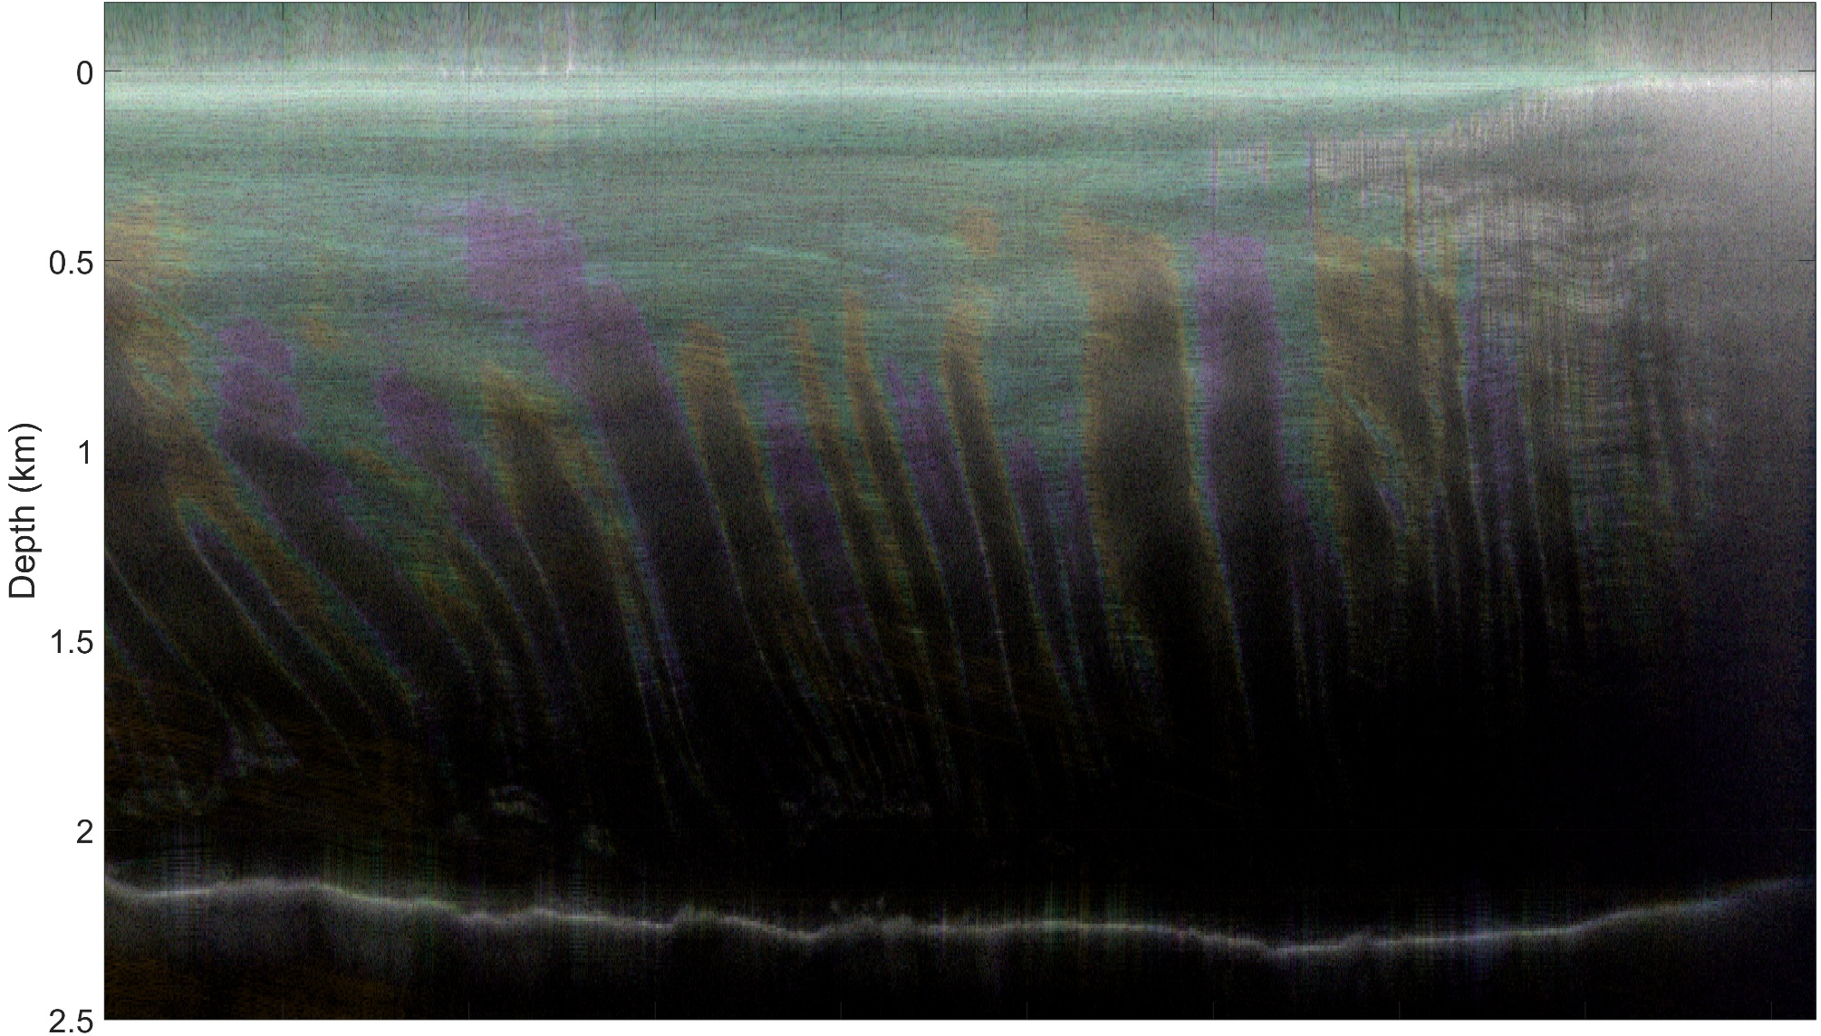
Rutford Ice Stream. Coloured SAR
O&R
T&G
P&B
center
margin
Red Olive
+
Green Teal
+
Blue Purple
PASIN 2
readability
SUMM
≈ 9 km
REFs

Slide 5
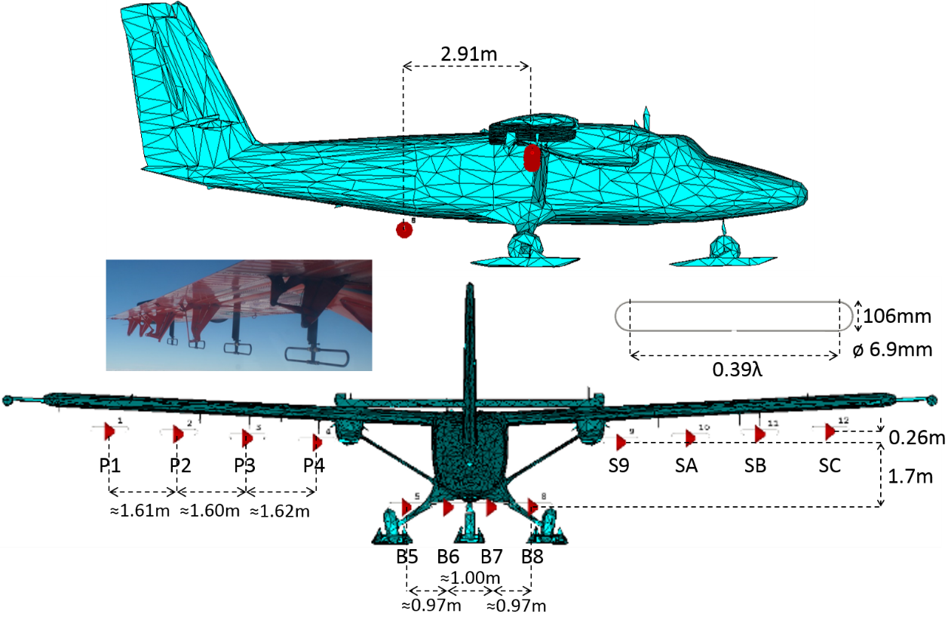
PASIN2 (Polarimetric Airborne Scientific INstrument, mark 2)
folded dipoles
150MHz
55 m/s
PASIN 2
2TX, 12RX = 24channels
SUMM
REFs

Slide 6
SAR image formation
ice surface
internal layers
bedrock
SAR processing
PASIN 2
-PRF/2
-15
0
15
PRF/2
-PRF/2
-15
0
15
PRF/2
Doppler frequencies (Hz)
Doppler frequencies (Hz)
SUMM
Integration vs. Diversity
REFs
Notes:
Detail of the previous image. I want to try the colour palette during presentations.

Slide 7
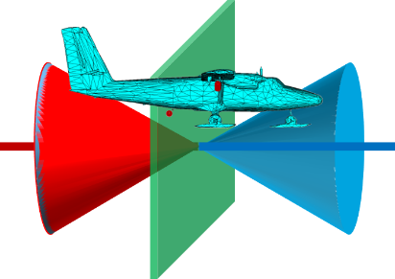
RGB Decomposition for along-track point of view
ice surface
internal layers
B
bedrock
R
G
B
G
R
G
B
PASIN 2
R
G
B
R
Y (R+G)
G
C (G+B)
B
R
B
G
-15
15
≈ -15° ≈ -8.3°
≈ 15°, in air ≈ 8.3°in ice (after refraction)
-15
15
-PRF/2
0
PRF/2
≈ 0°
-PRF/2
0
PRF/2
SUMM
Doppler frequencies (Hz)
Doppler frequencies (Hz)
Doppler spectrum ↔ Pointing angle
REFs
Notes:
Detail of the previous image. I want to try the colour palette during presentations.

Slide 8
Palettes aiming to universal readability
Typical
Protanopia
Deuteranopia
Tritanopia
G
Red = RGB (0.9, 0, 0)
Green (0, 0.8, 0)
Blue (0.1, 0.2, 1)
R
B
PASIN 2
T
Olive (0.5, 0.5, 0)
Teal (0, 0.5, 0.5)
Purple (0.5, 0, 0.5)
O
P
0.75·O + 0.25·R
0.75·T + 0.25·G
0.75·P + 0.25·B
SUMM
REFs

Slide 9
SAR Image index
Rutford Ice Stream
Recovery Ice Stream
PASIN 2
Sentinel Ice Stream (English Coast)
Thwaites Glacier (Western margin)
SUMM
REFs

Slide 10
Summary
Alternative representation of SAR images:
improves interpretation
any radar, any application
complements conventional SAR representation
Flexible choice of diversity:
doppler bandwidth
pulse bandwidth
…
Flexible choice of colours
data
PASIN 2
integration
diversity
SUMM
REFs

Slide 11
Mapping references
Mapping tool (Quantarctica):
We acknowledge the Norwegian Polar Institute’s Quantarctica package: https://www.npolar.no/en/quantarctica/
Matsuoka, K., et al., (2021) Quantarctica, an integrated mapping environment for Antarctica, the Southern Ocean, and sub-Antarctic islands. Environmental Modelling & Software 140, 105015. doi:10.116/j.envsoft.2021.105015
Ice flow speed map (MEaSUREs Program):
Rignot, E., J. Mouginot, and B. Scheuchl. (2017). MEaSUREs InSAR-Based Antarctica Ice Velocity Map, Version 2 [Data Set]. Boulder, Colorado USA. NASA National Snow and Ice Data Center Distributed Active Archive Center. https://doi.org/10.5067/D7GK8F5J8M8.
Rignot, E., J. Mouginot, and B. Scheuchl. 2011. Ice Flow of the Antarctic Ice Sheet, Science. 333. 1427-1430. https://doi.org/10.1126/science.1208336
Satellite surface image (LIMA):
http://lima.usgs.gov/fullcontinent.php
Bindschadler, R., et al., 2008, The Landsat Image Mosaic of Antarctica, Remote Sensing of Environment, 112, pp. 4214-4226
Ice flow speed colour map (Batlow):
The software : Crameri, F. (2018a), Scientific colour maps. Zenodo. http://doi.org/10.5281/zenodo.1243862
The research : Crameri, F., G.E. Shephard, and P.J. Heron (2020), The misuse of colour in science communication, Nature Communications, 11, 5444. doi.org/10.1038/s41467-020-19160-7
PASIN 2
SUMM
REFs

Slide 12
Rutford Ice Stream
Flow speed (m/yr, MEaSUREs)
≤ 50 m·yr⁻¹
50-100
100-150
150-200
200-250
Grounding line
250-300
83º W
Kealey Ice Rise
300-350
Carlson Inlet
≥ 350
PASIN 2
MEaSUREs: Rignot, E., J. et al. (2017). MEaSUREs InSAR-Based Antarctica Ice Velocity Map, Version 2 [Data Set] https://doi.org/10.5067/D7GK8F5J8M8
T04
T15
Rutford Ice Stream
T04
86º W
Batlow colour map: Crameri, F., et al. (2018a), Scientific colour maps. http://doi.org/10.5281/zenodo.1243862
0m
25km
50km
75km
100km
77º S
78º S
SUMM
LIMA Satellite surface image: Bindschadler, R., et al. (2008)
http://lima.usgs.gov/fullcontinent.php
We acknowledge the Norwegian Polar Institute’s Quantarctica package. https://www.npolar.no/en/quantarctica
REFs

Slide 13
Recovery Ice Stream
Flow speed (m/yr, MEaSUREs)
37º W
36º W
35º W
Grounding line
≤ 50 m·yr⁻¹
50-100
100-150
150-200
200-250
250-300
Filchner Ice Shelf
F11
300-350
80.75º S
≥ 350
PASIN 2
MEaSUREs: Rignot, E., J. et al. (2017). MEaSUREs InSAR-Based Antarctica Ice Velocity Map, Version 2 [Data Set] https://doi.org/10.5067/D7GK8F5J8M8
F09
Recovery Ice Stream
Batlow colour map: Crameri, F., et al. (2018a), Scientific colour maps. http://doi.org/10.5281/zenodo.1243862
0m
12.5km
25km
81º S
81.25º S
SUMM
LIMA Satellite surface image: Bindschadler, R., et al. (2008)
http://lima.usgs.gov/fullcontinent.php
We acknowledge the Norwegian Polar Institute’s Quantarctica package. https://www.npolar.no/en/quantarctica
REFs

Slide 14
English Coast Ice Stream
Flow speed (m/yr, MEaSUREs)
73º W
≤ 50 m·yr⁻¹
50-100
100-150
150-200
200-250
250-300
Grounding line
Sentinel Ice Stream
300-350
73.5º W
George VI Ice Shelf
≥ 350
F26
PASIN 2
MEaSUREs: Rignot, E., J. et al. (2017). MEaSUREs InSAR-Based Antarctica Ice Velocity Map, Version 2 [Data Set] https://doi.org/10.5067/D7GK8F5J8M8
74º W
Batlow colour map: Crameri, F., et al. (2018a), Scientific colour maps. http://doi.org/10.5281/zenodo.1243862
0m
12.5km
25km
73.5º S
73.75º S
SUMM
LIMA Satellite surface image: Bindschadler, R., et al. (2008)
http://lima.usgs.gov/fullcontinent.php
We acknowledge the Norwegian Polar Institute’s Quantarctica package. https://www.npolar.no/en/quantarctica
REFs

Slide 15
Thwaites Glacier
Flow speed (m/yr, MEaSUREs)
≤ 12.5 m·yr⁻¹
12.5 - 25
Thwaites Glacier
25 - 37.5
37.5 - 50
50 - 62.5
62.5 - 75
75 - 87.5
109º W
Western margin
≥ 87.5
PASIN 2
MEaSUREs: Rignot, E., J. et al. (2017). MEaSUREs InSAR-Based Antarctica Ice Velocity Map, Version 2 [Data Set] https://doi.org/10.5067/D7GK8F5J8M8
T11
110º W
Mount Murphy
Grounding line
Batlow colour map: Crameri, F., et al. (2018a), Scientific colour maps. http://doi.org/10.5281/zenodo.1243862
Mount Takahe
111º W
0m
32.5km
65km
75.5º S
76º S
SUMM
LIMA Satellite surface image: Bindschadler, R., et al. (2008)
http://lima.usgs.gov/fullcontinent.php
We acknowledge the Norwegian Polar Institute’s Quantarctica package. https://www.npolar.no/en/quantarctica
REFs

Slide 16
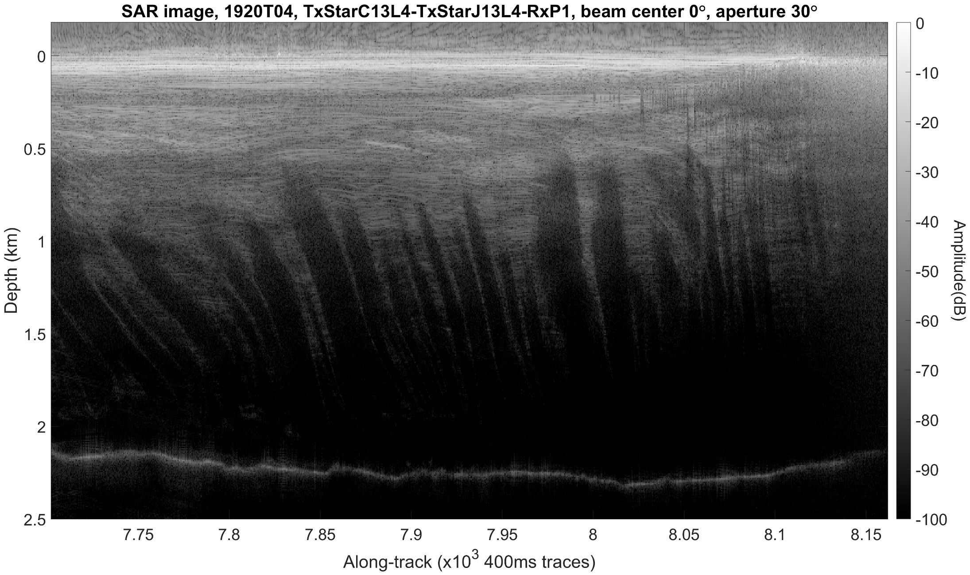
Rutford Ice Stream, across-flow. SAR image
center
margin
PASIN 2
SUMM
≈ 9 km
REFs

Slide 17
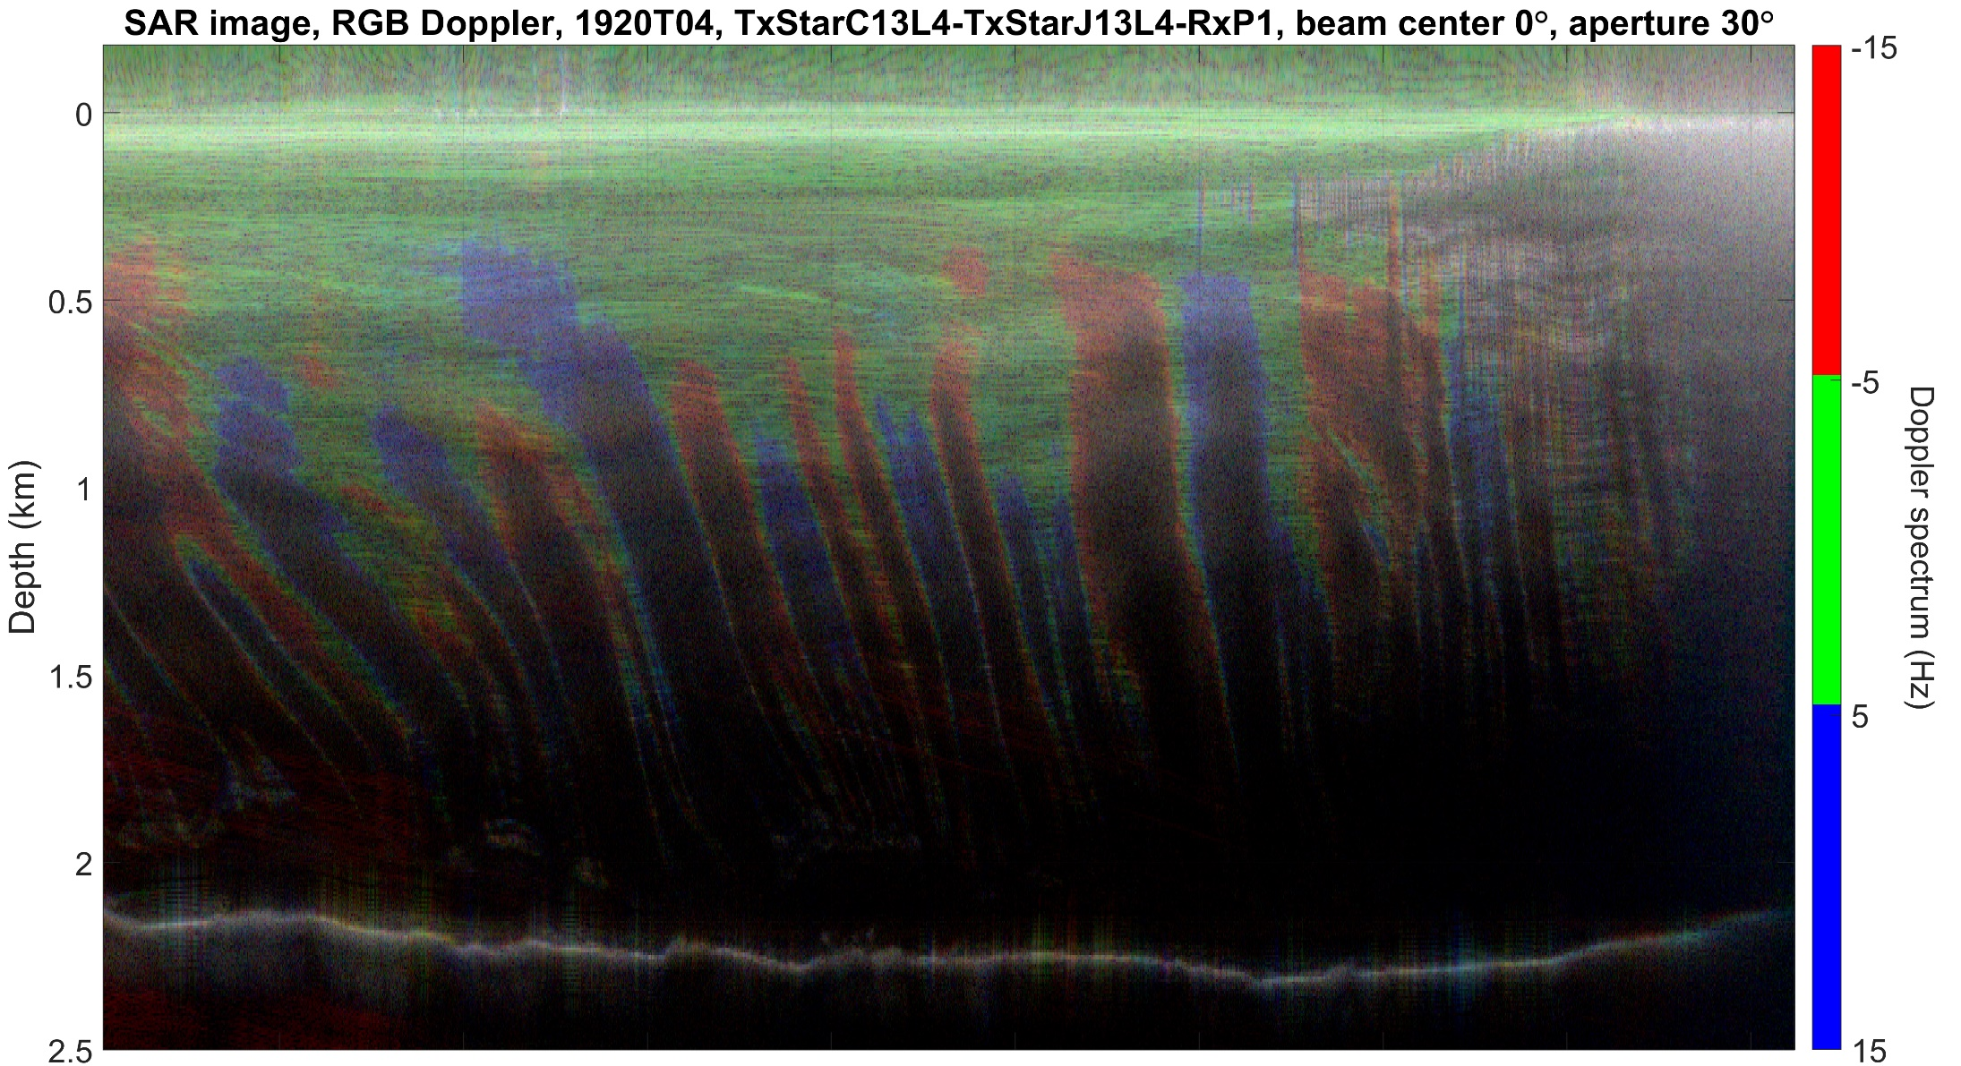
Rutford Ice Stream, across-flow. RGB Doppler Decomposition
center
margin
R
PASIN 2
G
Pure red(R)-green(G)-blue(B)
B
SUMM
REFs
≈ 9 km

Slide 18
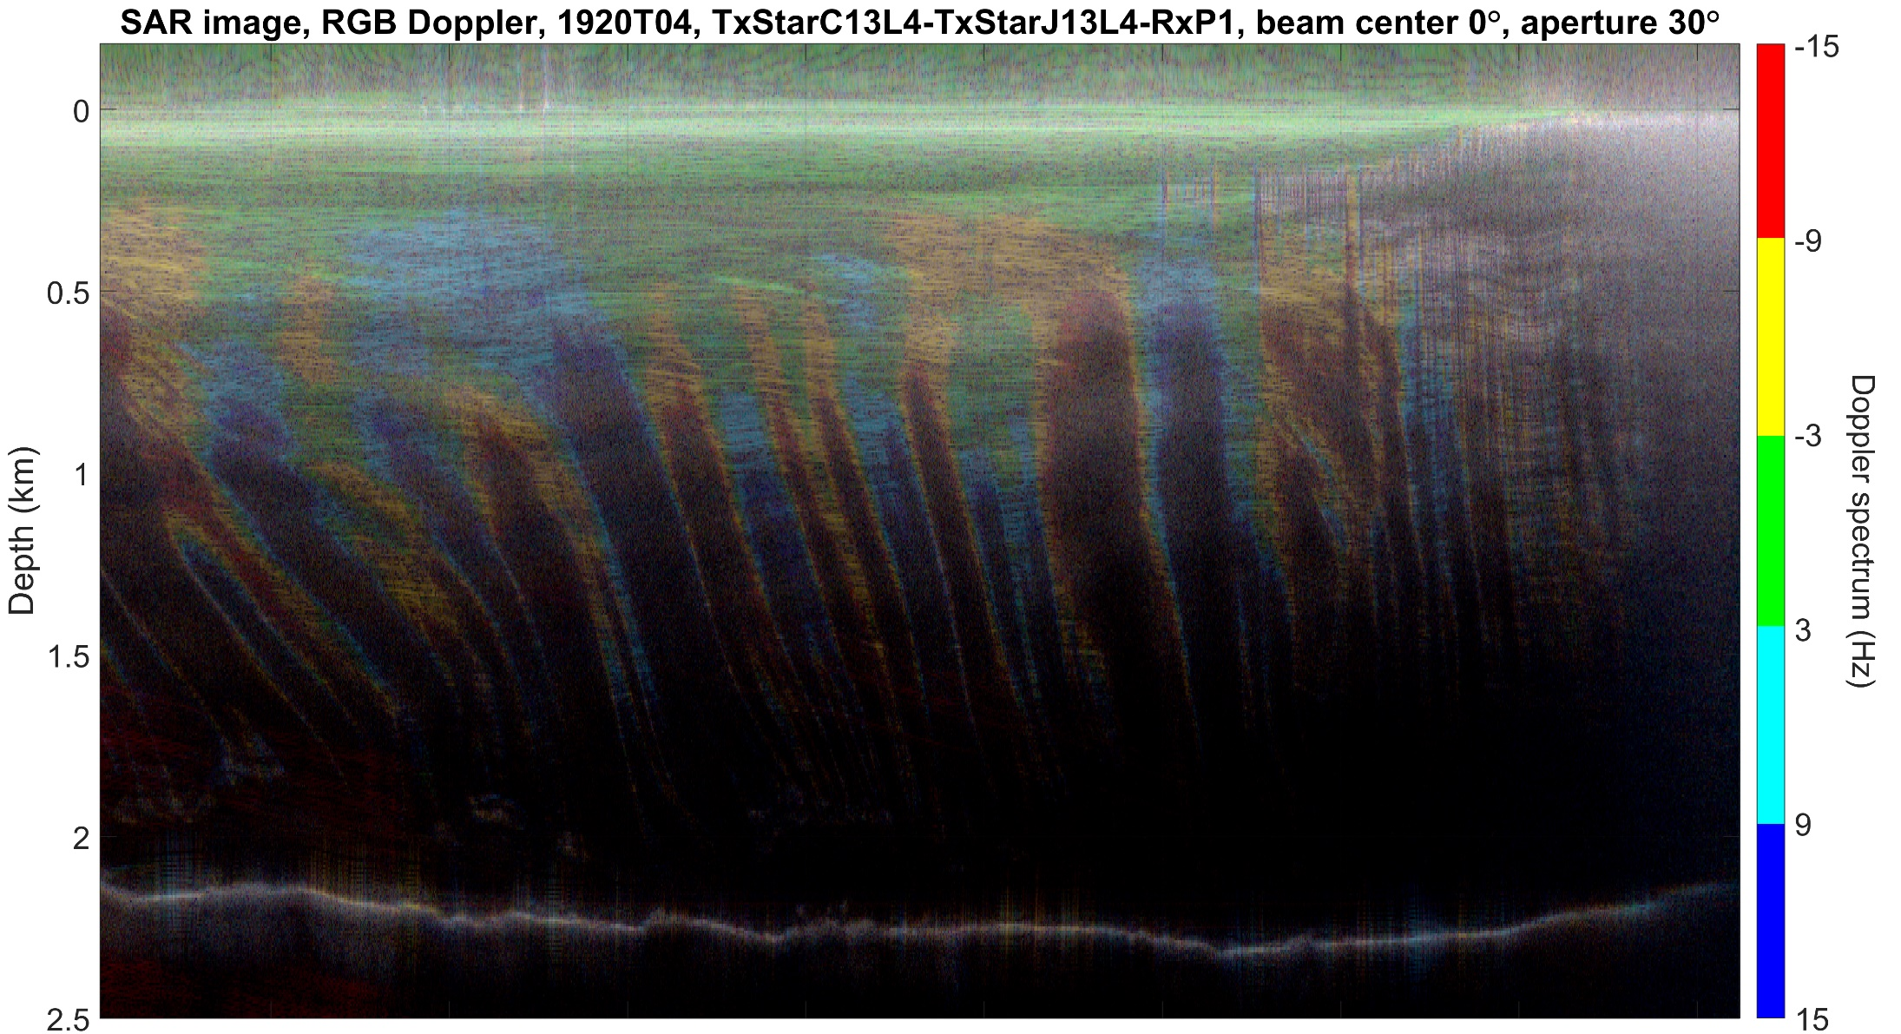
Rutford Ice Stream, across-flow. RGB Doppler Decomposition
center
margin
R
Y
PASIN 2
G
C
Pure red(R)-green(G)-blue(B)
B
SUMM
REFs
≈ 9 km

Slide 19
Rutford Ice Stream, across-flow. RGB Doppler Decomposition
center
margin
R
PASIN 2
G
Most intense band
B
SUMM
REFs
≈ 9 km

Slide 20
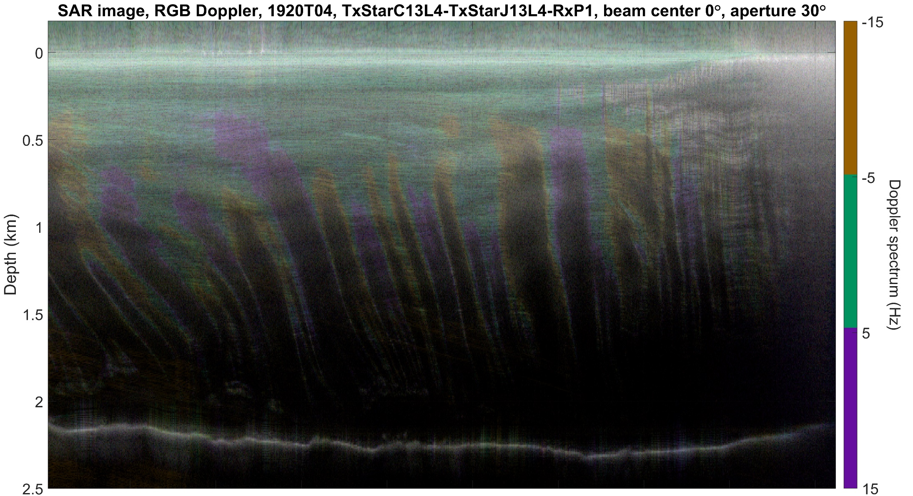
Rutford Ice Stream, across-flow. RGB Doppler Decomposition
center
margin
O + R
PASIN 2
T + G
Interpolation of olive(O)-teal(T)-purple(P) with R-G-B
P + B
SUMM
REFs
≈ 9 km

Slide 21
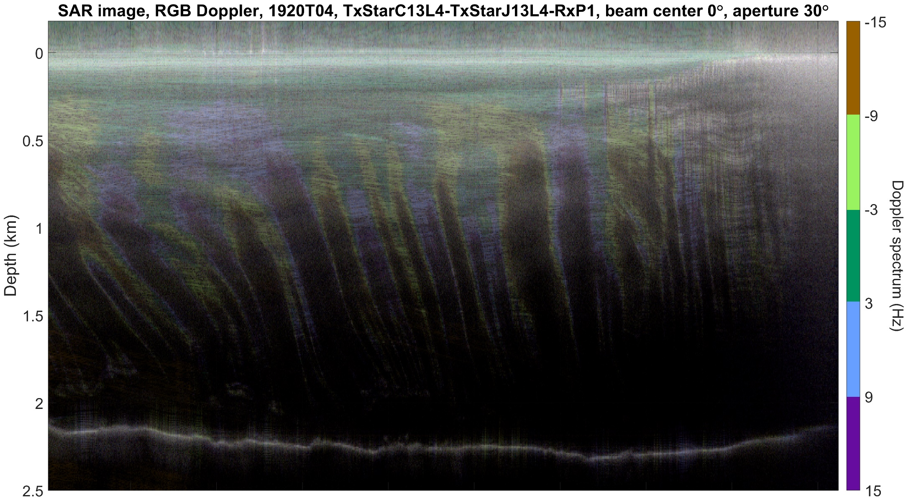
Rutford Ice Stream, across-flow. RGB Doppler Decomposition
O + R
center
margin
PASIN 2
T + G
P + B
SUMM
REFs
≈ 9 km

Slide 22
Rutford Ice Stream, across-flow. RGB Doppler Decomposition
center
margin
O + R
PASIN 2
T + G
Most intense band
P + B
SUMM
REFs
≈ 9 km

Slide 23
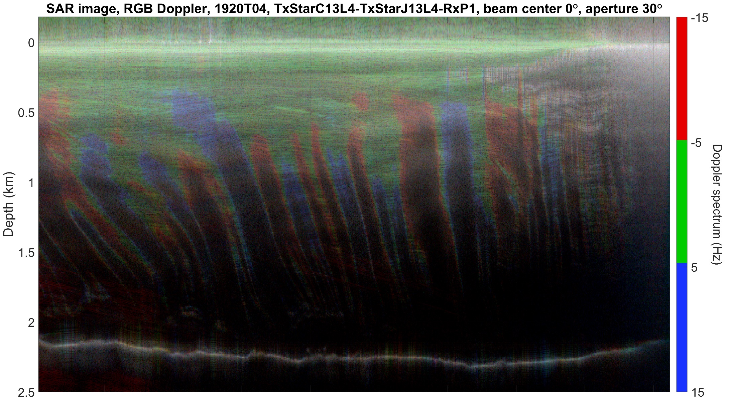
Rutford Ice Stream, across-flow. RGB Doppler Decomposition
center
margin
R
PASIN 2
G
Modified R-G-B
B
SUMM
REFs
≈ 9 km

Slide 24
Rutford Ice Stream, across-flow. RGB Doppler Decomposition
center
margin
R
PASIN 2
G
Most intense band
B
SUMM
REFs
≈ 9 km

Slide 25
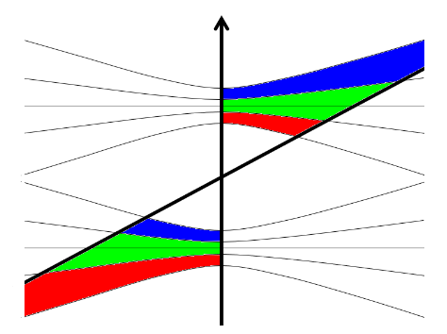
Recovery Ice Stream, ungrounded, across-flow. Range focussed
Flow speed map
Filchner Ice Shelf
A
A
B
Subglacial channel, oblique
B
Recovery Ice Stream
NPI’s Quantarctica package
MEaSUREs: Rignot, E., J. et al. (2017)
LIMA: Bindschadler, R., et al. (2008)
colour map: Crameri, F., et al. (2018a)
PASIN 2
R
O R
G
T G
SUMM
B
P B
REFs

Slide 26
Recovery Ice Stream, ungrounded, across-flow. Range focussed
A
B
PASIN 2
SUMM
REFs

Slide 27
Recovery Ice Stream, across-flow. RGB Doppler Decomposition
R
PASIN 2
G
B
SUMM
REFs

Slide 28
Recovery Ice Stream, across-flow. RGB Doppler Decomposition
O + R
PASIN 2
T + G
P + B
SUMM
REFs

Slide 29
Sentinel Ice Stream (English Coast), along-flow
Flow speed map
Sentinel Ice Stream
62
63
61
57
60
58
59
George VI Ice Shelf
NPI’s Quantarctica package
MEaSUREs: Rignot, E., J. et al. (2017)
LIMA: Bindschadler, R., et al. (2008)
colour map: Crameri, F., et al. (2018a)
PASIN 2
R
G
Sudden transition of the two types of ice according to the beamwidth of the backscattering:
broad white/grey (unstructured)
narrow colourful (structured)
B
O R
T G
P B
SUMM
REFs

Slide 30
Sentinel Ice Stream (English Coast), along-flow
Clear separation:
ice surface (green or teal&green ≈ horizontal flat surface)
shallow crevasses (white ≈ corner reflectors)
PASIN 2
R
G
B
O R
T G
SUMM
P B
REFs

Slide 31
Recovery Ice Stream, across-flow, grounded ice and margin
Flow speed map
Filchner Ice Shelf
A
B
A
Recovery Ice Stream
B
NPI’s Quantarctica package
MEaSUREs: Rignot, E., J. et al. (2017)
LIMA: Bindschadler, R., et al. (2008)
colour map: Crameri, F., et al. (2018a)
PASIN 2
R
G
The ice stream margin separates the two types of backscattering:
broad white/grey (unstructured)
narrow colourful (structured)
B
O R
T G
SUMM
P B
REFs

Slide 32
Recovery Ice Stream, across-flow, grounded ice and margin
Flow speed map
Filchner Ice Shelf
A
B
A
Recovery Ice Stream
B
NPI’s Quantarctica package
MEaSUREs: Rignot, E., J. et al. (2017)
LIMA: Bindschadler, R., et al. (2008)
colour map: Crameri, F., et al. (2018a)
PASIN 2
R
G
The ice stream margin separates the two types of backscattering:
broad white/grey (unstructured)
narrow colourful (structured)
B
O R
T G
SUMM
P B
REFs

Slide 33
Rutford Ice Stream
Flow speed map
Kealey Ice Rise
Carlson Inlet
A
B
A
Rutford Ice Stream
B
NPI’s Quantarctica package
MEaSUREs: Rignot, E., J. et al. (2017)
LIMA: Bindschadler, R., et al. (2008)
colour map: Crameri, F., et al. (2018a)
PASIN 2
R
G
Transitions from A to B:
stagnated ice
ice stream margin
across flow
along flow
B
O R
T G
SUMM
P B
REFs

Slide 34
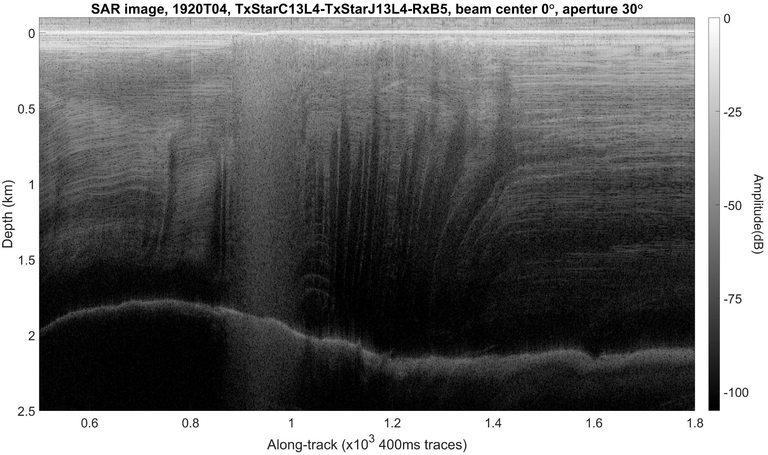
Rutford Ice Stream
PASIN 2
SUMM
REFs

Slide 35
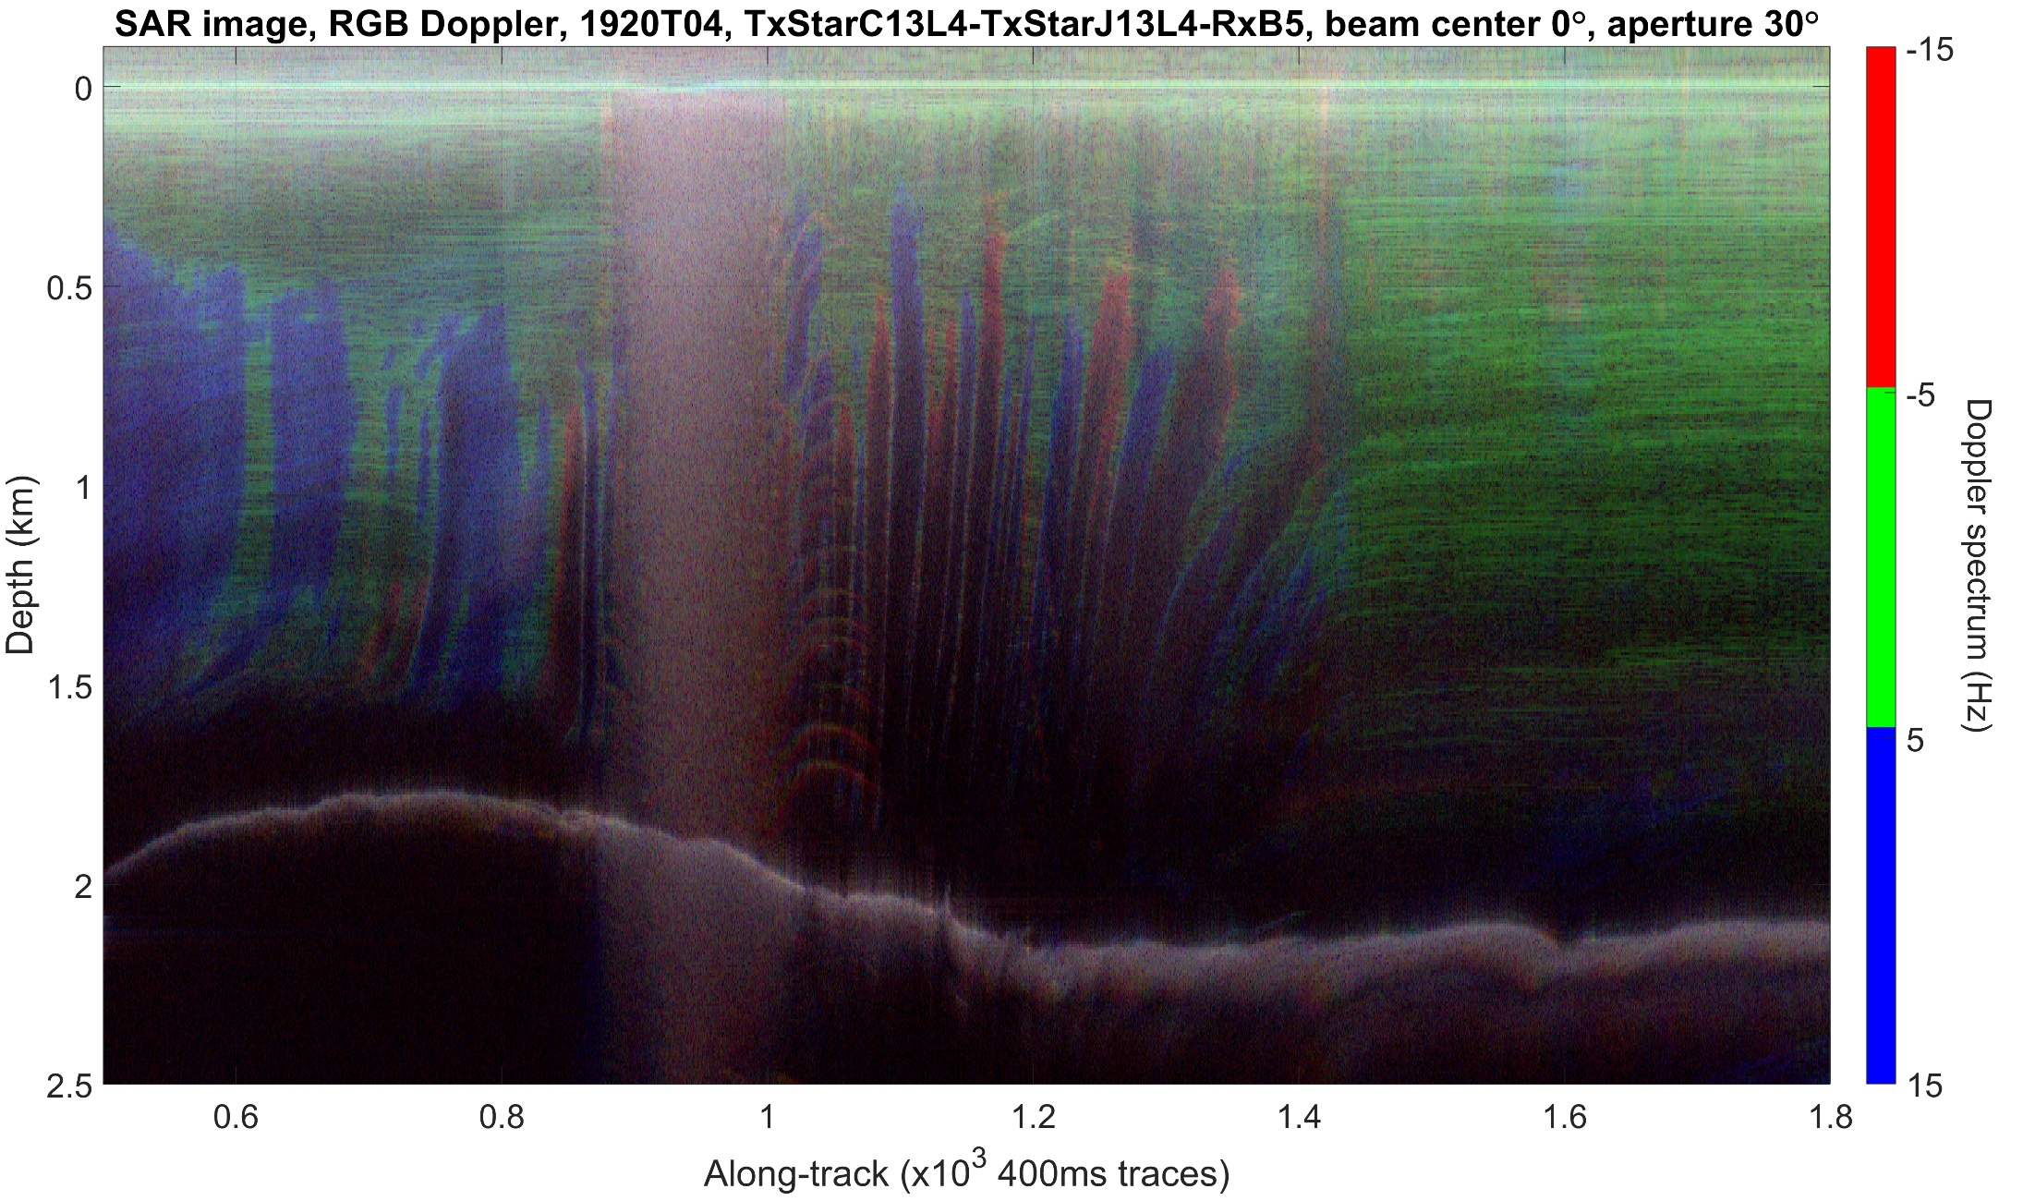
Rutford Ice Stream
R
PASIN 2
G
B
SUMM
REFs

Slide 36
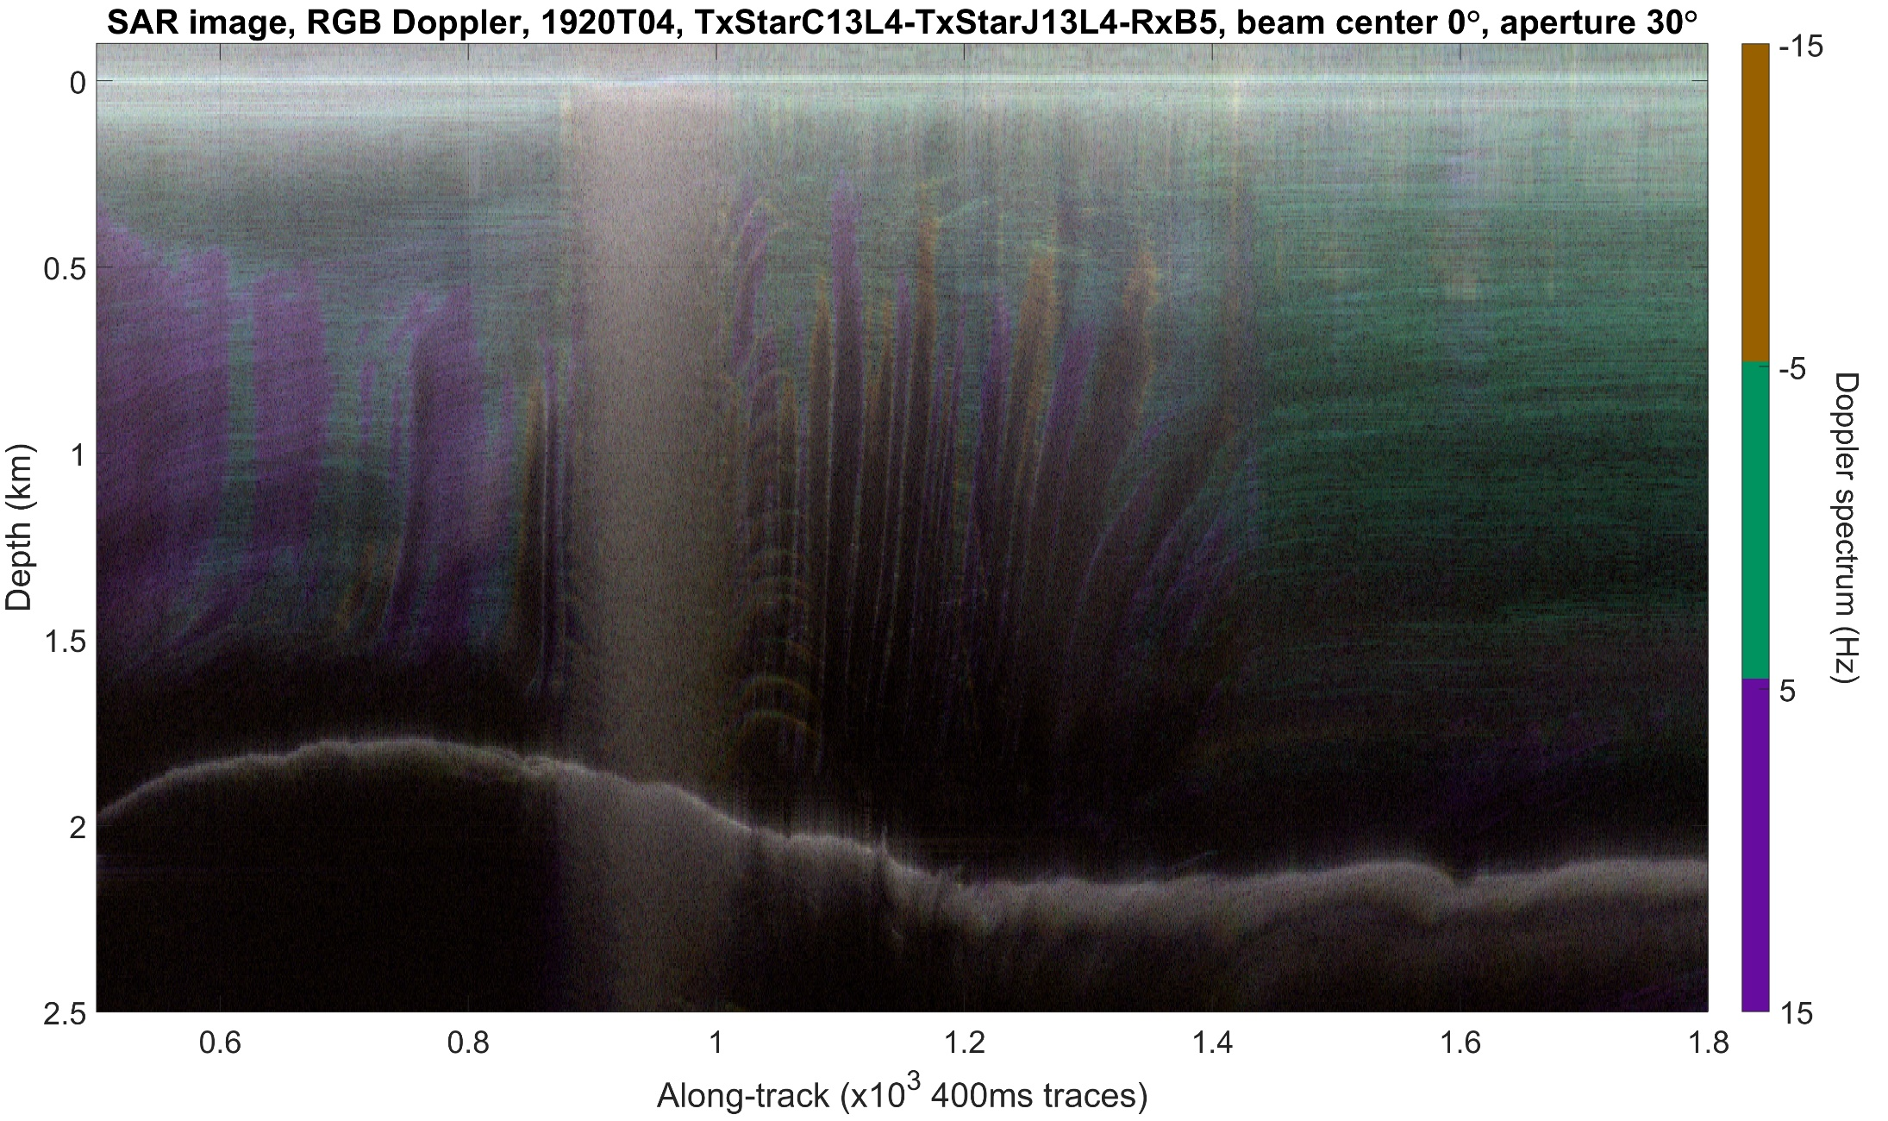
Rutford Ice Stream
O + R
PASIN 2
T + G
P + B
SUMM
REFs

Slide 37
Rutford Ice Stream
Flow speed map
Kealey Ice Rise
B
Carlson Inlet
A
B
A
Rutford Ice Stream
NPI’s Quantarctica package
MEaSUREs: Rignot, E., J. et al. (2017)
LIMA: Bindschadler, R., et al. (2008)
colour map: Crameri, F., et al. (2018a)
R
PASIN 2
G
Transitions from A to B:
along flow
(very short across flow)
ice stream margin
stagnated ice
along flow
bed depression and rise
B
O R
T G
SUMM
P B
REFs

Slide 38
Thwaites Glacier, Western margin, across-flow
Flow speed map
A
B
B
Thwaites Glacier
W. margin
A
Mount Takahe
NPI’s Quantarctica package
MEaSUREs: Rignot, E., J. et al. (2017)
LIMA: Bindschadler, R., et al. (2008)
colour map: Crameri, F., et al. (2018a)
R
PASIN 2
G
Tephra layers with broad (white) backscattering beamwidth
B
O R
T G
SUMM
P B
REFs

Slide 39
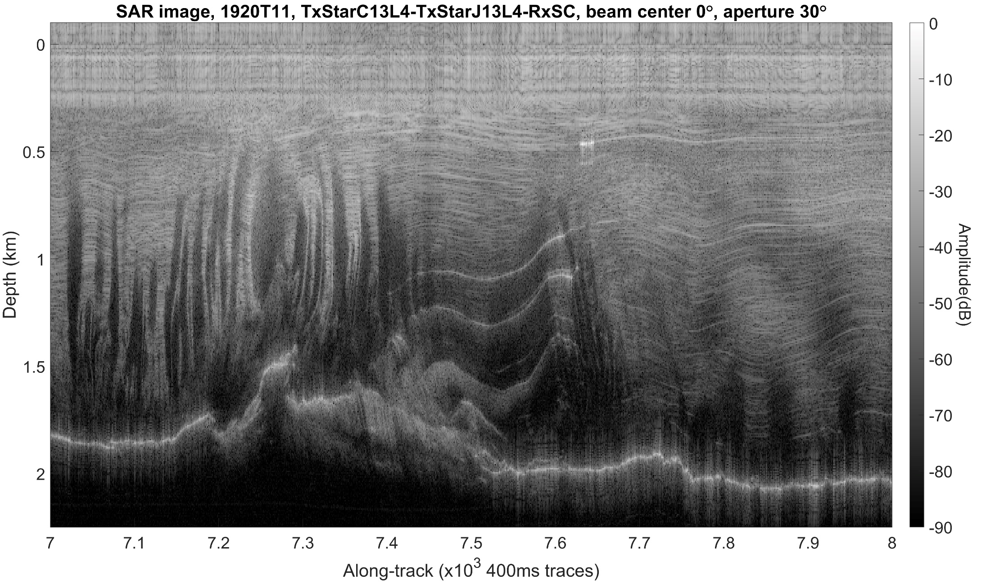
Thwaites Glacier, Western margin, across-flow
PASIN 2
SUMM
REFs

Slide 40
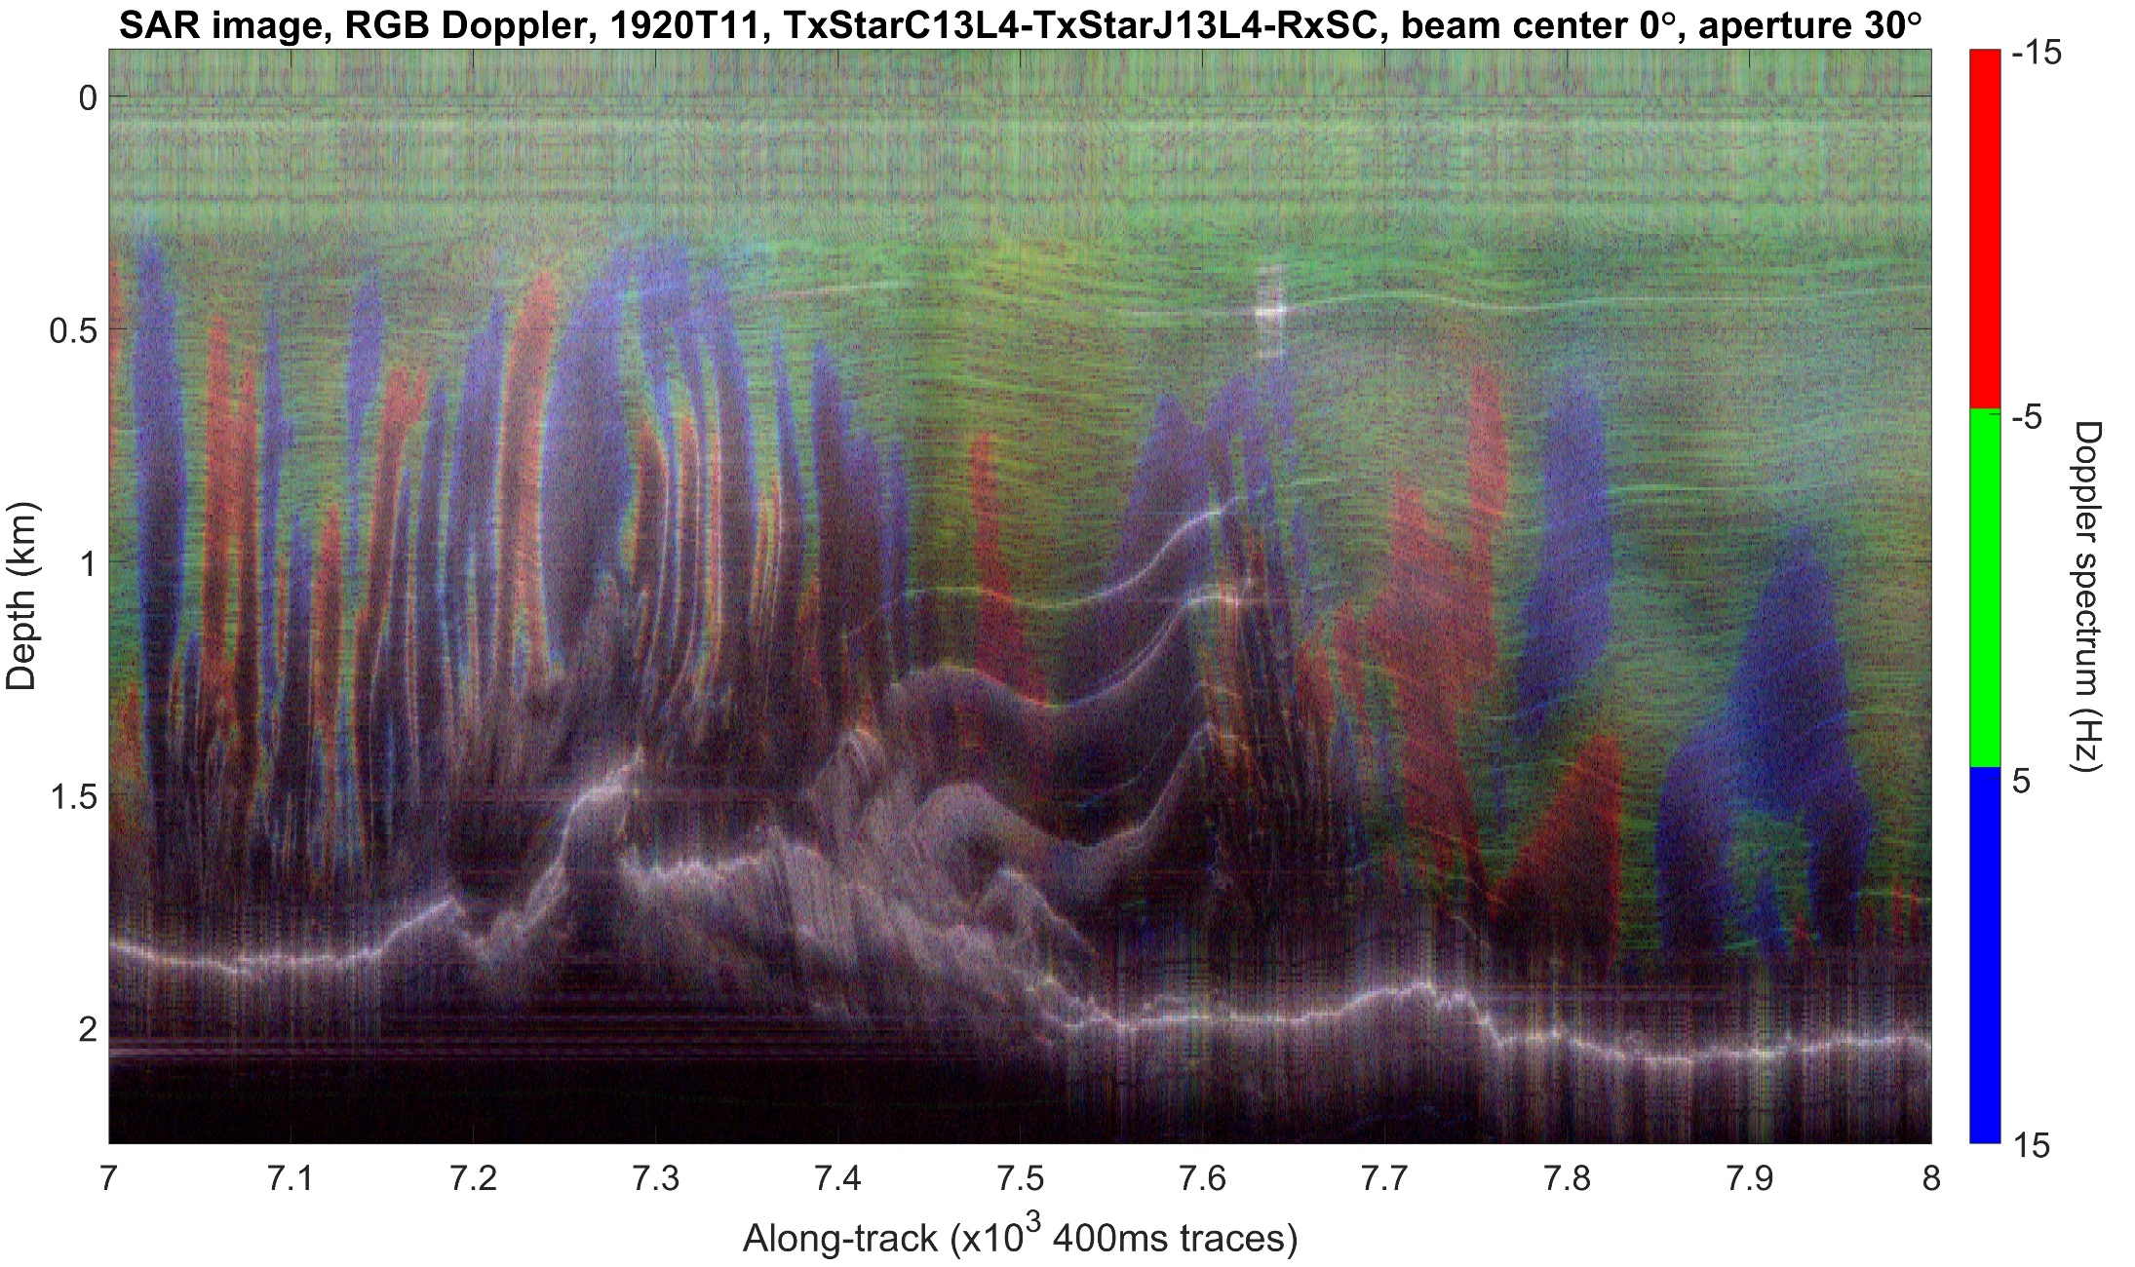
Thwaites Glacier, Western margin, across-flow
R
PASIN 2
G
B
SUMM
REFs

Slide 41
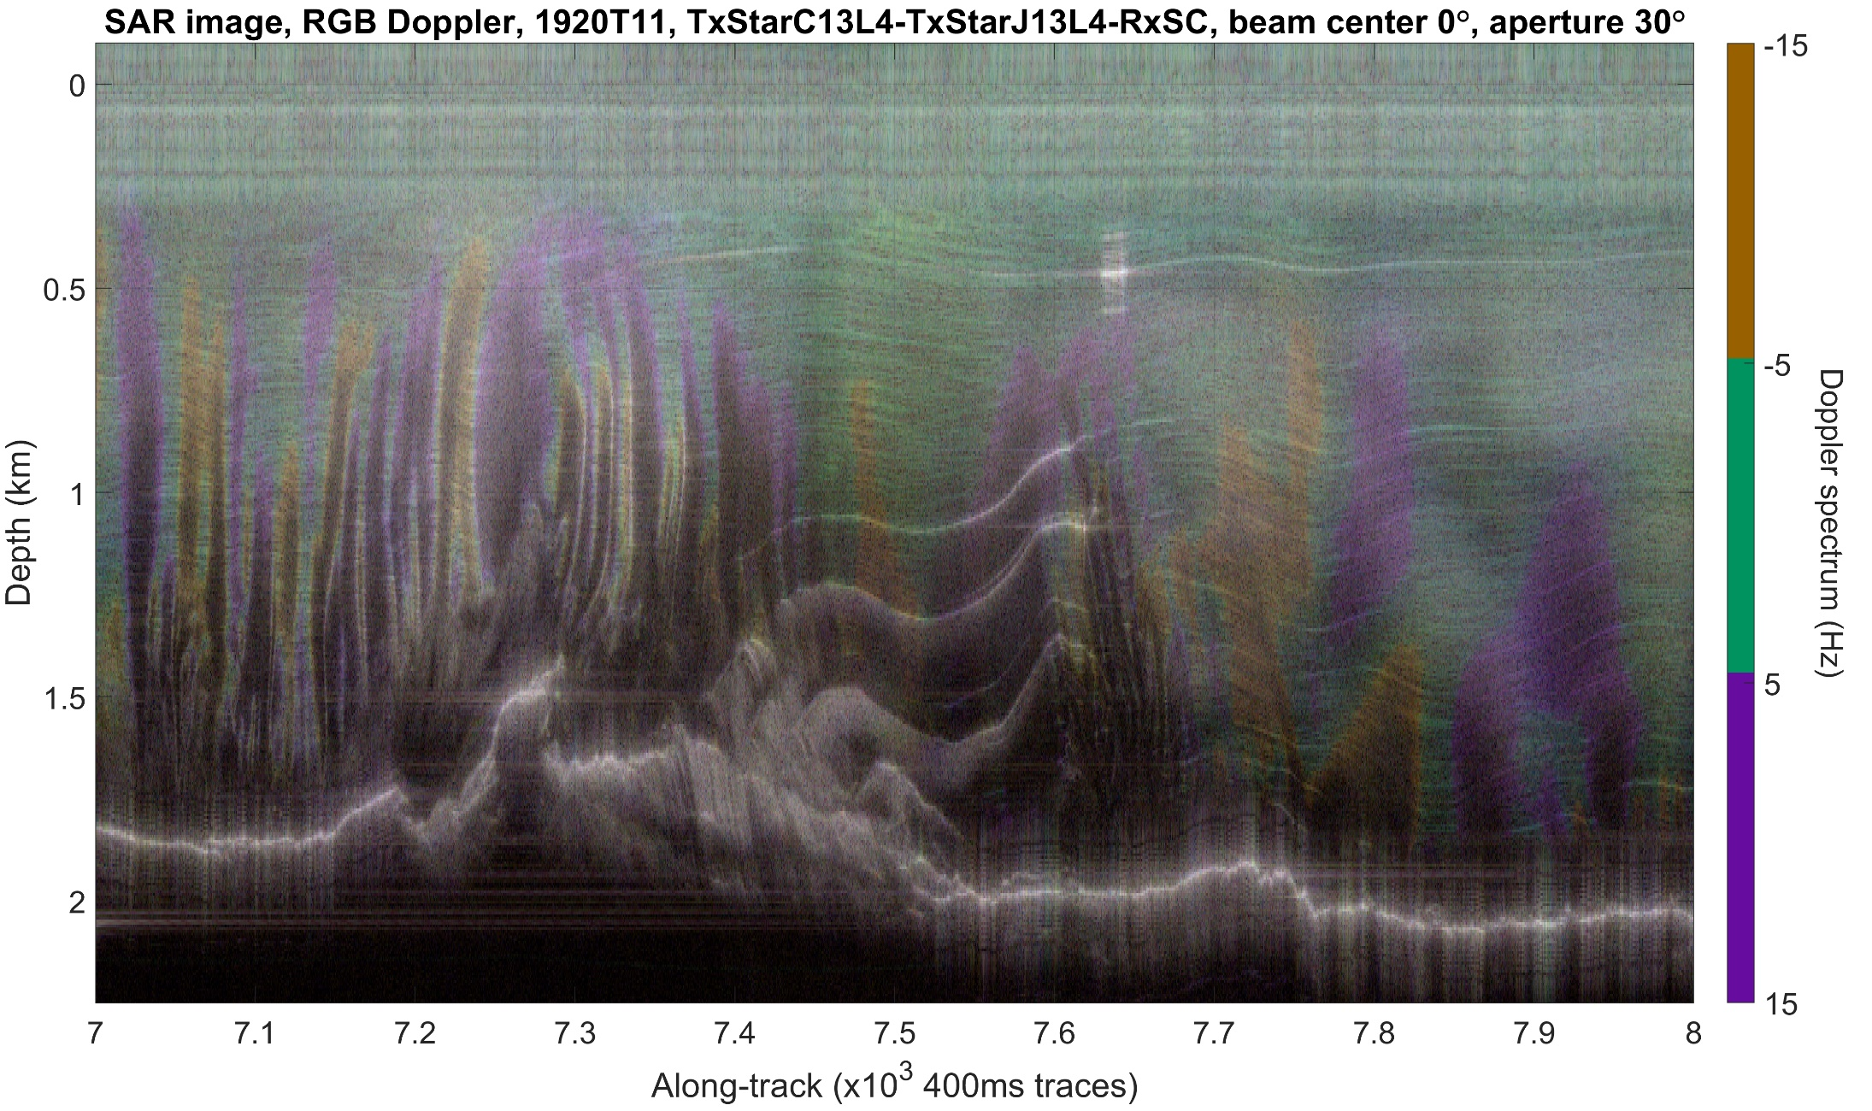
Thwaites Glacier, Western margin, across-flow
O + R
PASIN 2
T + G
P + B
SUMM
REFs

