Slide 1
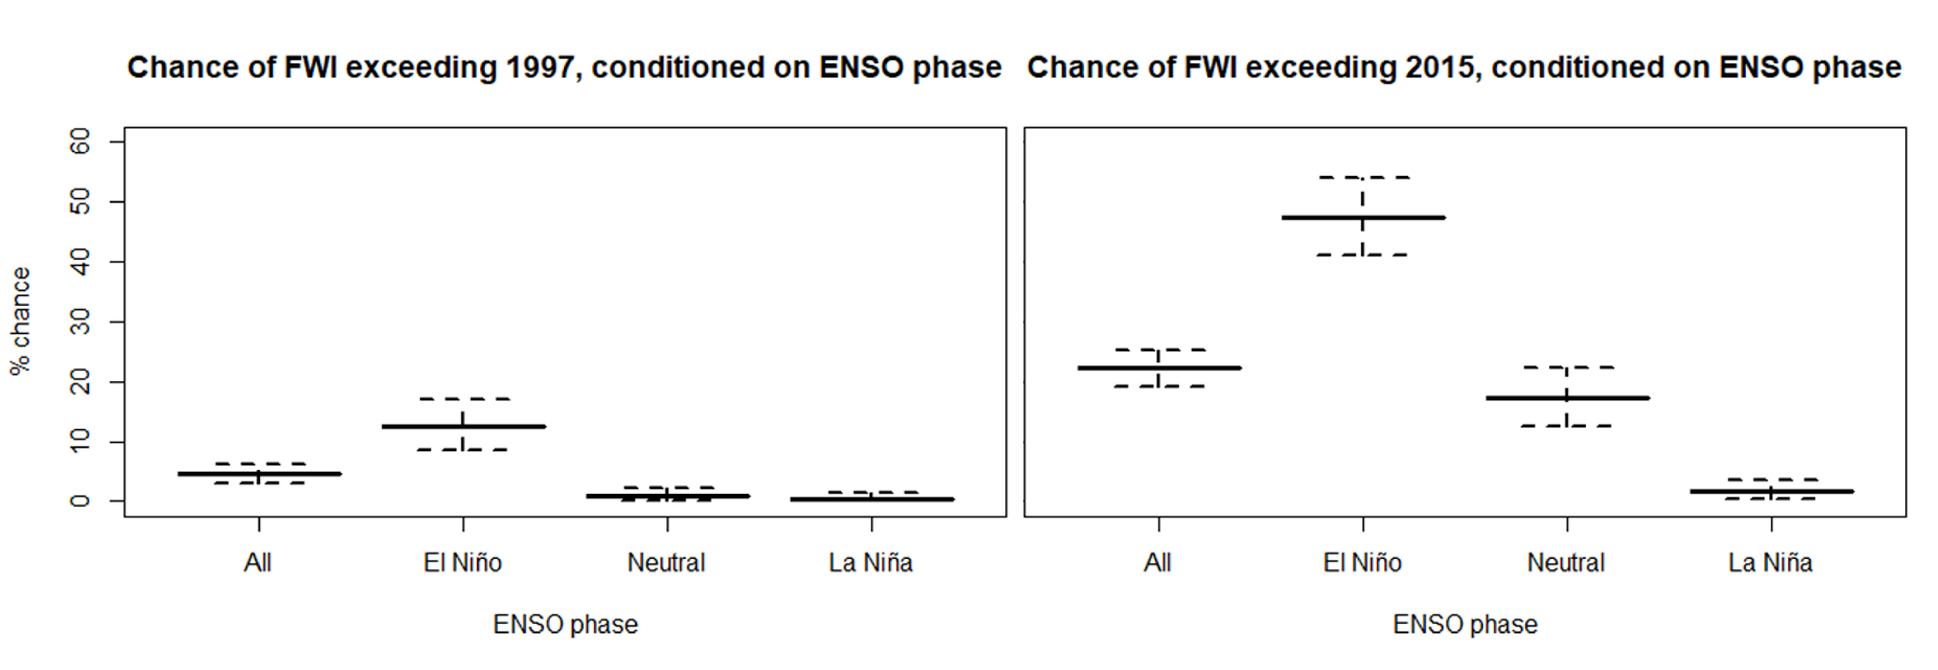
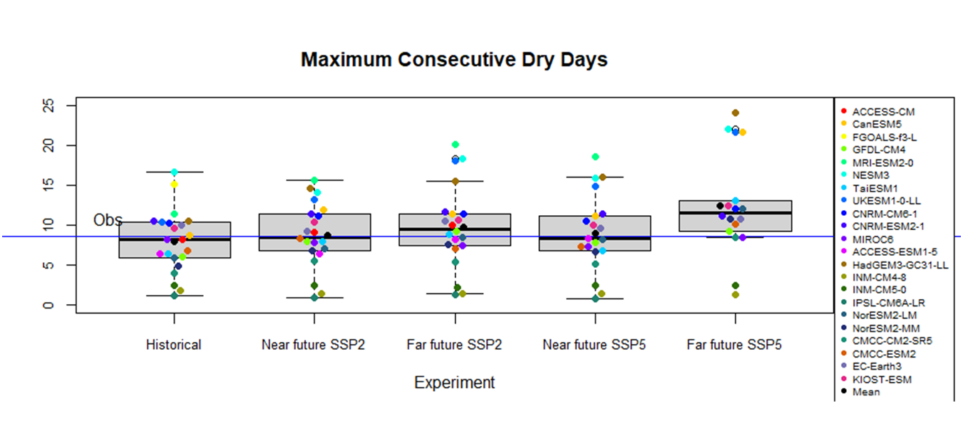
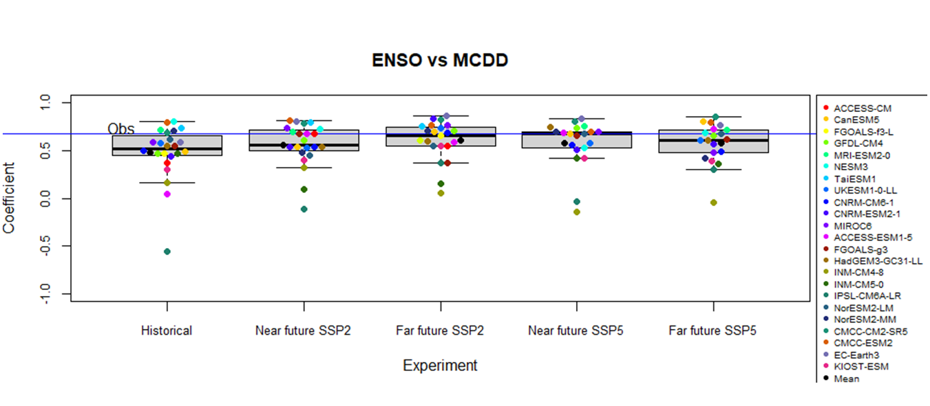
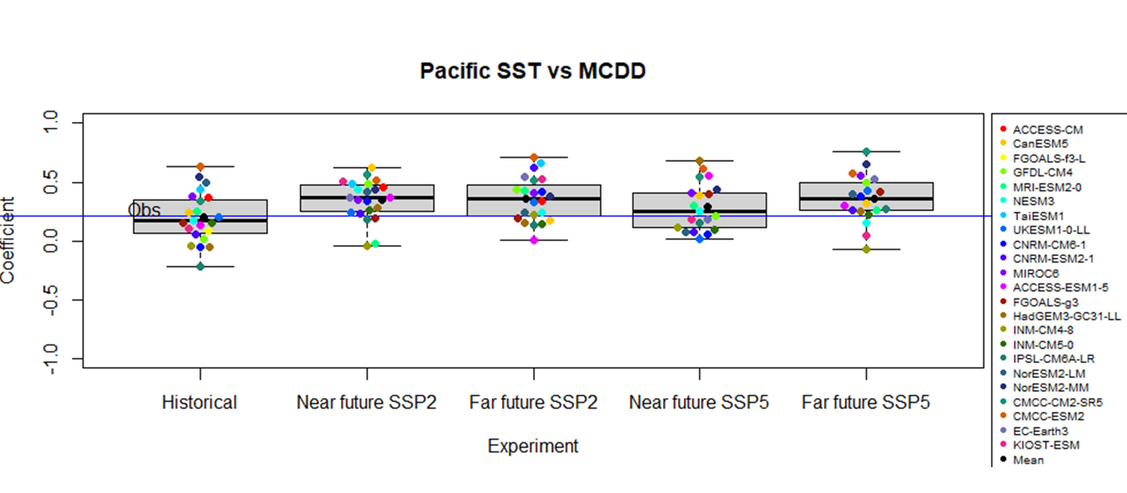
Understanding climate drivers of drought and fire multi-hazards in Indonesian Borneo using climate model and seasonal hindcast ensembles
Timothy Lam*¹, Jennifer Catto², Rosa Barciela³, Anna Harper^{2,4}, Peter Challenor², Alberto Arribas⁵
¹Centre for Doctoral Training in Environmental Intelligence, University of Exeter ²Faculty of Environment, Science, and the Economy, University of Exeter ³Met Office, Exeter ⁴Global Systems Institute, University of Exeter ⁵Microsoft, Reading
Correspondence email address: tl493@exeter.ac.uk
Approach
We analyse the bias-corrected GloSea6 seasonal hindcast and CMIP6 model ensembles to assess the present and future drought and fire risk over Indonesian Borneo, based on maximum number of consecutive dry days (MCDD) and the Canadian Fire Weather Index (FWI) during the dry season (JJA). We use a causal approach to statistical inference (Kretschmer et al. 2021, BAMS) to illustrate the drivers of drought and fire risk.
* p < 0.05
Fig. 3a
Fig. 1a
Fig. 1b
Fig. 4a
Fig. 1a & 1b: Based on GloSea6 seasonal hindcast, El Niño substantially elevates the risk of unprecedented fires. Under an El Niño, there is about a 50% chance that FWI exceeds that in 2015, about 2 times and 25 times greater than under neutral ENSO and La Niña, respectively.
Fig. 3a: Estimation of causal effect from ENSO to Borneo drought based on linear regression between standardised and detrended seasonal time series from the observational estimates. The causal link is strong and significant.
Fig. 4a: Estimation of causal effect from NE Pacific SST in MAM to Borneo drought based on linear regression between standardised and detrended seasonal time series from the observational estimates. The causal link is demonstrated through the path-tracing rule.
Fig. 2
Fig. 3b
Fig. 4b
Conclusions
Our detection of drivers enables seasonal forecasting of fire risk in Indonesian Borneo with a lead time of three months, and the predictability may be enhanced under a warming climate. Although El Niño significantly elevates drought and fire risks in Indonesian Borneo, FWI during historical fires may be exceeded even under neutral ENSO and La Niña conditions caused by Indian Ocean Dipole (IOD), East Asian Summer Monsoon, and extratropical drivers.
Fig. 2: Borneo MCDD for CMIP6 experiments (Historical: 1981 – 2014; Near future: 2021 – 2060; Far future: 2061 – 2100), compared with observational estimate (shown as blue line). Under the SSP585 scenario, MCDD may significantly increase towards the end of this century (p = 0.006).
Fig. 3b: Correlation coefficient between Borneo MCDD and ENSO for CMIP6 experiments (Historical: 1981 – 2014; Near future: 2021 – 2060; Far future: 2061 – 2100), compared with observational estimate (shown as blue line). The strength of association between ENSO and Borneo drought is not expected to change significantly in the future.
Fig. 4b: Correlation coefficient between Borneo MCDD in JJA and NE Pacific SST in MAM for CMIP6 experiments (Historical: 1981 – 2014; Near future: 2021 – 2060; Far future: 2061 – 2100), compared with observational estimate (shown as blue line). Under the SSP585 scenario, this driver may strengthen significantly by the end of this century (p = 0.001).
Acknowledgement This work forms a part of the first author’s PhD thesis, who received studentship award from UKRI Centre for Doctoral Training in Environmental Intelligence. This work was supported by The Alan Turing Institute’s Enrichment Scheme.

Slide 2
Understanding climate drivers of drought and fire multi-hazards in Indonesian Borneo using climate model and seasonal hindcast ensembles
- Supplementary materials
Timothy Lam, Jennifer Catto, Anna Harper, Rosa Barciela, Peter Challenor, Alberto Arribas

Slide 3
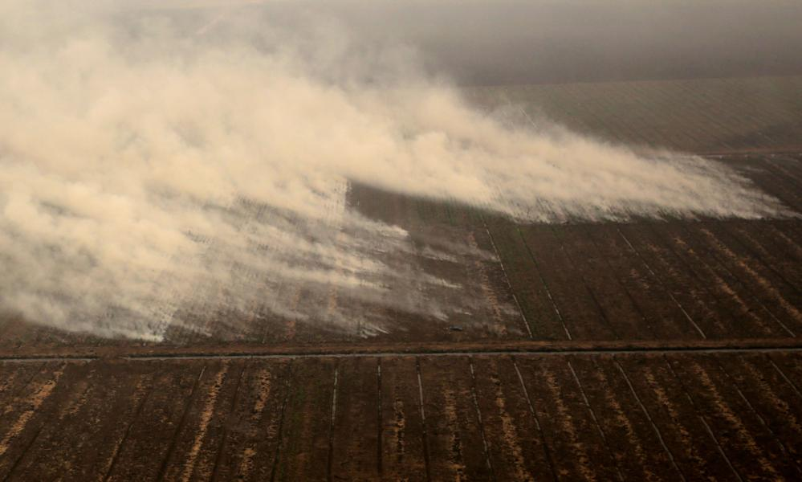
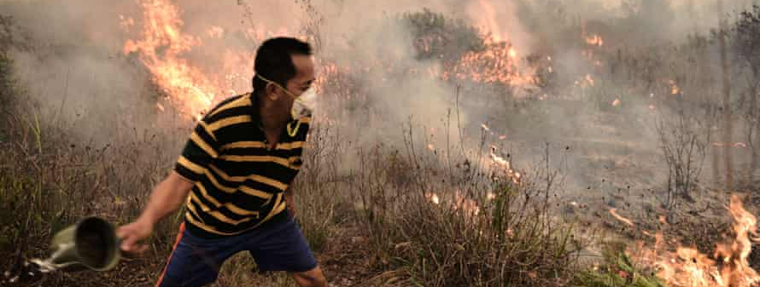
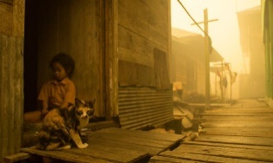
Motivation and Objectives
Identify large-scale ocean-atmosphere causal links leading to droughts and fires
Evaluate the likelihood of unprecedented drought and fire risks
Unfold possible changes of drought and fire risks and their drivers under a warming climate
→ Develop climate risk assessment and resilience building strategies for droughts and peatland fires in Central Kalimantan Province, Indonesian Borneo
More on kali-project.com
Source of pictures: The Guardian (2015)

Slide 4
Identify causal links leading to droughts and fires
Contingency table of FWI vs. ENSO
La Niña
Neutral
El Niño
0% | 8.3% | 25%
12.5% | 12.5% | 8.3%
20.8% | 12.5% | 0%
Dry
Knowledge-guided Casual Inference (Kretschmer et al. 2021, BAMS)
FWI (JJA)
Normal
Based on Hendon (2003), J. Clim
JJA Borneo FWI = 0.809 * (JJA ENSO) + c₁
Wet
Borneo fire risk (JJA)
ENSO (JJA)
Niño3.4 SST (JJA)
Based on standardised and detrended data from ERA5 and Niño 3.4 SST from NOAA

Slide 5
Observational estimates for calculating the FWI
Data Type/ Properties | 2m Air Temperature | U-wind | V-wind | Precipitation | Relative humidity
Provider | ERA5 | NOAA (based on Hadley SST) |  | CHIRPS | ERA5
Timescale | Daily (Noon local time) | Monthly |  | Daily | Monthly
Type | Reanalysis | Climate index |  | Satellite | Reanalysis
Resolution | 0.25° * 0.25° | N/A |  | 0.25° * 0.25° | 0.1° * 0.1°
Spatial Coverage | 2.8°S – 3.3°N, 109.8 – 118°E | N/A |  | 2.8°S – 3.3°N, 109.8 – 118°E | 5°S – 5°N, 120 – 170°W
Available years | 1979 – 2022 | 1870 – 2020 |  | 1980 – 2020

Slide 6
Observational estimates for quantifying teleconnections
Data Type/ Properties | Sea Surface Temperature | Niño 3.4 index | 10m Zonal Wind
Provider | Hadley Centre HadISST2.0 | NOAA (based on Hadley SST) | ERA5
Timescale | Monthly | Monthly | Monthly
Type | Satellite and in-situ | Climate index | Reanalysis
Resolution | 1.0° * 1.0° | N/A | 0.25° * 0.25°
Area of interest | 13 – 30°N, 117 – 160°W | N/A | 10°S – 10°N, 130 – 180°E
Available years | 1870 – 2015 | 1870 – 2020 | 1979 – 2022

Slide 7
CMIP6 models used in our study
More details of attributes and specifications available online at https://wcrp-cmip.github.io/CMIP6_CVs/docs/CMIP6_source_id.html

Slide 8
The UNSEEN approach to estimate unprecedented risk
We analysed the GloSea6 seasonal hindcast ensemble runs from 1993 – 2016 initialised every May to evaluate the likelihood of unprecedented Borneo fire risk and its teleconnections.
Model | Horizontal Resolution | Vertical Resolution | Atmosphere Initialisation | Ensemble size | Temporal range
GloSea6 | N216 (~60km) | 85 levels to 85 km | ERA-Interim | 7 per start date | JJA 1993 – 2016
Model | Variables | Timescale | Spatial coverage | Start dates
GloSea6 | Accumulated Precipitation, 2m Air Temperature, u-wind, v-wind and RH (in Borneo); Niño3.4 SST | Daily (at 06UTC for T2m and winds) | 2.8°S – 3.3°N, 109.8 – 118°E (Borneo); 5°S – 5°N, 120 – 170°W (SST) | 1, 9, 17, 25 May

Slide 9
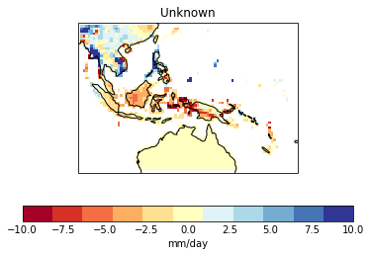
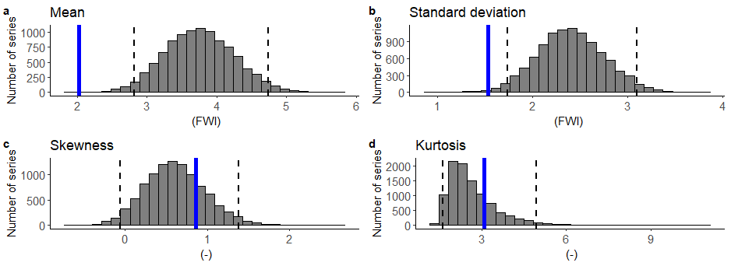
The UNSEEN approach to estimate unprecedented risk
We analysed the GloSea6 seasonal hindcast ensemble runs from 1993 – 2016 initialised every May to evaluate the likelihood of unprecedented Borneo fire risk and its teleconnections.
JJA daily mean pr (GloSea6 ensemble mean – CHIRPS)
Fidelity test of FWI – GloSea6 ensemble against ERA5 observational estimate
Fidelity test of FWI-ENSO correlation coefficient
The model overestimates FWI in Borneo due to a systematic dry bias, yet estimates the association between FWI and ENSO reasonably well.

Slide 10
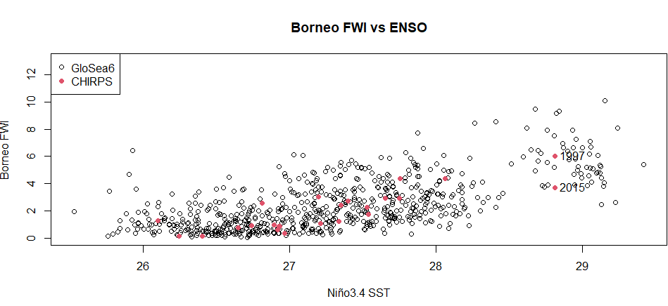
Likelihood of unprecedented drought and fire risks
Under an El Niño, there is around half chance that Fire Weather Index (FWI) exceeds that in 2015, which is 2 times and 25 times greater than under neutral ENSO and La Niña conditions, respectively.
Questions:
What is driving the droughts under neutral ENSO and La Niña conditions?
What causes the range of outcomes under an El Niño?

Slide 11
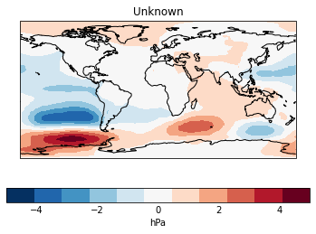
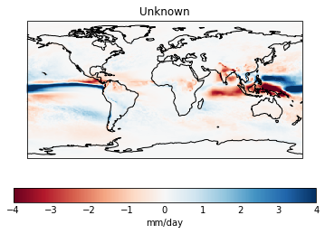
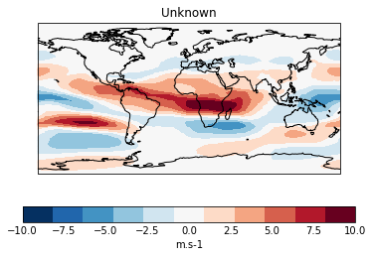
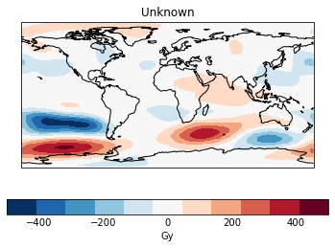
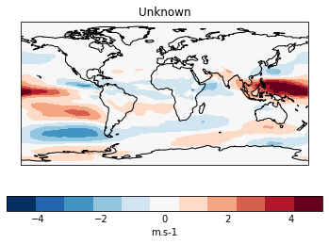
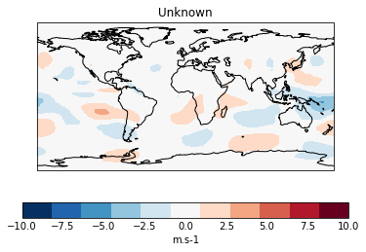
Atmospheric conditions under different ENSO phases
MSLP (JJA, El Niño mean – La Niña mean)
pr (JJA, El Niño mean – La Niña mean)
u200 (JJA, El Niño mean – La Niña mean)
z500 (JJA, El Niño mean – La Niña mean)
u850 (JJA, El Niño mean – La Niña mean)
v200 (JJA, El Niño mean – La Niña mean)
Under an El Niño, as inferred from the wind anomalies, an anomalous sinking arm forms over the Maritime Continent which elevates fire risk.

Slide 12
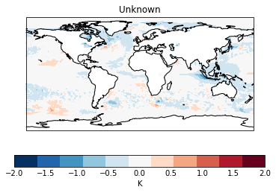
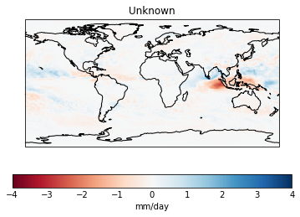
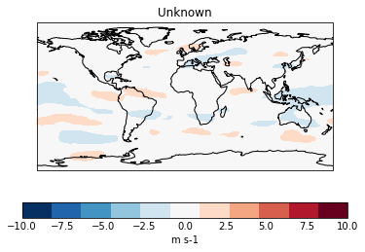
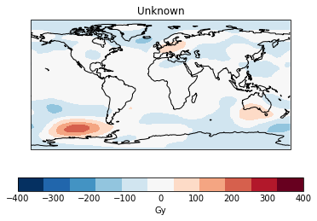
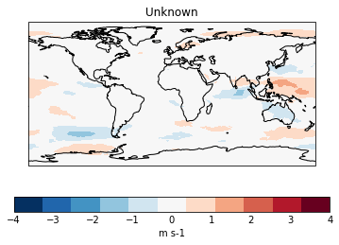
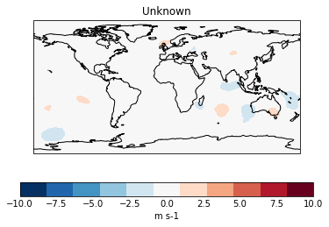
Atmospheric conditions under non-El Niño droughts
JJA SST anomaly
JJA pr anomaly
JJA u200 anomaly
JJA z500 anomaly
JJA u850 anomaly
JJA v200 anomaly
Considering all unprecedented FWI cases under neutral or La Niña conditions, the strongest driver appears to be the IOD (with average DMI at +0.972).

Slide 13
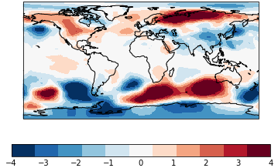
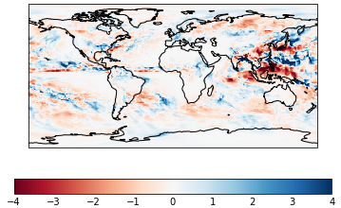
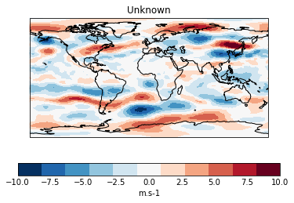
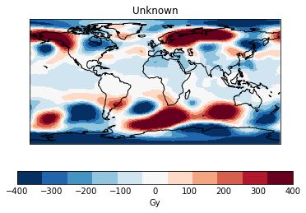
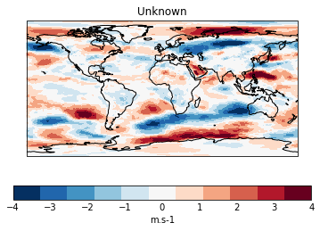
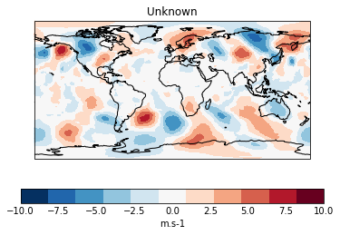
Atmospheric conditions under non-El Niño droughts
July MSLP anomaly
July pr anomaly
July u200 anomaly
hPa
mm/day
July z500 anomaly
July u850 anomaly
July v200 anomaly
Considering the top three FWI cases under neutral or La Niña conditions, it appears that a strong EASM may trigger El Niño-like wind anomalies associated with elevated fire risk.

Slide 14
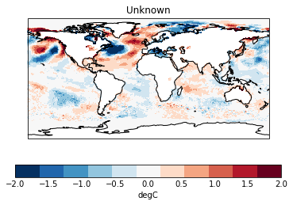
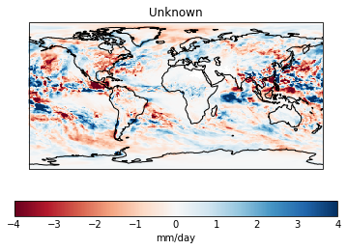
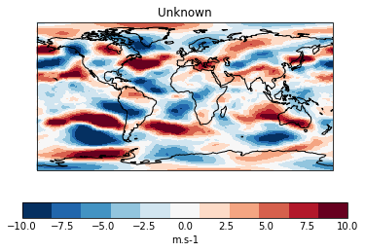
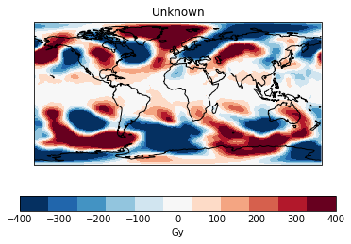
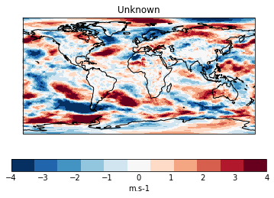
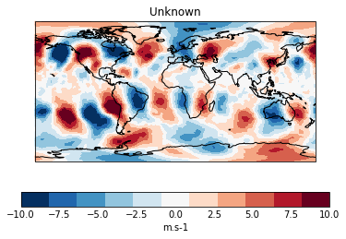
Range of outcomes under an El Niño
JJA SST
JJA pr
JJA u200
JJA z500
JJA u850
JJA v200
Considering the highest and lowest FWI cases under strong El Niños, it appears that the subsidence over Borneo may be amplified/dampened by local anomalous Hadley circulation influenced by the northern extratropical Rossby waves.

