Slide 1
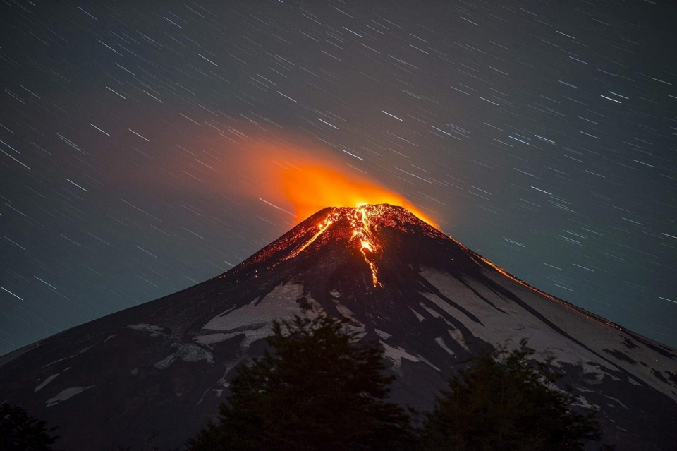
Climatic control on the location of continental volcanic arcs
Veleda A.P. Muller
Pietro Sternai, Christian Sue, Thibaud Simon-Labric, Pierre Valla
Villarrica volcano, Chile, Photo: Francisco Negroni

Slide 2
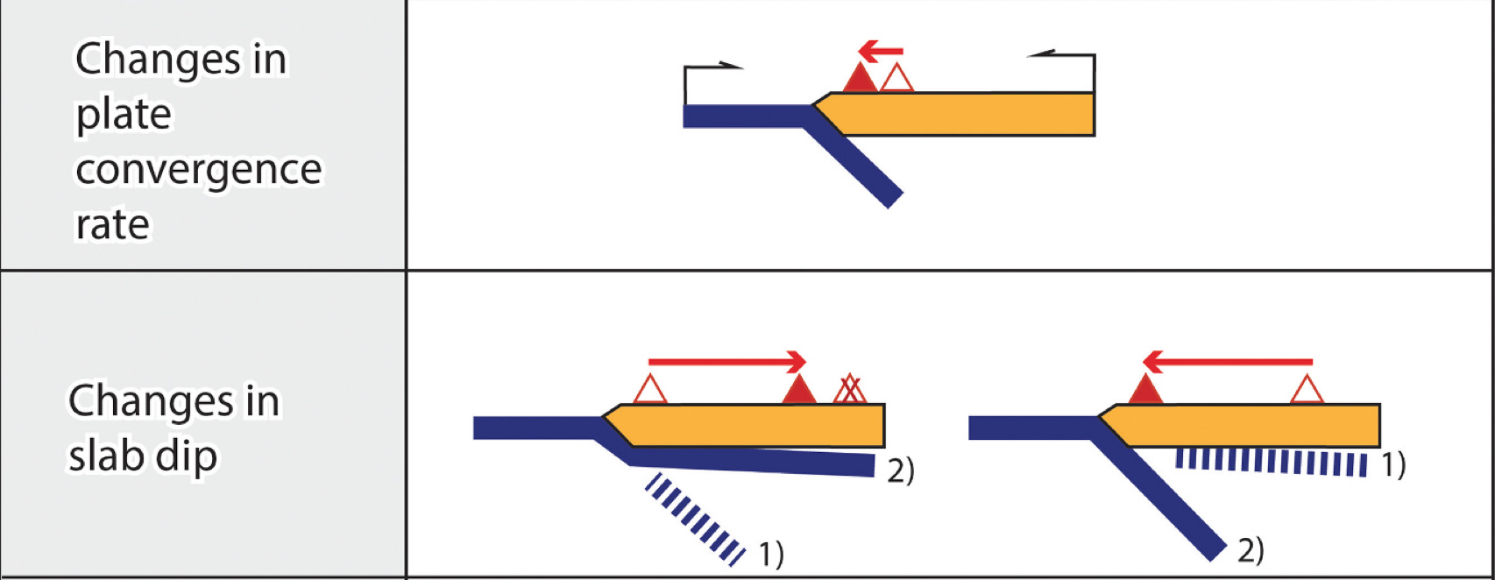
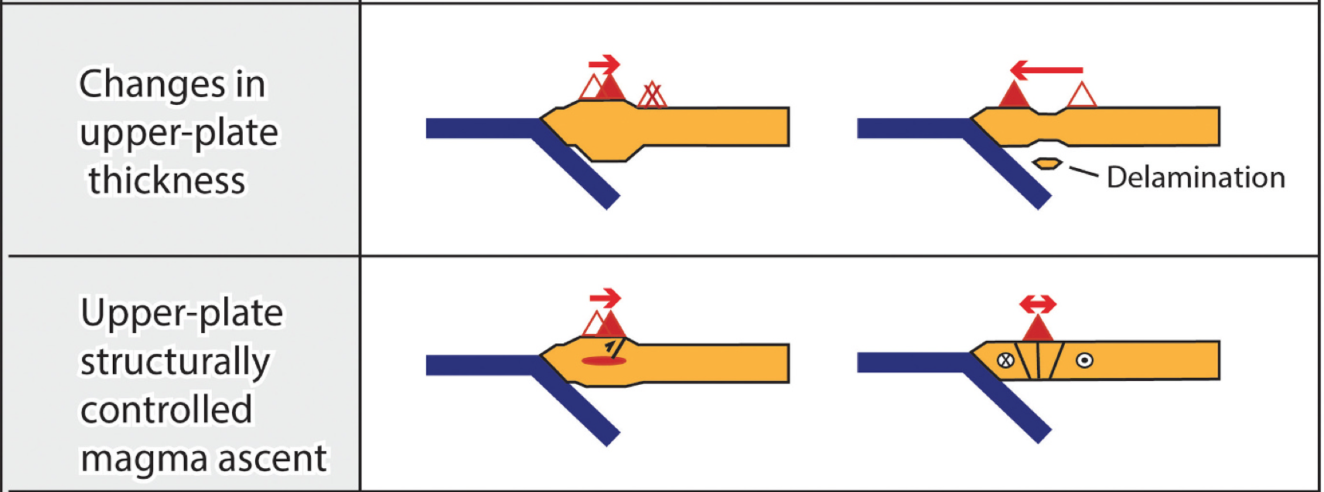
Introduction
Volcanic arcs in convergent plate margins
Vertical magma ascent
50 km
Subducting slab
Mantle wedge
100 km
England and Katz, 2010
Gianni and Luján, 2021

Slide 3
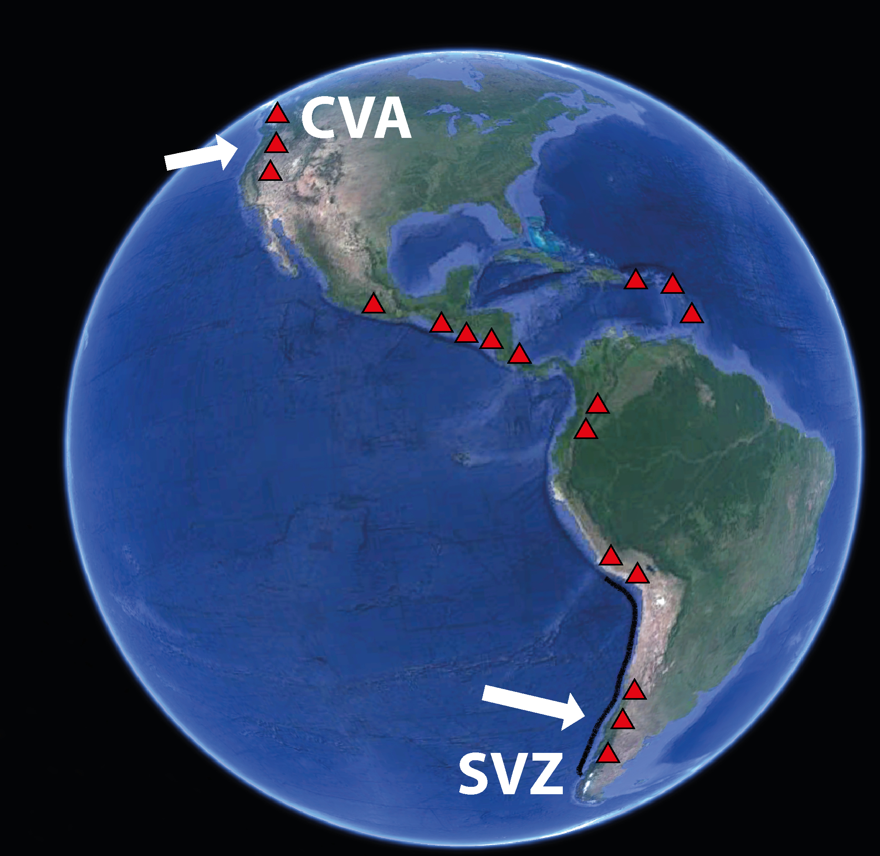
Southern Andes and Cascades Volcanic Arcs
Erosion rates
Orography
Topographic water divide
Erosion rates
Muller et al., 2022

Slide 4
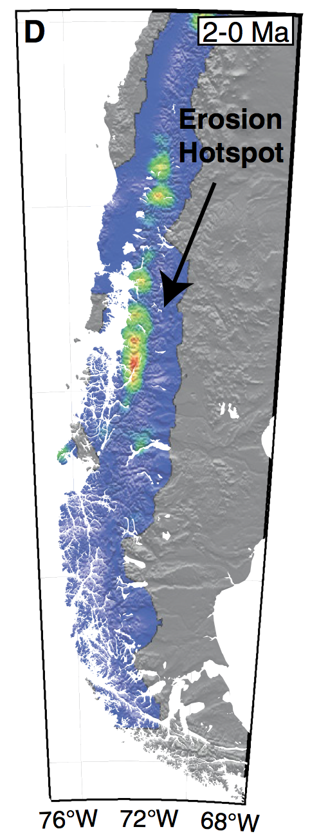
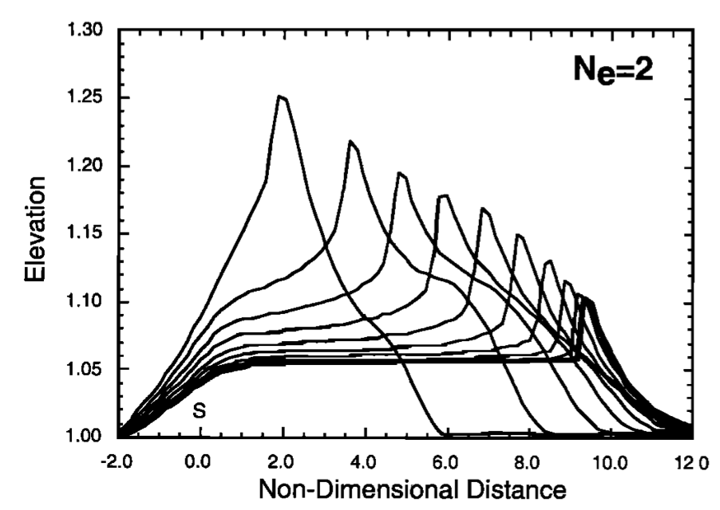
Orography and topography position
Guerra et al., 2016
Herman and Brandon, 2015
Willett, 1999

Slide 5
The Southern Andes Volcanic Zone
Muller et al., 2022

Slide 6
The Cascade Volcanic Arc
Muller et al., 2022

Slide 8
Thermo-mechanical numerical model
2 SETS OF SIMULATIONS
No imposed erosion: initial central and initial lateral topography
(prior and after the topography adjustment to orography)
2) Asymmetric erosion: Transient evolution of deformation and magma upwelling paths
Topo.
Crust
Lithosp.
Ast.
Topo.

Slide 9
1st set of simulations: No erosion
Central topography
Lateral topography

Slide 10
t initial
t final
1st set of simulations:
No erosion
Central topography:
Symmetric structures and magma ascent
Lateral topography:
Left-ward asymmetric structures and magma ascent
Muller et al., 2022

Slide 11
2nd set of simulations: Asymmetric erosion
Right-ward topography shift
Left-ward localisation of structures and magma ascent

Slide 12
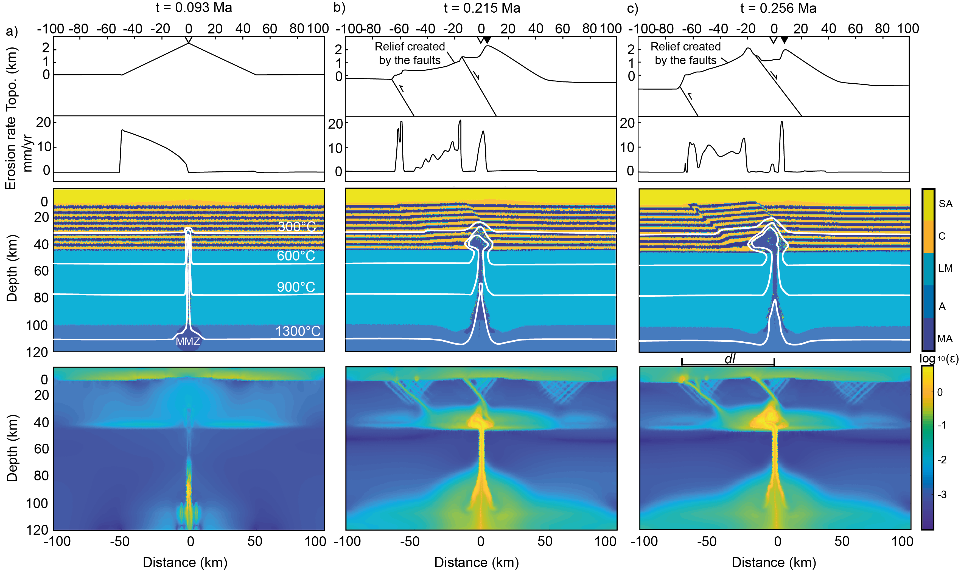
2nd set of simulations: Asymmetric erosion
Muller et al., 2022

Slide 13
Magnetotelluric data from the Osorno Volcano, SVZ
Díaz et al., 2020

Slide 14
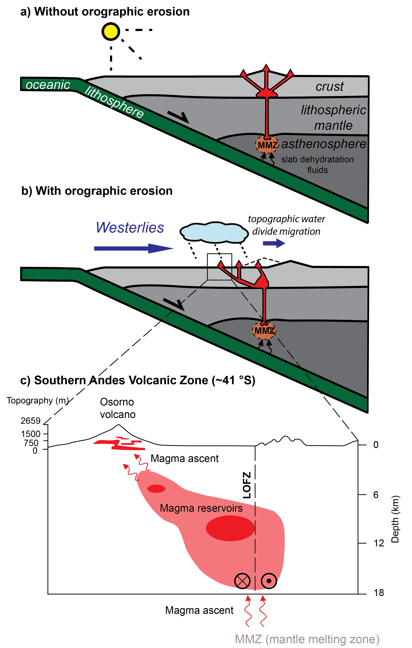
Conclusion
Plausible contributions of orography to:
Asymmetric strain localisation and (re)activation of structures
Forcing on the magma ascent windward
Volcanic arc location at the weak crustal zones
Muller et al., 2022

Slide 15
Thank you very much!
DOI: 10.1038/s41598-022-26158-2

