Slide 1



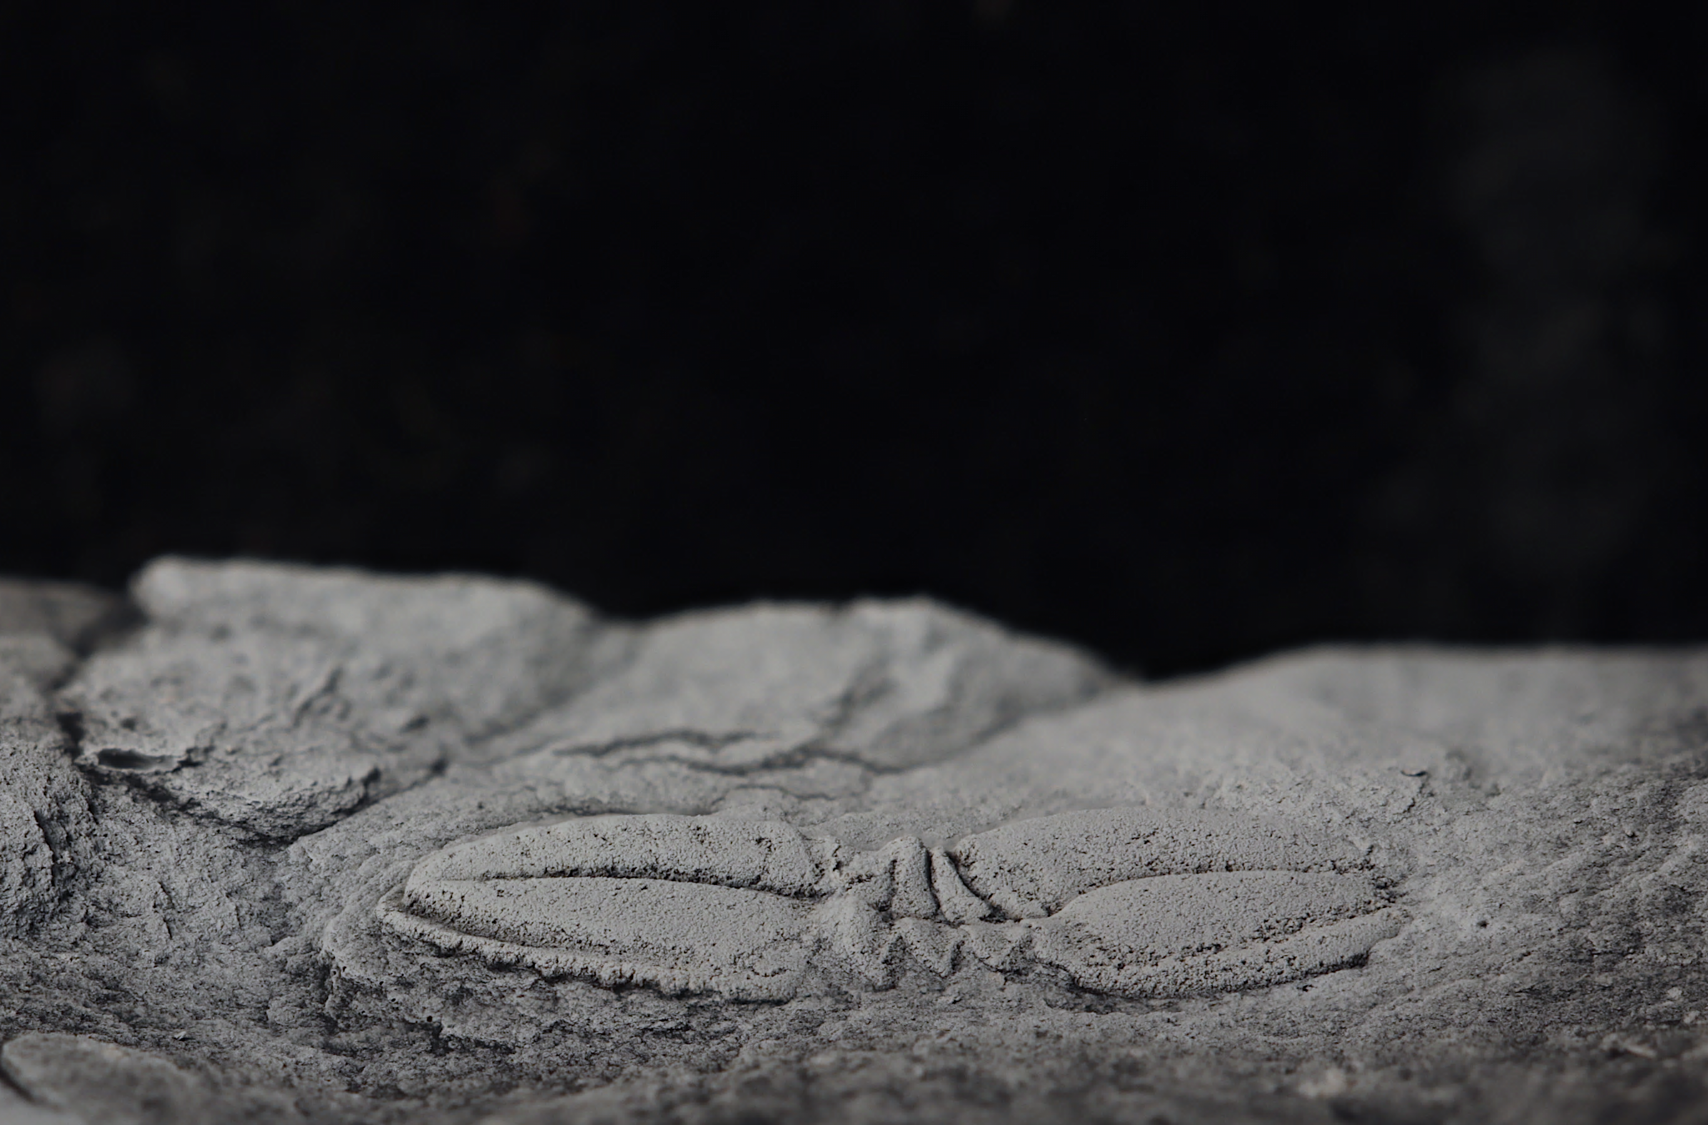
The regional Marianian Stage (after the latin ‘Mariani’, Sierra Morena, Andalusia) was introduced by Klaus Sdzuy in 1971.
This stage has suffered significant conceptual modifications since its original erection. At the moment, its correlation through the Iberian Peninsula is still a subject of debate.
The regional Marianian Stage (Cambrian Series 2) from the Ossa-Morena Zone, SW Iberia: trilobite biostratigraphy and international correlation
Thus, one of the main purposes of this work is to improve the trilobite biostratigraphy of the Marianian outcrops from the OMZ, evaluating the validity of some of these trilobites as index taxa and, therefore, clarifying their correlation potential throughout the Marianian outcrops from the Iberian Peninsula.
L. Collantes, S. Pereira, E. Mayoral, E. Liñán, R. Gozalo
Next

Slide 2
The Ossa-Morena Zone
Studied fossil sites
The Cambrian Series 2 is challenging for biostratigraphy and correlation. In current Europe, this series sequences are hard to identify due to the scarcity of its fossil record. An exception is the Ossa-Morena Zone (OMZ), southwestern Iberia, where lower Cambrian fossils are fairly abundant. The OMZ belongs to the southern branch of the Variscan Orogen of the Iberian Peninsula. Its Cambrian sequences are preserved in distinct ‘blocks’, showing a significant change of facies and thicknesses, most likely related to downthrow and tilting along an active growth fault during sedimentation.
Back
Next

Slide 3
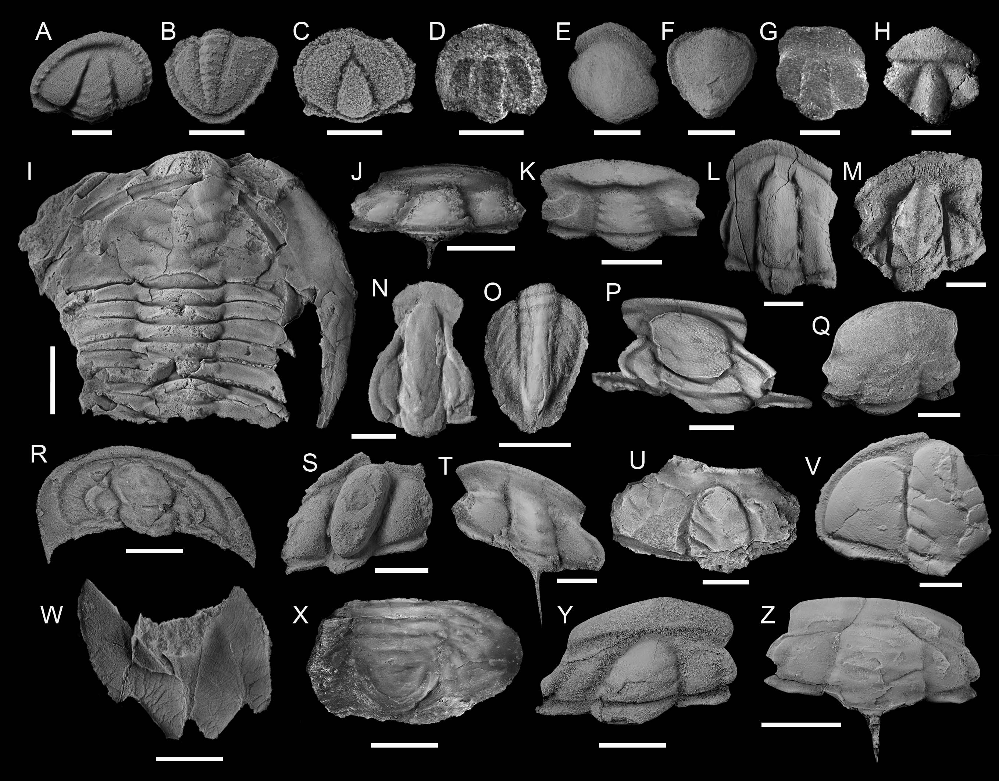
Up to now, twenty-three species of trilobites have been described so far, as well as other fossil groups like brachiopods, helcionellids, or chancellorids.
A-B) Serrodiscus bellimarginatus. C) Chelediscus garzoni. D) Calodiscus ibericus. E-F) Delgadella souzai. G) Hebediscus sp. H) Triangulaspis fusca. I) Andalusiana cornuta. J) Alanisia guillermoi. K) Strenuaeva sampelayoi. L) Hamatolenus (Protaldonaia) morenicus. M) Termierella sevillana. N-O) Perrector perrectus. P) Saukianda andalusiae. Q) Kingaspis (Kingaspoides) cf. velata. R) Callavia choffati. S) Hicksia elvensis. T) Rinconia schneideri. U) Atops calanus. V) Pseudatops reticulatus. W) Gigantopygus cf. bondoni. X) Eops eo. Y) Strenuella. n sp. Z) Acanthomicmacca? sp. Scale bars: 2 mm (A, B, E, F, T), 1 mm (C, D, H, I, G), 5 mm (J–S, Y), 10 mm (I, U–X, Z).
Back
Next

Slide 4
The OMZ record of trilobite fossils and, therefore, their biostratigraphy, has been hindered due to the limited continuity of trilobite facies, the poor preservation of the specimens, and tectonic distortion. Based on work carried out in recent years, we present the updated trilobite distribution and contribution for the biostratigraphical subdivision of the Marianian Stage in the OMZ, to improve and refine intra- and inter-regional correlation.
Back
Biostratigraphic range and zonation of the main trilobite taxa from the OMZ
Next

Slide 5
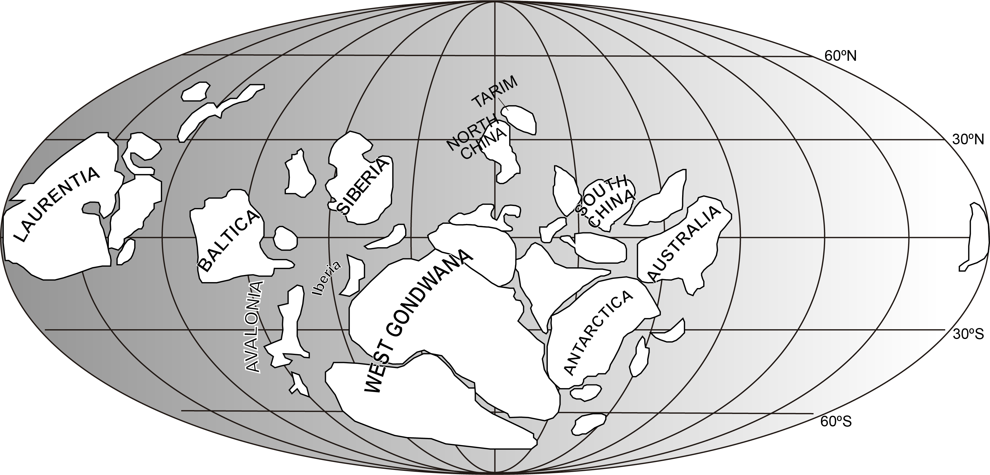
Strenuaeva
Saukianda
Andalusiana
Calodiscus
Delgadella
Triangulaspis
Serrodiscus
Hebediscus
Strenuella
Callavia
Chelediscus
Atopidae
The new biostratigraphical data strengthens the correlation with Cambrian Series 2 sequences along the western Gondwana margin (e.g. Morocco, Germany), western and eastern Avalonia (Newfoundland and United Kingdom), Baltica (Scandinavia and Holy Cross Mountains) and Siberia. In addition, biostratigraphical correlations with Laurentia (Taconic Allochthon, Greenland and the “Great Basin”) and also with Australia have been improved.
Back
Paleobiogeographic distribution of selected trilobite taxa from the OMZ plotted on a Cambrian palaeogeographic map. Based map modified from Scotese and McKerrow (1990), McKerrow et al. (1992), Dalziel (1997) and Malinky and Geyer (2019).
Next

Slide 6
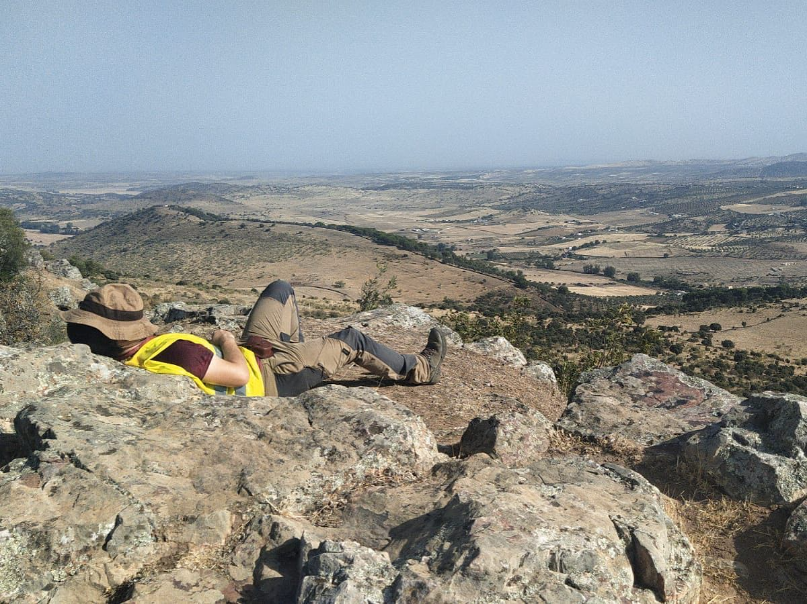
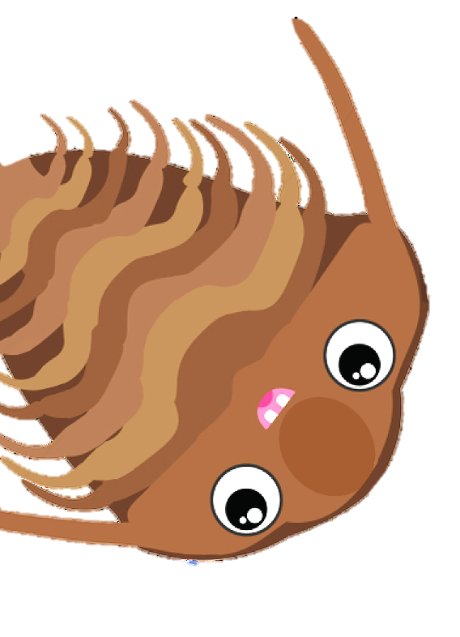

Thank you for
your attention!
Pst! Do yo want to know more about me and my research? Scan the QR code!
Home
Back

